Slide 1
Shedd Aquarium
Things That Made Life Easier
Featuring Wordfly

Slide 2
Unprecedented new normal with an abundance of caution during these trying times…
Closed: Mar 13-Jul 3
Mid Nov-Jan 27th
25% Capacity
Virtual Encounters
V15.1.17, Custom Website, Self-hosted

Slide 3
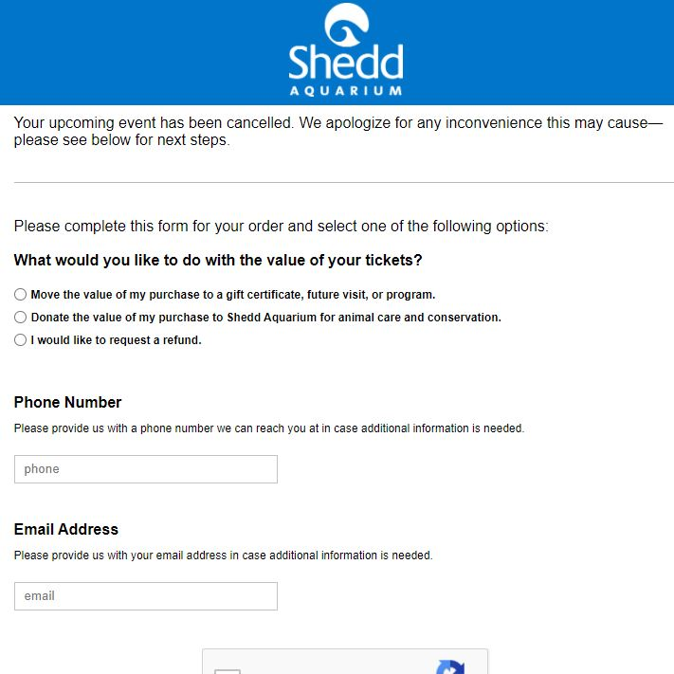
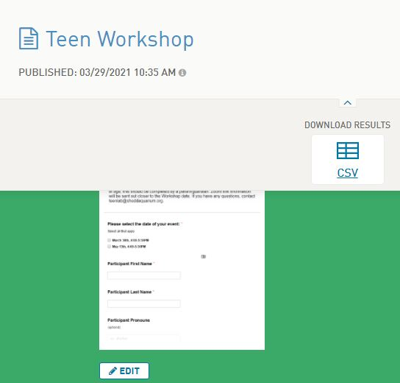
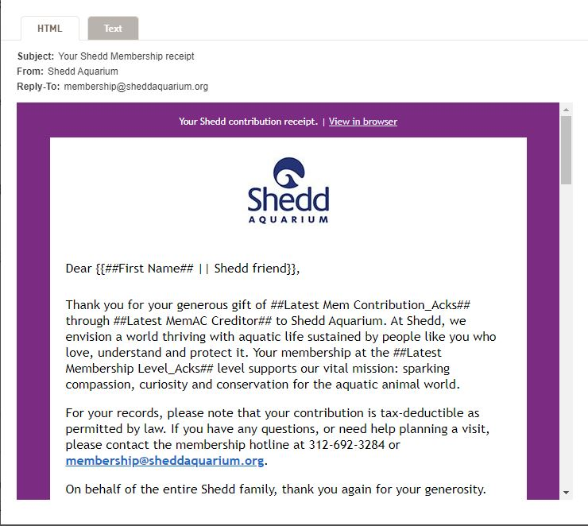
Wordfly Tools
Cancellation Surveys/CSIs
Pre-program surveys and triggered zoom links
Dynamic Pre-visit emails

Slide 4
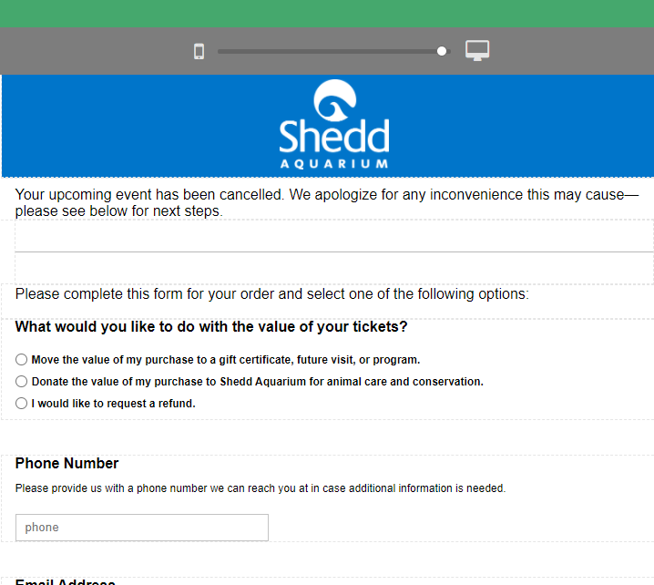
Cancellation Surveys
Closures, Cancelled events and conversion to free days
Create Pages template in WF
Map CSI fields
Link to Pages survey in an email body
Send to a Tessitura List
Check CSIs
View CSIs on records with integration

Slide 5
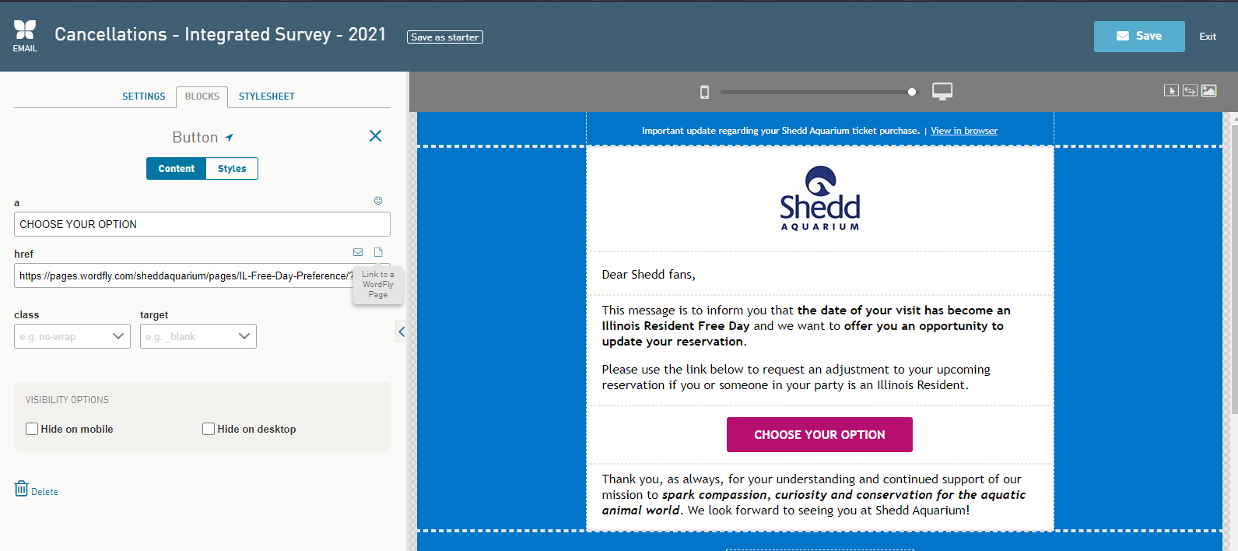
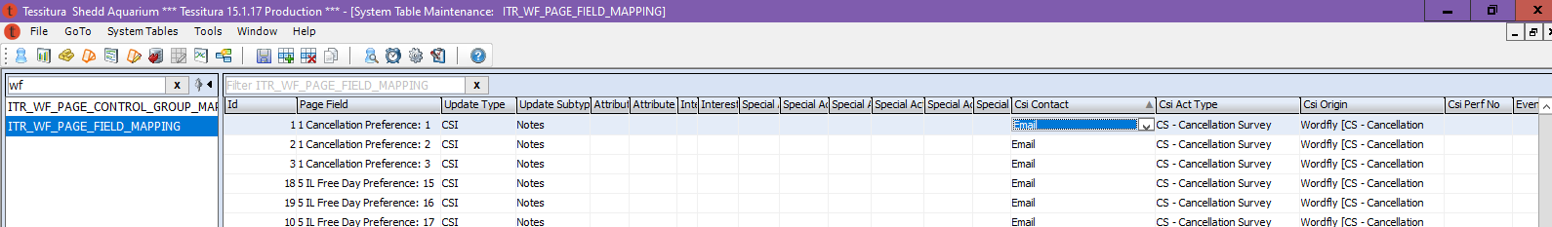

Slide 6
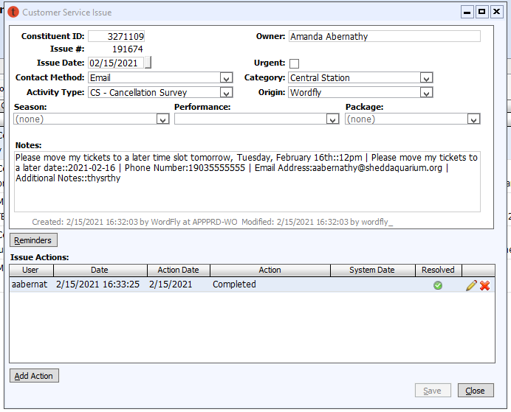
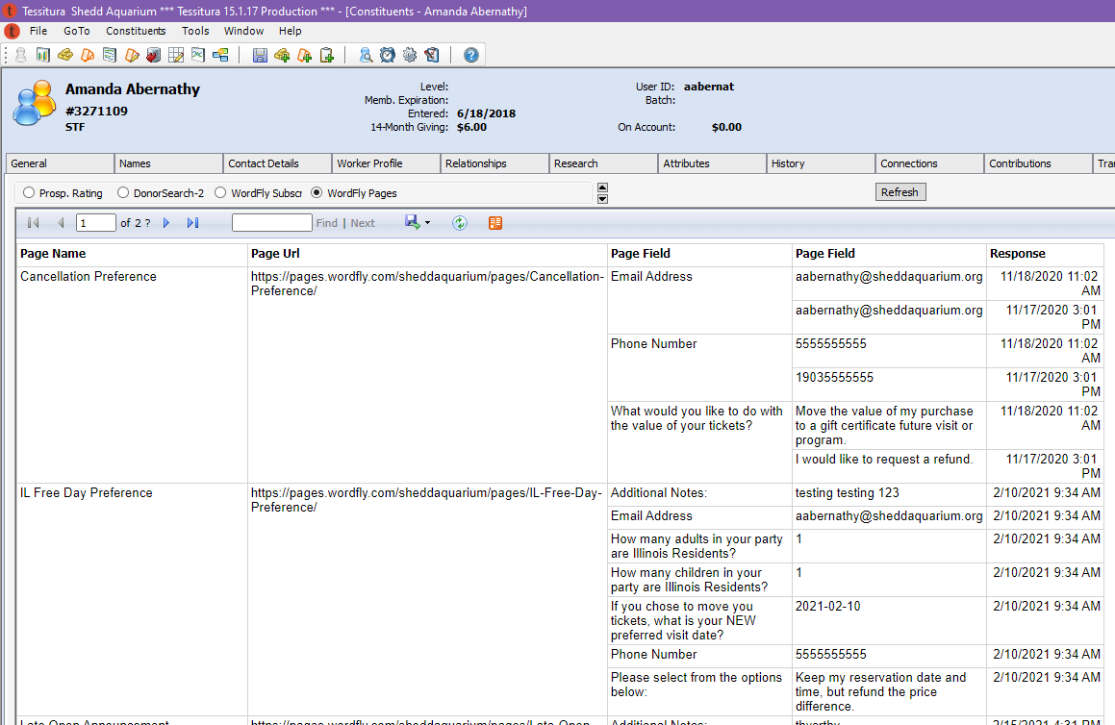
Integrated Tab
CSI

Slide 7
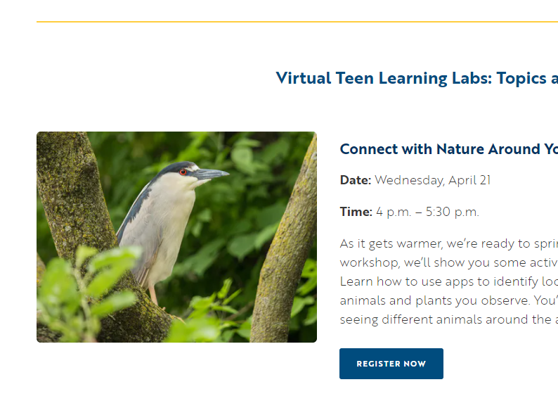
Virtual Teen Workshops
Pre-Event Survey
  Emailed hourly to buyers
Waivers
  Attached to confirmation
  Uploaded to documents
Zoom Links
  Only email links to those that have waivers
  Can now override unsubscribes

Slide 8
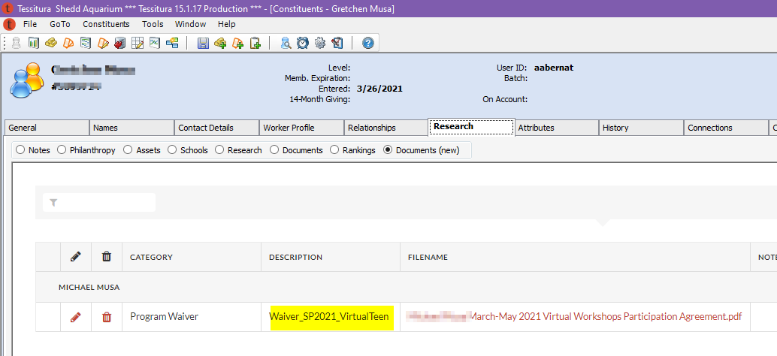
Virtual Teen Workshops

Slide 9
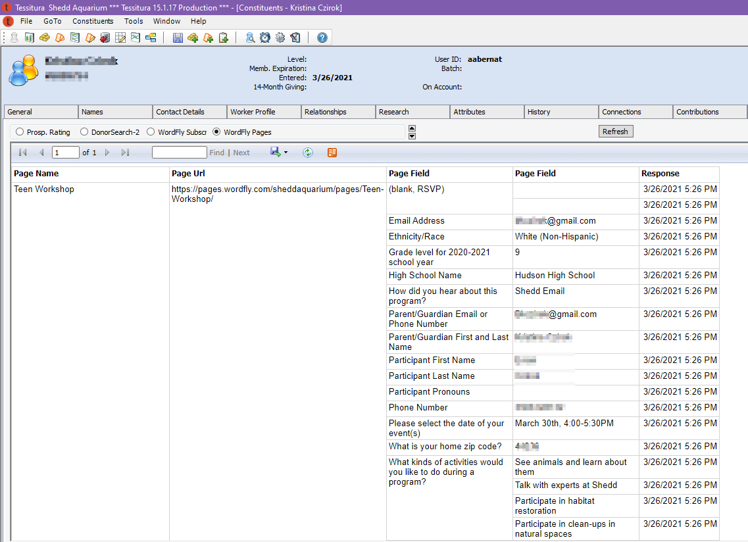
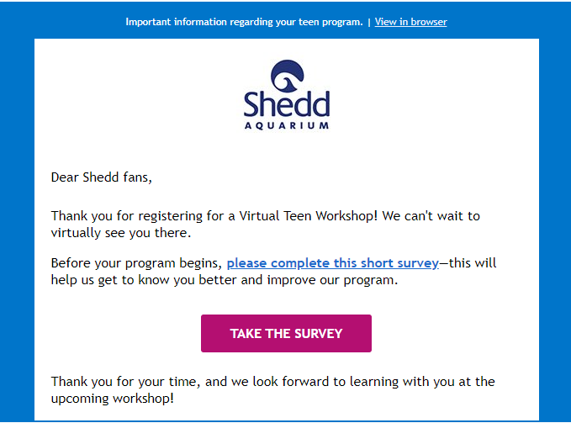
Teen Programs: Surveys
Send survey every hour to new buyers
Writes back to CSI and WF pages custom tab

Slide 10
Teen Programs: Waiver Uploads

Slide 11
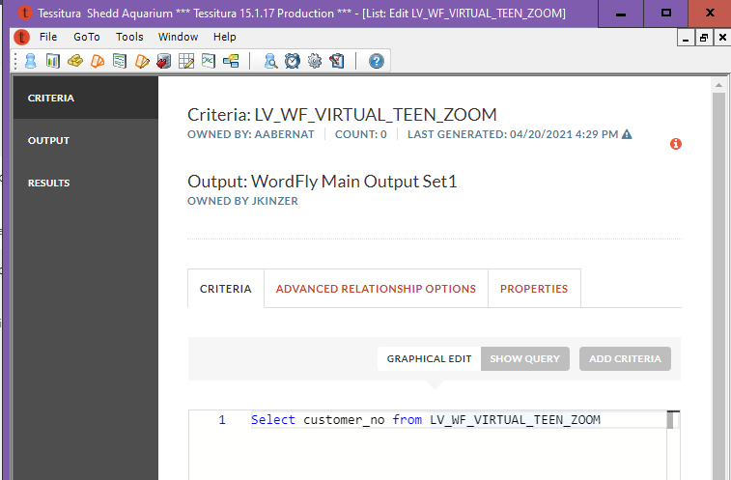
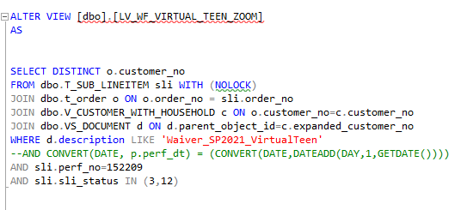

Teen Programs: Triggered Zoom Emails
Create a view
Select customer # from view

Slide 12
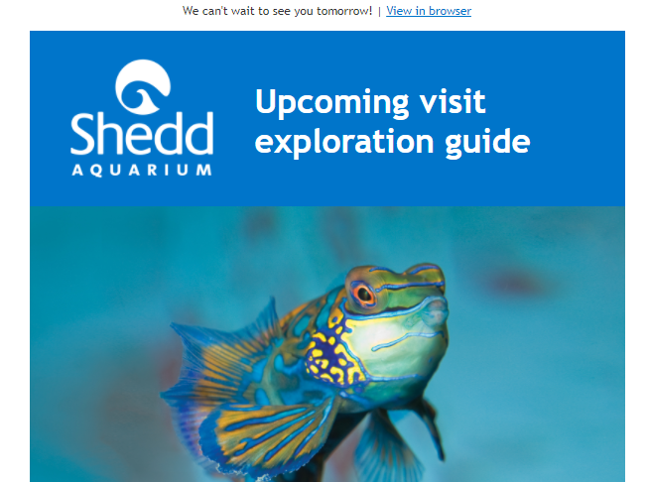
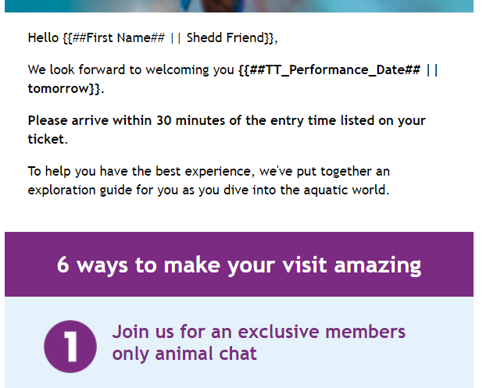
Dynamic Pre-Visit Emails

Slide 13
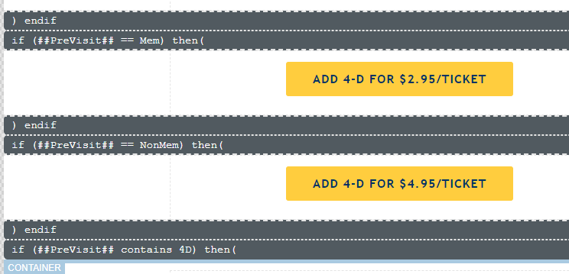
Dynamic Pre-Visit Emails
Pre-Visit emails with blocks of content triggered by member status and 4D
  NonMem
  NonMem4D
  Mem
  Mem4D
Tracking clicks
  Maps and mask guidelines get clicked!

Slide 14
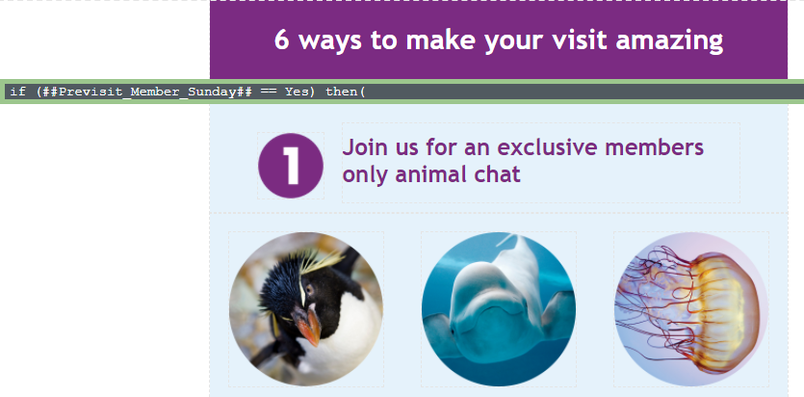
Dynamic Pre-Visit Emails: Next Step
Add a block that goes to members with 9am and 10am tickets to invite them to Animal Chat

Slide 15
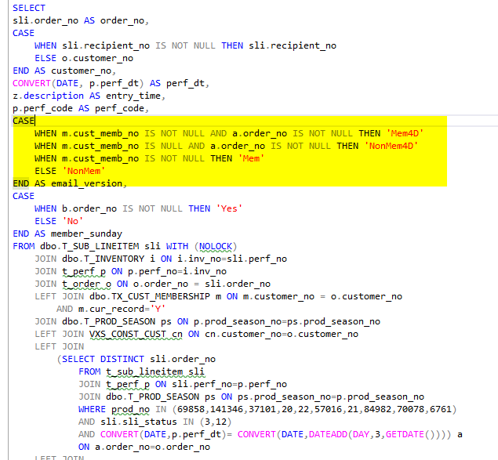
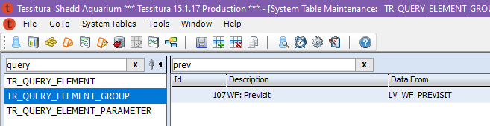
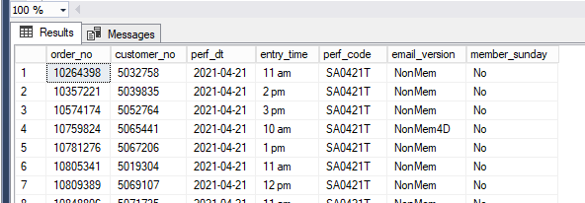
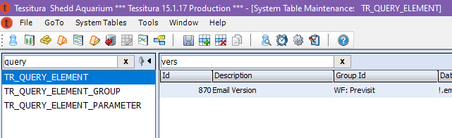
Pre-Visit Emails: Output Elements
Created a view
Calculate member status and 4D status
Made output element for version

Slide 16
Amanda Abernathy
aabernathy@sheddaquarium.org

