Slide 1


Delivering a Great
Training Session
PRACTICAL TIPS AND ACTIVITIES

Slide 2
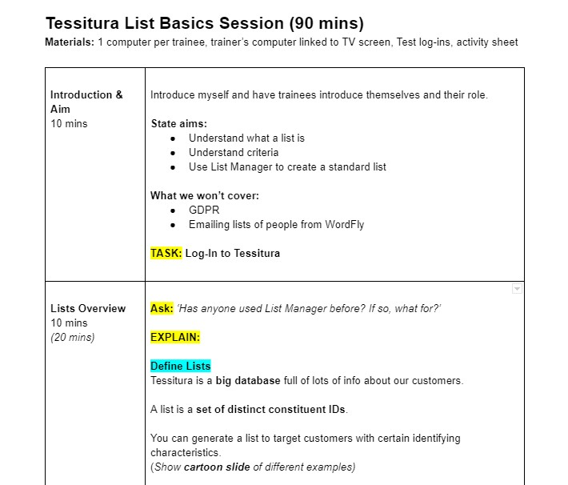
Lesson Plans - A Worthy Investment!
List materials needed
State aims / objectives
Section by key skills and topics
Note ideal timings
Include activities, questions to
ask, clear wording

Slide 3


Top Tip 1: Think Active
Don't just talk... do things!
The more your learners do, the more
they will remember
Ask questions and start discussions
Have learners follow on own computer as you
demonstrate
Pair/group work to practice scenarios like
ticket selling, constituent record creation
Do quizzes, Easter egg hunts, and get learners
to write questions for each other

Slide 4


Top Tip 2: Consider Jargon
Don't assume knowledge
Explain the meaning of any industry or
venue-specific words
“Take the COBOs to the box office please.”
“I'll meet you in the RFH in 10 minutes.”
“My BOCA is broken!”

Slide 5


Top Tip 3: Use Mnemonic Devices
Tricks to help people remember information
Rhymes, songs, chunking, acronyms,
acrostics, association, alliteration
ROYGBIV - Colours of the rainbow
'FACE' and 'Every Good Boy Deserves Fruit' -
musical notation
Ctrl + G = Opens a constituent record / gets
into the person's 'Guts'
'In' and 'Has' = All 'in' one row (of a
spreadsheet) VS they 'have' it somewhere

Slide 6
During the Session...
MONITOR
Watch and listen
Allow peer-teaching - don't
answer everything yourself
Note what people find
difficult in case you can
simplify it next time
TAKE BREAKS
Move
Stretch
Eat and drink
CHECK UNDERSTANDING
Ask lots of questions
Use concept checking
questions with definite
answers
Don't ask 'Do you
understand?'

Slide 7
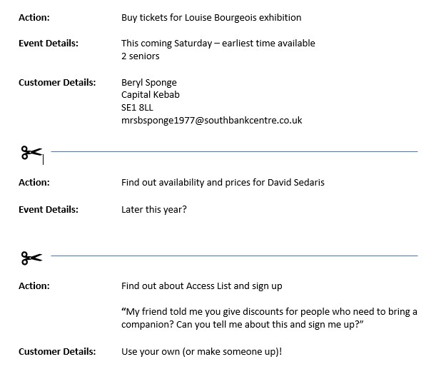
Lucky Dip - A Great Revision Activity
Write down a selection of scenarios
covering skills taught
Chop into strips and put in envelope
Learners work in pairs/threes to
draw out a slip of paper and work
through it as customer and staff
member (in Test!)
Reverse roles and select another
scenario

Slide 8





Sarah's Successful Delivery Toolkit
Lesson Plans
Think Active
Find and build
games like Lucky
Dip
Sarah's
Top Tips
Jargon Bust
Monitor, Check
Understanding,
Take Breaks
Use Mnemonic
Devices

