Slide 1
EU Data Insights Tessitura Community
27/09/2022
Chair: Yasmin Bentley – Royal Albert Hall

Slide 2
Introductions
Name
Role
Organisation
What would you want to gain from this group

Slide 3
Topical Discussion - Customer behaviours
Are they changing? How are you tracking it? what challenges are you facing?

Slide 4
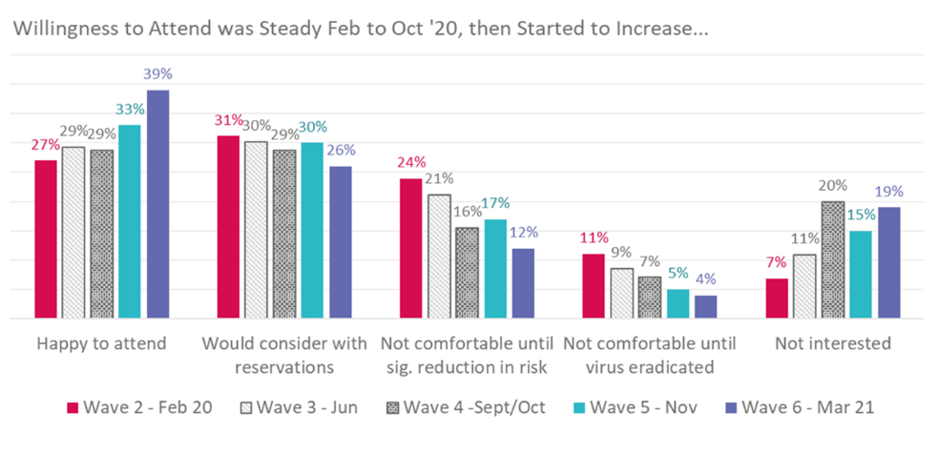
Audience Behaviours – How are they Changing post pandemic/Cost of living
Audience Agency latest insights suggest willingness to attend is up to 39% April 2022 from 30% in November 2021
Source: https://www.theaudienceagency.org/evidence/covid-19-cultural-participation-monitor/recent-key-insights

Slide 5
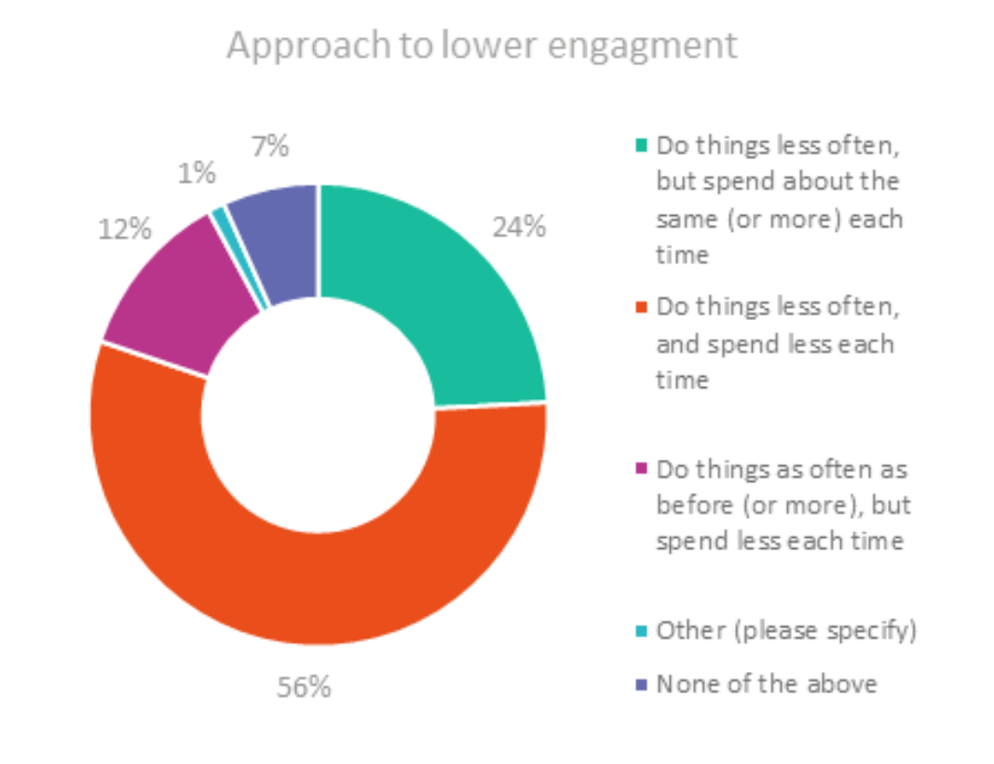
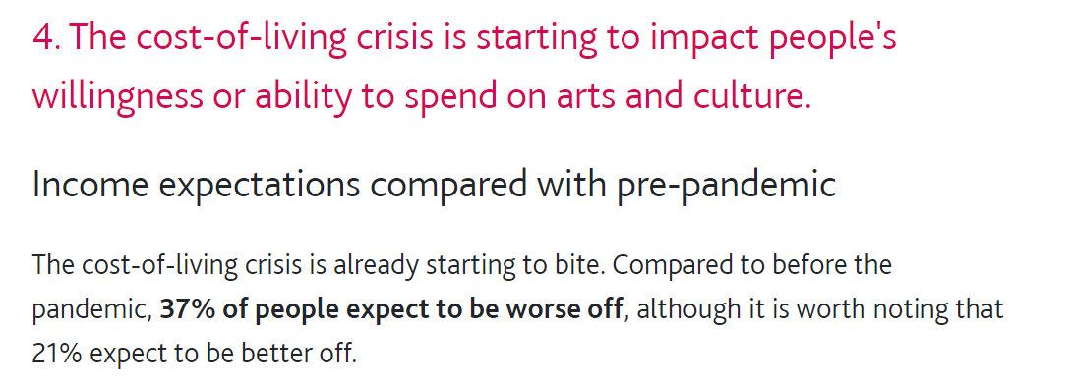
Audience Behaviours – How are they Changing post pandemic/Cost of living
Source: https://www.theaudienceagency.org/evidence/covid-19-cultural-participation-monitor/recent-key-insights

Slide 6
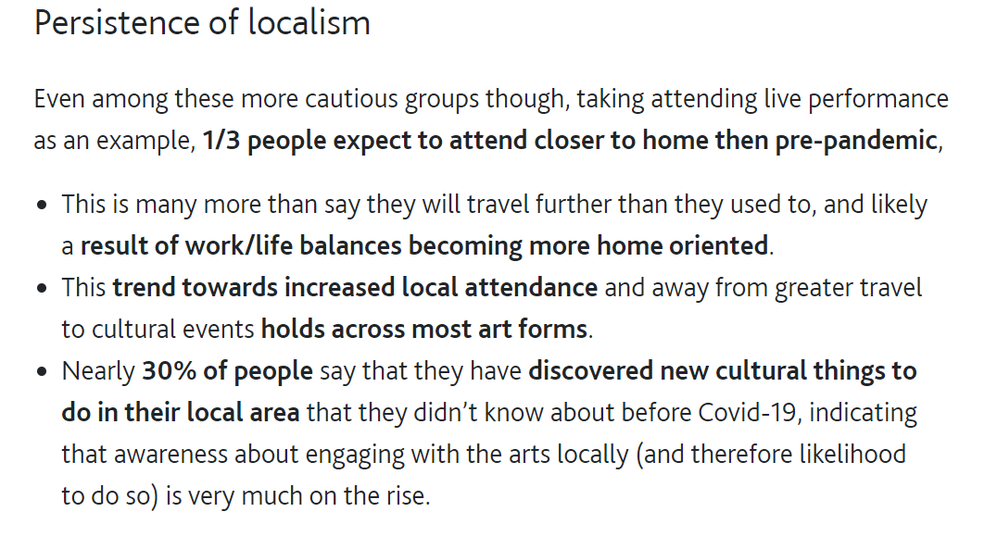
Audience Behaviours – How are they Changing post pandemic/Cost of living
Source: https://www.theaudienceagency.org/evidence/covid-19-cultural-participation-monitor/recent-key-insights

Slide 7
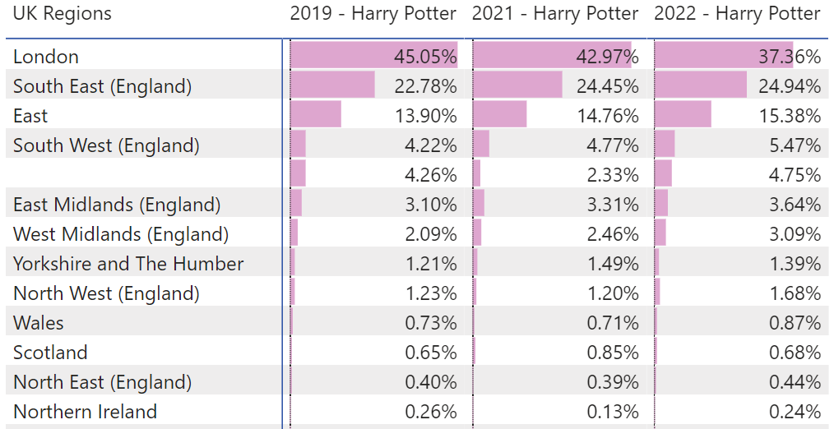
Royal Albert Hall – What are we tracking
Whilst we have audiences from around the globe, our core audiences have historically been relatively local. We’re seeing similar percentages of customers traveling from outside London for performances on like for like performances.

Slide 8
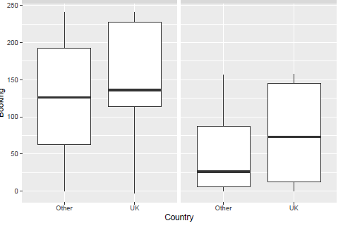
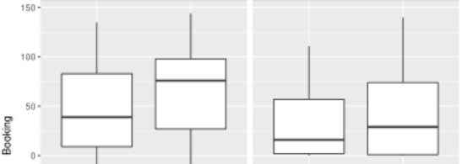
Royal Albert Hall – What are we tracking
On some shows like for like we’re seeing customers booking significantly later than they have in the past, some of this is influenced by shorter on sales.

Slide 9
Challenges we’re facing
Inconsistent like for like comparisons - Postponed shows mean longer on sale periods which makes it harder to track behaviours
Lack of Benchmarks - Historically we haven’t had benchmarks for customer behaviours so lacking consistent comparison points and KPI’s
Point of comparison – We’re still going back to 2019 as a base year for comparison as our last full year of consistent data which is becoming more and more irrelevant over time.
Understanding price resistance - still trying to work out how we can accurately track how customers are reacting to price.

Slide 10
Breakout – Discussion
Are you tracking customer behaviours
  if so how?
  If not what are the barriers your facing?
  What do you want to know about your customers behaviours that you don’t currently have insights on?
  What are the challenges

Slide 11
Thank You for attending
TLCC – 11th & 12th October
EU Data insights Networking Opportunity
Wednesday 12th at 12-1pm in the Lower River Room
Come chat and find out how you can get involved!

