Slide 1

Analytics Customisations
Gary Halliday, Head of Business Systems – Roundhouse

Slide 2

A bit about the Roundhouse
………………………………………………………………………………………………………………………………………….
Last year we held 317 performances and gigs
But that’s only a small part of what we do
We also worked with over 6000 young people to help them develop skills for careers in the creative industries
We have 24 studios exclusively for young people
We ran 198 projects and drop-in sessions

Slide 3
The requirement
………………………………………………………………………………………………………………………………………….
Annual reporting on the overall engagement of young people
Reports to each department on the effectiveness of their programme
KPI reporting in line with the business plan

Slide 4
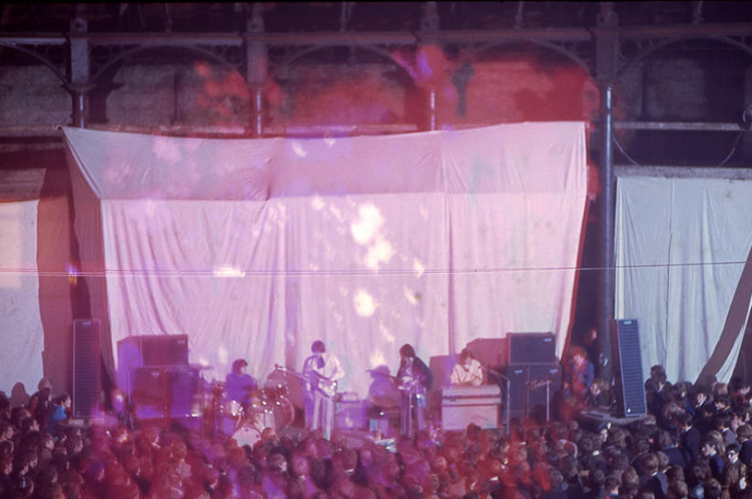
The past

Slide 5
How we did it
………………………………………………………………………………………………………………………………………….
The DBT team would run two massive queries to extract the data
Over to the Youth team…
Manually categorise (and re-categorise) all projects and young people
Add columns, recalculate fields, add more data that wasn’t in Tessitura!
Use lots of pivot tables and even more formulas

Slide 6
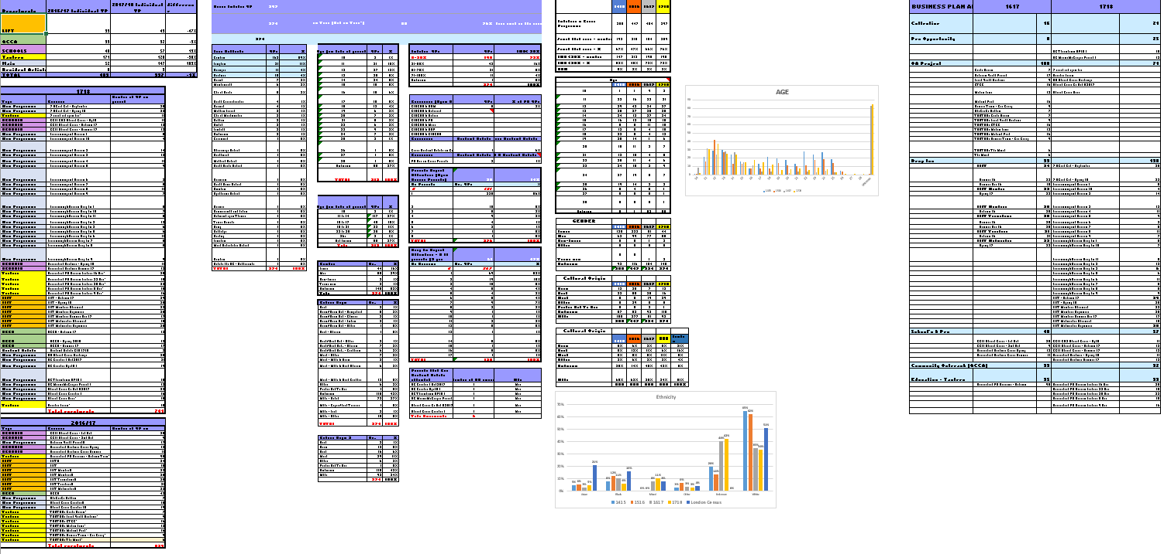
The result

Slide 7

Section title Option A
This took three months!

Slide 8
What we (and Tessitura) did
………………………………………………………………………………………………………………………………………….
Created all the projects in Tessitura
Tagged all of our youth projects
Developed a specification based on our massive spreadsheet
Created five custom tables and views
Amended the load procedure to add these to the Elasticube
Added a row in TX_ANALYTICS_DIVISION_ELEMENT
Saved a formula for individual young people

Slide 9
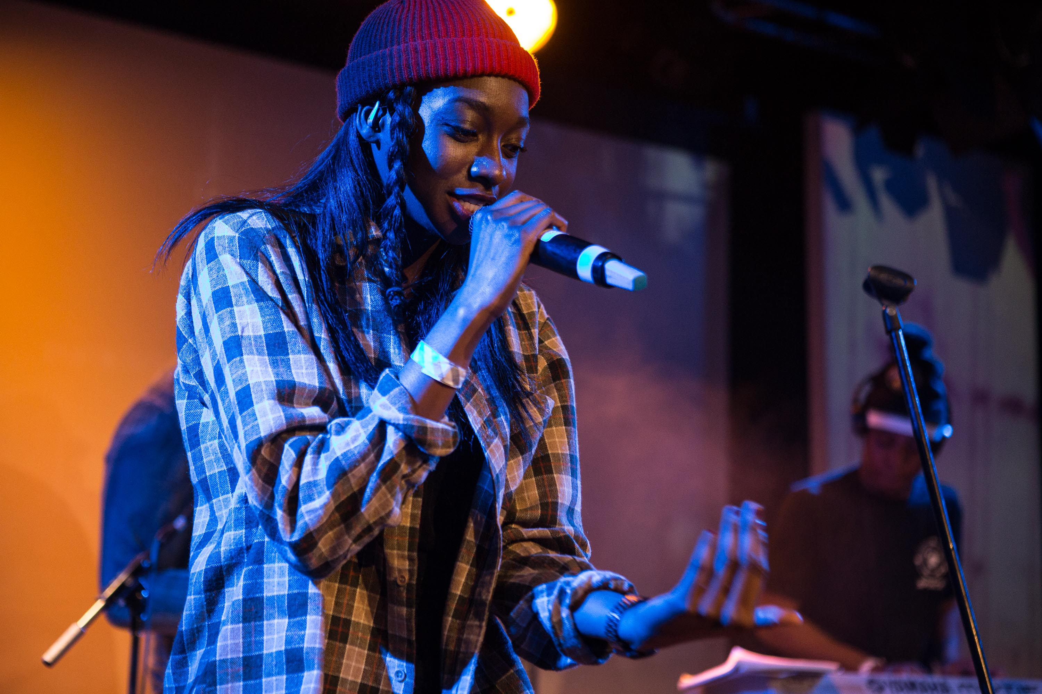
The present
The present
The Present

Slide 10
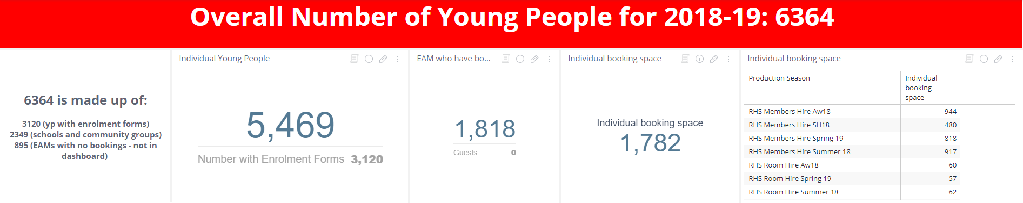
Top level numbers

Slide 11
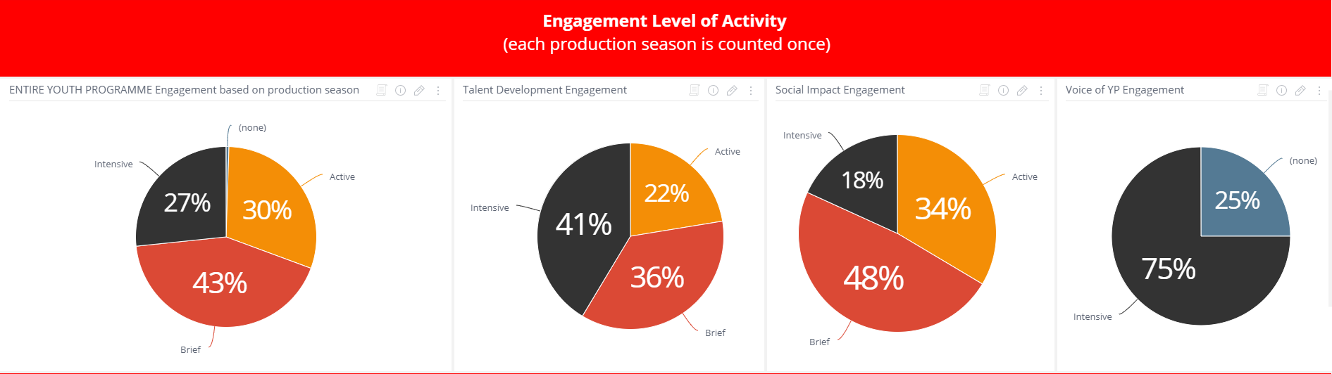
Engagement by activity level

Slide 12
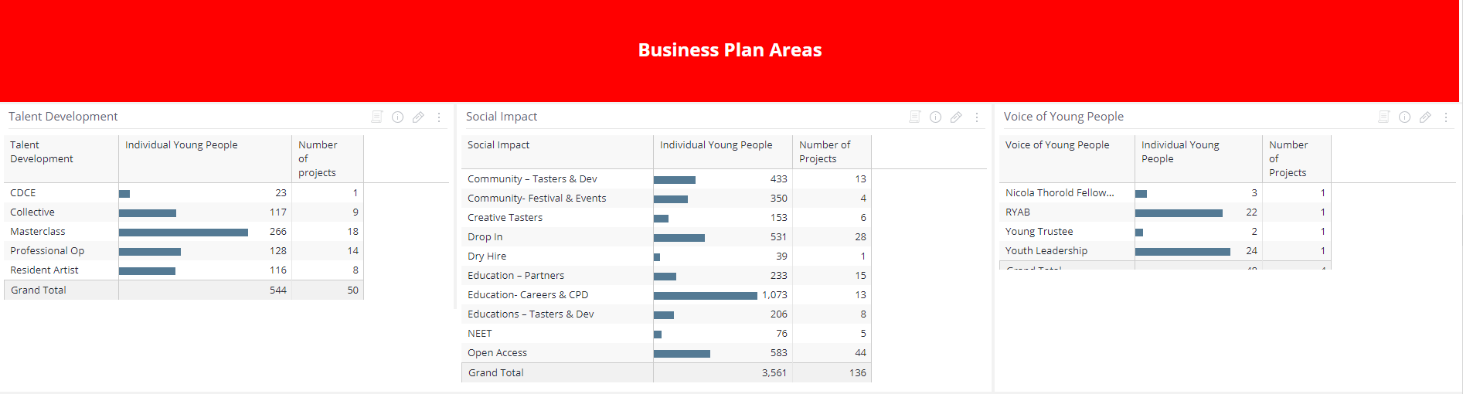
Strands of our business plan

Slide 13
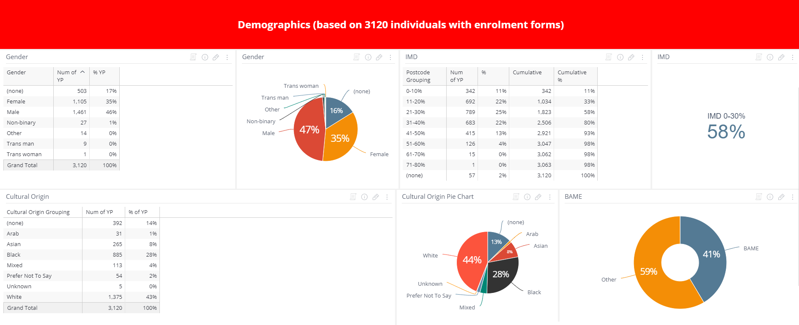
Demographics

Slide 14
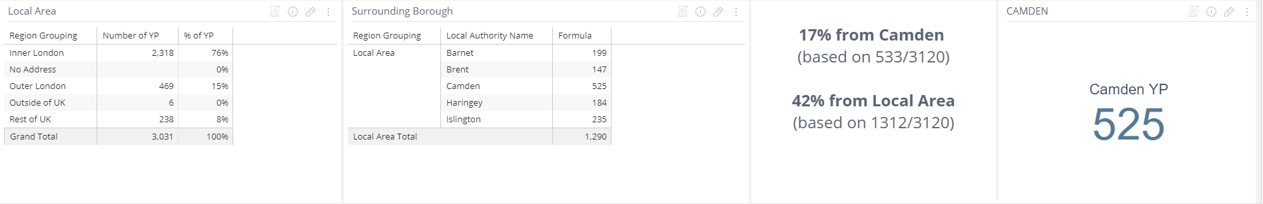
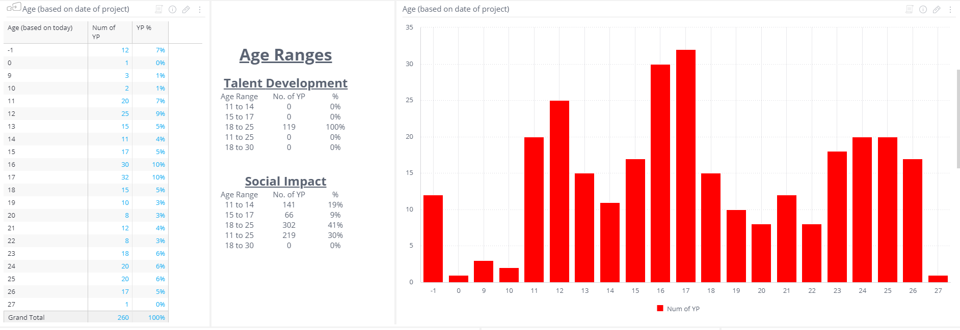
Even more demographics

Slide 15
Issues
………………………………………………………………………………………………………………………………………….
There was a lot of confusion about numbers not adding up
What we do verses what makes logical sense!
We didn’t really know how to use it

Slide 16
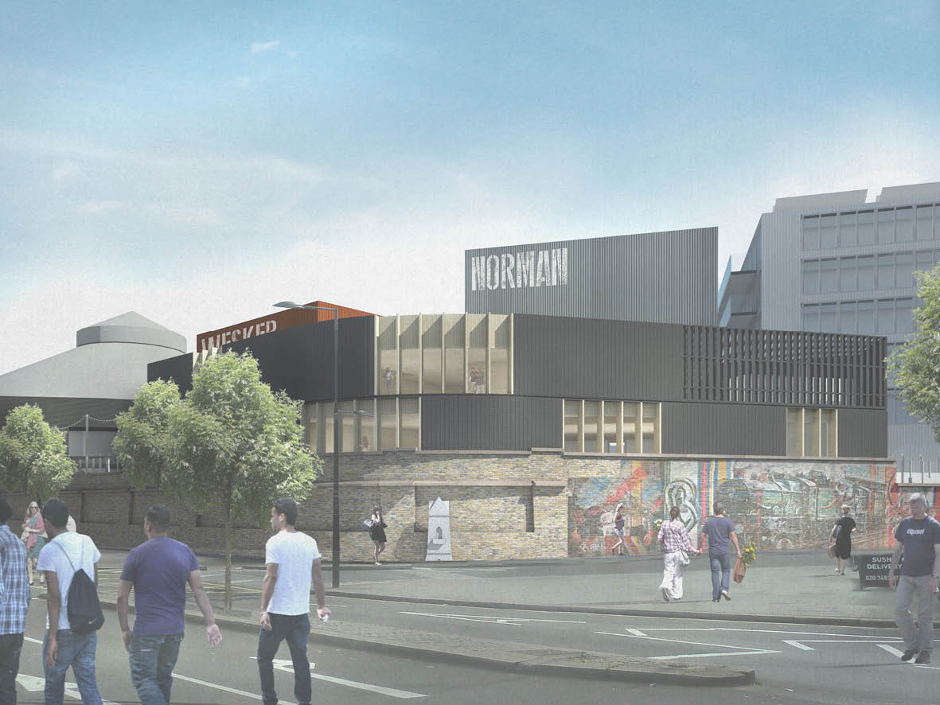
The future

Slide 17
Next steps
Training session with Tessitura on customisations
Age ranges for projects
Take advantage of the new system tables in 15.1
Everything else…

Slide 18






Coming soon
………………………………………………………………………………………………………………………………………….
Reporting database

Slide 19

End slide
Any questions?

Slide 20
End slide
Thank You!
gary.halliday@roundhouse.org.uk

