Slide 1
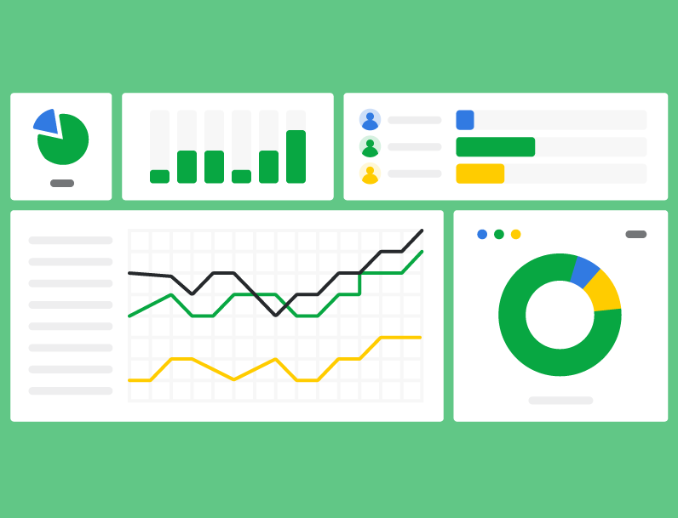
Insightful interactive dashboards
Sara Vergara-Muro | Insights Manager
17 June 2019

Slide 2
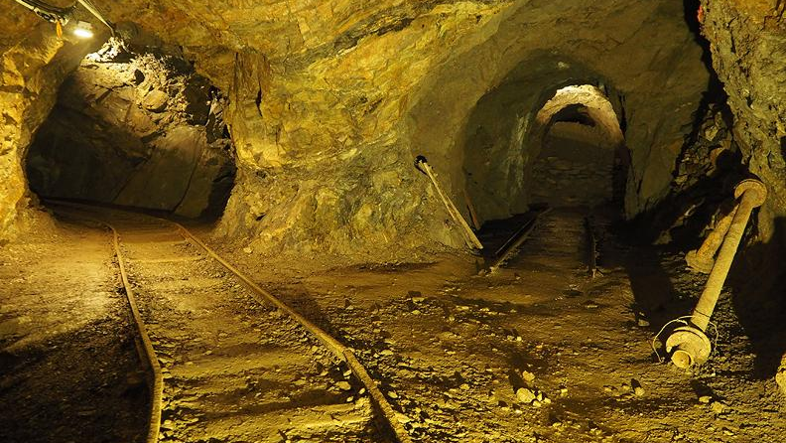
Q: What would you like to know about our shows and our audiences?

Slide 3
Performance sales / campaign success
Audience profile
Performance quality
INTERNAL DATA

Slide 4
Power BI
Individual tables on T-stats with limited depth of analysis
Individual reports on Tessitura with limited filters
Dashboards with multiple tables loaded and endless possibilities for cross-breaks and visual representations

Slide 5

Insights are what humans make from analytics

Slide 6

Insightful interactive dashboards
Database knowledge
Needs and objectives of the teams

Slide 7


Slide 8

The dream

Slide 9
Objectives
Improve communication and monitoring of KPIs by making these relevant, consistent, understandable and easily accessible across the organisation
RELEVANT
CONSISTENT
UNDERSTOOD
ACCESSIBLE
Efficiently data-driven business decisions
Notes:
The reasons why this is important
The data that was being shared was inconsistent. Having a complex ticketing system means that the data can be segregated and filtered in multiple ways. Different people have different understanding of what’s the most accurate value. Therefore there was a need to come to an agreement and know when to use what.
There was also a lack of communication about the data, meaning that people could access reports but not necessarily an explanation of what those numbers mean
However, in some cases access to the data points was also very restrictive, segregated and time-consuming. Therefore we had to find ways to provide answers to the business questions in a more efficient manner

Slide 10

One step at a time
Understand the business questions
Identify the metrics and KPIs
Identify the best data sources to measure the KPIs
Build the model in the data visualization tool
Construct the reports with visuals and relevant filters
Communicate data points – what it is and what it means to the relevant teams
Ensure ALL the data was accessible in our database

Slide 11
THE BUSINESS QUESTIONS
Performance sales and campaign monitoring
Audience profile
Performance quality
back

Slide 12
















































Audience profile
Demographics:
Gender split
Age average and range
Diversity
Location
Lifestyle
Interests (crossovers)
  Loyalty to the Hall
  Loyalty to the series
Upsells
Booking patterns
Advance bookings
Party size
Booking preferences
  Seat demand
  Time
Frequency of previous booking

Slide 13
Monitoring sales and campaign success
Understanding demand vs. previous shows
Price analysis
  Seat preferences
  Price sensitivity
Sales – revenue, tickets and occupancy by performance date
  Seasonal sales vs. one-off shows
  Against the different marketing activities
  Against the budget (breakeven), potential value, forecast
E-mail campaign impact
A/B tests at a glance
Newsletters – revenue per content
Targeted emails – revenue per segment
Offers – impact of promotional emails

Slide 14
Customer feedback
Quality of the overall experience - NPS
Ratings on the different interactions with the Hall (i.e. touchpoints across the customer journey)
Quality of the Performance
Deeper understanding on the experience – Coded Open ended comments
What works vs. what need to be improved
back

Slide 15
identifying the best sources for the different data points
Tessitura
Booking history
Artifax
Performance details
SnapSurvey
Demographic data
Customer journey feedback
back

Slide 16
Audience profile
Demographics:
Gender split
Age average and range
Diversity
Location
Lifestyle
Interests (crossovers)
  Loyalty to the Hall
  Loyalty to the series
Upsells
Booking patterns
Advance bookings
Party size
Booking preferences
  Seat demand
  Time
Regularity of visits
Preferred sales route
Post-show survey
Tessitura
back

Slide 17
ensuring the data is all in the same place
Tessitura
Database
Artifax
Database
SnapSurvey
Spreadsheet
Import the data from the survey onto a new database in the server
back
Notes:
Before starting to build any analytical models. We needed to assess where our data was gonna to come from

Slide 18
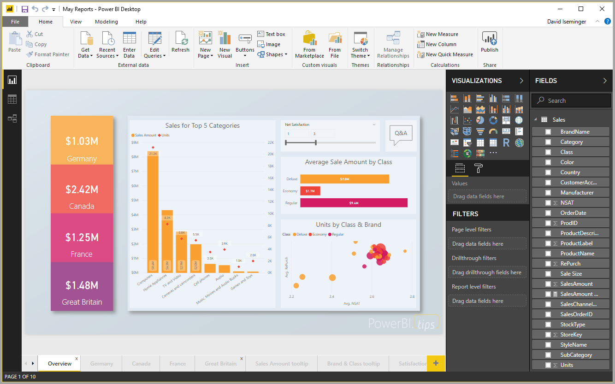
Data visualization tool

Slide 19
Please note the following dashboards are for educational purpose only and contain dummy data

Slide 20
Audience profiles

Slide 21
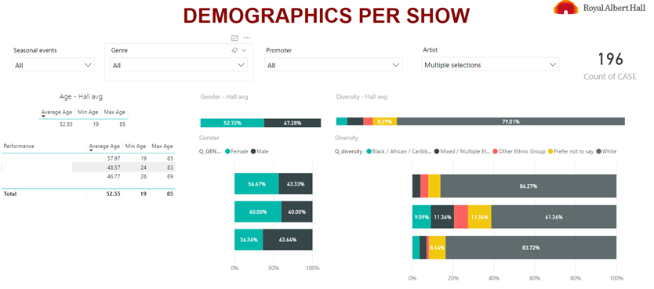
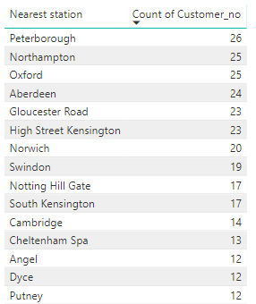
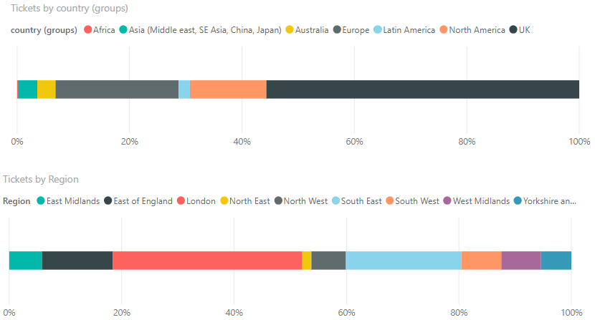
At a glance we can already identify key trends in this dashboard in terms of demographics per show
A good number of visitors came from Peterborough, Northampton and Oxford
Show attracting a younger audience
Show with a more diverse audience
Show attracting more a male audience
45% are overseas visitors
Of the UK attendees roughly a third are from London

Slide 22
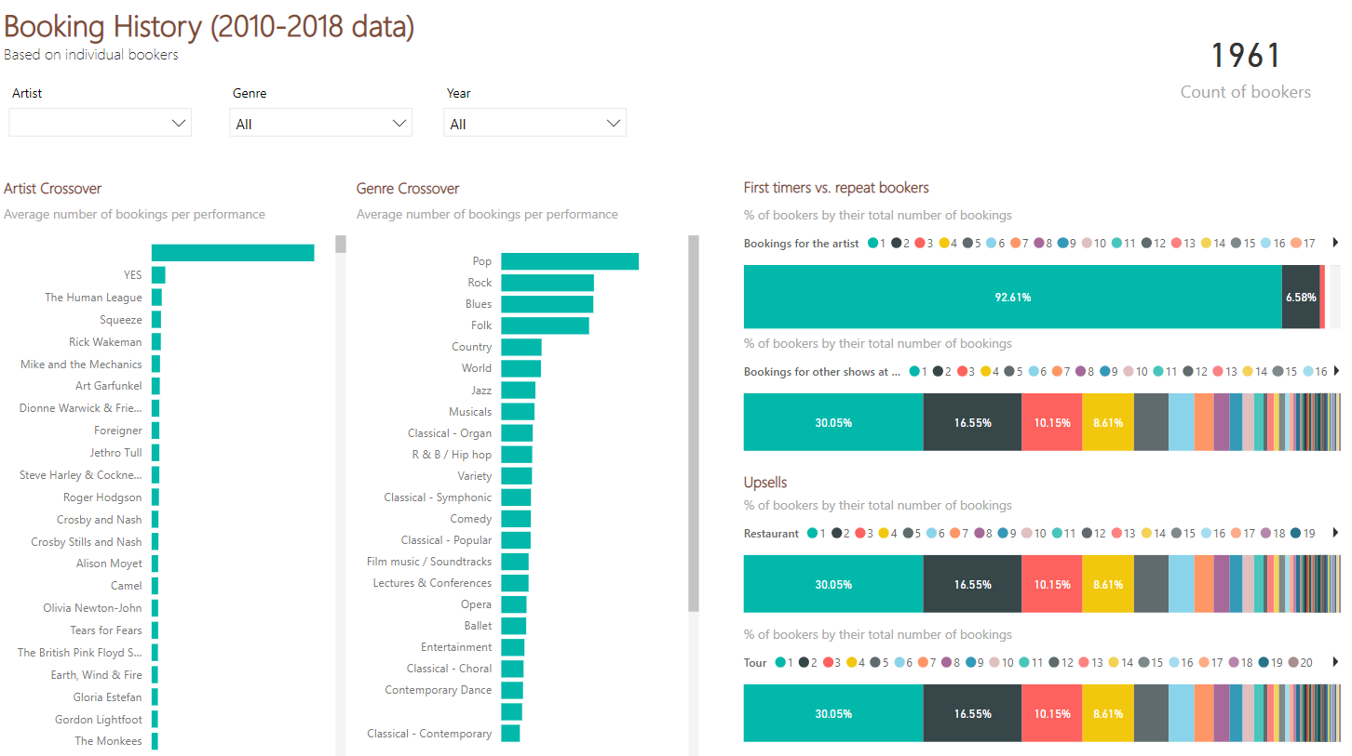
At a glance we can already identify key trends in this dashboard in terms of our audience intersts
93% were seeing this artist at the Hall for the first time
People who came to see artist XX had also seen YES and Human league.
Overall, this audience is made of Pop and Rock fans
70% had already been at the Hall
Restaurant
The different restaurant offer was equally popular except for Arena Bars
Tour

Slide 23
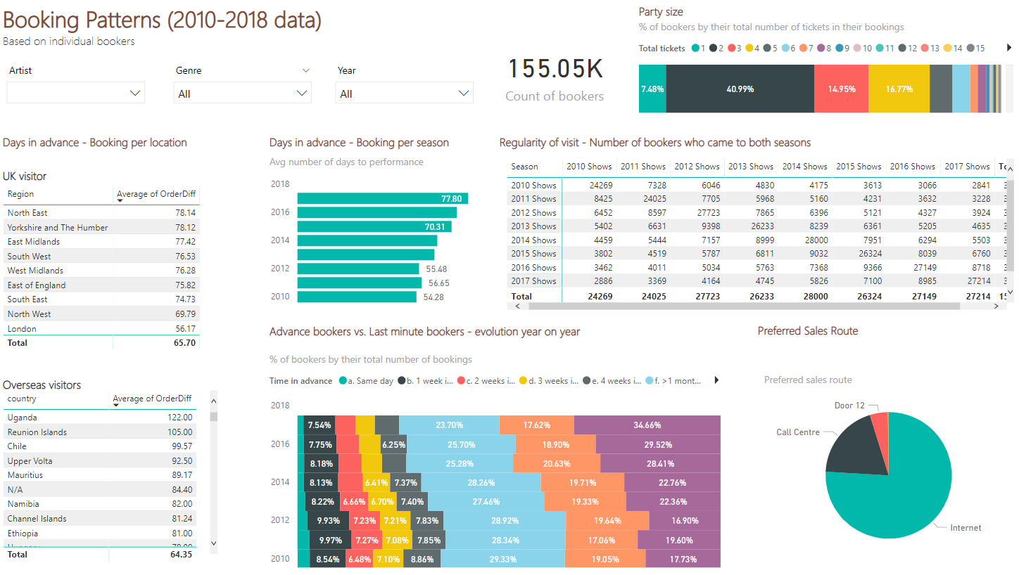
At a glance we can already identify key trends in this dashboard in terms of booking patterns
COUPLES AND SMALL GROUPS
RECENCY
The further on time their last visit the less likely they are to repeat with us
INCREASE SUCCESS
Since 2010 there are 3k more attendees
ADVANCE BOOKING
A greater proportion of attendees books in advance

Slide 24
sales

Slide 25
Looking at which seats sold best for different show to adjust our pricing strategy
Seat area capacity per time to performance date

Slide 26
Campaign assessment

Slide 27
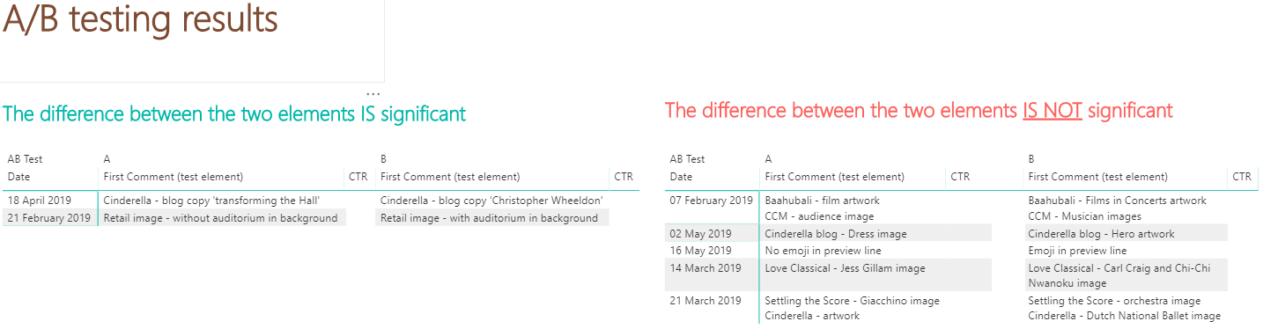
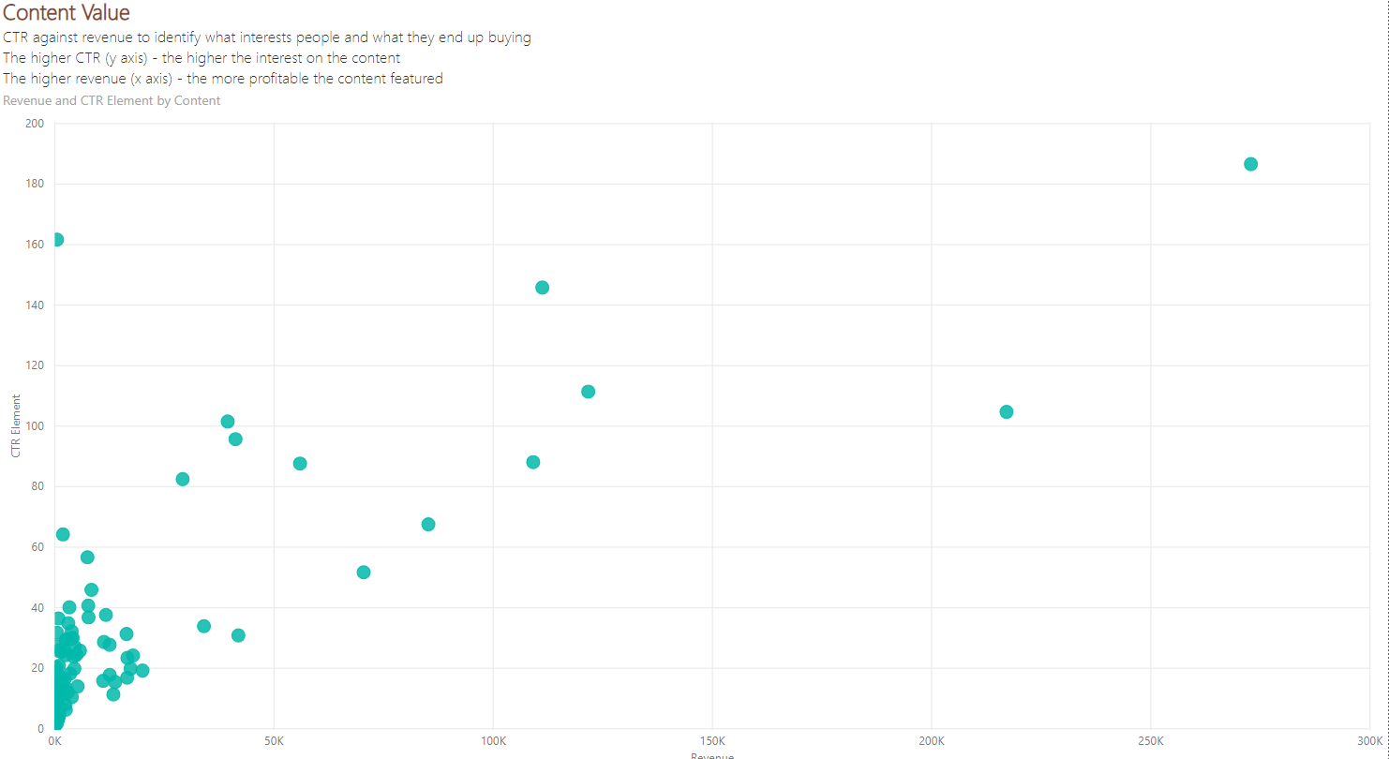
The e-mail campaign

Slide 28
Customer feedback

Slide 29
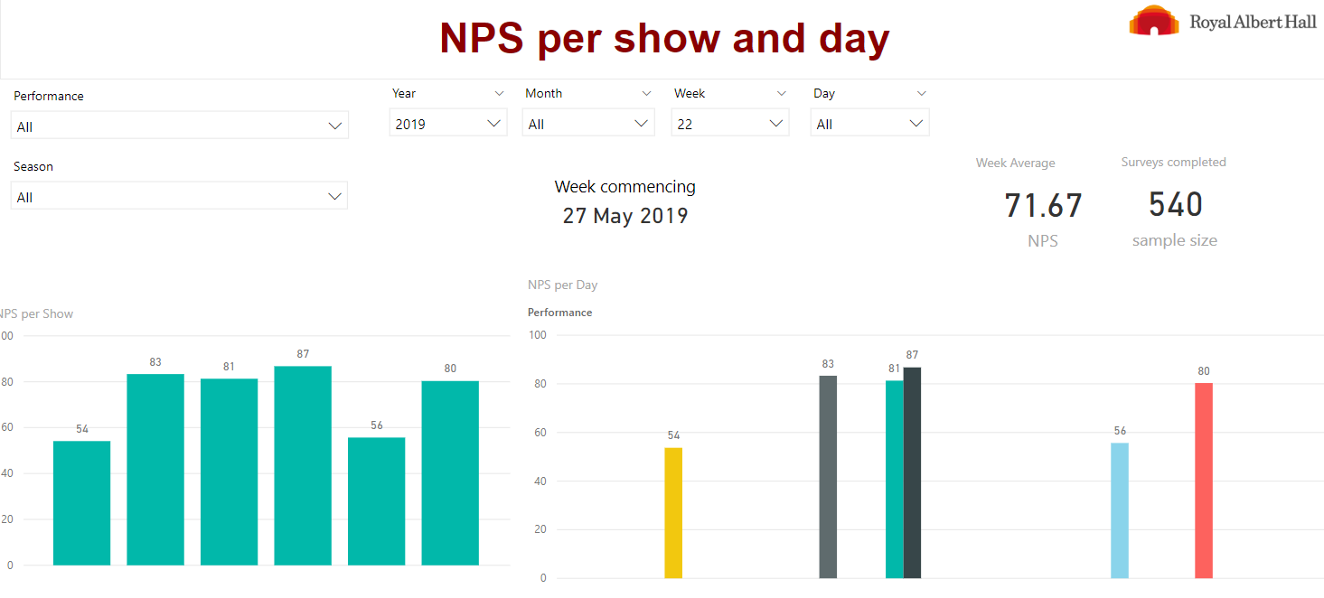
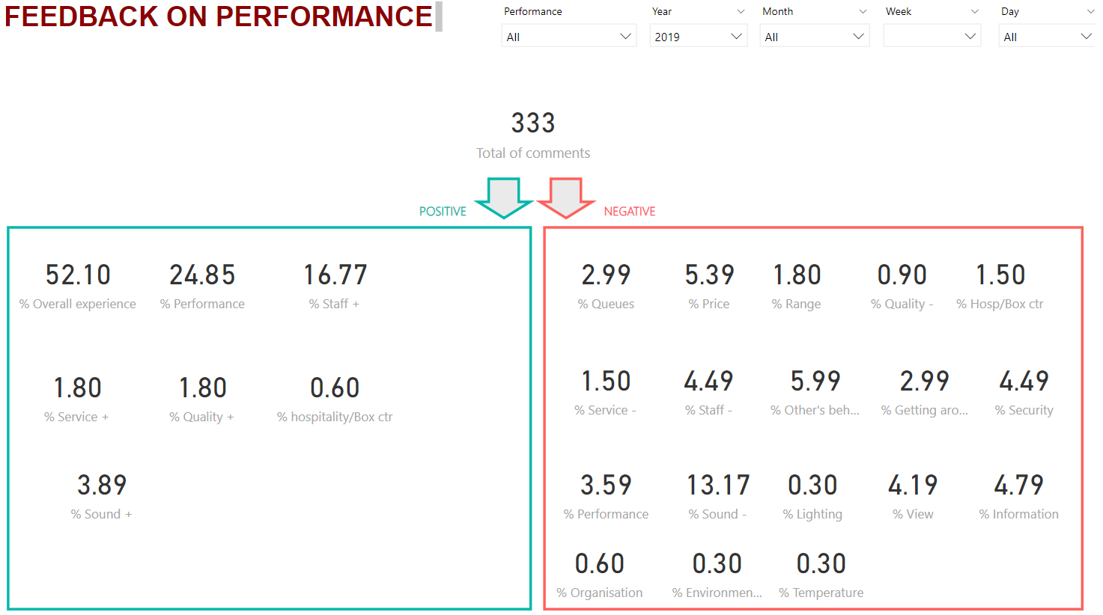
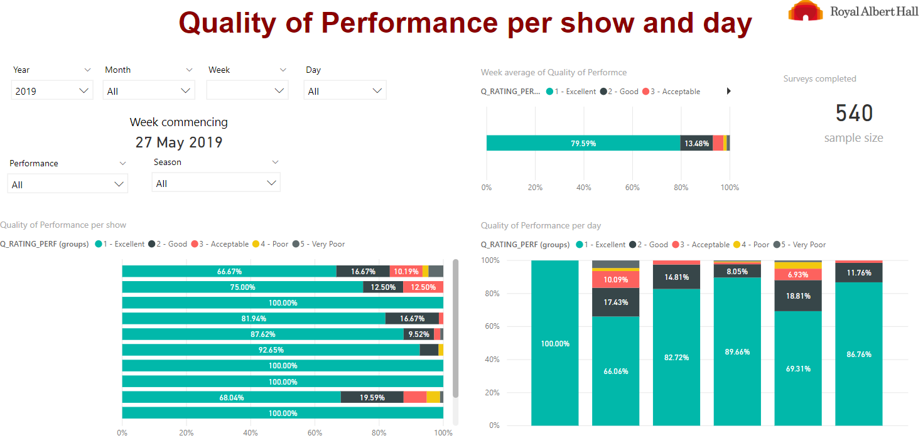
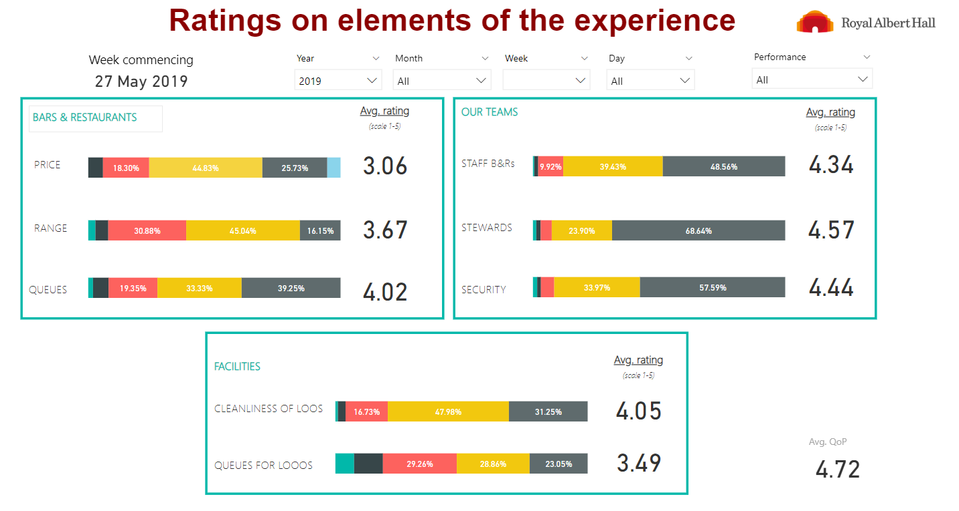
Key information on customer feedback per show with just one click

Slide 30
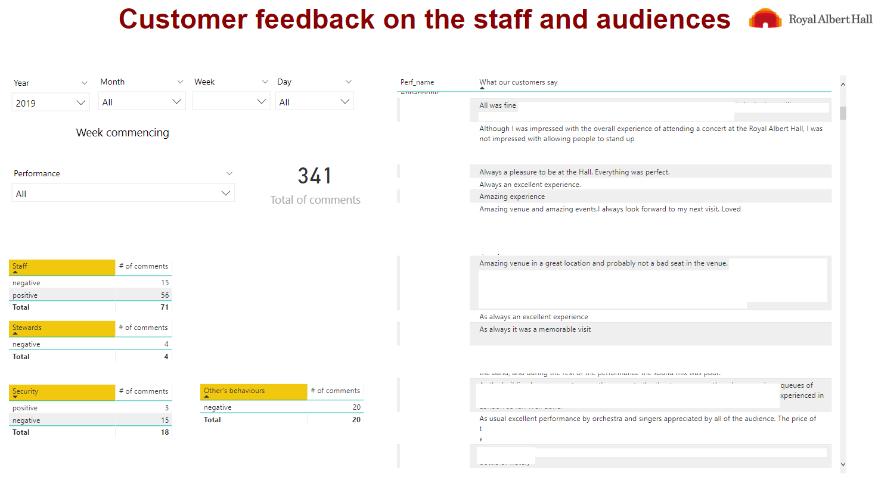
Informing the different departments on what needs to be improved moving forwards
Dashboard for Front of House team
back

Slide 31
Communicate the data
Running on demand reports and commenting the key findings adding our final recommendations
Setting regular reports and educate the audience on the different metrics used in a previous presentation
Make the reports fully accessible and conduct training to help other colleagues interpret the results and make clear notes on the reports
Organise drop-in sessions for the different people in need of data insights to discuss these needs

Slide 32
Final thoughts
?
Combining data from Tessitura with other databases, and spreadsheets for example:
Email and campaign results
Survey results
There will always be an additional step to build the data models on Power BI
Anyone accessing Tessitura could already see results straight away, however, who will create these reports?

Slide 33
Back to the room
What metrics and KPIs do you monitor?
How do you report on these KPIs?
How do the insights role interacts / works together with the IT team and data holders?

Slide 34
Thank you

