Slide 1


Finance Reporting and Reconciliation
(a VERY brief introduction)
Lloyd Stringer
Product Analyst
Notes:
Reporting and Reconciliation is a tricky topic. I would say that between some of you and most of you will have custom finance reporting to make your accounting processes easier.
But sometimes things go awry with those – perhaps you’re processing income in a different way or are trading with new income streams that haven’t been accounted for.
When getting used to these processes – or when you’re starting out with Tessitura for the first time – first principles will always be useful.

Slide 2
Consistent data entry
Matching parameters that affect the same data point
Leave optional parameters empty
Three Keys of Report Reconciliation
Notes:
Highlights the importance of rigorous process. Users should open new batches every day. Closed at the end of the day. Postings should be dated (or backdated) to match those transaction dates.
You’ll see in my examples
The point of optional parameters on reports is to filter (or hide!) data. Only ever set required fields. Any optional fields should either match, or only affect how the reports renders.

Slide 3
GL Summary Report
Transactions by Posting
Income by Payment Method
Posting Report
Key reports
Notes:
This report provides a GL distribution summary, detailing the posted debit and credit amounts to each GL number, for a range of posting dates.
Useful for finding details underlying the GL Summary report or Posting Report for a given posting number or date. The results can be filtered by GL account numbers, transaction type, batch type group, fiscal year, and/or a list.
Shows all payment method activity over a date range.
The posting report details or summarizes financial transactions, debits and credits to GL accounts contained in a posting.
These four reports are the beginnings of Tessitura acting as a sub ledger to your main finance system, showing the detail or your summary financial data

Slide 4
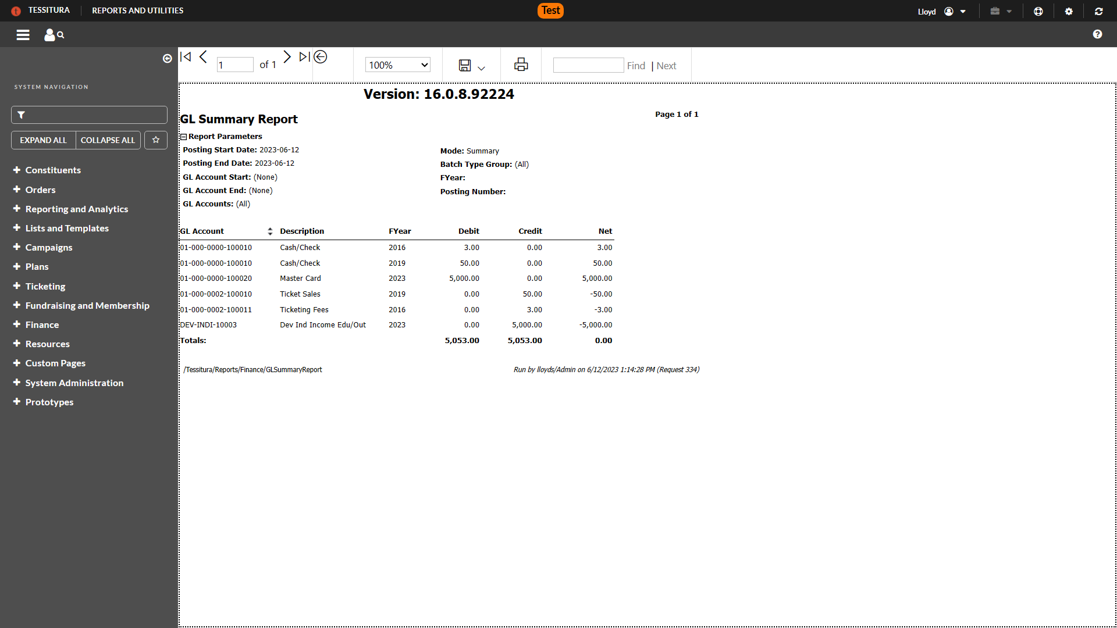
Notes:
Performance Transaction Detail

Slide 5
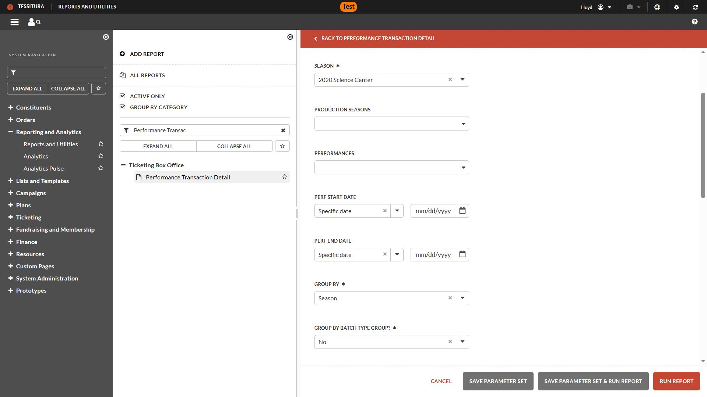
Notes:
Sub-ledger level details to pick apart credit and debit activity taking place in your General Ledger
Also useful when researching returns and exchanges
Season is a required parameter, to help narrow down the events being analysed
‘Group by’ section define how the report will look, and how the transactions will be grouped together

Slide 6
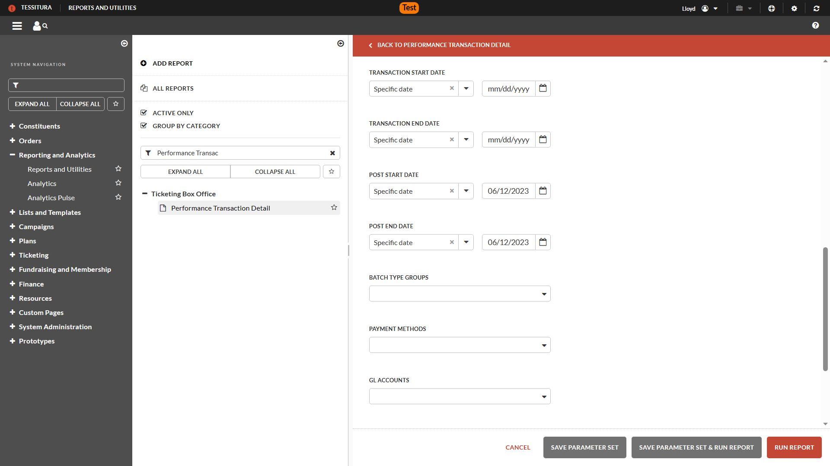
Notes:
Because we’re reconciling, posting date (transaction date) are crucial
Because I remember the three keys to reconciliation, everything else is blank

Slide 7
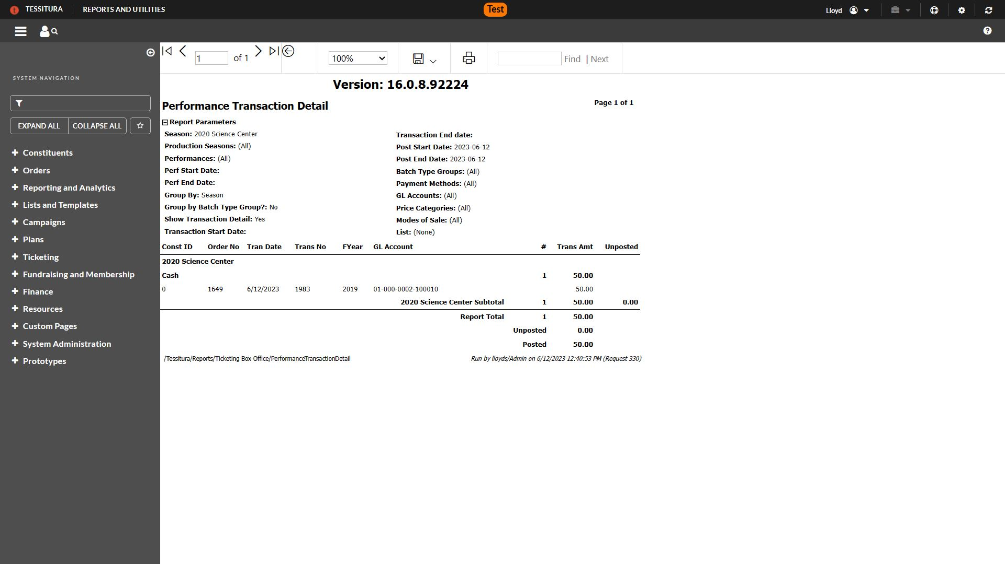
Notes:
This is the result, and we can se that it matches
When we look at the detail, we can see the payment methods that were used. I only used cash on my order, but if I had split payment methods, each part of the transaction would have its own line. Very useful for seeing how Tessitura has applied payments
Negative amounts are helpfully shown in red, and in brackets. That’s useful for seeing revenue debited from that event (refunds or exchanges)
‘Ticket Change’ section will show revenue credited to that event from other sources than payment methods. Exchanges, overriding fees or contrbutions.

Slide 9
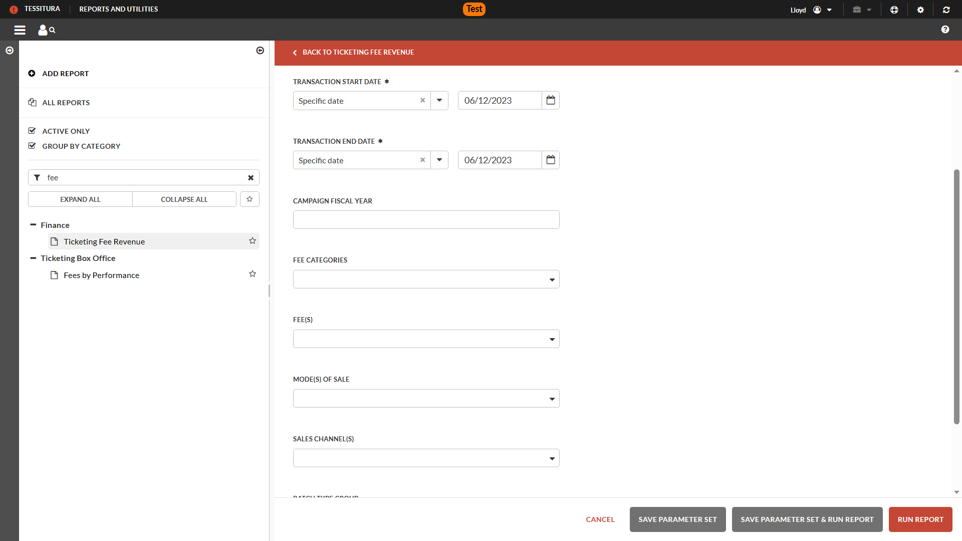
Notes:
Ticketing Fee Revenue Report
Provides sub ledger level details for fee revenue. Fees added for delivery, service fees, processing fees, sometimes for taxes
Doesn't have posting, but does have transaction start and end
Consistent Data Entry - you'll have the posting date and transaction dates the same

Slide 10


Slide 11
Notes:
Fund Activity Report
The ultimate workhouse for fundraising-related revenue. Pledges, Gifts, Payments. Future to Current. Date-restricted giving. Pledge write-offs.

Slide 12
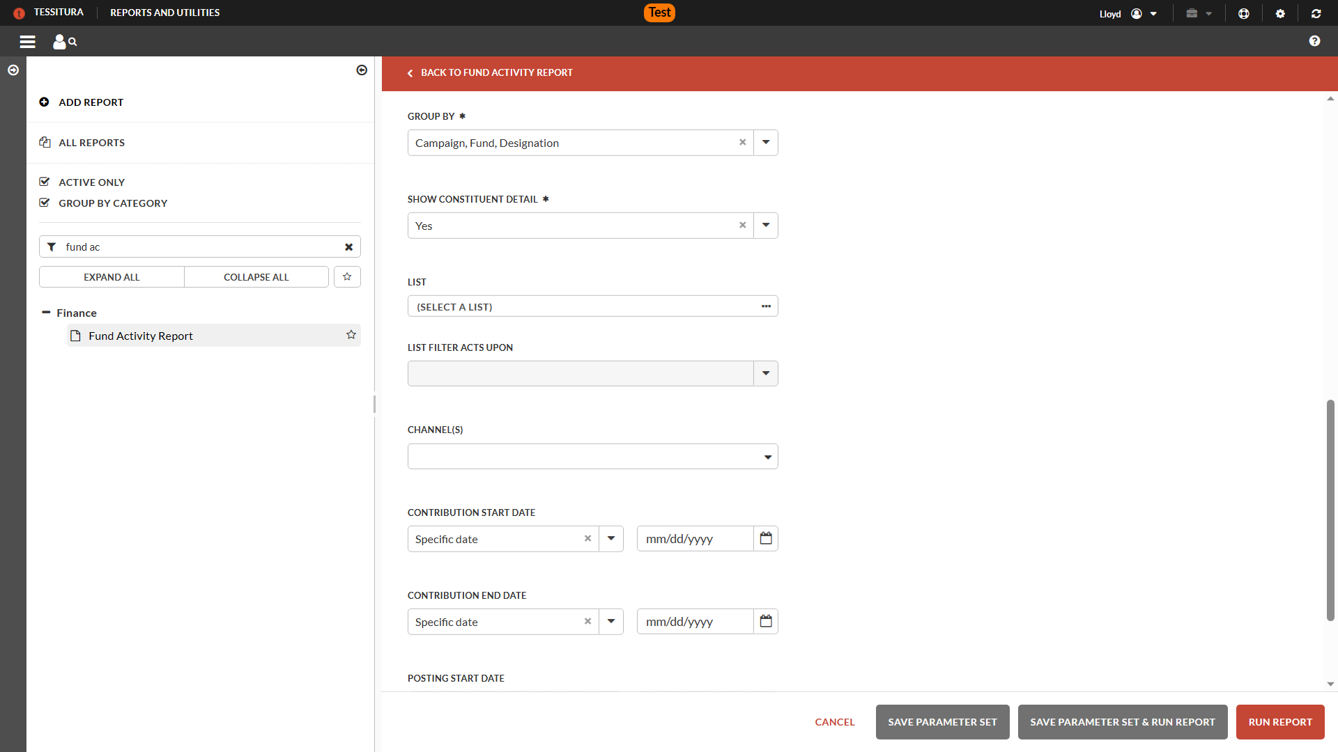
Notes:
Groupings offered by payment method, or by contribution-related coding
Ability to show detail down to the constituent level
Remember that contribution date is next to useless in finance land. You might have a membership that’s paid for monthly, but all those transactions are linked to a single contribution date.
That’s why there are separate rows – multiple transactions for scheduled contributions

Slide 13
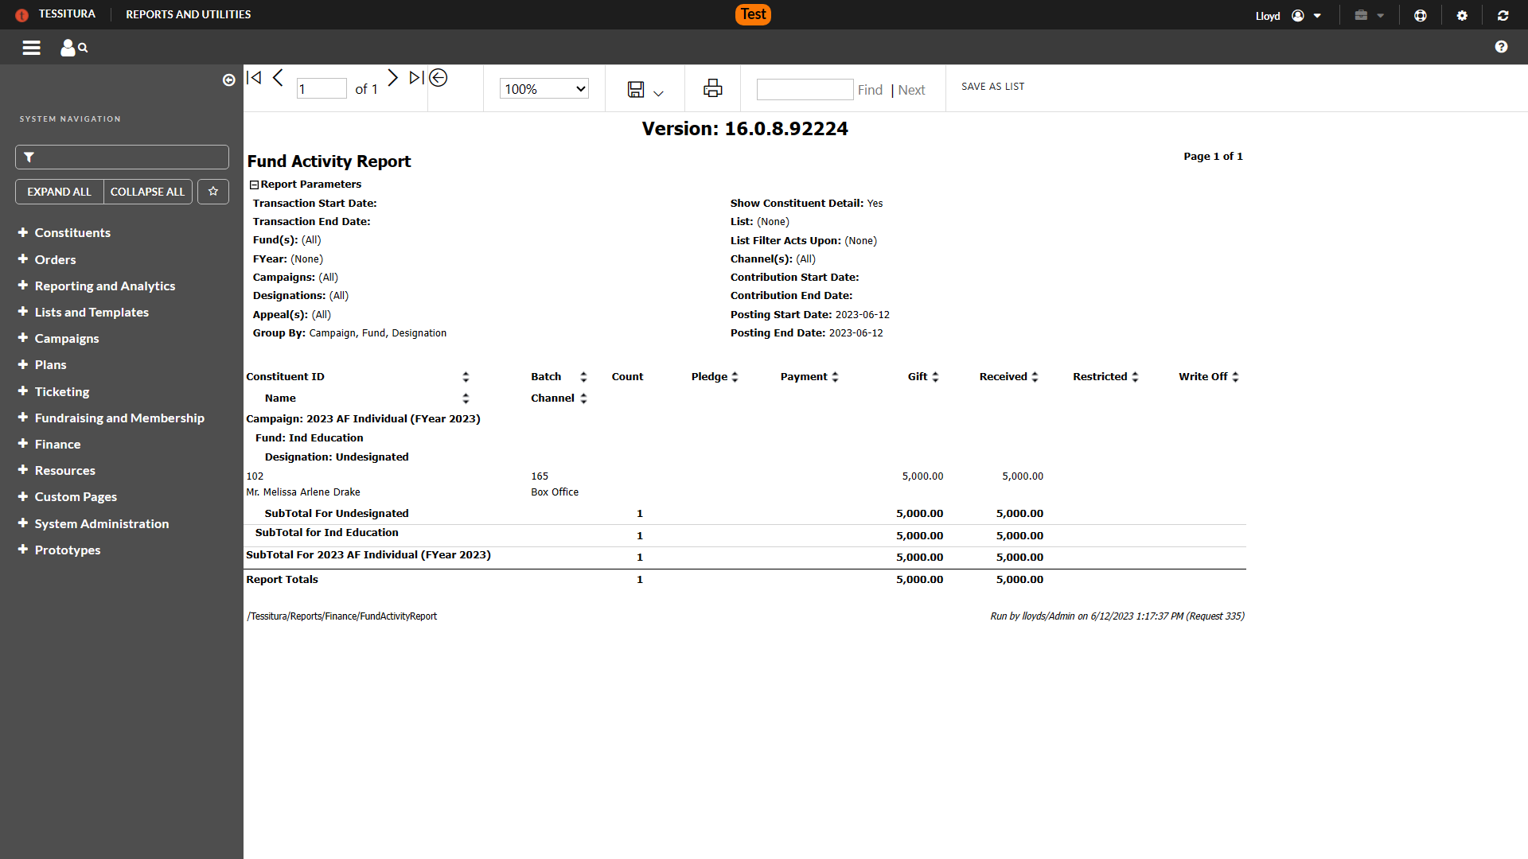
Notes:
Campaign, Financial Year, Fund, Designation, Constituent, Channel
Breaks down Pledge, Payment, Gift, Received, Restricted, Write-off

Slide 14
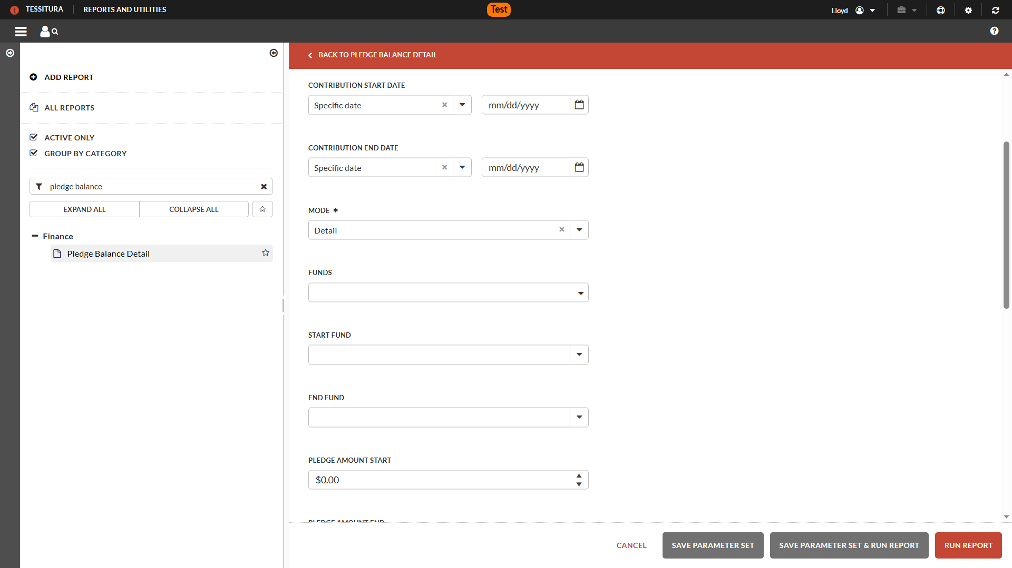
Notes:
--Pledge Balance Detail
Great for the future
How outstanding pledge balances are broken down by fund, and from whom

Slide 15
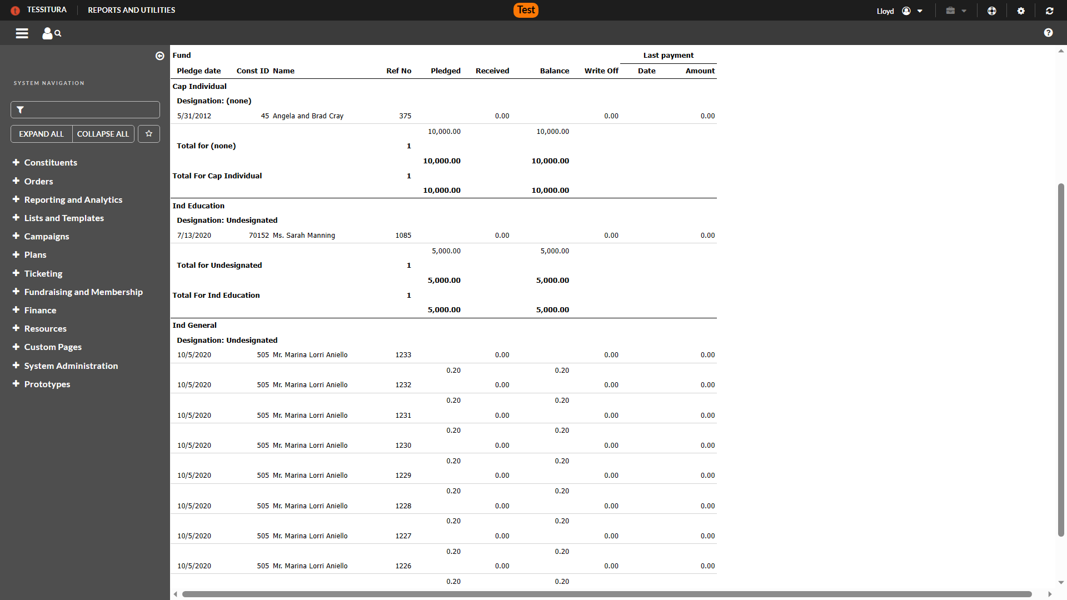

Slide 16

Introduction to Finance Course
https://tinyurl.com/IntroToTessituraFinance
Notes:
Excellent resource for the basics, with follow-on deep dives into Ticketing and Fundraising

Slide 17

Quick Start to Finance Reports
https://tinyurl.com/TessituraFinanceReports
Notes:
Top reports based on the following criteria:
Ease of use
Focus on the identified reporting need
Low level of reliance on specific business practices

