Slide 1
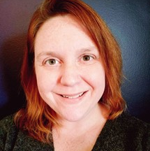
Group sales and field trips, from taking the call to welcoming at the door
Rachel Vest, Presenter
Thursday, May 11, 2023

Slide 2
INTRODUCTION
Notes:
Welcome and thank you for joining me for Group sales and field trips, from taking the call to welcoming at the door
Rachel Vest, Support Lead, White Woman in my 30s wearing, and behind me are the screen with our slides for today’s presentation.
After this session you’ll have a better understanding of how constituents are best set up and used in group sale and field trip situations, and some of the best practices for group sales orders and invoicing.

Slide 3

2 Scenarios for our Session
Group Sales to a Performance
Field Trip at a Museum using general admission
Notes:
Today we’ll explore 2 common group sales scenarios and some best practices, tips, and tricks for a smooth patron experience by looking at group sales to a performance and a field trip to a general admission venue.

Slide 4
CONSTITUENTS
Notes:
As we go through the presentation I’ll be using examples from both versions 15 and 16. For our purposes today we’ll use everyone’s favorite teacher Ms. Frizzle and her classroom as our test case.

Slide 5
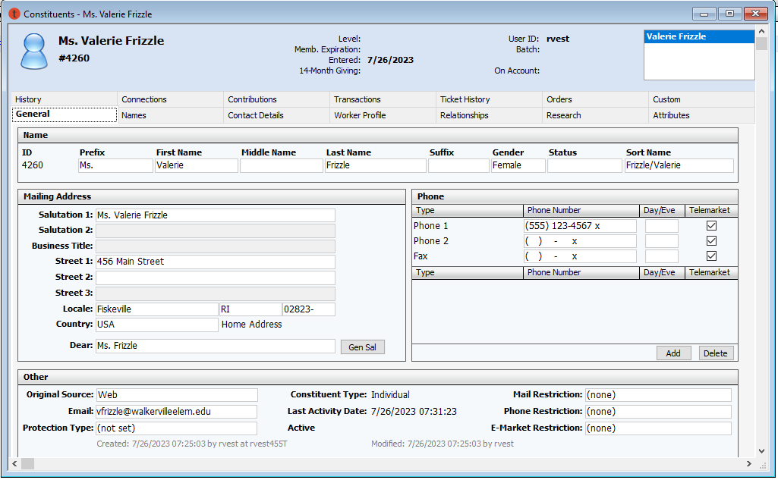
Individual Record Type
Notes:
We’ve just got a call and our fearless Group leader is ready to book a performance and fieldtrip for the school year. First let’s take a look at Ms. Frizzle’s individual record and make sure that all of her information is correct. As an individual this record has a home address, and Ms. Frizzle’s direct email and home telephone number. It may include personal order history as well. Let’s find out if Ms. Frizzle has been affiliated to her school for this group purchase.

Slide 6
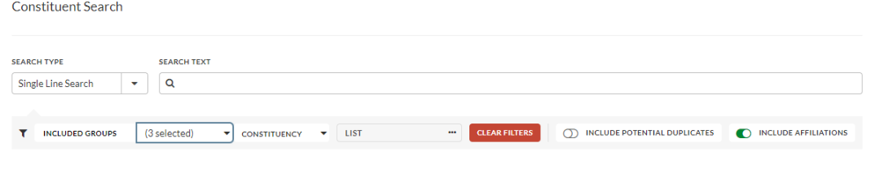
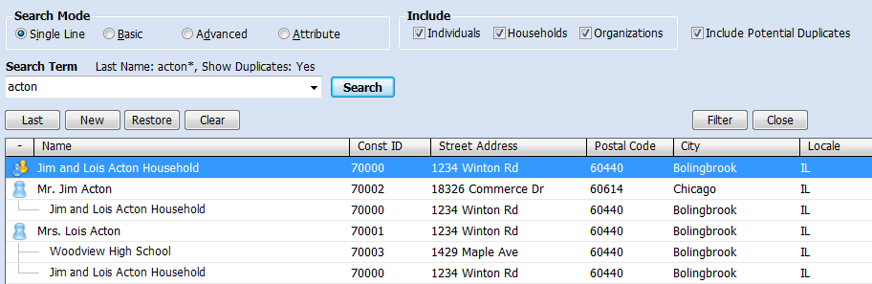
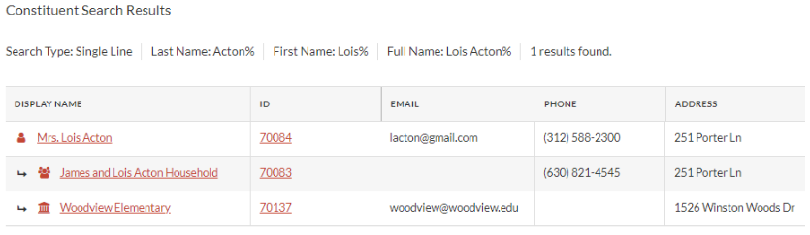
Constituent Searches
v15
V16
Notes:
Here are examples of the Constituent Basic search in both versions 15 and 16. Note that for both we’ll want to be searching for groups and affiliates by using the Include in Results field and Including Affiliations constituent searches. In version 15 we use the check boxes under the Include Box and want to be sure Individuals and Organizations are both checked. In Version 16 we would use the filter option to include Groups, selecting at least individuals and organizations, and toggle on the Include Affiliations option.

Slide 7
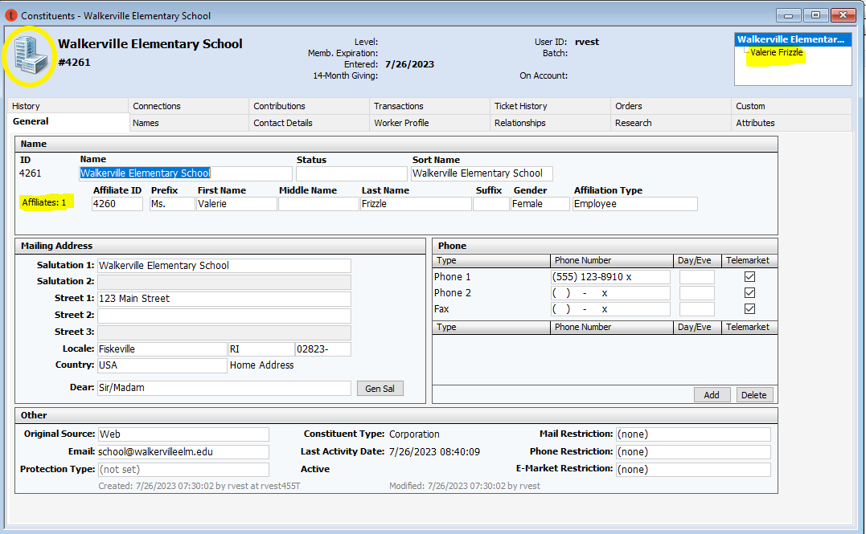
Organization Record Type
Notes:
Voila! Our search results included Walkerville Elementary School, to which Ms. Frizzle is Affiliated. Here we have a record using the Organization Type, notice that the icon in the top corner was a person on the individual record and is now a building, and the affiliated records are shown in the upper corner and listed just below the Organization name. Here we see the school address, main phone number, and email. Before we move on to placing an order lets review some best practices and setup for both record types.

Slide 8
Constituent Best Practices
Use Organization Constituent records and Affiliations whenever possible
Constituents can be viewed in a browser
Consider a Group Sales Constituency
Notes:
As a best practice we suggest using Organization Type records when your group is from a School, University, or Business. We then recommend individual records be affiliated to the Organization for your group leaders.
Constituents can be viewed in a browser (in v15 via Tessitura on the Go and in v16 through the Tessitura Web Application. ) We will talk more about some browser based viewing features later in the presentation.
Some organizations find a Group Sales Leader constituency useful for group leaders with whom you have a long term relationship. The constituency can be useful for tracking behavior over time, and quickly identifying long time repeat group leader relationships in the Constituent Header. Constituencies are best used as highly visible indicators on the constituent record, as criteria for lists and extractions, as filters in Analytics, and as criteria for pricing rules. Keep in mind that constituencies are designed to describe a constituent’s high-level, current relationship to your organization. A constituency would not be helpful for a one time Group Sales buyer. Constituencies take active planning and require ongoing management, for example keeping current with start and end dates. I recommend referencing the Constituency Planning portion of the documentation to help determine if this is the right path for your organization.

Slide 9
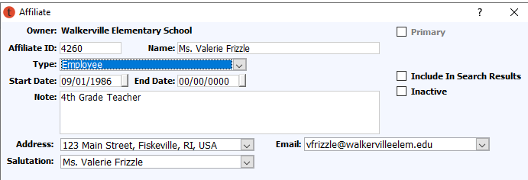
Affiliation Setup
Constituent and Affiliation types are controlled in the TR_CUTS_TYPE and TR_AFFILIATION_TYPE system tables
When affiliating to an Organization be sure to setup the desired contact data.
Notes:
Lets dive a little deeper into the Affiliation setup. If your organization doesn’t have types set up to fit your needs for group sales the Constituent Type for example, “School,” can be added to the TR_CUST_TYPE system table and if you need to add “Teacher” as an affiliation type it can be added in the TR_AFFILIATION_TYPE system table.
When adding an Affiliate a separate window will open. It is important to note that this information is used specifically for lists. If your organization wanted to pull a list of all schools who purchased last year and you want to reach the teachers affiliated with the school the preferred mailing and electronic address for the teacher would be determined from data in this window. The entries made in this window do NOT pull through to any orders. We’ll discuss how to use affiliate information in an order a bit later.
Looking at Ms Frizzles Affiliation we know we have her home phone number and address, but when pulling a list of organizations with groups we would like to reach all affiliated teachers at their work addresses, both physical and electronic. We can change that by selecting the correct addresses from the drop downs. We can also include these selections as part of our search results by using the Include in Search Results checkbox and should Ms. Frizzle leave her job we can add an end date and make this affiliate inactive.

Slide 10

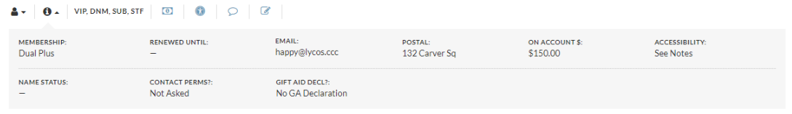
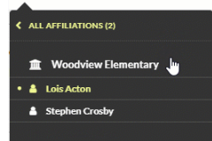
The Constituent Header
Make use of Icons
Add a Photo for Group Leaders
Affiliate Jump To Menu to quickly navigate
Notes:
There is one more piece of the constituent record that we can make some simple additions to that can give a quick snapshot of a group leader and their upcoming activity, and that’s the Constituent Header. Here is a sample of the header for a household and the Affiliate Jump to Menu for a school from version 16. In version16 we’ve added more icons for a quick visual reference to any important information, for example if there are accessibility needs. We’ve also added the option to upload a photo in the header. This is great for any staff who may be greeting your group for a field trip or performance so that they can quicky identify the group leader. The Photo appears just to the right of the Constituent Name and ID.
The affiliation jump to menu replaces the box that was in the version 15 header. The example shown here for Woodview Elementary is opened by clicking the constituent category icon in the constituent header in the upper left corner and displays a tree of the current group and its individual affiliates. When an organization record is selected, the menu is populated with affiliates of the organization. When an individual record is selected, the menu is populated with the primary affiliated household, if one exists and an additional link is displayed at the top of the menu. Clicking the link displays all groups to which the individual is affiliated, from which a different group (for example the school) can be selected as the context used to populate the menu.
For groups we recommend the Transactional Header which comes out of the box and can be edited to include useful elements like Next attendance, Open CSIs, and any On-Account information to help you better manage your groups at first glance. Here we have a sample header from v16 and a sample of the
Add the actual header

Slide 11
ORDERS
Notes:
Before we move onto the next section lets do a quick Re-cap of constituent set up:
Use org type records and affiliations for groups
Setting Addresses in the add affiliate window is used specifically for lists and does NOT filter through to orders.
You can view constituents in a browser
Make the most of your headers by adding elements, icons, photos.
Now that we have an understanding of the constituent record and we’ve made sure Ms Frizzles record and affiliations are following best practice we can move on to booking her orders!

Slide 12
Ticketing Setup Best Practices
Create a Group Sales MOS
Create Group Sales Price Types
For partial payments
  Leave the Must be Paid check box blank
  Check the Allow Uns/Paid box
Use Confirm Mode to avoid printing tickets
Notes:
Before any group sales orders are booked a review of best practices for Ticketing setup is essential. These best practices will make booking the order, printing tickets and confirmations, tracking payments, and reporting on orders smooth for you and your team.
Lets start with setting up an Internal Group MOS. (context not optimized on TNEW because the order would go to the teacher’s individual or household account)
In order to take full advantage of functionality from reporting to recording attendance that is specific to Groups or Field Trips we recommend creating Group specific Modes of Sale and Pricetypes. We’ll see a little later on some of the attendance features tied specifically to modes of sale that your organization might only want to use in special cases. Separate Modes of Sale allow for this more customized behavior.
Groups sales Modes of Sale will likely be setup with the Allow unseated and unpaid check box checked so that orders can be partially paid.
The confirm mode option, when checked, will alter the default of the Print Order window such that the Acknowledgement box is checked and the Tickets, Receipts, and Header boxes are. This setting is most useful for modes of sale used to manage orders for which acknowledgments like order confirmations are printed or emailed more regularly than tickets.

Slide 13
Order Best Practices
Use Owner and Initiator fields
Use the Alt Address function
Take advantage of Order Notes
Set up payments that are easy to edit
Create a Group Sales Specific confirmation
Notes:
I’ll go in depth with Screen shots on the next slides but we’re going to make certain that we book Ms. Frizzles order in the most effect way but using the owner and imitator fields, the alt address function, including order note, setting up easily edited payments, and sending an informative confirmation every time payment is made.

Slide 14
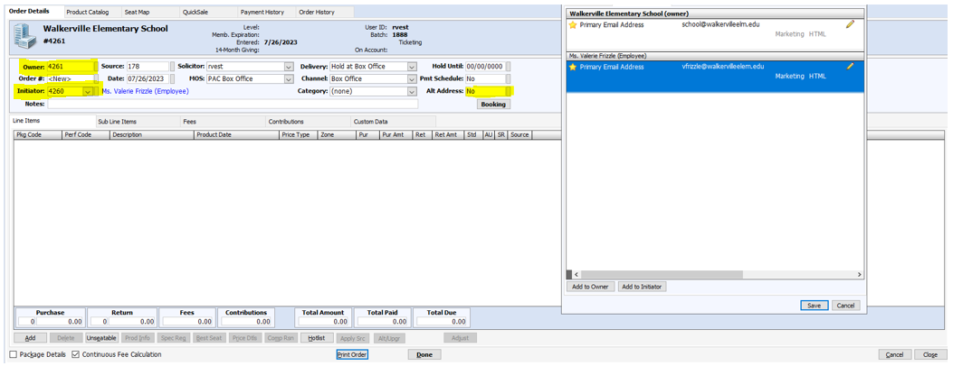
Order roles and Alt Address
Notes:
Let’s start booking our order! We want the order to stay with the organization record so the Owner ID will be for the elementary school and the initiator will be Ms. Frizzle.
We don’t want confirmations or tickets sent to the generic inbox at the school so we want to make sure the email goes to Ms. Frizzle every time without asking our team to remember to change the email on the print order screen.
Once the initator ID is entered you can assign default addresses to the order using the Alt Address field. The Alt Address field is used to select a postal address as the shipping address for the order (the address that will be printed on a ticket header), and/or an email address for emailing order acknowledgments, print at home tickets, and mobile tickets.
Clicking the chicklet, using the keyboard shortcut Ctrl+D, or selecting Shipping Address from the Orders menu. opens the Select Contact Points window:
The window has two tabs, Postal Address and Electronic Address.
The Postal Address tab displays all postal addresses on file for the constituent. Addresses are grouped by constituent. The primary address for the constituent is noted with a star.
The Electronic Address tab displays all email addresses on file for the constituent. The primary address for the constituent is noted with a star.
Please Note: To access the Send Mobile Tickets button on the Print Order window, an email address must be selected here.
When an initiator's postal address is selected, the salutation for the initiator is used for ticket headers, ticket order billing, and ticket order acknowledgments and confirmations.
When an initiator's email address is selected, the salutation for the initiator is used for email confirmations.
To select an address for the order, simply click on it and when you’ve finished choosing addresses click Save.
Existing addresses can be opened for editing by clicking on the icon beside the address.
A new address can be added to the owner by clicking the Add to Owner button.
When an initiator is selected for the order, a new address can be added to the initiator by clicking the Add to Initiator button.
Once saved a value of Postal is displayed in the Adr field when a postal address other than the default is selected for an order, a value of Email is displayed when an email address other than the default is selected, and Postal/Email is displayed when both an alternate postal address and email address is selected.

Slide 15
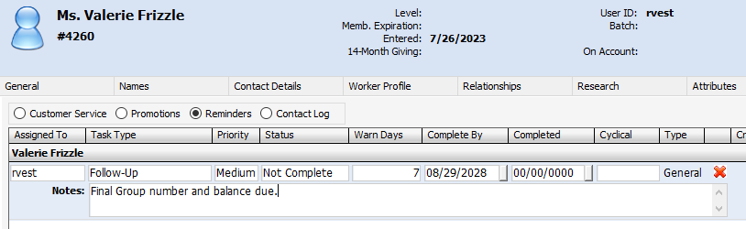
Order Payments
Use the invoice payment method only if you must print tickets.
Create a Group Sales Invoice as an order confirmation instead.
Use the payment plan feature for auto-billing
Set reminders for payments due
Notes:
We’ve now made certain Ms. Frizzle will receive all communications and tickets by default, selected our Group Sales MOS, and reserved tickets. Its now time to take partial payment and Ms. Frizzle will need an invoice for her school to write us a check.
How do we process this payment?
The invoice payment method is useful if you must print tickets, however the invoicing for group sales often requires flexibility and frequent changes. Updates need to be sent as numbers fluctuate and payments are received. To help track the payments made and remaining balance, along with any seat adjustments Ms. Frizzle may need we suggest creating an order confirmation with INVOICE or Group Sales invoice at the top.
Because Ms. Frizzle will need to pay by check we also do not recommend using the payment plan feature, which is intended for Auto Billing. Rather we suggest setting up reminders on Ms. Frizzles record for important payment and seat adjustment due dates.
The Reminders screen on the Connections tab of constituent records is just the place to manage the process. Reminders can be assigned to users so that they appear on the user's personalized list of reminders, which can be set to open each time the user logs in to Tessitura. You’ll see here I’ve created a reminder for the final attendance and balance. I’ve set warn days to 1 week prior to the deadline so Ms. Frizzle can request her check.
As a person working in group sales you can access all of your reminders at any time (not just at login) from the Tools menu or by clicking the View Reminders button on the toolbar:

Slide 16
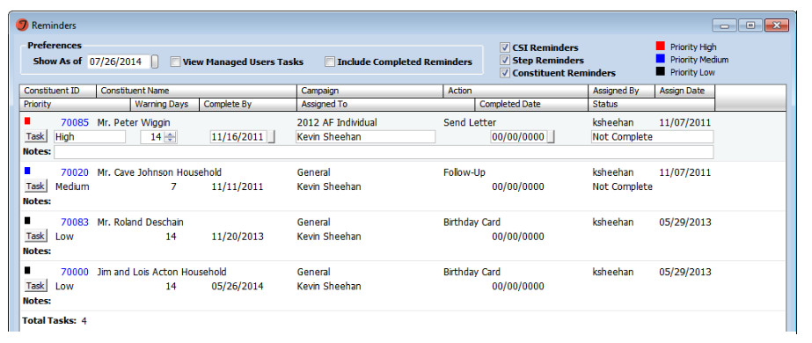
Reminders
Notes:
As a person working in group sales you can access all of your reminders at any time (not just at login) from the Tools menu or by clicking the View Reminders button (the clock icon) on the toolbar.
From here the Reminders Screen will open and you can make updates to existing reminders directly from this screen.

Slide 17
Order Confirmations
HTML Templates with Barcodes for Tickets
Payments made, balance due, and subline items
Separate Invoice and Ticket template for groups
Use an Order Confirmation for your Contract
Set Barcode prefixes to match scanning setup
Notes:
We’ve booked Ms. Frizzles order, taken her initial payment and now we need to send her an invoice, order confirmation, and even a contract for her records.
For print at home or mobile tickets set up HTML Templates with Barcodes for Tickets use the recipe book provided in the documentation. We’ll see this on the next slide.
Using the recipe book you can also create templates or modify order confirmations for groups to show payments made, balance due, and subline items.
You may consider an Invoice Template and Separate Ticket template for your groups to keep track of invoice payments without cluttering the confirmation with subline items.
You might also consider creating your group sales contract as an order confirmation that can be sent directly from the order screen
As we look ahead to order fulfillment you’ll also need to make certain your Barcode prefix matches your scanning needs. With access control There is new way to build order QR codes so they are scanned correctly and can allow for Group Order Entry. Barcodes on a confirmation must include a prefix and be padded with 0s according to default entry values (for example barcodes can be set to have specific length ie 10 character.)

Slide 18
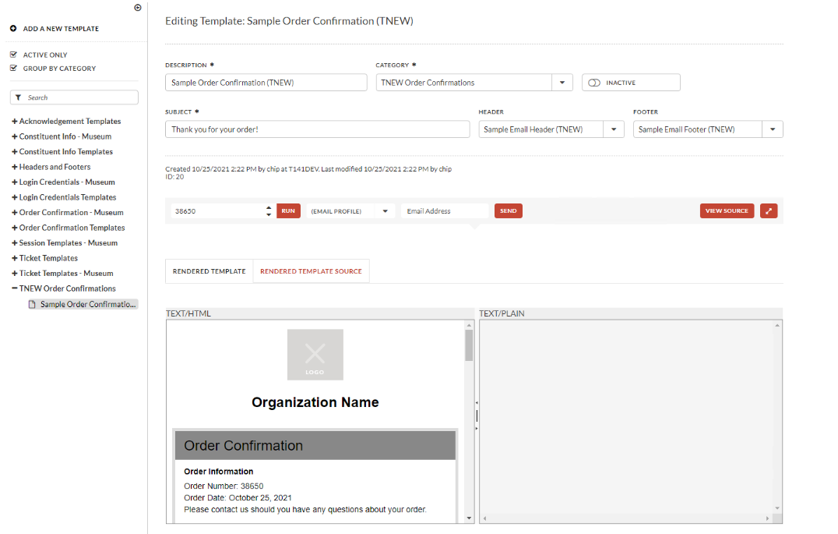
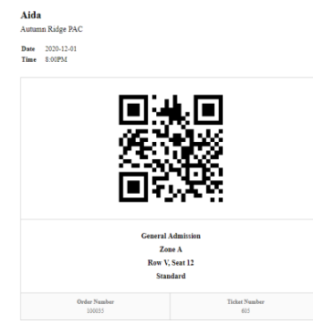
HTML Templates
Notes:
Here is the HTML template editor in V16 and a Mobile ticket barcode.
If you aren’t comfortable creating templates we can provide that as a billable service. Simply open a project ticket and our Professional Services team would be happy to set up a meeting to discuss the scope and cost of the project.

Slide 19
FULFILLMENT
Notes:
Before we move onto the next section lets do a quick Re-cap of Orders
Setup an internal Mode of Sale for group sales
Use Owner and Initiator fields and Alt Address function
Set up payments that are easy to edit and use reminders to track payments rather than the invoice payment method or payment plans for auto billing.
Create a Group Sales Specific confirmations, consider templates for contracts, invoices, and order details
With the orders booked, paid, and tickets sent we are ready to meet Ms. Frizzle and her students at the door.

Slide 20
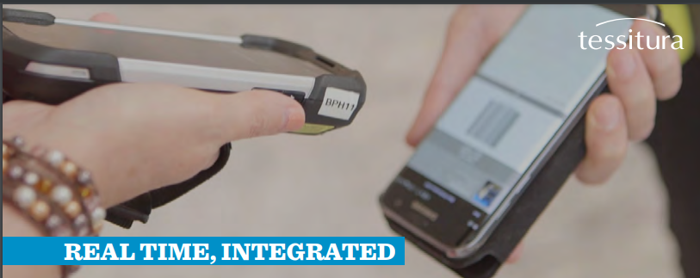
Access Control
Notes:
The first thing we’ll need to do is scan the tickets or track attendance. We have rebuilt Access Control (formerly NSCAN) from the ground up in version 16 for a more integrated patron and member experience.

Slide 21
Access Control
Validate tickets at multiple entry points
Streamline group check-in even with multiple entry points or arrival times
Deliver Personalized Messages to guests upon arrival
Know instantly when Group leaders arrive with email or text alerts
See real time attendance reports on your scanner
Notes:
Here are few scenarios that might happen when Ms. Frizzle and her students arrive for their field trip, that Access control is able to manage:
We may need to Validate tickets for general and timed admission at multiple entry points, for example if some students require an accessible entrance to a museum for their field trip.
We can Streamline group check-in even with multiple entry points or arrival times by using Group Entry by Order is now part of the main Entry Scanning functionality. We will look at this on our next slide.
We want to make certain the group is given a warm welcome and that they are reminded of their first activity. We can Deliver Personalized Messages to guests upon arrival welcoming them to the venue and sending them to the group’s first meeting point. Acknowledging them, when is your lunch period, etc.
We can also Know instantly when Ms. Frizzle arrives with email or text alerts so you can meet her in person.
We can view real time attendance reports on your scanner so you can ensure that her entire group has arrived.

Slide 22
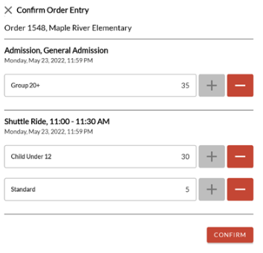
Group Entry by Order
This feature can be useful for quickly managing check-in for group orders
Using subline items the scanner shows the available number of tickets not marked attended
Notes:
Lets dive a little deeper into the Group Entry by Order feature.
In this Scenario: Ms Frizzles students arrive separately to the museum but all of the group members have the same barcode or QR code from a mobile ticket shared by Ms. Frizzle. Some members of the group enters through the main entrance while others use a more accessible entrance.
When an order number is scanned, Tessitura Access Control checks if the order number exists and then if there are any sub line items (SLIs) in the order for performances valid on the device profile that have been printed but not yet marked Attended.
The scanner operator can change the number attended by using the plus or minus buttons on the scanner and scan in only 2 of the students who have entered through their door. Then confirm. The number attended will automatically update and when the next group arrives only the number of unattended tickets will appear when scanned. Ms. Frizzle can also be informed that 2 of her students have already arrived.
Group order Entry setup requires a Barcode with a specified prefix, we might choose the letter “G” that is different from the prefix for order ID or Membership Card. The barcodes are managed in the system tables
AC_ORDER_NO_LENGTH and AC_ORDER_NO_PREFIX.

Slide 23
Auto Attend
Tickets are marked attended at the time of sale or during the doors open and close times.
Setup on MOS tab of Performance setup
Physical tickets can be printed if desired.
Notes:
Another option for Ms. Frizzles group is to fast track their entrance to our venue either on their field trip or at the theatre doors. You will save time getting her large group through the door Setting up Auto Attend allows tickets to automatically be marked as Attended at the time of sale, with or without the printing of a physical ticket.
This feature is also useful for when you to bypass the scanning of tickets purchased on-site as well as for facilitating contactless transactions.
Setup on MOS tab of Performance setup so you can choose to use auto attend for only your Group MOS

Slide 24
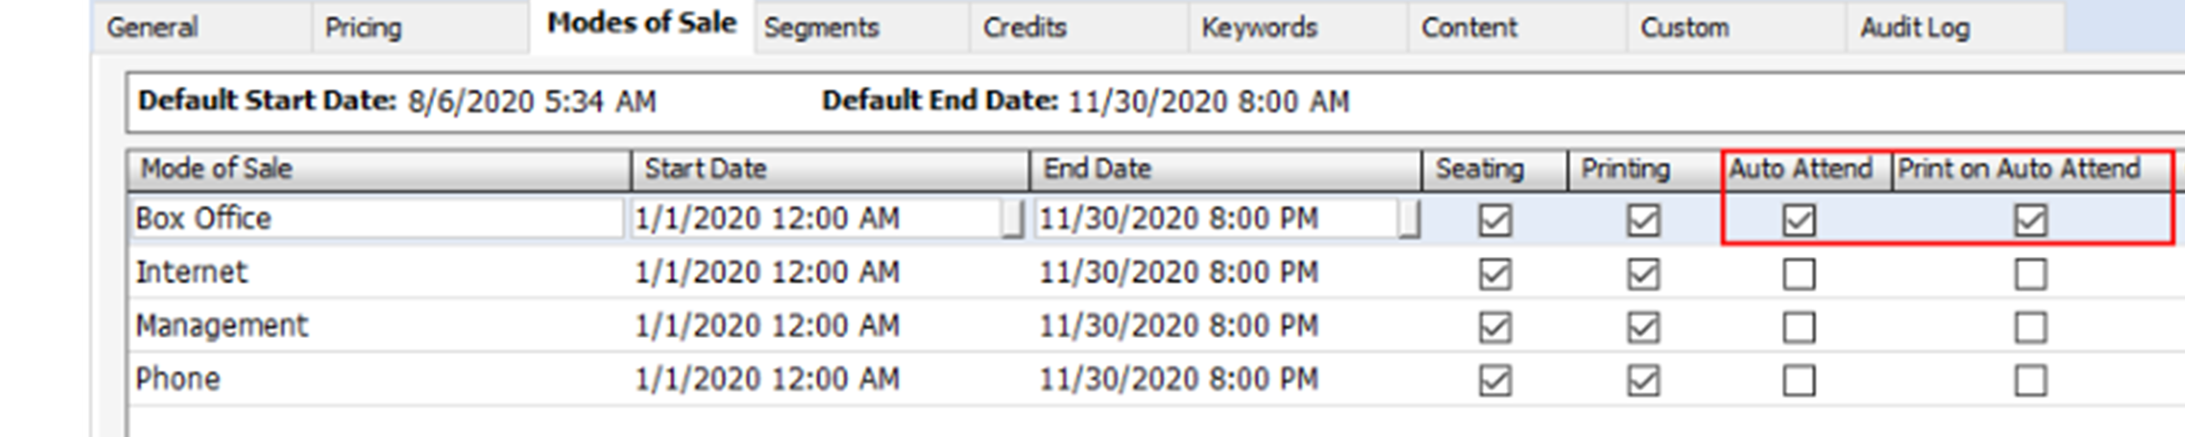
Auto Attend Setup
Notes:
Auto Attend is setup on the MOS tab of performance set up and the options.
Check the Auto Attend box on a mode of sale if tickets purchased in that mode of sale should be marked Attended when printed during the active auto-attend period.
Check the Print on Auto Attend box if a physical ticket should also be printed when auto-attend occurs. If this box is not checked, tickets can only be printed during the active auto-attend period through a reprint (i.e. the initial attempt to print will mark tickets Attended without generating physical tickets, but reprinting after that will generate a physical ticket).
Auto Attend can also be used in a General Admission scenario where the group has tickets to the museum which we would like have tickets to the IMAX movie which need physical tickets that we would like to have scanned. In this scenario our group members are sold a flex package and have a composite ticket. This more complex scenario is covered in the documentation and we would also be happy to discuss this setup at the solution center.

Slide 25
Resource Booking
Comprehensive way to book a field trip
With assignment duration for each resource
Booking can be made from the ticket order
Browser friendly reports
Notes:
Now that Ms. Frizzle and her students have all been scanned into the museum it’s time for them to embark on their busy field trip. Ms. Frizzle has reserved some classrooms, a lunch space, and a docent tour for her students. All of which we’ve been able to set up for her via resource booking and we can access from a browser on our mobile phone if questions arise during the field trip.
A booking is a collection of resource assignments used to reserve resources. Resource assignments can be added to a booking individually or by selecting a booking template, a reusable set of resource type assignments and booking header field settings.
For example, a booking template can be created for grade school group visits, containing the typically required resource types for grade school visits (a bus parking space, a classroom, a teacher or expert, a lunchroom, and a docent tour) and the typical assignment duration for each resource.
If you’re interested in setting up resource booking we do have some great in depth recordings on TN.com, or please visit the Solution Center.

Slide 26
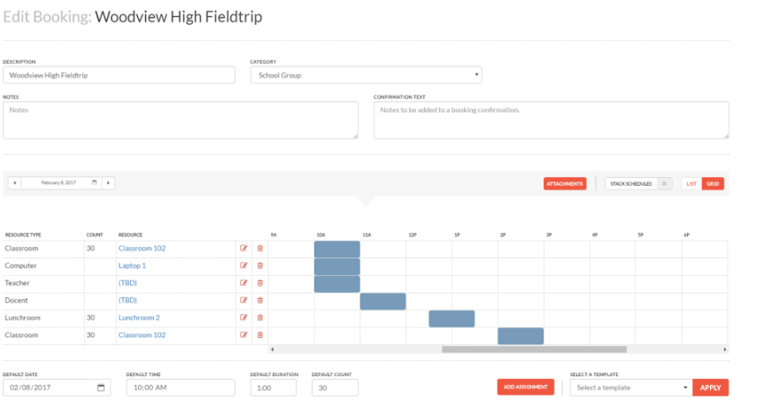
Resource Booking
Notes:
Here is a sample booking. This group requires a classroom, computer, teacher, docent, and lunchroom. This is a great example of how bookings can be used for a space, person, or even items like AV equipment. Ms. Frizzles next trip to the zoo or aquarium might show a booking resource full of animal encounters and their handlers. There are so many possibilities.

Slide 27
Additional Topics or Assistance
Some member organizations use plans to help track frequent Group Sales buyers or manage payment and other deadlines.
Visit the Solutions Center
Notes:
Just one other topic to mention, which like Resource booking is more advanced in its setup, is the use of plans to track group sales. Now that Ms. Frizzle’s field trip has ended we’d like to cultivate several more visits from her in the future. In cases like this some organizations have used plans to tracking a full season of marketing and outreach to frequent group buyers like Ms. Frizzle. We would be happy to discuss this more in depth at the Solution Center or through a Support Ticket.

Slide 28
Notes:
We’ve covered a lot in fulfilling our group sales at the door from Access control and Auto Attend to Resource Booking and follow up on the next group sale with the use of plans. Thank you for joining me today!
We have time for questions, if you’re attending virtually please enter them in the chat!
I would be happy to discuss any of these topics further with you and will be in the Solution Center Captiva - Ballroom Level tomorrow from 7:30am until 12:30 pm.

