Slide 1
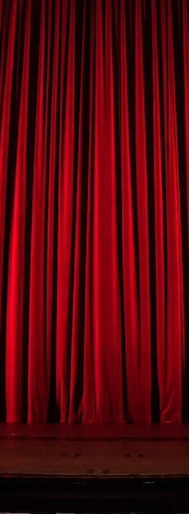


Education & Audience Development Community Group
March 28th, 2023 Meeting

Slide 2
Agenda
I. Check-ins and Introductions / Mingling (5 minutes)
II. TLCC Call for Proposals - Lean Coffee (15-20 minutes)
III. Analytics for Education Presentations & Discussion (30 minutes)
IV. Housekeeping and heads up on our next meeting (5 minutes)

Slide 3
Meet the team!
Katherine Tolbert - Community Engagement Manager for Starlight Theatre in Kansas City, Missouri
Mike Krauss - Director of Academy Operations at Cincinnati Ballet in Cincinnati, Ohio
Megan Trujillo – Education Program Specialist at the Mystic Aquarium in Mystic, Connecticut

Slide 4
TLCC Call for Proposals
TLCC Presentation proposals are due Tuesday April 11th, 2023
Katherine has been selected to be a reviewer for proposal submissions.
Lean Coffee Discussion!

Slide 5
Analytics for Education
Building performances to get information
Preview of a dashboard report
Building a widget and setting filters
Questions and discussion

Slide 6
Housekeeping & Next Meeting
Email Strategy collaboration
Next meeting is May 24th, 2023, at 11:00 a.m. EST
We will post the details for the next meeting soon!

Slide 7
Thank you for attending!

