Slide 1

DBA by Default
Katie Lachance-Duffy
Philadelphia Regional Arts Consortium
Notes:
Katie Lachance-Duffy
Philadelphia Regional Arts Consortium

Slide 2










Notes:
16 orgs in consortium, spanning the east coast of the US from Maine to Florida

Slide 3
My Path to Becoming DBA
Before PRAC:
Point of Sales developer
At PRAC:
Application Systems Analyst
Free-lance musician
Database Administrator
Tessitura Project Director
Notes:
Been at PRAC for 13 years
Undergrad degree in CSE
Mostly trained in C++, Java
Came from an object-oriented mindset with no database experience or understanding.
Hired to create customizations for the consortium, but along with that started managing the database (someone had to do it, but PRAC didn’t know that).
No formal SQL training. Learned from MS Access tutorials and SQL books.

Slide 4


PRAC Technical Setup
2006–2016
Remote servers hosted in a co-location
Managed service provider for IT
2017-Present
RAMP
This Photo by Unknown Author is licensed under CC BY-SA-NC
Notes:
Can speak to DBA’ing in self-hosted env as well as in RAMP

Slide 5
Let’s discuss…
Getting started with SQL & DBA’ing
Leveraging SQL Server Management Studio
Self-hosted vs. RAMP considerations
Database maintenance
Troubleshooting Tips

Slide 6




SQL? Select What Now?
Tutorials
  Online
Tessitura code
Notes:
Tips for learning syntax for SQL – online resources, using redgate, sandboxes
Learn syntax
I used MS Access tutorials to learn general syntax, although some keywords and function names/order of parameters are different.
TLCC archives

Slide 7



Free Online Resources
Q&A Forum
SQL, ASP, etc.
SQL-related articles, scripts, & forums
Free webinars
Physical & virtual chapters
Notes:
SQL Server Central: online articles, weekly compilation of news related to databases, daily emails on hot topics, new articles. The daily emails are an excellent “morning coffee” routine for me!

Slide 8
Let’s discuss…
Getting started with SQL & DBA’ing
Leveraging SQL Server Management Studio
Self-hosted vs. RAMP considerations
Database maintenance
Troubleshooting Tips
Notes:
Make SSMS work for you so you can more easily do your job

Slide 9
Configure SSMS:
Built-In Hotkeys
Built-in Favorites
Refresh Intellisense | CTRL+SHIFT+R
sp_help (Shows object info) | ALT+F1
Show/Hide Query pane | CTRL+R
SSMS version-dependent
Full list on MSDN.microsoft.com
Notes:
There are a number of built-in shortcuts provided in SSMS. Different versions may offer different shortcuts.

Slide 10
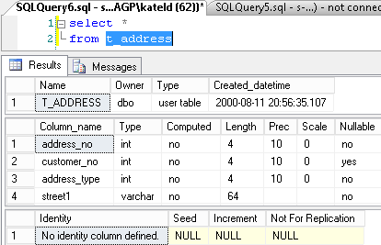
Configure SSMS:
Built-In Hotkeys:
ALT+F1 (sp_help)

Slide 11
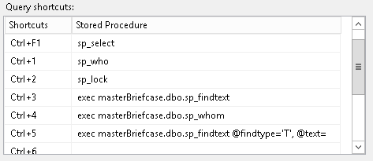
Configure SSMS:
Create Your Own Hotkeys
Add more short-cuts
  Tools→Options
  →Environment→Keyboard
  Arguments can be passed
Notes:
Get creative with the hotkeys. Use them for commands that you find yourself typing a lot.
Top 50
Find command

Slide 12
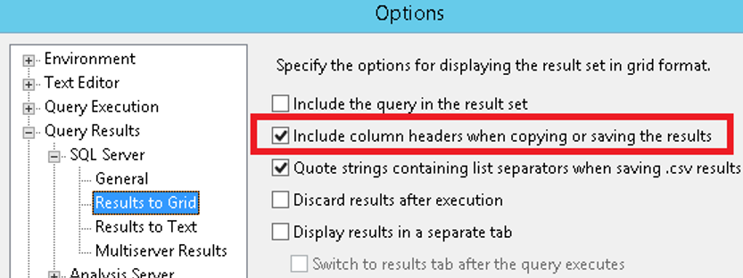
Configure SSMS: Other Options
Include column headers in result set

Slide 13
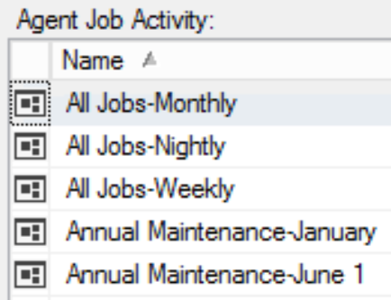
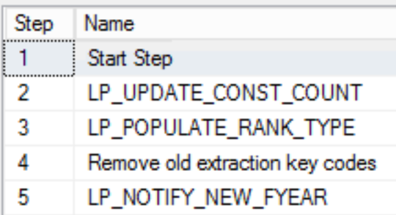
Configure SSMS: Job Scheduling
Combine jobs by schedule
Include a “Start Step” for easier history monitoring

Slide 14
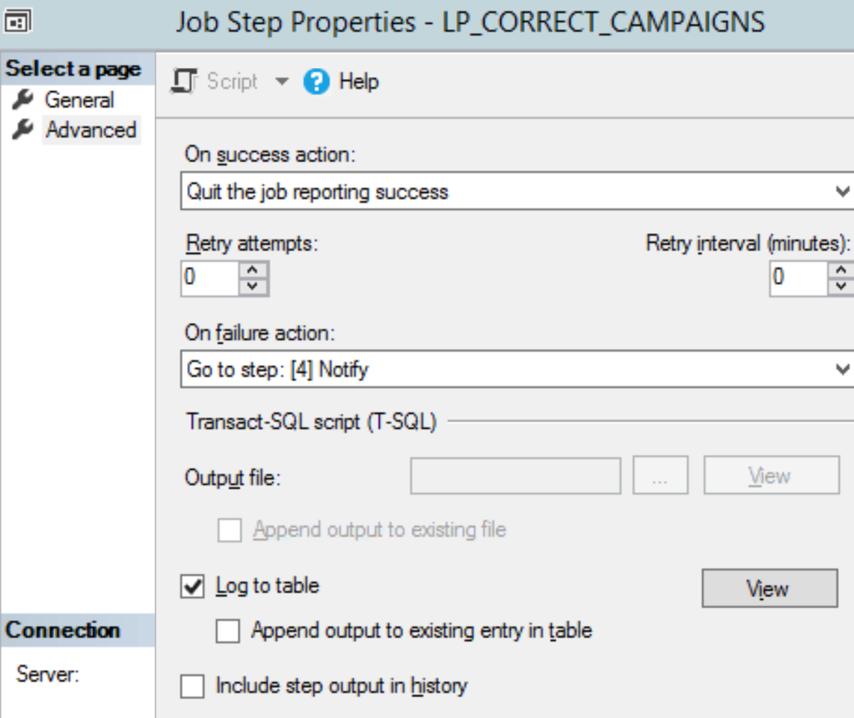
Configure SSMS: Job Scheduling
Save job step output to table

Slide 15
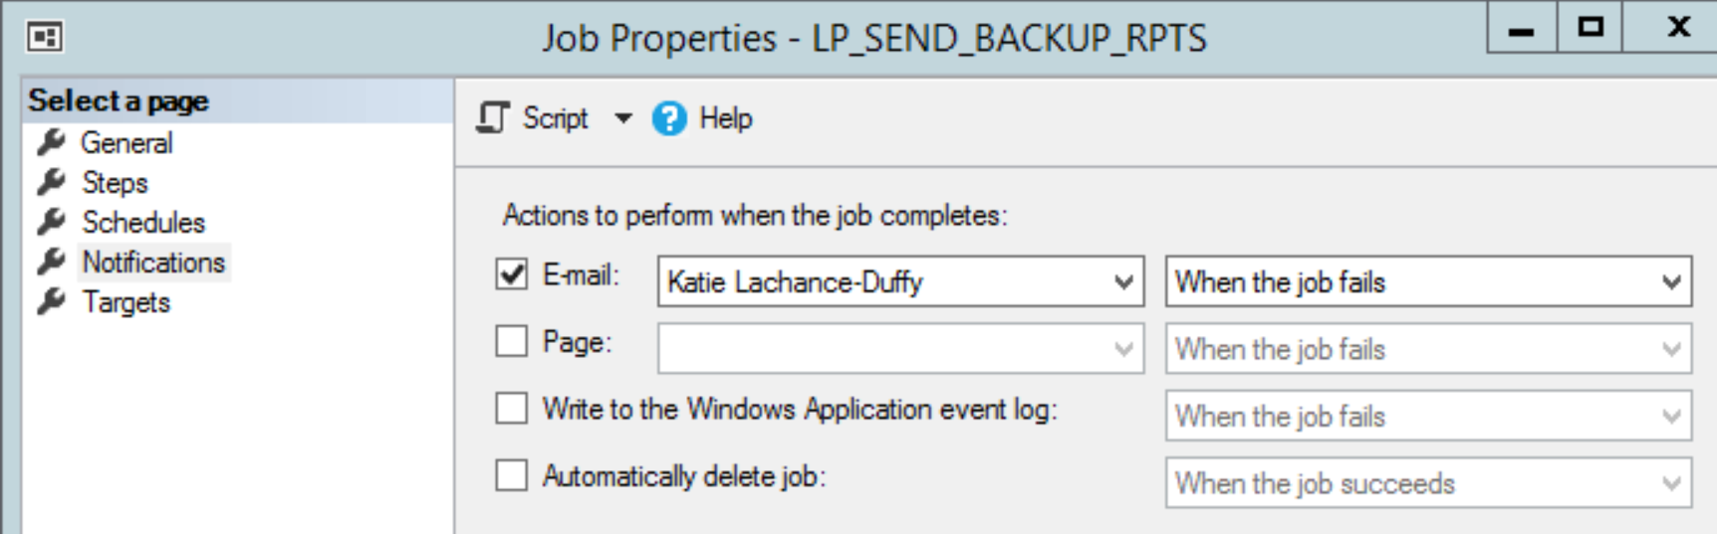
Configure SSMS: Job Scheduling
Get notified when jobs fail

Slide 16
Searching Object Contents
 | Redgate SQL Search | LRP_FindText
Free | ☑ | ☑
Interactive GUI | ☑
Customizable |  | ☑
Searches Comments | Always | Can be toggled
Searches Tessitura table data |  | ☑
Available from: | https://www.red-gate.com/products/free-tools | Google (basic) TessituraNetwork.com (TASK-Shared Reports)
Notes:
Redgate’s tool is terrific for quick searches, but if I want to avoid false positives from comments, my version of sp_findtext is more useful.
LRP_findtext queries tess-specific table contents as well, like t_keyword, tr_query_element

Slide 17
Let’s discuss…
Getting started with SQL & DBA’ing
Leveraging SQL Server Management Studio
Self-hosted vs. RAMP considerations
Database maintenance
Troubleshooting Tips

Slide 18
Self-hosted DBA vs. RAMP DBA
 | Self-Hosted | RAMP
Autonomy | ✓
Safety Net |  | ✓
Sysadmin Access | ✓ | Can: ~View & create DB objects Cannot: ~Kill sessions ~View SQL logs ~Create SQL users
SQL Server Agent jobs | Full access | Can: ~Schedule jobs ~View all jobs Cannot: ~Alter jobs created by other users
Notes:
~RAMP has less headaches, more safety net
~cannot kill sessions
~no sysadmin db access
~technically are supposed to request refreshes rather than scheduling the job yourself
~cannot maintain jobs created by other users, including failed extractions
DBA lite in RAMP: all the more reason to hone your skills, keep up to date on SQL changes, maybe download SQL Server Express

Slide 19
Let’s discuss…
Getting started with SQL & DBA’ing
Leveraging SQL Server Management Studio
Self-hosted vs. RAMP considerations
Database maintenance
Troubleshooting Tips

Slide 20
Regular Database Maintenance for the DBA
 | Self-hosted | RAMP*
Back up databases | Full backup nightly Differential 2x/Day Incremental every 15 min
Maintain indices Rebuild all Create for custom tables | ✓
 |  | ✓
Monitor changes to db objects | ✓ | ✓
Review SQL Error & Agent logs | ✓ | ✓
Review table heaps, slow queries, etc. | ✓ | ✓
*If no checkmark, RAMP staff handles this
Notes:
~NOT A COMPLETE LIST
~regular db maintenance: self vs. RAMP-hosted
--look at DB Stats report, SQL error logs & agent, look for indices on custom tables that are missing or not used, table heaps

Slide 21
Data Maintenance
 | Frequency | Self-hosted | RAMP
Recreate data encryption key | Annually | ✓ | ✓
Remove old extraction keycodes | Monthly | ✓ | ✓
Save off db & file backups to external disk | Monthly | ✓
Script all jobs | Monthly | ✓
AP_UPDATE_CAMPAIGN | Weekly | ✓ | ✓
AP_UPDATE_APPEAL | Weekly | ✓ | ✓
Notes:
These are suggestions only!

Slide 22
Data Maintenance
 | Frequency | Self-hosted | RAMP
EIS_IMP_CHANGED_LOAD_NEW (Full) | Nightly | ✓ | ✓
TP_CHECK_SEAT_STATUS_BATCH | Nightly | ✓ | ✓
TP_CHECK_BASE_STATUS | Nightly | ✓ | ✓
UP_CLEAR_WEB_TABLES | Nightly | ✓ | ✓
TP_POPULATE_FULLTEXT | Nightly | ✓ | ✓
UP_FIND_INVALID_CHARACTERS | Nightly | ✓ | ✓
Constituent data cleanup | Nightly | ✓ | ✓
Notes:
These are suggestions only!

Slide 23
Data Maintenance
 | Frequency | Self-hosted | RAMP
EIS_IMP_CHANGED_LOAD_NEW (Incremental) | Hourly | ✓ | ✓
TP_UPDATE_TICKET_HISTORY | Hourly | ✓ | ✓
TP_UPDATE_PACKAGE_HISTORY | Hourly | ✓ | ✓
Monitor TPS/Report server | Hourly | ✓ | ✓
TP_POPULATE_FULLTEXT | Hourly | ✓ | ✓
UP_FIND_INVALID_CHARACTERS | Hourly | ✓ | ✓
Notes:
These are suggestions only!

Slide 24
Data Maintenance: Extras
Table data
TR_BATCH_PERIOD
TR_CALENDAR_TEXT
TR_CITYSTATE
Nearby colleges?
Inactivate dorm addresses in June
Track school grades?
Move students to the next year in June
Notes:
Don't forget about these!

Slide 25
General Maintenance Best Practices
Refresh Test on a regular schedule
Create a 3rd instance of Tessitura
Notes:
~Refresh test regularly, e.g. 1st & 3rd Mondays of the month
~Dev instance useful for developers & longer term projects like upgrades

Slide 26
Let’s discuss…
Getting started with SQL & DBA’ing
Leveraging SQL Server Management Studio
Self-hosted vs. RAMP considerations
Database maintenance
Troubleshooting Tips

Slide 27

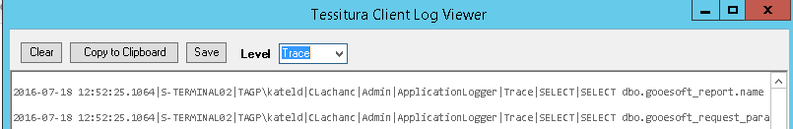
Troubleshooting: Tracing
SQL Server Profiler
  SSMS→Tools
  Many options, including filtering by spid
Tessitura Log Viewer
Notes:
Spid: server process ID

Slide 28
Congrats! You’re the DBA!
Explore
Explore online tools & forums
Leverage
Leverage SQL Server Management Studio
Maintain
Regularly maintain your databases

Slide 29

Katie Lachance-Duffy
Tess Project Director/DBA/Application Systems Analyst
catherine@artsphilly.org

