Slide 1

Contact Point
Purposes & Permissions in a Consortium
Katie Lachance-Duffy
Philadelphia Regional Arts Consortium
Notes:
Talking about cpps in consortium environment

Slide 2










Notes:
Katie Lachance-Duffy
Application Systems analyst, dba, tess project director
Philadelphia Regional Arts Consortium
Been at PRAC for 13 years
16 orgs in consortium, mostly in the Philadelphia area but span from Maine to Florida

Slide 3
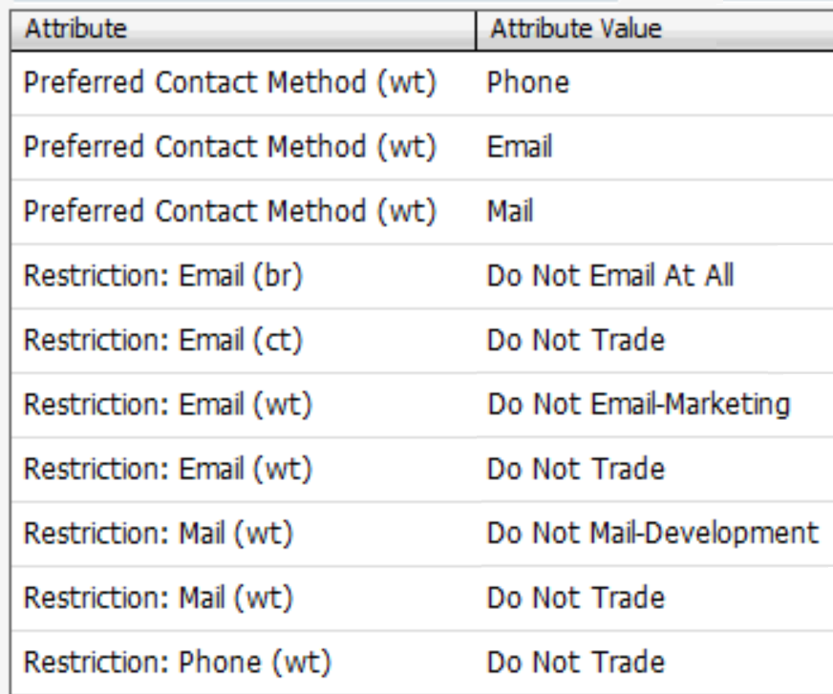
In the beginning…
Complex attributes & mail purposes
Tracked positive & negative global contact permissions, per organization
Eventually streamlined to only tracking restrictions
Notes:
Licensee since 2006
Did “I want to receive communications on this” need to be tracked separately from “I don’t want to receive these types of communications”?
In 2006, the options to track this information, without just having tons of attributes, was limited

Slide 4
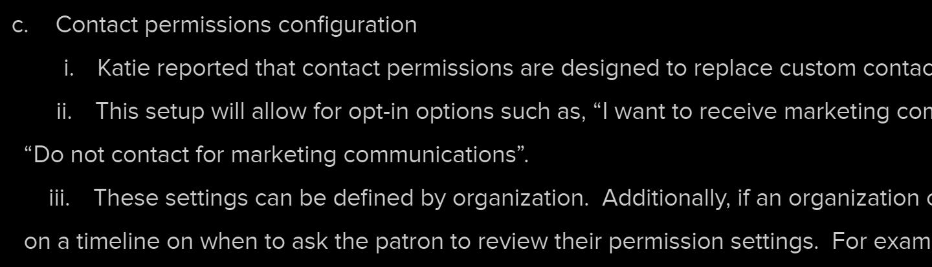
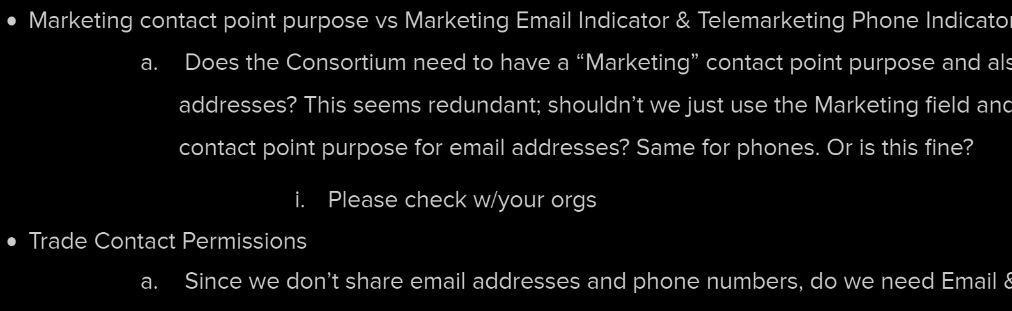
Migration Process: Planning
Consortium Staff worked with Operations Committee to guide transitions:
  Mail purposes → Contact Point Purposes (v12)
  Contact Restriction attributes → Contact Permissions (v14)
  Streamlining purposes & permissions
Notes:
from mail purposes (pre-v12) to contact point purposes (v12) to permissions (v14), consortium orgs were involved in process of defining how to use the functionality
Ops Committee consists of at least 1 member from each consortium org.
Meet every other month to discuss data-related projects and decisions.
Power users at their organizations and are charged with representing their organization’s data-related interests.

Slide 5
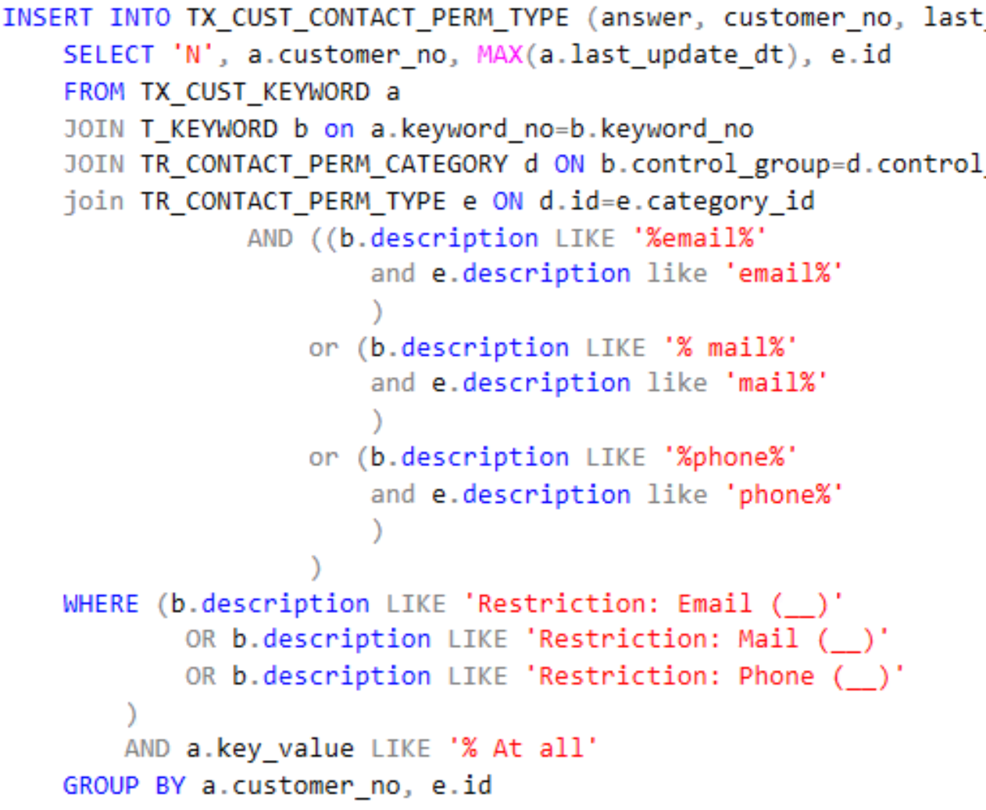
Migration Process: Implementation
Custom script made simple by naming conventions
Notes:
Migrations have all been through custom scripts
Wasn’t terribly aware of TN’s migration tool, but moving and consolidating them via script was painless due to uniform naming conventions.

Slide 6
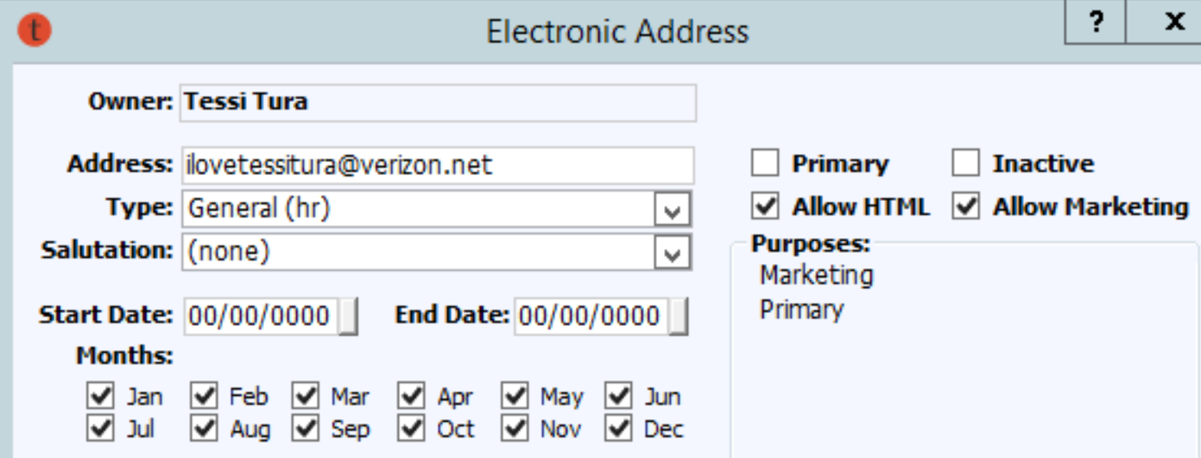
Life After Migration
Moved marketing preferences to canned fields
Notes:
~Marketing contact preference removed for phone & email to use built-in fields

Slide 7
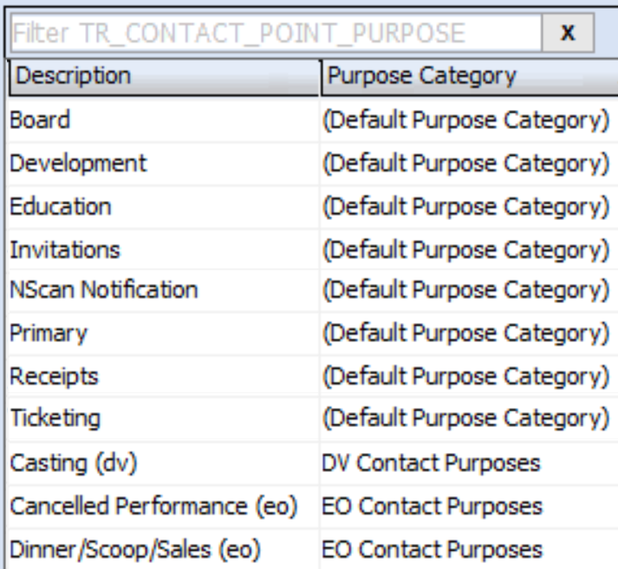
Life After Migration
Contact data is control-grouped → Global Contact Point Purposes
Notes:
~Contact pref types don't have to be control-grouped if the underlying data is

Slide 8
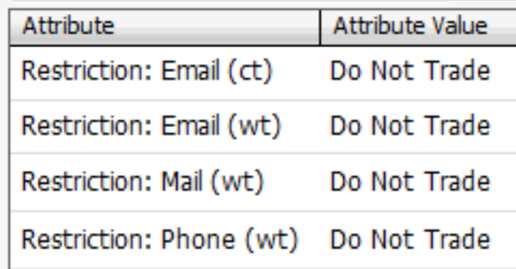
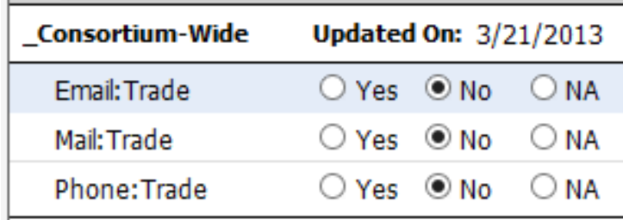
Life After Migration
Consolidated Trade Restriction across consortium
Notes:
~Consolidated trade restriction
~making the assumption that if patron doesn’t want their contact info given out from one org, they probably don’t want it given out from other orgs either

Slide 9
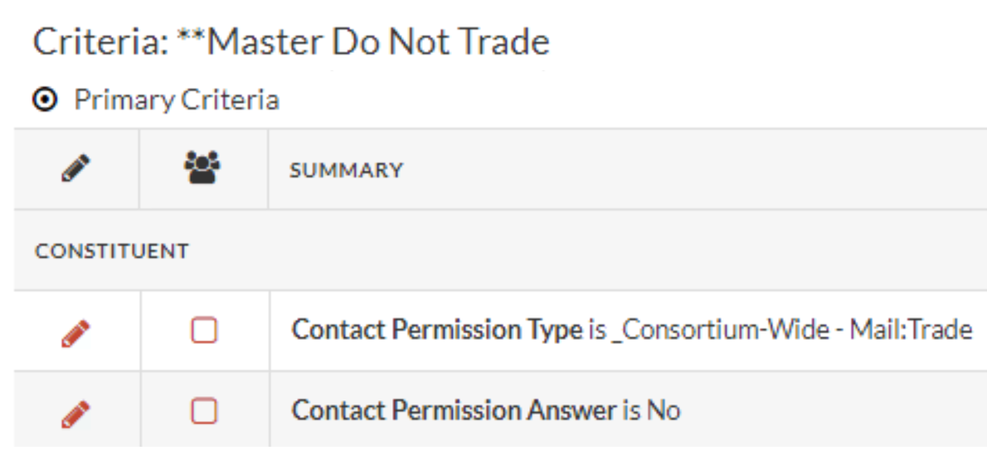
Life After Migration
Simplified list logic
All canned functionality
Notes:
~Simplified list building (no longer need suppression lists for each consortium org and nightly rebuilds of those lists)
~All per-org restriction & preference attributes removed and just the canned ones exist now

Slide 10

Katie Lachance-Duffy
Tess Project Director/DBA/Application Systems Analyst
catherine@artsphilly.org

