Slide 1
Tessitura Merchant Services
General Update
April 2022

Slide 2

Tessitura Merchant Services
Our new solution will transform the payment experience for you and your customers. Your organization will benefit from a secure streamlined transaction chain powered by global payment provider Adyen.
Tessitura’s expert team handles all onboarding and support. Your customers gain access to modern payment options with leading security protections online and at point of sale

Slide 3

Examples of Adyen Customers
Notes:
https://www.adyen.com/customers

Slide 4
Benefits
Payment processing onboarding and support is fully handled by Tessitura’s expert team. This will streamline the complete payment processing experience in all aspects – for new and existing members alike.
Contactless cards and Contactless through Apple Wallet will be supported when launched (Google Pay and PayPal… etc will be introduced at a later date – TBD)
Tokenization is included at no additional cost – this is key for rebilling and payment plans. Streamlines checkout process from patron's experience as well
Card Updater Service supported – Once card is tokenized the back-end system will automatically update if card is expired, lost or stolen.
Remove friction online with one-page checkout and saved credit cards
Tessitura Merchant Services will provide the highest security standards in the payment card industry – PCI-DSS (Payment Card Industry Data Security Standards) and P2PE (Point to Point Encryption).

Slide 5
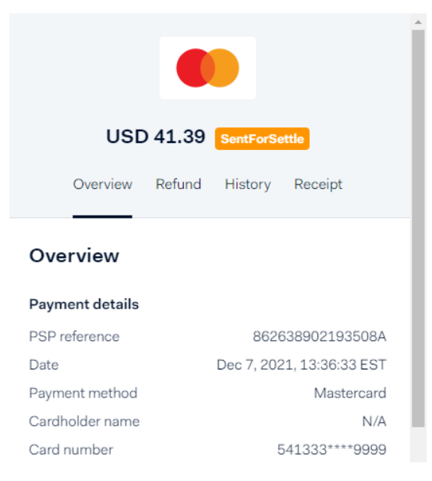
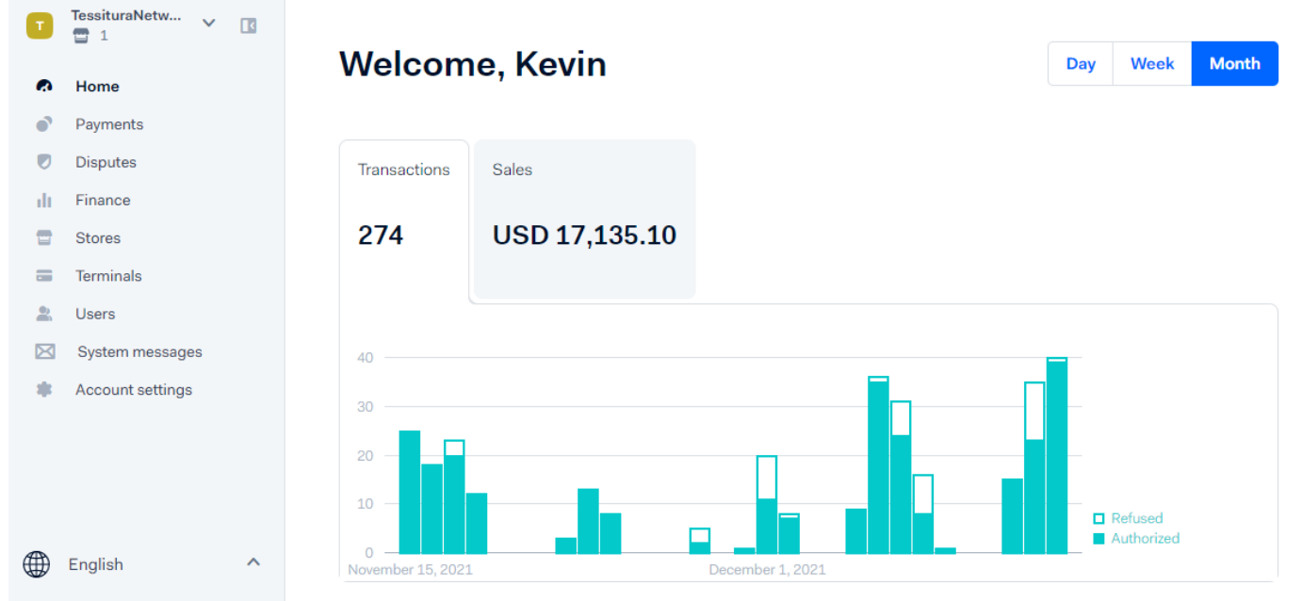
Essentials Reporting
Payment Details
Essentials Home Screen

Slide 6
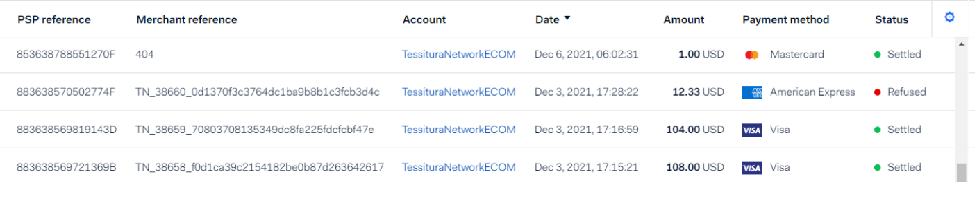
Essentials Reporting
Payments Page

Slide 7
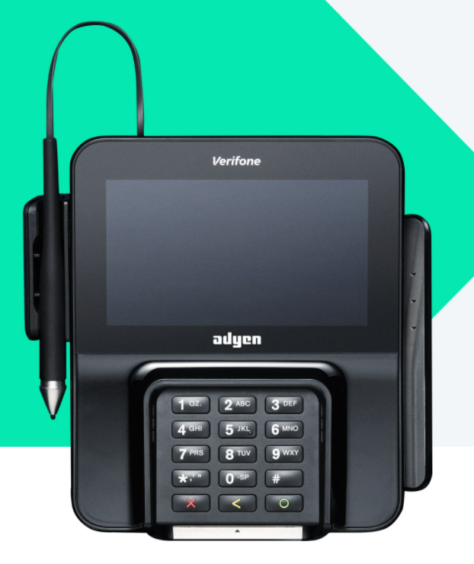
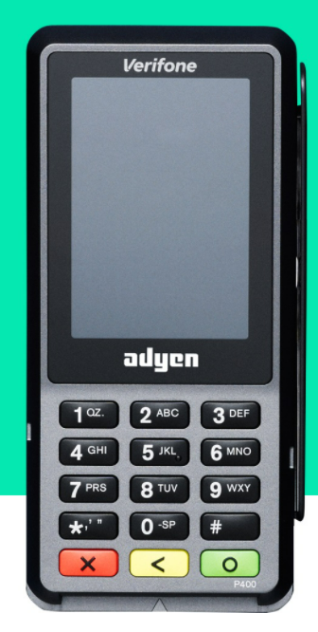
Hardware
M400
P400 Plus
EMV
Contactless
Apple Pay
Ordered directly through Tessitura
Ongoing support directly through Tessitura support team

Slide 8


Interested in learning more?
Contact Adam Grigsby, Member Success Manager
  adam.grigsby@tessituranetwork.com
  1 (888) 643-5778 x653
Watch tessituranetwork.com for our upcoming Open House events on payments.

