Slide 1

TESSITURA
EUROPEAN
CONFERENCE
DUBLIN 2016
Notes:
Welcome

Slide 2



PRESENTER
Kevin Sheehan : Tessitura Network
QUICK SALE AND PRICING RULES SETUP
Share your favourite content and photos! #TECDublin16

Slide 3

The Plan
Quick walkthrough of key setup pieces for QuickSale and Pricing Rules
Open the floor to work through your questions and scenarios

Slide 4
QuickSale

Slide 5
What is QuickSale?
A simplified graphical interface designed for streamlined order processing.
Utilizes sales layouts of buttons to add performances, packages, contributions, memberships, and fees to an order.
Notes:
Tessitura has always been quick to sell tickets - using keyboard shortcuts and standard processes you can sell pretty Quickly.
Quicksale is a graphical interface that allows you to bring together a range of sales options in a single screen.
So not just conventional ticket sales but also items like memberships, contributions, packages and user defined fees for Merchandise, all available from one screen.
It is button based and is touch screen capable, so very similar to POS style interfaces you may see at retail style outlets.
As its name suggets it is intended for standard sales functions, so there may be more complex transactions such as exchanges that are not really compatible with the QS screen. In those circumstances its any easy switch back to the main Order Details screen.

Slide 6
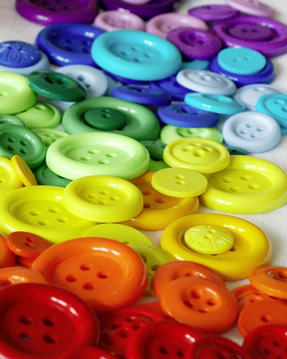
Button Types
Navigator
Performance
Performance (Relative)
Package
Package (Relative)
Contribution
Contribution Round Up
Memberships
Fee
Notes:
There are 9 different button types

Slide 7
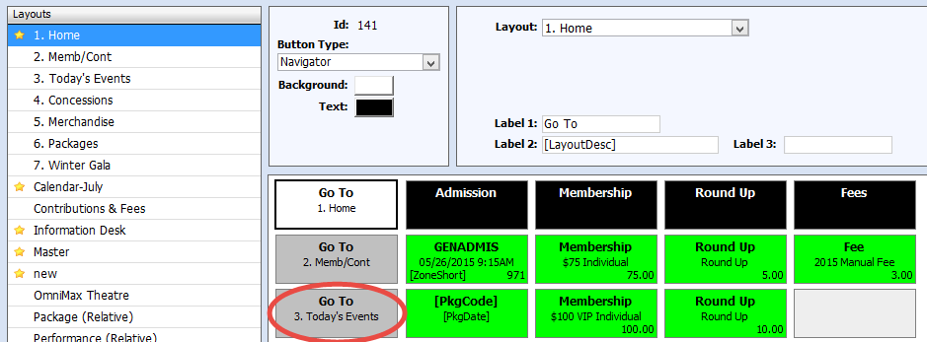
1. Navigator Buttons
Used to move to another layout
Notes:
>>
Navigator button are used to switch from the current sales layout to another sales layout.
This is most commonly between a primary and secondary layout, but can also be used to navigate between two secondary (non-primary) layouts.
For example, instead of having separate buttons for all of today's IMAX screenings on your Primary Admissions layout, you could create a secondary layout full of IMAX sessions buttons and use a single IMAX navigator button on the default Primary layout to take operators to the IMAX layout.
Navigator buttons can also be used as text only buttons. This can be useful to assist with visual structure or logical groupings of buttons on the layout

Slide 8
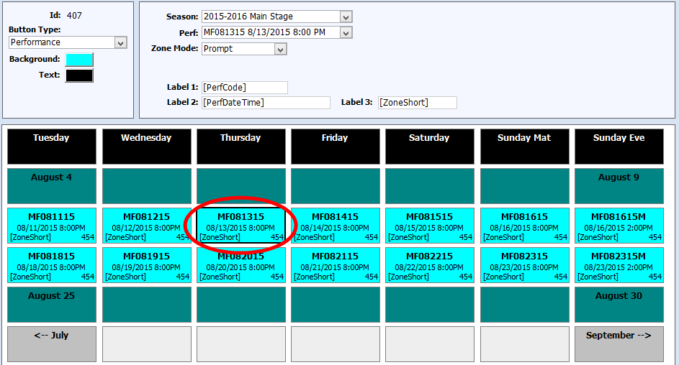
2. Performance Buttons
Adds a specific performance to the Order
Notes:
The Performance button type is used for buttons that add a fixed performance to the order.
Select Season, and then Performance
[PerfCode], which is replaced by the performance code of the performance selected for the button
[PerfDateTime], which is replaced by the performance date and time
[ZoneShort], which is replaced by the short description for the price zone selected when the Zone Mode is set to Specific.
Label 4 – Explain availability, if specific zone selected, only availability in that zone displayed. Not dynamic, need to reload QS to see latest availability

Slide 9
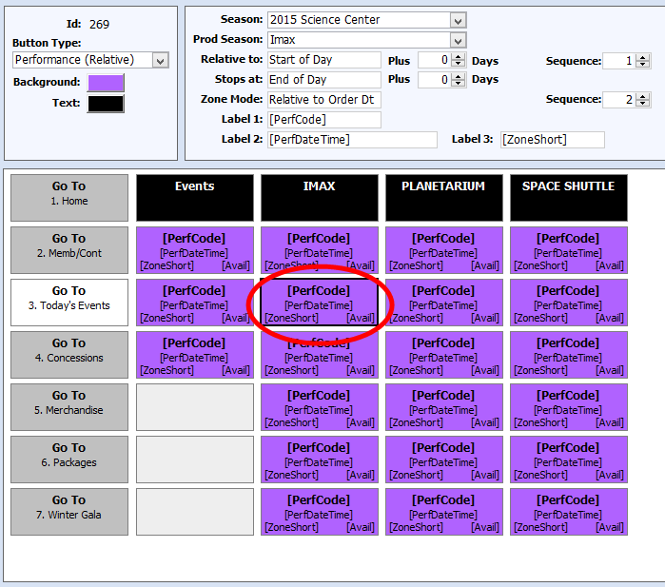
3. Performance (Relative)
Performance and zone changes over time
Notes:
Which performance is added to the order is based on relative date settings, so that the performance added by the button can change without having to manually reconfigure the button.
For example a button could always represent ‘tonights’ performance without the need to re-set the date each day.
Or maybe you have a timed admissions performance every day with multiple timed Zones
Or a movie showing with a run every night for 2 weeks,
Or an exhibition running for 3 months and you want the Box Office layout to have the current days exhibition entry as the perf button
Additionally, when working with zone times for timed admission the Zone selected for the performance also has separate controls which can also use relative time settings. For example, a button can be configured to always add the FIRST entry time for today's special exhibit or the NEXT entry time for today's special exhibit.

Slide 10
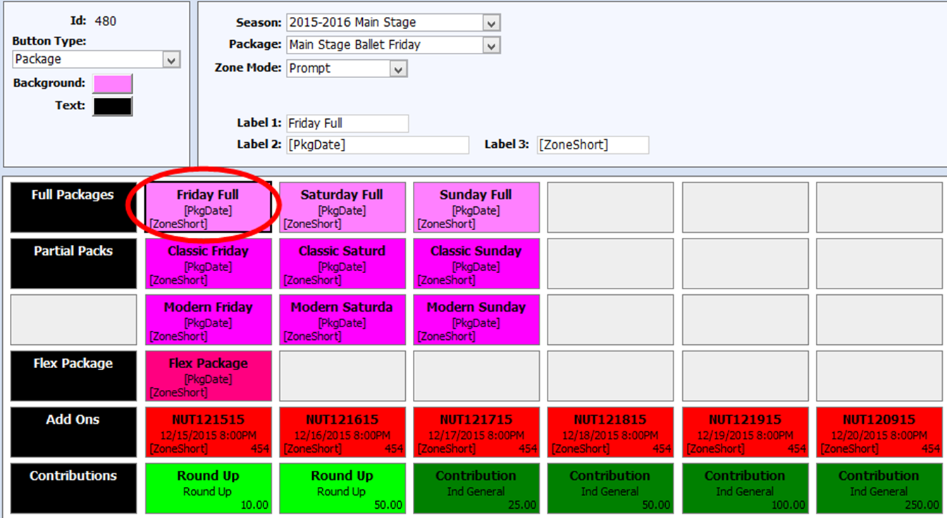
4. Package Buttons
Adds specified package to the order
Notes:
If a facility has been defined in the package (ie all perfs are in the same facility) then you can select a Zone Mode.
For non-fixed seat packages and flex packages that don't have a zone map selected (i.e. the performances in the package do not all use the same zone map), the Zone Mode field will not be available and the button will function in Best Available mode.
Tokens:
[pkgCode], which is replaced by the package code of the package selected for the button.
[PkgDate], which is replaced by the package date of the package selected for the button, if one exists.
[ZoneShort], which is replaced by the short description for the price zone selected when the Zone Mode is set to Specific
> Label 4 is not used

Slide 11
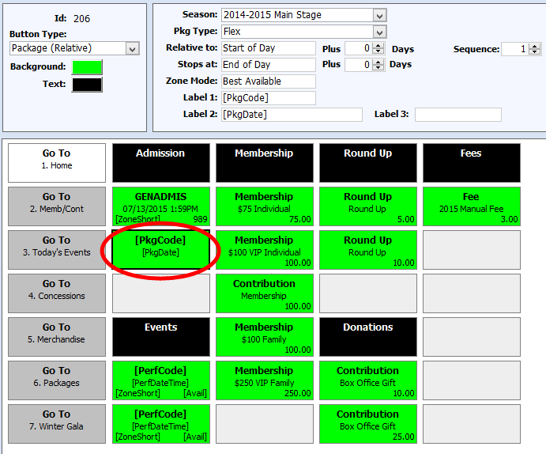
5. Package (Relative)
The Package added by the button changes over time
Notes:
NOTE: This button type can only be used with packages that have a package date defined. The Package Date field was added to packages in v12.1
If you have packages of this type then which package is added to the order is based on relative date settings.
So like the Performance (Relative) buttons the package added by the button can change over time without having to manually reconfigure the button.
EG the button can be configured to always add today's combo ticket package to an order.
The button functions by finding all packages of the specified package type in the specified season with a package date in the calculated date range
> and then selecting the n^{th}(1st, 2nd, etc.) package from the list of qualifying packages, based on the ‘Sequence’ setting

Slide 12
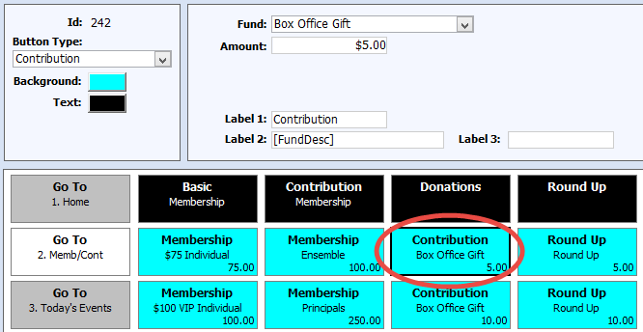
6. Contribution Buttons
Fixed contribution amount to a fixed Fund
Notes:
The Contribution button type is used for buttons that add a contribution of a fixed amount to an order using a specific Fund. Contribution buttons have just 2 configuration fields:
Fund – The fund to which the contribution will be made.
Amount – The amount of the contribution.
NOTE: The default contribution campaign, membership rules, and acknowledgement rules associated with the selected fund are used when the contribution is added to a ticket order.
Label 1 – Defaults to fixed text of Contribution. Can be replaced with any other fixed text value or left blank.
Label 2 – Defaults to the token of [FundDesc], which is replaced by the name of the fund selected for the button. Can be replaced with a fixed text value or left blank.
Label 3 – No default. A fixed text value can be entered, if desired.
Label 4 – The fixed contribution amount is displayed.
To capture a contribution value other than the set values you will need to flip back to the Contributions tab on the main ticket order screen.

Slide 13
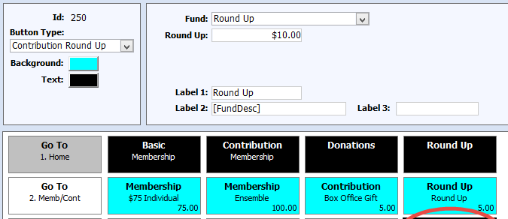
7. Contribution Round Up Buttons
Adds a contribution that will round up the order total to the nearest multiple of the number specified
Notes:
The Contribution Round Up button type is used to add a contribution to the order that will round up the order total to the nearest multiple of the number specified. For example, if a round up contribution was set to $5, and the current order total was $42, a $3 contribution would be added to the order to round the total up to $45. If the round up value was set to $10, and the current order total was $42, an $8 contribution would be added to the order to round the total up to $50.
Note: Changes to an order after a round up contribution is added to the order does not recalculate the amount of the existing contribution.
Fields are:
Fund – The fund to which the contribution will be made.
Round Up– The contribution amount will be set to a value that will round the current order total up to the nearest multiple of this number.
NOTE: The default contribution campaign, membership rules, and acknowledgement rules associated with the selected fund are used when the contribution is added to a ticket order.
Label 1 – Defaults to fixed text of Round Up. Can be replaced with any other fixed text value or left blank.
Label 2 – Defaults to the token of [FundDesc], which is replaced by the name of the fund selected for the button. Can be replaced with a fixed text value or left blank.
Label 3 – No default. A fixed text value can be entered, if desired.
Label 4 – The round up multiple is displayed. Note that this is not the amount of the final contribution, but rather the value entered in the Round Up field.

Slide 14
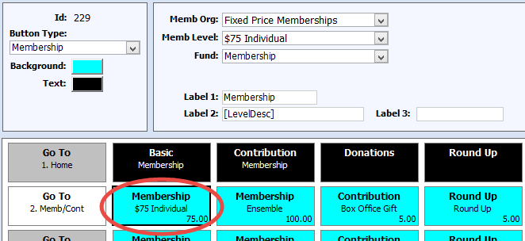
8. Membership Buttons
Adds a contribution and membership at a specified level
Notes:
The Membership button type is used for buttons that add a contribution to the order to create a membership, at a specified level and in the selected membership organization. The contribution amount is set to the starting value for the selected membership level. This button type is ideal for fixed amount, product style membership, common at museums and cultural attractions.
Wont become active until a Constituent is selected
The following configuration fields:
Memb Org – The membership organization from which to pull membership levels.
Memb Level – Contributions generated by the button will be for the start amount of the selected membership level, and membership records created or affected by the transaction will be set to the selected level. The dropdown is populated with all levels in the selected membership organization.
Fund – The fund for the membership contribution. The dropdown is populated with all funds associated with an active campaign associated with the selected membership organization.
Label 1 – Defaults to fixed text of Membership. Can be replaced with any other fixed text value or left blank.
Label 2 – Defaults to the token of [LevelDesc], which is replaced by the name of the membership level selected for the button. Can be replaced with a fixed text value or left blank.
Label 3 – No default. A fixed text value can be entered, if desired.
Label 4 – The start amount for the selected membership level (which will be the amount of the contribution added to the order).

Slide 15
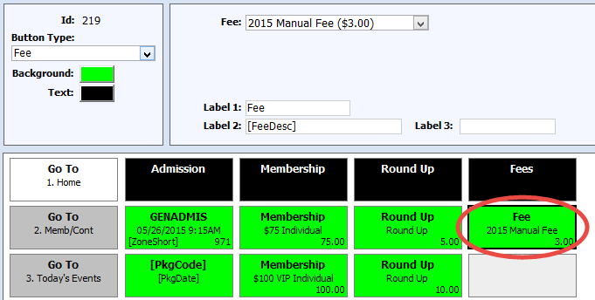
9. Fee Buttons
Adds the specified user-defined fee to an Order
Notes:
The Fee button type is used to add a specified user-defined fee to the order.
This button type is generally used when using fees to manage merchandise or services, like a self-guided tour recording.
Fee buttons have just one configuration field which is the fee that will be added to the order.
The dropdown is populated with user-defined fees, grouped by season and fiscal year.
NOTE: If the selected fee is deleted, the button will be automatically deleted from the sales layout.
Label 1 – Defaults to fixed text of Fee. Can be replaced with any other fixed text value or left blank.
Label 2 – Defaults to the token of [FeeDesc], which is replaced by the name of the fee selected for the button. Can be replaced with a fixed text value or left blank.
Label 3 – No default. A fixed text value can be entered, if desired.
Label 4 – The fee amount.

Slide 16
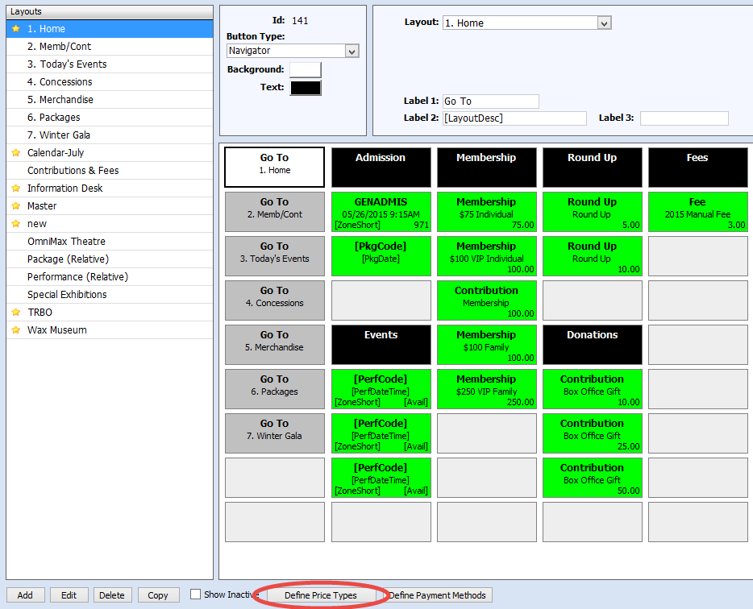
Defining Price Types
Notes:
When a sales layout is marked as Primary, price types must be associated with the layout.
If you are navigating to secondary layouts the Price Types for any performances on the secondary layouts need to be defined on the Primary layout.
When the layout is the default for an order's mode of sale, buttons for the associated price types will be displayed when a performance or package is selected. Associating price types with a sales layout also allows you to control the ordering of the price type buttons.
If an associated price type is not available (based on the mode of sale, the user's security rights, active dates on the price type, and/or it not existing on the product), the button for that price type is hidden and buttons for other available price types slide left to fill the gap left by the unavailable price type.

Slide 17
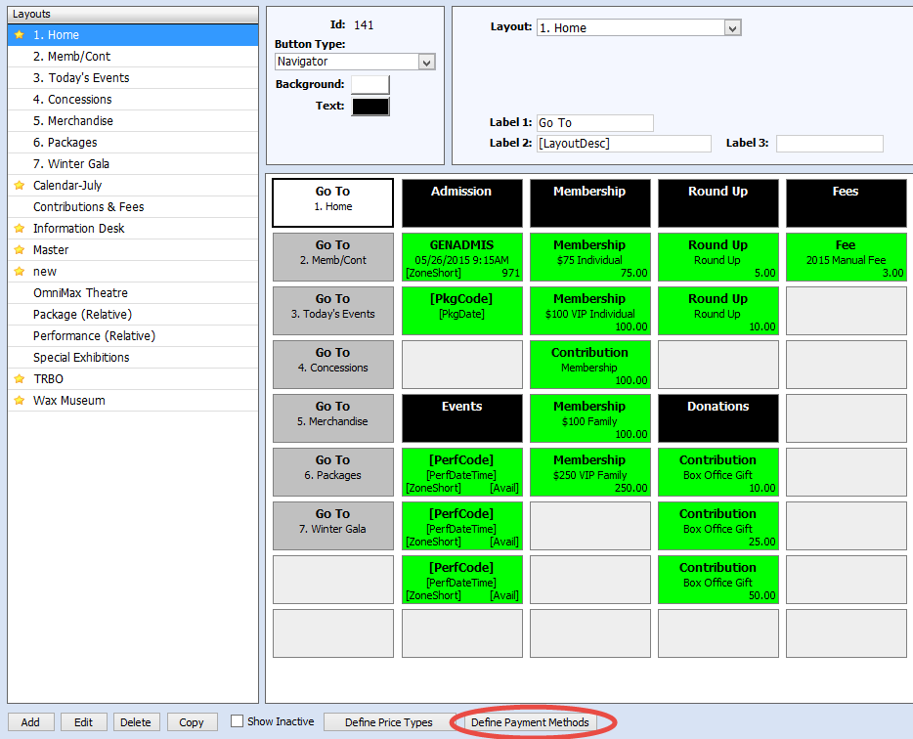
Defining Payment Methods
Notes:
When a sales layout is marked as primary, payment methods must be associated with the layout. When the layout is the default for an order's mode of sale, buttons for the associated payment methods will be displayed when paying for the order. If an associated payment method is not available (based on the user's security rights and/or the business unit of the current batch), the button for that payment is still displayed but is inactive.
Associating payment methods with a sales layout also allows you to control the ordering of the payment method buttons.
NOTE: Only payment methods with a payment type of Cash, Check, Gift Certificate, or Credit Card can be associated with a sales layout.

Slide 18
Pricing Rules

Slide 19
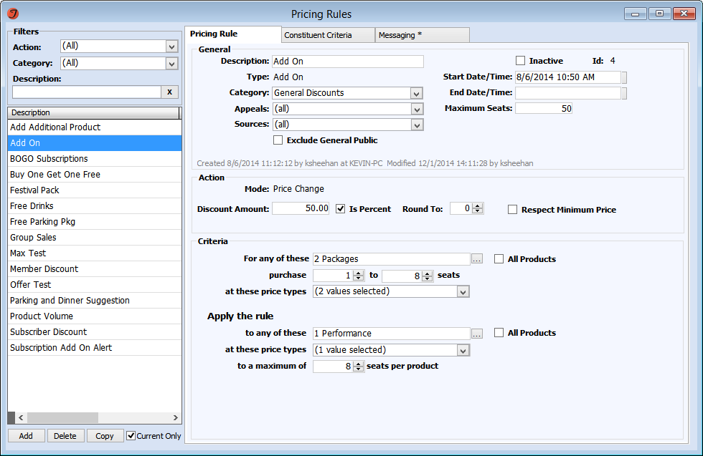
Pricing Rules Screen
Notes:
List of rules on the left
Rule details on the right
Rule details are organized into 3 tabs

Slide 20

Pricing Rule Tab: Action
Price Change
  Reduces price by a fixed amount or a percentage
  Can set to respect the minimum price
  Rules can edit prices even when users can’t
Notes:
Price Change edits price
For layered pricing, you can set layers to be excluded from rules
Percentage discount, for percent of total price, include all layers, respect minimum, set minimum to default for excluded layers
Fixed amount discount deducted from the total ticket price and allocated proportionally across all the price layers included in pricing rules

Slide 21

Pricing Rule Tab: Action
Price Type Change
  Changes affected SLIs to specified price type
  Price type must be on product and associated with MOS
  Users don’t need security access to PT
Notes:
Price Type Change

Slide 22

Pricing Rule Tab: Action
Message Only
  Delivers message without any pricing changes
  Hides max/limit fields in General and Criteria sections
Notes:
Message only

Slide 23
Rule Types
Product Only
Seat Volume
Multiple Price Type
Product Volume
Add On
Buy One Get One
Notes:
Rule types control the rule criteria functionality. The 6 rule types we have were distilled from the feedback provided by users (through past conference sessions and the MAC) and cover the vast majority of pricing scenarios they provided.
We’ll start by looking at the simplest rule type, the Product Only rule.

Slide 24
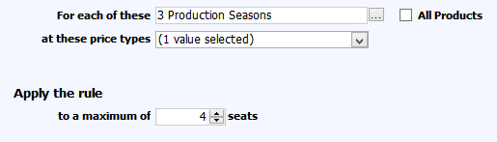
Product Only
For basic discounts triggered by a source
For basic discounts triggered by constituent criteria
Notes:
The Product Only rule formula is:
For each of the selected products at a set of selected price types, apply the rule to a max of N tickets.
In other words, if you buy a qualifying product, using a qualifying price type, you get the discount on up to the specified number of tickets.
This rule type is good for
basic discounts triggered by a source, which would be specified in the rule header. Source based price type changes are very similar to offers, and if you don’t need any of the special offer specific functionality I highlighted earlier, you could start to use Product Only rules instead of offers. Additionally, this rule type can be used to implement source based price edits on the web, which is something you haven’t been able to do before.
Product Only rules are also good for basic discounts triggered by constituent criteria, which is how you could set up automatic member or subscriber discounts.
To select products for all rule types you open the product chooser by clicking the … button. Alternately, if any product should qualify, you can check the All Products box.

Slide 25
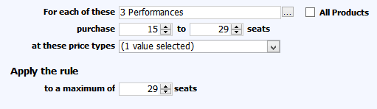
Seat Volume
For group sales discounts
Will discount all qualifying tickets
Notes:
The Seat Volume rule formula is:
For each of the selected products, purchase X to Y tickets, at a set of selected price types, and apply the rule to a max of N tickets per product.
In other words, if you buy a quantity of tickets in the specified range for a qualifying product, using a qualifying price type, you get the discount on up to the specified number of tickets.
This rule type is good for group sales types of discounts.
Keep in mind that the purchase range defines when the rule will apply, not how many tickets are discounted. Using the example in the screenshot, if there are only 14 tickets, nothing gets discounted. But if you cross the upper end of the range, you also get no discount. So if you purchase 30 tickets, no tickets will be discounted. The maximum setting at the end of the criteria controls how many tickets will be discounted once the rule is applied. So if you wanted a purchase of 30 tickets to give 29 discounted tickets and 1 full price ticket, you would set the upper purchase limit to something greater than 29 (like 999) and the max tickets value to 29. A reason to cap the qualifying ticket range at a smaller number would be if there is a different discount available when you purchase more than 29 tickets.

Slide 26
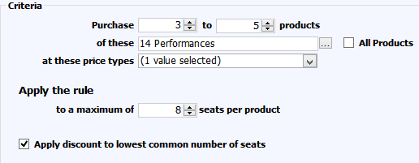
Product Volume
For bundling or faux-packages
Don’t need the same number of tickets for each performance
Performances added to an order as part of a package are NOT counted as performances
Notes:
The Product Volume rule formula is:
Purchase X to Y products from this set of products, at a set of selected price types, and apply the rule to a max of N tickets per product.
This rule is good for product bundling style discounts, which you might also think of as packaging on the fly.
With Product Volume discounts, constituents don’t have to purchase the same number of tickets for each performance (unlike with an actual package), but when the Apply Discount to Lowest Common Number of tickets box is checked, the same number of tickets will be discounted in each performance. For example, if you buy 1 ticket to Prod A, 1 ticket to Prod B, and 6 tickets to Prod C, you only get 1 ticket discounted for Prod C
Once again, the purchase ranges define when the rule is applied, not how many tickets can be discounted. So using the example in the screenshot, if you buy 6 products, you get no discount just the same as if you only bought 2 products.
Talk about how you can’t set up a rule that will fire based on which perfs you select in a flex package.

Slide 27
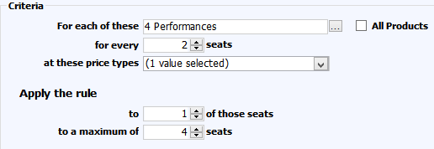
Buy One Get One
For buy one get one style discounts
The discounted ticket(s) must already be in the cart
The discounted ticket(s) must be included in the qualifying number
Notes:
The Buy One Get One rule formula is:
For each selected product, for every X tickets at the selected price types, apply the rule to Y of those tickets, to a max of N tickets.
This rule can be used for buy one get one free offers, or buy 2 get 1 half price offers, or even buy 1 get 3 10% off if you wanted.
It’s important to remember that discounted tickets must already be in the cart in order for the rule to fire, and the discounted tickets must be included in the qualifying number.
When this rule is applied, if the initial price is not the same for all qualifying tickets, the lowest priced SLIs are discounted. Note that this “discount the lowest priced ticket” behavior is limited to Buy One Get One rules at this time.

Slide 28
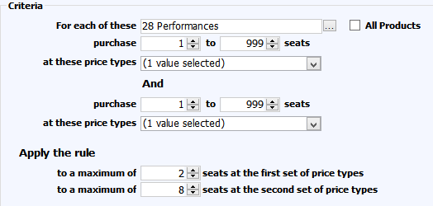
Multiple Price Type
For family plan discounts
Will discount all qualifying tickets
Notes:
The Multiple Price Type rule formula is:
For each of the selected products, purchase X to Y tickets at a set of selected price types, and also purchase X to Y tickets at a different set of selected price types, then
apply the rule to a max of N tickets at the first set of price types and a max of N tickets at the second set of price types
This rule type would be good for family plan style discounts, where if you buy a combination of Adult tickets and Child you get a discount on all of the tickets.
Note that if you use Price Type Change as the discount mode, all tickets will end up at the same, discounted price type. For example, Adult tickets and Child tickets all become Family tickets.
As with the Volume rules, the purchase ranges define when the rule will apply, not how many tickets can be discounted. The Maximums control how many tickets at each price type can be discounted.
So if you wanted to set up a rule that would discount 2 Adult tickets and 4 Child tickets while leaving a 3rd adult ticket at full price, you would need an upper Adult purchase limit greater than 2 and an Adult max value equal to 2.

Slide 29
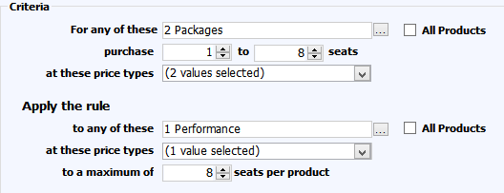
Add On
For add on discounts, like buy a subscription get the holiday show at a discount
The additional product must already be in the cart
Notes:
The final rule type is add on
The Add On rule formula is:
For any of the selected products in the first set, purchase X to Y tickets at the selected price types, then apply the rule to any of different set of selected products at the selected price types to a maximum of N tickets per product.
This rule can be used for add on discounts, such as buy a subscription and get the holiday show at a discount.
Remember that the add on product must already be in the cart; the rule doesn’t add the discounted product
Also remember that the purchase range only defines when the rule applies. Using the example in the screenshot, that would mean if you buy 9 tickets for the package, you don’t get the discount on the add on product (the rule doesn’t qualify anymore).

Slide 30
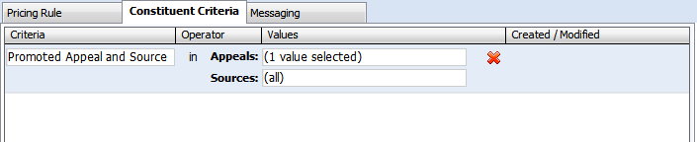
Constituent Criteria
Can be used with any rule type
Most likely use with Product Only rules
Constituent must meet all criteria
Notes:
This tab is used to add constituent criteria to the rule. Constituent criteria can be used with any rule type.
You can add multiple constituent criteria to a rule, and if you do a constituent must meet all the criteria in order for the rule to fire.
Owner or initiator

Slide 31

Available Criteria
Attribute
Constituency
List
Exclusion List
Promoted Appeal and Source
Ranking
Notes:
There are 6 criteria available:
The criteria you can use with a rule are limited in order to minimize the processing cost of constituent criteria. All of these criteria are things you can manage in bulk, including with scheduled utilities, so that the process intensive work can be moved away from when the rules run.

Slide 32
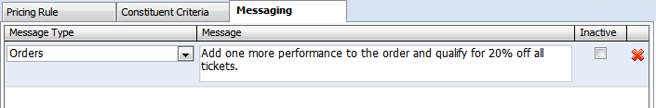
Messaging
Delivered whenever the rule qualifications are met
2 standard message types, can add additional custom types
Only one message per type
Notes:
This tab is used to add messages to the rule. The messages are delivered whenever the rule is applied to an order.
You can have one message per message type, allowing you to set up different messages for different audiences or situations.
There are 2 standard message types, one for display to operators in the application and one for printing on tickets. TNEW has 6 message types used to set different messages for display in different parts of the purchase path. If you have a custom site, you can add as many custom message types as you need for your custom web integration.
HTML can be entered into messages for display on the web, however the application doesn’t have a WYSIWYG editor at this time.
8000 characters
Up to this point we’ve been talking about rules in the context of changing price, however it is also possible to deliver a message without changing the price using Message Only rules.

Slide 33
Bonus Slides

Slide 34
Performance (Relative): Relative To
Start of Day
  12:00 AM on the order date
  The button’s product WILL NOT change throughout the day
Order Day Time
  The order date and time
  The button’s product WILL change throughout the day
Notes:
To select a performance, we define a date range and find all performances in that date range.
The beginning of the date range is set with the Relative To field, which has two relative options
>> The first parameters you choose are - the season then the Production Season to start the set up of the button
Then the ‘relative to’ and the ‘stops at’ parameters, indicate what performances to look at in the above season and production season - basically start looking here and stop looking here for performance in the selected production season.
Starting with ‘Relative to’ .. this is the ‘start looking for performances here’ We have the options…
Relative to…Start of Day which means
12:00 AM on the day in which the order is placed so 12am today
The button’s product WILL NOT change (move) throughout the day
Relative to…Order Day Time
Which means start looking at perfs relative to the order’s date AND time
The button’s product WILL change (move) throughout the day
Relative to…Fixed
You define a specific date and time …

Slide 35
Performance (Relative): Relative To
If ORDER date/time = 08/11/2016 10:45
and
PERFORMANCE date/time = 08/11/2016 10:00
then…
Start of Day: Includes the performance
Order Day Time: Excludes the performance
Notes:
…well……………here is another way to look at ‘start of day’ or ‘order date time’ …
If the ORDER date and time is today 12/4/16 10:45am and the PERFORMANCE is today 12/4/16 at 10:00am, then…
Start of Day parameter: ( start looking from 12am) Includes the performance
Order Day Time parameter: Excludes performance because its 10.45 am and the perf was at 10am.
Order Date on new orders always defaults to the current date and time
Use Start of Day for things like today’s Admissions Performance button (where the perf time is irrelevant)
Use Order Day Time for things like the next movie showing (Perf time actually represents a start time)

Slide 36
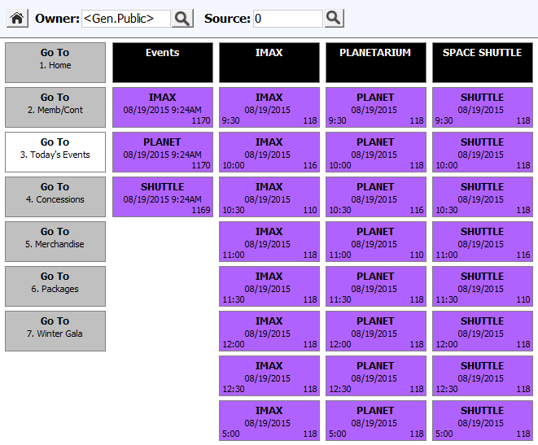
Relative to Start of Day
Notes:
Here we are at the start of day before the first sessions - all buttons are active

Slide 37
Relative to Start of Day
Notes:
Now its later in the day around 11.15am - the earlier Buttons have become inactive based on Zone time

Slide 38
Relative to Order/Day Time
Notes:
Here we are at the start of day before I first sessions - all buttons are active – but in this example the Relative to selection was ‘Order/Day Time’

Slide 39
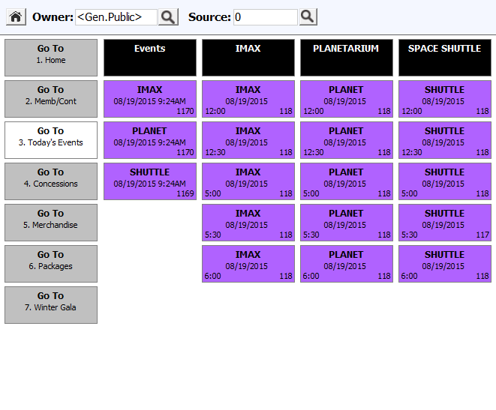
Relative to Order/Day Time
Notes:
Later in the day the buttons have essentially slid up as earlier buttons are in the past
So just to recap that
CLICK
Relative to start of day keeps the buttons in the defined location but inactivates them as the current time passes the perf time
Relative to Order day/time moves the buttons and removes the inactivated times off the screen

Slide 40

Performance (Relative): Future Dates
Start of Day includes the Plus field, which is used to add days to the order date
Notes:
>> Use this feature if you want to set a button to automatically select tomorrows performance.

Slide 41
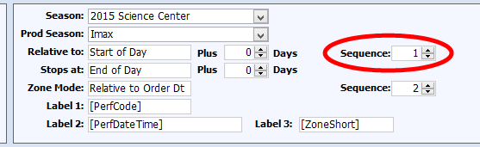
Performance (Relative): Sequence
If multiple performances (or timed zones) exist within the Relative To/Stops At range, the exact product is defined by selecting the Sequence
Sequence 1 is the first performance within the defined range
Notes:
>> So what is this sequence parameter?
The sequence controls which performance (the 1st,2nd 3rd etc) we are going to consider first
based on the season, production season and the period defined by the starts at/ends at parameters.
when all the performances with performance dates and times in the parameter range are found, they are ordered by performance date and time.
So for this production season, starting at 12am ending at 11.59pm….. we may have 6 performances in that period
The sequence will define Which performance is used for the button – the default sequeunce of 1 means use the first performance out of the 6, sequence 2 selects the second performance in the period etc
And extending it into a later date
Setting that Start of day “Plus” to 1 (meaning tomorrow morning) and end of day plus 1 – meaning tomorrow night
The sequence behaves in the same way except it will select the first performance tomorrow, not today.

Slide 42
Performance (Relative): Zone Mode
Relative to Perf Day
  Zones ordered by zone times; the nth zone is selected
  (specified by the Zone Mode Sequence value)
  Used when the button’s zone should be fixed the entire day
Relative to Order Date
  Only uses zone times on/after order time, ordered by zone time; the nth zone is selected (specified by the Sequence value)
  Used when button’s zone
  should change throughout
  the day
Notes:
>> Now zones
2 options for relative zones
1) Relative to perf day
1) Relative to order date
Zones Relative to perf day -
Zones for the performance are ordered by zone times, and the Sequence selects what zone you want in that group.
Good for when you want the Zone used by the button to be fixed (i.e. it does not move) throughout the day.
> Zones Relative to order date
This selects zones for the performance but only with zone times on or after the order time, ordered by zone time. and on top of that the Sequence selects what zone you want in that group ie do you want the first zone relative to the time right now, or maybe the zone time after the first zone.
For when you want the zone used by the button to change throughout the day.

Slide 43
QUESTIONS?
“Impermanence - anonymity - that’s what I’m looking for; a vast restless place that doesn’t give a damn about the past..”
Brian Friel, Philadelphia Here I Come
Notes:
Welcome

