Slide 1

TESSITURA
EUROPEAN
CONFERENCE
DUBLIN 2016
Notes:
Welcome

Slide 2



PRESENTERS
Joanna Sigsworth : Nottingham Playhouse
Melanie Ryan : City of Birmingham Symphony Orchestra
Carmel England : Roundhouse
SEGMENTATION
DIVIDE AND CONQUER
CONTENT PLANNER
Kyle Jarvis : National Theatre
Melanie Ryan : City of Birmingham Symphony Orchestra
Share your favourite content and photos! #TECDublin16

Slide 3

SEGMENTATION:
DIVIDE AND CONQUER
An Extrinsic Approach
Joanna Sigsworth
Head of Marketing & Communications
Notes:
Thank you.
I’m here to tell you about Nottingham Playhouse’s segmentation journey

Slide 4

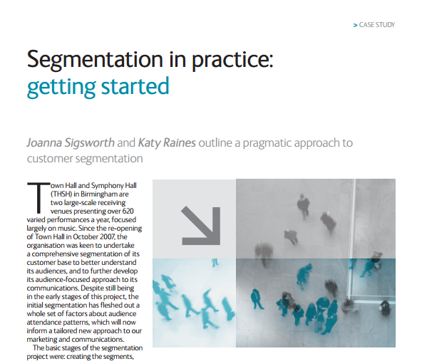

INTRODUCING…
Developed segmentation model at Town Hall Symphony Hall, Birmingham, with Indigo Ltd
Brochure costs reduced by 23% in 12 months
ROI doubled
@JoannaSigsworth
culturehive.co.uk/resources/segmentation-in-practice
Notes:
First some introductions..
I’m Joanna Sigsworth, Head of Marketing and Communications at Nottingham Playhouse, and I joined the team in January this year. I’ve worked in Arts Marketing for more years than I care to remember, including roles with Northern Ballet, the BBC, Town Hall Symphony Hall in Birmingham and Curve Theatre in Leicester.
At THSH I developed their segmentation model with Indigo Ltd, reducing costs and increasing Return On Investment
You can read more about that project online at culturehive.co.uk

Slide 5


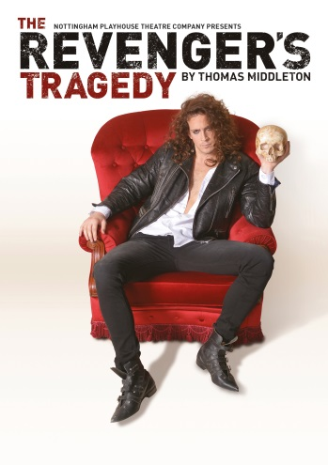
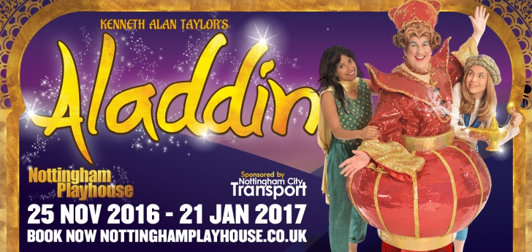
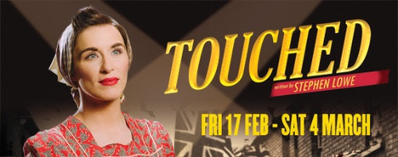
INTRODUCING…
Nottingham Playhouse
Producing theatre
In house and visiting work
Over 122,000 tickets sold, generating over £2m at the box office in 2015/16
Registered charity
ACE National Portfolio Organisation (NPO)
Founder partner of Ticketing Network East Midlands (TNEM)
@NottmPlayhouse
nottinghamplayhouse.co.uk
Notes:
And now to introduce Nottingham Playhouse to you. Here’s a photo of our spectacular Grade 2* listed building, designed by Peter Moro, and home also to Anish Kapoor’s Sky Mirror
We create between 9 and 13 theatre pieces annually encompassing 20th century drama, classics and new writing as well as our legendary panto.
And we also receive a range of visiting work including comedy, dance, music, family shows, musicals
To give you an idea of the scale of our organisation, last year we sold over 122k tickets taking over £2.04m at box office
We’re a not-for-profit organisation and registered charity
We’re also an Arts Council England National Portfolio Organisation and also receive subsidy from Nottingham City Council.
We’re also a founder partner of the Ticketing Network East Midlands consortium - the first of its kind in the UK.
And here’s our Twitter handle

Slide 6

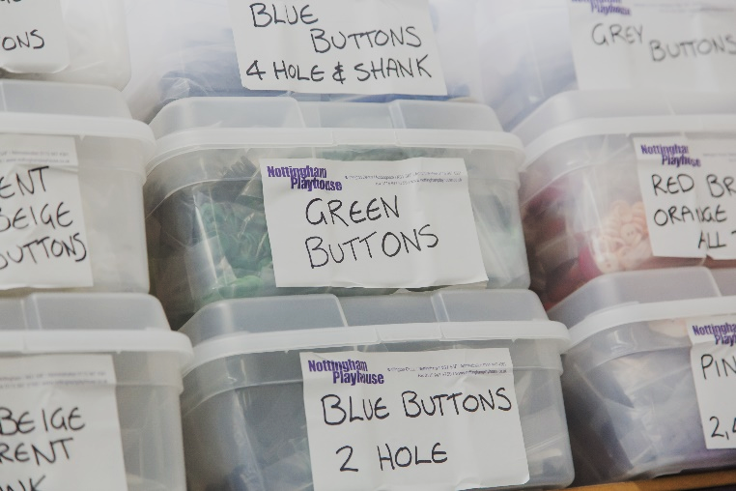
OUR SEGMENTATION JOURNEY
At January 2016:
Audiences defined by:
  Show genre, title and performers
  Current vs lapsed
Traditional approach to creating lists for direct marketing:
  Attenders of previous similar shows
  Brochure requesters
  Email list joiners
Excellent CRM tools available: systems and data
Notes:
I’m beginning our segmentation journey with an analogy from our Wardrobe department:
Here are some buttons. You can sort of see what’s going on there, spotting some yellow, green and blue ones.
But to really lay your hands quickly on exactly the buttons you want, you sort them out into useful groups. If the buttons were audience members instead, then the Playhouse’s starting point is more like the photo on the left.
In January this year, when I joined the company
Audiences were defined by the show they attended and whether they were currently attending or not
Direct marketing lists were created looking at who had attended previous similar shows and whether customers had asked to join the mailing list
However, we had fantastic CRM tools available that we weren’t using to our full potential

Slide 7
INTRINSIC VS EXTRINSIC APPROACHES
Intrinsic Models
Belongs naturally and uniquely to the organisation
Enables highly tailored communications with existing audience members
Offers no insight to non-attenders and limited understanding of first time attenders
Cannot be applied in customer acquisition campaigns
Extrinsic Models
Built from outside the organisation
Enables some tailoring of communications with existing audience members
Allows understanding of non-attenders and first time attenders
Can be applied in acquisition programmes
Notes:
When embarking on a segmentation journey, you’re facing a couple of options. Do you start with an intrinsic approach or extrinsic approach? I should say that I’ve borrowed the terms intrinsic and extrinsic from the RSC – they’re not technical jargon, but useful descriptions of the 2 choices available. To explain the difference:
Intrinsic models are built with the individual organisation’s data, so they are highly bespoke and give you a fantastic depth of insight into current and past customers. BUT because they’re built from your data, they don’t tell you anything about customers not on your database, so can’t be applied in customer acquisition campaigns for example.
Extrinsic models are the opposite. They are built on data from outside the organisation so they can offer some insight into existing customers, but come into their own for campaigns aimed at non-attenders and first-time customers

Slide 8
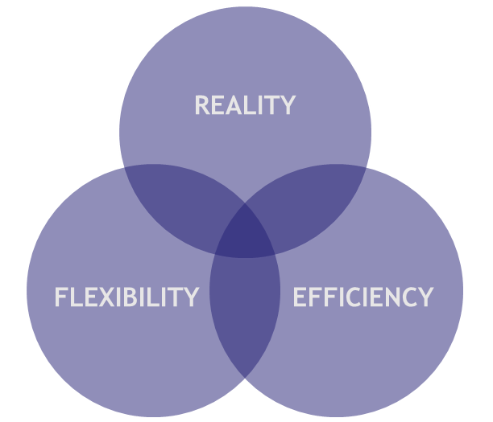
EXTRINSIC FIRST STEP
The Audience Agency’s Audience Spectrum Model
Requirement of ACE NPO agreement
Free of charge access
Provides a common marketing language for different organisations
Audience Finder tool
Need further time to create an intrinsic model
PRAGMATIC
Notes:
Nottingham Playhouse started our journey with an Extrinsic model: The Audience Agency’s Audience Spectrum model.
You might ask why?
For completely pragmatic reasons.
Firstly, use of the model is a requirement of our ACE NPO funding agreement. The extent to which we adopt the model is up to us, but we are required to supply data and support it’s development at the very least.
Access to the model is free of charge (I’ll come back to that later)
It provides a common marketing language for all NPOs and in a world of increased partnership working, e.g. co-productions & visiting companies, that common language is important
It comes with the Audience Finder tool – I’ll come back to that later too
Finally, we need further time to develop our own intrinsic model

Slide 9
AUDIENCE SPECTRUM
Audience Spectrum segments the UK population by their attitudes towards culture, and by what they like to see and do. There are 10 segments.
Commuterland Culturebuffs
Affluent and professional consumers of culture
12% of English Households
Metroculturals
Prosperous, liberal, urbanites interested in a very wide cultural spectrum
5% of English Households
Experience Seekers
Highly active, diverse, social and ambitious, engaging with arts on a regular basis
8% of English Households
theaudienceagency.org/audience-spectrum
Notes:
Could you give me a show of hands as to who is also using Audience Spectrum?
OK, to give you a very brief overview:
Audience Spectrum segments the whole UK population, to household level, by their attitudes towards culture, and by what they like to see and do. There are 10 segments. There’s a vast amount of detail in the model, but in brief…
Starting with the segment most engaged with arts and culture, we have the Metroculturals, prosperous city dwellers, interested in a wide range of culture and about 5% of English households
Then the Commuterland Culturebuffs, affluent professionals in the suburbs, about 12% of English households
Experience Seekers are city dwellers, though of a younger age range than the Metroculturals, around 8% of English households

Slide 10
AUDIENCE SPECTRUM
Trips and Treats
Mainstream arts and popular culture influenced by children, family and friends
17% of English Households
Dormitory Dependables
Suburban and small towns interest in heritage activities and mainstream arts
16% of English Households
Home and Heritage
Rural areas and small town, day-time activities and historical events
10% of English Households
theaudienceagency.org/audience-spectrum
Notes:
Next we have segments that are less engaged with the arts, though still have some engagement:
Dormitory Dependables live in suburbia and smaller towns, with a mainstream interest in the arts, representing 16% of English households
Trips and Treats are again interested in mainstream and popular culture, heavily influenced by their kids, family and friends, around 17% of English households
Home and Heritage are more rural households and older people, around 10% of households

Slide 11
AUDIENCE SPECTRUM
Up Our Street
Modest in habits and means, popular arts, entertainment and museums
8% of English Households
Facebook Families
Younger suburban and semi-urban, live music, eating out and pantomime
12% of English Households
Kaleidoscope Creativity
Mixed age, low level engagement, free local events, outdoor arts and festivals
10% of English Households
Heydays
Older, less engaged, crafts, knitting, painting, sheltered housing, church group or community library
4% of English Households
theaudienceagency.org/audience-spectrum
Notes:
Finally the least engaged segments,
Up Our Street, with less disposable income, their interest is in popular culture and entertainment, around 8% of English households
Facebook Families, younger, suburbians with an interest in live music and, if the attend the theatre, go to pantomime, around 12% of households
Kaleidoscope Creativity, a mixed age group, but with limited means would be interested in attending free, local events, around 10% of English households.
The final segment is Heydays, the oldest group and least engaged. Around 4% of English households

Slide 12
AUDIENCE FINDER
Database containing data from over 100 million tickets, 34 million transactions and over 180,000 surveys from across England.
Box Office Dashboard
Survey Dashboard
Hitwise Dashboard
Mapping Tool
TNEM data automatically uploaded from Tessitura system into Audience Finder since February 2016.
Nottingham Playhouse audience surveys undertaken quarterly since April 2016.
Access free of charge via online portal:
Annual summary level data
Benchmark against regional and national level data
theaudienceagency.org/audience-finder
Notes:
As I mentioned, part of the Audience Spectrum package is the Audience Finder online tool
A database containing data from across the UK, as well as survey data from ACE funded organisations
It’s an online tool, with various dashboards and a mapping tool
TNEM data has been automatically uploaded from Tessitura since February 2016 and we have historic data going back 5 years in the system
As an NPO, the Playhouse has undertaken Audience Finder audience surveys quarterly since April
We have free of charge access to annual summary level data and are able to benchmark at a regional and national level

Slide 13
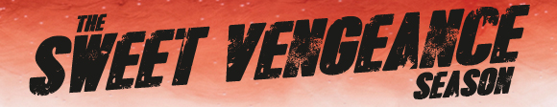
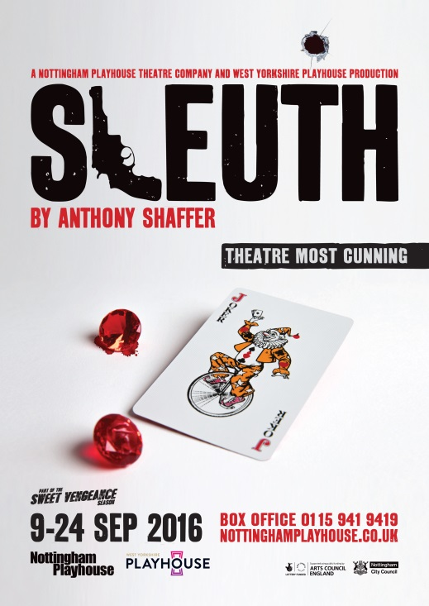
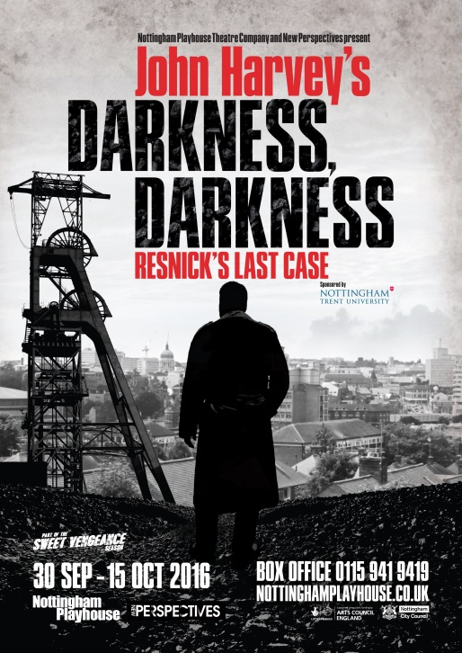
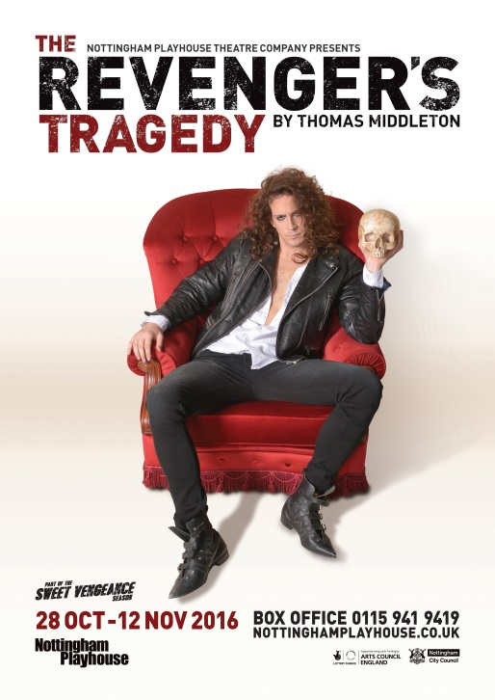
SEGMENTATION AND INDIRECT MARKETING
Experience Seekers & The Sweet Vengeance Season Example
Notes:
So, how have we used these tools in practice?
To date we’ve been using the segmentation for indirect marketing.
Here’s an example of this Autumn’s Sweet Vengeance season, which was a season of 3 plays, Anthony Schaffer’s classic Sleuth, a new play by John Harvey based on his novel Darkness Darkness and the Jacobean play The Revenger’s Tragedy by Thomas Middleton

Slide 14
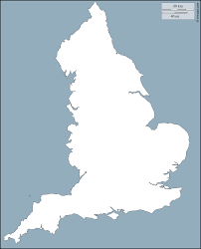
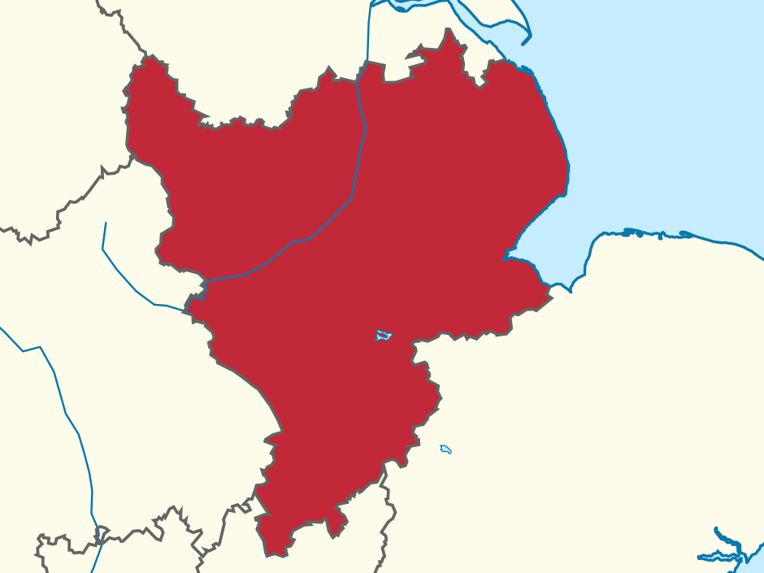
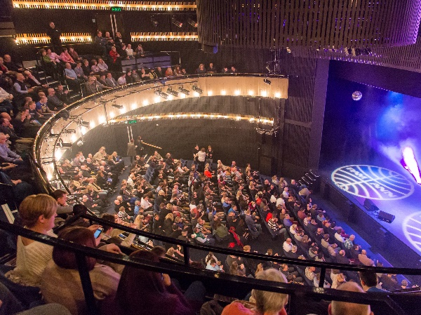
SEGMENTATION AND INDIRECT MARKETING
Experience Seekers & The Sweet Vengeance Season Example
Experience Seekers are:
Highly active, diverse, social and ambitious
Important and significant part of urban arts audiences
Younger singles and couples
Students, recent graduates and in those in early-mid career stages
Interests cover mainstream, contemporary and culturally diverse offers
Search for new things to do with disposable income for leisure activities
Digitally savvy
8%
5%
11%
Notes:
We set targets for each segment within our overall show targets, but for the purposes of today I’ll focus in on the Experience Seekers segment.
Giving you a little more information on who the Experience Seekers are, as I mentioned before:
Highly active, diverse, social and ambitious
Important and significant part of urban arts audiences
Younger singles and couples
Students, recent graduates and in those in early-mid career stages
Interests cover mainstream, contemporary and culturally diverse offers
Search for new things to do with disposable income for leisure activities
Digitally savvy
They represent 8% of English households
Only 5% of households in our region, the East Midlands
On average they are 11% of audience members at Nottingham Playhouse

Slide 15
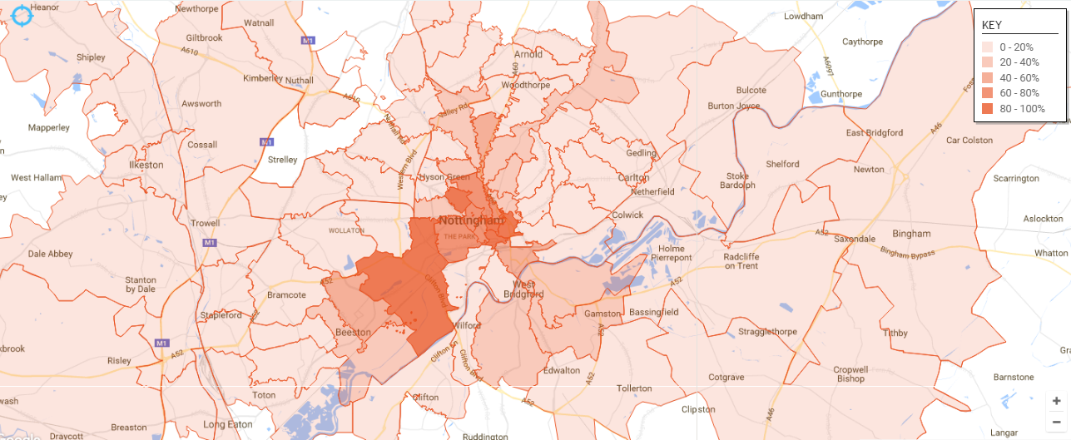
SEGMENTATION AND INDIRECT MARKETING
Experience Seekers & The Sweet Vengeance Season Example
Target areas for door drops, distribution, outdoor, advertising and media
Notes:
In practical terms, this Autumn we used Audience Finder’s mapping tool to locate Experience Seekers
Using the software gives us postcode sectors to concentrate our indirect marketing efforts, including distribution, door drops, outdoor, advertising and press and media. You can see on the map, the clear areas (in the darker colours) where Experience Seekers are found in the city of Nottingham.

Slide 16
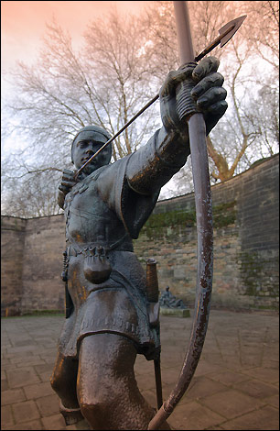
SEGMENTATION AND DIRECT MARKETING
Audience Spectrum Database Tagging
Import of Audience Spectrum coding at customer level complete by November 2016
Every customer in the TNEM database who has booked in the last 3 years is tagged
Tagging our database enables:
  Deeper understanding of our audiences across a wider range of KPIs
  Ability to analyse data against multiple criteria
  Use as criteria for extracting direct marketing data
  Improved ability to tailor messaging for audience segments
  Enhanced monitoring of campaign effectiveness and ROI
Notes:
Audience Spectrum has more power when applied to direct marketing, which involves tagging our customer base. I should state that this phase is not part of the free of charge service from the Audience Agency.
The import of Audience Spectrum coding at customer level complete by November 2016
Every customer in the TNEM database who has booked in the last 3 years is tagged.
Tagging our database enables:
Deeper understanding of our audiences across a wider range of KPIs
Ability to analyse data against multiple criteria
Use as criteria for extracting direct marketing data
Improved ability to tailor messaging for audience segments
Enhanced monitoring of campaign effectiveness and ROI
To put it in a very Nottingham way, with the help of Robin Hood, the city’s most famous son here, it allows us to hit the target bullseye

Slide 17
NEXT STEPS…
Creation of intrinsic segmentation model to allow us to further refine our direct and indirect marketing
Use of Audience Spectrum intelligence to aid the creation of our intrinsic model
Using intrinsic and extrinsic models together to develop marketing approach to the whole customer life cycle
  Non-attenders
  First timers
  Regular attenders
Notes:
What next? Our Segmentation journey is really only just beginning
Our next step will be to create our own intrinsic segmentation model so that we can further refine our direct and indirect marketing
We’ll use the Audience Spectrum intelligence as part of that process
And having both models together will help us to develop our marketing approach across the whole customer life cycle, from Non-attenders to First timers to Regular attenders.
It’s exciting times.

Slide 18
THANK YOU
Joanna Sigsworth
Head of Marketing & Communications
Nottingham Playhouse
@JoannaSigsworth
Notes:
Thank you

Slide 19

SEGMENTATION
DIVIDE AND CONQUER
Melanie Ryan
CRM & Insight Manager

Slide 20
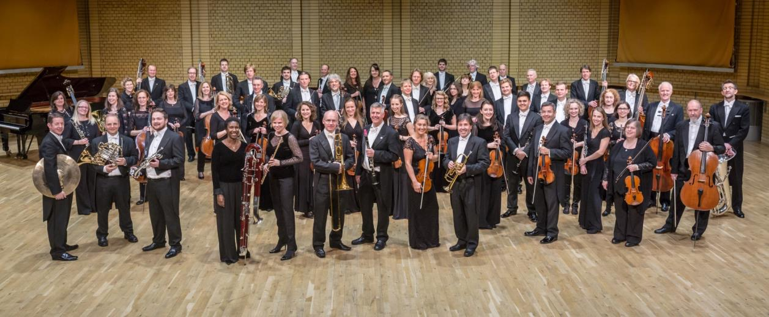
WHO WE ARE
Notes:
Resident Orchestra at Symphony Hall
Global reputation, international touring, regularly on Radio 3/ Classic FM

Slide 21
OUR TESS JOURNEY SO FAR
CRM for marketing, development and insight
Tickets sold on Spektrix at Symphony Hall
Import tix sales daily into Tess
Went live 1 December 2014
Notes:
Needed a CRM system for mkting (ticket bookers, stakeholders) and development (members, donors, corporates, trusts)
We promote our own season, but tix sales managed through THSH box office.

Slide 22
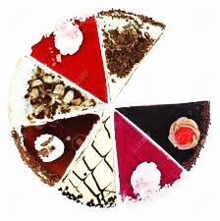
SEGMENTING AT THE CBSO
MARKETING
DEVELOPMENT
Bespoke
Based on existing attenders - intrinsic
Live picture
Wealth screening
Snapshot - static tags
Notes:
Not going to talk about the development segmenting, but just to note we can take elements of both when building marketing lists & development prospects

Slide 23
INITIAL RESEARCH
Classical attenders at Town Hall Symphony Hall (THSH)
Carried out by Baker Richards
Attender Behavioural Variables with strong clusters around
  Frequency
  Product preferences
Overlaying with qualitative survey data
Classical concerts rated by programme accessibility
Notes:
Strongest variables in cluster analysis looking at whole range of variables = Frequency & Product/Repertoire choices
Qual questionnaire asking about wider attitudes to attending, to music, and media consumption, digital engagement. Survey data tied back to database
Because 2/3 of our performances are traditional classical performances, it was helpful to break this product group down further, so we developed and tested a way of scoring core classical performances by their ‘accessibility’ to middle market – how familiar and popular the pieces and soloists/conductors were.

Slide 24
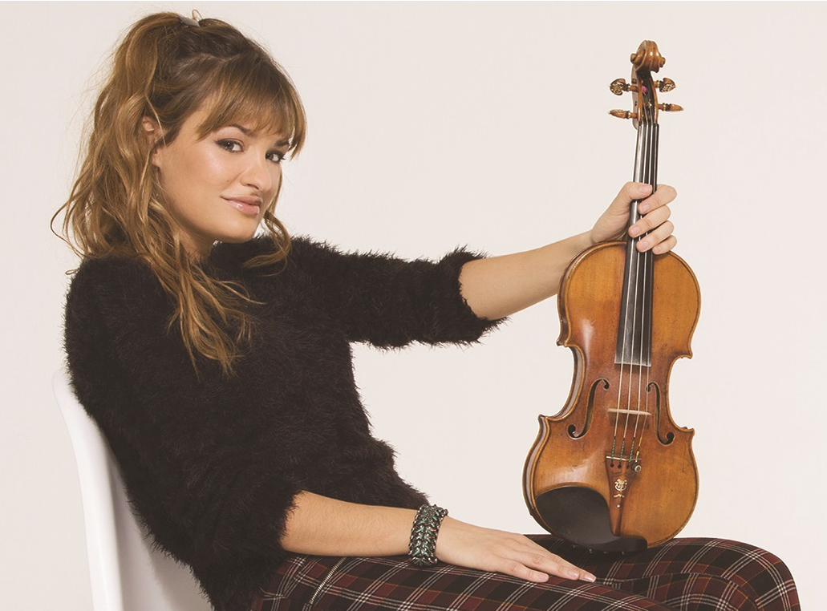

CBSO PRODUCTS
CORE CLASSICAL
POPULIST
Evening & Matinee
Rated niche to popular (0-5)
Nicola Benedetti: Tchaikovsky
Friday Night Classics
Christmas & New Year
Classic FM Hall of Fame
Notes:
Strongest clusters around Frequency and Product preferences.
Frequency we’ll come onto shortly. Our products are split into four main groupings:
Core Classical
Populist
Family
Other
Eg Benedetti scored as Rep Score 5 – very popular artist playing well-loved repertoire

Slide 25
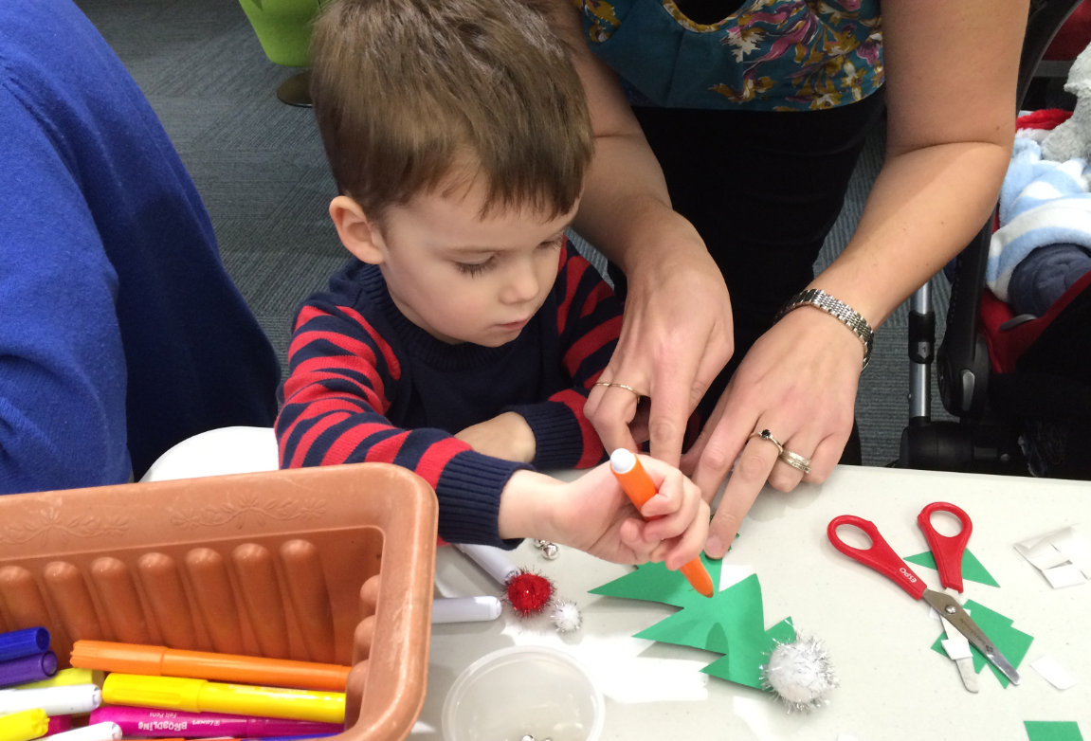
CBSO PRODUCTS
FAMILY EVENTS
OTHER PERFORMANCES
Family Concerts
Notelets (pre-school)
Frozen In Concert
Schools concerts
Singalong with the CBSO
CBSO Youth Orchestra
Chamber music at CBSO Centre
Notes:
Other is a catch-all for the smaller strands

Slide 26
OUR SEGMENTS
Derived from
customer
frequency &
product
choices
Segments to
match Products
Split further
by frequency
Concert Strand | Concerts Attended Ever | Segment | % Constituent
Crossover | Regular (4+) | 01. Rovers | 13%
 | Occasional (2–3) | 02. Tempted by Something Else
Classical | Regular (4+ with 80% at core or matinee) | 03. Committed Classicals | 48%
 | Occasional (2–3) | 04. Occasional Classicals
 | Once | 05. New Classical
Populist | Regular (4+ with 80% at FNC or Christmas) | 06. Committed Populists | 30%
 | Occasional (2–3) | 07. Good Nights Out
 | Once | 08. New Populist
Family | Regular (2+ with 80% at Family) | 09. Involved Families | 5%
 | Once | 10. New Family
Other | Regular (2+ with 80% at Other) | 11. Frequent Other | 4%
 | Once | 12. New Other
Notes:
Developed with Baker Richards (prior to Segmentation Engine)
Quick recap - most significant clusters of customers when looking at a variety of behaviourable variables came out around Frequency and product
Frequency groupings – we (like lots of arts organisations) have lots of ‘oncers’, so there’s a ‘New’ category for all apart from those people who crossover between strands. Largest %s of our customer base fall into the Classical and Populist, so we have 3 categories (regular, occasional and new). Within our Committed Classicals and Committed Populists we have super frequent attenders who are our package bookers.
In order to have useable amounts of data in each segment, the calculations are based on 80% of what people attend (ie what they usually attend)
Intrinsic - based on existing customer base, live picture as it updates nightly

Slide 27
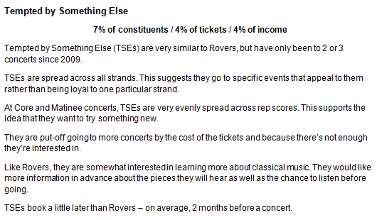
PROFILES OF SEGMENTS
Enrich
Box Office
data by
overlaying
survey
data
Notes:
Developed Prose profiles, and also have typical behavioural stats in a table form, so we can quickly compare behaviour differences between segments.

Slide 28

MORE SLICING AND DICING
Recency
Annual Frequency
Repertoire score
When do they book?
Tix yield
Member, Subscriber or Group
Notes:
Depending on the nature of campaigns, and what and when we’re trying to communicate, it’s really useful to have extra factors we can filter down on. So for example, if a mailing is going by post rather than email, we would be more concerned on costs, and perhaps limit the segments further by recency.
Or if we have a particularly tricky concert of unfamiliar music, we may choose to hone our targeting further by choosing only Classical segments with a preference for niche classical repertoire.

Slide 29
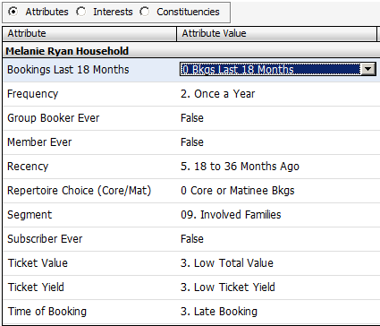
IN TESSITURA
Notes:
Managed as dropdown cohorts in Attributes, actual numerical value held in Interests
Some variables can be used in T-stats anaylsis
Based on up-to-date purchasing
Segment and the other variables are written back to Attributes and Interests overnight at Household level.

Slide 30
USING THE SEGMENTATION
Artistic team – understanding audiences
Marketing team – understanding behaviours
Planning large seasonal campaigns
Smaller marketing campaigns
Notes:
Shared with Artistic team, goodwill and interest is there – but marketing needs to drive this into the process of artistic thinking, as audience champions within the organisation
Also the scoring of concerts by their repertoire is used to inform target setting for concerts (eg niche – lower £s than mid-rep)
Can also eg look at postcodes to inform door drops etc; but would also use Audience Finder for media consumption etc

Slide 31
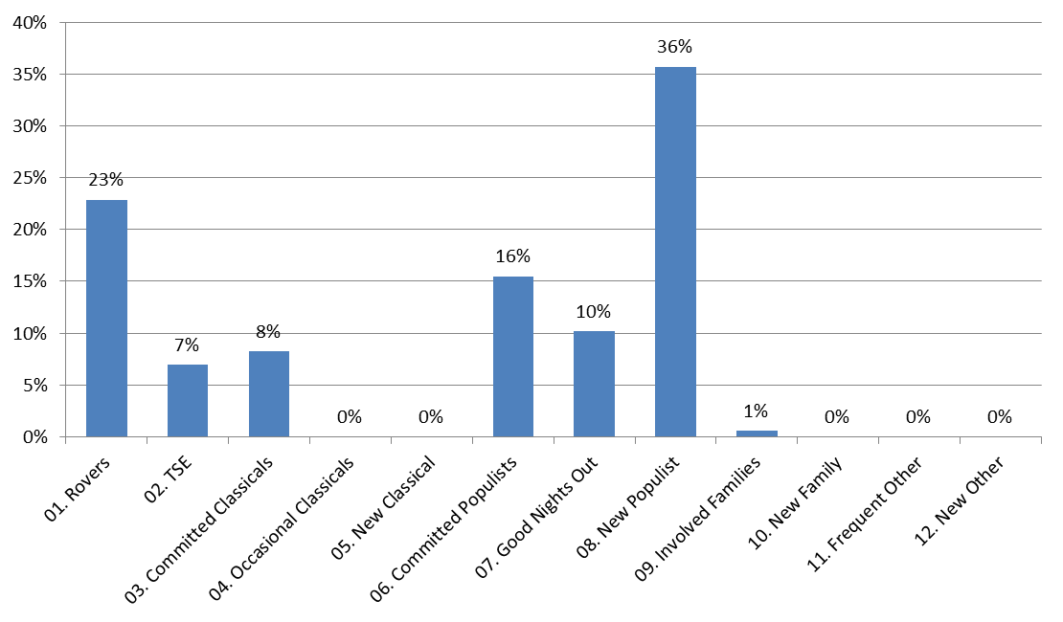
WHO’LL BE AT THE CONCERT?
Festive Favourites with Hugh Dennis
Notes:
Next step – using this to inform printed programme content etc

Slide 32
CUSTOMER JOURNEYS
Audience Development
product ladder = ‘easy’ to ‘harder’ repertoire
Who rebooks?
slight bias towards those who had 1st attended low rep score (more ‘niche’), and against Friday Night Classics & Festive
And what do new attenders actually come to next?
2nd concert more likely to be FNC and Festive
New Populists tend to come back to same
New Classicals tend to gravitate to middle grade of repertoire
Notes:
Because each of our concerts has been segmented into product strand and further still by accessibility rating, we can track customer journeys.
Looking at new attenders from our 1415 season and what those who re-attended (24%) came to next we can see traditional ‘drug dealer’ view of Audience Dev (get them in on soft stuff and move onto the harder stuff) doesn’t hold true for these bookers.

Slide 33
TRENDS BY SEGMENTS
Notes:
When we’re looking at trends, we can also break down by segments to enhance our understanding of what’s going on.
So here we can see New segments much more likely to book online than the most frequently attending segments.

Slide 34
Concerts and Segments
AVERAGE GROUP SIZE
Notes:
And here we can deduce Rovers are very sociable / Committed Classicals are not very sociable – this fits the anecdotal evidence we have of some regular attenders at classical concerts wanting to introduce friends to classical music, and using our populist Friday Night Classics strands to do this.

Slide 35
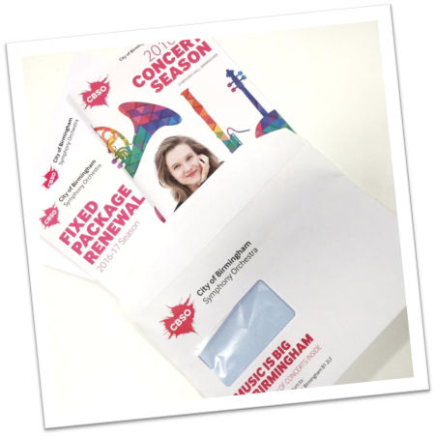
2016-17
SEASON LAUNCH
Top targets – Package bookers & Members
after that...
Targeted segments who responded best to 15-16 launch
Plus ‘New’ segments who were recent
Excluded Late bookers
Mailed 9k brochures to past attenders (non-member/packages) = reduction of 6k items mailed, saving £4k
Response rate doubled to 7%
Notes:
56 page brochure – expensive to produce and send, overwhelming to digest for infrequent customer

Slide 36
2016-17
SEASON LAUNCH
Early bookers % responded = 2 x that of Mid bookers
Committed segments % responded = 2 x that of Occasional segments
% responded in direct correlation with customer recency category
- from 19% for Future Bookings, to 1% for 18-36 months
Cost almost as much to mail as income brought in for those who last attended 18-36 months
Those excluded from brochure mailing and non-responders, received our Termly guide
- sent closer to events taking place, less overwhelming
Notes:
Next season we’ll probably cut recency cut-off back to 18 months (rather than 36) for this mailing, and approach these people differently.
Season launch is not the best way to contact infrequent, new and late bookers.

Slide 37
A-Z OF THE CBSO CONCERT
Tighter targeting works for smaller campaigns too
A/B testing for emails for this concert
- best segments to target v second tier of targets
Best segments
– double % constituents responded
– spend per constituent 3x larger
Notes:
Marketing team use the segmentation in their daily campaign tactics within Extraction manager.

Slide 38
WE LEARNT…
Hard to track people’s journeys through Segments as they attend more concerts
Go Live + Segmentation model = hard!
…but helped to configure correctly
As customer history builds, we need a cut-off point (past 4 years)
Notes:
Without making LOTS of static lists

Slide 39
WHERE WE GO NEXT
more monitoring and experimenting
- some A/B testing of emails
how we can take easier snapshots, to track journeys?
using Segments in Output Sets to make email content dynamic
mryan@cbso.co.uk baker-richards.com

Slide 40

Segmentation
Carmel England
TEC Dublin
November 2016

Slide 41


Introducing…
………………………………………………………………………………………………………………………………………….
Carmel England
carmel.england@roundhouse.org.uk
@hellocarmel
Roundhouse Head of Marketing
CRM, Project Manager, Creative Producer, Audience Developer, Social Galvaniser
Sydney Theatre Company
ANZTRUC
Notes:
A bit about me…
Worked in international festivals, university-based theatres, galleries, producing theatre companies
Many artforms – visual arts, film, theatre, music, etc
Worked in Sydney, Australia for 8 years, including 3 years at Sydney Theatre Company, where I oversaw their CRM strategy implementation and was on the organising committee of ANZTRUC, the Aus/NZ Tessitura Regional Users’ Conference

Slide 42
Segmentation: divide & conquer
………………………………………………………………………………………………………………………………………….
Roundhouse
Segmentation project methodology
Ensuring cross-functional buy-in
Sydney Theatre Company
Segmentation as a foundation for a CRM strategy
Tessitura integration
Notes:
We’ve heard about specific segmentations in Nottingham and Birmingham
Going to take a step back and talk a bit about our project methodology rather than the segmentation itself (partly because half way through!)
Then I will briefly use STC as a case study of post-project implementation/Tessitura integration

Slide 43
Roundhouse
………………………………………………………………………………………………………………………………………….
Camden, London
Former train repair shed, Gin warehouse
50 years as performing arts venue
Live music, circus, dance, theatre, events
Sackler Space R&D
Youth charity: Creative Projects for 11-25s
Camden Beach
Apple Festival
Roundhouse Radio
Notes:
Diverse business model
Multiple revenue streams

Slide 44
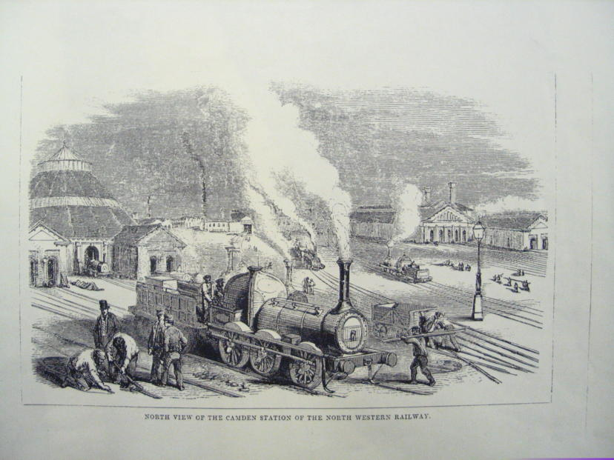
Section title option B
Notes:
1847 we looked like this

Slide 45
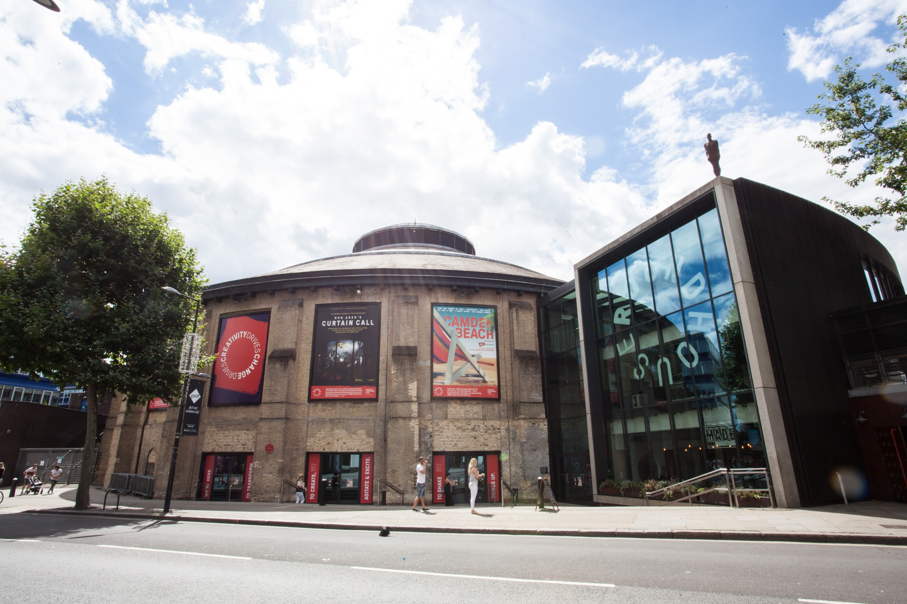
Section title option B
Notes:
In 2016 we look like this

Slide 46
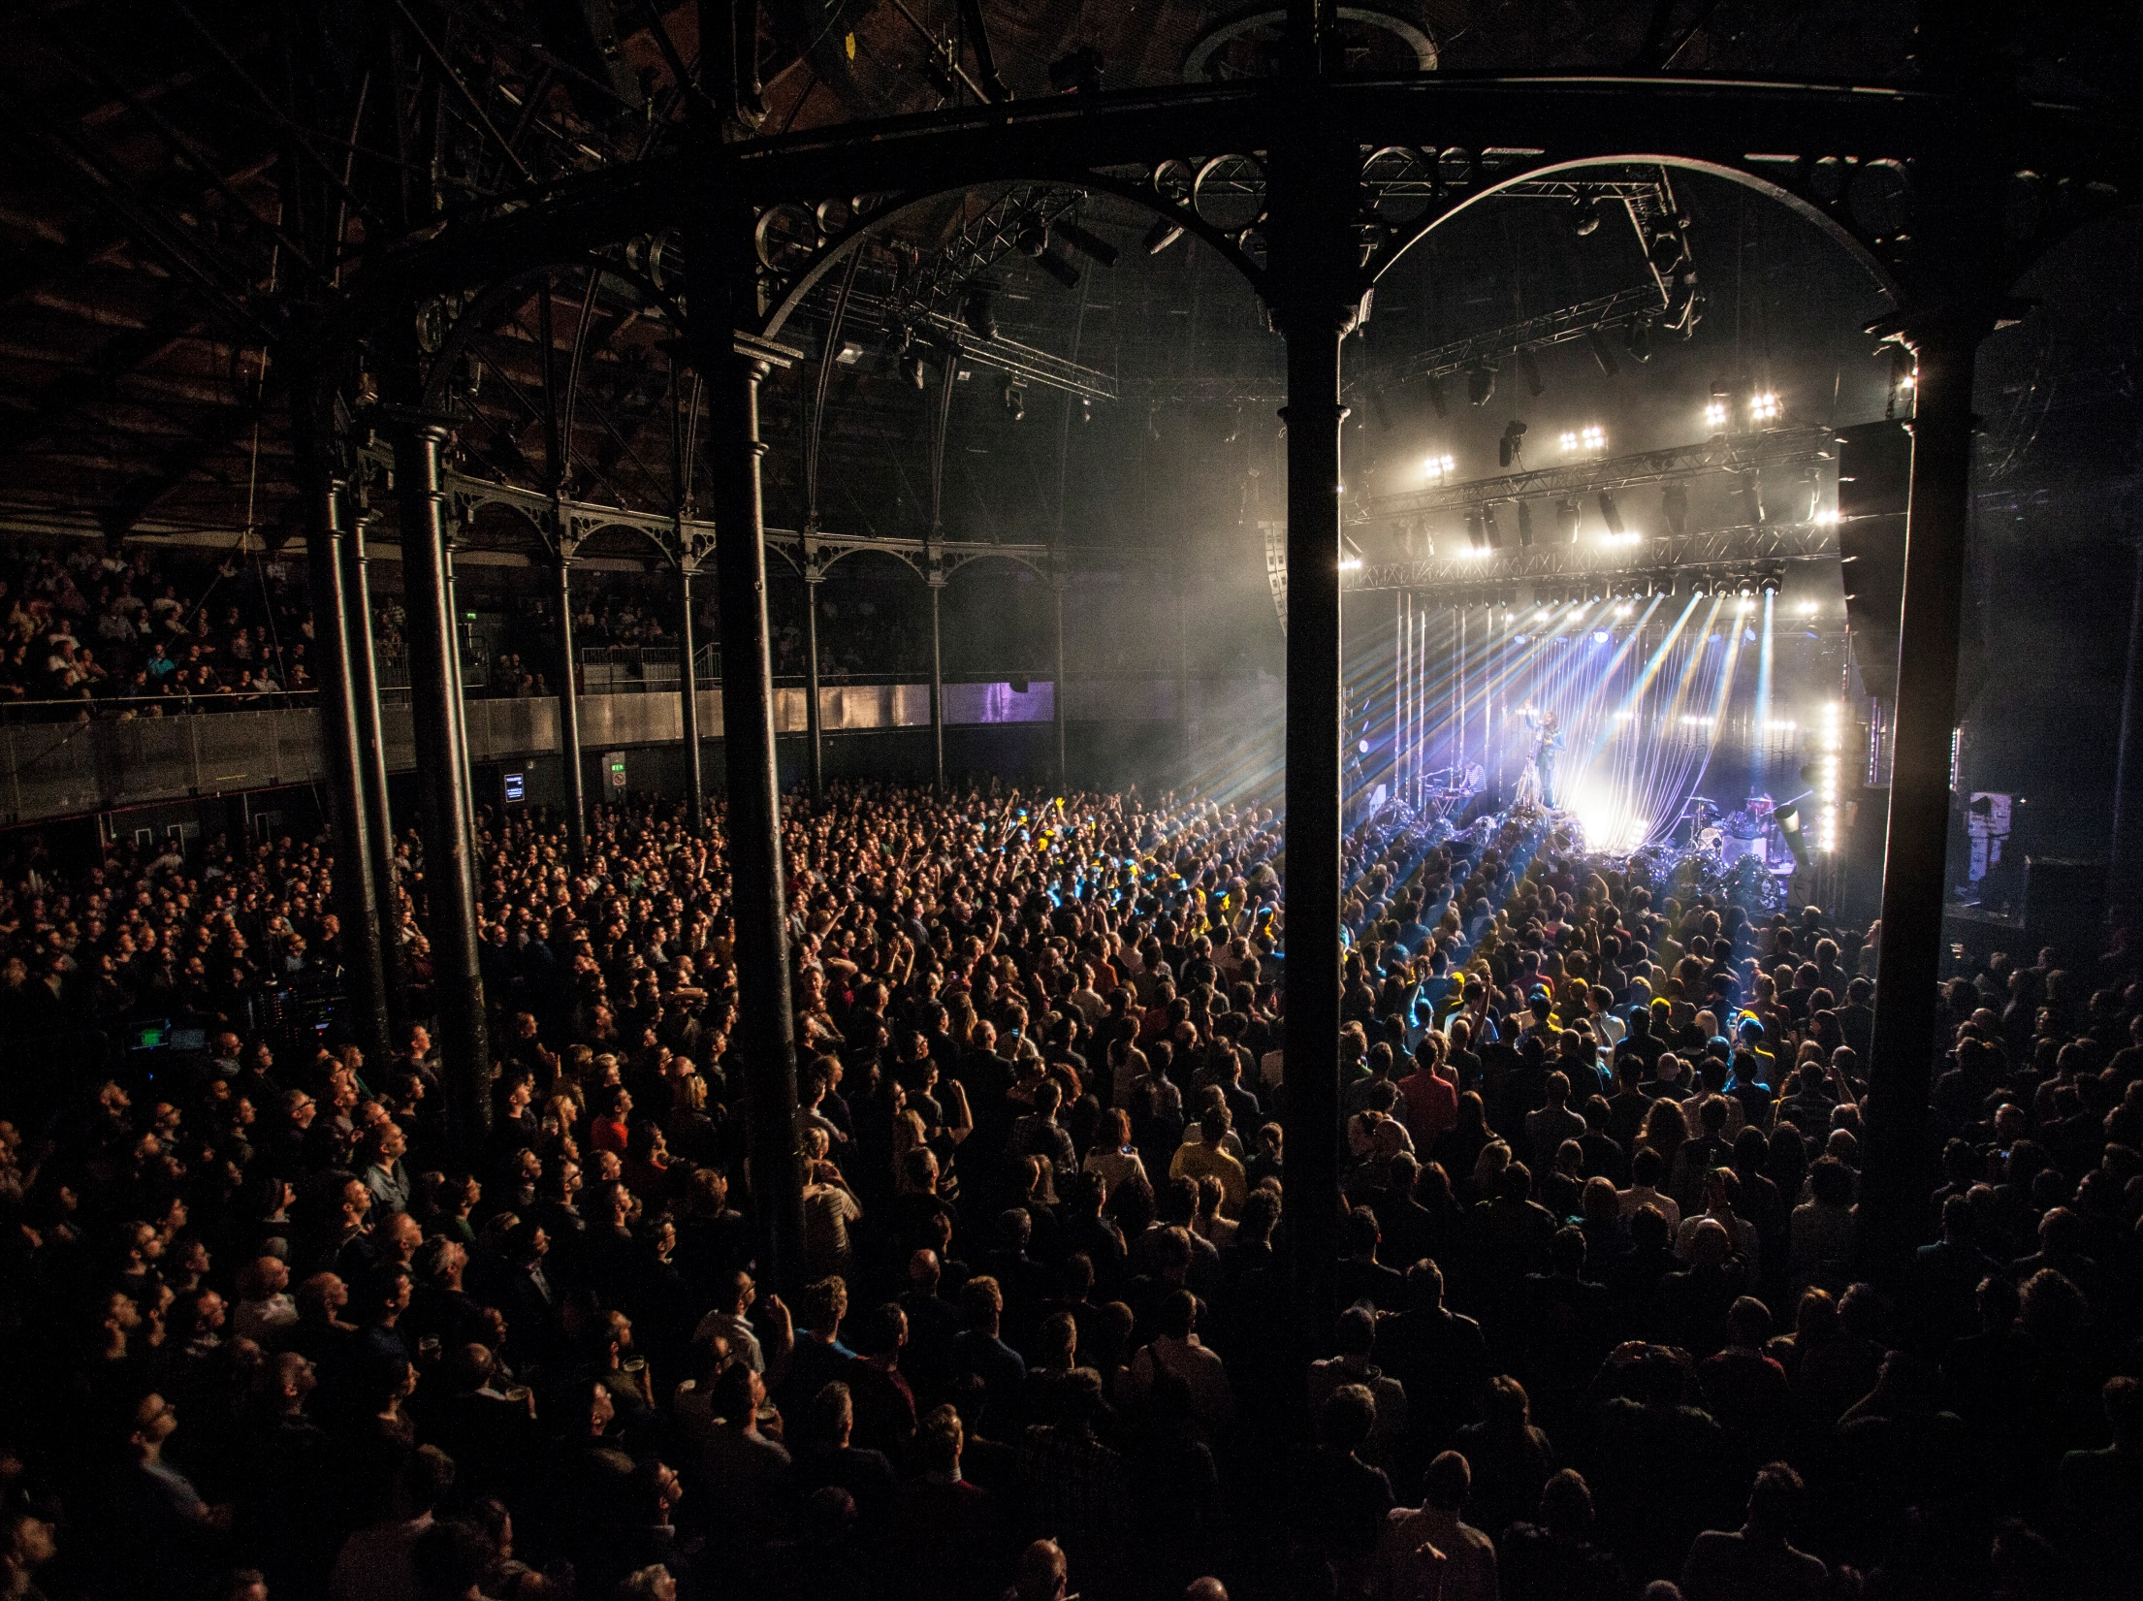
Section title option B

Slide 47
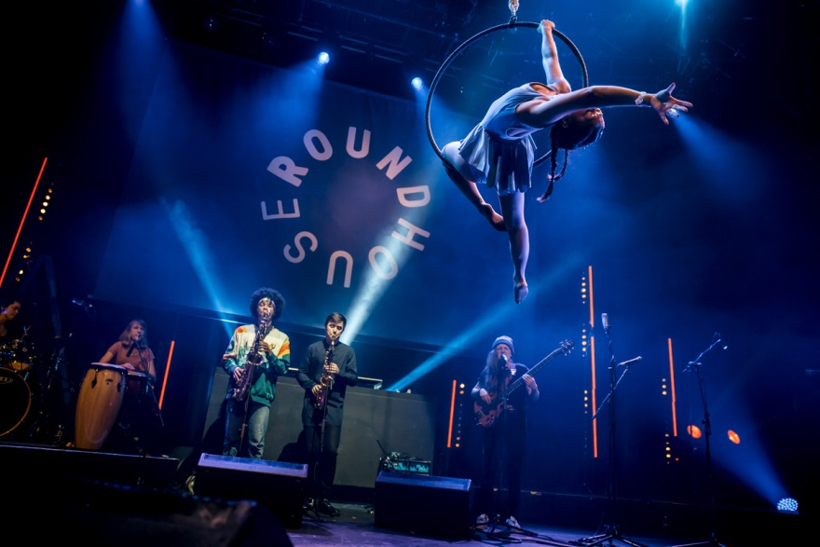
Section title option B

Slide 48
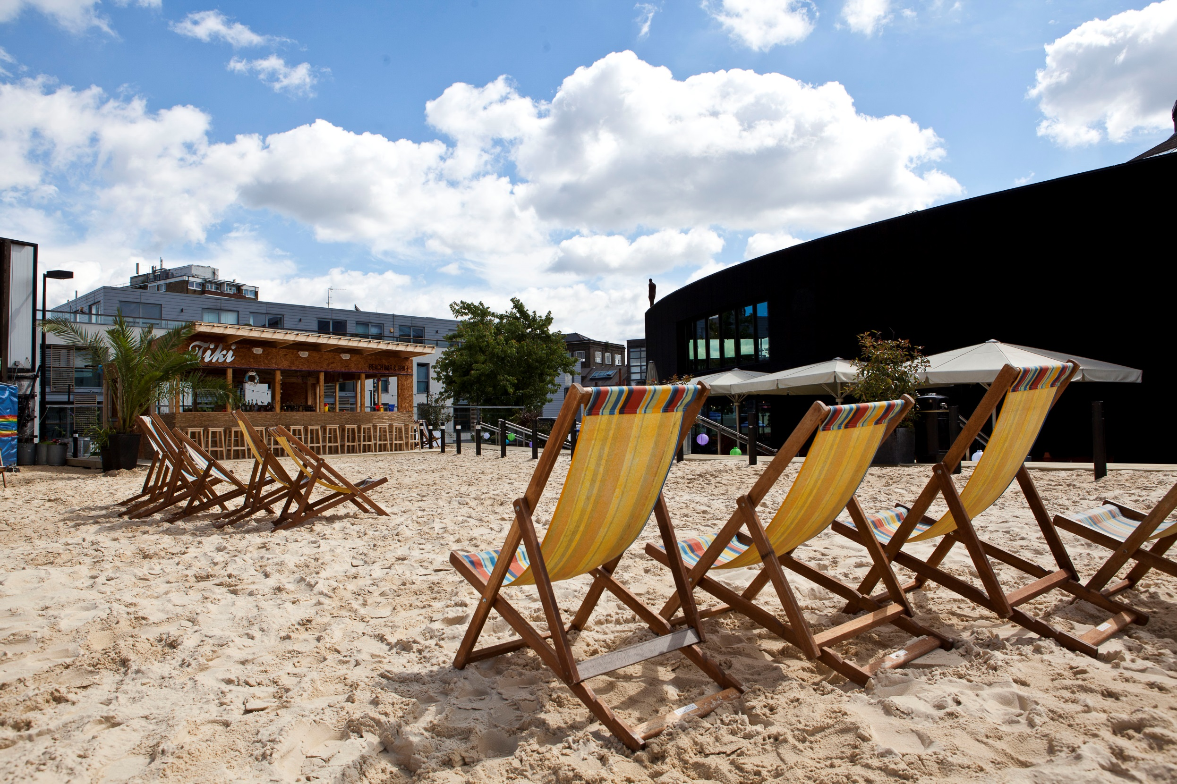
Section title option B

Slide 49
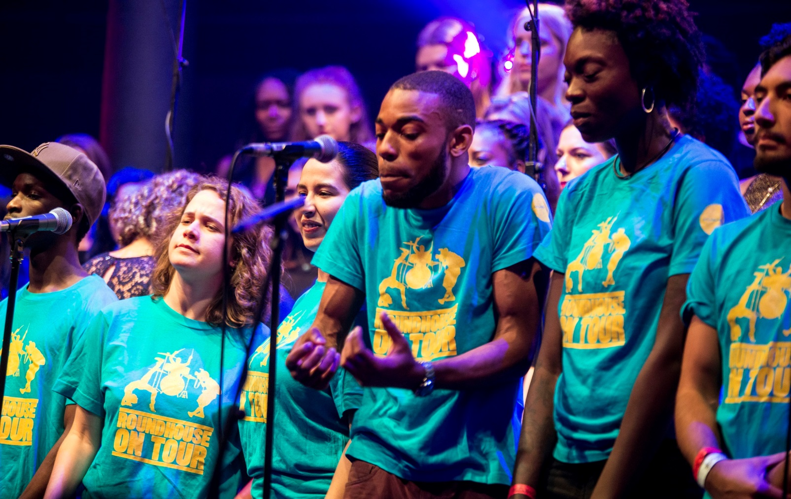
Section title option B

Slide 50
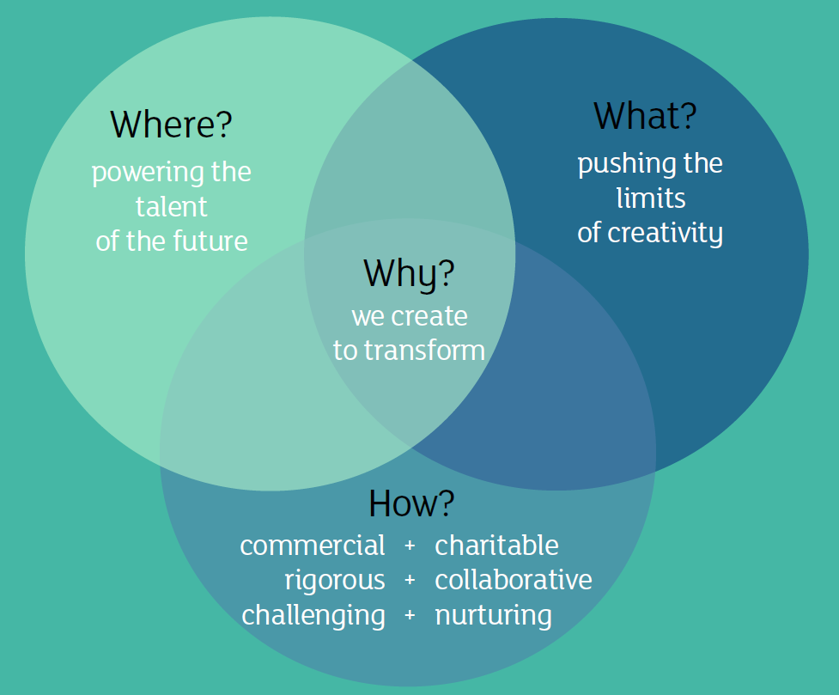
Vision/Mission
………………………………………………………………………………………………………………………………………….
Notes:
Primarily exist because of the charitable work we do with young people, the rest of our business is about fuelling this
Balance creative, cultural, charitable

Slide 51

Section title Option A
Our audience segmentation journey
Basis for a CRM Strategy. Truly pan-organisational
To deliver the following customer perspective:
  “Roundhouse knows who I am, what I am interested in, recognises my commitment, enriches my experience and treats me like an individual.”
Notes:
I started as Head of Marketing in August 2015 and with my background in CRM, was keen to see where the org was at with this.
First priority = rebrand and prep for 50th anniversary, then turned my attn to CRM
Org needed to better understand its audiences before embarking on a truly CRM approach
Desire to improve customer perspective

Slide 52
Situation analysis
………………………………………………………………………………………………………………………………………….
10 years’ worth of data
Half a million individual records
Almost 80% of bookers have been only once
Aud understanding = behavioural
Many assumptions
Notes:
So where we we at?
Dot points here
Assumptions across org – not necc same

Slide 53
January 2016
………………………………………………………………………………………………………………………………………….
Deep understanding of Roundhouse audiences across all our activity, to inform the organisation’s strategic direction
Strong, communicable, understood lexicon with which we talk about and evaluate our audiences across the organisation
Audience segments considered in everything we do
Foundations for a CRM Strategy to increase loyalty, retention, personalisation of communications, to ensure we provide the best customer experience and service to our audiences
Notes:
Worked with Insights and Data Manager to build a business case for investment
Wanted to lay some solid foundations for what will undoubtedly be a long term, multi-staged project
Knew that true success would only come if this was embraced by the whole organisation
Had just implemented new brand with successful pan-organisational involvement and buy-in so wanted to build on this
Needed to have £ to invest in project

Slide 54
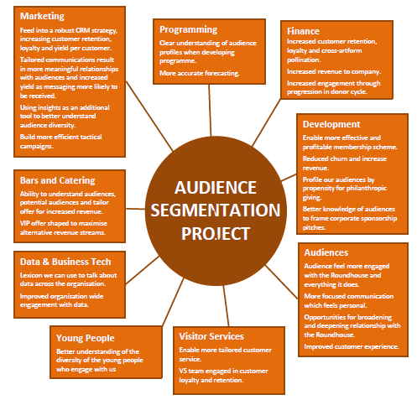
Notes:
Demonstrated benefits across entire org
Included overarching vision for project
A basic explanation of what segmentation is
What we were planning to do
The project goals
Links with Business Plan
The longer term road map
Practical outcomes
Risks of not doing the project

Slide 55
Inclusion and governance
………………………………………………………………………………………………………………………………………….
Created Core Project Group to guide project (with representatives from Marketing, Data and Insights, Visitor Services, Youth Strategy, Development)
Created three Steering Groups
  Artistic Programming/Youth Strategy
  Operations/Finance/Bars & Kitchen
  Development/Ticketing/Marketing/Visitor Services
Involved at commencement stage, interim and completion
Notes:
From the beginning of the project wanted to inform the direction and priorities of the project from across org
This will also ensure adoption and use when the project’s first phase is complete
Talk through these dot points

Slide 56
Project in progress
………………………………………………………………………………………………………………………………………….
Appointed supplier – joint pitch by The Audience Agency and Baker Richards
Intrinsic/Extrinsic approach
Steering Groups have fed into project goals
First phase of data mining complete
Draft segments to come on 24 November
Tessitura integration planned Jan 2017
Notes:
Haven’t yet completed project (hope to present at TLCC!)
But going really well
Appointed AA/BR – with an extrinsic/intrinsic approach, so can use our own data and do deep analysis of our audience’s rel with us, as well as understand who they are in the wider market (esp the 80% oncers)
Stakeholders across organisation already looking forward to having and using it, considering it in their planning

Slide 57
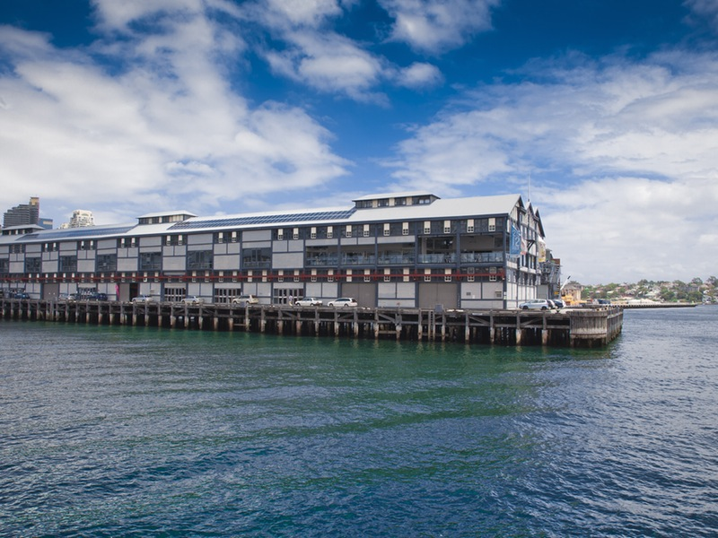
Section title option B
Sydney Theatre Company

Slide 58
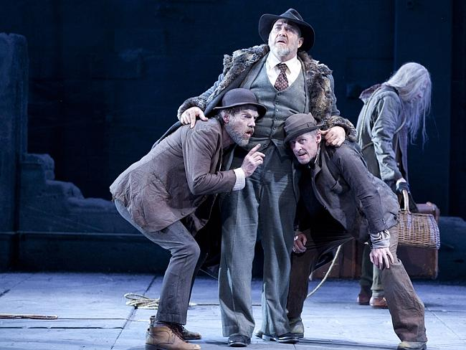
Section title option B

Slide 59
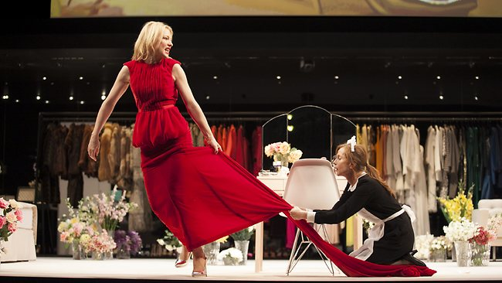
Section title option B

Slide 60
Producing theatre company
………………………………………………………………………………………………………………………………………….
16 plays per year, 4 venues
Created on site at The Wharf
Subscription packages, casual tickets
Loyal audiences
Sydney = 4 million, less competition culturally
The Main Stage Theatre Company

Slide 61
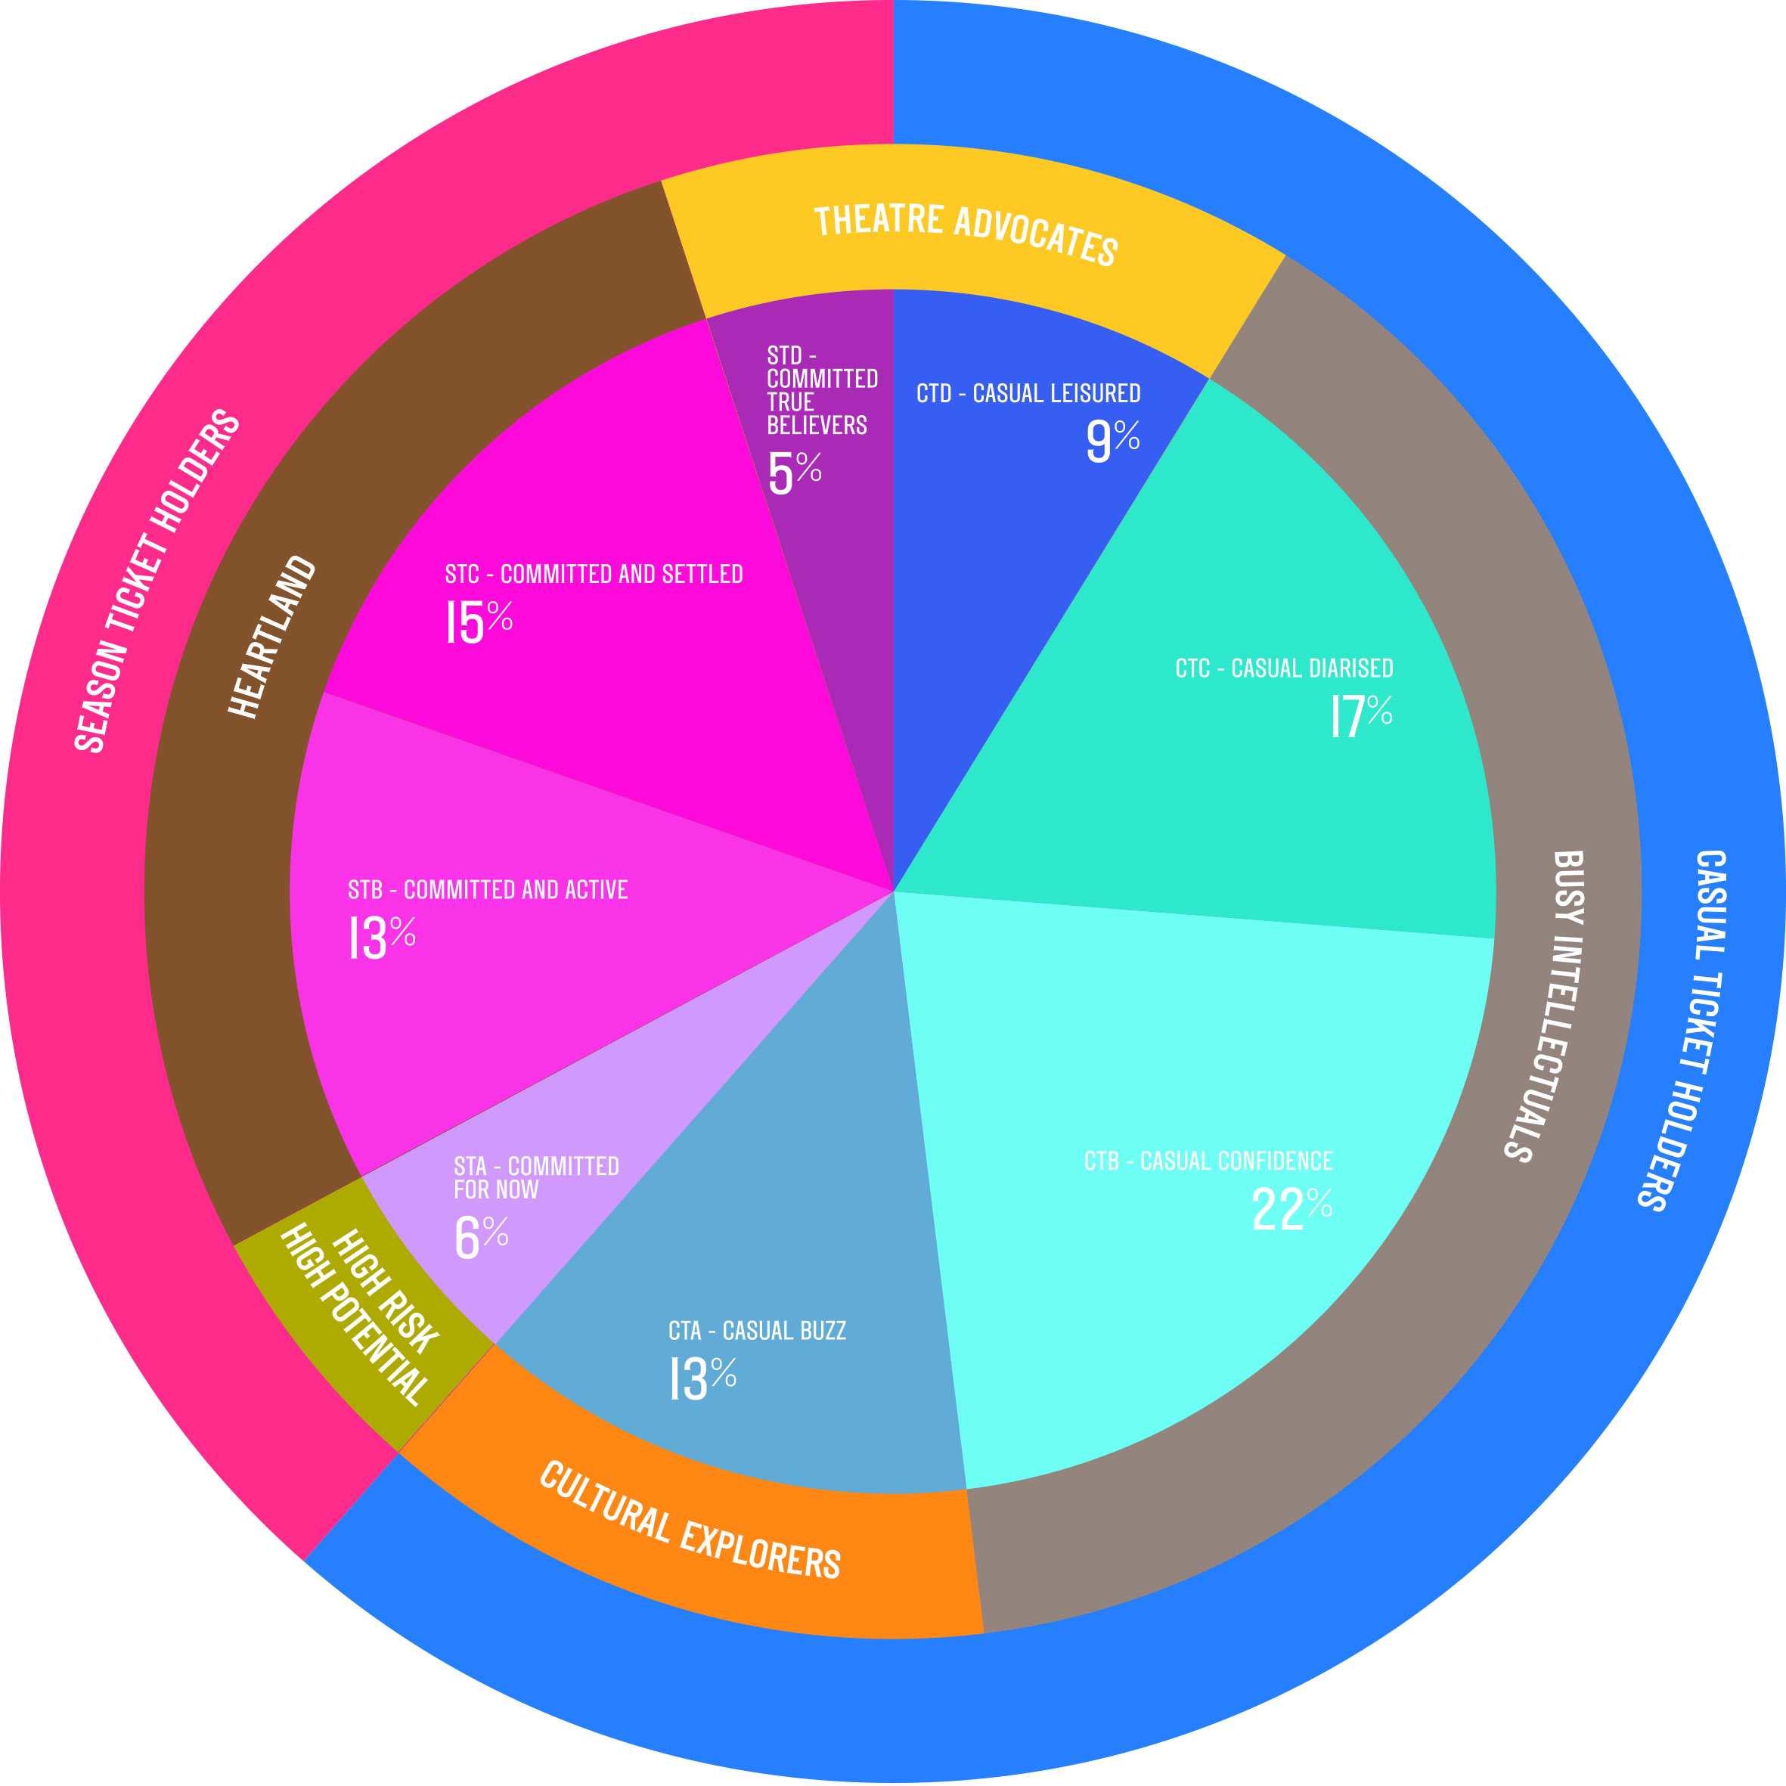
8 customer segments
………………………………………………………………………………………………………………………………………….
Notes:
4 Subscriber ticket segments, 4 Casual ticket segments
Strategy by segment over time
Some to move along journey, some to increase yield, some to decrease churn, some to surprise and delight, reward loyalty, encourage advocacy, strategies for ‘volatile’ segments
Use ready reckoner and speak to specific segment strategies (just go through inner circle)
End with STD and Storm Boy eg

Slide 62
Tessitura integration
………………………………………………………………………………………………………………………………………….
Segmentation stored in custom table
Available as list parameter
Segments updated nightly via scripts
Stored monthly so can do longitudinal analysis
Practically – used in planning, extractions, T-Stats, evaluation
Notes:
Talk through how it integrated with Tessitura

Slide 63

End slide
Thank You!
www.roundhouse.org.uk
carmel.england@roundhouse.org.uk

Slide 64
QUESTIONS?
“Impermanence - anonymity - that’s what I’m looking for; a vast restless place that doesn’t give a damn about the past..”
Brian Friel, Philadelphia Here I Come
Notes:
Welcome

