Slide 1

TESSITURA
EUROPEAN
CONFERENCE
DUBLIN 2016
Notes:
Welcome

Slide 2



PRESENTERS
Gemma Hall : Glyndebourne
Karen McCarthy : Glyndebourne
Laura Scott : Southbank Centre
Mark Steel : Tessitura Network
PAPERLESS DIRECT DEBITS
Watch you BACS!
CONTENT PLANNERS
Laura Scott : Southbank Centre
Ben Dart : Sadler’s Wells
Share your favourite content and photos! #TECDublin16

Slide 3

Karen McCarthy
Operations Manager

Slide 4
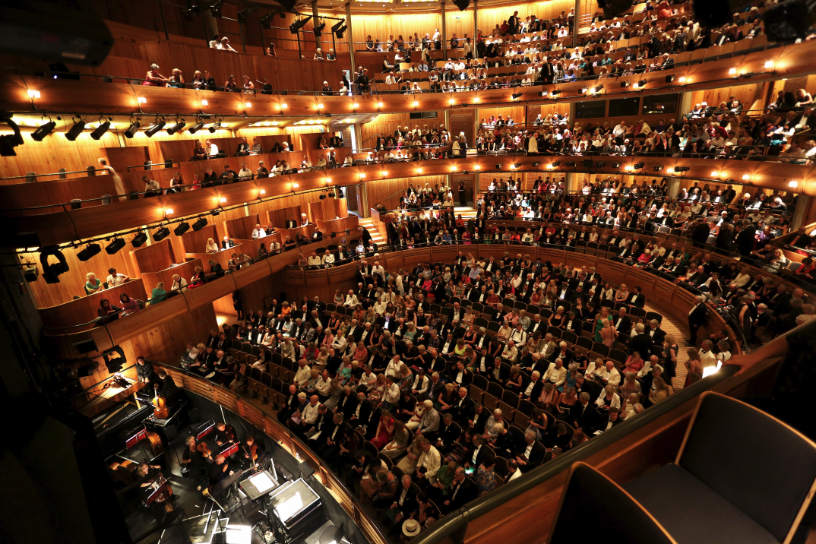


Founded in 1934
New house opened in 1994
1294 Seat Auditorium
123,368 tickets sold in 2016

Slide 5




Slide 6
Glyndebourne Membership Scheme
9,000 Glyndebourne Festival Society Members
4,500 Associate Members
10 – 12 Year Waiting List
12,010 Direct Debits
537 New Direct Debits in 2016

Slide 7
Direct Debit Glossary
Direct Debit
an arrangement made with a bank that allows a third party to transfer money from a person's account on agreed dates, typically in order to pay bills.
AUDDIS
stands for Automated Direct Debit Instruction Service. Utilising AUDDIS allows an organisation to submit Direct Debit Instructions to Bacs electronically rather than sending them by post.
Paperless
Paperless Direct Debit (PDD) is a service that allows an organisation to set up a Direct Debit instruction and collect payments without customers having to fill out and sign a paper mandate.
bacs.co.uk

Slide 8
Timeline

Slide 9
Paperless Direct Debit
Application Form
Signed by 2 authorised signatures from your bank account
To be approved by sponsor bank
  Scripts for Telephone and Face-to-Face
  Web Pages
  Confirmation Letters
  2 Members of staff must successfully complete the mandatory BACS PDD Online Training Course

Slide 10
What is Modulus Checking?
Modulus checking is a validation check of sort code and account number combinations using a mathematical algorithm. It confirms that the account number that a customer has given you can validly be paired with the sort code that they have provided.
Reduces the number of rejections and improves customer service
Mandatory requirement for Paperless DD to be done at the Point of Sale and not subsequently re-keyed
PCA Predict Payment Validation cloud-based service

Slide 11
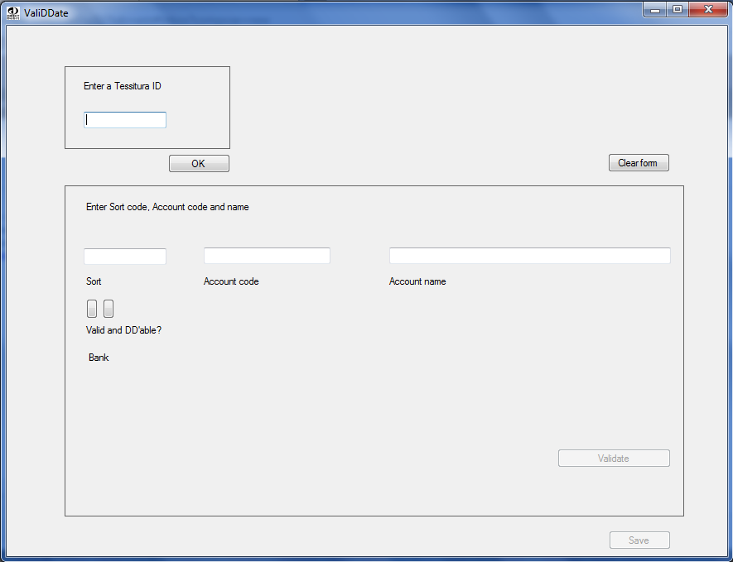
Our Application

Slide 12
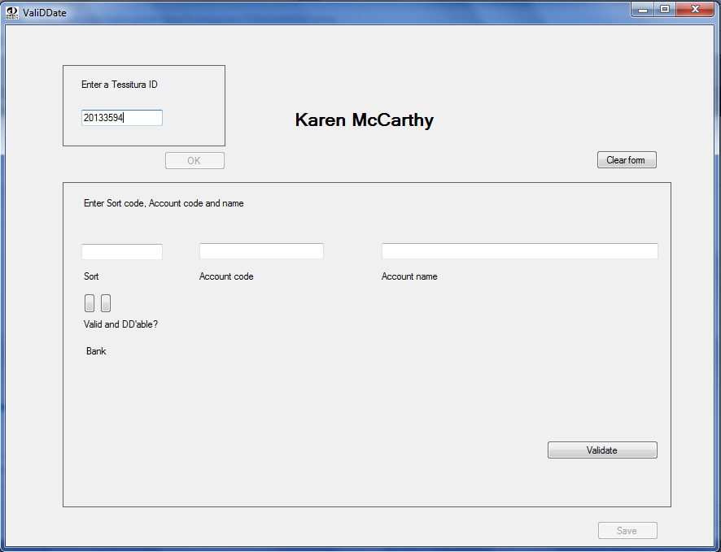
Our Application

Slide 13
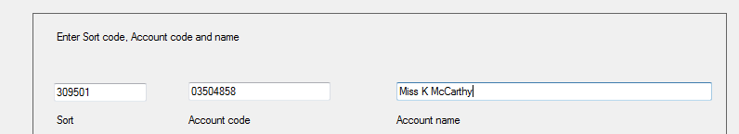



Our Application
Bank Account VALID
Direct Debits ACCEPTED
Bank Account INVALID
Direct Debits NOT ACCEPTED
Bank Account VALID
Direct Debits NOT ACCEPTED

Slide 14
Still to Solve
Adding an incremental prefix to the Direct Debit details to create a unique suffix for reference number.
Merging partly masked bank details into the confirmation DDI
Website – One day!!

Slide 15

Karen McCarthy
  Operations Manager
karen.mccarthy@glyndebourne.com

Slide 16
Paperless direct debits
Getting started and Testing

Slide 17
Southbank Centre
Performing Arts Centre in central London
21 acres, 4 primary venues incl. Royal Festival Hall & Hayward Gallery
Tessitura implemented Jan 2007
Currently on version 12.5.1

Slide 18
Laura Scott
Receivables and Cash Manager, Southbank Centre
Joined in June 2005
Finance representative at TBUG (Tessitura Business User Group)
Chair of EU Finance Tessitura User Group

Slide 19
Back to basics
Check out the BACS service user guide
www.bacs.co.uk
Make contact with your bank, they are usually very helpful and they have to sponsor your application.
GRPBACSDD@lloydsbanking.com
Tel: 0345 9825 325 opt 2

Slide 20
Getting started
You must have live AUDDIS status before using the paperless Direct Debit service and must have completed both an AUDDIS and separate paperless Direct Debit application form issued by your bank.
Your bank must approve all paperless Direct Debit material, including scripts, confirmation letters, internet screens and any other material prior to use. Any subsequent changes to documentation or scripts must be approved by your bank prior to use.

Slide 21
Tessitura Set up
TR_DIRECT_DEBIT_TYPE = Links your bank details to the payment method used for the instruction and payment files
Set up Account type “Direct Debit” = This will be needed to add the bank mandate to the constituent record
Set up Billing type “Direct Debit” = This will be needed to run the Direct Debit Electronic Setup report (used for submitting instructions to the bank) and also for running the Pledge Billing and Direct Debit Pledge Bills reports (both used for extracting the payment file)

Slide 22
Things to consider when testing
Make sure all teams are fully aware of the processes and impacts (e.g. best practice v compliance)
Double check all associated software is compatible with your process (e.g. bank validation and verification)

Slide 23
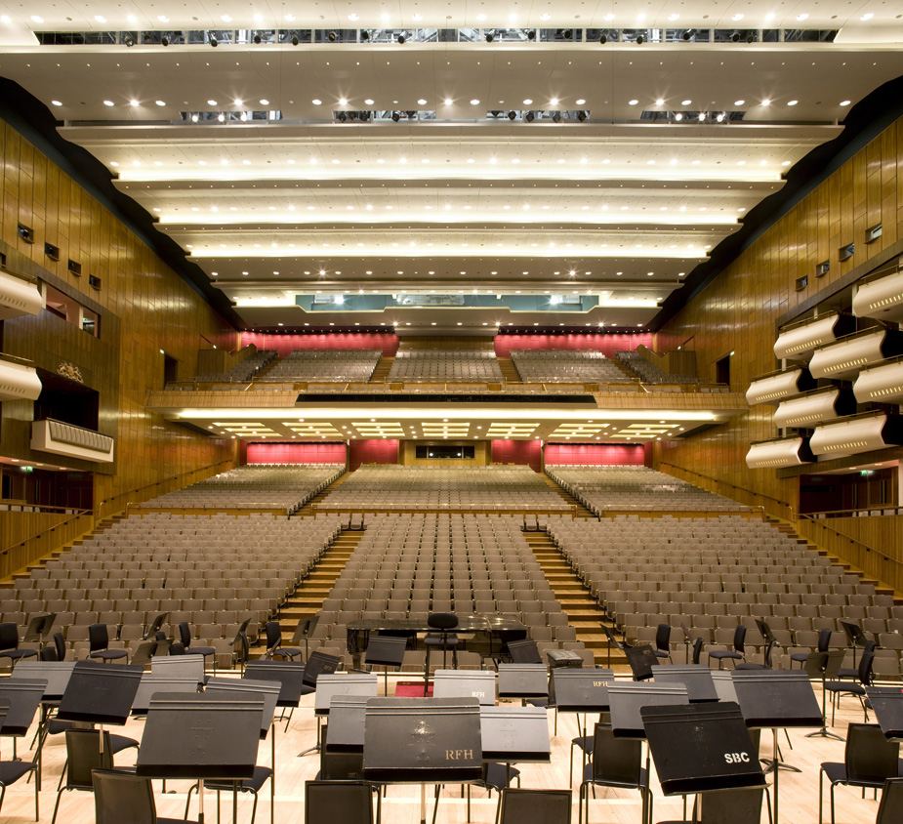
Any Questions?
020 7921 0696
Laura.scott@southbankcentre.co.uk

Slide 24

Others transact. Tessitura transforms.
www.tessituranetwork.com

Slide 25


Direct Debits Online
www.tessituranetwork.com

Slide 26

Mark Steel
Application & Support Consultant
Sutton Coldfield, West Midlands
www.tessituranetwork.com

Slide 27
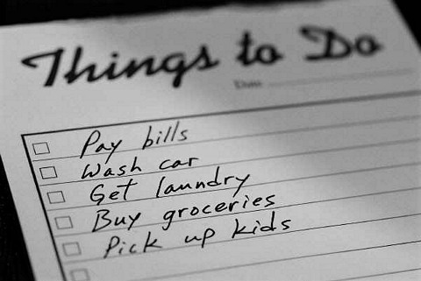
Agenda
Understanding the Web API
Limitations for pledges and unpaid orders
Capturing Direct Debit details online
www.tessituranetwork.com

Slide 28

Web API
“A server-side web API is a programmatic interface consisting of one or more publicly exposed endpoints to a defined request–response message system, typically expressed in JSON or XML, which is exposed via the web—most commonly by means of an HTTP-based web server.”
Wikipedia
www.tessituranetwork.com

Slide 29

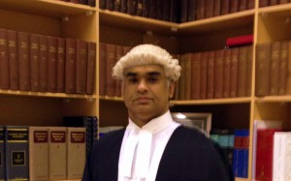
Web API
Handles conversation between your SQL server and applications
Makes sure everything is above board
Maintains security
www.tessituranetwork.com

Slide 30

Web API
www.tessituranetwork.com

Slide 31

Limitations
Fully paid items
Payment schedules in Ticket Orders
TNEW requires the first payment and only handles CC data
www.tessituranetwork.com

Slide 32

Contribution Import Utility
Imports pledges and gifts
Setup billing schedules
Used for data conversions
www.tessituranetwork.com

Slide 33

Online Direct Debits
Using custom procedures….
Record account data into T_ACCOUNT_DATA
Create an entry in TW_CONTRIBUTION_IMPORT
Trick the web into thinking the customer is a member
Overnight import the contributions
www.tessituranetwork.com

Slide 34
QUESTIONS ?
“Impermanence - anonymity - that’s what I’m looking for; a vast restless place that doesn’t give a damn about the past..”
Brian Friel, Philadelphia Here I Come
Notes:
Welcome

