Slide 1



PRESENTERS
Anna Coles : Wales Millennium Centre
Rog Hildreth : Royal Northern College of Music
Dara Hogan : Abbey Theatre
MODERATOR
Mark Steel : Tessitura Network
TN Express Web: From Out-of-the-box to Innovation
Teaching an old dog TNEW tricks
CONTENT PLANNERS
Ruth Harris : Royal Shakespeare Company
Lloyd Stringer : Donmar Warehouse
William Gregg: Philharmonia Orchestra
Share your favourite content and photos! #TECDublin16

Slide 2

TNEW: Mostly Out-of-the-Box
Anna Coles
Database Team Leader

Slide 3
TNEW: Mostly Out-of-the-Box
Session Outline
Festival of Voice
Bilingual Customizations
Staff Ticketing

Slide 4
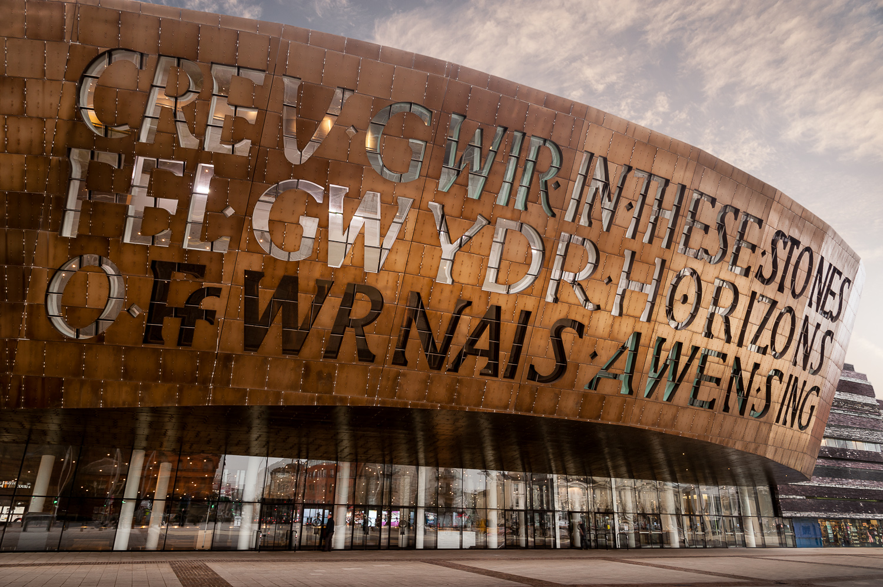
TNEW: Mostly Out-of-the-Box
Wales Millennium Centre

Slide 5






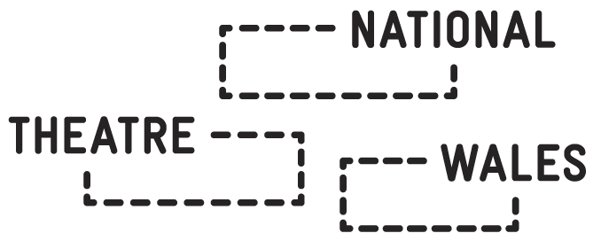
TNEW: Mostly Out-of-the-Box
The Consortium

Slide 6
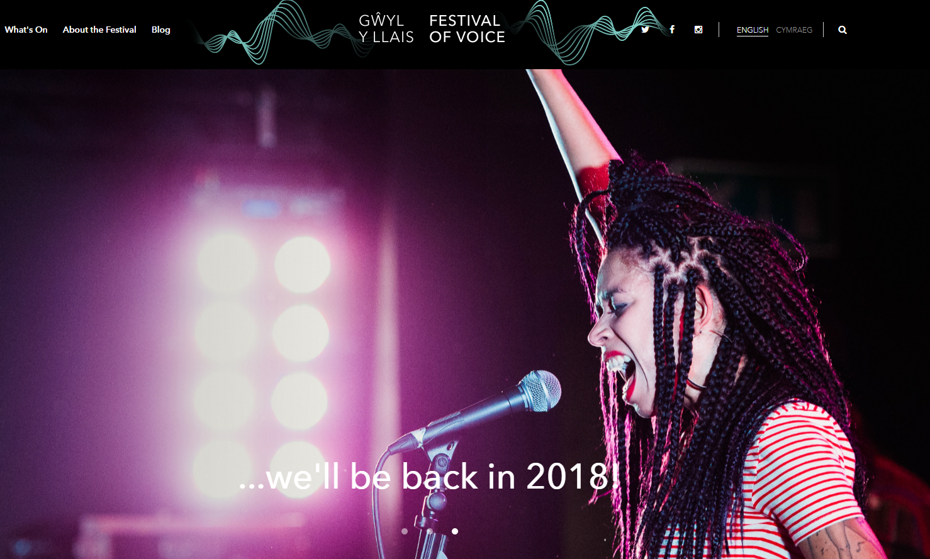
Festival of Voice
10 day festival in June 2016
Over 12,000 participants
78 Performances
38 Concerts
13 Venues across the city
7 World premieres
Notes:
10 day festival in June 2016
Local, national & global singers & artists
Over 12,000 participants
78 Performances
38 Concerts
13 Venues across the city
7 World premieres

Slide 7
TNEW: Mostly Out-of-the-Box
Why?
Central Hub
Biennial Project
No venue confusion
Testing Opportunity
Notes:
Central hub for Festival of Voice
Stand alone project repeated every 2 years
To ensure no confusion over performance venues
Opportunity to test out new web providers for our main site

Slide 8
TNEW: Mostly Out-of-the-Box
Main Requirements
Ability to integrate with Tessitura
Ability to integrate with Tessitura
Fully bilingual due to ACW policies
Fully bilingual due to ACW policies
Time frame delivery
Time frame delivery

Slide 9
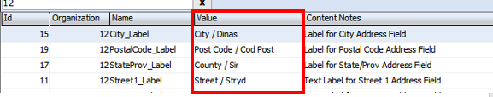
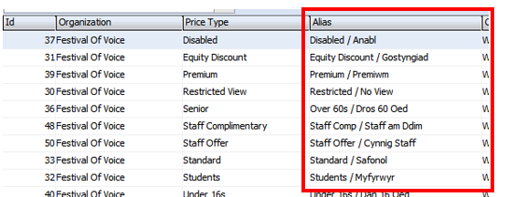
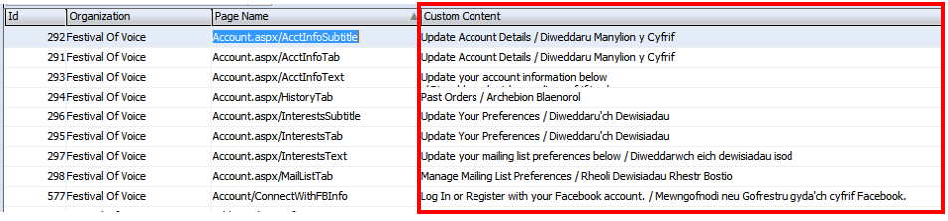
TNEW: Mostly Out-of-the-Box
Making the site bilingual
Most things achieved in Tessitura!

Slide 10
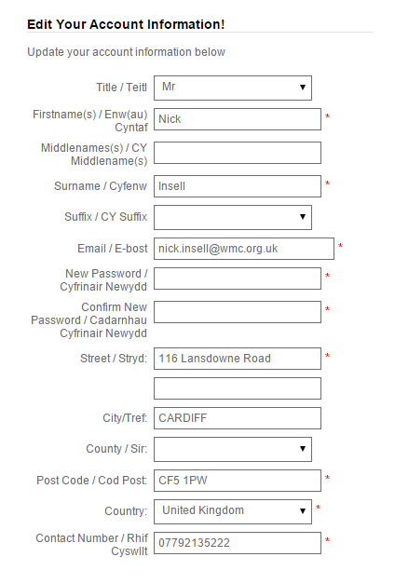
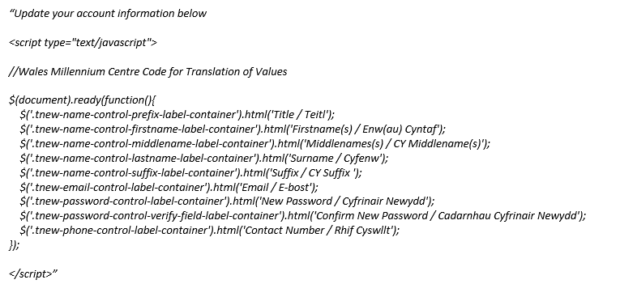
TNEW: Mostly Out-of-the-Box
Bilingual Stumbling Blocks
Not all labels on the account page could be edited within Tessitura

Slide 11
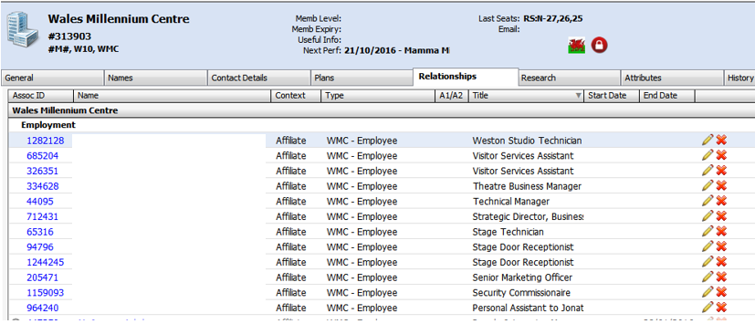
TNEW: Mostly Out-of-the-Box
Staff Ticketing
Manage & maintain Staff records through Tessitura

Slide 12
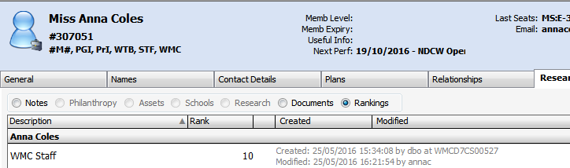
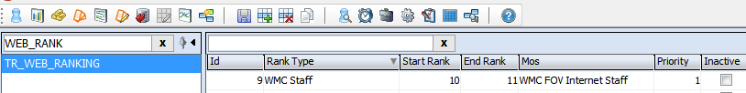
TNEW: Mostly Out-of-the-Box
Staff Ticketing
Mass added WMC Staff rank onto everyone’s record
Which changed the users MOS when logged into the website

Slide 13
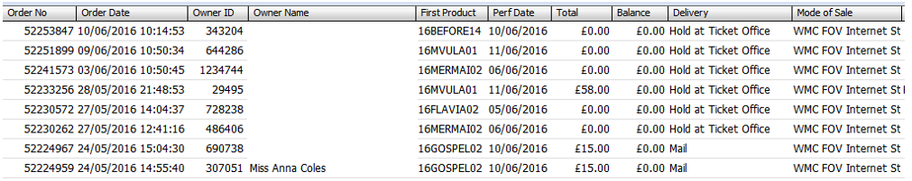

TNEW: Mostly Out-of-the-Box
Staff Ticketing
Allowed our staff members to book their tickets online and still get the staff offer applied
Which meant our Contact Centre had more time to sell general public tickets!

Slide 14

TNEW: Mostly Out-of-the-Box
Thank you for listening!
Anna Coles
Database Team Leader
anna.coles@wmc.org.uk

Slide 15
Rog Hildreth
Marketing & Customer Services Data Officer
RNCM, Manchester, UK
TNEW FUN WITHOUT CODE

Slide 16
The following examples are all things you can already do in TNEW, no customisations or code-writing required!
1. Unusual Event Set-Up in TNEW
2. Online Donation Set-Up in TNEW

Slide 17

Event Example: RNCM Student Ball
Requirements for online sale:
Hidden from public events calendar
No booking fees
Bookable meal options
Further info on dietary requirements
Remove postage option
Limit of tickets per order

Slide 18
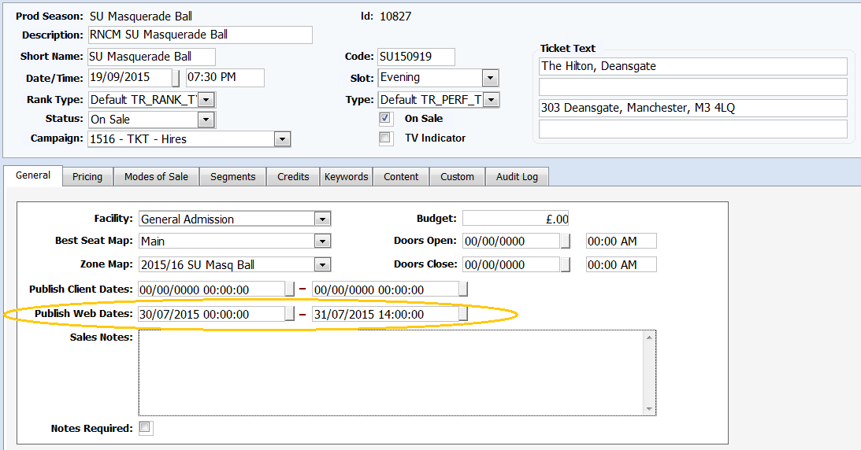
Hide An Event From Your Calendar
Easy!
Publish it
Copy and save the link to the event from your web browser
Change the Publish Web Dates into the past
V.11
(sorry)

Slide 19
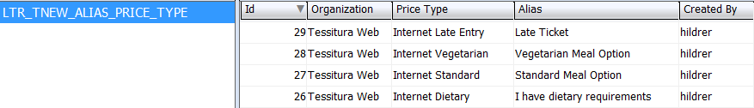
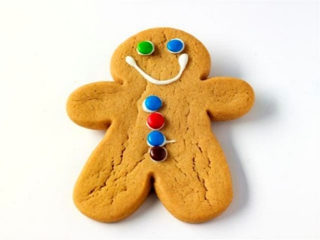
Fees, Price Types, and Meal Options
Make some new Price Types
Enable online, but don’t apply fee rules (check for any “All Price Type” rules)
Use LTR_TNEW_ALIAS_PRICE_TYPE System Table to give your price options more detailed names

Slide 20
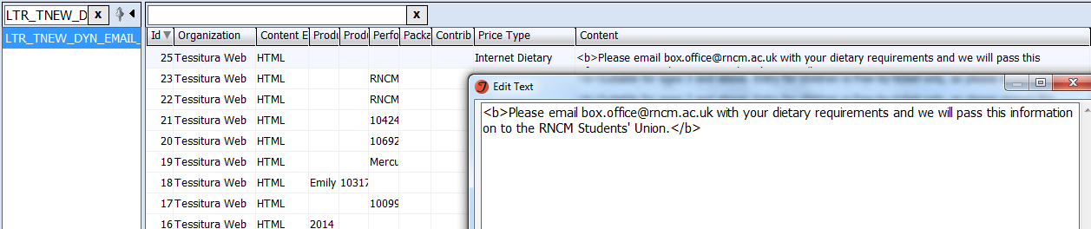
Further info on Dietary Requirements
Add dynamic text to LTR_TNEW_DYN_EMAIL_CONTENT, tied to the specific Internet Dietary (aka “I have dietary requirements”) Price Type
This will appear on the Booking Confirmation page and Email Confirmation
*Doesn’t have to be tied to Price Type, can be an entire performance, package or contribution fund! (More on that later)

Slide 21
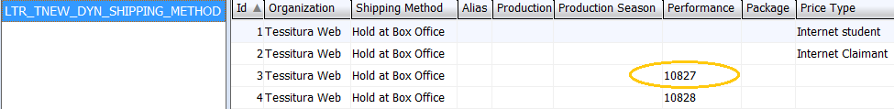
Remove the Postage Option
Use LTR_TNEW_DYN_SHIPPING_METHOD to specify tickets bought for a particular event can only be held at Box Office
*Also useful for discount Price Types where ID is always required on collection!

Slide 22

Using Promo Codes
This particular event was already hidden from the calendar, but Promo Codes made it extra secure and allowed me to impose a stricter 2-ticket limit on these Price Types (as RNCM default is 9 per order).
To hide a price behind a Promo Code:
  Campaigns>Appeals add a source and note the number
  Go to TR_WEB_SOURCE_NUMBER table, input the source number and a “codeword” of your choosing
  Add an Internet-Enabled Price Type to the performance
  On your Mode Of Sale tab in the performance, select “Offers” and link the source to the Price Type and maximum tickets per transaction if applicable
  DONE! Price will only appear with Promo Code entered…

Slide 23
…BUT
If you want to email customers the link with the Price Types already active, add &promo=yourpromocode to the link!
so
http://tickets.rncm.ac.uk/single/SelectSeating.aspx?p=10827
becomes
http://tickets.rncm.ac.uk/single/SelectSeating.aspx?p=10827&promo=SUHILTONBALL
*If it’s an internet-only offer, you might want to put the Appeal>Source Code in a Control Group which your frontline staff can’t see, so as not to fill their sources with codes they won’t be using.

Slide 24
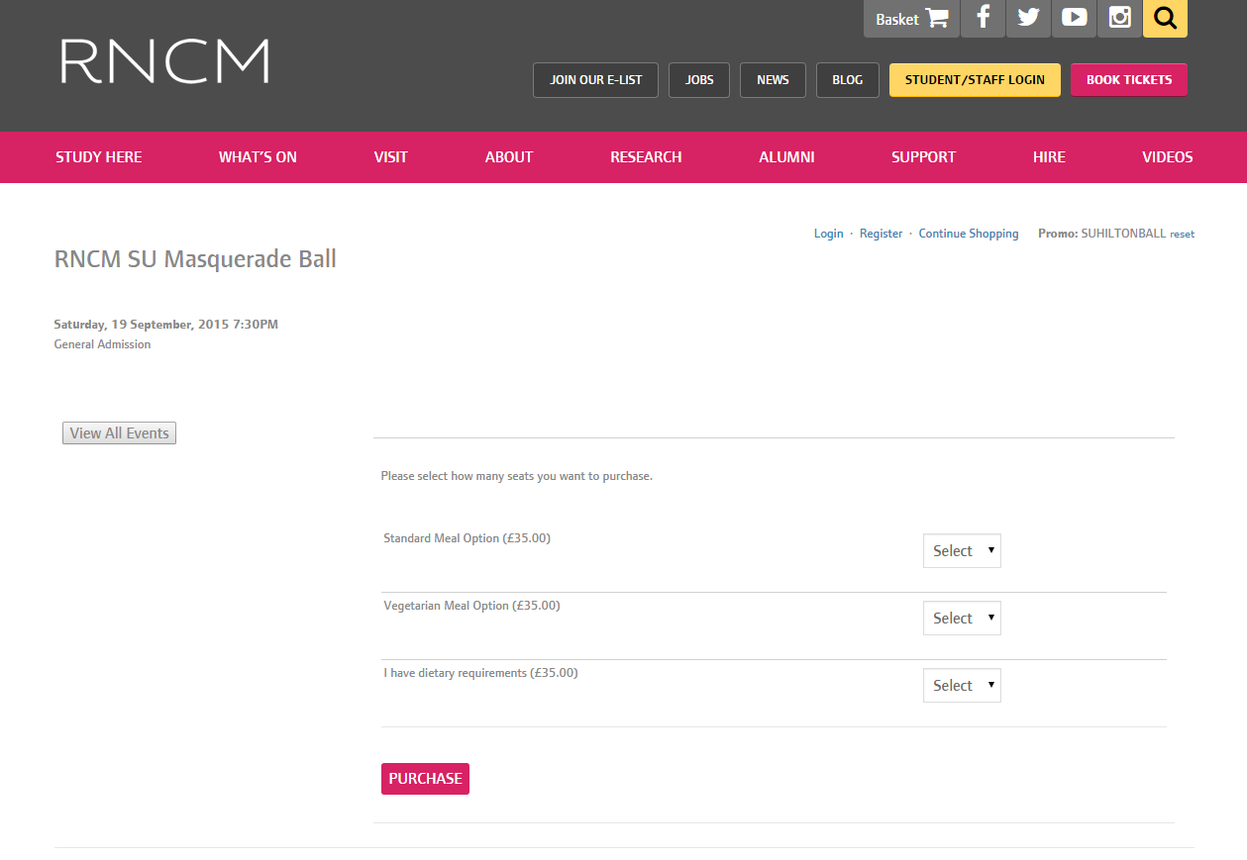

Slide 25
Examples of other uses
Promo Codes for one-off special offers and pre-sales
If emailed, usually embed code in link
Promo Codes can be used to trigger a Mode Of Sale change online, which could then leave only the Promo Price available*
*However, this may prohibit other items from being added in the same transaction
*If more than one offer in same email USE THE SAME PROMO CODE!
(In order for TNEW to accept a new Promo Code, the customer would have to “reset” the code in their browser)
Hide all Price Types on members-only events with a Promo Code, so can still advertise event as a membership recruitment tool
Added-Value Ticket. For a book launch, if there is a Ticket+Book option, use a new Price Type, with an alias, Dynamic Text to explain where to collect the book, and a different ticket design to repeat this info
Seating area which only has a Promo Code price available. Have this area as the default first zone choice, then send a Promo Code link to the “best available” booking page

Slide 26

Online Donation Example
For a fundraising campaign, I was asked to set up multiple fund options, each selectable by the customer, each with slightly different requirements.
Different descriptions for each fund
Fixed or editable amounts
Requests for information from the customer
Different “Thank You” messages

Slide 27
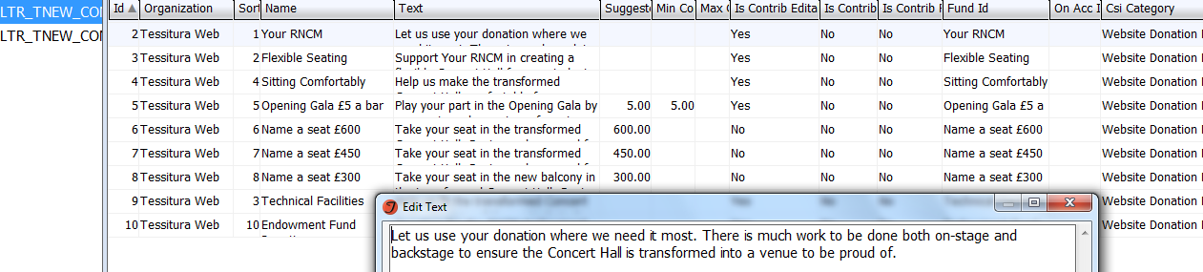
Steps
Set up Funds
- GL in Campaigns>References>GL Accounts
- Fund in Campaigns>References>Fund
- Attach to a Campaign
2. Create an entry for each fund in LTR_TNEW_CONTRIB_TYPE
- Add text to describe each fund
- Enter suggested amounts and if these are editable by the customer
- Connect a CSI to each fund (you might want a new CSI type for this)

Slide 28
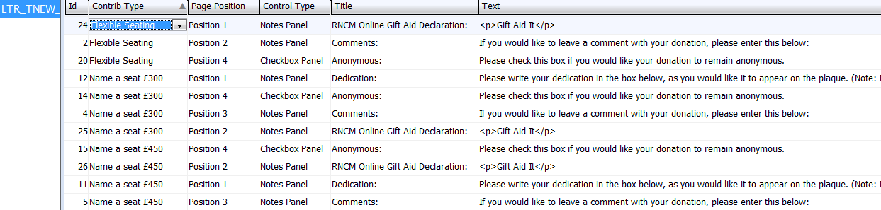
3. In LTR_TNEW_CONTRIB_TYPE_CONTROLS set up Checkboxes and Notes Panels (text boxes) against each fund as required.
- This is space for the customer to tell us what we need to know (eg. seat dedication or consider donation anonymous)
- This will fire straight into a CSI when the donation is completed
*SHORTCUT* For UK Organisations, a Gift Aid Customisation is available from Tessitura, but for my purposes I asked customers to declare Y/N in a text box.
4. As before, use LTR_TNEW_DYN_EMAIL_CONTENT for a “Thank You” message, with a different message for each Fund. (Use “Contribution” column.)

Slide 29
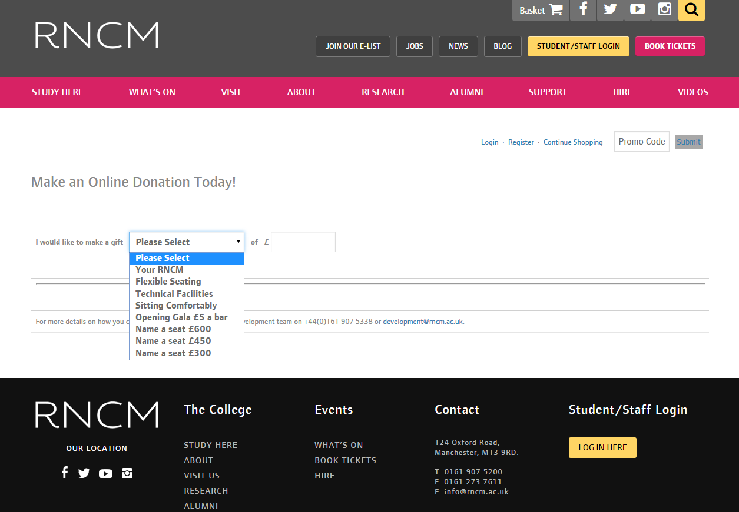

Slide 30
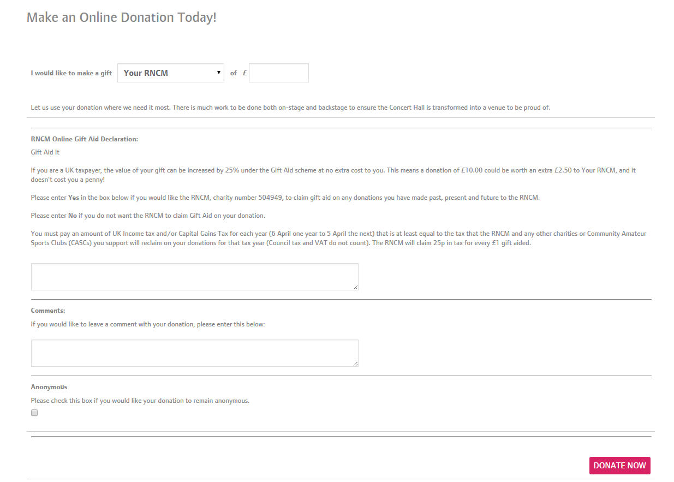

Slide 31
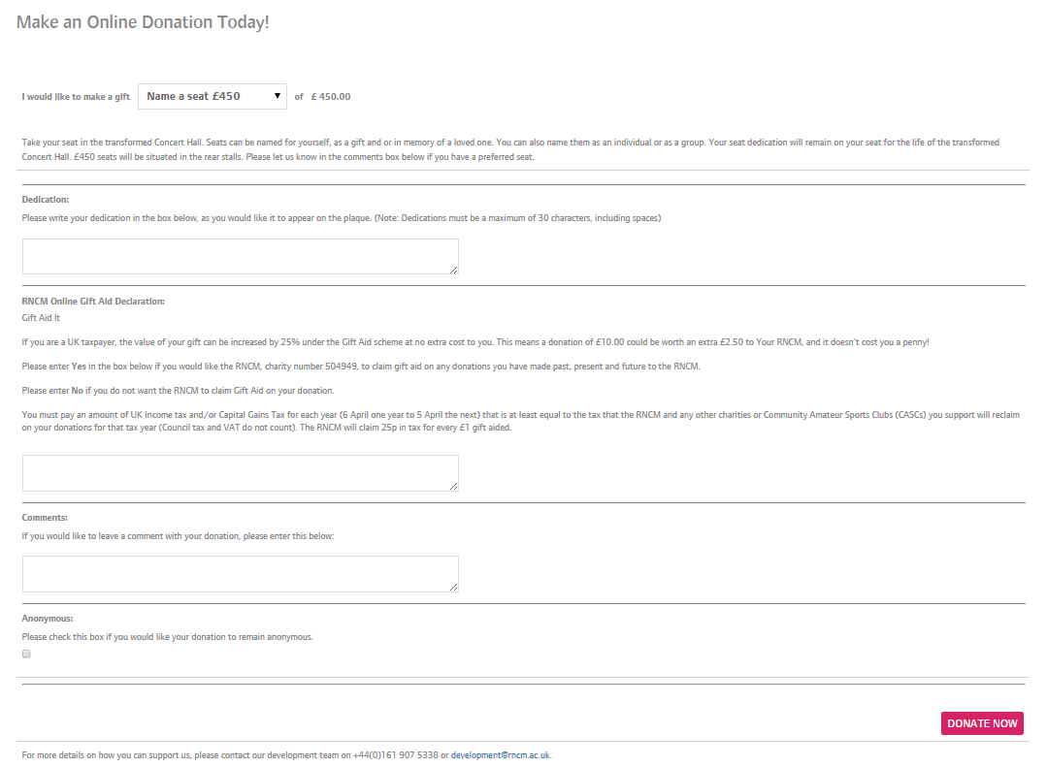

Slide 32
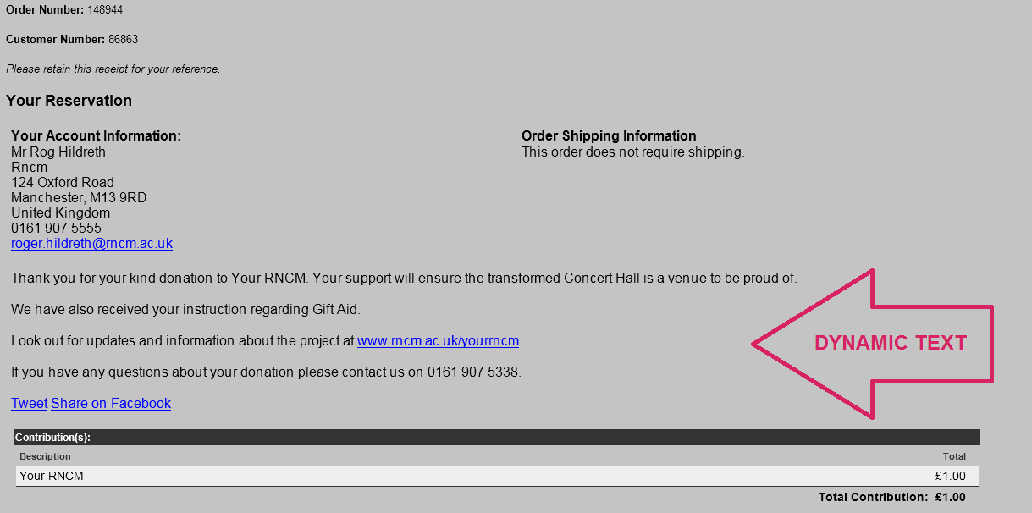
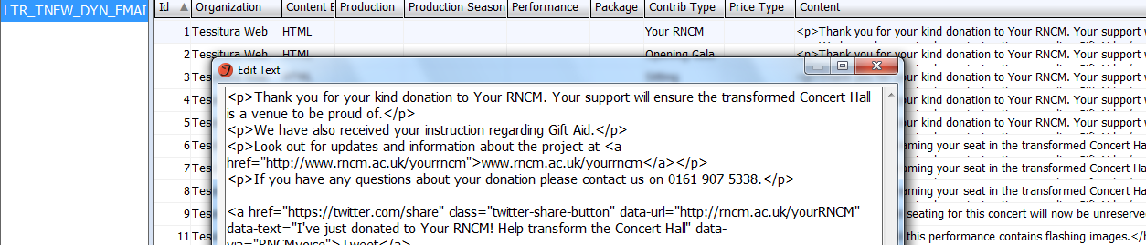

Slide 33

View all your TNEW wording in: LTR_TN_EXPRESS_WEB_CONTENT
A few examples:
Shipping/DonationAsk = Message for your suggested contribution at checkout
Confirmation.aspx = Order Confirmation text
Login.aspx/ShortRegTab = Mailing List sign-up heading
SoldOut_Text = Text in TNEW Calendar when On Sale is not ticked for a performance
Plus the wording for any statement, question, button or content on your TNEW page.

Slide 34
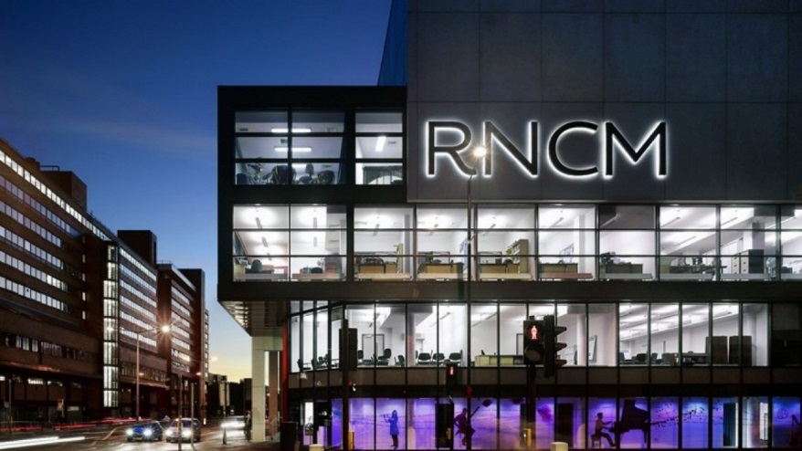
roger.hildreth@rncm.ac.uk
Rog Hildreth
Marketing & Customer Services Data Officer
RNCM

Slide 35

Abbey Theatre
TNEW Customisations
Dara Hogan – Database Systems Manager
Notes:
Introduce self.
Abbey since 2008. Before that RSC.

Slide 36
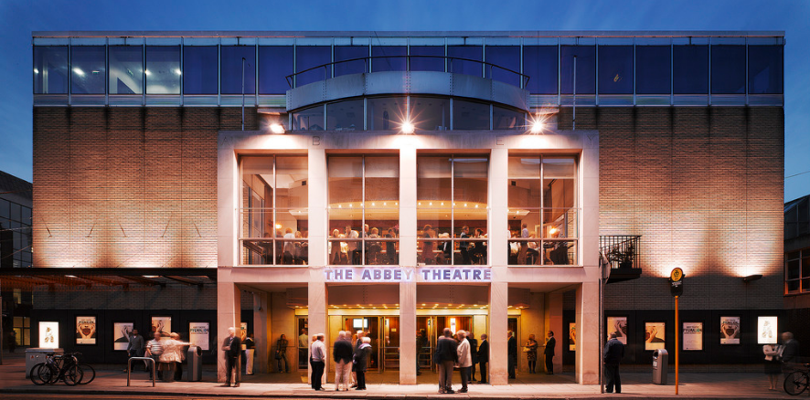
Abbey Theatre
National Theatre of Ireland
2 Spaces: 492 seats and 100 seats
Tessitura since 2008
Went Live with TNEW in May 2016.
49% sales are online
Notes:
Firstly, a quick background on the Abbey.

Slide 37
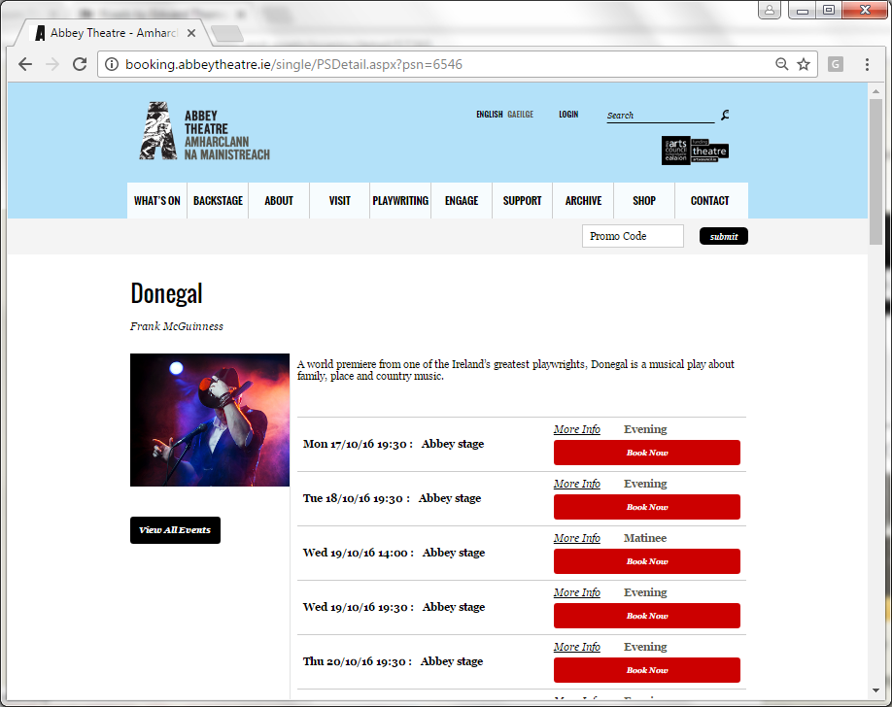
Notes:
Our TNEW Pages. – Banded to match main site. Styled in CSS. By our web developers. 3rd Party.
SELF Hosted TNEW template to make customisations easier to manage.
Explain Template.

Slide 38
1. Cross Selling Page
2. Gift Vouchers
Notes:
Not about TNEW as a product, but about customisaing.
Two customisations I’m going to show today.
Set these up during implementation of TNEW. Had these features on previous site and were critical to business, but not supported by TNEW out of the box.
Cross selling page…for programmes & restaurant. By Mark Steel from Network during our implementation. Pre Cart Page.
Gift Vouchers page… by our Web Developers using Javascript & CSS and custom form functionality.

Slide 39
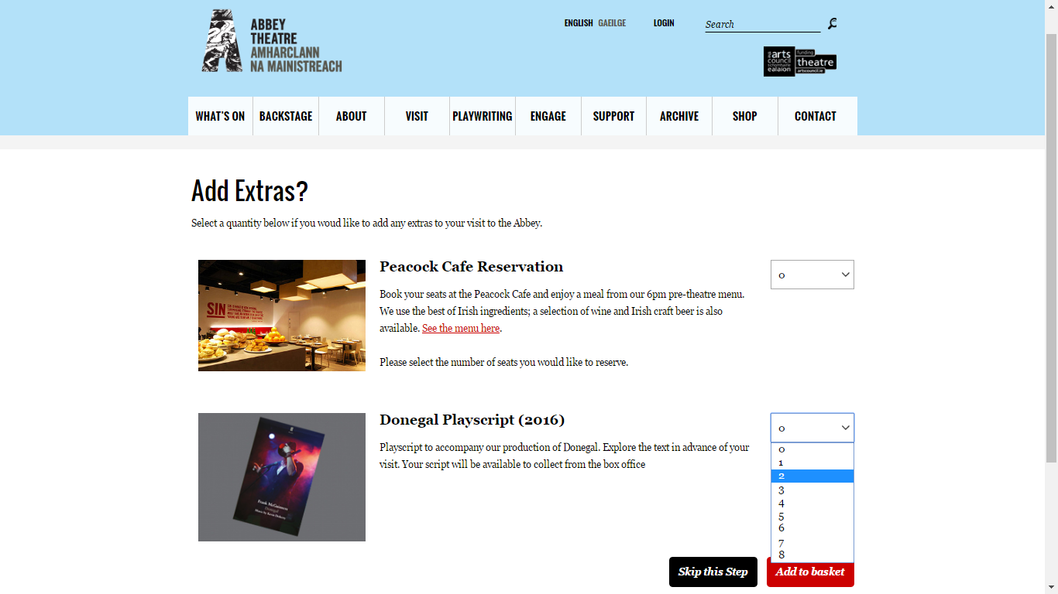
Notes:
1st Example: Cross Selling Page.
Show Live Example. Donegal Sat 19th.

Slide 40
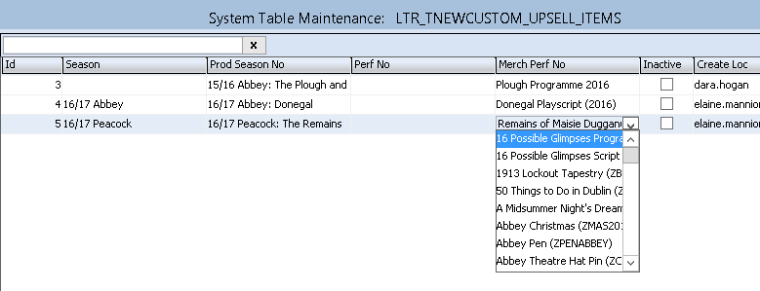
Notes:
Setup with flexibility. Using System Tables.
To Manage Configuration & Content.
Example here for Donegal Play script cross sell item.
Can have up to 5 items on sale on once. We keep it to max 2.

Slide 41
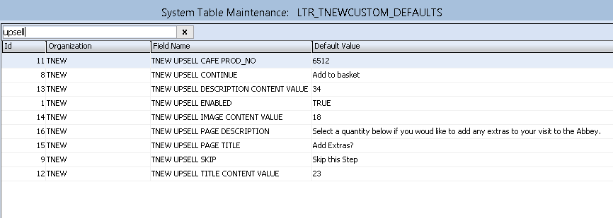
Notes:
All content text in system table, so very easy to change. E.g. Title, Skip Button.
Café setup by production id. Logic for this bit in Stored Procedure. Quite specific to Abbey.

Slide 42
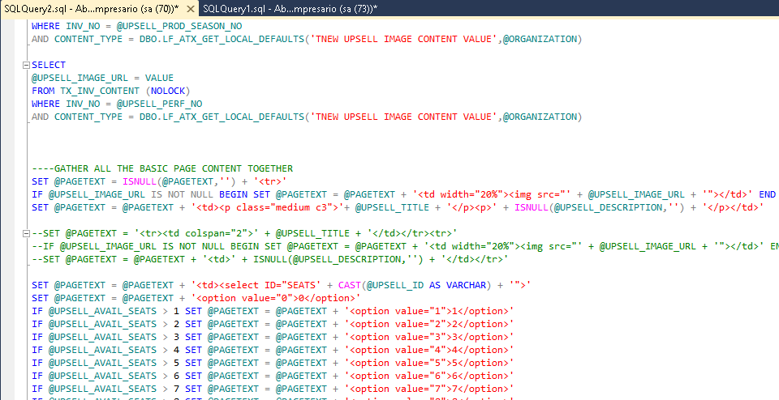
Notes:
Not aimed as a technical presentation, so just quicky going to show behind the scenes. Don’t worry if makes no sense.
This is what Mark did. Showing you as it’s easy to change HTML on page if needs. This is in SQL SP.
E.g. Upsell image and title here in html, and the numbers in the choose dropdown.

Slide 43
Notes:
Recap. Some code in the SP that Mark did. System Table entries.
And we have this page promoting products.
Results.

Slide 44
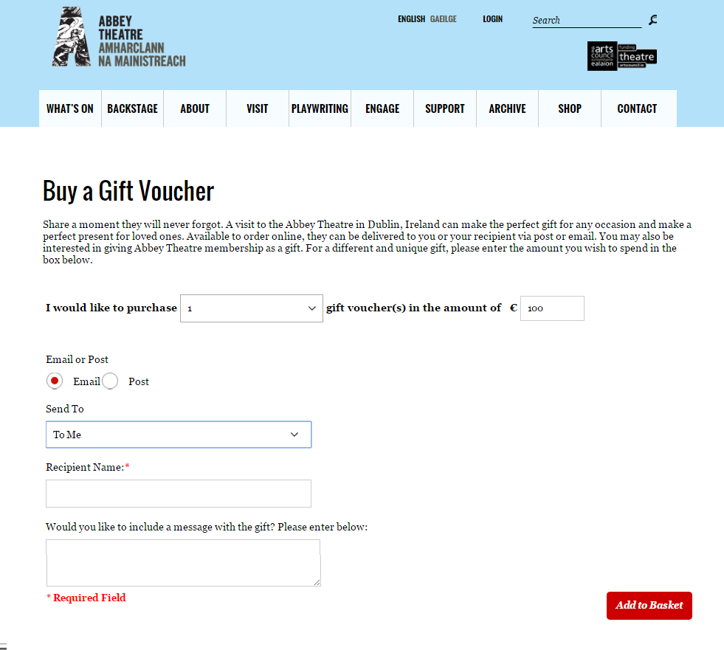
Notes:
2nd Example: Customised Gift Voucher Page.
Live Example.
Part at top not ideal. Could not change this in customisation.
Used the TNEW Custom Form feature to add fields.
Java script to show and hide fields.
Fields change depending on choices.

Slide 45
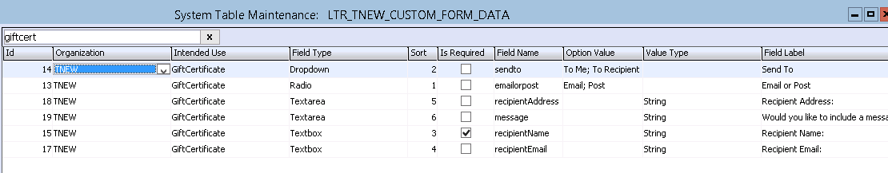

Notes:
That page created, again from a system table. Custom form table.
Add a row for each field you want.
E.g. Email / Post radio button.

Slide 46
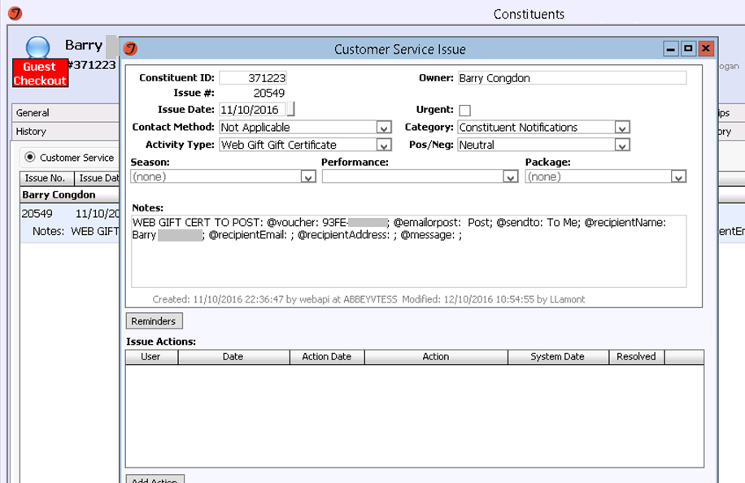
Notes:
Saves a CSI to Tessitura, that triggeres a manual processing for Postal ones.

Slide 47
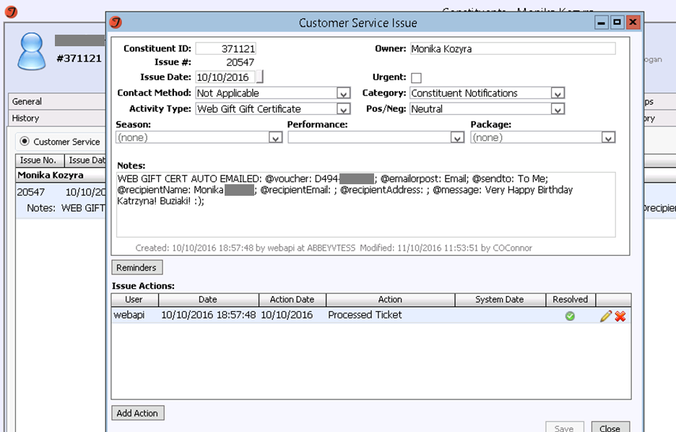
Notes:
For Email ones, we use a custom SP to Auto generate and attach a PDF voucher to an Email.
Also creates this CSI with the data, but a closed CSI.

Slide 48
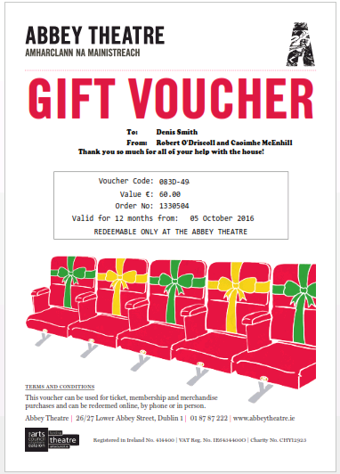
Notes:
Results in this PDF attached to an email. (Much like PAHT).
Previously on Tessitura, it needed a phone order, manual generation of a PDF, and manually attached to an email for Gift Vouchers.
At Christmas time this is impossible with the workload.
Since TNEW, this is all now automatic.
A customer can go onto our website on Xmas morning, Buy a voucher, receive it to email, print it out, and put it under the tree.
Results.

Slide 49
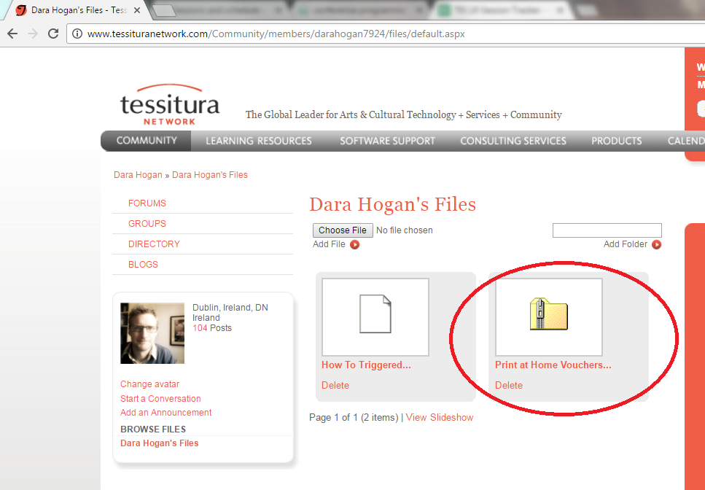
Notes:
We have some custom code to go from the CSI to the Emailed Voucher.
Shared up on my profile on tessituranetwork.com

Slide 50
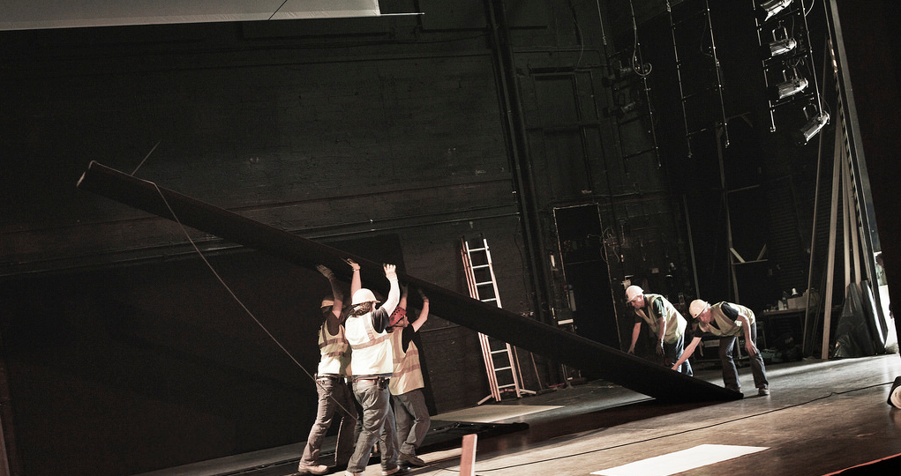
Contact: Dara Hogan
Database Systems Manager
dara.hogan@abbeytheatre.ie
Notes:
Summary.
2 Customisations. Cross selling pre cart. With code in a stored procedure.
Gift Vouchers & Membership. Using Custom Form System Table.
To conclude. – TNEW is a great product out of the box,
Also, by lifting the lid and doing some work behind the scenes, you can.
Enhance TNEW for your own specific business requirements.
Contact me if any questions:

Slide 51

QUESTIONS?
“Compliments pass when the quality meet.”
Brendan Behan, Borstal Boy
Notes:
Welcome

Slide 52

WHAT’S NEXT?
BREAK 15.30-15.45
Hogan Foyer / Level 6 Foyer
BREAKOUT SESSION EIGHT
15.45-16.45
Notes:
FRIDAY Breakout session 7 What’s next slide

