Slide 1

TESSITURA
EUROPEAN
CONFERENCE
DUBLIN 2016
Notes:
Welcome

Slide 2



MODERATOR
Sarah Stratton : Birmingham Hippodrome
PANEL
Geraint Williams : IT Governance Ltd
Alex Jameson : Royal Opera House
PCI COMPLIANCE
Are you hiding behind the PCI sofa?
CONTENT PLANNERS
Susanna Caudwell : Halle Orchestra
Debbie Harland : Old Vic Theatre
Share your favourite content and photos! #TECDublin16

Slide 3

The PCI DSS
Tessitura 2016
18th November 2016
Geraint Willaims
IT Governance Ltd
www.itgovernance.co.uk
Notes:
Safeguarding your IT infrastructure and data security
prevention,
readiness and
controls

Slide 4

Who am I
Protect • Comply • Thrive

Slide 5
Agenda
What is the PCI DSS certification
What are SAQ’s
Data flow and payment channels
Third parties and compliance
Protect • Comply • Thrive
Notes:
The PCI DSS is updated on a 3 year cycle set by the PCI Security standards council. We have just clicked and rolled over into a new cycle and version 3 of the PCI DSS was published on the 7th November.
From the 1st Jan 2014 you can certify against V3 or stay with V2. Version 2 is being retired on the 31st Dec 2014.
Today will be looking at the technical analysis of the changes between version 2 and version 3 of the standard
Examining what was meant by business as usual
And the probable effect the changes will have on Merchants and Service providers.
Will finish with some Q&A

Slide 6
PCI DSS
1 Standards
Managed by the Security Standards Council
5 Compliance Programs
Managed by the five payment brands
Merchants
Report to acquirers
Service Providers
Report to merchants and/or payment brands
Multiple levels
Defined by payment bands
Multiple Compliance methods
Defined by payment bands

Slide 7
Applicability
Applies to all entities that are involved in, or can affect the security of payment processing.
The storage, transmission or processing of card data.
It applies to all instances where there is a PAN (12-19 digits) involved or affected

Slide 8
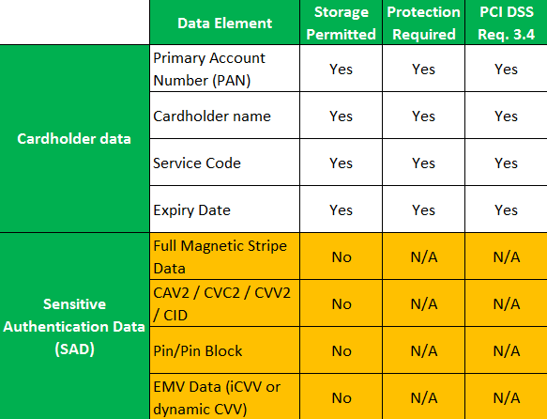
Account data

Slide 9
Applicability
Even if the merchant has outsourced all card processing, if they are getting the payments into their account from payment cards they are responsible for PCI Compliance and that of their service providers

Slide 10


Merchants & Service providers
Merchants – receive payments from payment cards into their accounts
Service providers – all other entities that could be involved

Slide 11
Why do entities become certified
It is a contractually requirement
They want to do it as part of being ethical handlers of card data
Been asked/forced to do it by the acquiring banks or clients/third parties

Slide 12
How is it enforced?
Payment Brands
Require the Acquirers to be compliant by making all their merchants compliant
Acquirers
Need all their merchants to be compliant in order to become compliant themselves
Merchants
Need all their service providers to be compliant to achieve compliance
Service Providers
Enforced by fining the Acquirers
Enforced by fining the merchants
Enforcement depends on contracts

Slide 13
Possible punitive actions
Enforced forensic investigations paid for the merchant by accredited investigators, a complex investigation can take months and day rates are high £1000 per day is not unusual.
Fines for being breached based on the volume of compromised cards, each payment brand can imposes its own fine structure if its card have been compromised
Monthly fines for not being complaint that will continue until all remediation work has been completed
Increased transaction charges for processing payments
Increased/stricter compliance conditions imposed with higher costs involved in becoming and maintain compliance
Investigation and fines from ICO; this could be several ICO’s if data of cardholders from multiple countries is compromised.

Slide 14
Scoping certification
The size of the elements that are involved with handling card data - the cardholder data environment (CDE)
The size of the elements that can affect the security of the CDE
Without segmentation/isolation it could mean everything is in scope of the certification

Slide 15
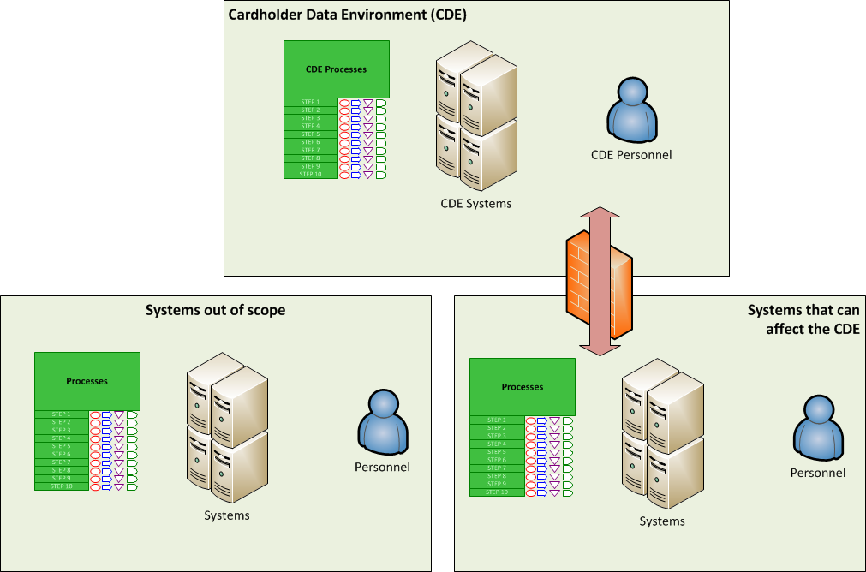
Scope of certification

Slide 16
Do it all or do it all
The PCI DSS is the minimum level of security that meets the requirements of the payment brand
All controls/requirements are mandatory
All must be either in place, have a compensatory control that is equally as a strong or not applicable.

Slide 17
Achieving compliance
Build compliance in from the start
Less expensive
Easier to achieve
Add compliance afterwards
Can be very expensive
Very difficult to achieve

Slide 18
RoC vs SAQ
 | Main controls
SAQ A | 21
SAQ A-EP | 148
SAQ B | 38
SAQ B-IP | 62
SAQ C-VT | 62
SAQ C | 114
SAQ P2PE | 24
SAQ D | 250
RoC | 250

Slide 19
SAQ
SAQ | Description
A | Card-not-present merchants (e-commerce or mail/telephone-order), that have fully outsourced all cardholder data functions to PCI DSS compliant third-party service providers, with no electronic storage, processing, or transmission of any cardholder data on the merchant’s systems or premises. Not applicable to face-to-face channels.
A-EP | E-commerce merchants who outsource all payment processing to PCI DSS validated third parties, and who have a website(s) that doesn’t directly receive cardholder data but that can impact the security of the payment transaction. No electronic storage, processing, or transmission of cardholder data on merchant’s systems or premises. Applicable only to e-commerce channels.
B | Merchants using only: Imprint machines with no electronic cardholder data storage, and/or Standalone, dial-out terminals with no electronic cardholder data storage. Not applicable to e-commerce channels.
B-IP | Merchants using only standalone, PTS-approved payment terminals with an IP connection to the payment processor with no electronic cardholder data storage. Not applicable to e-commerce channels.
C-VT | Merchants who manually enter a single transaction at a time via a keyboard into an Internet-based, virtual payment terminal solution that is provided and hosted by a PCI DSS validated third-party service provider. No electronic cardholder data storage. Not applicable to e-commerce channels.
C | Merchants with payment application systems connected to the Internet, no electronic cardholder data storage. Not applicable to e-commerce channels.
P2PE | Merchants using only hardware payment terminals included in and managed via a validated, PCI SSC-listed P2PE solution, with no electronic cardholder data storage. Not applicable to e-commerce merchants.
D | SAQ D for Merchants: All merchants not included in descriptions for the above SAQ types.
 | SAQ D for Service Providers: All service providers defined by a payment brand as eligible to complete an SAQ.

Slide 20
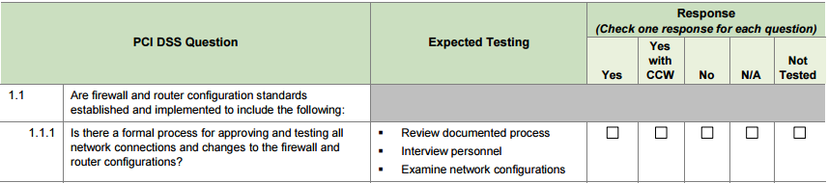
SAQ Level Compliance
A QSA led SAQ audit will look to see if the implementation would meet the requirements of the standard without gathering the evidence
An internal audit tends to be less vigorous in accessing if the requirement is in place.

Slide 21
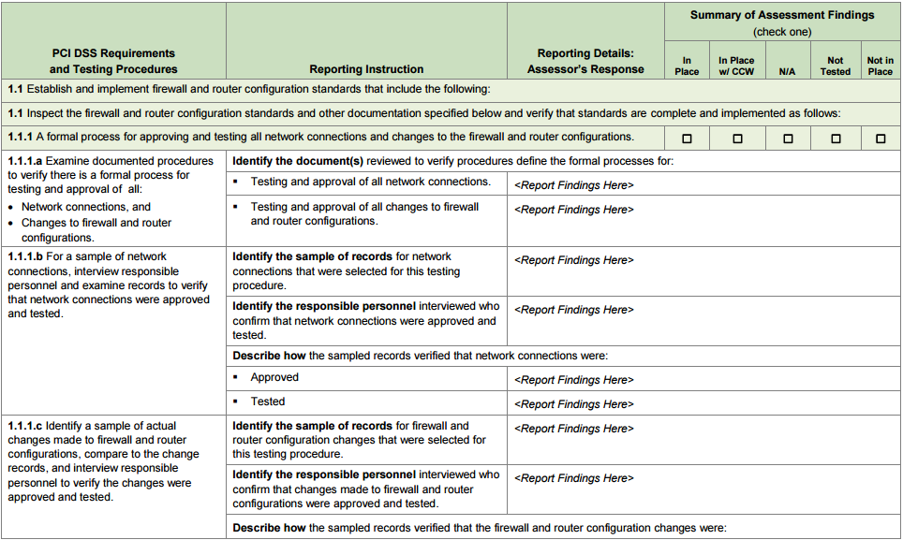
RoC level compliance

Slide 22
Payment Channels
E-commerce
  Selling via Web Sites
Face To Face
  Retail, Brick and Mortar Merchants
Mail or Telephone Order (MOTO)
  Catalogue shops, call centres

Slide 23
Payment Channel Applicability
 | E-Commerce | Face 2 Face | MOTO
SAQ A | YES | N/A | YES
SAQ A-EP | YES | N/A | N/A
SAQ B | N/A | YES | YES
SAQ B-IP | N/A | YES | YES
SAQ C-VT | N/A | YES | YES
SAQ C | N/A | YES | YES
SAQ P2PE-HW | N/A | YES | YES
SAQ D Merchant | YES | YES | YES
SAQ D Service | YES | YES | YES
RoC | YES | YES | YES

Slide 24
E-Commerce Payments
Application programming interface (API)
Direct Post [Form submission]
iFrame
response.redirect

Slide 25
Face 2 Face
Card terminal
  Called a Point of Sale (POS) Terminal, card terminals are exclusively for cardholder present transactions. Card terminals include both automated card swipe and manual data entry systems.

Slide 26
MOTO
Call centre
  Includes any person-to-person transfer of card details over the telephone. Call centre payments are manually keyed into a card terminal or directly into a virtual terminal for automated payment processing by a PSP.
IVR
  Short for Interactive Voice Recognition, IVR refers to an automated self service channel that permits you to enter card details and transaction value data over the telephone, using the keypad or voice commands.
Virtual terminal
  An online card terminal for manually entering credit card information for CNP telephone and mail orders without the need for a full-scale internet payment solution.

Slide 27
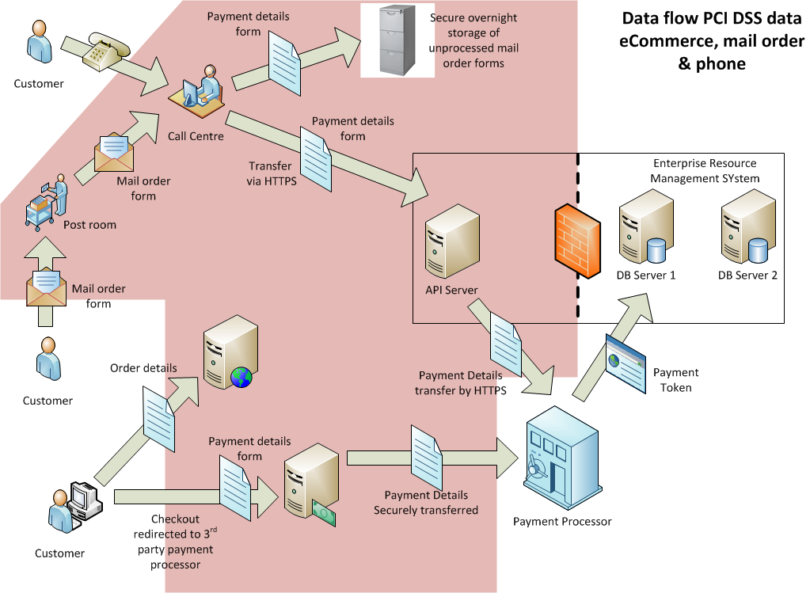
Data flow diagrams

Slide 28
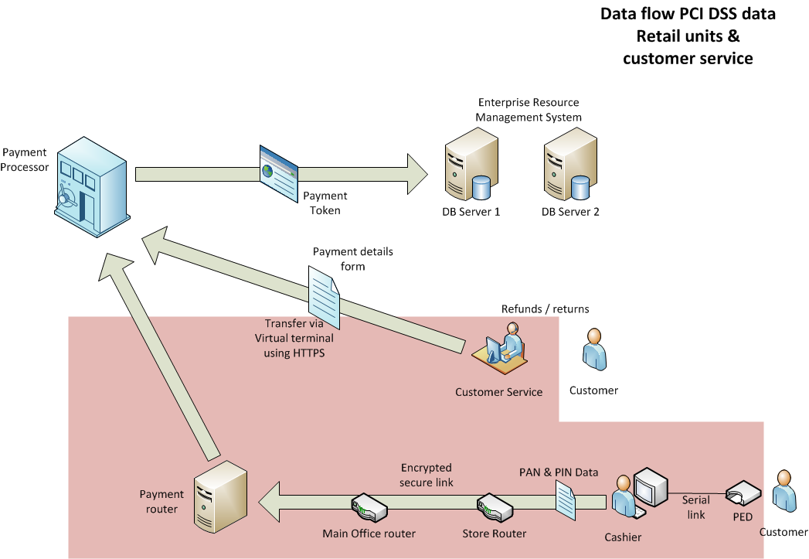
Data flow diagrams

Slide 29
Where to find us
Visit our website: www.itgovernance.co.uk
E-mail us: servicecentre@itgovernance.co.uk
Call us: 0845 070 1750
Follow us on Twitter: https://twitter.com/#!/itgovernance
Read our blog: http://blog.itgovernance.co.uk/
Join us on LinkedIn www.linkedin.com/company/it-governance
Join us on Facebook www.facebook.com/ITGovernanceLtd
Protect • Comply • Thrive

Slide 30




Contact details
Blogs
  geraintw.blogspot.co.uk
  wirelessmscresearch.blogspot.co.uk
  http://blog.itgovernance.co.uk/author/geraint-williams/
Linkedin
  uk.linkedin.com/in/geraintpwilliams
Twitter
  twitter.com/#!/GeraintW
Personal website
  www.geraintw.co.uk
  email
  gwilliams@itgovernance.co.uk
© IT Governance Ltd 2016
Protect • Comply • Thrive
Notes:
gwilliams@itgovernance.co.uk
@GeraintW
uk.linkedin.com/in/geraintpwilliams

Slide 31

Tessitura
&
PCI Compliance
Alex Jameson
Database Lead

Slide 32
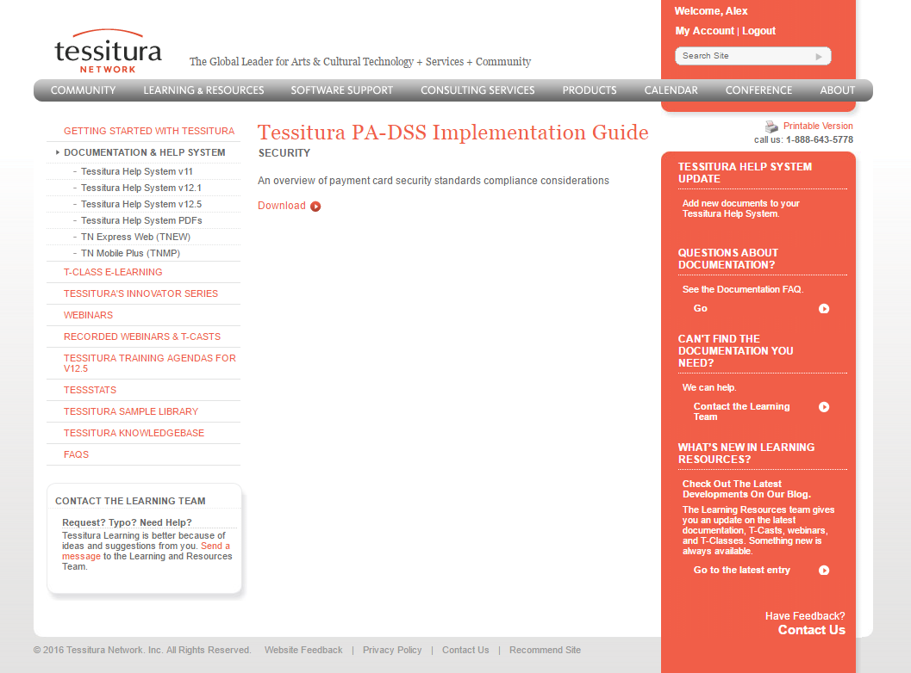
Tessitura & PCI Compliance
Tessitura’s PA-DSS Implementation guide – available on Tessitura Network.
Search for “PA-DSS”

Slide 33
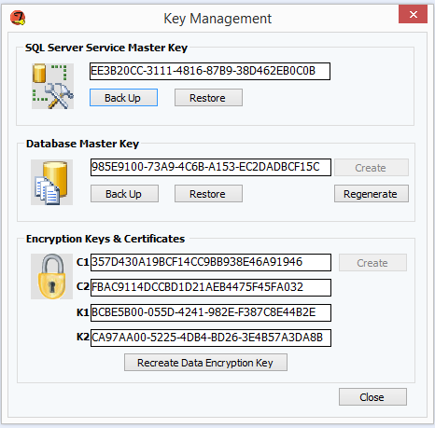
Tessitura & PCI Compliance
Recreate Data Encryption Key –
this must be done annually. Fulfills PCI-DSS requirements 3.4, 3.5 and 3.6.

Slide 34
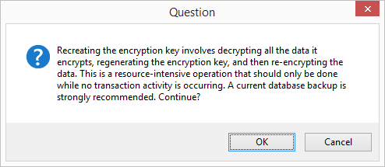
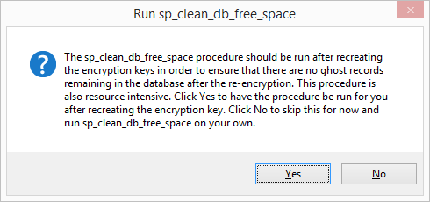
Tessitura & PCI Compliance
Recreate Data Encryption Key (cont’d)
Choose how to run sp_clean_db_free_space – this clears ‘ghost’ records

Slide 35
Tessitura & PCI Compliance
Purge Credit Card process
Parameter | Value | Explanation of what will be updated
End Payment Date | Today – 12 months | (will limit the credit card accounts to be deleted based on the last time the account was used. Only accounts which have not been used since the end payment date parameter will be affected - The end payment date is the pmt_dt in the t_payment table)
End Billing Exp Date | Today – 12 months | (will limit the accounts to be deleted based on accounts used in payment schedules which have an expiration date BEFORE the billing account expiration end date)
Purge Inactive Billing Accounts? | Yes | (This deleted accounts in t_account_data that are attached to fully paid orders, contributions, and invoice schedules)
Purge Payment Accounts? | Yes | (This deletes accounts used in payments from t_account_data)

Slide 36
Tessitura & PCI Compliance
Purge Credit Card process – cont’d
Parameter | Value | Explanation of what will be updated
Purge Credit Card Log? | Yes - (End Log Trans Date Today – 12 months) | (This will limit the deletion on log records to rows created PRIOR to the credit card server log trans end date)
Retain all Credit Cards with an Expiration Date after | Today – 12 months | this prevents any account with an expiration date after the entered date from being deleted from t_account_data)
Exclusion List | (None) | We have no list of excluded constituents
Counts Only? | No | We will run the purge in review mode prior to committing to the actual update

Slide 37

Tessitura & PCI Compliance
Card holder and other sensitive data are encrypted using 3DES –
so if you query T_ACCOUNT_DATA, act_no (credit card number)
is unreadable?
Not correct.
However only SQL users with SQL ‘sysadmin’ role – can run this.
To quote Chuck Reif from Tessitura Network– “it’s important to follow all
best security practices including the Principle of Least Privileges.
Which means that sysadmin rights should be severely restricted.”
Who has sysadmin rights on your Tessitura SQL Server?

Slide 38
PCI COMPLIANCE
“Compliments pass when the quality meet.”
PANEL DISCUSSION
Brendan Behan, Borstal Boy
Notes:
Welcome

Slide 39

WHAT’S NEXT?
BREAK 15.30-15.45
Hogan Foyer / Level 6 Foyer
BREAKOUT SESSION EIGHT
15.45-16.45
Notes:
FRIDAY Breakout session 7 What’s next slide

