Slide 1

TESSITURA
EUROPEAN
CONFERENCE
DUBLIN 2016
Notes:
Welcome

Slide 2



PRESENTER
Karyn Elliot : Tessitura Network
ROADMAP
WEB PRODUCTS
Share your favourite content and photos! #TECDublin16

Slide 3
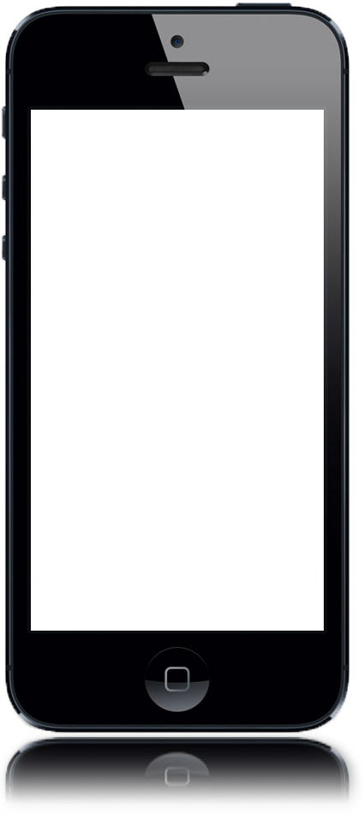
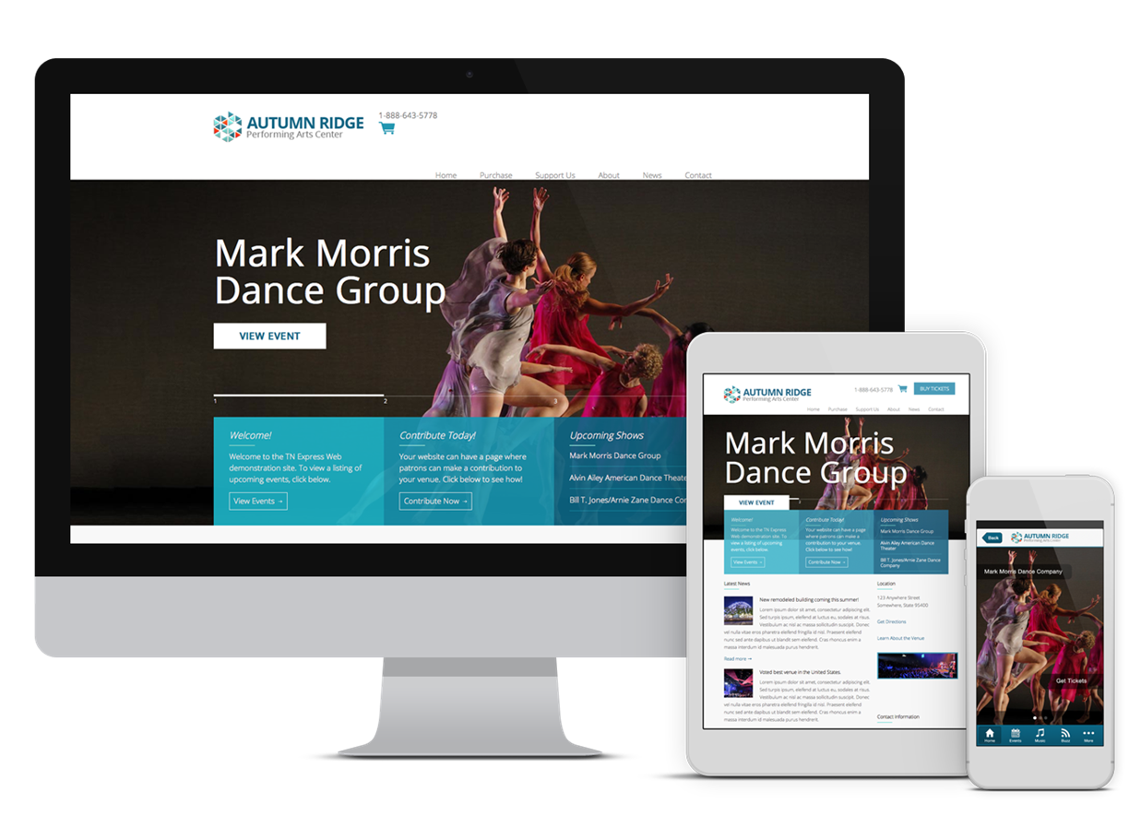
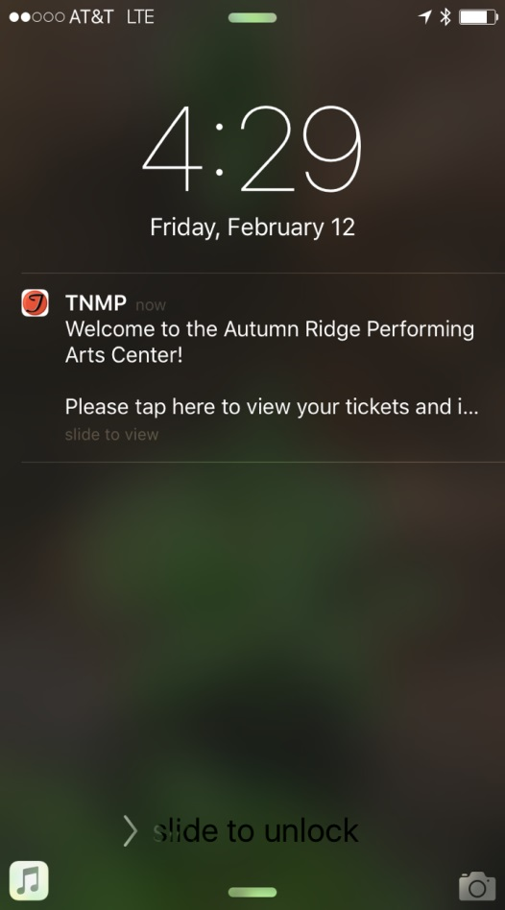
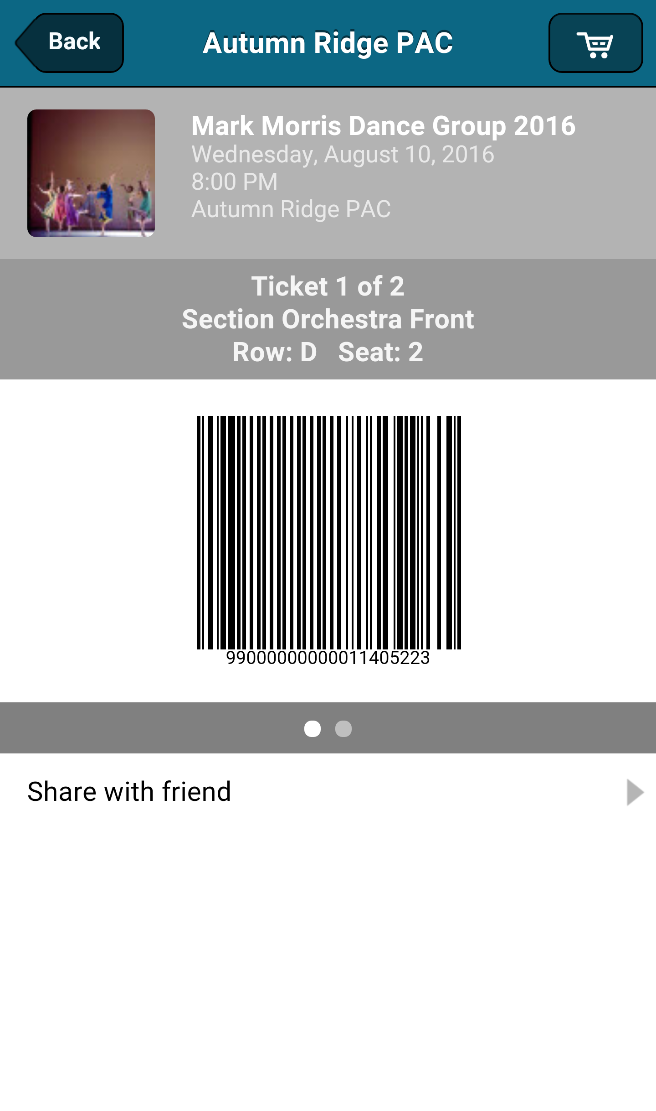
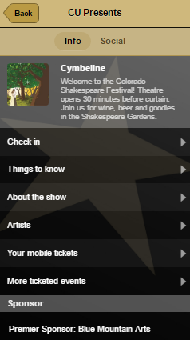
TNEW + TNMP = Beautiful Duet
Website: Browse, Search, Buy
TNMP: Engage + Concierge
Notes:
One of things I want to do is put you in the right mindset about how TNMP plays with TNEW, and responsive website in general.
As fans of culture, I’m sure that you know that the best duets aren’t just two musicians duplicating the same notes. They are playing off each other, making each other better.
And that’s exactly how TNMP and TNEW interact.
TNEW takes the opening notes. Your patrons use it to browse and buy tickets. And it gets the job done quickly and seamlessly.
And then TNMP starts to play. And as it plays it finds way to enhance the experience of your users beyond that ticket purchasing path. Whether that’s with timely notifications, easy access to your venue with tickets and membership, or detailed content specifically designed to be used at your venue.

Slide 4
TN Express Web v7 Rollout

Slide 5

V7 TNEW Vision
Responsive Design with Feature Parity
Target Launch: First half of 2017
2-Phased Approach
User Testing as features are built

Slide 6
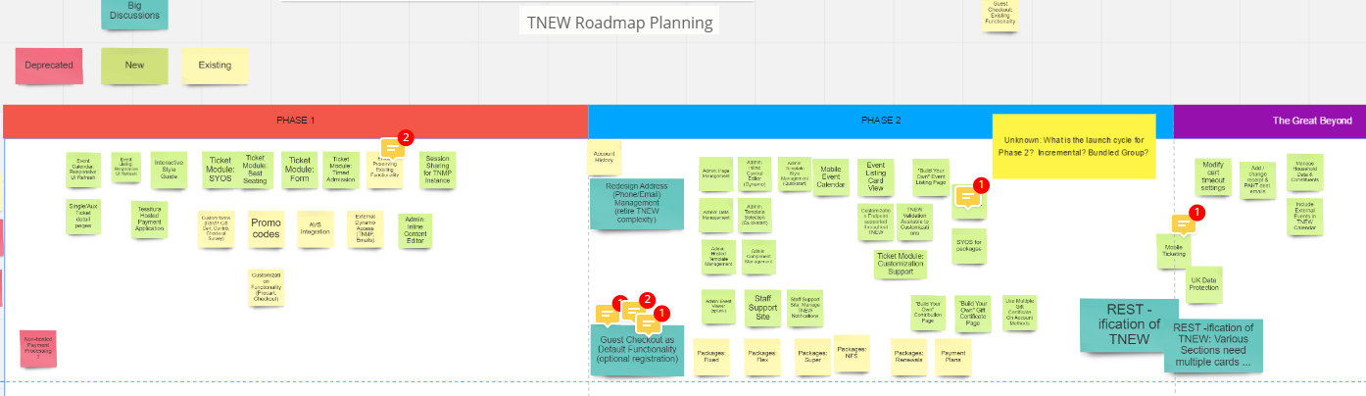
TNEW v7 Planning
Notes:
https://realtimeboard.com/app/board/o9J_k0vxS3Q=/

Slide 7

Phase 1: Q1
Phase 2: Q2
Account Management
Contributions
Memberships
Gift Certificates
Refined Single Ticket Path
  Calendar + Listing
  SYOS + Best Available w/Detail
HTML Cart File
Hosted Payment app
Admin Page Improvements
Subscription Packages
Improved Guest Checkout
Rewritten Account History
TNEW Customization plug-ins
Bootstrap 3 framework for responsive styling and standardized CSS
Notes:
We’ll be going live with Bootstrap v3.3.7

Slide 8
V14 Functionality & TNEW v7 Lifecycle
Integration “Contact Permissions” for Data Protection
Credit Card tokenization
Integration of additional REST calls
New Tessitura email template support on TNEW
Resource Scheduling

Slide 9
Responsive Skinning Approaches

Slide 10
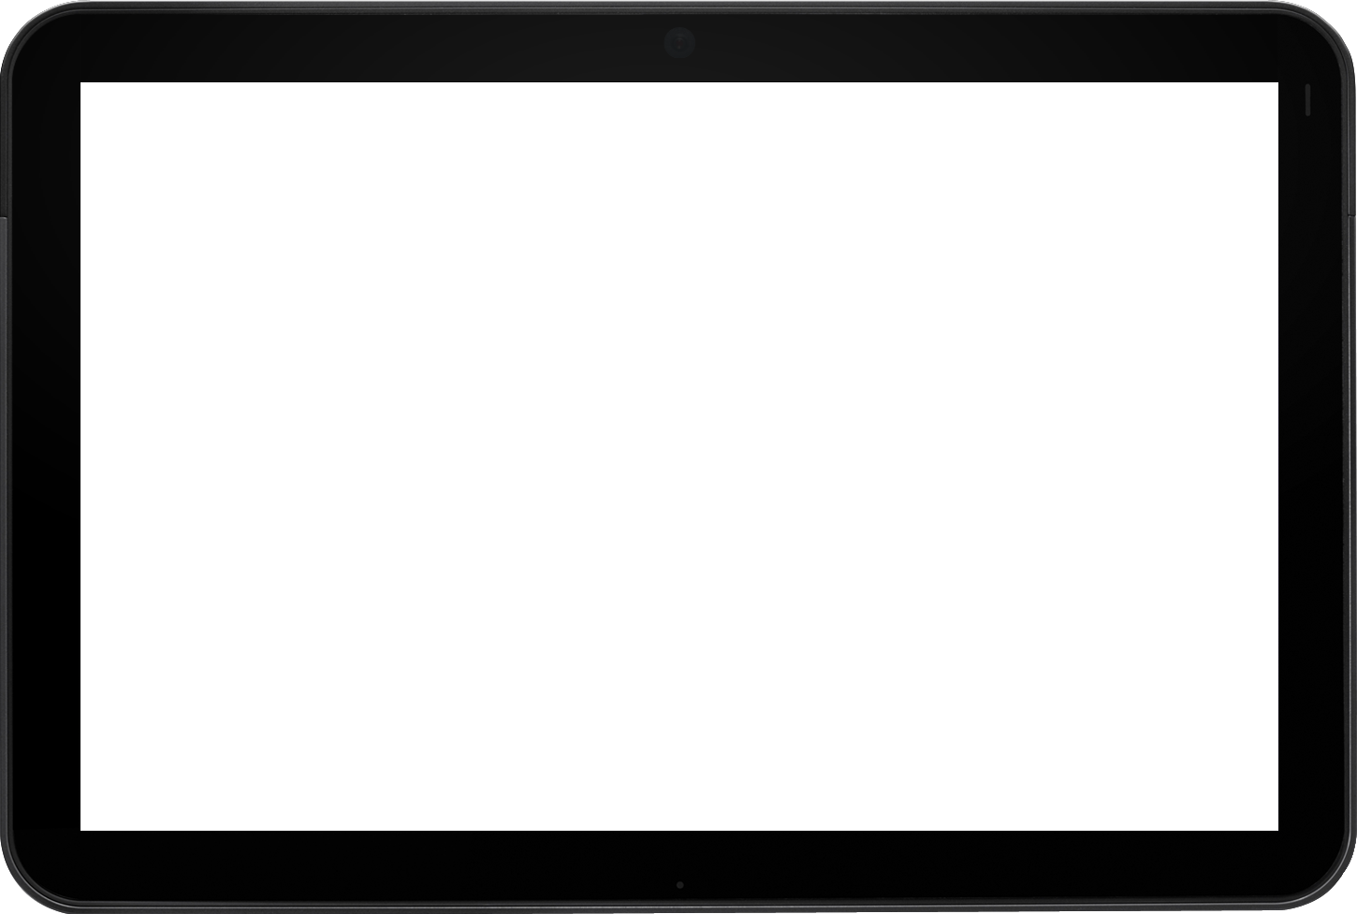
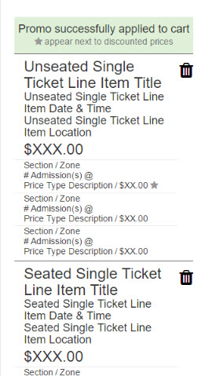
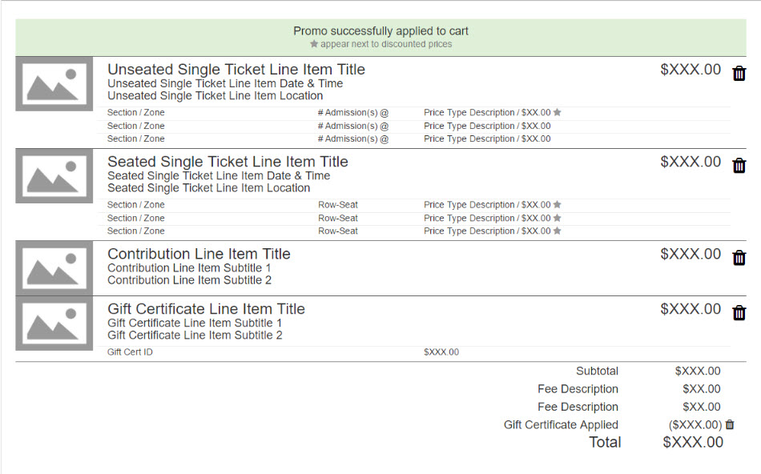
TNEW: whitelabel
Notes:
So lets take a look:: TNEW v7 as it will be delivered to your doorstep.
Responsive - one breakpoint currently at 480px
Picking up enhancement requests- cart overhaul -
Uses fluid grid system, and will look great across devices.
It provides good structure, and multiple handles to customize look and feel of TNEW.
Trying not to make Assumptions.

Slide 11
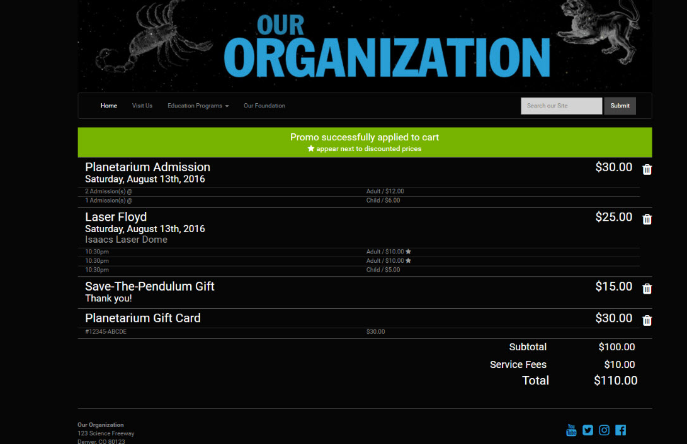
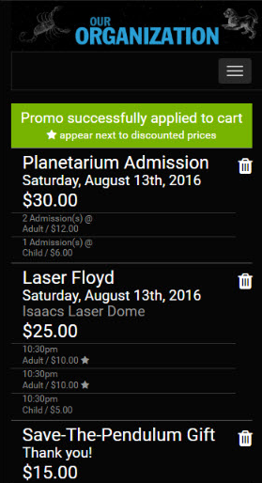
TNEW: quick start template
Notes:
. Slow Down .
When you migrate, you may not need to completely redo your template.
Styling TNEW will be easier than ever before, so you may choose to.
We’ll have several options to get you started quickly, if needed.

Slide 12
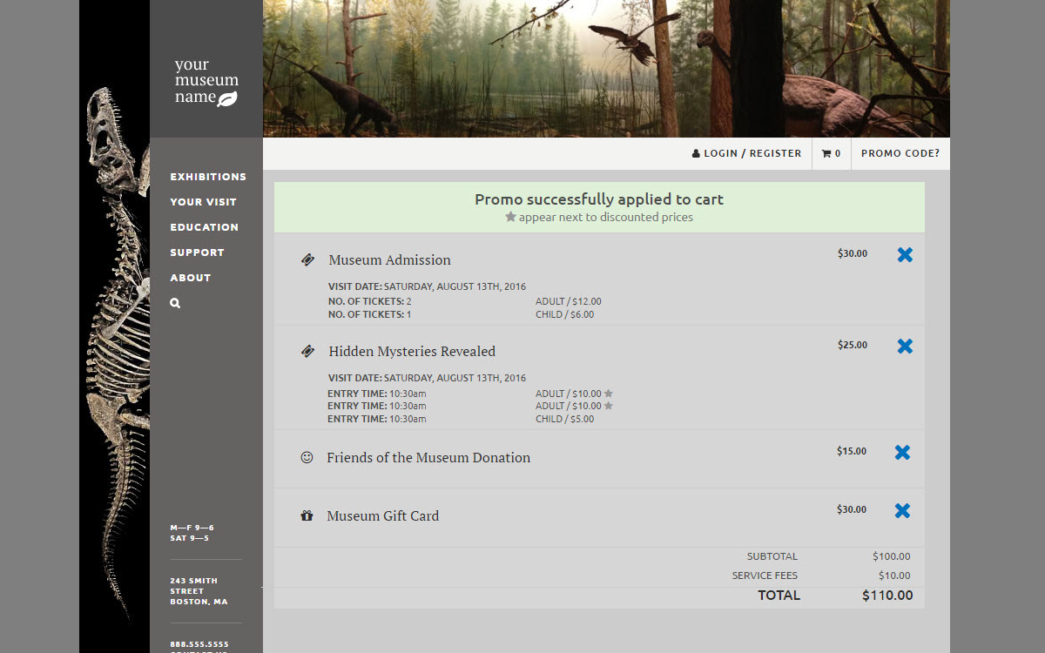
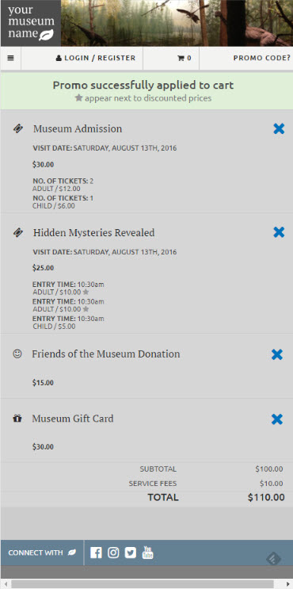
TNEW: custom hosted template
Notes:
As you’ll see shortly –elements are clearly marked up with IDs and Classes.
If you find that you need to make adjustments to your template – you can….
Makes customization easy
Using Bootstrap 3 and JQuery 2
Well documented and ubiquitous.
Let’s take a look quickly at what’s under the hood.

Slide 13
New Admin Features

Slide 14
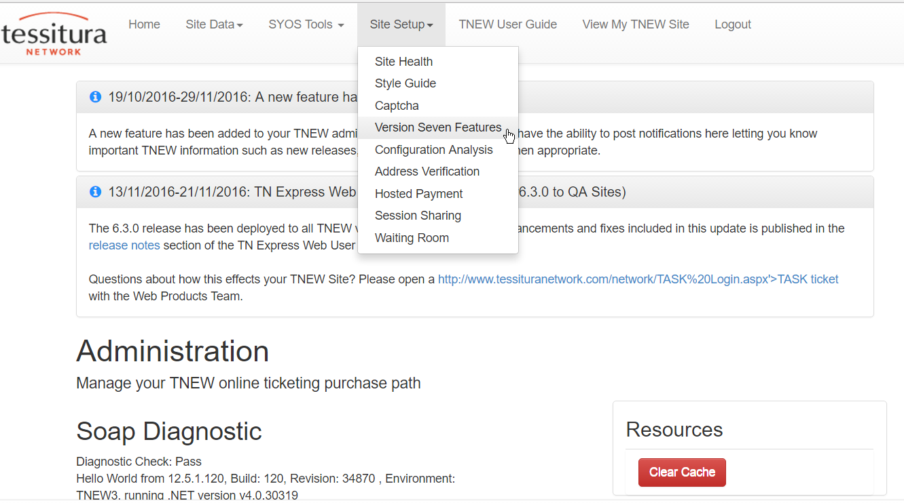

Slide 15
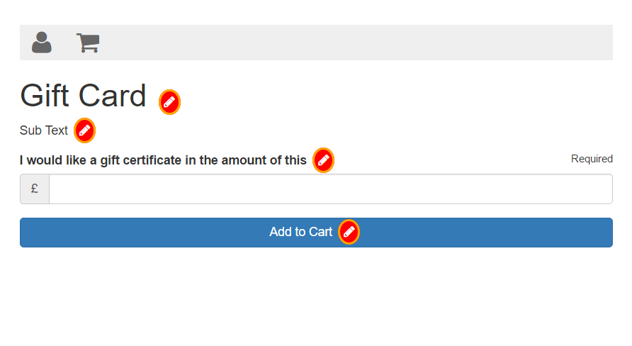

Slide 16
Improved Cart Styling

Slide 17
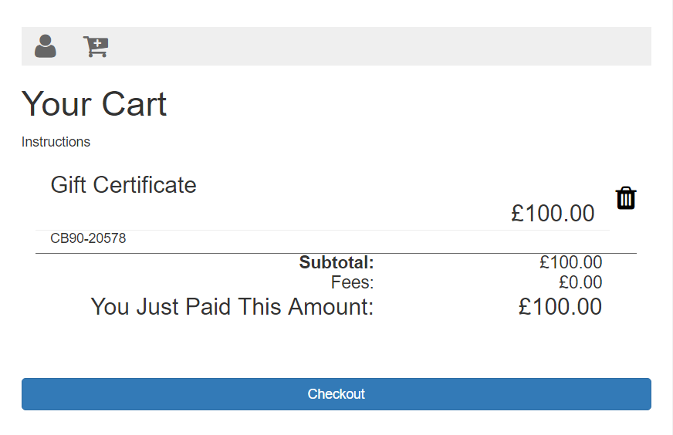
Notes:
Wireframe: https://ux-v7.tnew.info/single/detail.timed-admission.html
Staging Site: http://express.tessituranetwork.com/staging/

Slide 18
TN Mobile Plus v3.5 Planning

Slide 19
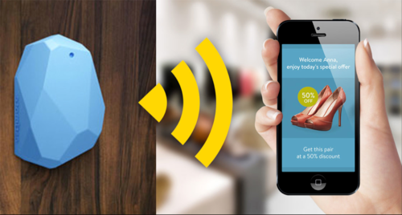
Coming Soon…

Slide 20
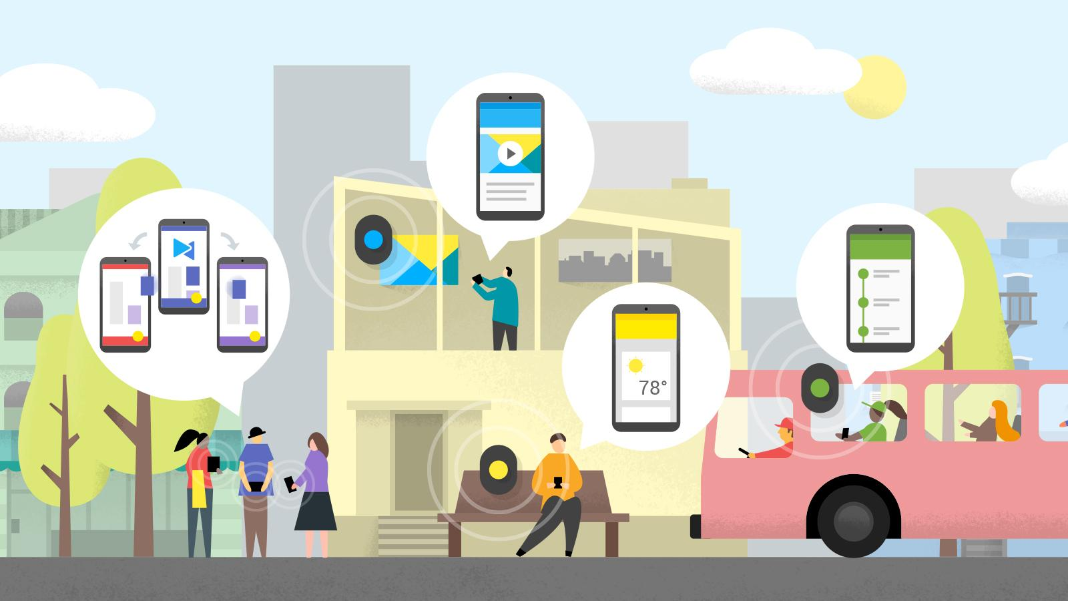
Coming Soon…Beacons
Connect with users within a few feet
Deliver highly targeted content
Customer heat-map
Unlimited possibilities
Notes:
Now I’m going to talk about another technology for the future -Beacons.
This one is more concrete than the App as a Service example - we are looking to integrate Beacons into TNMP within the next 6 months.
You’ve probably heard of beacons but don’t know what they are.
They function like mini-geofences. Instead of using large scale location detectors like GPS, cell towers or wifi stations, they use Bluetooth signals emitted from little tiny beacons that are detected by your phone.
Once the phone detects that signal it can then decide what to do.
It can deliver content such as images, text and video
It can trigger a notification
It can simply report that a user was there so that you can create a heat-map of activity.
The possibilities are unlimited.

Slide 21
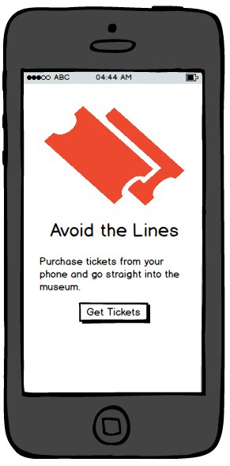
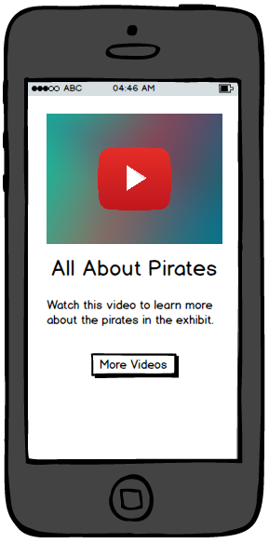
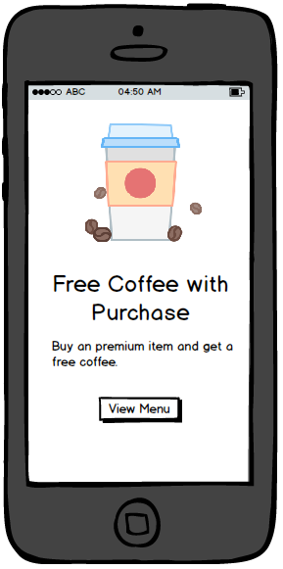
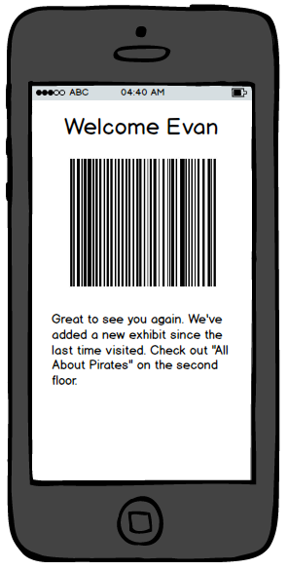

Beacons Example
Entrance
Concessions
Exhibit
Exhibit
Ticket Sales
Restroom
Notes:
For an example I’ve created a very simple drawing of a venue. Inside each of the dashed lines is a beacon, and the dashed line represent the area where a phone would detect that signal.
So when a user enters the venue and the phone detects the beacon it can pop up the tickets or membership barcode automatically.
It also could be personalized to send a specific message to the user.
If the user goes to ticket sales they could be prompted to save time and get out of line by buying tickets from their phone.
When they go to an exhibit they can receive additional content about that exhibit such as text, a youtube video and a link to more detailed info.
And of course when the user goes near the concessions you can try to upsell them with an offer.
It’s all about providing a tailored, personalized experience.
And to wrap up, that really gets at the heart of our goal. We want to make TNMP the digital concierge for your users, and to make you guys look smart. That’s our mission.

Slide 22

Web Products
Roadmapping

Slide 23
Discussion Topics
Prioritizing v7 phase II rollout
How do you see Resource Scheduling fitting into TNEW?
Responsive Package Functionality
Puzzle: Leveraging TNMP Functionality
“The Great Beyond” ideas for new TNEW & TNMP features
Notes:
Questions for subscription discussion: https://tessitura.atlassian.net/wiki/pages/viewpage.action?pageId=90898668

Slide 24
Get Involved

Slide 25
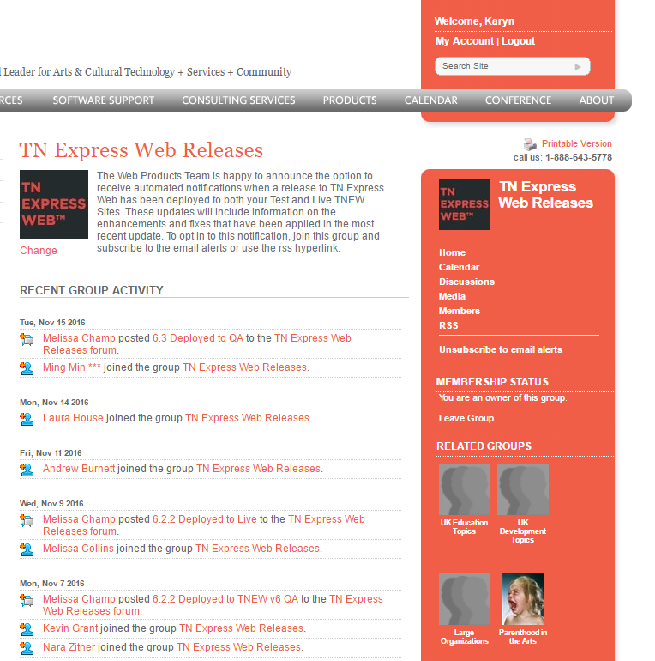
Stay Involved: Release Notes
Subscribe to the TNEW Releases Forum on TessituraNetwork.com

Slide 26

Stay Involved: UX Research & Feedback
Email UX@Tessituranetwork.com to:
  Participate in stakeholder review sessions
  See Development “Sprint demos”
  Volunteer for Beta testing

Slide 27
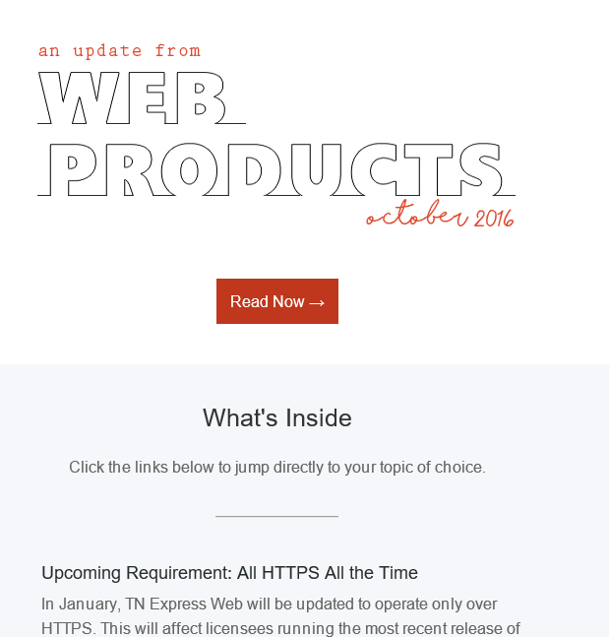
Stay Involved:
Subscribe to the Web Products newsletter

Slide 28

WHAT’S NEXT?
BREAK 14.15-14.30
Hogan Foyer / Level 6 Foyer
BREAKOUT SESSION SEVEN
14.30-15.30
Notes:
FRIDAY Breakout session 6 What’s next slide

Slide 29
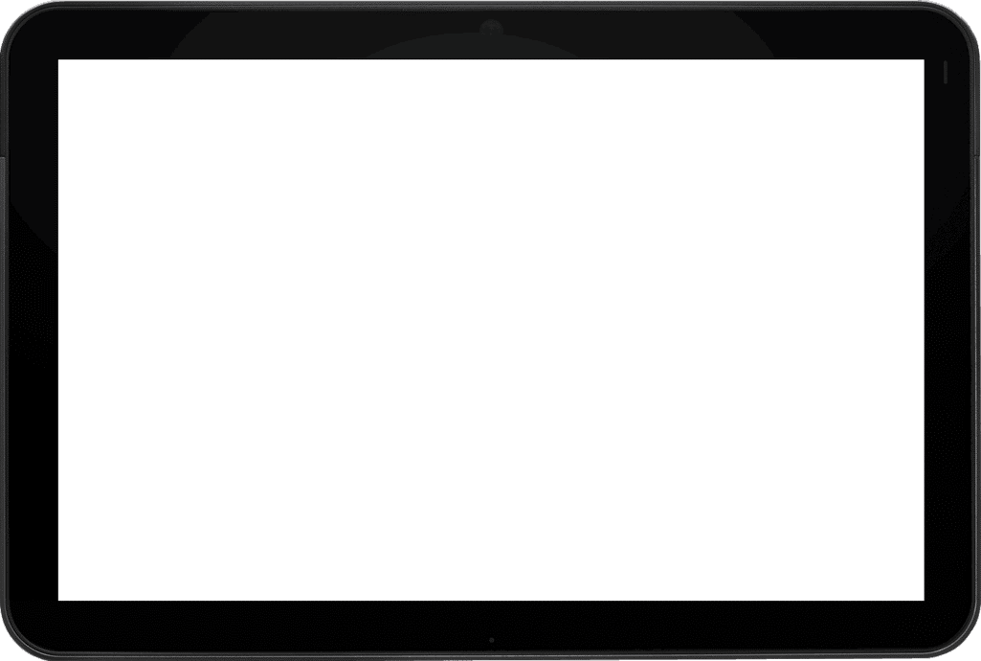
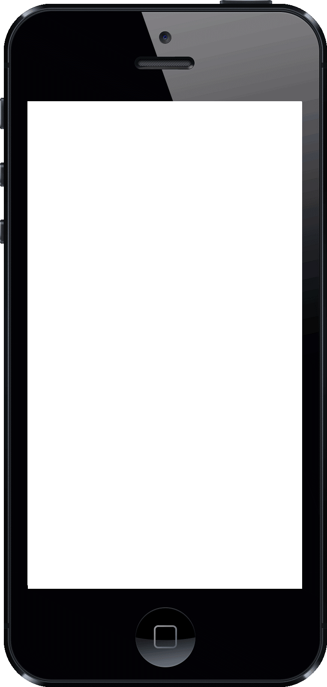
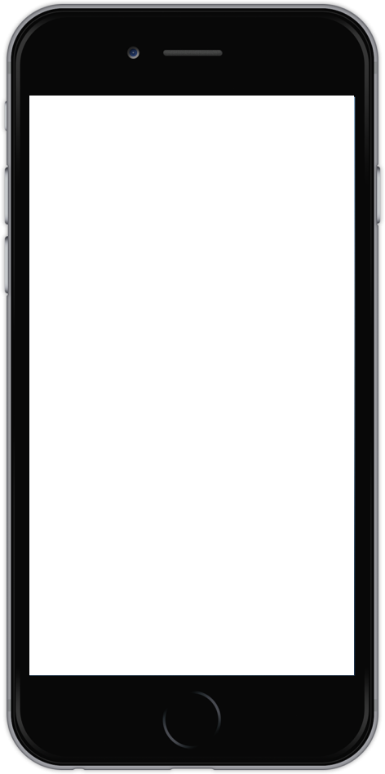
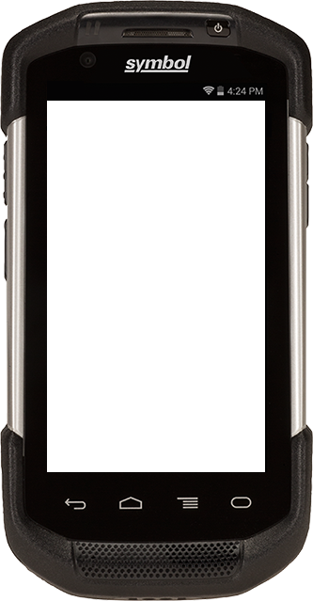
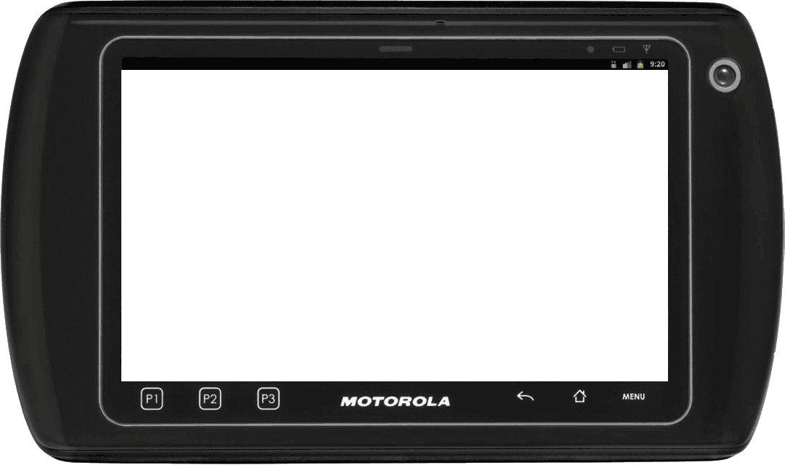
iPhone 5
iPhone 6
NSCAN
Android TC70
Mobile Device Templates
TRBO Motorola ET1
Tablet

