Slide 1

TESSITURA
EUROPEAN
CONFERENCE
DUBLIN 2016
Notes:
Welcome

Slide 2



PANEL
Hannah Jasper : Southbank Centre
Alice Hands : Theatre Royal & Royal Concert Hall
Donna Scott : Birmingham Hippodrome
Aynsley Young : Theatre Royal Newcastle
BOX OFFICE MANAGER 101
On the job tips and tricks for running a box office
CONTENT PLANNER
James Broderick : National Theatre
Share your favourite content and photos! #TECDublin16

Slide 3
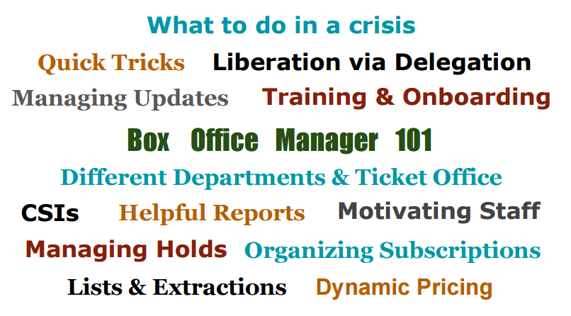

Slide 4

WHAT’S NEXT?
BREAK 14.15-14.30
Hogan Foyer / Level 6 Foyer
BREAKOUT SESSION SEVEN
14.30-15.30
Notes:
FRIDAY Breakout session 6 What’s next slide

