Slide 1

TESSITURA
EUROPEAN
CONFERENCE
DUBLIN 2016
Notes:
Welcome

Slide 2



PRESENTERS
Sarah Stratton : Birmingham Hippodrome
Alison Atkinson : Donmar Warehouse
Victoria O’Brien : Roundhouse
Nikki Barnett : JW3
DBA TIPS AND TRICKS
Confession time with your friendly neighbourhood DBA
CONTENT PLANNERS
Rebecca Sheldon : Mayflower Theatre
Debbie Harland : Old Vic Theatre
Share your favourite content and photos! #TECDublin16

Slide 3

  DBA Tips & Tricks
  Sarah Stratton
  Business Systems Manager

Slide 4

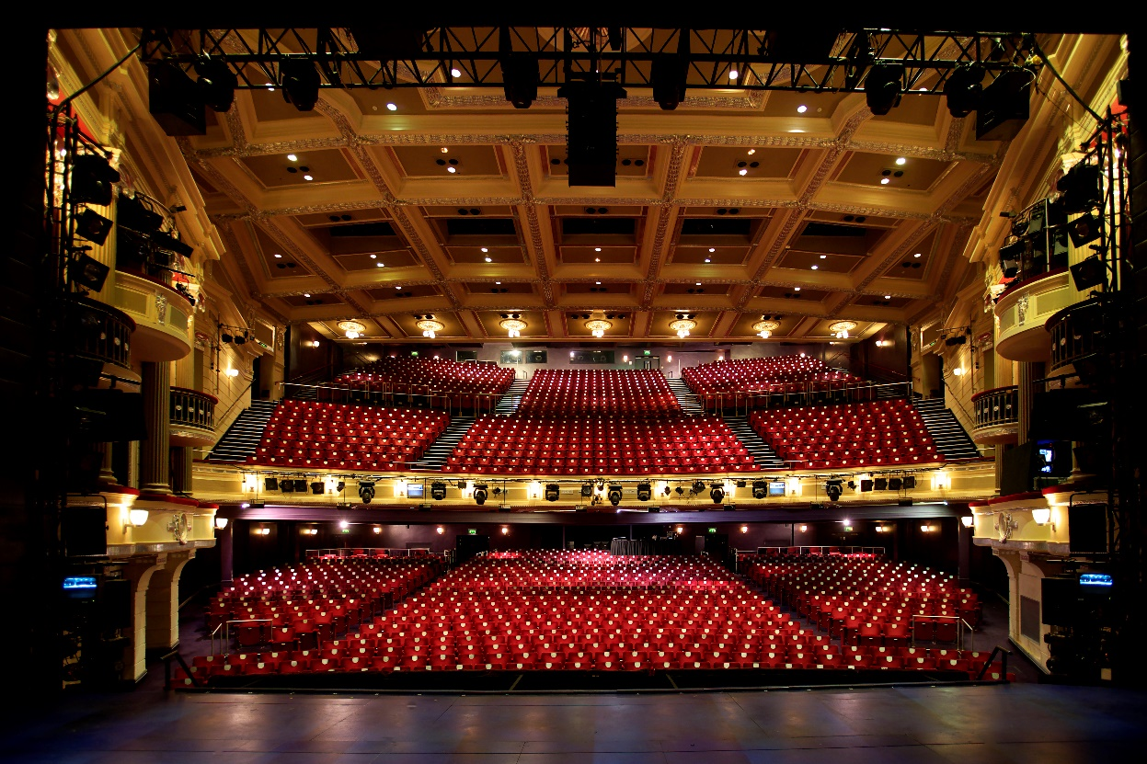
A world-class Birmingham arts scene,
with the Hippodrome centre stage.

Slide 5
Main Stage
c.400 performances a year
500,000+ visitors
Main Stage: 1,843 seats
Patrick Centre: 206 seats
Hippodrome CREATIVE
Artistic commissions
Strategic creative learning programme
300,000+ audiences and participants
100’s of volunteers
1000’s of discounted tickets for schools

Slide 6
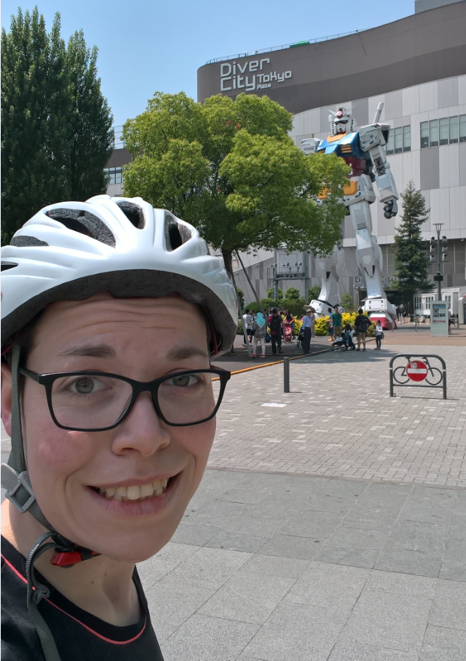
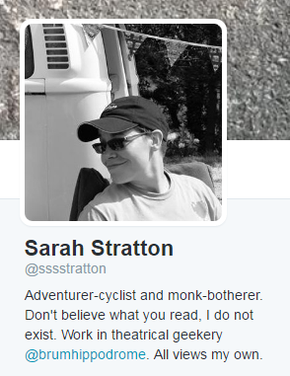

Slide 7


Slide 8


Slide 9
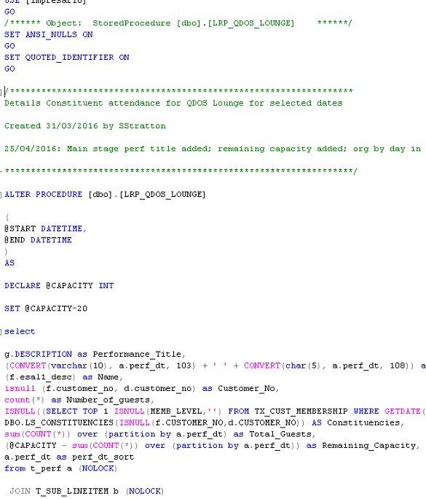
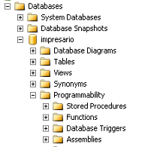
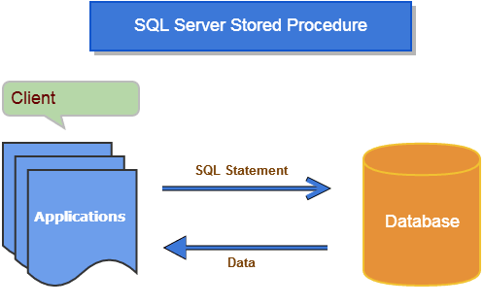

Slide 10
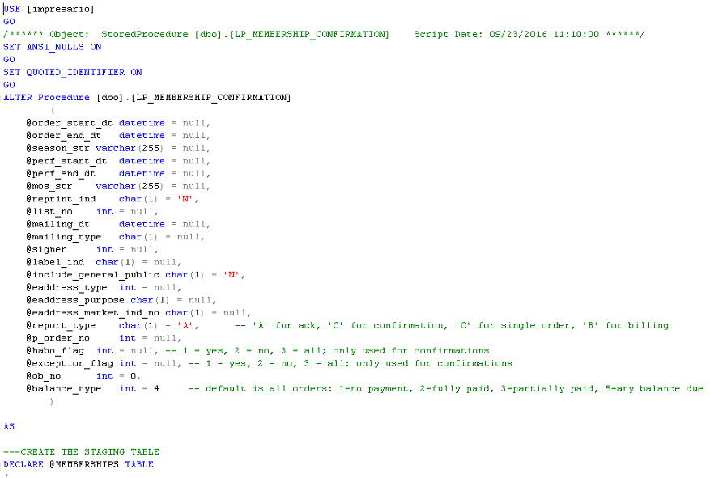

Slide 11
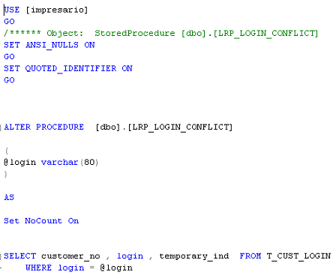

Slide 13
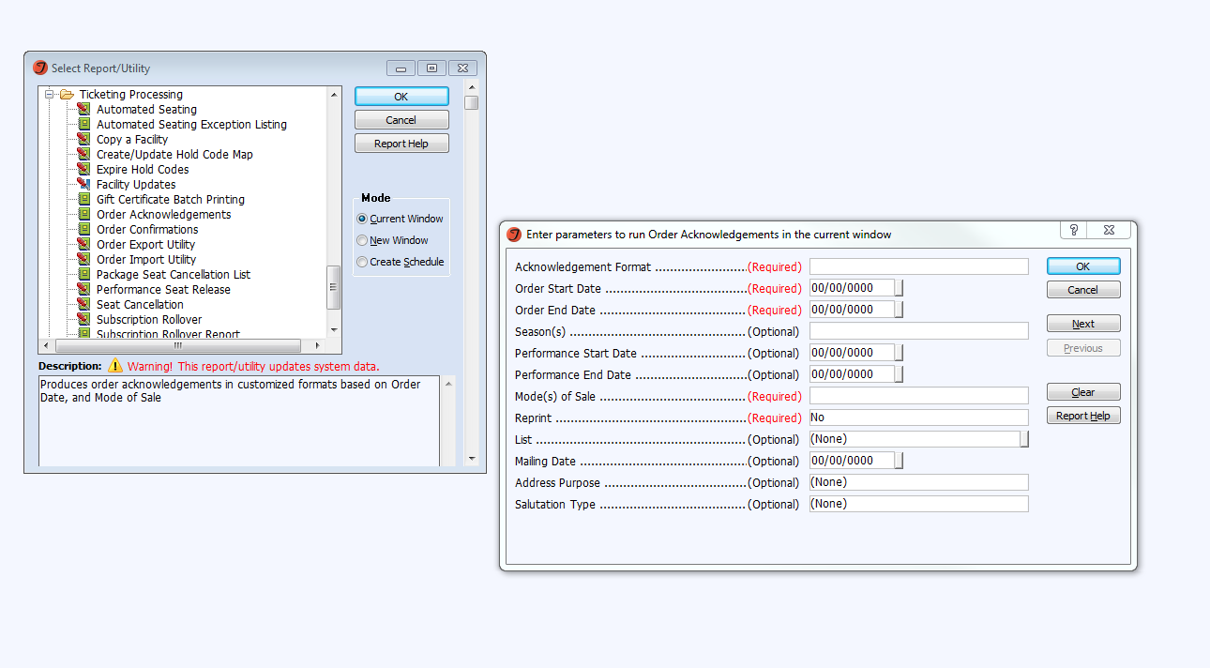

Slide 14
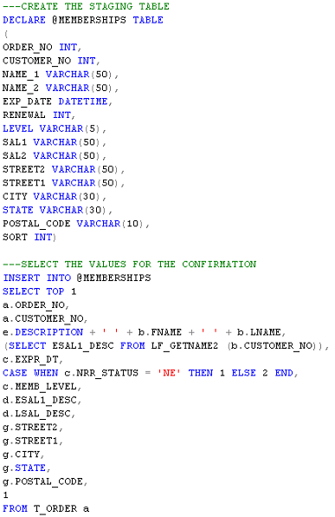
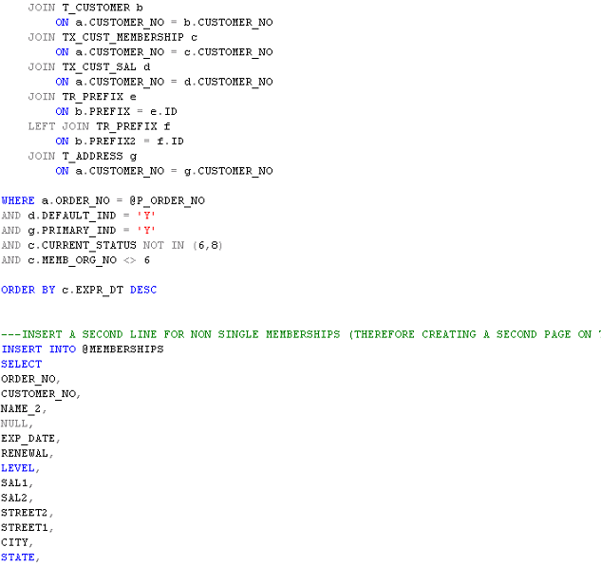

Slide 15
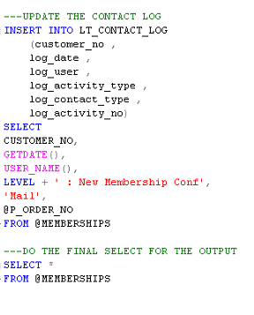
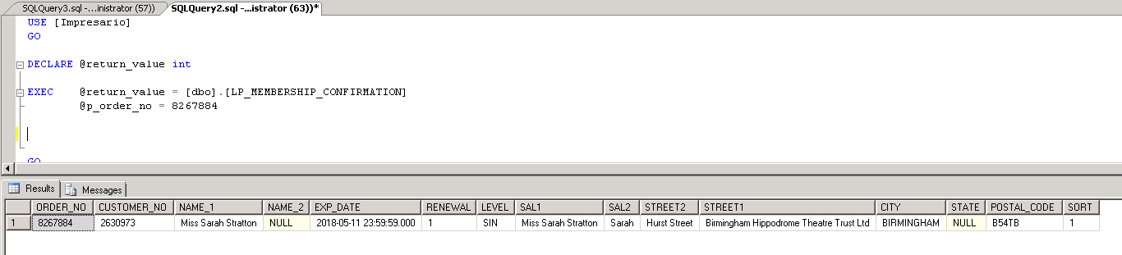

Slide 16
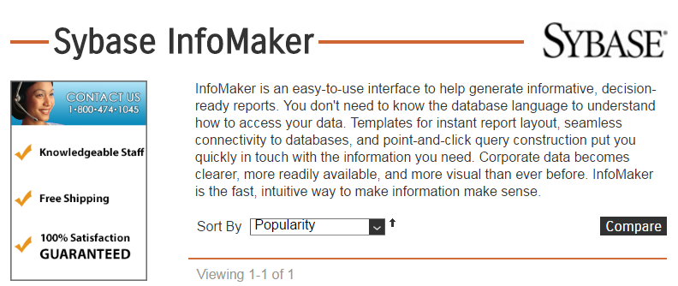

Slide 17
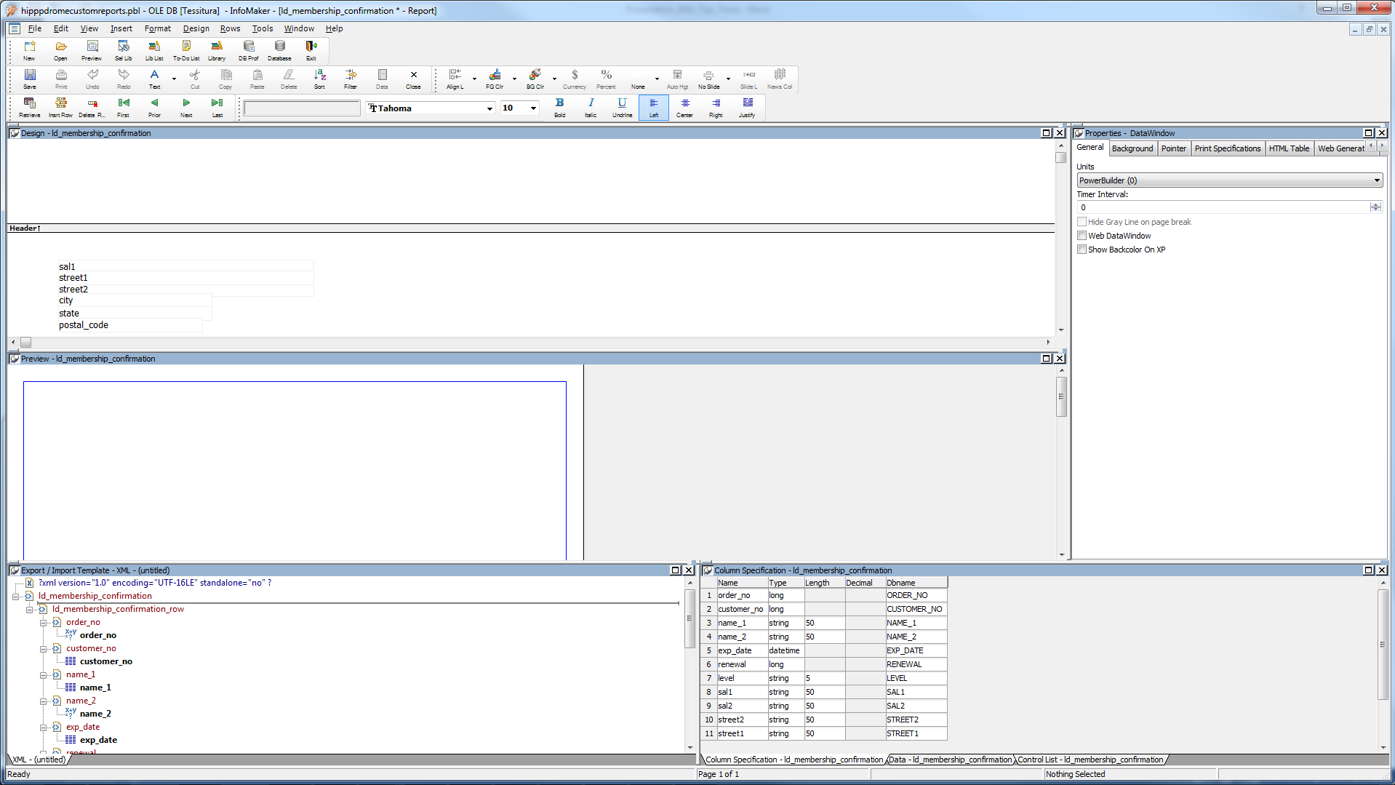

Slide 18
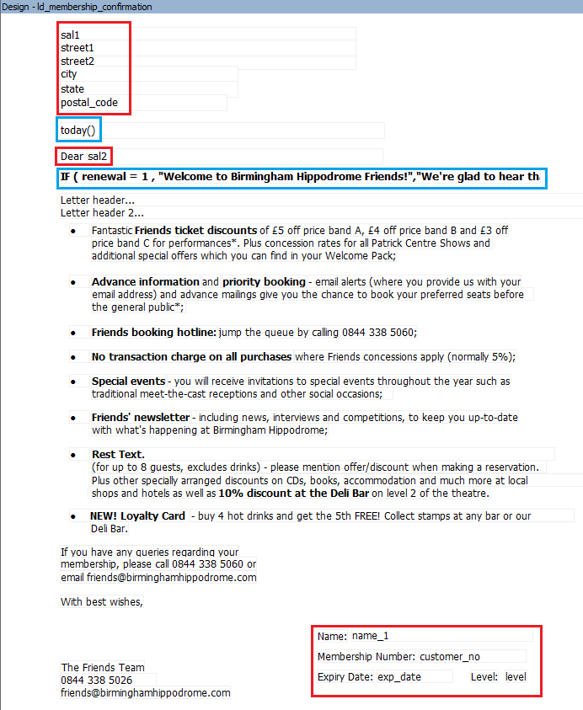
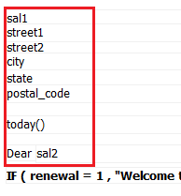
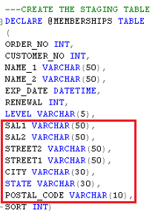
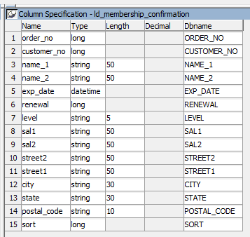

Slide 19
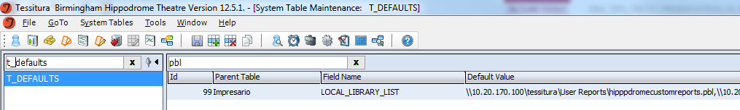
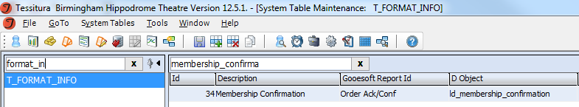

Slide 20
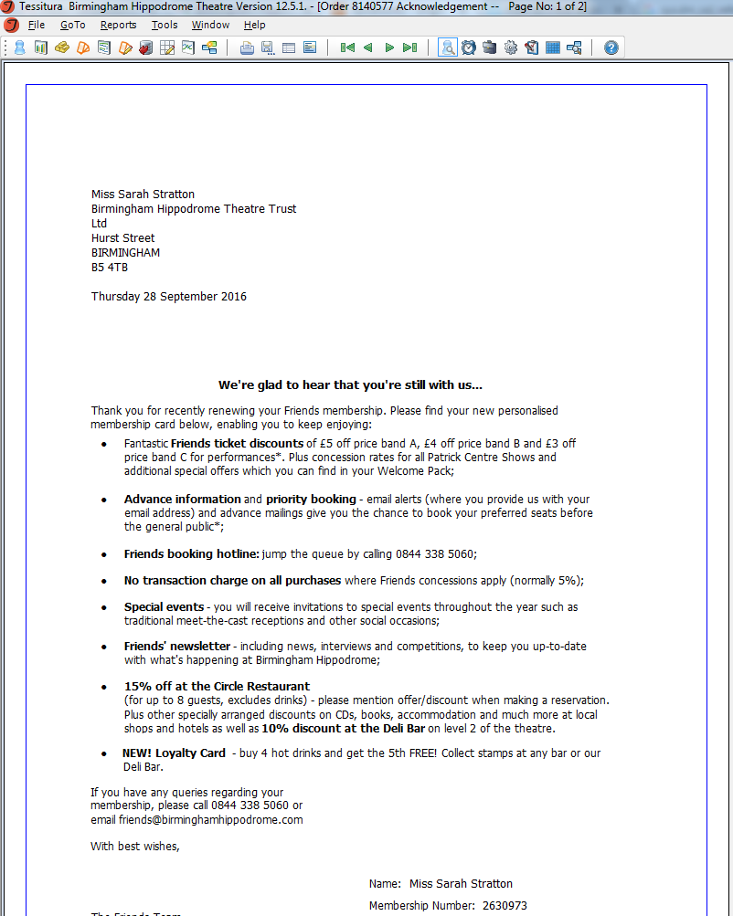
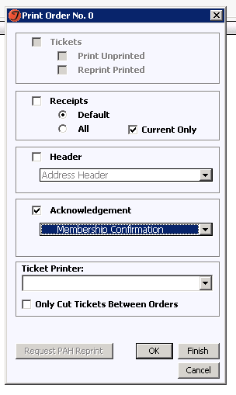

Slide 21
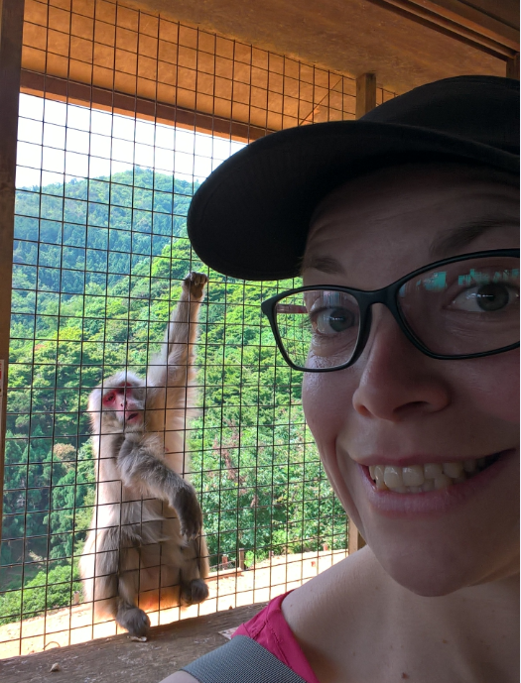

Slide 22

Important Info
Sarah Stratton
Business Systems Manager
Birmingham Hippodrome
Email: sarahstratton@birminghamhippodrome.com
Tel: +44 0121 689 3112
Twitter: @sssstratton
Preferred beverages: tea, gin, Guinness
Enjoy the conference!

Slide 23

Getting to know the
Security Application
Alison Atkinson
Digital Projects Manager
Donmar Warehouse

Slide 24

Donmar Warehouse
251 seat theatre in the heart of London’s West End
Reputation for artistic excellence
One of the UK’s leading producing theatres: new work, classics and innovative revivals
Artistic Director: Josie Rourke
Executive Producer: Kate Packenham
Notes:
Tiny theatre with international reputation.

Slide 25

Tessitura
Tessitura licensee since 2009 for Development and Membership
Taking over ticketing from January 2017
Developing new integrated website for ticket sales and membership management
Notes:
We’re bringing ticketing in-house from January 2017 – the first time we will have had a box office function.
In parallel, we’re developing a new integrated website for ticket sales and membership management.

Slide 26
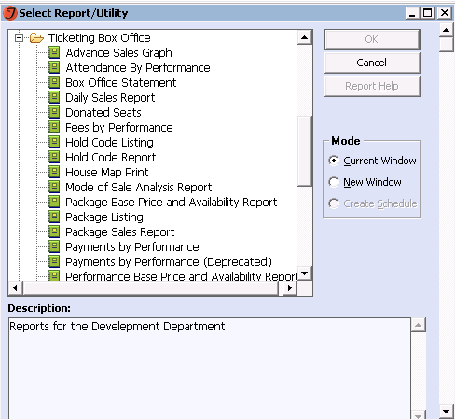
Reports
– the full set

Slide 27
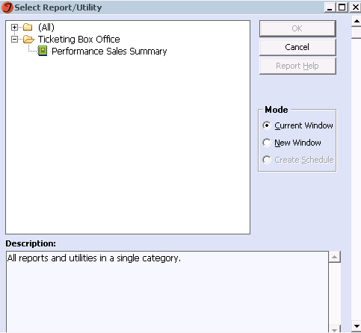
Reports
– very restricted

Slide 28
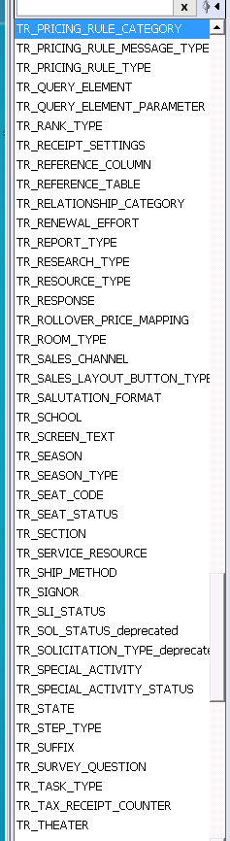
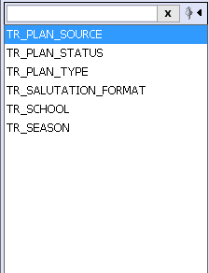
Tables
Who needs to see tables?
Who needs to edit tables?

Slide 29
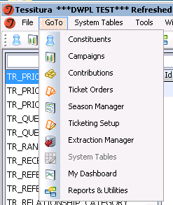
Security objects
Items greyed out:
Menu
Tabs
Radio buttons
Constituent record contents can
also be controlled by constituency

Slide 30
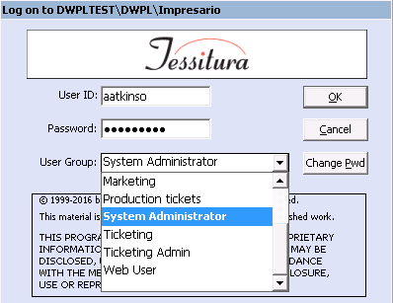
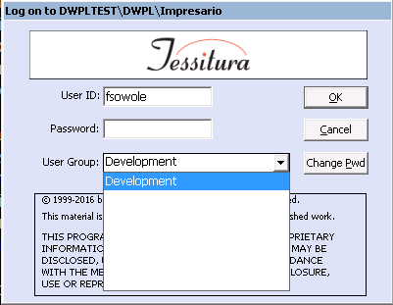
User Groups

Slide 31
User 5
User 4
User 1
User 2
User 3
User Group A
User Group B
User Group C
Constituency
Data Objects
Security
Objects
MOS
Price Type
Reports/Utilities
Hold Code
Batch Type
Payment method
Security Objects
Tables
Control Groups
Service Resources
(REST)

Slide 32
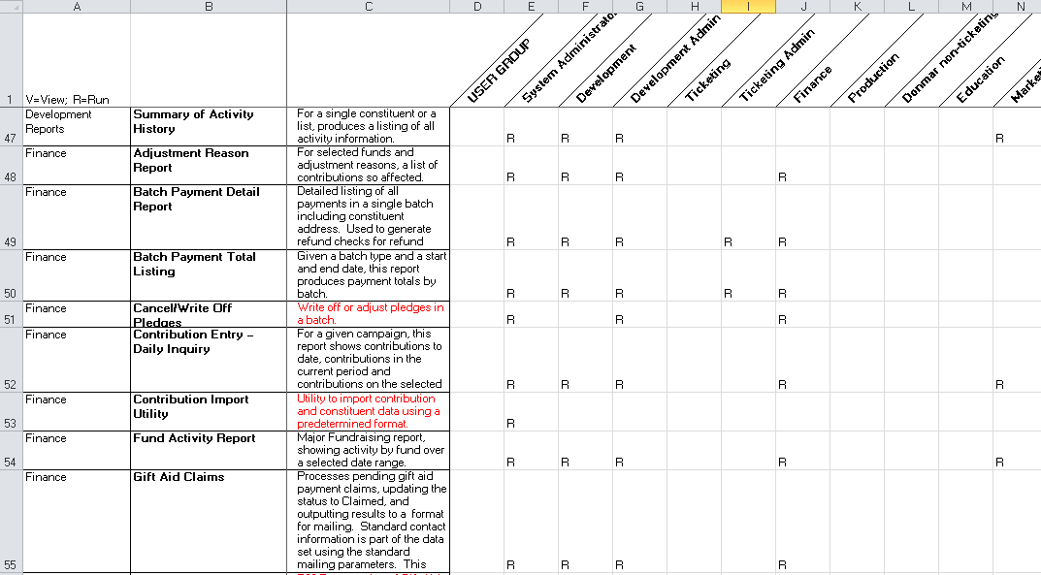
Security planning

Slide 33
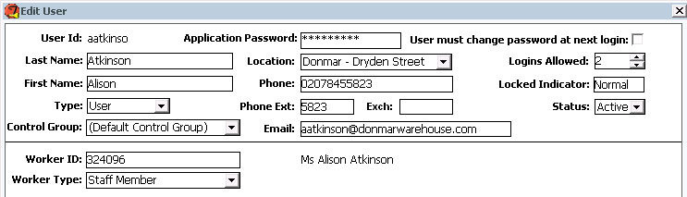
Security: more than password resets!

Slide 34
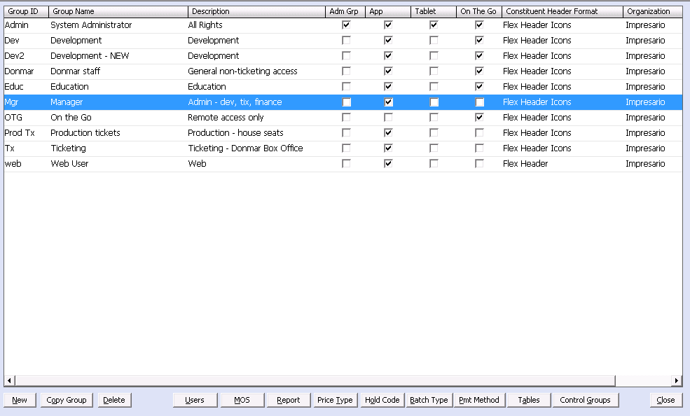
Security module: user groups

Slide 35
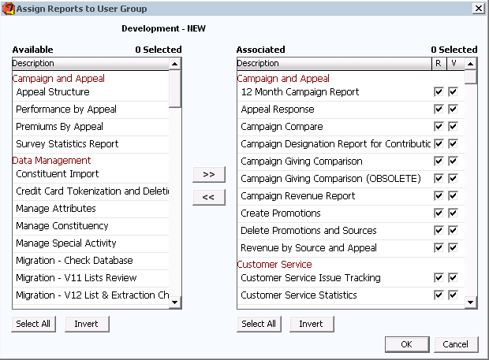
Security module: Reports
R=run
V=view when scheduled

Slide 36
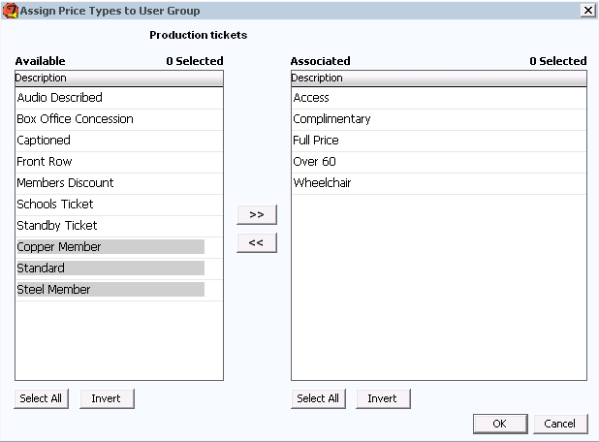
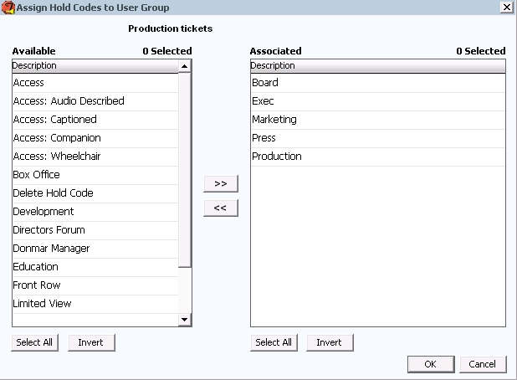
Price Types and Hold Codes

Slide 37
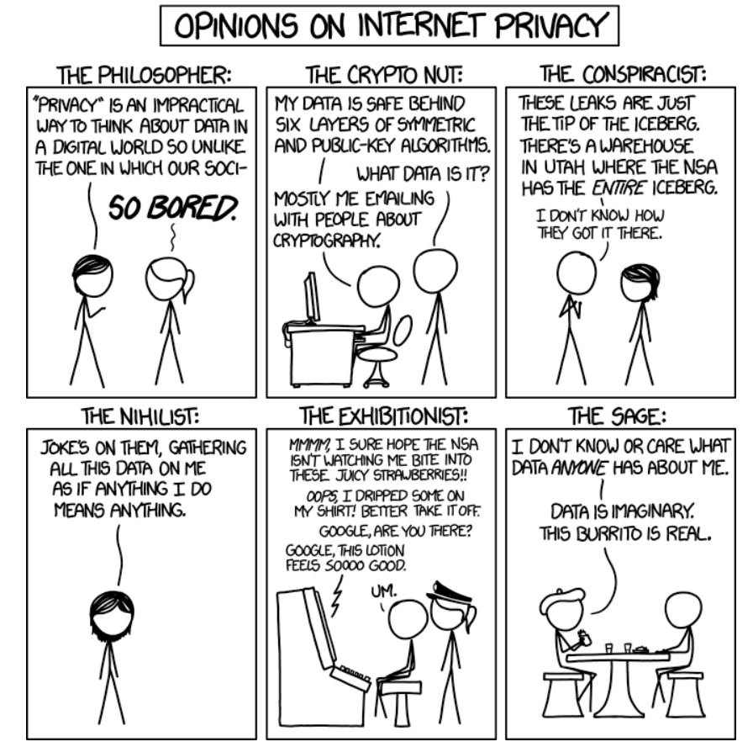
Security is Important
xkcd.com
Used under Creative Commons
licence

Slide 38

Alison Atkinson
Digital Projects Manager
Donmar Warehouse
aatkinson@donmarwarehouse.com

Slide 39

DBA – Tips and Tricks
Victoria Carlin O’Brien
Insights & Data Manager
Roundhouse Trust
formerly Data Analyst + Programmer National Theatre

Slide 40
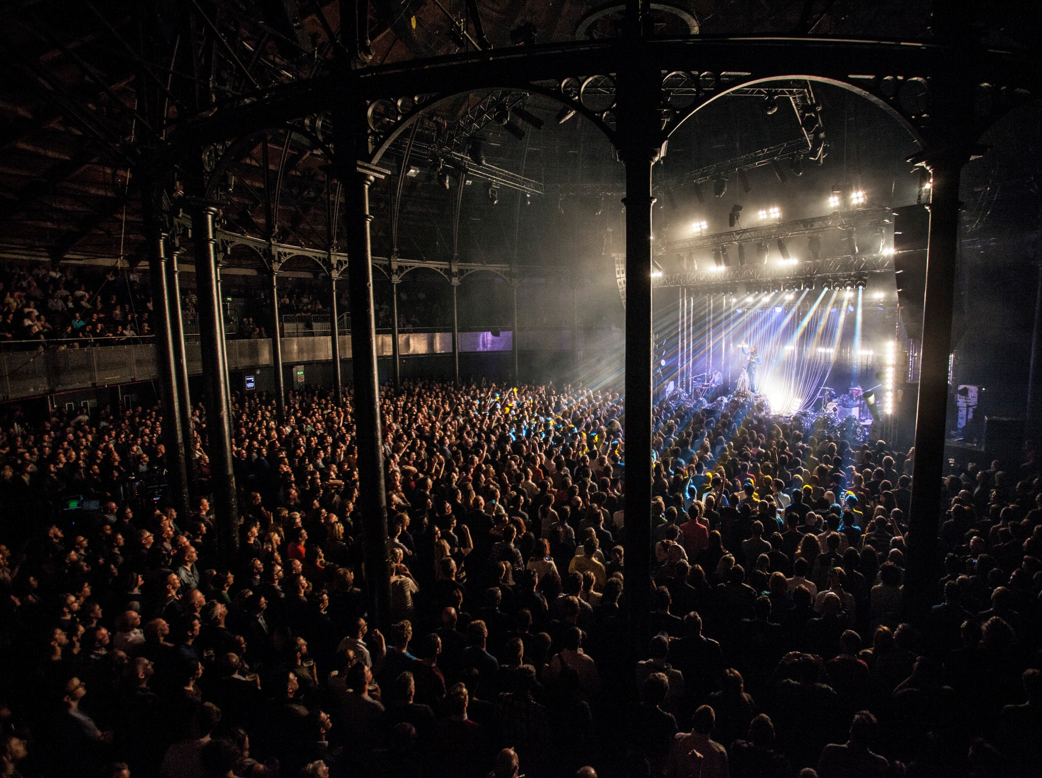
Section title option B
Roundhouse
Creativity drives change drives creativity drives change drives…
The Roundhouse is one of the most incredible live performance spaces in the world where the biggest names in music, theatre, circus and spoken word take to the stage every day. A former railway engine repair shed, the Grade II* listed building was transformed into a groundbreaking performing arts venue 50 years ago, and we have welcomed legendary artists from all over the world to perform in our unique spaces.

Slide 41

Section title Option A
Who can be a DBA?
Notes:
A lot of Tess users wander into the DBA world from wanting to know more from their database, having played with editing queries in list manager, creating their own criteria and probably becoming quite the wiz with excel. It makes sense to want to look at reporting next and it can be quite exciting. It can also be overwhelming and easy to run off with an idea that might not actually be useful to the organisation. However, pretty soon someone is going to ask you for a report and this might help. First let’s look at how to teach yourself – a quick easy way to navigate report builder, stored procedures without too much expectation. An easy win – updating a report that whilst it works, staff transfer contents to something nicer

Slide 42
Section title Option A
Reporting
Notes:
A lot of Tess users wander into the DBA world from wanting to know more from their database, having played with editing queries in list manager, creating their own criteria and probably becoming quite the wiz with excel. It makes sense to want to look at reporting next and it can be quite exciting. It can also be overwhelming and easy to run off with an idea that might not actually be useful to the organisation. However, pretty soon someone is going to ask you for a report and this might help. First let’s look at how to teach yourself – a quick easy way to navigate report builder, stored procedures without too much expectation. An easy win – updating a report that whilst it works, staff transfer contents to something nicer

Slide 43
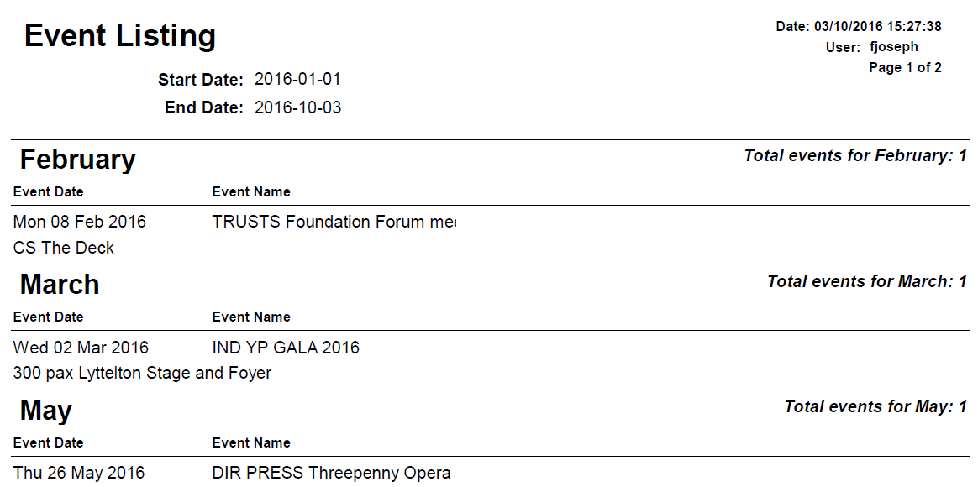

What’s wrong with the current?
………………………………………………………………………………………………………………………………………….

Slide 44
What’s wrong with the current?
………………………………………………………………………………………………………………………………………….
Brings in EVERY event in between
Month pulled from temp table
Event notes missed or empty?

Slide 45
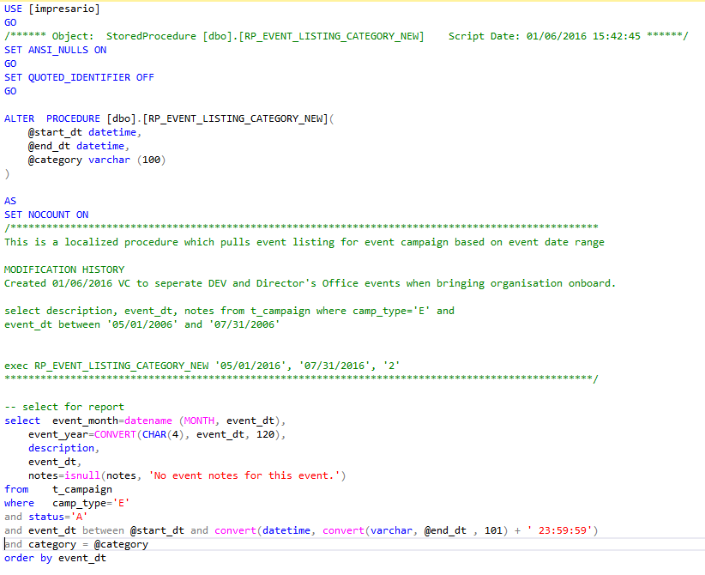
………………………………………………………………………………………………………………………………………….
Shiny new parameter
Note for next DBA

Slide 46

………………………………………………………………………………………………………………………………………….

Slide 47
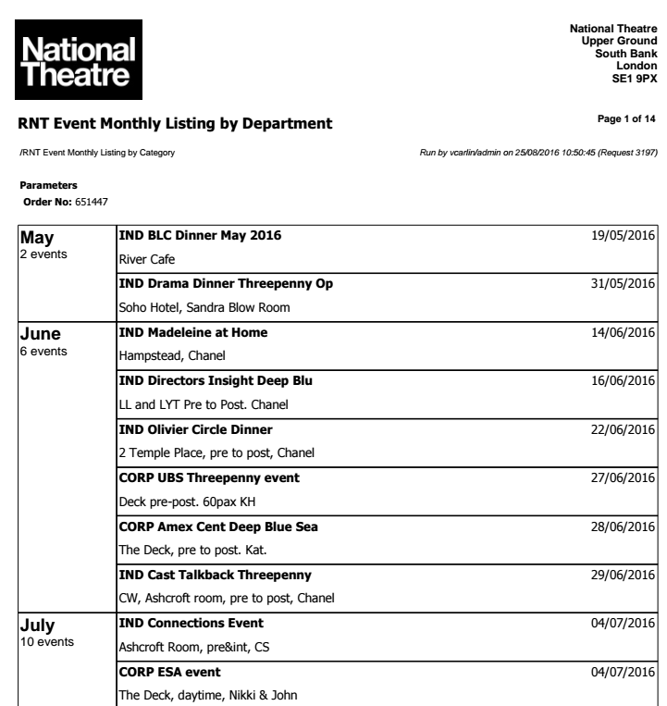
………………………………………………………………………………………………………………………………………….
Logo - good for meetings &
on-boarding
Standardising templates
Default in VS – DON’T PANIC

Slide 48
Section title Option A
Now STOP
Notes:
Review with the users – don’t spend hours re-formatting in VS or Report Builder only to have your heart broken by someone who doesn’t like bold type. Then build.

Slide 49
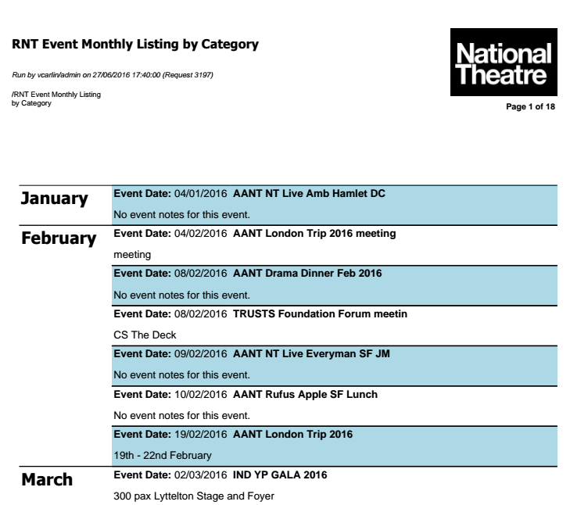
………………………………………………………………………………………………………………………………………….

Slide 50
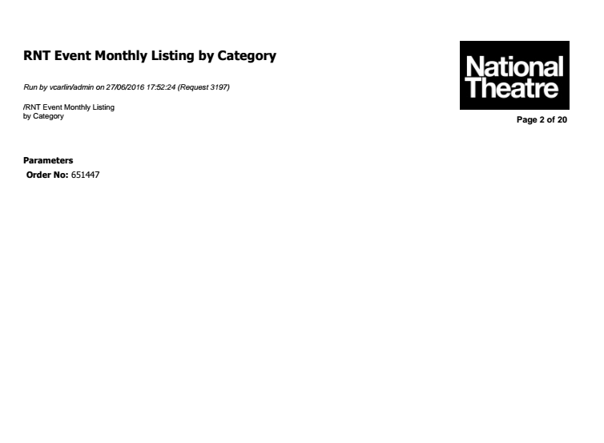
………………………………………………………………………………………………………………………………………….
!!!!

Slide 51
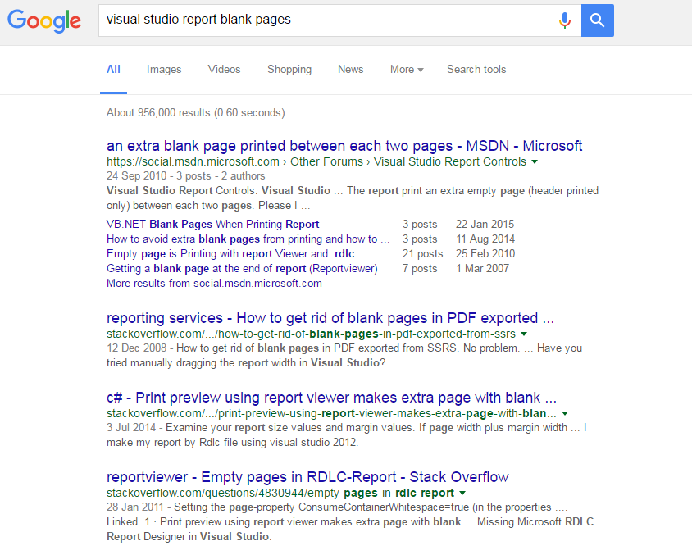
………………………………………………………………………………………………………………………………………….

Slide 52
Section title Option A
Custom Reporting
Questions to ask:
Notes:
First up – questions to

Slide 53
Section title Option A
Custom Reporting
Questions to ask:
WHY WHAT’S WRONG WITH THE CURRENT ONE?
Notes:
First up – questions to

Slide 54
Section title Option A
Custom Reporting
Questions to ask:
WHY WHAT’S WRONG WITH THE CURRENT ONE?
Yeah, I guess a spreadsheet probably isn’t the best option for you
Notes:
First up – questions to

Slide 55
Section title Option A
Custom Reporting
Questions to ask:
WHY WHAT’S WRONG WITH THE CURRENT ONE?
Yeah, I guess a spreadsheet probably isn’t the best option for you
Do I really have to open Infomaker?
Notes:
First up – questions to

Slide 56
Section title Option A
Custom Reporting
Questions to ask:
WHY WHAT’S WRONG WITH THE CURRENT ONE?
Yeah, I guess a spreadsheet probably isn’t the best option for you
Do I really have to open Infomaker?
Are you going to want a graph with that?
Notes:
First up – questions to

Slide 57
Section title Option A
Custom Reporting
Questions to ask:
WHY WHAT’S WRONG WITH THE CURRENT ONE?
Yeah, I guess a spreadsheet probably isn’t the best option for you
Do I really have to open Infomaker?
Are you going to want a graph with that?
Are you sure you can’t run a list through an out of the box report?
Notes:
First up – questions to

Slide 58
Section title Option A
Reporting
Legitimate Questions to ask:
Are you sure you can’t run a list through an out of the box report?
Is this a report you want to run often or as a one-off?
Are you going to want a graph with that?

Slide 59
What do they want to report?
………………………………………………………………………………………………………………………………………….
Is this a one-off solution?
Would a db-mail query with a splash of HTML be a faster solution?
Who will be using the information – do they use Tess?
In what format? Is this to be exported to something else?
Is it external?

Slide 60
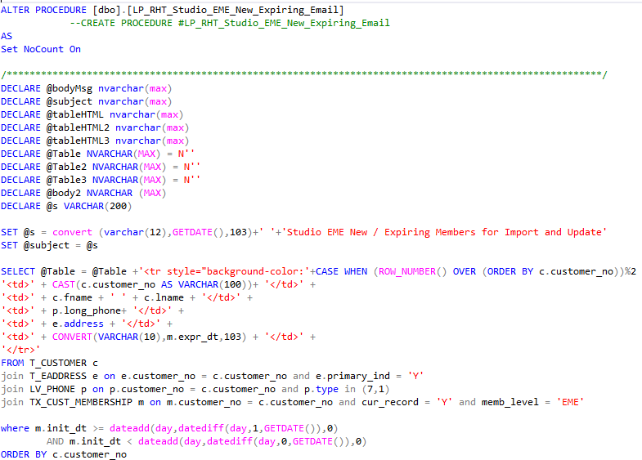
………………………………………………………………………………………………………………………………………….

Slide 61
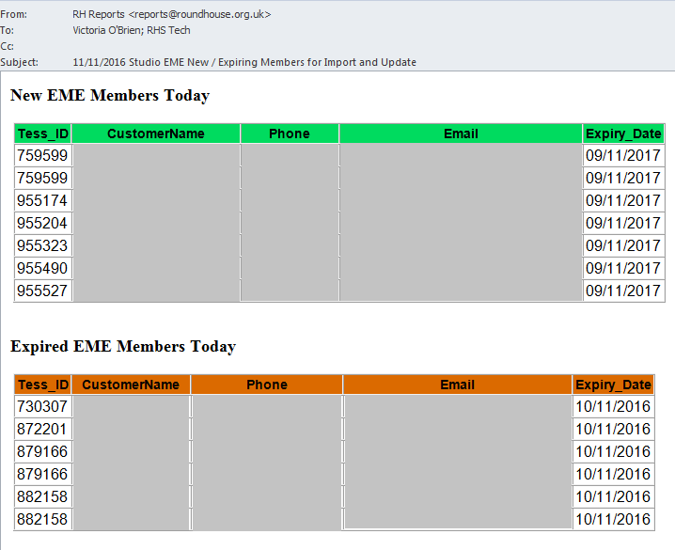
………………………………………………………………………………………………………………………………………….

Slide 62
Section title Option A
Make your SQL
do the work

Slide 63
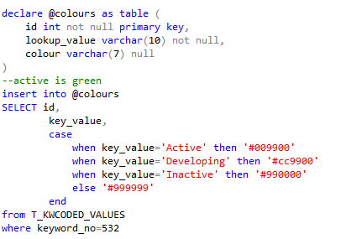
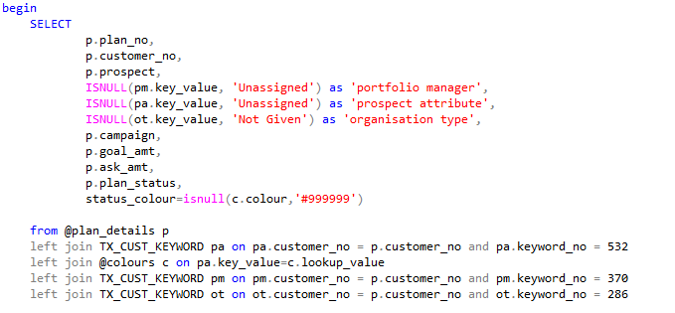
………………………………………………………………………………………………………………………………………….

Slide 64
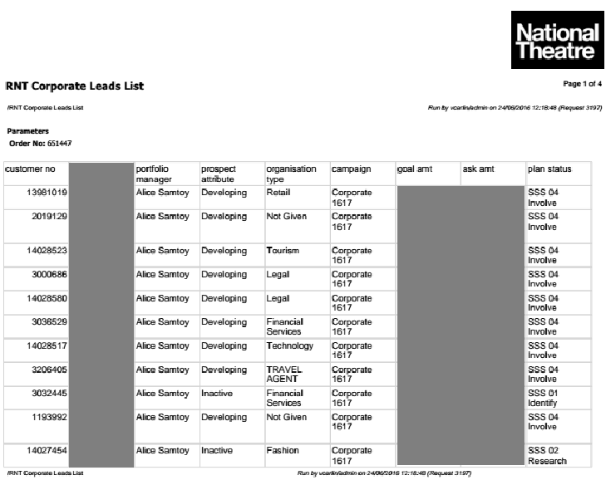
………………………………………………………………………………………………………………………………………….
Get the data into your report software then review with users
Identify most important data column for users

Slide 65

………………………………………………………………………………………………………………………………………….
Get the data into your report software then review with users
Colour table does grouping for you and simplifies conditional formatting

Slide 66
Here take this, it’s dangerous to go alone:
………………………………………………………………………………………………………………………………………….
The Tessitura Admin Group
Your company’s previous TASK tickets
Other people’s reports – don’t struggle on your own
Bitbucket, Google Drive, keep your code close and useable
LEARN YOUR JOINS & THE VALUE OF TEMP TABLES

Slide 67

End slide
Thank You!
victoria.obrien@roundhouse.org.uk
www.roundhouse.org.uk

Slide 68

Nikki Barnett
Development Coordinator

Slide 69
Gift Aid Process
Gift Aid is a tax-incentive that enables charities to re-claim tax on donations made by UK tax-payers provided
The individual is subject to UK income tax
The charity records confirmation by the individual, e.g. Gift Aid Declaration

Slide 70
What is this process about?
Gift Aid Process
Cross – departmental project involving the following areas:
CRM – Gift Aid process in Tessitura
Development – Donors and Contributions
Finance - Gift Aid claims for HMRC

Slide 71
Objectives
Gift Aid Process
‘Tidy’ Gift Aid records in database - Tessitura
‘Tidy’ scope of payments to be claimable in Gift Aid
Set up a process across Tessitura, Development and Finance
Retrieve Gift Aid figures for HMRC and Board of Trustees – focusing on contributions above £1000

Slide 72
Challenges
Gift Aid Process
Main challenge – no Gift Aid process/workflow installed and documented across teams (Tessitura, Development & Finance)
Contributions at Household level without Initiator
Result: these were ‘Not Eligible’ and therefore not eligible for reclaim

Slide 73
Challenges
Gift Aid Process
Declarations attached to Household constituents – Declarations should be attached to Individual only
Declarations with ‘end date’ when should have an ‘open date’ or future date – except if requested by Donor
Result: Gift Aid classed as ‘No Declaration’ and automatically excluded

Slide 74
How to solve the problem and set up a process?
Gift Aid Process
Focus on contributions above £1000 - retrieve Donors and contributions per Fund
Retrieve Gift Aid report by Out of Scope, Not Eligible, No Declaration and To Be Claimed, and compare contributions with donors’ lists/reports
Update Foundations’ contributions as not Eligible – cannot claim Gift Aid on Foundations
Attribute Initiator to Household contributions in the list
Run Gift Aid Declarations Utility to update Gift Aid Declarations
Run Gift Aid Payments Update Utility

Slide 75
But still some contributions are still classed as not claimable!
Gift Aid Process
Tessitura script (Attributes automatically Initiators to Household contributions)
Run Tessitura script to attribute Initiators at Household level contributions
Script was run in Tessitura Test and then after reviewing results it was run in Tessitura Live
1st part - in SQL to provide details of changes that will be made
2nd part – update statement that performs update

Slide 76

Gift Aid Process
Script to update contributions in bulk to determine the initiator for each record
Attributed the Primary Affiliated as Initiator

Slide 77
Process/workflow for the future
Gift Aid Process
No Declarations at Household level
Always Initiator in Household contribution
Keep Payments and Funds in scope

Slide 78
Process/workflow for the future
Gift Aid Process
Run Gift Aid Payment utility
Run Gift Aid Declarations – to update all Declarations
Run Gift Aid Claim in Output Mode only
Happy with results? - Run Gift Aid Claim in Review Mode
Use Gift Aid Spreadsheet or R68 or prepare internal Financial reports to claim money to HMRC

Slide 79
Contacts
Gift Aid Process
Nikki Barnett
Development Coordinator
Nikki@jw3development.org.uk
Joana Matos
CRM Systems and Web Coordinator
joana@jw3.org.uk

Slide 80
QUESTIONS?
“If I am occasionally a little over-dressed, I make up for it by being always immensely over-educated.”
Oscar Wilde, The Importance of Being Earnest
Notes:
Welcome

Slide 81


WHAT’S NEXT?
LUNCH 12.15-13.15
Hogan Foyer / Hogan Suite
Sponsored by:
BREAKOUT SESSION SIX
13.15-14.15
Notes:
FRIDAY Breakout session 5 What’s next slide

