Slide 1

TESSITURA
EUROPEAN
CONFERENCE
DUBLIN 2016
Notes:
Welcome

Slide 2



PRESENTERS
Liz Baird : Wales Millennium Centre
Matthew Ingham : Theatre by the Lake
Hannah Jasper : Southbank Centre
CONTENT PLANNER
Sophie Anthony : Wales Millennium Centre
UPSELLING TIPS & TRICKS
FRONT LINE SALES TACTICS FOR FRONT LINE SALES TEAMS
Share your favourite content and photos! #TECDublin16

Slide 3

Upselling Tips & Tricks
Liz Baird
Rheolwraig Canolfan Gyswllt
Contact Centre Manager

Slide 4
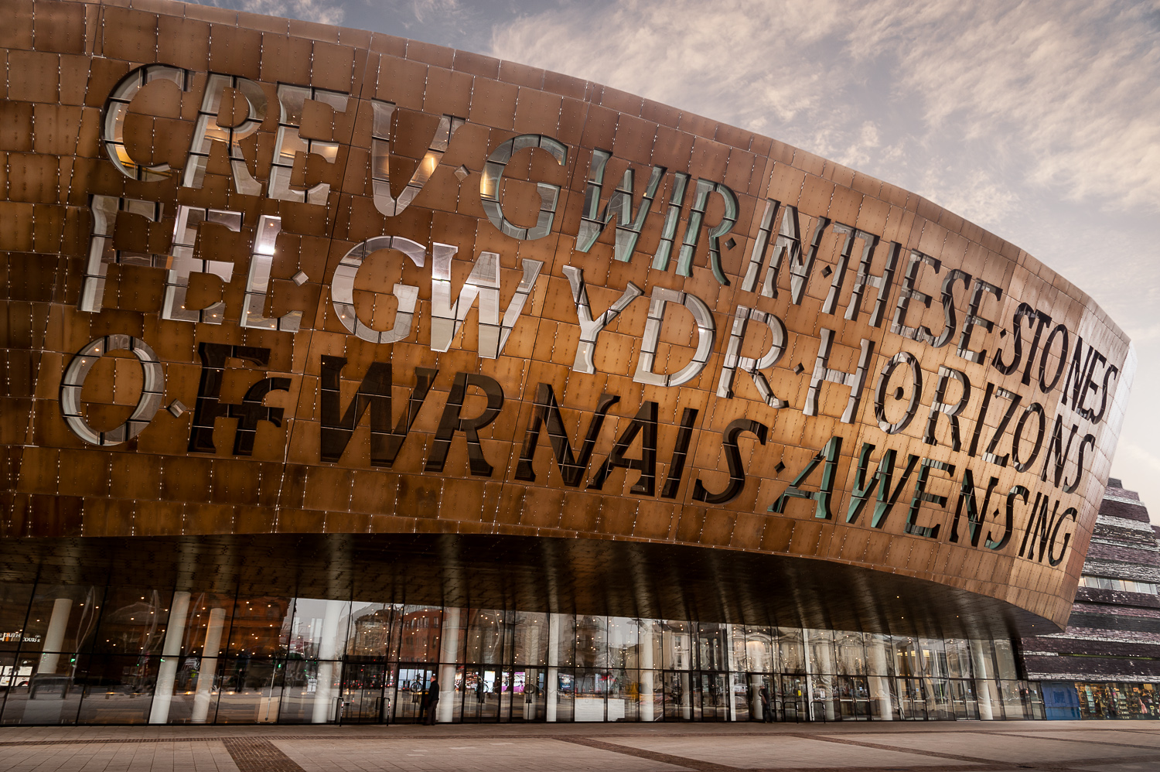
Upselling Tips & Tricks
Wales Millennium Centre

Slide 5







Upselling Tips & Tricks
The Consortium
Notes:
We’re a Master licensee for the Tessitura consortium in Wales. There are 8 companies within the consortium including us – spot the non-welsh venue…..
Yes, big shout-out to Liverpool Everyman & Playhouse….

Slide 6
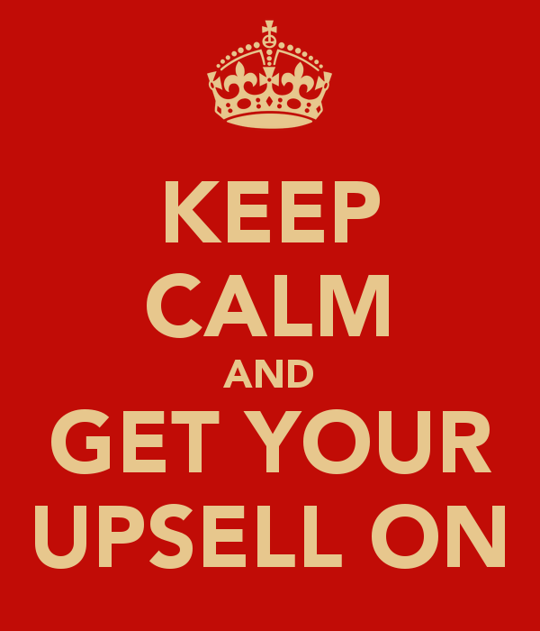
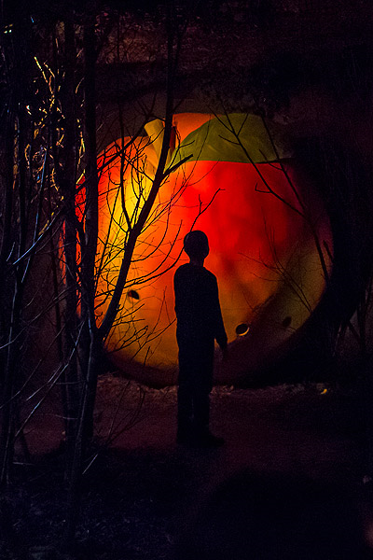

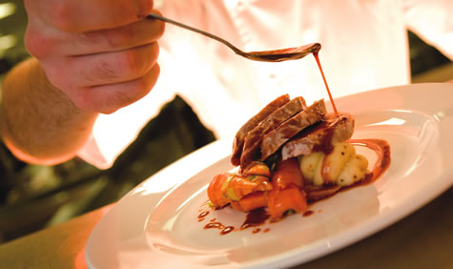
Upselling Tips & Tricks
Session Outline
Notes:
During this session I’ll talk about
Sales Training and Techniques we use @ the Centre
What we’ve done recently to increase sales for our Restaurant and how we track this.
Upselling Memberships through Ranking / Plans and Pricing Rules
Speed of sale – Our use of Quick Sale for on-the-day sales

Slide 7


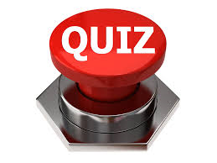

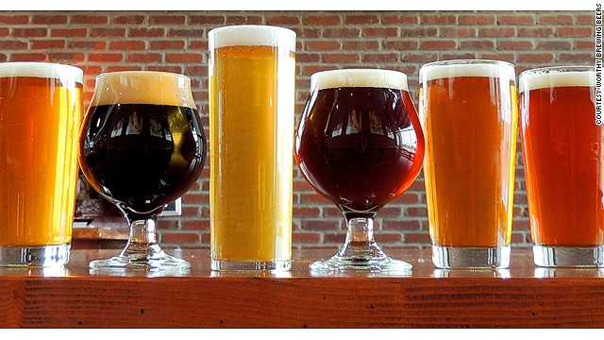

Upselling Tips & Tricks
Upselling Tips
Product knowledge
Incentives
Training
Notes:
Sales Training -
Why do we need to sell? Understanding of Staff
Any Profit made by Restaurant helps pay for Creative & Learning Opportunities
Customer Experience – enhancing night for customer, adding to memorable occasion
How do we sell? Methodolgy (Attention / Interest / Match / Close)
Confidence in why we’re doing this.
Know your product – Guest Speakers / CCA led quizzes
Incentives – Currently for Restaurant Sales – Team and Individual Prizes Ranging from shop vouchers to bowling & beer to Parkour / Trampolining at Go Air. Team Prizes – vouchers for our restaurant amount ranging £5-£30 per person depending on target reached.

Slide 8
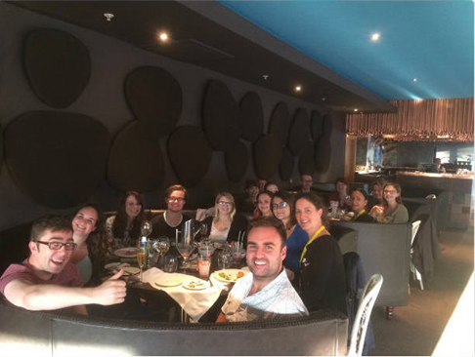
Upselling Tips & Tricks
Upselling Restaurant Meals
Notes:
Staff Engagement – Night out in our Restaurant
Staff Tasting Food and Cocktails – good time by all
Successes in Sales since Sept….

Slide 9



Upselling Tips & Tricks
Upselling Promise Memberships
Advanced Notice and/or Priority Booking
Access to our online members' area for updates, special offers and discounts
20% discount at our Restaurant & Bars
'Buy One Get One Free' on all hot drinks at our coffee shops
Notes:
Individual Membership is £35 / Joint is £50
For this they get:
Most of the Offers are for the our main stage productions so target our most regular bookers

Slide 10
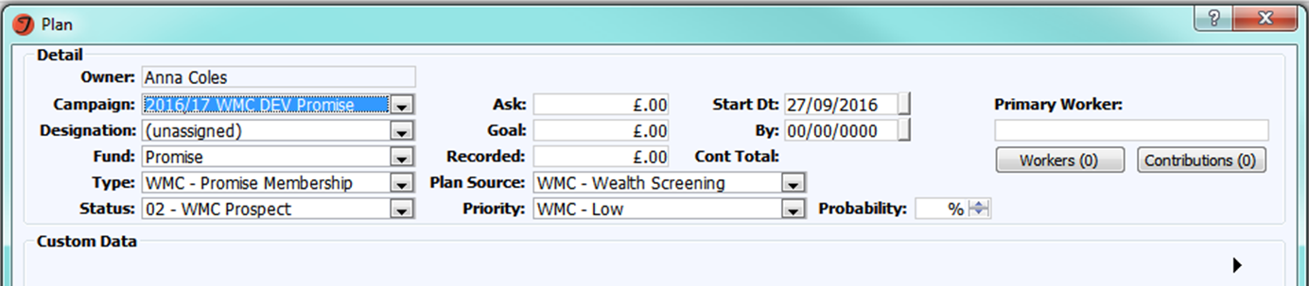
Upselling Tips & Tricks
Identify Potential Prospects
4,555 – Potential Promise Prospects
Notes:
Our procedure identifies those who are potential promise prospects by looking at people who have booked 3 or more shows in our DGT theatre within the last year.
It excludes:
All members both past and present
Anyone in a household with a member
Press contacts, Trusts, Donors, Sponsors, Group Bookers & Corporate Members
Tickets that have been booked using a Staff Offer, Staff Comp, Comp, Resident & Company Member price type
Tickets that were sold at £0
Searching the entire database for people who fit into this category pulled backed 4,555 constituents – we only currently have around 2,000 members on our lowest level scheme.
Overnight Procedure – Adds Promise Prospect rank onto the constituent / Adds a Plan within the current years membership campaign

Slide 11
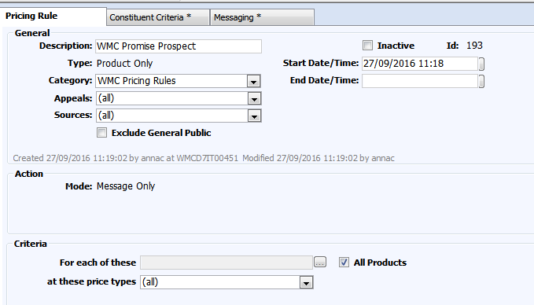
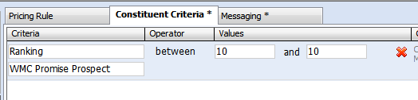
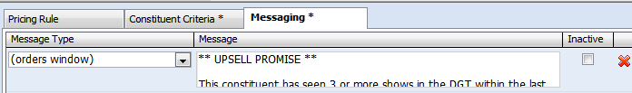
Upselling Tips & Tricks
Pricing Rule Setup
Setup a Pricing Rule that is triggered by the rank type and value
Notes:
To get this working with pricing rules we setup a pricing rules that is triggered by the rank type and value of 10.
On setup:
- Add the pricing rule as product & message only, to be available on all products at all price types
The constituent criteria is Ranking between 10 & 10 for WMC Promise Prospect
The messaging tab controls where you want the message to appear and what you want to message to say.

Slide 12
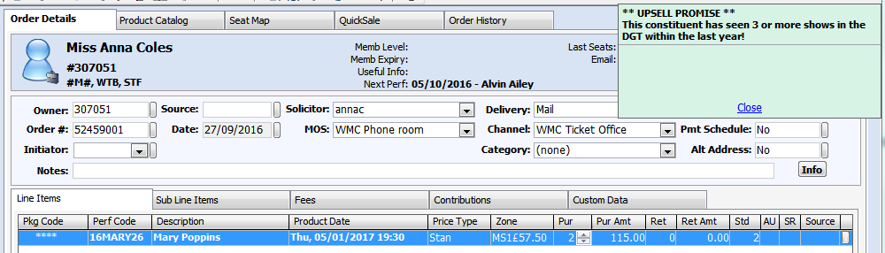

Upselling Tips & Tricks
Order Screen
Next time a prospect books over phone/front counter, the Contact Centre Assistant will be prompted to upsell promise:
Notes:
When a customer who has been identified as a prospect next books on the phone or at our front desk the CCA will see a pricing messaging rules advising them to upsell promise membership as the customer has booked enough times within the last year to have gained some form of benefit from the membership.
The CCA will then upsell Promise and ask if they want to join.

Slide 13
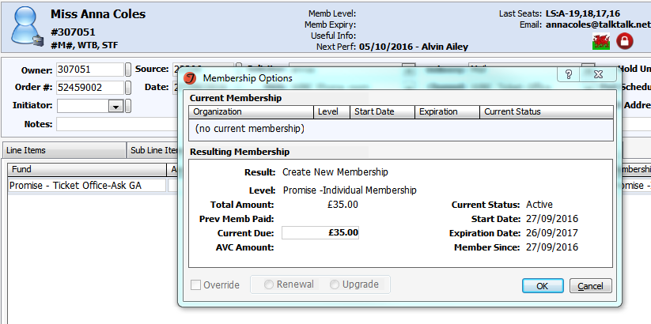
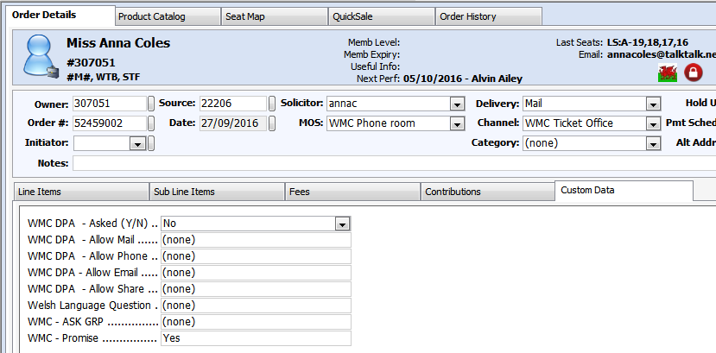
Upselling Tips & Tricks
If Yes:
The Contact Centre Assistant processes the membership as normal.
And logs ‘Yes’ in the WMC – Promise Custom tab.
Notes:
If they have opted to buy the membership:
The CCA will process the membership as normal and the customer will become a member.
They will also log, via the custom data tab that the person has opted into a Promise membership.
If No, then CCA would log via custom tab that the customer declined Promise membership
Or another option for “More Information”. This then will add an attribute overnight. We can then use scheduled report to identify info requests.

Slide 14
Upselling Tips & Tricks
Future Considerations
2 or more opening night bookings
2 or more bookings on public on-sale
2 or more restaurant bookings
Notes:
Once we have fully rolled this procedure out and it’s successfully working we will look to expand the criteria that a constituent needs to fall into in order to gain membership benefit.
Examples include:
2 or more restaurant bookings
2 or more opening night bookings
2 or more bookings on a public on-sale date.

Slide 15
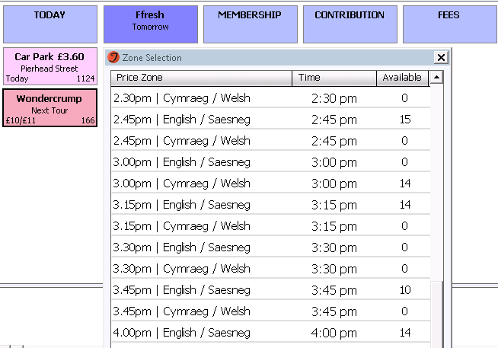
Upselling Tips & Tricks
Quick Sale
Notes:
To Improve speed of sale we’ve started to use the Quick Sale feature for Car Park Vouchers and On-the-day Tours.
We’ve currently a Roald Dahl Exhibition that has tours every 15 mins in either English or Welsh. That’s a total of 66 possible tour times. To make it quick to search through the CCA quicks on the “Quick Sale Tab” in the Order Screen, then this screen pops up. They can then easily scroll through to see which tours still have availability at a glance.

Slide 16
Upselling Tips & Tricks
Thank you for listening!
Liz Baird
Contact Centre Manager
Liz.Baird@wmc.org.uk

Slide 17
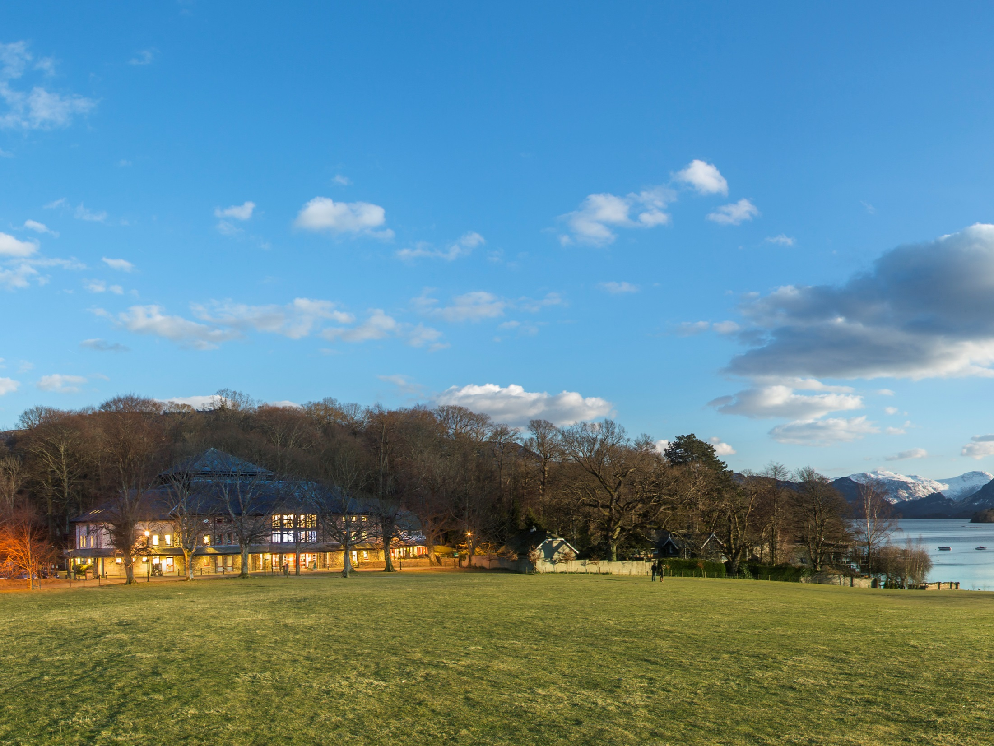

“The most beautifully located and friendly theatre in Britain”
The Independent

Slide 18
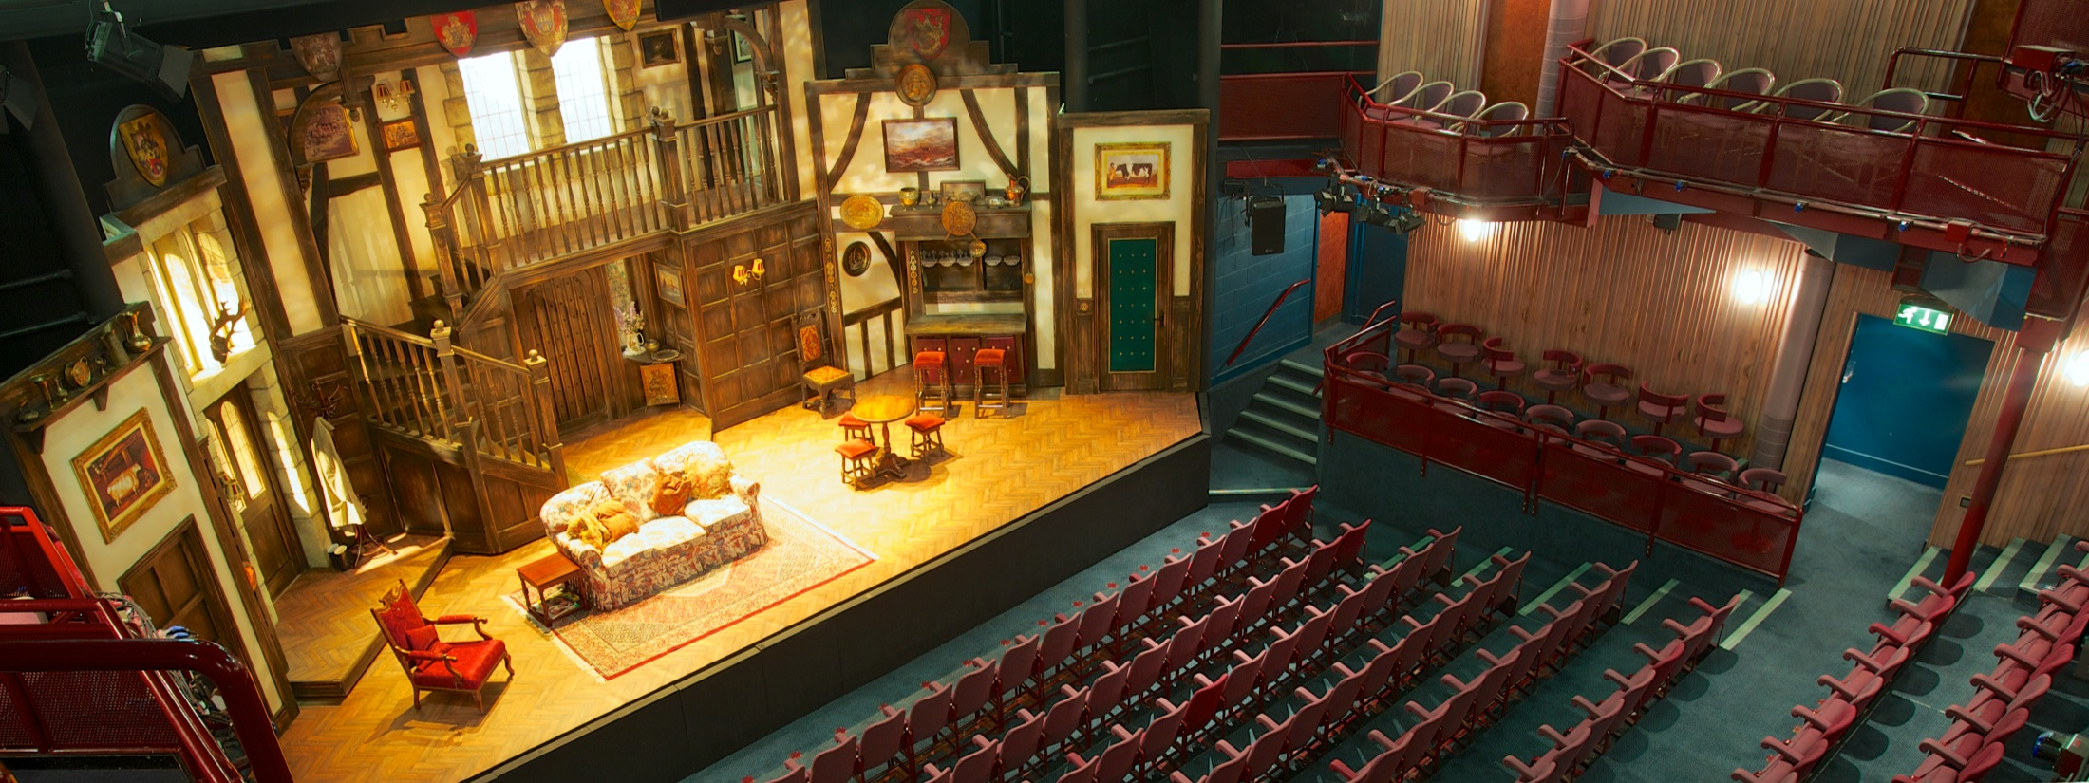
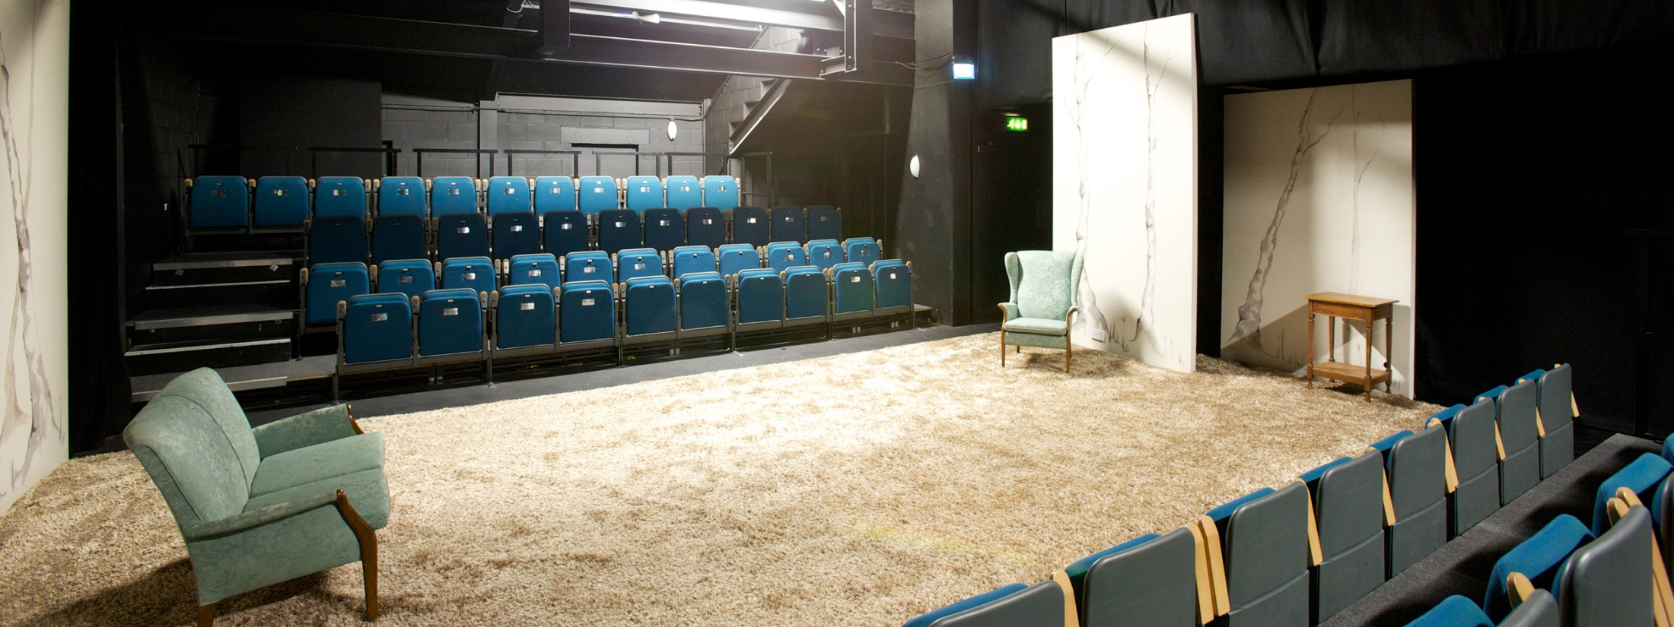
Main House
Studio

Slide 19
Main House
Studio

Slide 20
Open: 364 days a year
750 performances:
9 in-house productions
Visiting work
Festivals (inc. Words by the Water,
Jazz Festival, Mountain Festival)
Annual audience: 135,000

Slide 21
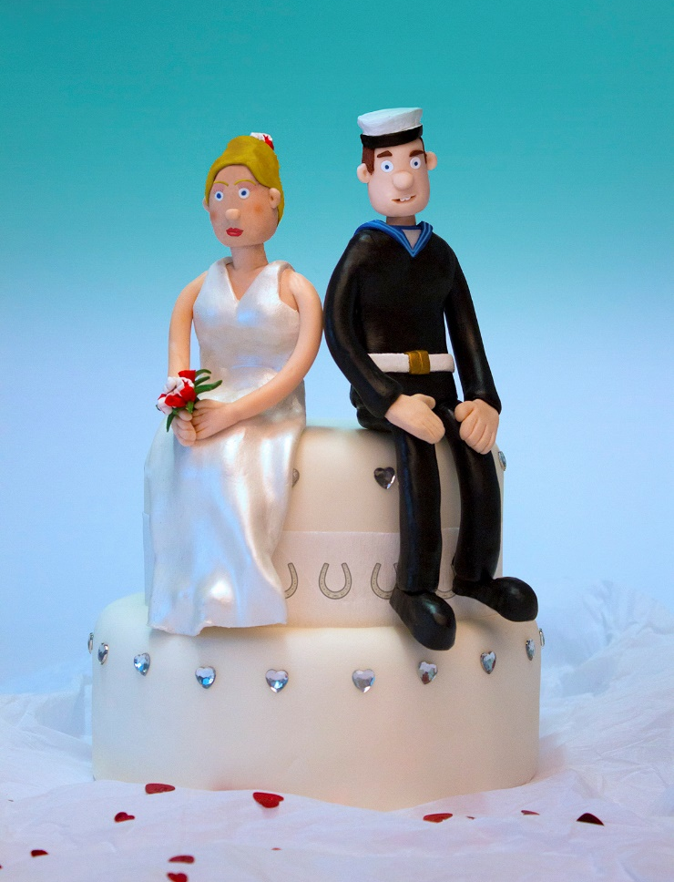

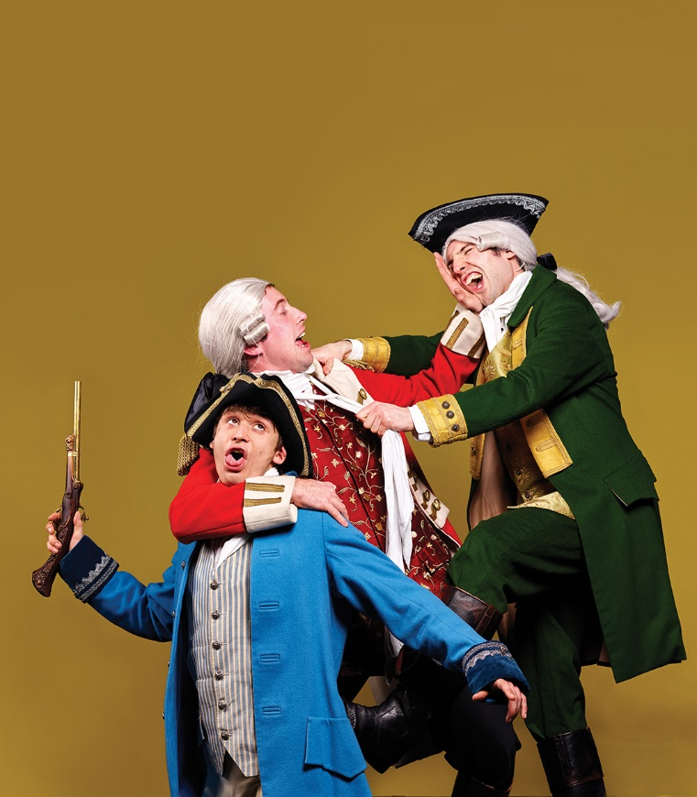

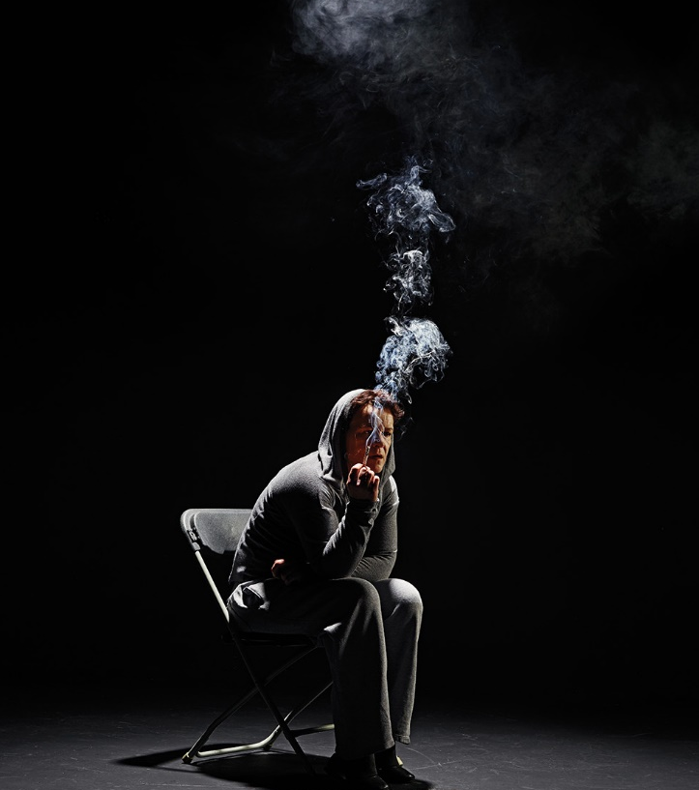

Summer Season 2016

Slide 22


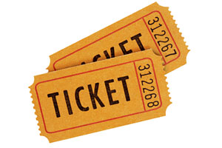
Pricing Rules
The idea
Tessitura define Pricing Rules as:
“Pricing rules are used to trigger automatic price changes and deliver messages based on selected order, product, and constituent criteria.”
Two types of rule:
Price
Messaging
Notes:
Pricing Rules are triggered when a change is made to the basket that makes the order meet the criteria set by the rule.

Slide 23
Price Rules
Price Type Change
Full SplOffer
Price Change
£25 £19.95

Slide 24
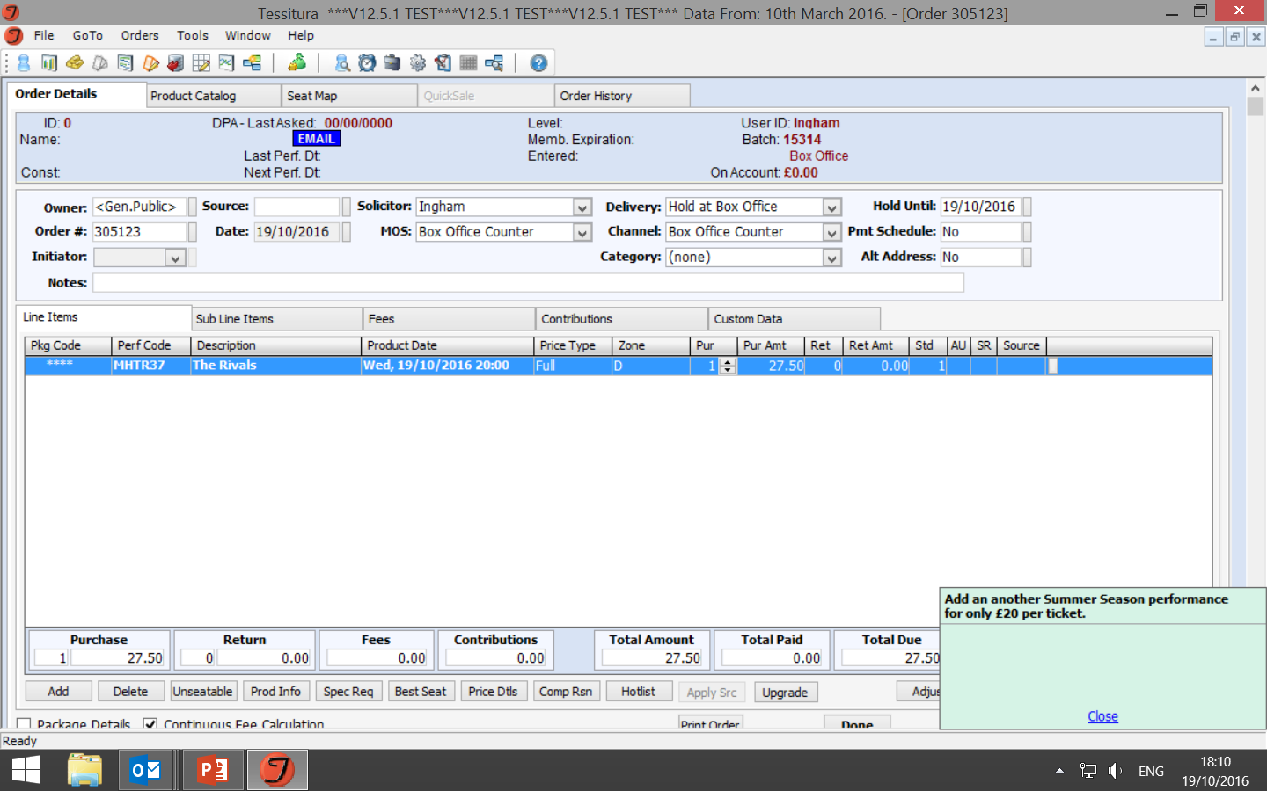
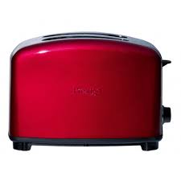
Messaging Rules
A rule can display
a popup message for the Box
Office operator or an online
User, alongside a
Pricing Rule or as a
message only.

Slide 25
Upselling with Pricing Rules

Slide 26
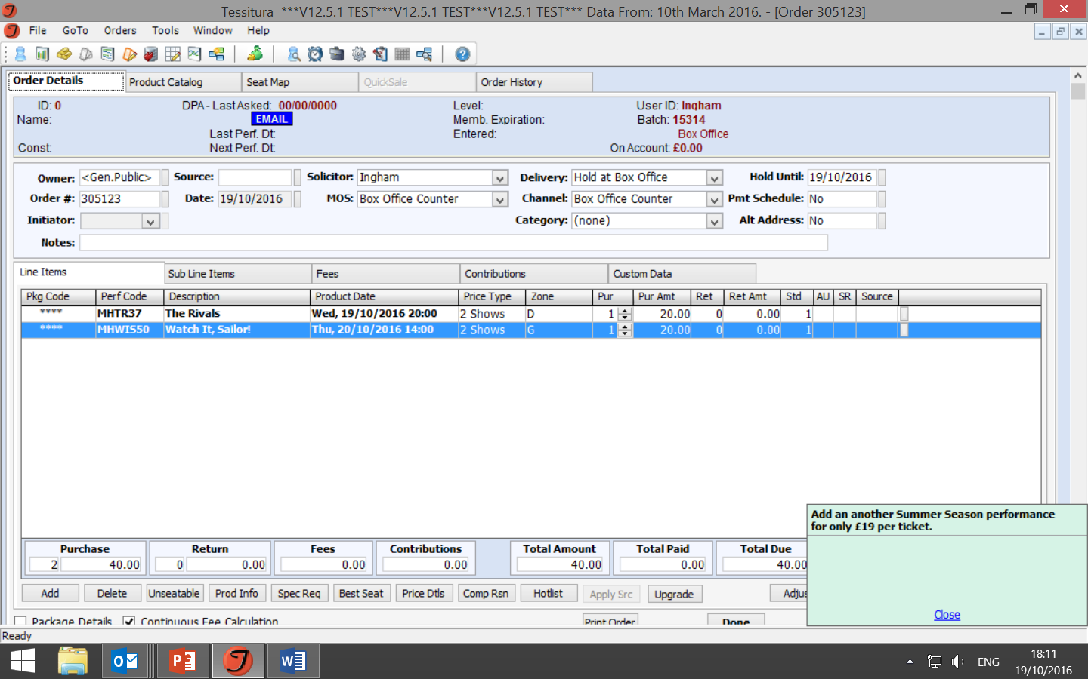
Theatre By The Lake’s Rep season, giving Pricing Rules a good rep
2, 3, 4 show mini season tickets:
Why not add another show?

Slide 27

Group bookings

Slide 28
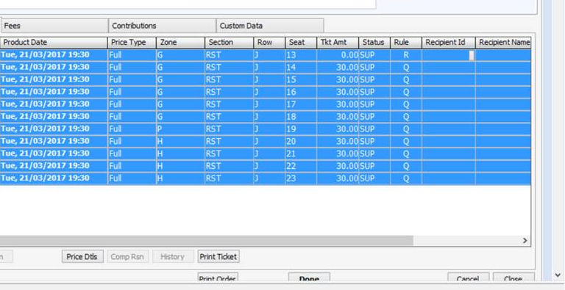
Groups
Buy 10 tickets get another one free:

Slide 29
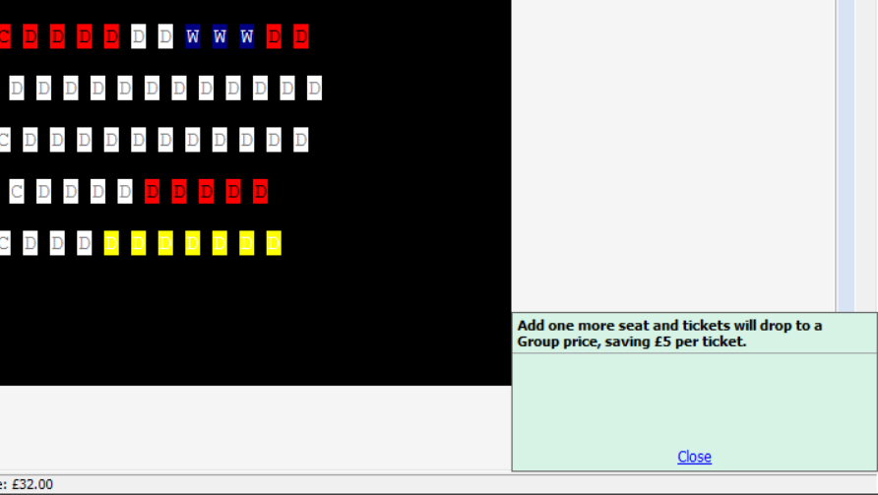
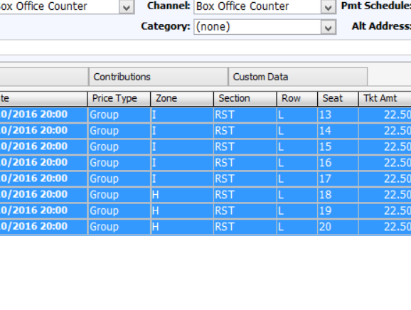
Groups
Buy more than 8, save £5 per ticket:

Slide 30
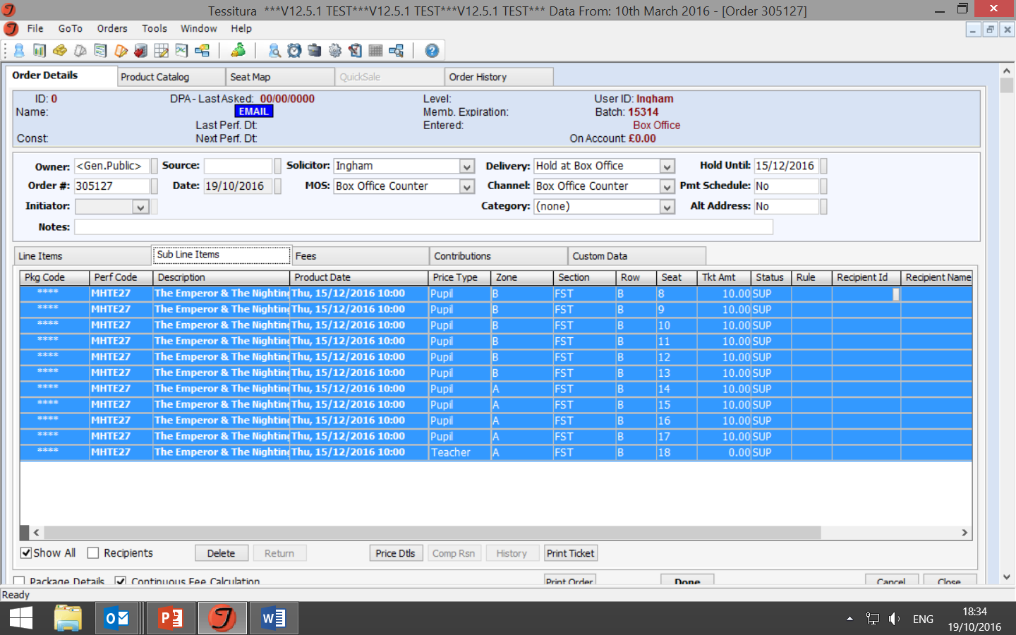
Groups: Schools
1 free teacher per 10 pupils

Slide 31
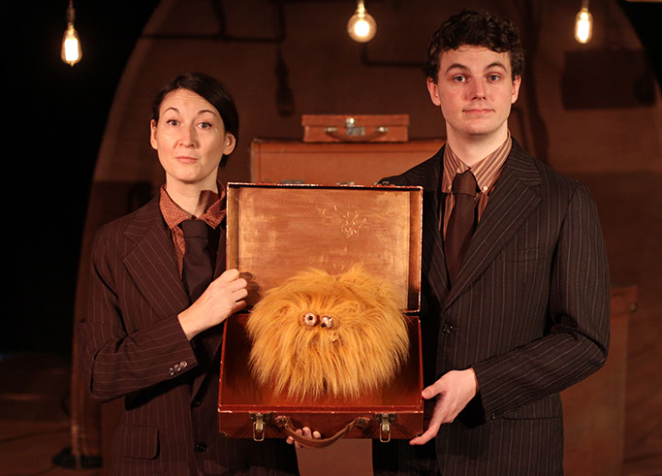
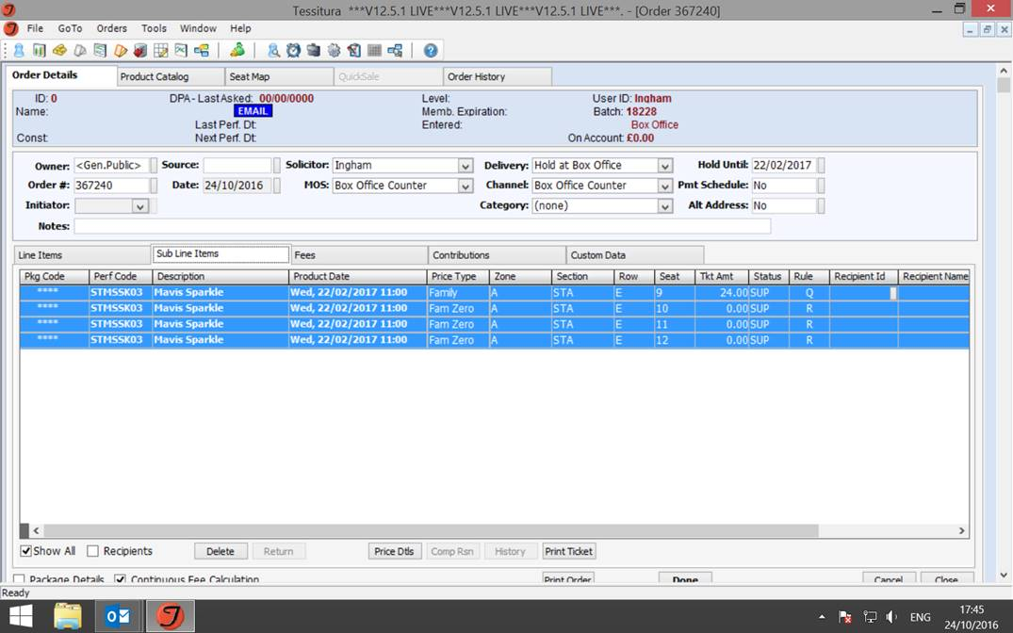
Family Tickets

Slide 32
A quick aside
Content advisories

Slide 33
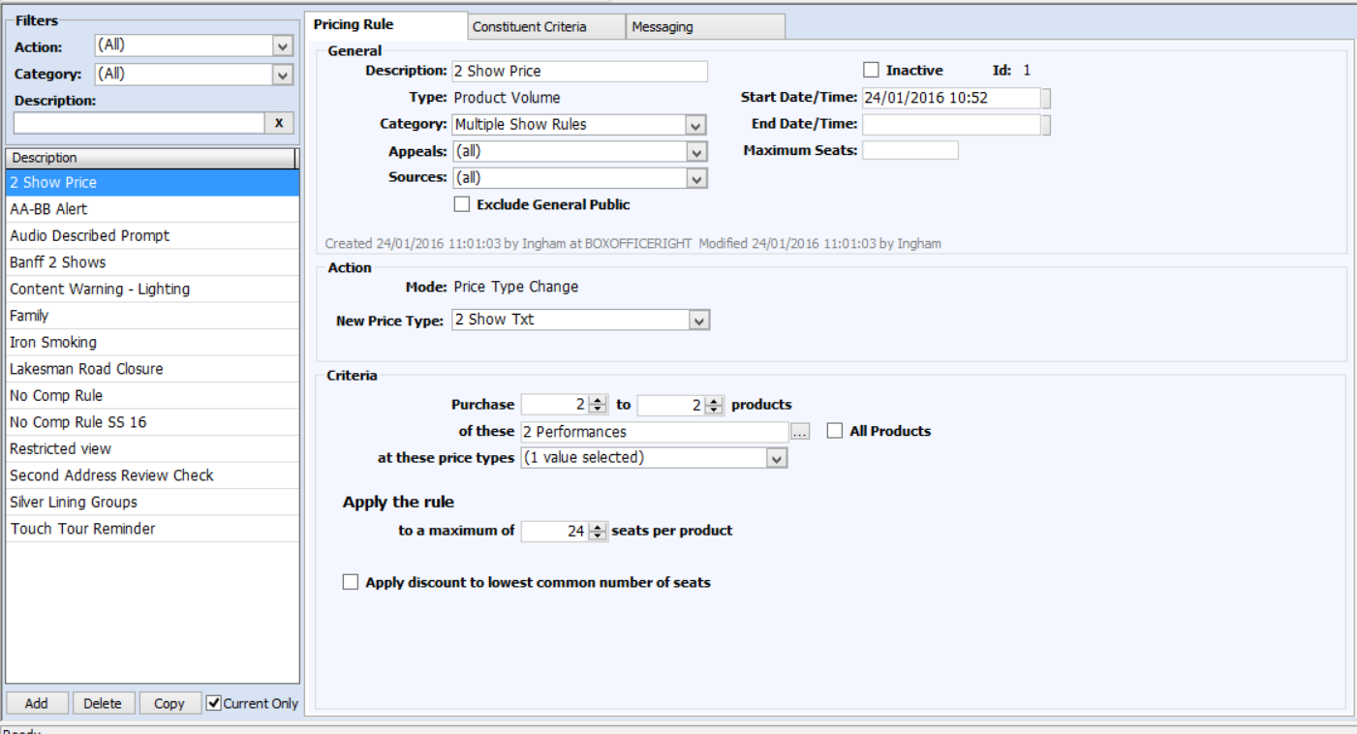
Setup
It’s not that scary…

Slide 34
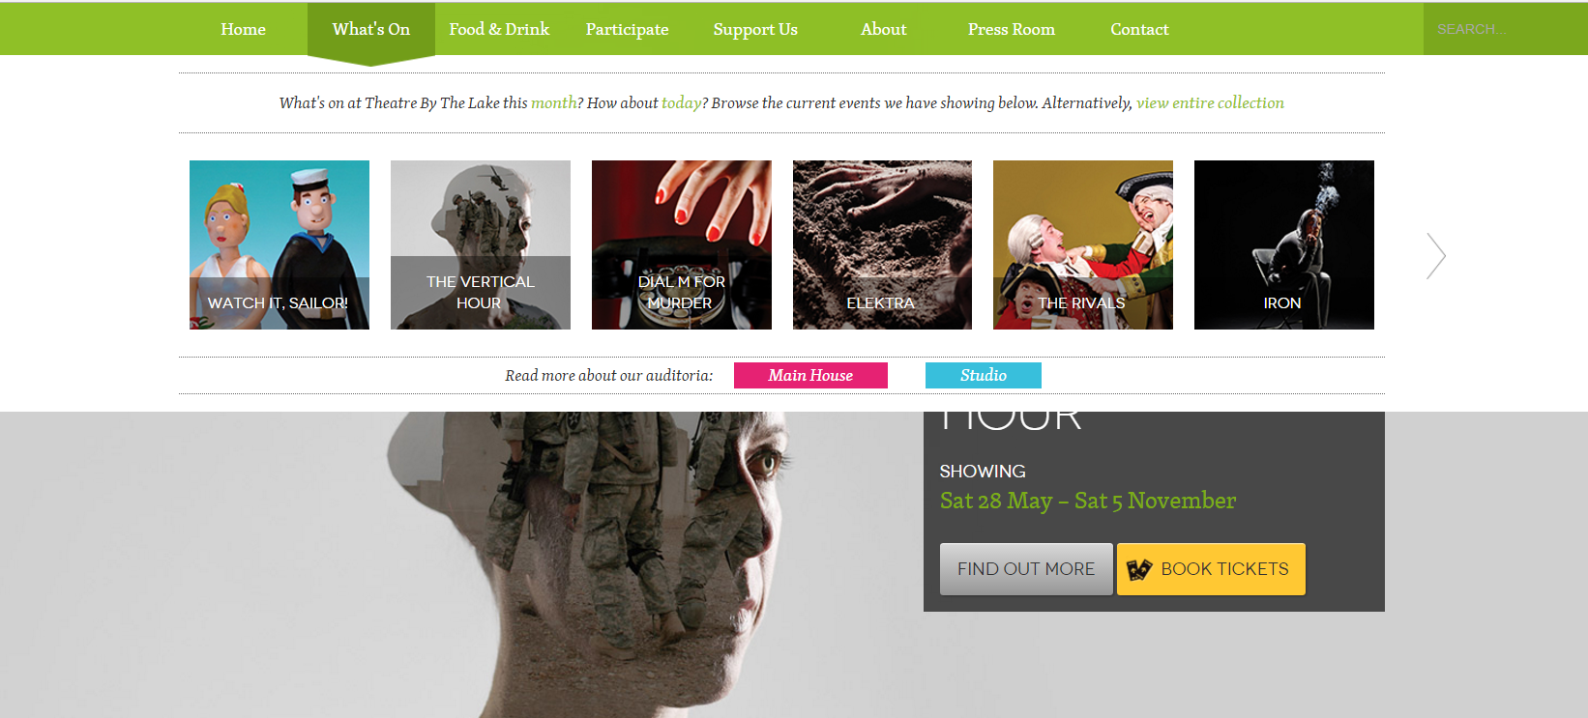
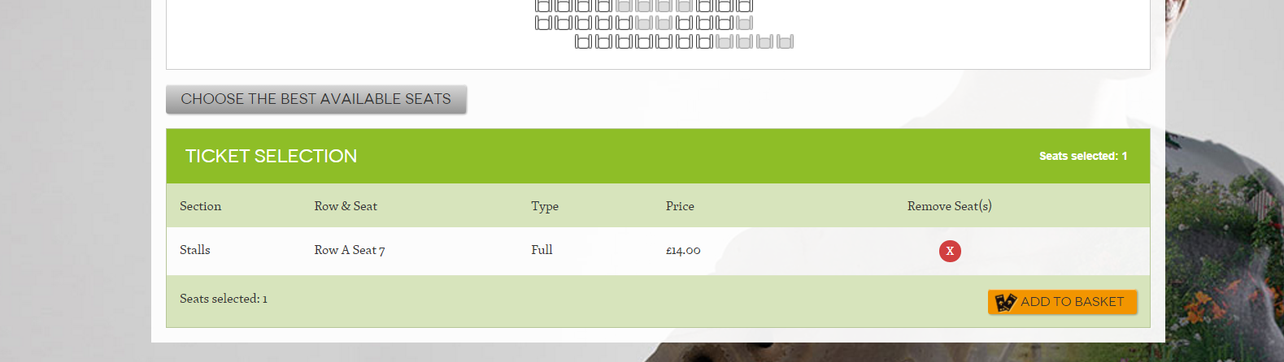

Slide 35
Any questions?
Matt Ingham
Sales Team Leader
Theatre By The Lake
matthew.ingham@theatrebythelake.com

Slide 36
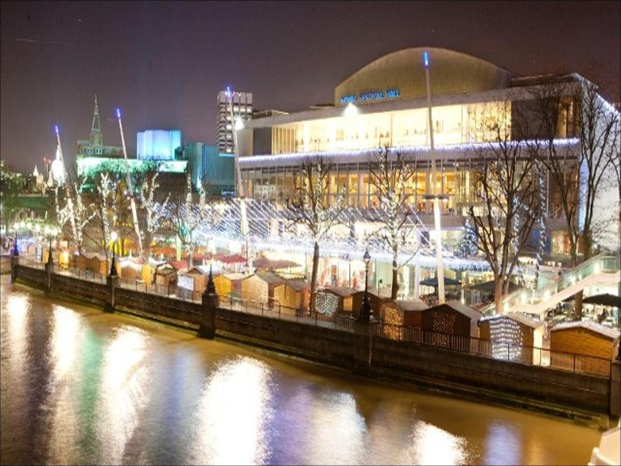
Southbank
Centre
Upselling with Tessitura

Slide 37
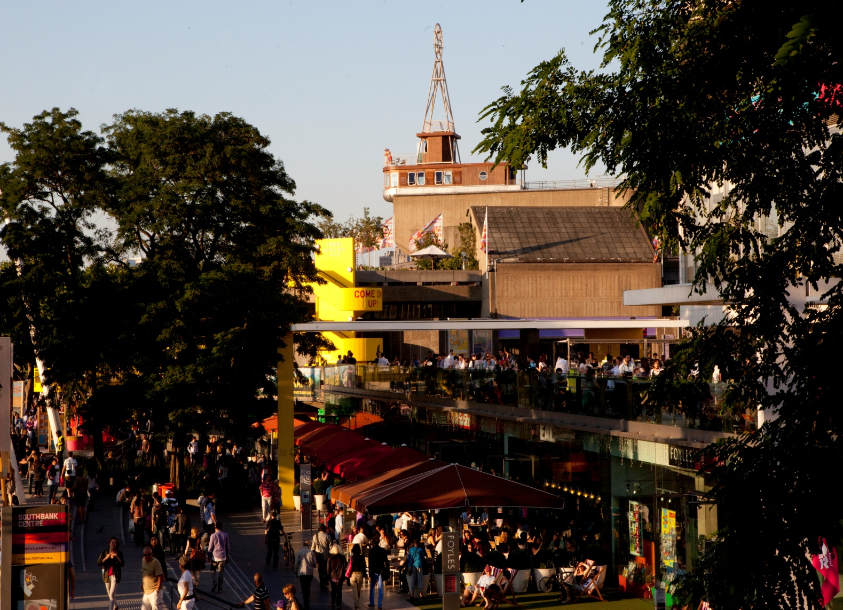
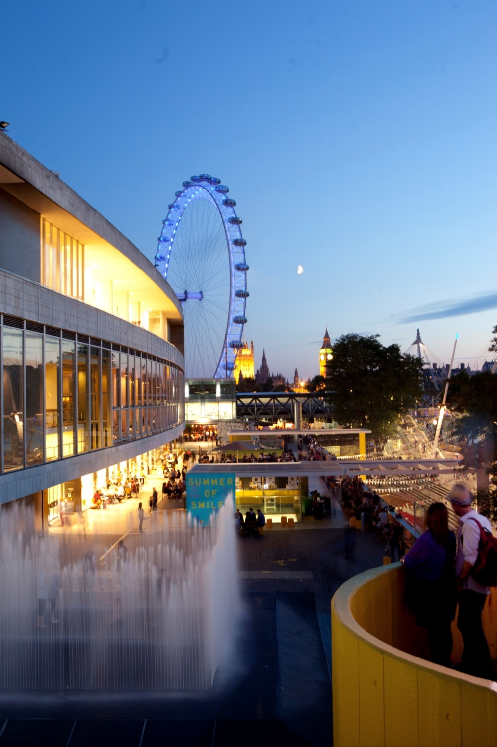
Southbank Centre is the UK’s largest arts centre occupying a 21-acre festival site.
5400 onsite events last year
3200 were ticketed
Remainder free non ticketed
Notes:
SC Overview

Slide 38

Upselling through the ages
Notes:
There has always been a desire to upsell or cross sell events. If someone buys one performance why not 2 or 3?

Slide 39

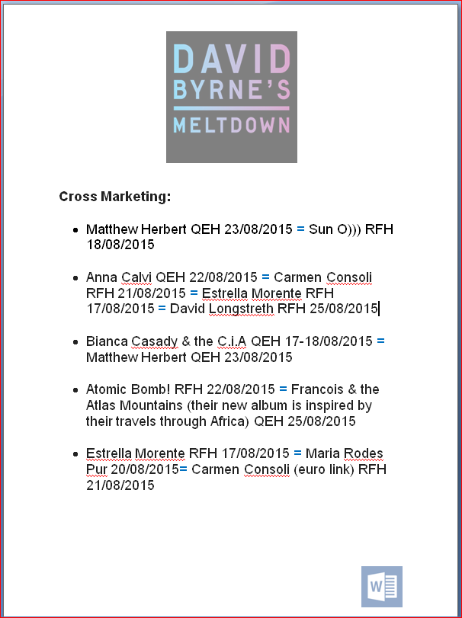

Notes:
In the old days someone from Marketing would list the events that the sales team could attempt to cross sell. These were printed and handed out ont he morning of an onsale.

Slide 40
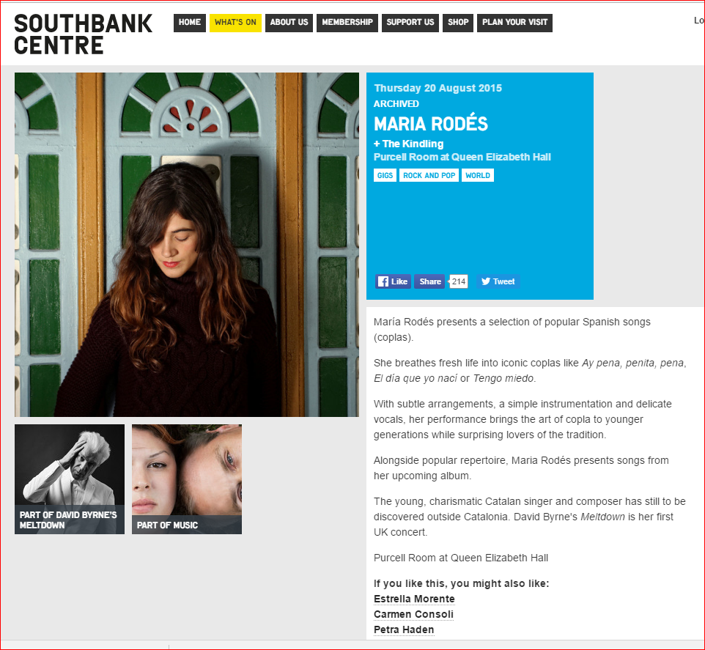

Notes:
We then advanced by adding the cross sell functionality to the web using manually added links. This does not tie in with the basket sales and need to be added each time the copy was updated.

Slide 41
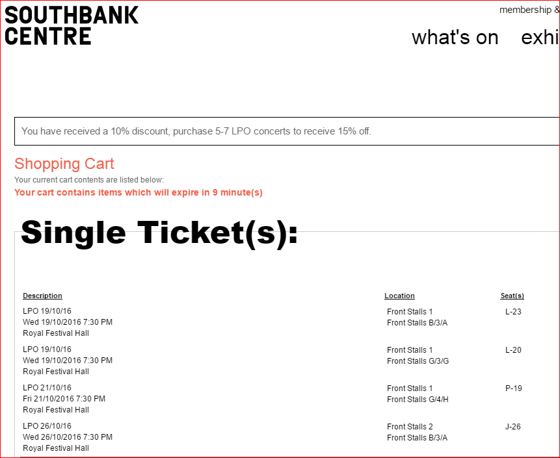
Notes:
Pricing rules is the future we now encourage series bookings with messaging and auto discounts.

Slide 42
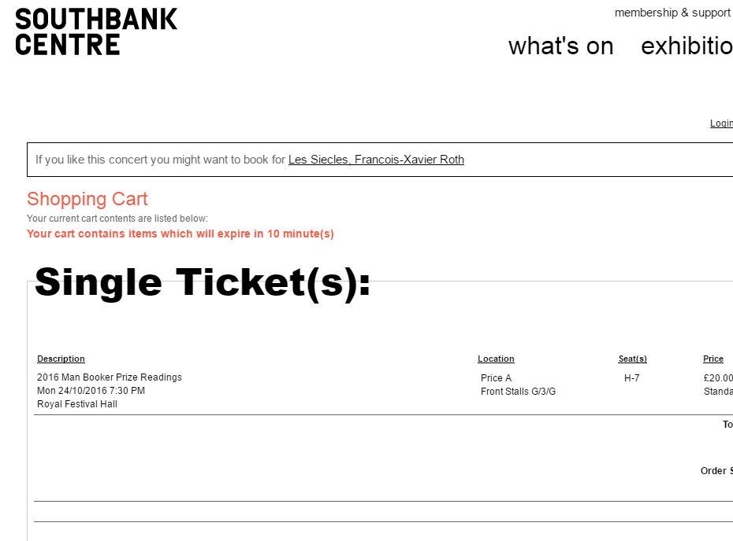
Notes:
Also to promote events once another event has been booked.

Slide 43
Donations
Money boxes
Paper forms available in the foyer
Development team
Using Tessitura!

Slide 44
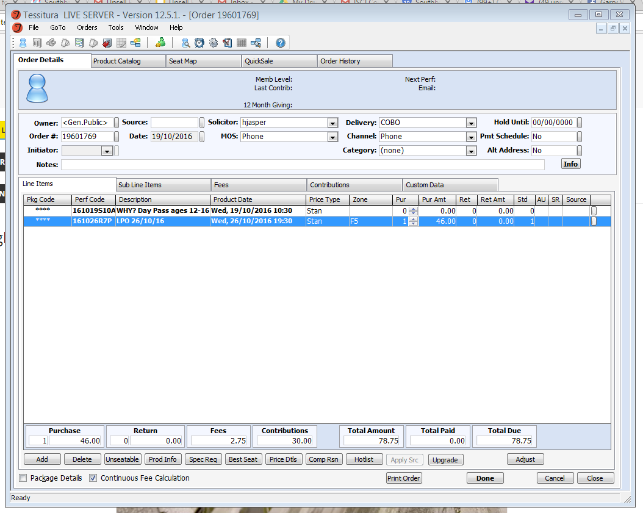
Book a ticket

Slide 45
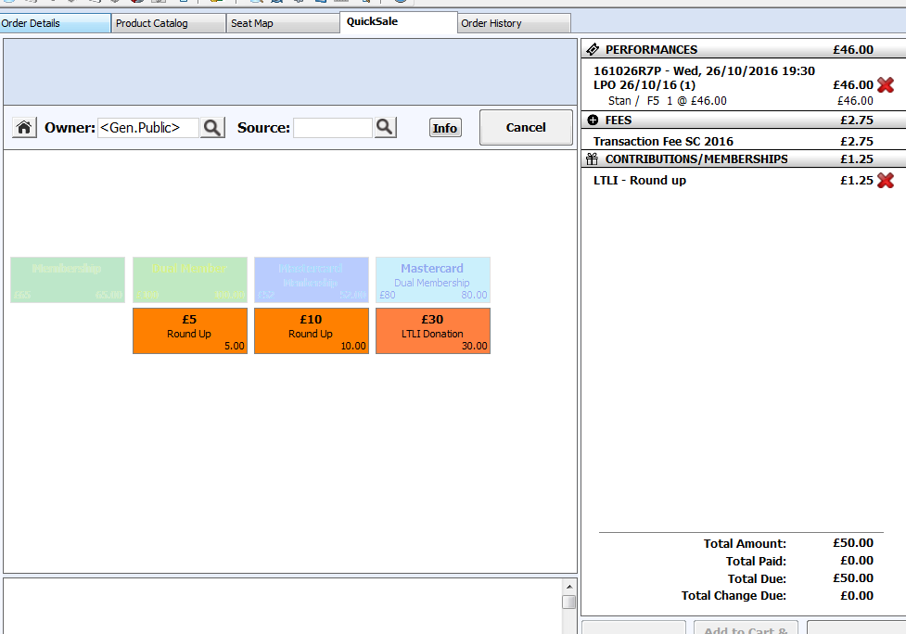
Go to the quick sale tab and choose to round up the amount to the nearest £5 or £10

Slide 46
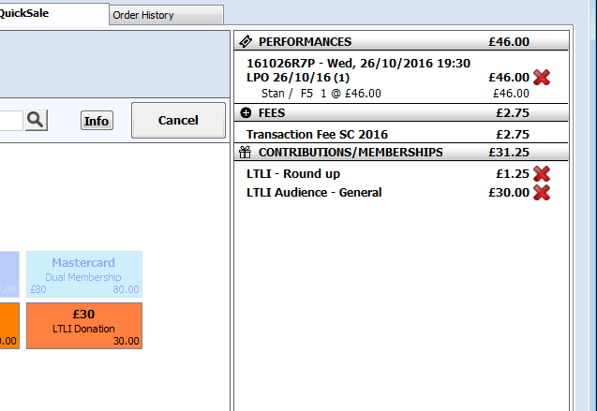
The other option is a set amount also found in the quick sale box

Slide 47
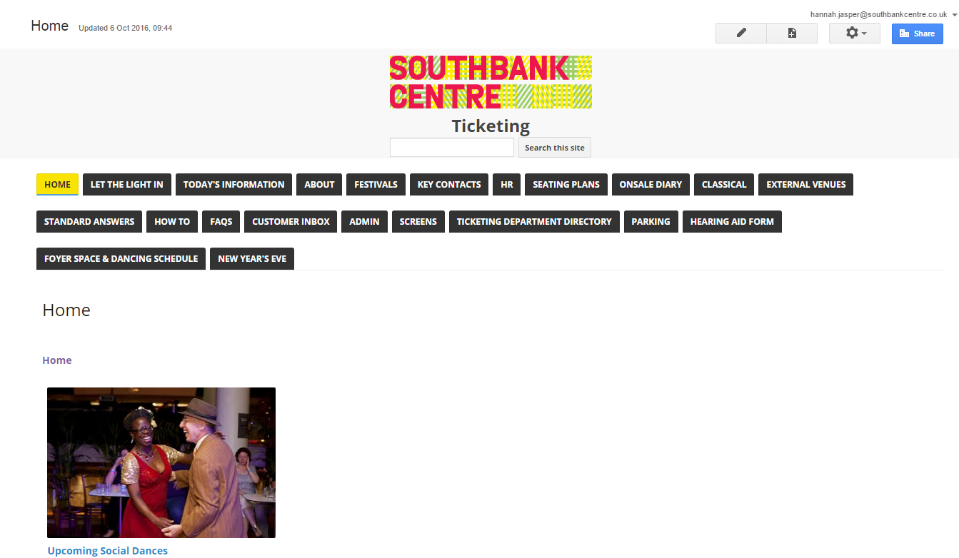
We also have our Google intranet to fall back on if everything goes wrong

Slide 48
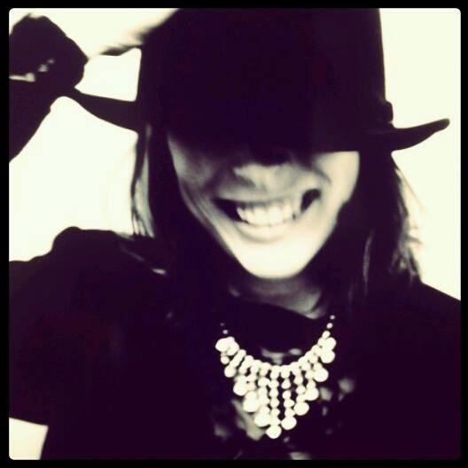
Southbank Centre
Hannah Jasper
Ticketing Operations Manager
hannah.jasper@southbankcentre.co.uk

Slide 49
QUESTIONS?
“If I am occasionally a little over-dressed, I make up for it by being always immensely over-educated.”
Oscar Wilde, The Importance of Being Earnest
Notes:
Welcome

Slide 50


WHAT’S NEXT?
LUNCH 12.15-13.15
Hogan Foyer / Hogan Suite
Sponsored by:
BREAKOUT SESSION SIX
13.15-14.15
Notes:
FRIDAY Breakout session 5 What’s next slide

