Slide 1

TESSITURA
EUROPEAN
CONFERENCE
DUBLIN 2016
Notes:
Welcome

Slide 2



MODERATOR
Graeme Ellis : Science Museum Group
PANEL
Liz Moon : National Theatre
Melanie Ryan : City of Birmingham Symphony Orchestra
PERSONALISATION AND CREATING ENGAGING CONTENT
It’s going to get personal!
CONTENT PLANNERS
Kyle Jarvis : National Theatre
Melanie Ryan : City of Birmingham Symphony Orchestra
Share your favourite content and photos! #TECDublin16

Slide 3

Liz Moon
Marketing Officer
lmoon@nationaltheatre.org.uk

Slide 4

At the National we make world-class theatre that is entertaining, challenging and inspiring.
And we make it for everyone.

Slide 5
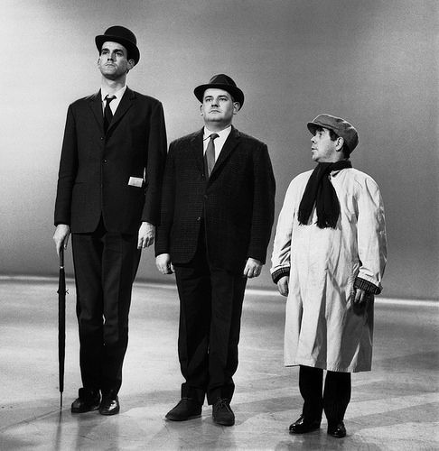
Segmentation
Recency/Frequency
Browsing habits

Slide 6
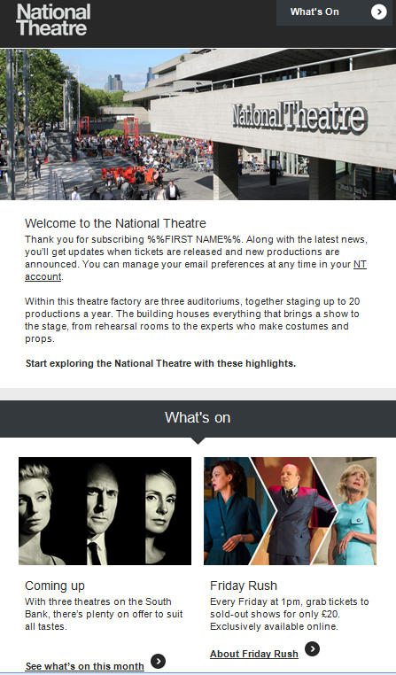
Welcome
‘Thank you for subscribing, Liz’
Recommendations.

Slide 7
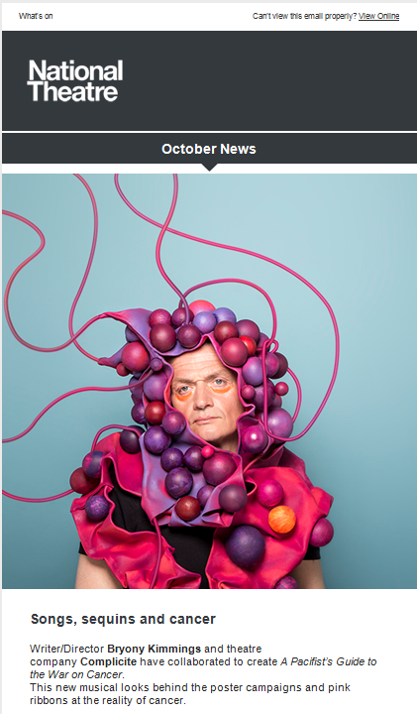
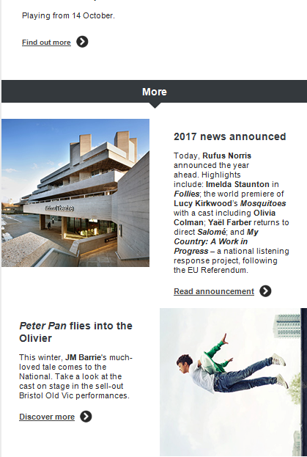
NT News
Main production
Sub-section

Slide 8
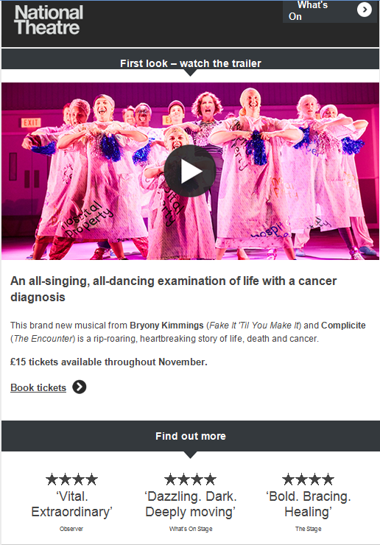
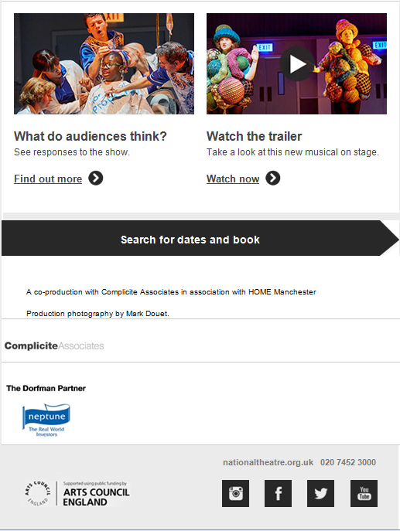
Web-tracker
Video

Slide 9
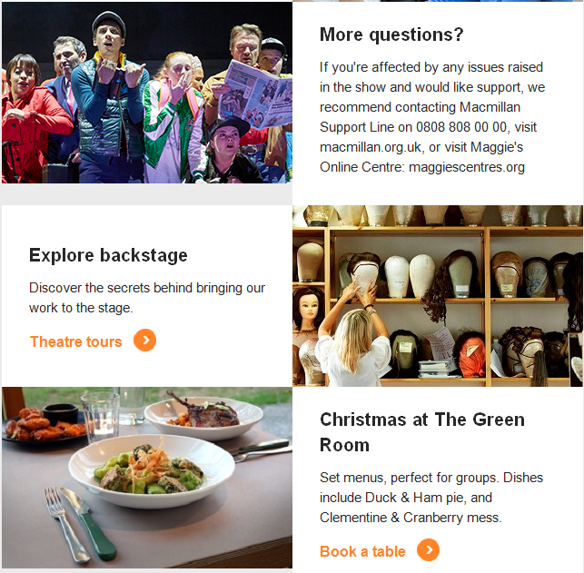
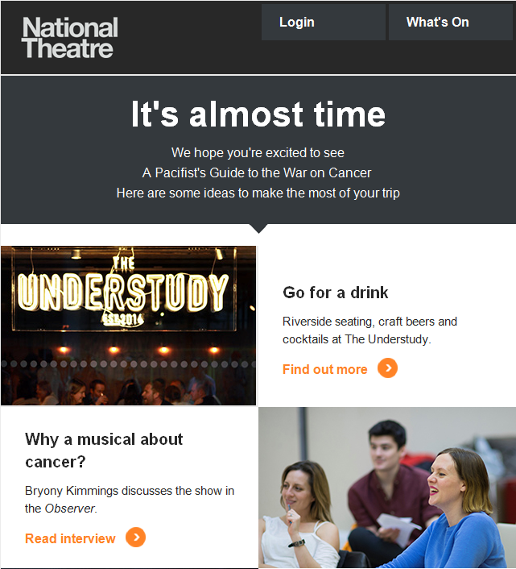
Pre-show
Show specific

Slide 10
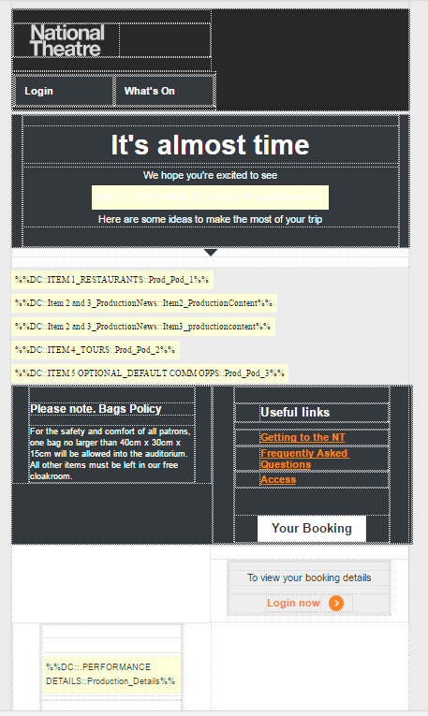
‘IF’ Rules
If production = X then content = Y

Slide 11
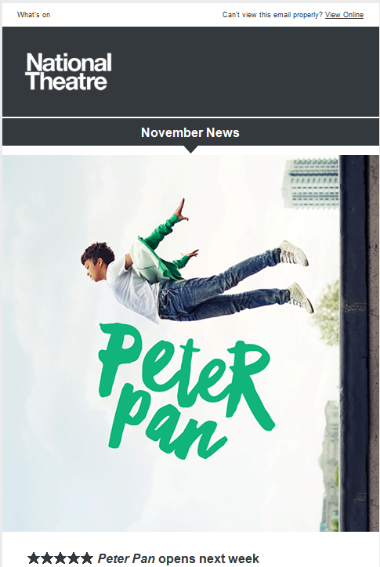
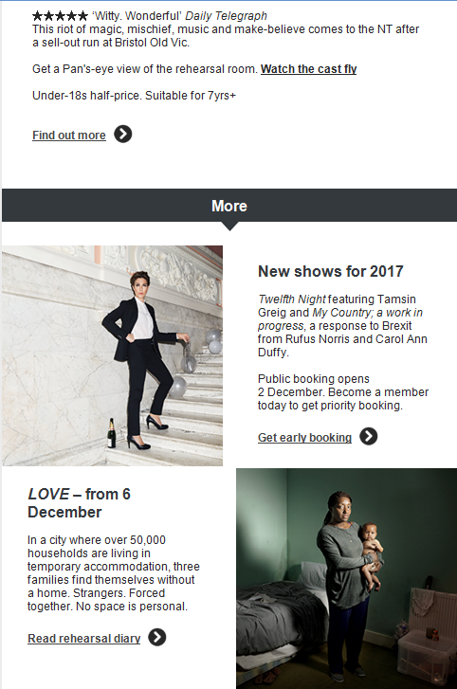
NT News
Main production
Sub-section
Sub-section using if rule

Slide 12
What’s next?
Real-time personalisation
Real-time segmentation
Automation

Slide 13


Slide 14
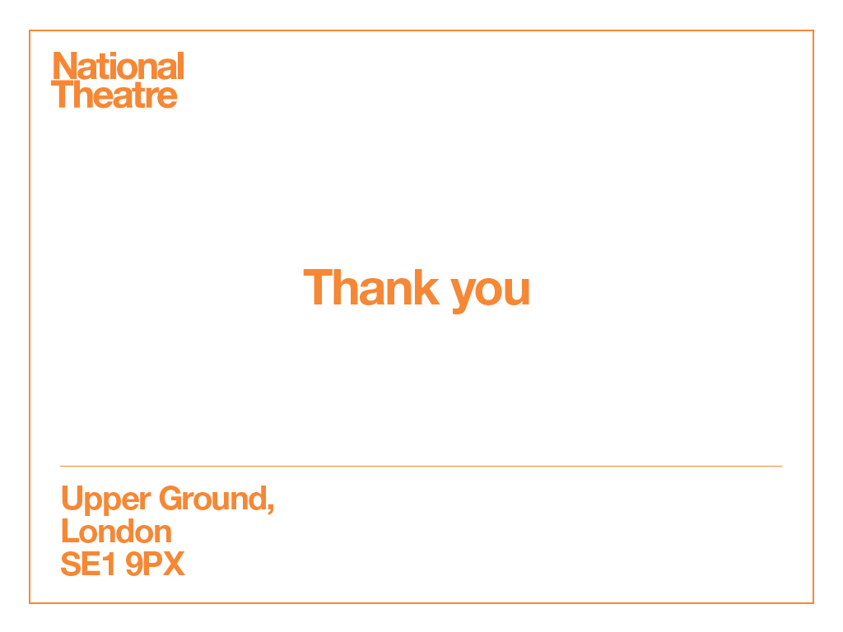
Liz Moon, Marketing Officer
lmoon@nationaltheatre.org.uk

Slide 15

PERSONALISATION
It’s Going to Get Personal
Melanie Ryan CRM & Insight Manager

Slide 16
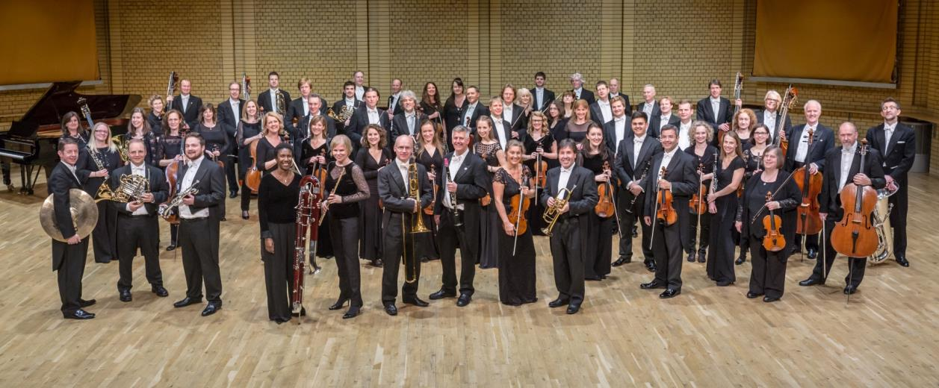
WHO WE ARE
Upstream Photography
Notes:
Resident Orchestra at Symphony Hall
Global reputation

Slide 17
PERSONALISING
OUR SEASON LAUNCH
Season Launch generates 1/3 of Birmingham Season income
Mix of offline (postal) and online
Highly Personalised Offline – next year online too!

Slide 18
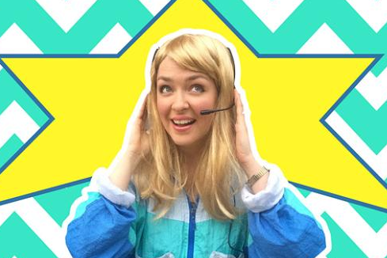
THE CHALLENGE…
Multiple parameters – 100s of possible combinations
Driving…
the mailing pack’s physical contents
the messages

Slide 19
WHAT TYPE OF CUSTOMER
Drives… | Key Message | Other Messages | Physical Pack Contents
Member (x 10 levels) | Priority booking date for Member Level | Core Classical Tailored Events copy | Hand-signed at higher levels Member Events booking sheet
Fixed Concert Package (x 10 series) | Renew! Exact Series and Seat renewal details | Core Classical Benefits of renewing | Personalised Fixed package renewal form
Flexi Concert Package (x 9 frequency bands) | Renew! Book 1 more concert than last year = Free Concert | Core Classical Benefits of renewing | Part personalised Flexi package renewal form
Group Booker | Group Offer benefits | Populist & Matinee events
Other past attenders | Book package to save | Product message tailored to Segment
Access scheme, comes on CBSO coach…. |  |  | Disabled Parking ballot Coach booking form

Slide 20
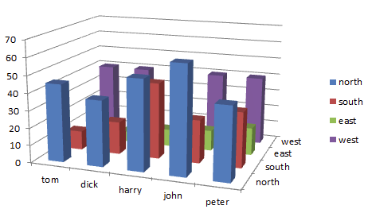
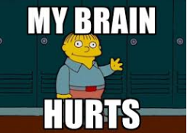
Customers can be any combination of these. So we needed…
Or even
more
dimensions…
Notes:
Multiple dimensions

Slide 21

LUCKILY…
Extraction Manager & Output Sets
Mailmerging logic

Slide 22
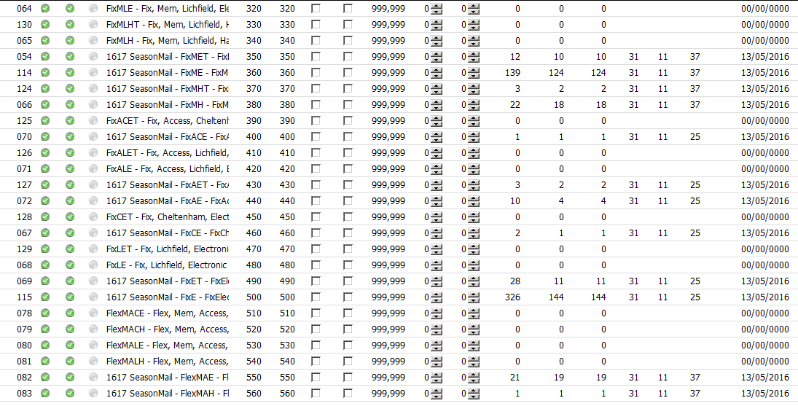
EXTRACTION MANAGER to manage segments receiving differing pack contents
Notes:
80 possible pack combinations.
Created Extraction segments for all possible physical pack combinations of inserts/ handsigned or not.
40 had customers that qualified for the segment, some with 1 customer in, some with hundreds in.
Extraction file contained segment number so we could then filter on what would be in-house/mailing house, print off each segment and fulfil separately.
Can re-use Extraction structure next year.

Slide 23
MICROSOFT WORD creating our Covering Letters - one master, endless versions…
1. Paragraph structure
Para A = introductory paragraph
Para B = artistic season copy
Para C = renew/ book package message, etc
2. Different versions of each paragraph
eg (B0, B1, B2… B6) - on customer type
3. One ‘library’ Word document of all versions
each paragraph has a bookmark
4. One Word letter, with ‘If… then’ merge field for each paragraph
taking to bookmark location in library document
Notes:
In the paragraph versions, Some ‘If… then’ merges for minute detail (eg member level priority date)

Slide 24
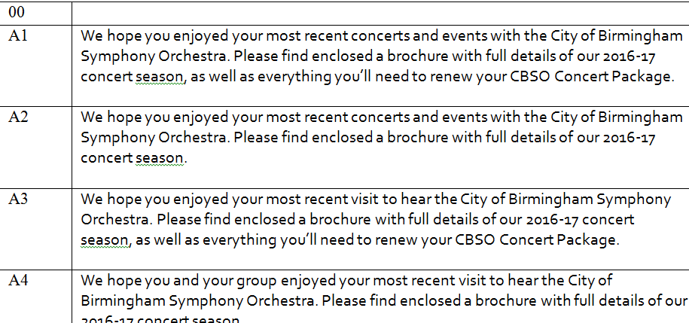
INTELLIGENT PARAGRAPHS

Slide 25
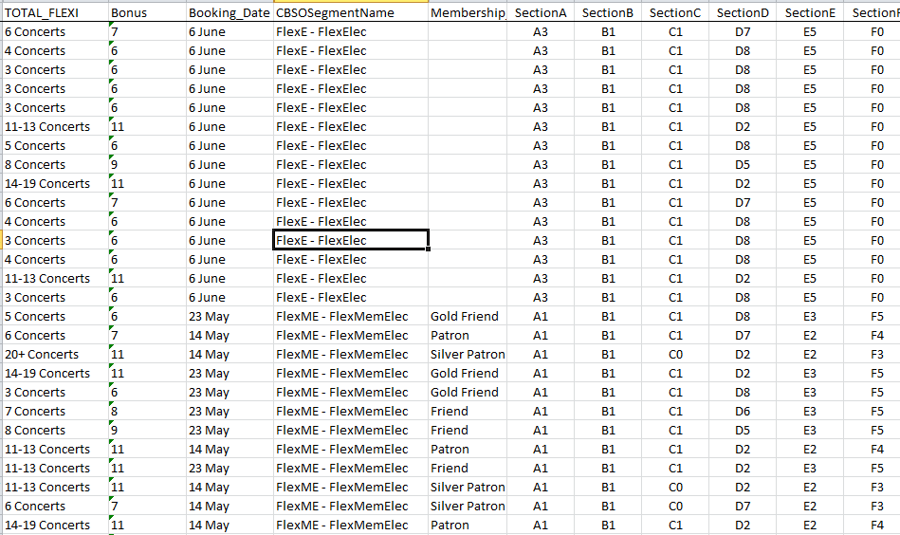
DATA MERGING
Standard and Customised Output Set Elements
Excel Extraction data, column for each paragraph
Notes:
Saved us writing over 50 core versions of letter, and then mailmerging the finer detail into each of those. If a pack was lost in the post, could reprint the exact letter from one master for that customer
Some custom output set fields too – give some examples

Slide 26
WHAT HAPPENED?
Personalised messages giving relevant messages/ incentives
Other factors…
Impact of new Music Director
Stronger Package Messages (to avoid new THSH booking fee)
Packages
£78k/ 3251 more tickets sold through packages
Priority Period
23% increase in £s and # Tix
32% increase in # Bookers
Overall (2 months in)
10% increase in £s
9.7% increase in # Tix
705 more people booked
Notes:
Helped that we had strong messaging anyway
- extraction segments to drive physical pack content
- output elements and Visual Basic in macro in Excel to drive conditional merges of fields and paragraphs in the letter
Resulting in... highly personalised letters and packs that reflected their past behaviour and preferences and gave them relevant renewal & upgrade incentives/ messages about the new season. So far sales are good!
Including much higher open rates for personalised emails

Slide 27
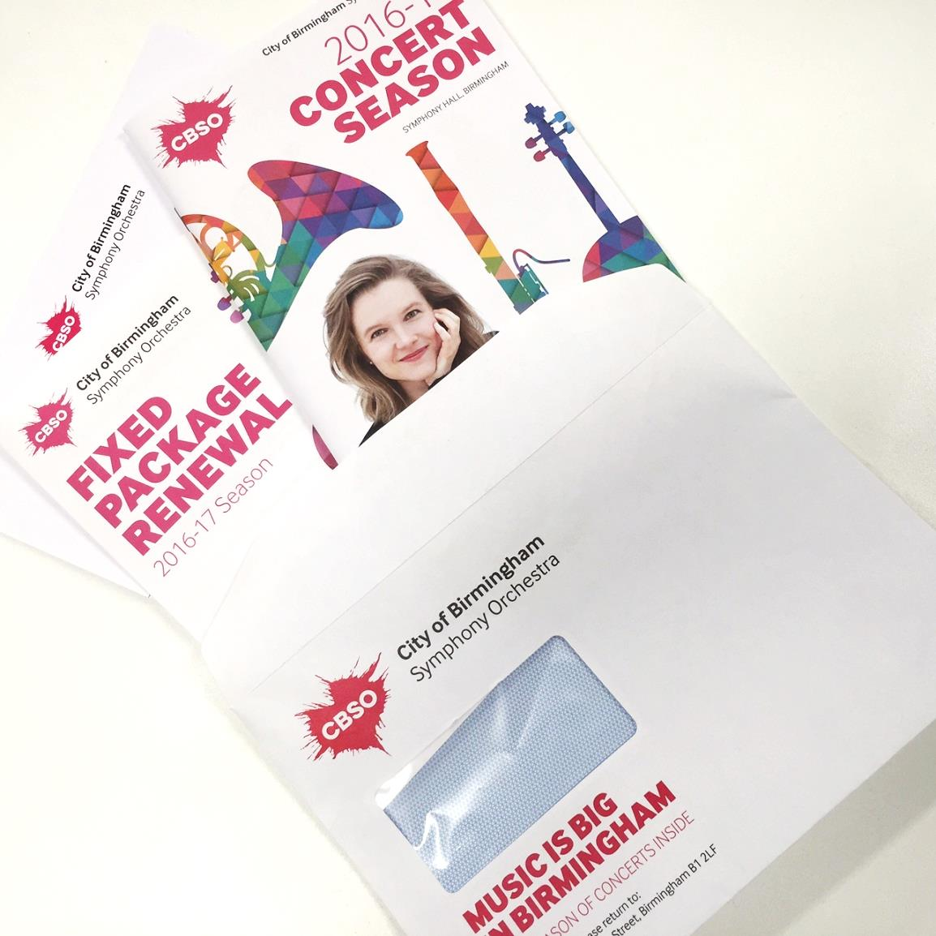
TA-DAH!
Notes:
Highly personalised packs

Slide 28
“There is man in his entirety, blaming his shoe when his foot is guilty.”
PERSONALISATION AND CREATING ENGAGING CONTENT
PANEL DISCUSSION
Samuel Beckett, Waiting for Godot

Slide 29

WHAT’S NEXT?
BREAK 11.00-11.15
Hogan Foyer / Level 6 Foyer
BREAKOUT SESSION FIVE
11.15-12.15
Notes:
FRIDAY Breakout session 4 What’s next slide

