Slide 1

TESSITURA
EUROPEAN
CONFERENCE
DUBLIN 2016
Notes:
Welcome

Slide 2



PRESENTERS
Chole Hearne : Wales Millennium Centre
Ciara Dunbar : Abbey Theatre
CONTENT PLANNER
Chole Hearne : Wales Millennium Centre
Claire Griffin : Roundhouse
THE STORY OF THE CUSTOMER JOURNEY
Work hard to get their thrill!
Share your favourite content and photos! #TECDublin16

Slide 3

The Story of the Customer Journey
Chloë Hearne
Application Specialist
Notes:
Good morning..
Today I will be providing a very basic overview of the some of the initiatives adopted by the Wales Millennium Centre that form part of the customer journey.
The initiatives are by no means exhaustive, but hopefully give you a flavour of the warm, Welsh welcome we strive to offer our visitors.
I will also be focussing in on how the Operations teams use Tessitura to streamline the customer experience.

Slide 4
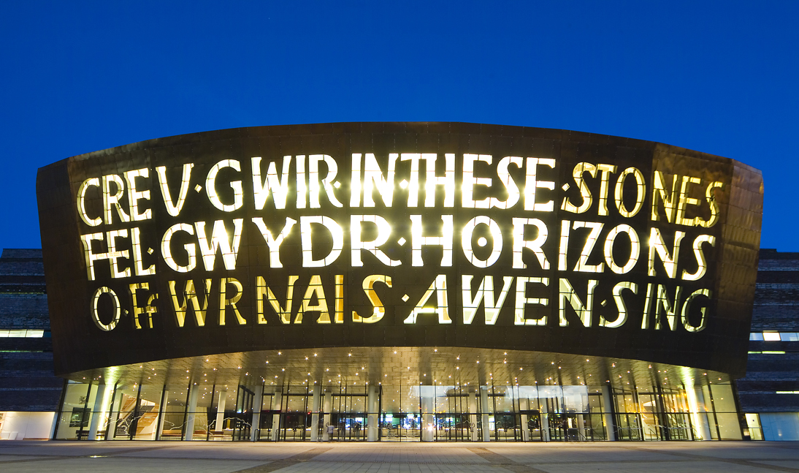
About Us
13.5 million visitors since opening
Wales’ no.1 cultural visitor attraction
8 resident organisations
4000
free performances
Consortium with 7 other organisations
4100+
theatre performances
Notes:
To put it into context, here are some facts about the Centre.
Based in Cardiff Bay, opened by the Queen in November 2004.
Range of shows opera/musicals/dance/Circus/Drama and Orchestral performances
We are a Charity – with any money raised from the shows, restaurant & bars and any extra going back into the Centre’s outreach and community work.
Over the last 2 years the Centre’s vision has evolved. We have branched out into putting on our own productions – Man2Man, our first main-stage musical Only the Brave was showcased in March of this year and in 2017 will see our next musical – Tiger Bay, which we are extremely proud about and gives us plenty of opportunity to for lots of people to get involved and feel part of the Centre’s journey.
This summer we launched Festival of Voice – which is a city-wide celebration of the voice – with performances in venues all across Cardiff.
We also collaborated with National Theatre Wales to co-produce “City of the Unexpected” which was large free outdoor weekend-event celebrating the life and works of Roald Dahl. This involved 12K participants and 2-300K people attending across the weekend. This increased accessibility to the arts and put Wales on the Map.
The Centre’s aims are to “Inspire our Nation. Impress the World”. The reason we need to fundraise and upsell, in all sorts of ways, is to support this great ambition.

Slide 5







About Us
The Consortium
Notes:
We are also proud to be part of a Consortium with 7 other organisations.

Slide 6
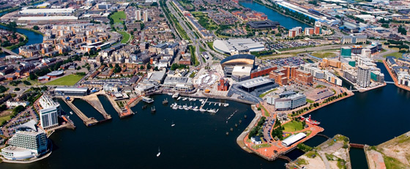
So, what are the reasons for visiting the Centre?
Attend a performance
Restaurant Booking
Events
Purchase goods from a retailer
Business meeting
Tour Booking
Workshop
Visit resident organisations
Use the toilet
Notes:
The reasons for visiting the Centre are numerous, with the purposes listed being only some of them.
We’ll be focussing on the customer journey primarily for the purpose of attending a performance, but we’ll briefly touch on some elements that form part of the event or restaurant booking experience also.

Slide 7
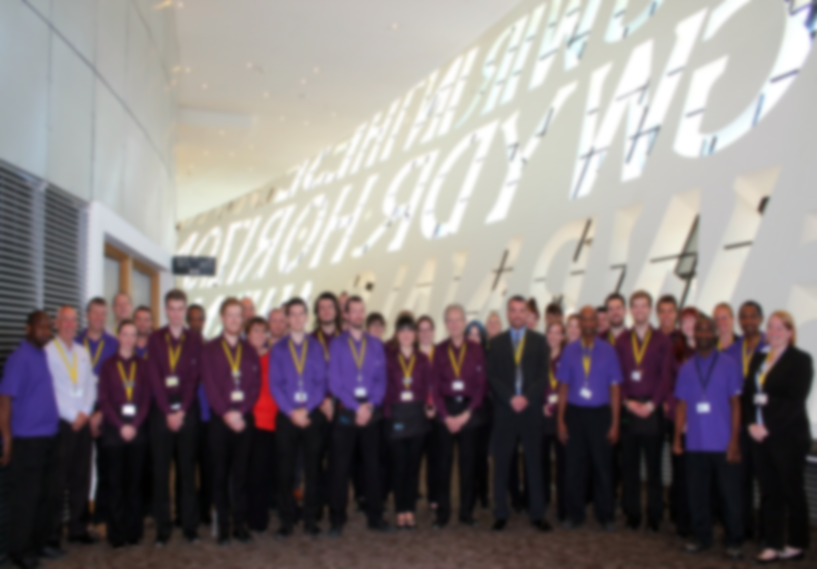
Customer Journey – Attending a performance
Pre- / during
visit
Post-
visit
Notes:
So focussing on the performance element of the customer journey, we’ll consider the journey in two parts; pre-/during visit and post- visit.

Slide 8
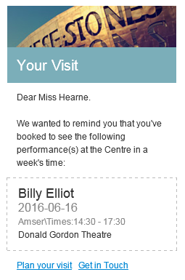
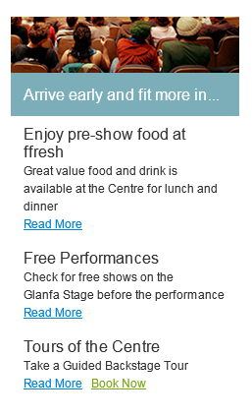
Pre-visit highlights
1. Triggered pre-show emails through Wordfly
Wordfly response recorded on Constituent record
Notes:
As Wordfly is integrated with Tessitura, it provides FOH with a great opportunity to track what communications have been sent to customers. This comes in particularly useful if customers have turned up on the wrong date or time. The team can see what emails have been sent and the customers response.

Slide 9
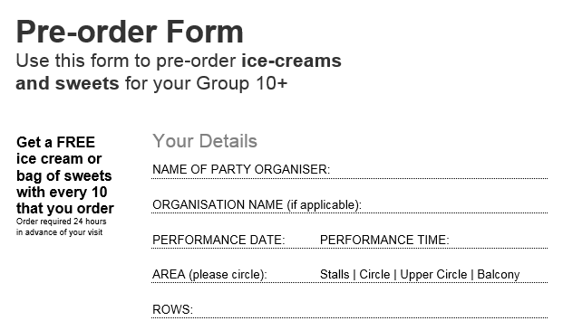
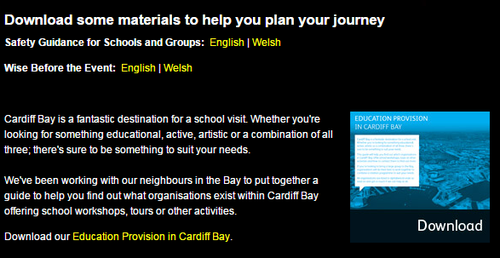
Pre-visit highlights
2. Enhanced Group visitor experience
Payment reminder emails
Customer care calls
Welcome Host service
Pre-bookable hospitality
Guidance for school groups
Coach Driver benefits
Group organiser benefits
Notes:
We strive to make the Group booking experience unique and special for our visitors. We believe that ‘groups get more’ and therefore offer a number of initiatives.
Such initiatives are listed, but of particular significance during a customers visit is the welcome host service and pre-bookable hospitality. This provides groups with reassurance that their group will get the best and most carefree experience possible. In turn, it reduces the likelihood of seating issues and stock management problems.

Slide 10

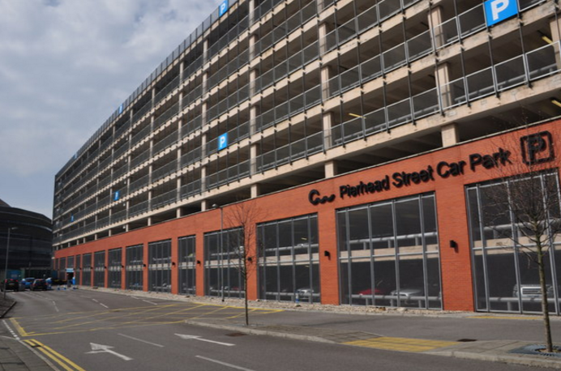

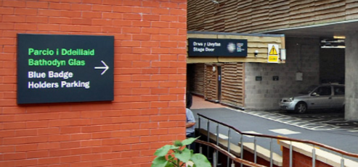
Pre-visit highlights
3. Pre-bookable car park, programmes & ice creams
Notes:
Pre-paid vouchers can be exchanged for goods at sales points
Programme/Ice cream vouchers are processed on PointOne for financial reconciliation
Car park vouchers are scanned at front desk during visit

Slide 11

Pre-visit highlights
4. Special Requests
Pre- Summer 2015
Combination of CSI’s & Outlook calendar reminders

Slide 12

Pre-visit highlights
4. Special Requests
Post- Summer 2015
New special request process – Presented on at TEC15
Objectives
Improve efficiency
Maintain history on constituent record
Clear, user friendly reporting

Slide 13
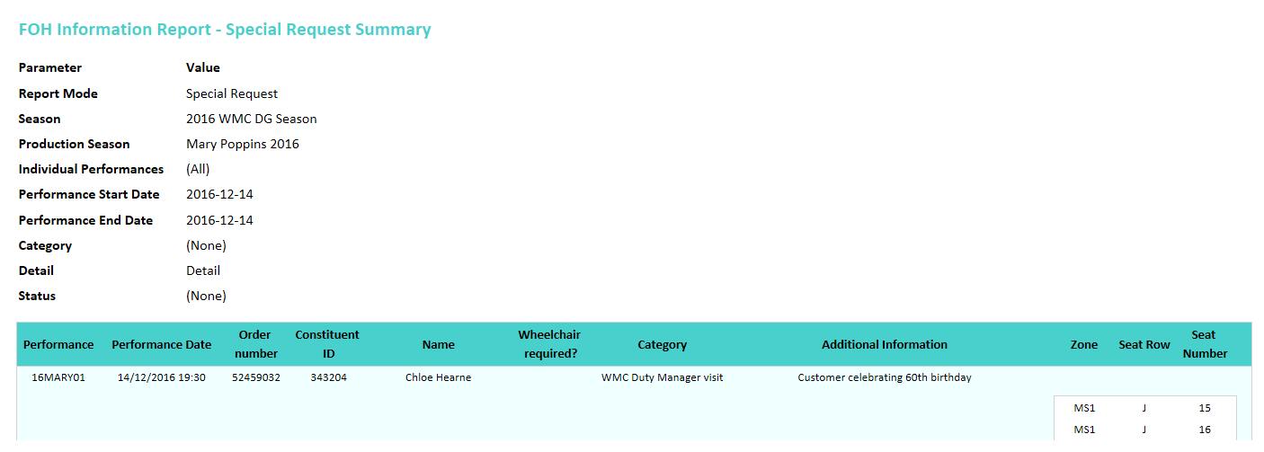
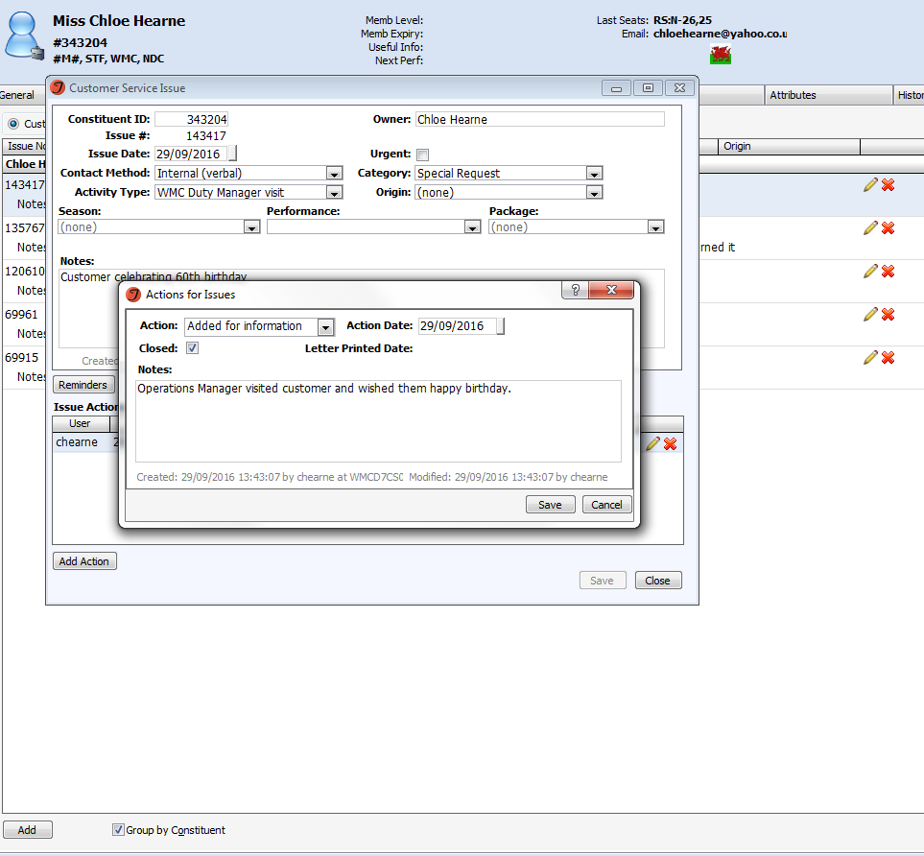
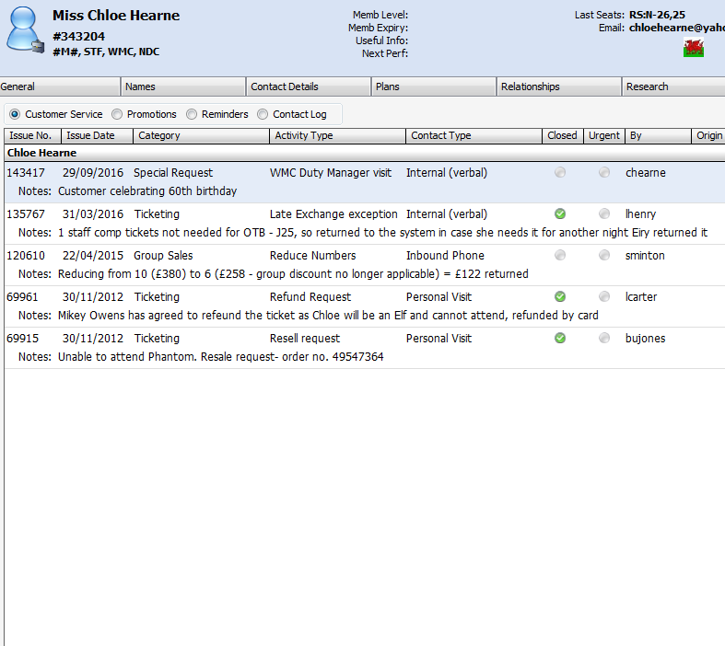
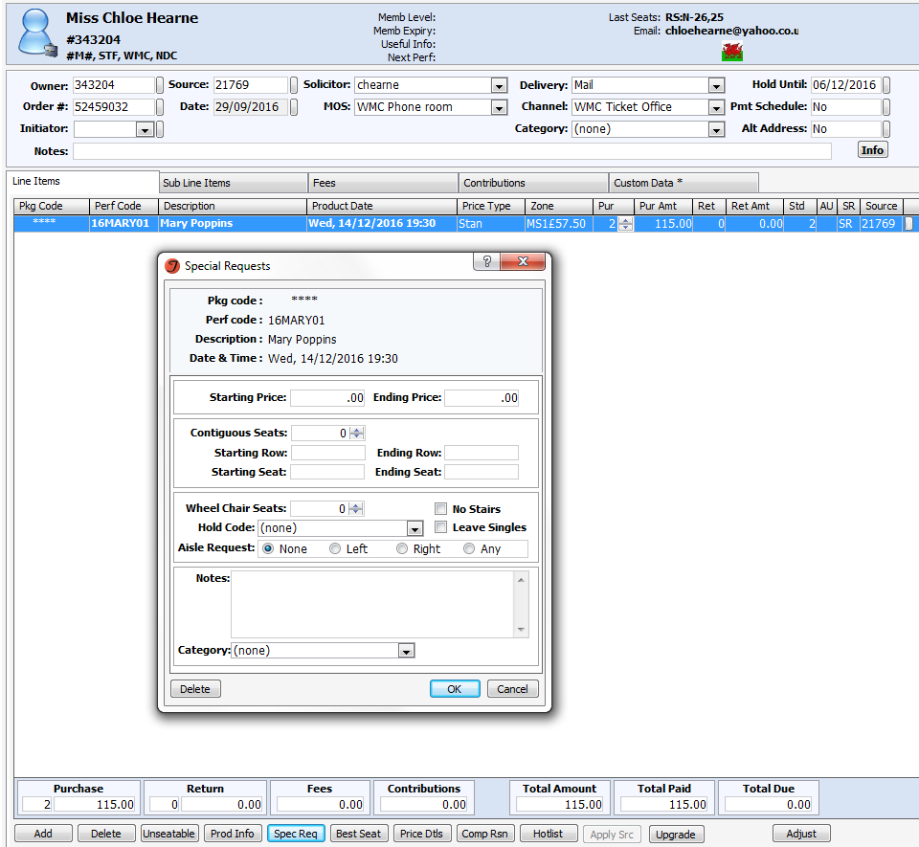
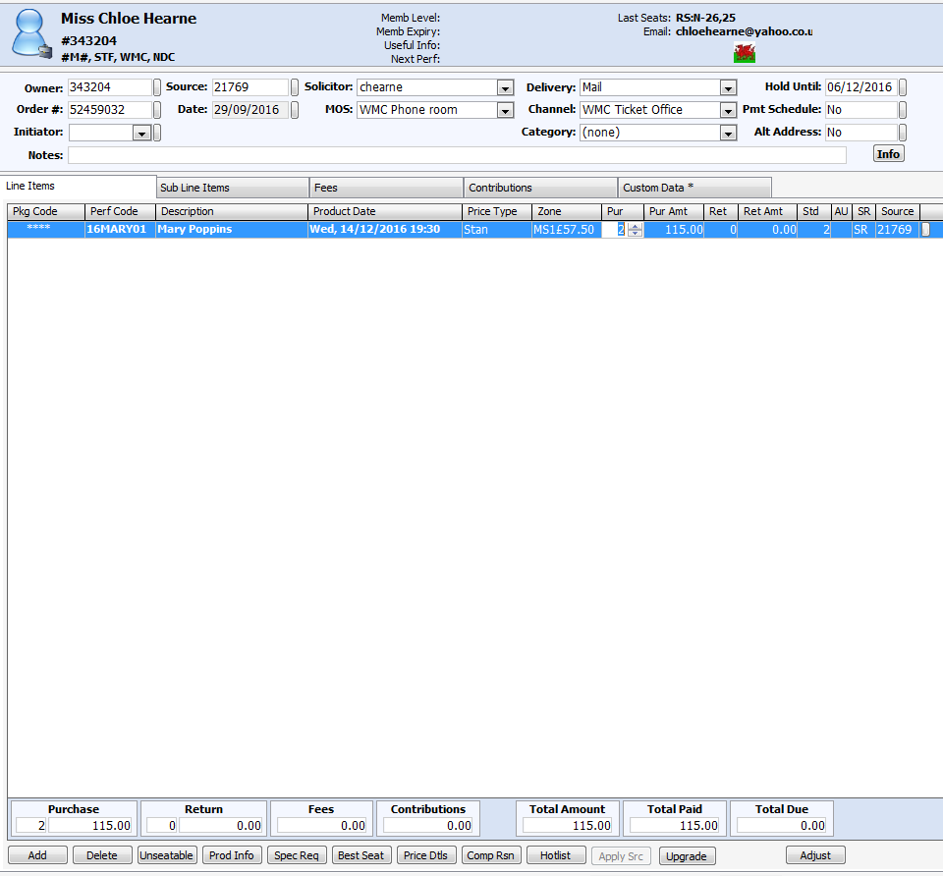

Pre-visit highlights
4. Special Requests
Special requests added per line item, not per order
CSI closed by FoH Manager so that we can report on activity
New step: Stored procedure runs to transfer information logged in Spec Req to a CSI.
Scheduled custom report called Front of House Information
Click through to order or constituent record
CSI closed by FoH Manager so that we can report on activity

Slide 14
Pre-visit highlights
Objectives
Improve efficiency
Maintain history on constituent record
Clear, user friendly reporting

Slide 15
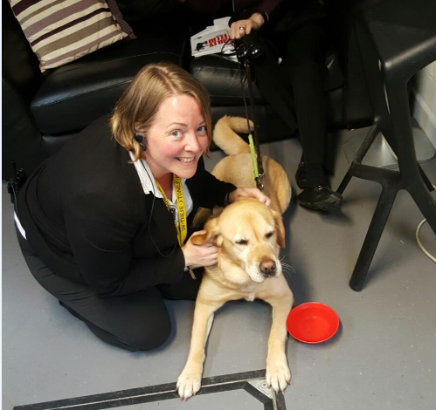
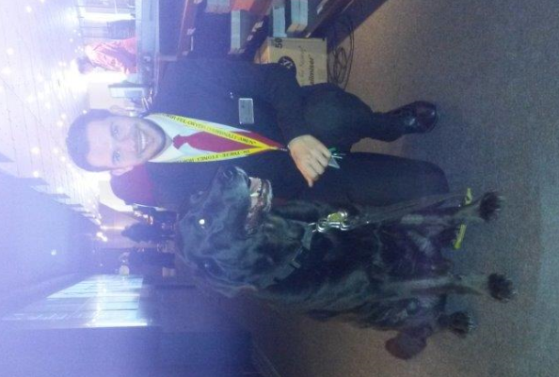
Pre-visit highlights

Slide 16
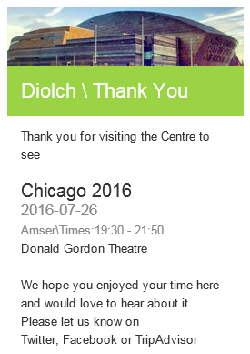
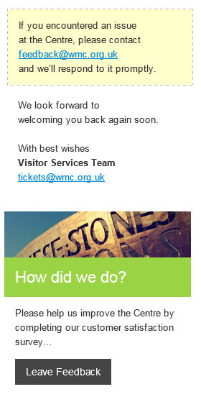

Post-visit highlights
1. Wordfly post-show emails
Wordfly response recorded on Constituent record

Slide 17
Post-visit highlights
2. Customer Experience Working Group
Social Media
Written customer feedback
Customer Experience Group
Customer Experience
Hospitality
Marketing
Contact Centre
Technical
Facilities Management
Post-show survey
CSI’s
Post-show reports
Informs customer service strategy

Slide 18
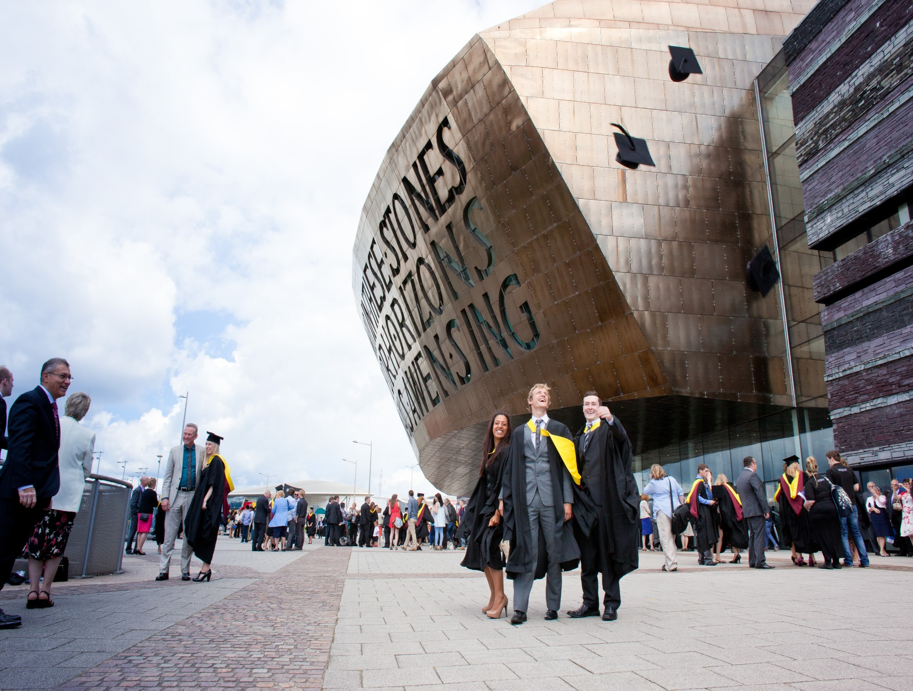


Events
Notes:
An example of where we have used Tessitura to form part of the event customer journey is the Cardiff Met graduations, as presented on at TEC15.
We have worked with Cardiff Met to successfully manage graduation ticketing using Tessitura.
Some of the highlights of this were:
PAH ticketing
Improved FOH operations as FOH team could manage issues independently
Queue waiting times decreased

Slide 19
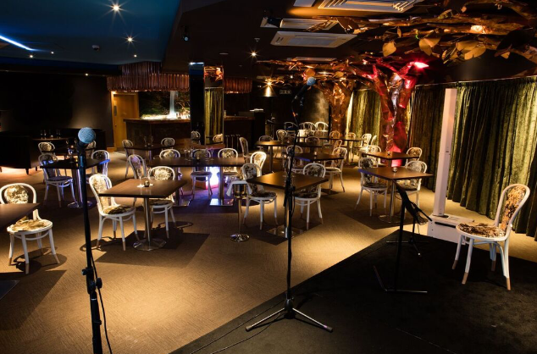
Restaurant Bookings
Notes:
Restaurant bookings are made via Tessitura. A job then runs to update the bookings in PointOne.
Using Tessitura – PointOne integration functionality, the restaurant is able to efficiently redeem gift certificates and check for membership validity via the EPOS system. Previously they’d have to contact the Contact Centre or walk to the Front Desk.
Using Tessitura in this way helps to streamline the customer journey.

Slide 20
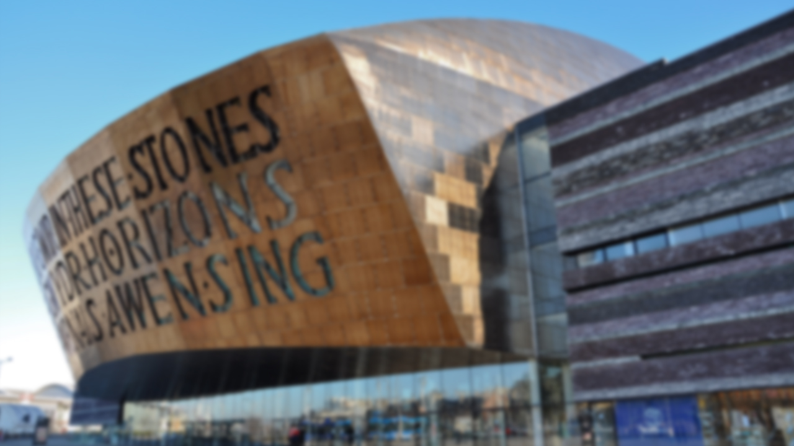
Any Questions?
Diolch / Thank you
Chloë Hearne
Application Specialist
chloe.hearne@wmc.org.uk

Slide 21
The Story of the Customer Journey: Group Sales at the Abbey Theatre
Ciara Dunbar- Group Sales Coordinator
Friday 18th November- 10am
All Star Suite 688-9, Croke Park.

Slide 22
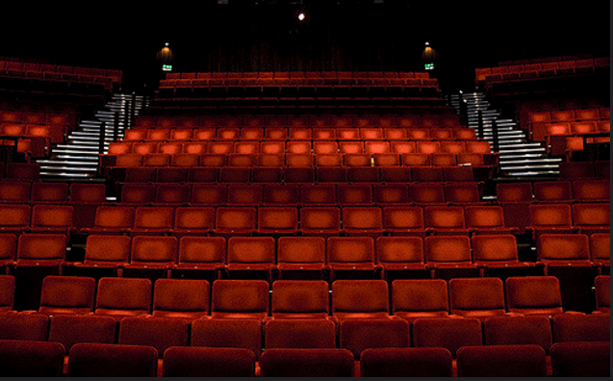
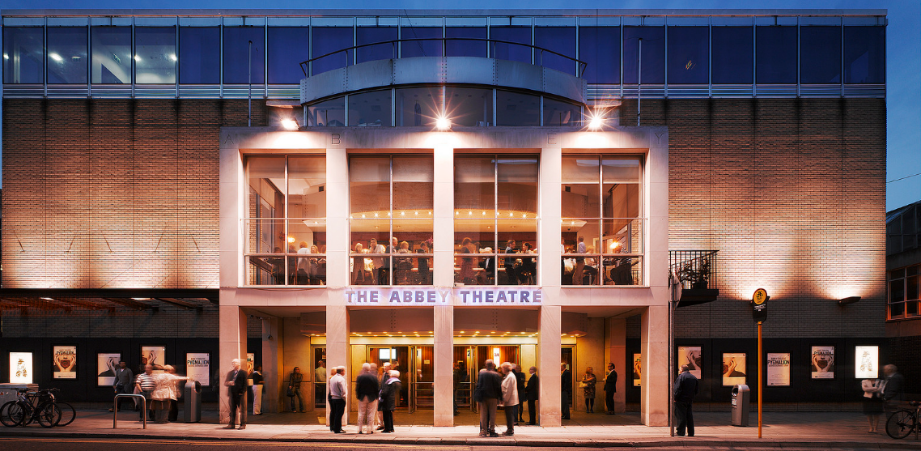
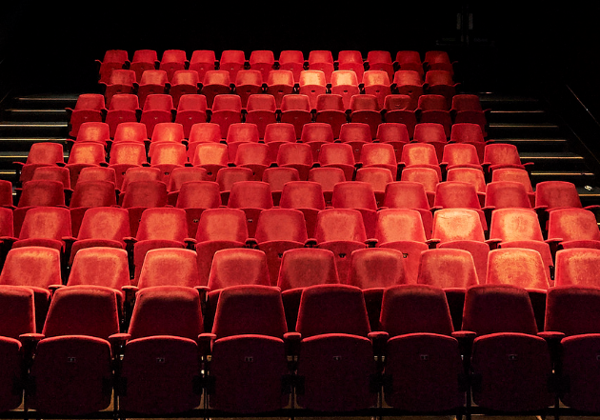
The Abbey Theatre - Abbey stage and Peacock stage
Brief history of the Abbey Theatre
The Abbey stage
The Peacock stage
Productions

Slide 23
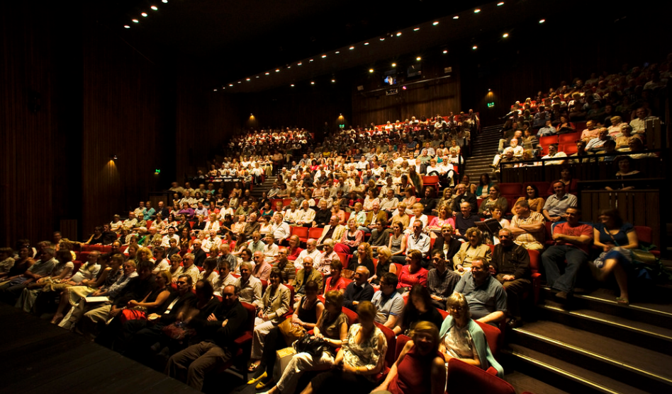
Group Sales Coordinator role
  Background of the role
  Who are our main audiences?

Slide 24
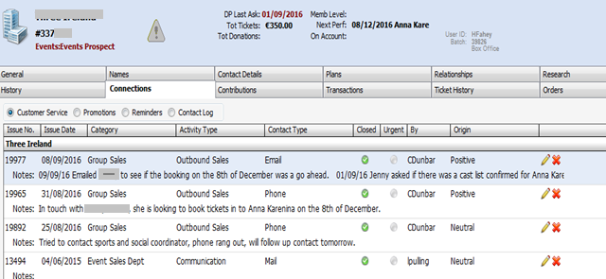
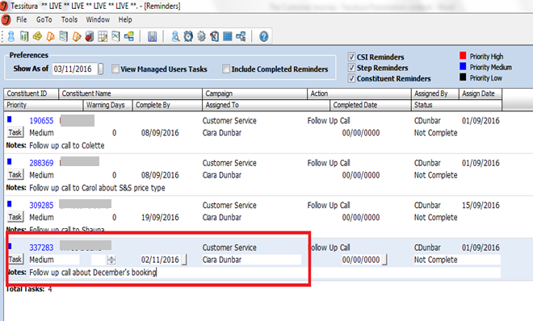
Starting a new customer journey
Find new groups with interest in current and upcoming shows
CSIs
Reminders

Slide 25
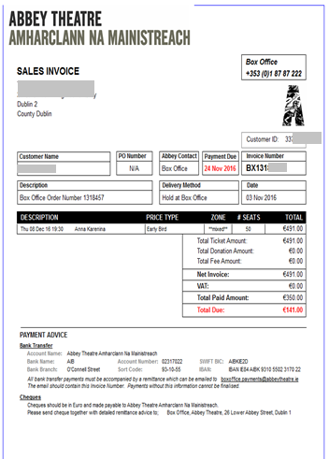
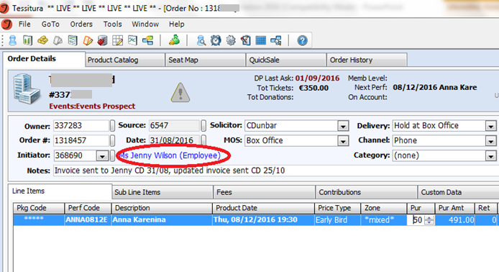
Booking a group in
Benefits of group bookings at the Abbey Theatre
Group rates
Group booking process

Slide 26
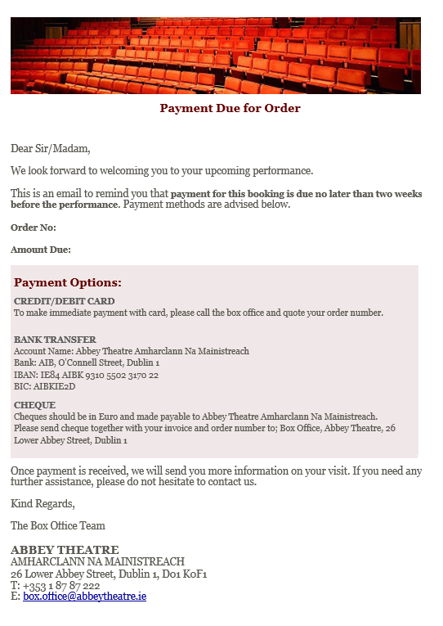
Group payment for a performance
Payment due date
Triggered WordFly email
Courtesy box office calls

Slide 27
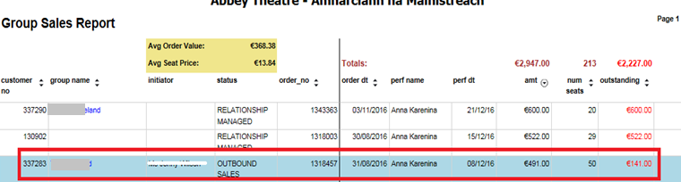
Group sales tracking report
Revenue tracking
Parameters of report

Slide 28
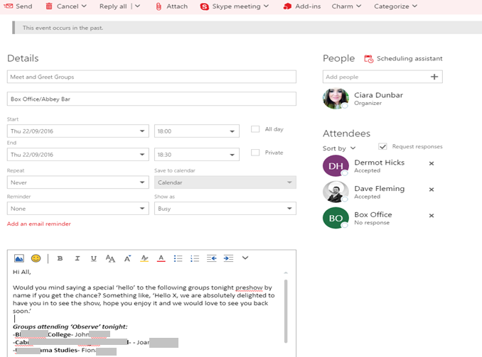
A week before a group visits
Calendar invites

Slide 29
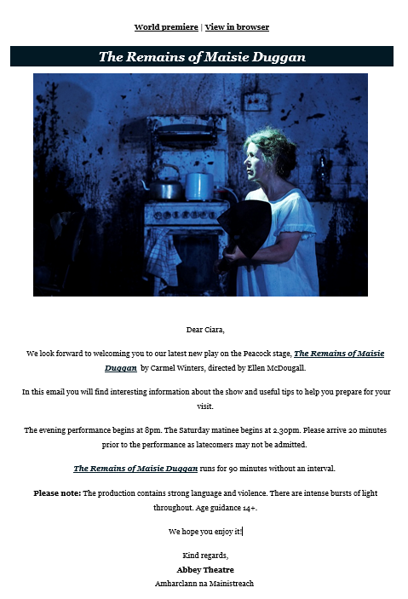
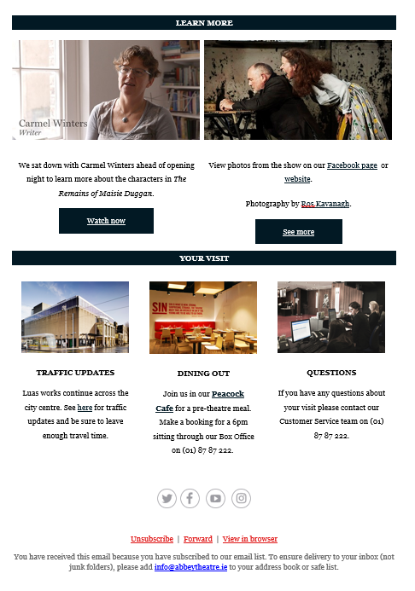
Preshow email

Slide 30
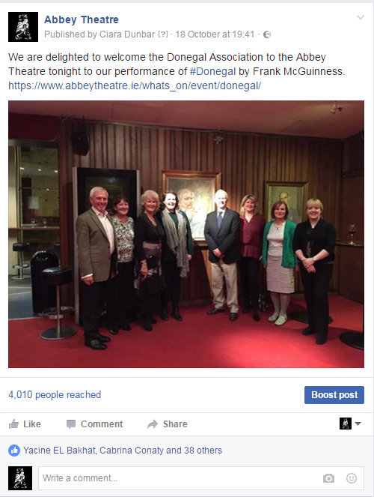
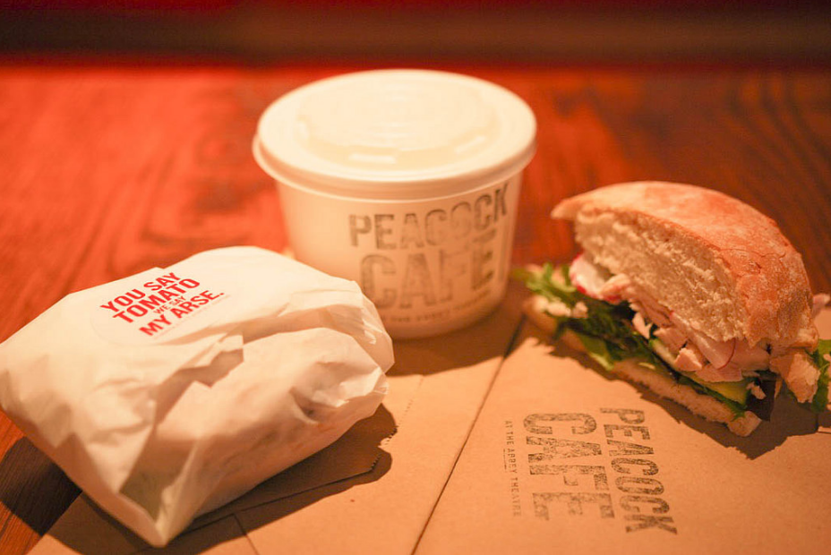
During the group’s visit
Meet and Greet
Peacock Café
Reserve area in the bar
Interval Drinks
Social Media

Slide 31
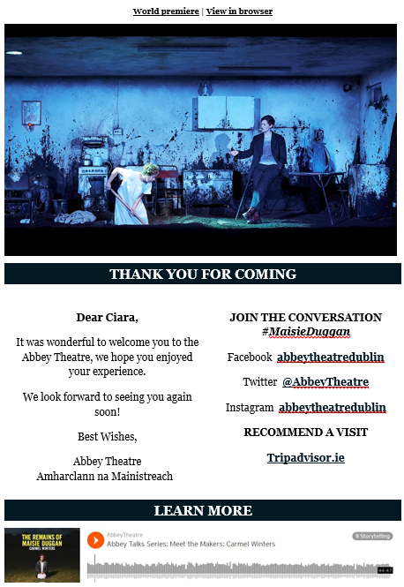
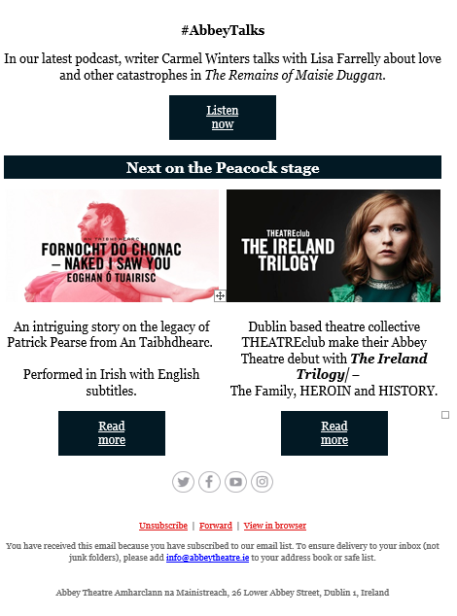
Post show email

Slide 32

After the group’s visit
Capturing feedback
Dear Group Booker,
Many thanks for your recent booking. We hope that you enjoyed your visit. We always want our customers to have a positive and engaging experience when they book at the Abbey Theatre and we would love if you could fill out this short survey to tell us what you thought.
You could be in with the chance of winning a pair of tickets to the first ever staging of Othello at the Abbey Theatre. On the 400th anniversary of Shakespeare’s death, we are proud to present this contemporary thriller, featuring Peter Macon in the leading role.
Please follow this link to the survey. I look forward to seeing you again soon.
Warm regards,
Ciara Dunbar
Group Sales Coordinator

Slide 33
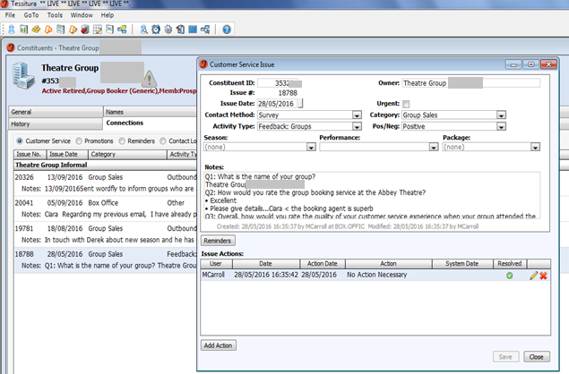
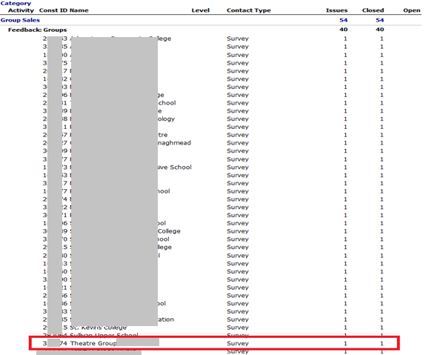
Tracking feedback
Saved as CSI
CSI statistic report

Slide 34
Thank you, questions are welcome!
ciara.dunbar@abbeytheatre.ie
+353-1-887-2200
Add me on LinkedIn https://www.linkedin.com/in/ciaradunbar

Slide 35
“There is man in his entirety, blaming his shoe when his foot is guilty.”
QUESTIONS?
Samuel Beckett, Waiting for Godot

Slide 36

WHAT’S NEXT?
BREAK 11.00-11.15
Hogan Foyer / Level 6 Foyer
BREAKOUT SESSION FIVE
11.15-12.15
Notes:
FRIDAY Breakout session 4 What’s next slide

