Slide 1

TESSITURA
EUROPEAN
CONFERENCE
DUBLIN 2016
Notes:
Welcome

Slide 2



PRESENTERS
Scott Turner : Liverpool Everyman
Anna Coles : Wales Millennium
Jessica Hill : Royal Shakespeare Company
CONTENT PLANNER
Jessica Hill : Royal Shakespeare Company
USING YOUR DATABASE TO FIND PROSPECTS
DISCOVERING HIDDEN TREASURE IN YOUR PATRON DATABASE
Share your favourite content and photos! #TECDublin16

Slide 3
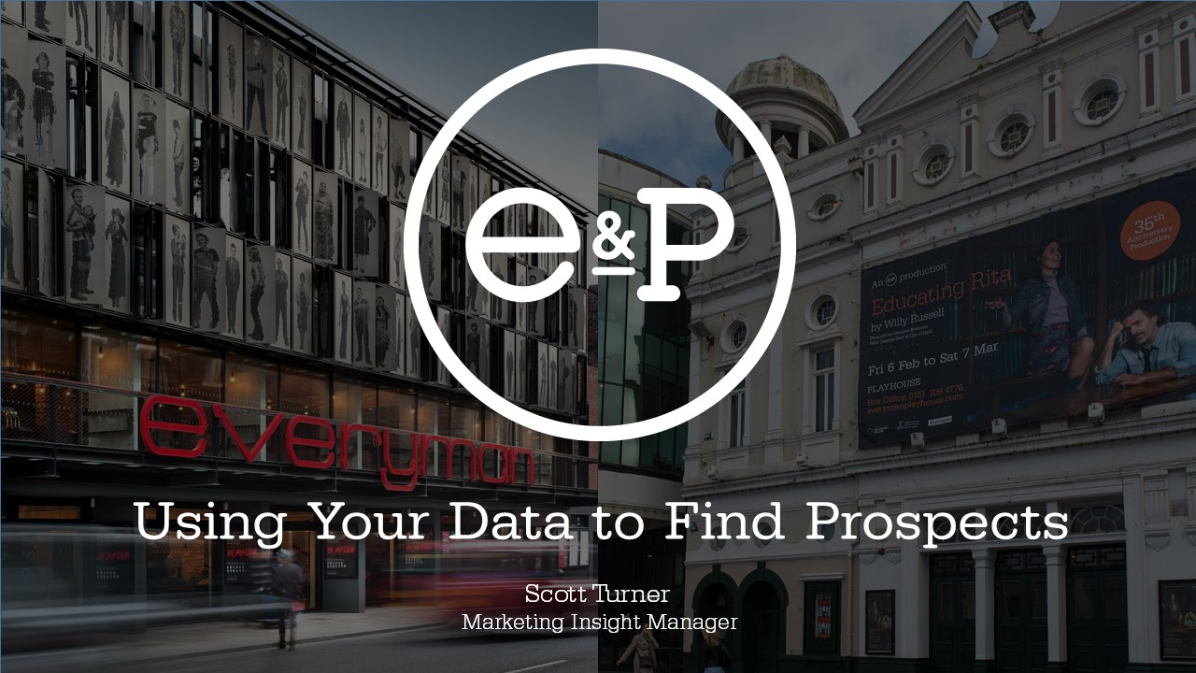

Slide 4
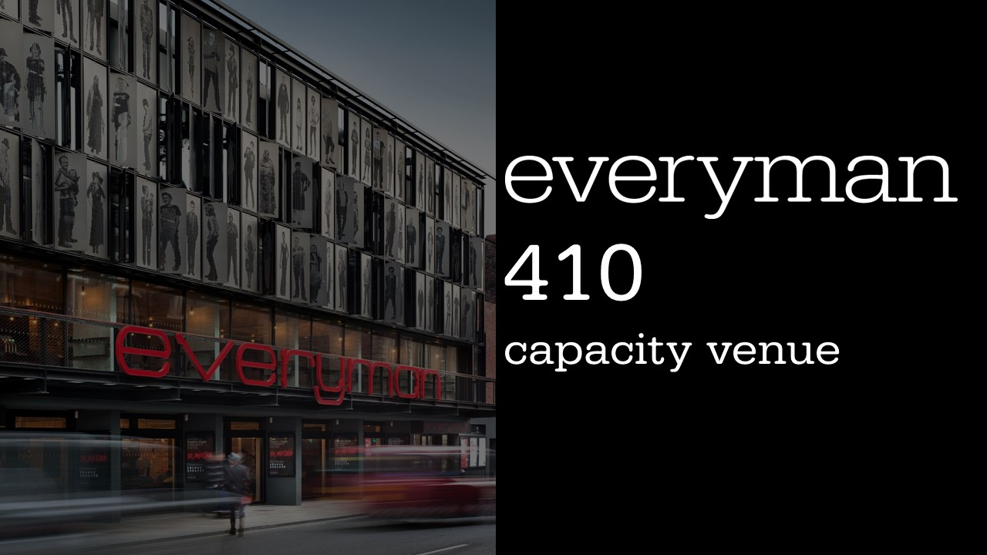

Slide 5
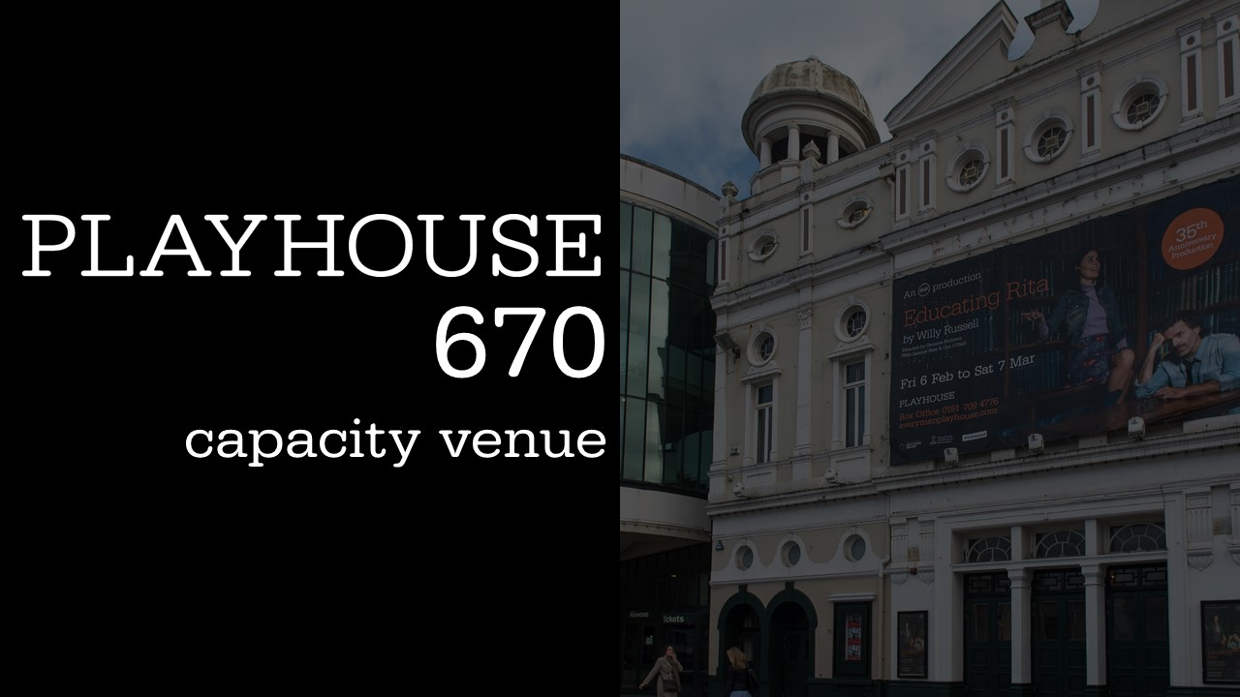

Slide 6


Slide 7
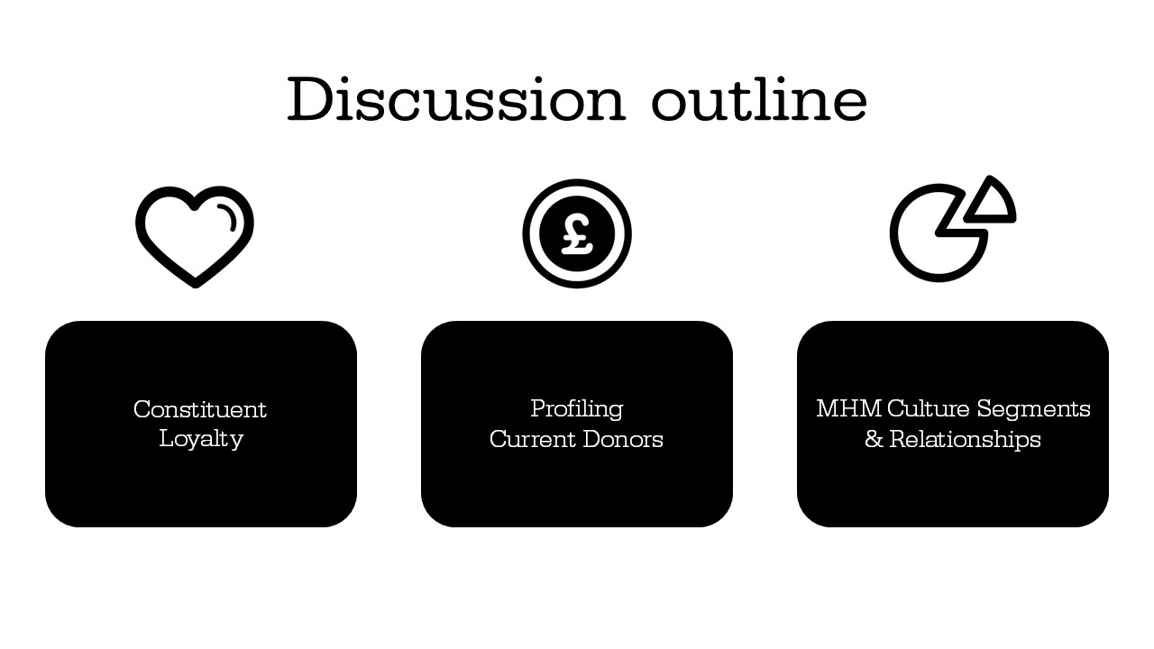

Slide 8
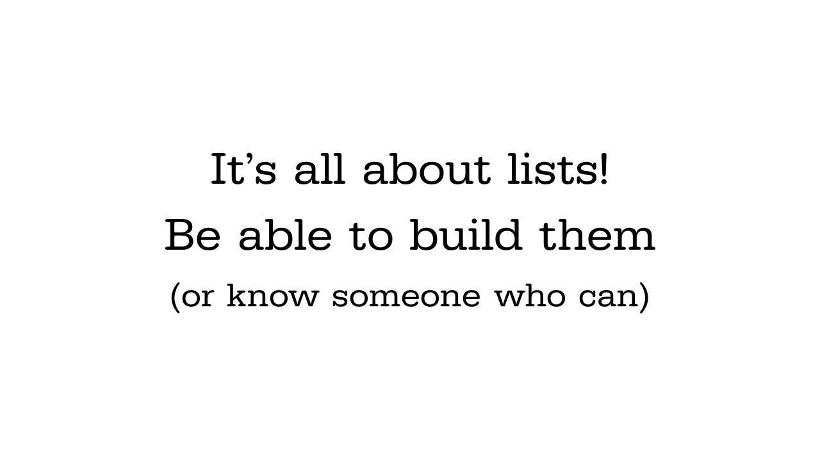

Slide 9
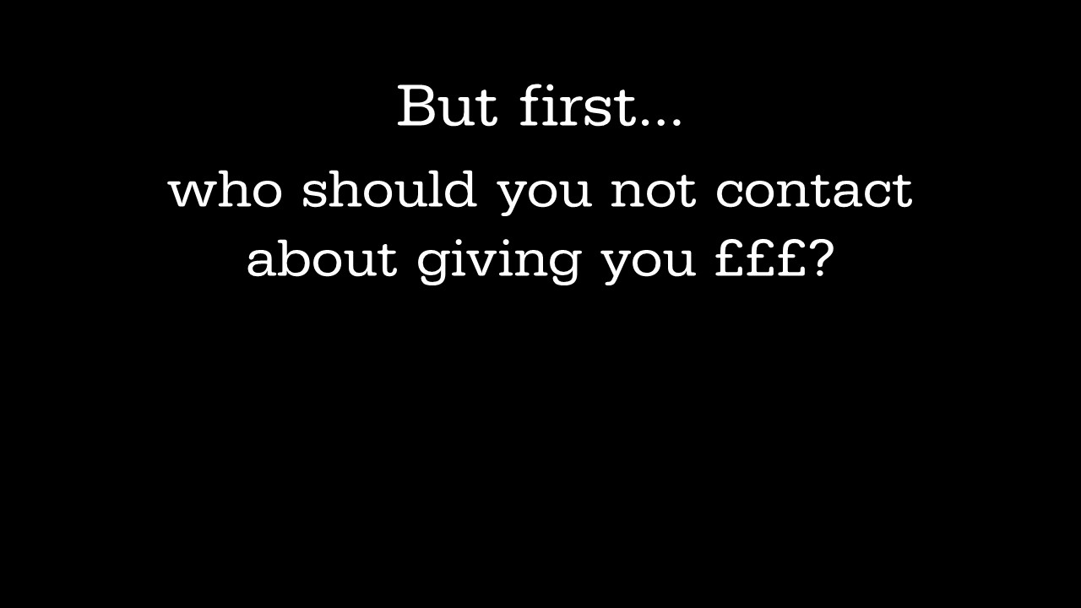

Slide 10
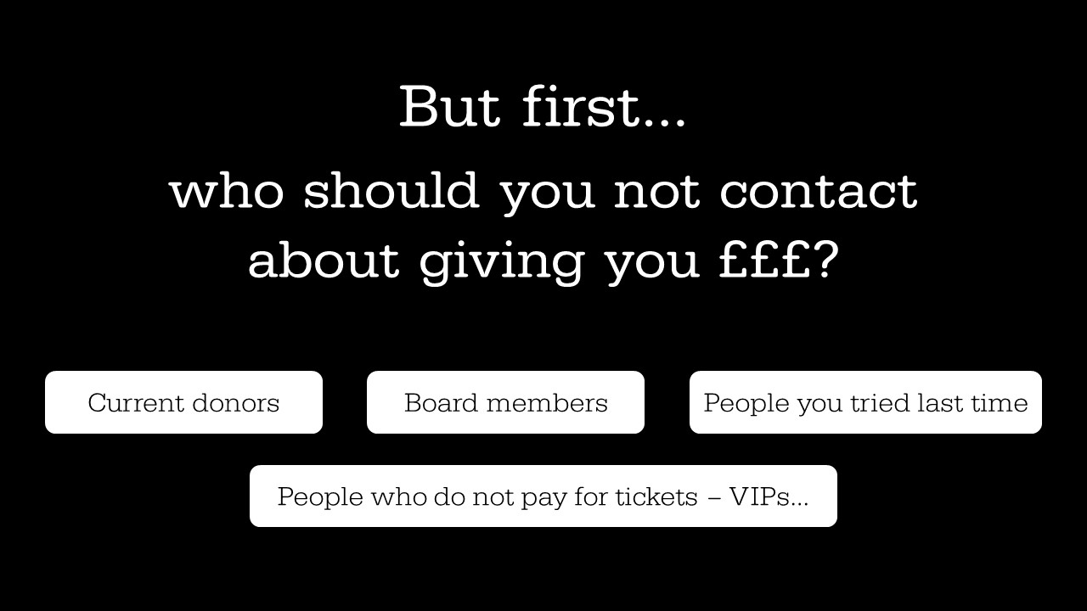

Slide 11
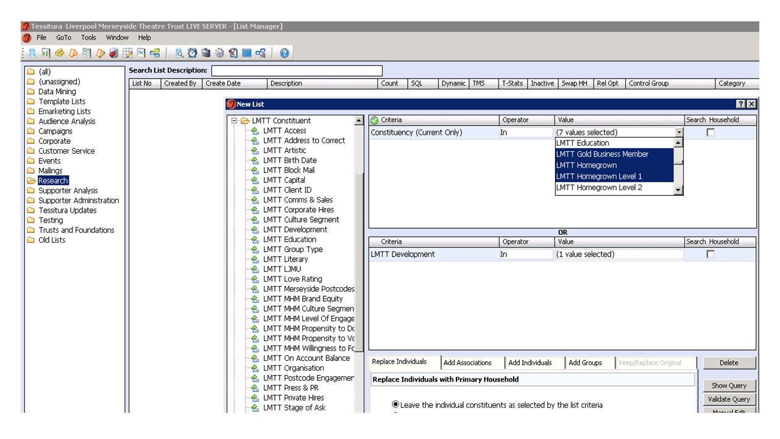

Slide 12
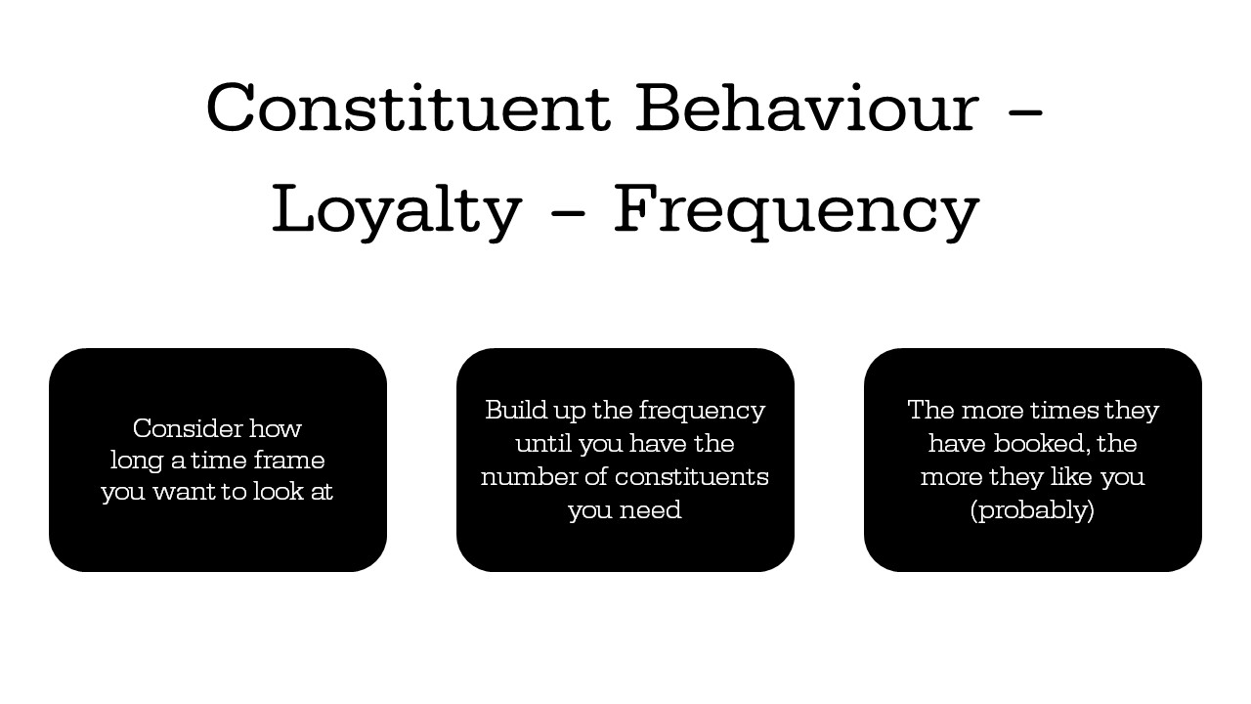

Slide 13
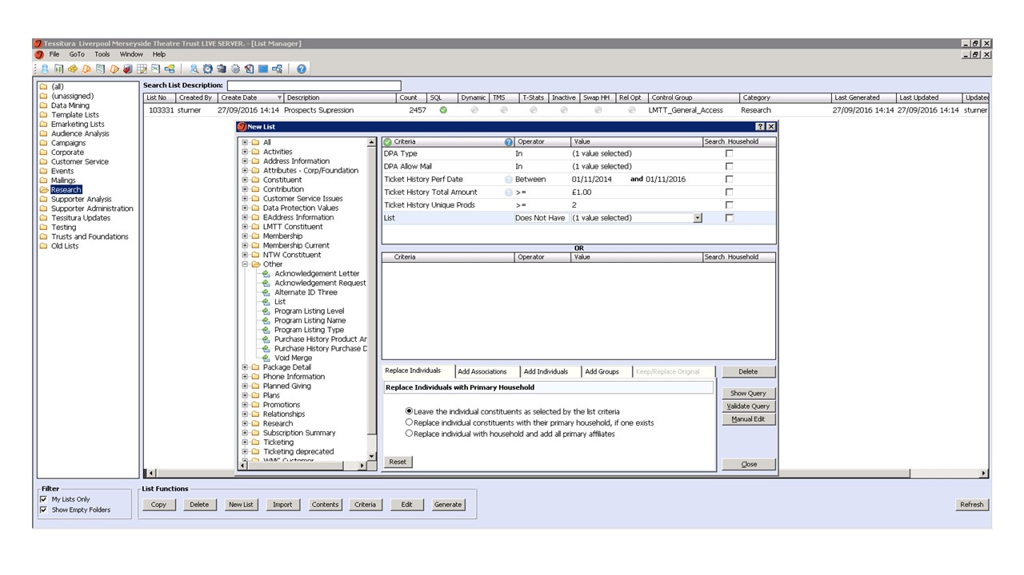

Slide 14
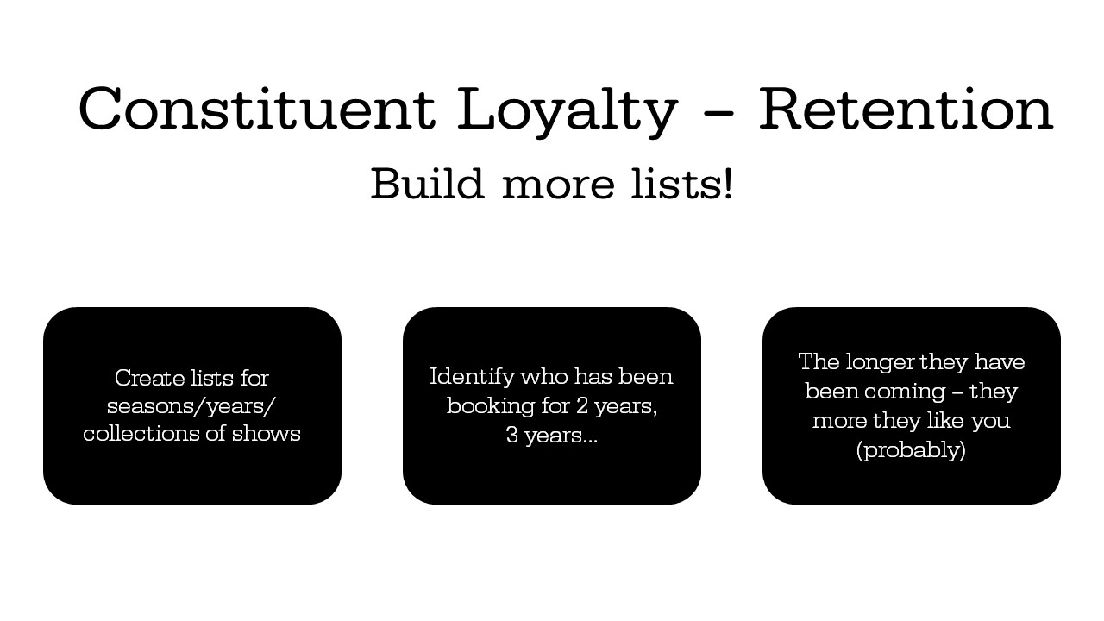

Slide 15
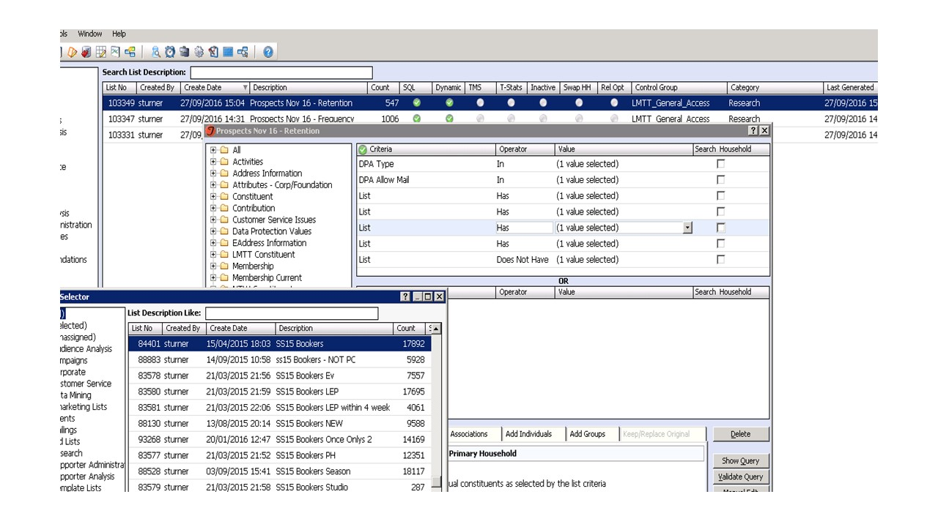

Slide 16
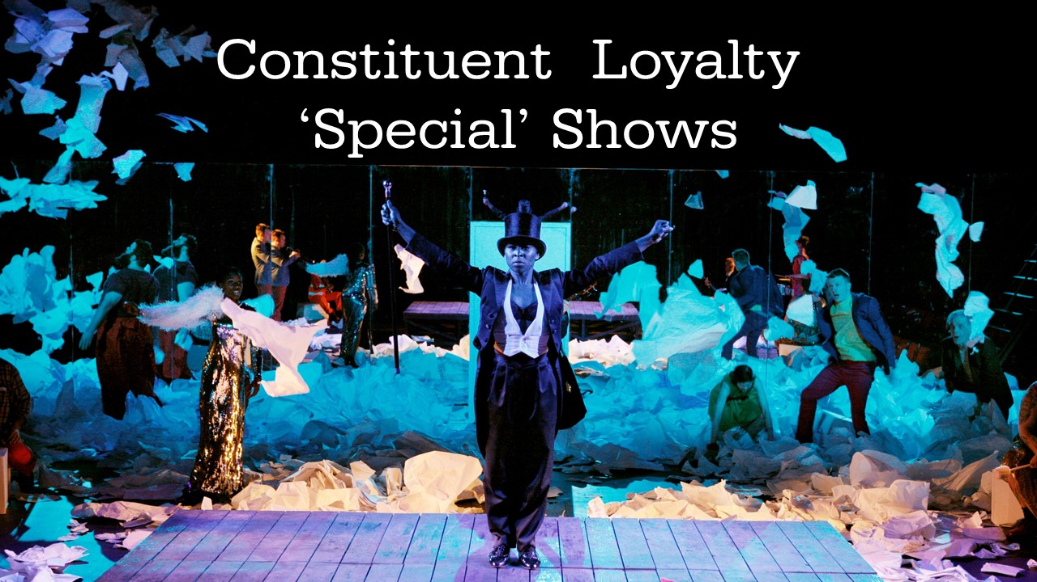

Slide 17
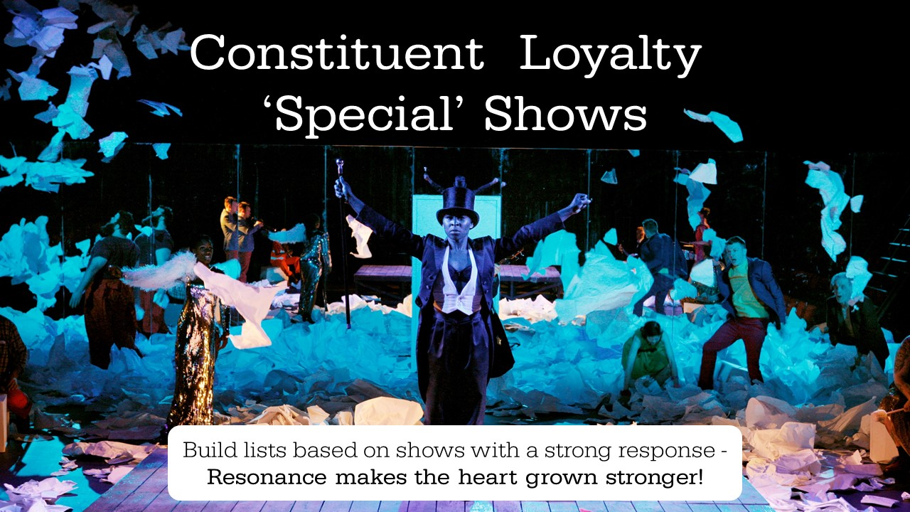

Slide 18
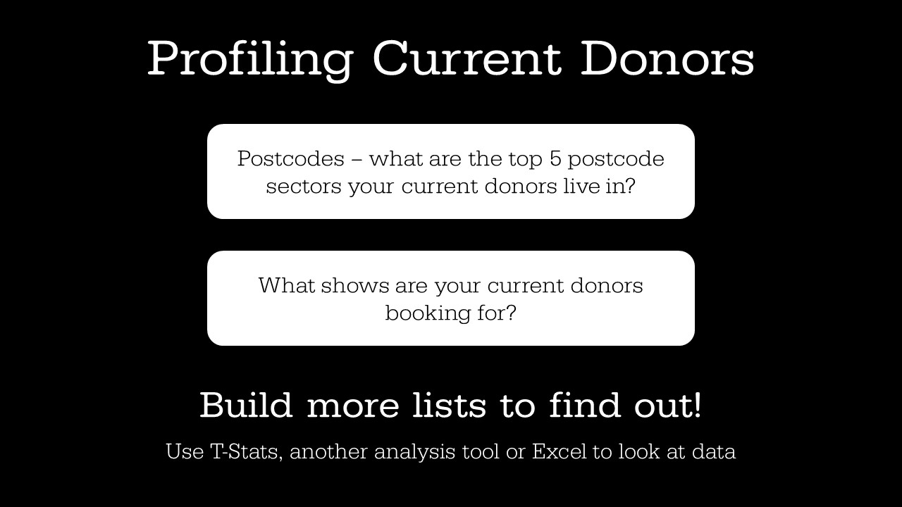

Slide 19
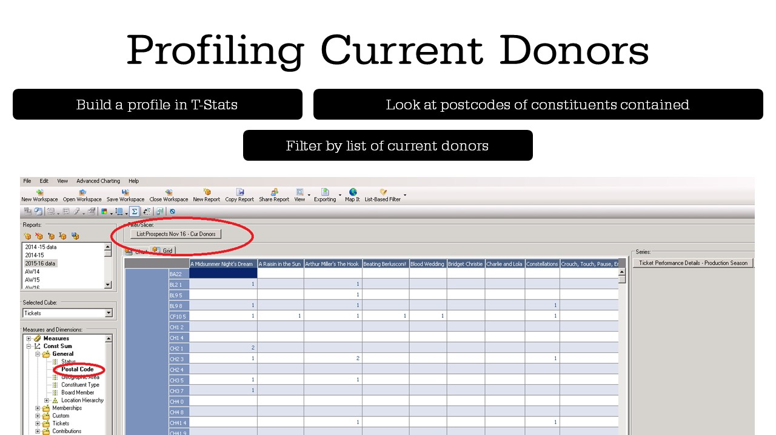

Slide 20
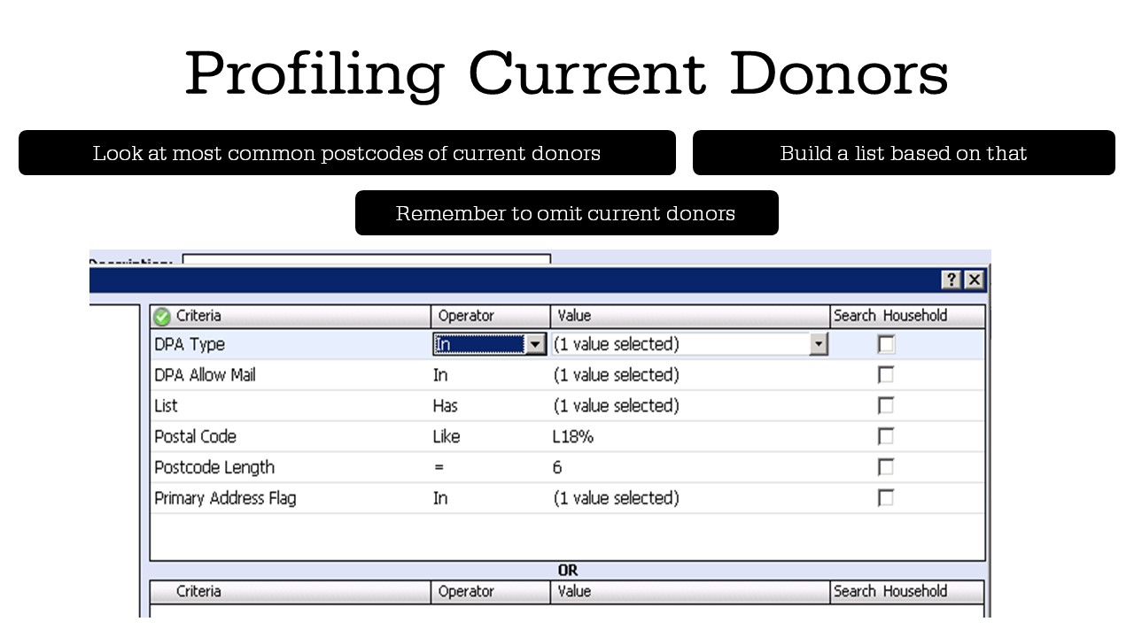

Slide 21
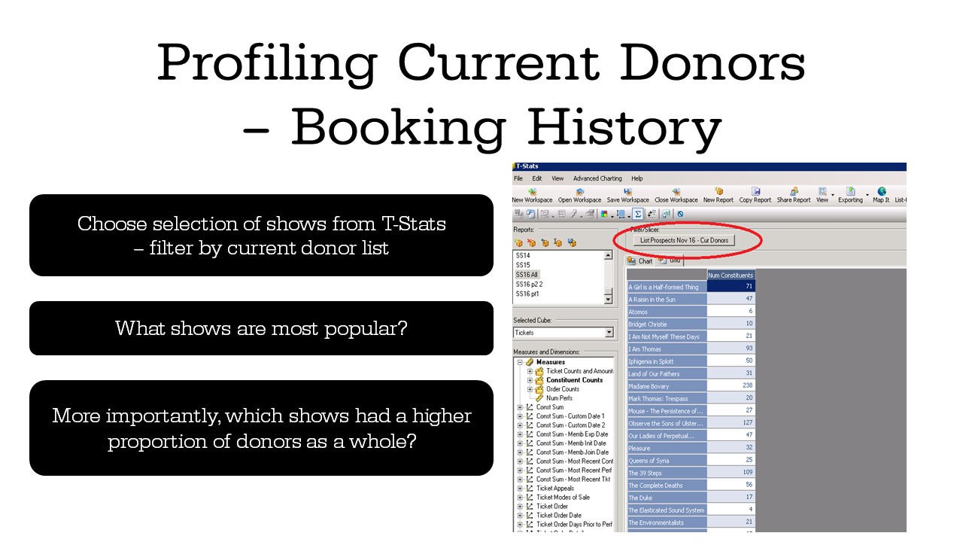

Slide 22
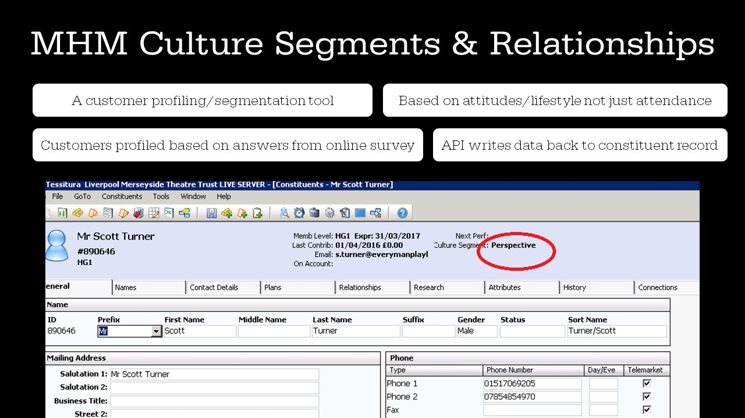

Slide 23
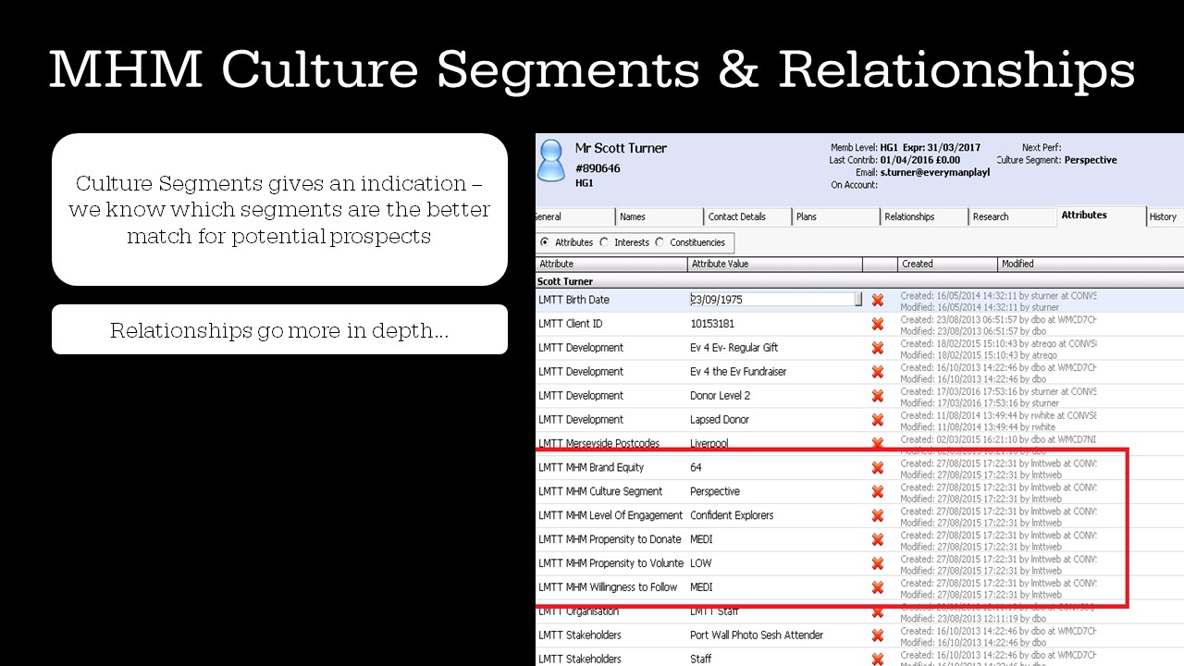

Slide 24
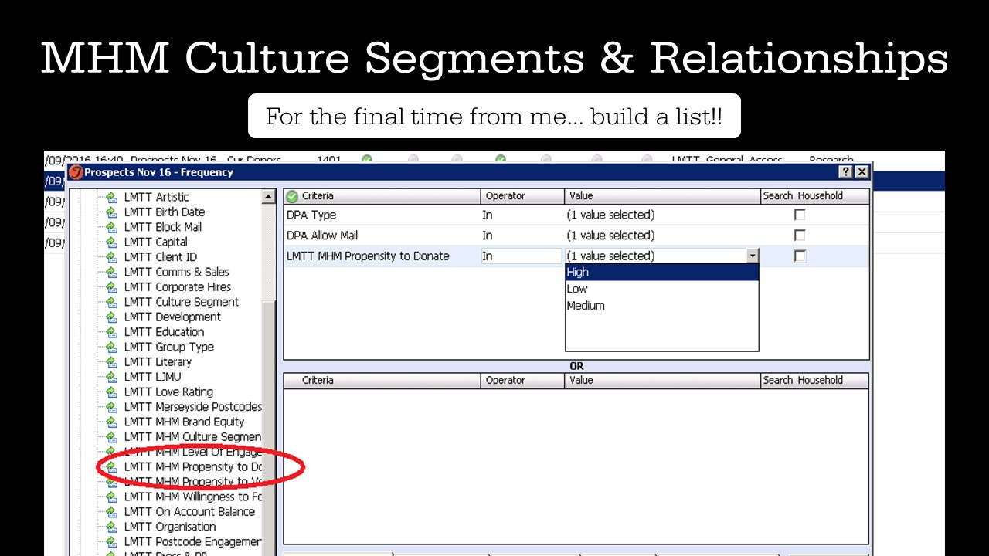

Slide 25


Slide 26

Using Your Data to Find Prospects
Anna Coles
Database Team Leader

Slide 27
Using Your Data to Find Prospects
Session Outline
Plans, Rankings & Pricing Rules
Identifying Prospects
Criteria
Future Considerations

Slide 28
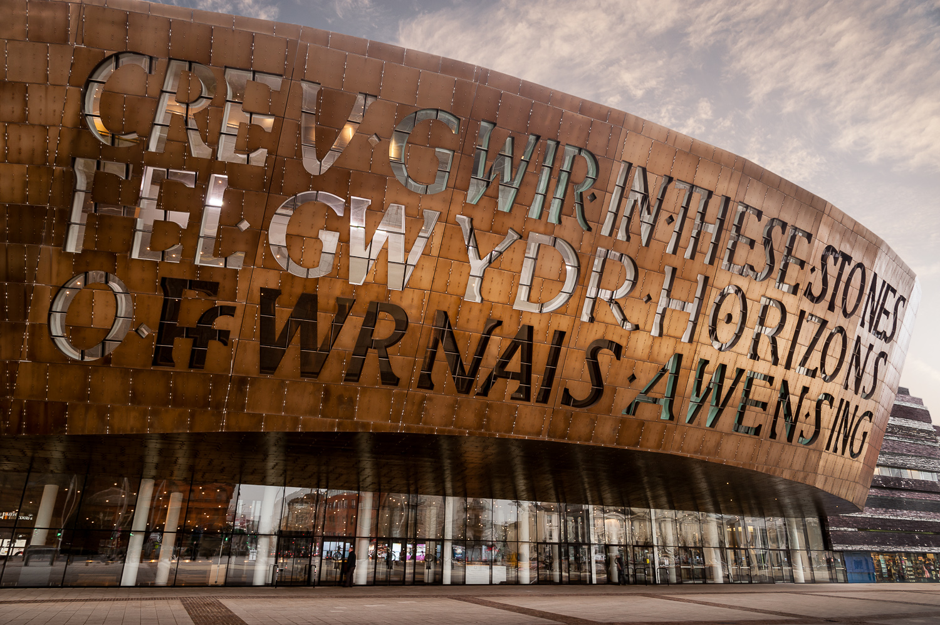
Using Your Data to Find Prospects
Wales Millennium Centre

Slide 29







Using Your Data to Find Prospects
The Consortium

Slide 30
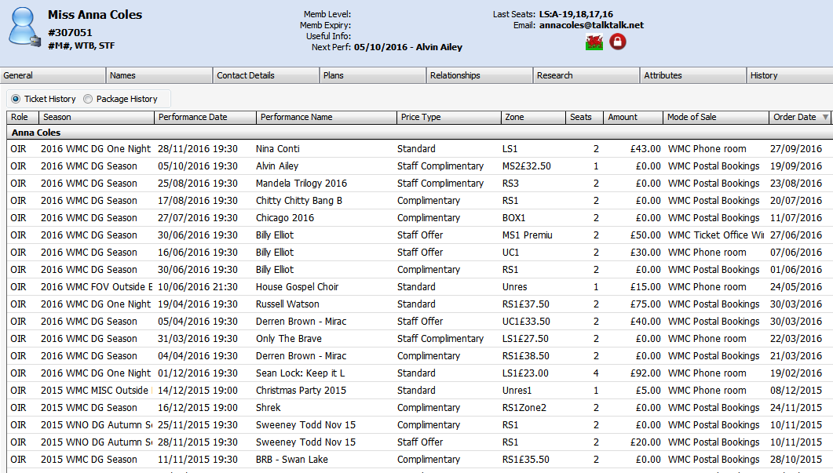
Using Your Data to Find Prospects
Identify Potential Prospects
Those who have paid to see 3 or more productions in our Donald Gordon Theatre within the last year
4,555
Excludes:
Past and present members
Anyone in a household with a member
Press, Trusts, Donors, Sponsors, Group Bookers & Corporate Members
Tickets booked using Staff Offer, Staff Comp, Comp, Resident & Company Member price types
Tickets sold at £0
X
X
X
Notes:
Our procedure identifies those who are potential promise prospects by looking at people who have booked 3 or more shows in our DGT theatre within the last year.
It excludes:
All members both past and present
Anyone in a household with a member
Press contacts, Trusts, Donors, Sponsors, Group Bookers & Corporate Members
Tickets that have been booked using a Staff Offer, Staff Comp, Comp, Resident & Company Member price type
Tickets that were sold at £0
If you look at my record you can see that I am not a member and if you ignore all the staff offer & comp tickets you can see that I have booked 3 standard tickets in our DGT within the last year.
Searching the entire database for people who fit into this category pulled backed 4,555 constituents – we only currently have around 2,000 members on our lowest level scheme.

Slide 31
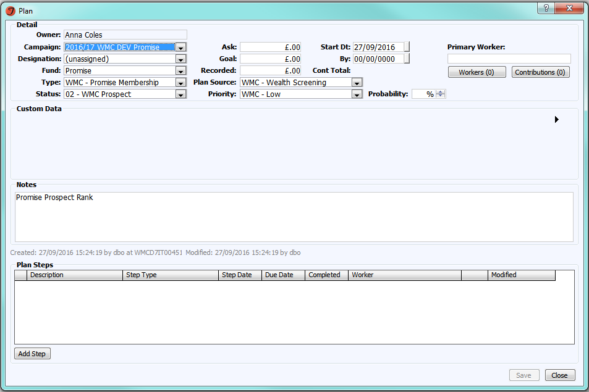
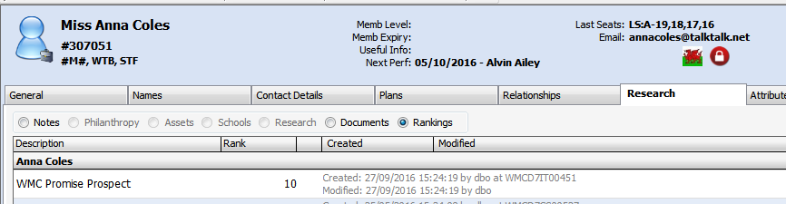
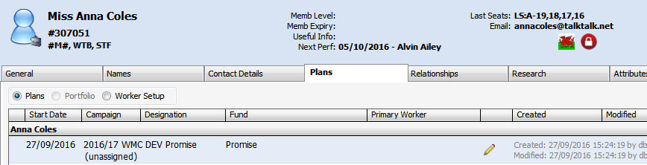
Using Your Data to Find Prospects
Overnight Procedure
- Adds WMC Promise Prospect rank type to the constituents record:
- Adds a WMC Prospect Plan to the constituents record:
Notes:
We have 2 overnight job for this process.
The first job takes care of the prospects that have been identified.
This job:
Adds a ‘Promise Prospect’ rank onto the constituents account
Adds a plan within the current years membership campaign on the account, with the status set as ‘WMC Prospect’
The correct Promise Campaign is worked out by taking the date the procedure is run and slotting it into the correct promise campaign start and end dates. So in this example, running it today works out that the correct campaign is 2016/17 WMC DEV Promise.

Slide 32
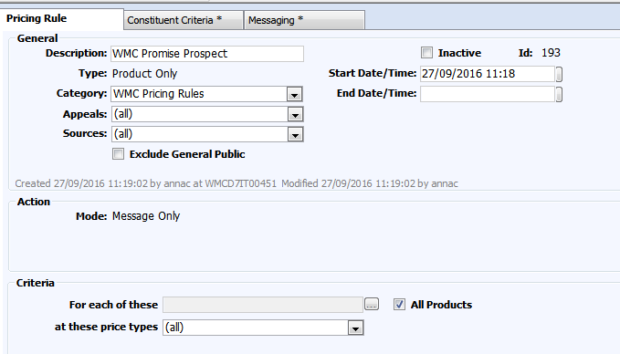
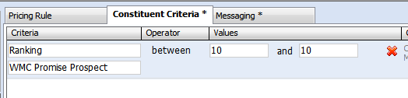
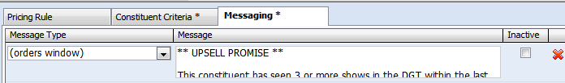
Using Your Data to Find Prospects
Pricing Rule Setup
Setup a Pricing Rule that is triggered by the rank type and value
Notes:
To get this working with pricing rules we setup a pricing rules that is triggered by the rank type and value of 10.
On setup:
- Add the pricing rule as product & message only, to be available on all products at all price types
The constituent criteria is Ranking between 10 & 10 for WMC Promise Prospect
The messaging tab controls where you want the message to appear and what you want to message to say.

Slide 33
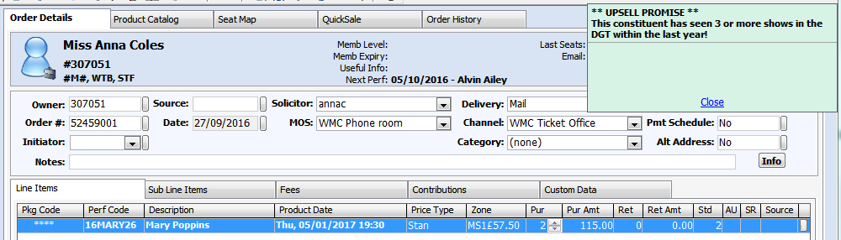
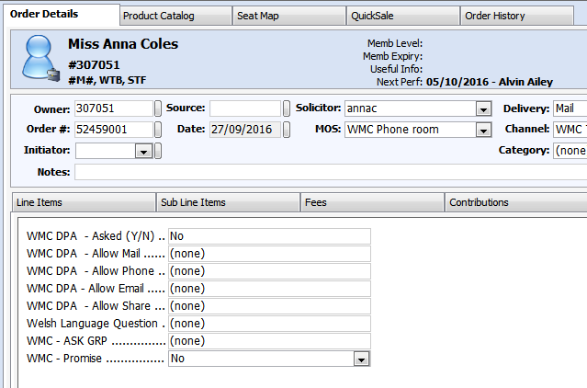
Using Your Data to Find Prospects
Order Screen
Next time a prospect books with our Ticket Office, the Contact Centre Assistant will be prompted to upsell promise:
With the ability to log the outcome via a Custom Data tab in the Order Details screen:
Notes:
When a customer who has been identified as a prospect next books on the phone or at our front desk the CCA will see a pricing messaging rules advising them to upsell promise membership as the customer has booked enough times within the last year to have gained some form of benefit from the membership.
The CCA will then log, via the custom data tab in the order screen whether or not the constituent has opted to buy promise or whether they have declined.

Slide 34
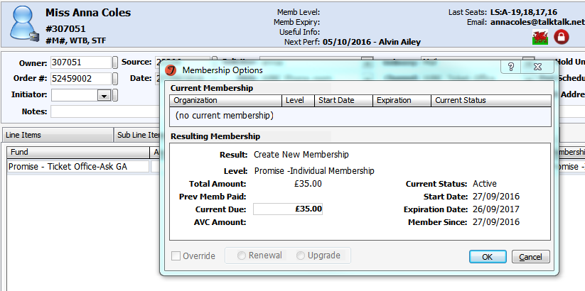
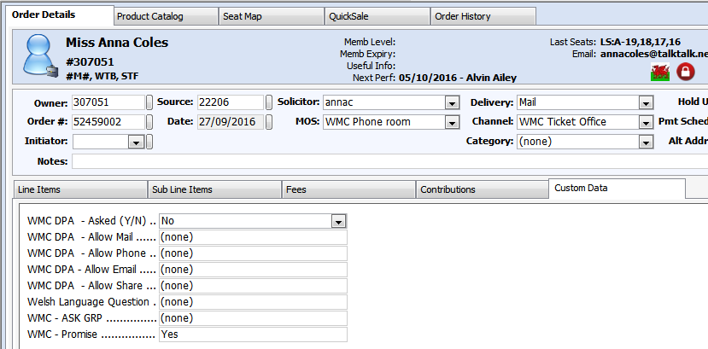
Using Your Data to Find Prospects
If Yes:
The Contact Centre Assistant processes the membership as normal.
And logs ‘Yes’ in the WMC – Promise Custom tab.
Notes:
If they have opted to buy the membership:
The CCA will process the membership as normal and the customer will become a member.
They will also log, via the custom data tab that the person has opted into a Promise membership.

Slide 35
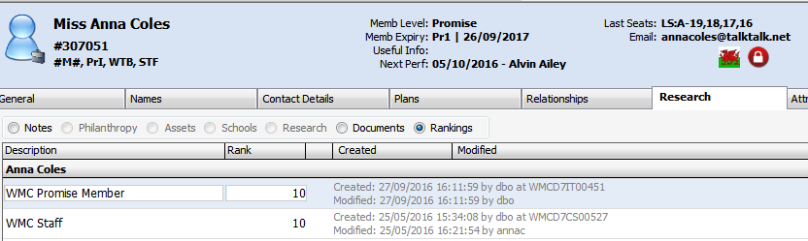
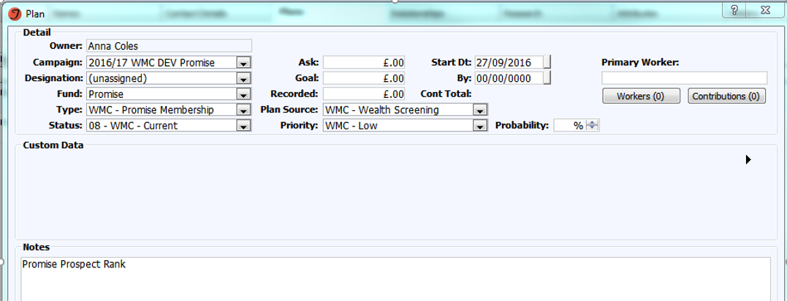
Using Your Data to Find Prospects
Overnight Procedure
- Updates the rank from Prospect to Member:
- Updates the Plan from Prospect to Current:
Notes:
The second overnight procedure then looks at all orders created where a prospect has booked on the previous day.
If the prospect has chosen to become a member, the procedure:
Updates the rank from Prospect to Member
Updates the Plan from Prospect to Current
This will then ensure that the pricing rule doesn’t trigger next time the customer books.

Slide 36
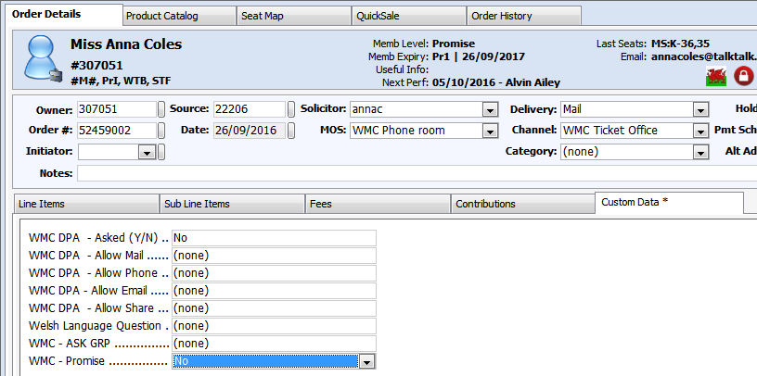
Using Your Data to Find Prospects
If No:
The Contact Centre Assistant processes the order as normal but logs a ‘No’ in the Promise Custom tab:
Notes:
If the decline the membership:
The CCA processes the order as normal but logs a ‘No’ in the Promise custom tab.

Slide 37
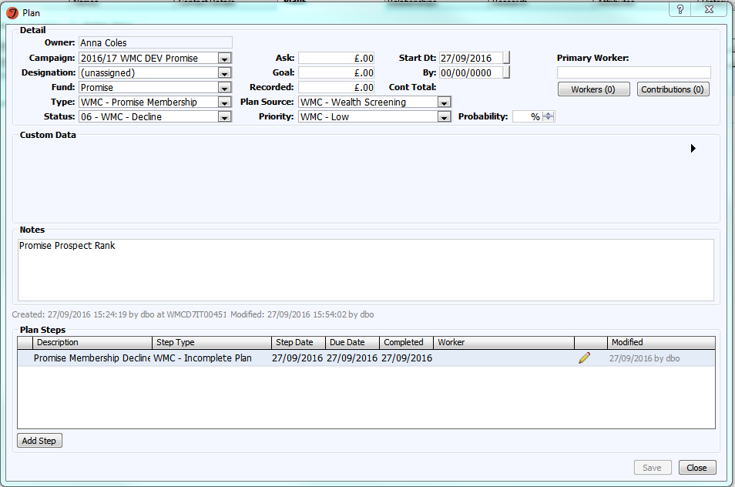
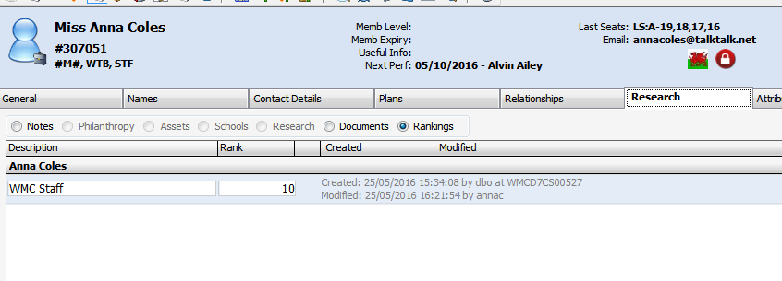
Using Your Data to Find Prospects
Overnight Procedure
-Updates the plan with declined information
- Removes the rank from the constituents account
Notes:
The second nightly procedure will then:
Remove the ranking from the constituents record
Update the plan so that it holds ‘declined’ information (change the status from WMC Prospect to WMC Decline and add a WMC – Incomplete Plan as a step)
Adding the step type will allow us to monitor how much time has passed since the initial refusal.

Slide 38
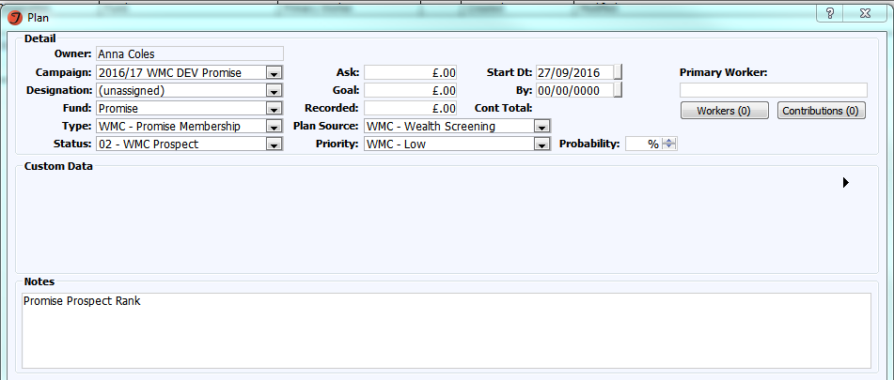
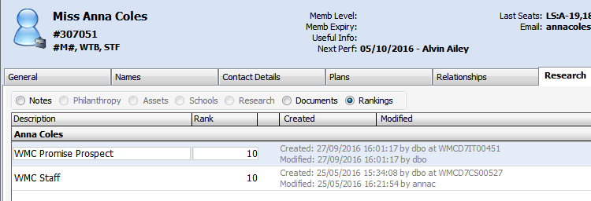
Using Your Data to Find Prospects
Re-prospecting
Once 6 months has passed from the initial decline:
The Plan is re-opened
And the rank is re-added
Notes:
Once 6 months has passed from the initial decline date and providing the constituent still meets the prospecting criteria:
The plan is re-opened and reset back to a ‘Prospect’ status
The rank is re-added to the account
This will then mean that the next time the constituent books with us, the pricing rule messaging will pop back up allowing the CCA to once again offer a membership to them.

Slide 39
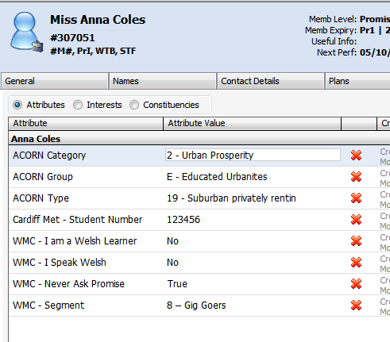
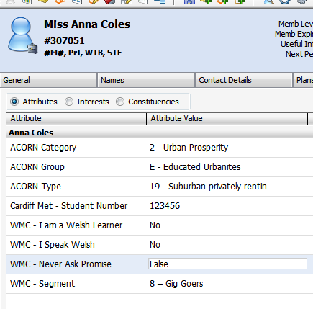
Using Your Data to Find Prospects
Never Ask Again
Attribute Value = True if they wish to never be asked again.
Value can be changed to ‘False’ if they change their mind
Notes:
If the constituent asks to never be offered the membership again:
The CCA can add a ‘WMC – Never Ask Promise’ attribute to the constituents account and set the value = True. This will then ensure the constituent is excluded from the initial procedure that adds the prospect rank to the account.
If the constituent changes their mind and would happily be asked the question again, the attribute can be changed to ‘False’, allowing the procedure to then include them in the prospecting again.

Slide 40
Using Your Data to Find Prospects
Future Considerations
2 or more opening night bookings
2 or more bookings on public on-sale
2 or more restaurant bookings
Notes:
Once we have fully rolled this procedure out and it’s successfully working we will look to expand the criteria that a constituent needs to fall into in order to gain membership benefit.
Examples include:
2 or more restaurant bookings
2 or more opening night bookings
2 or more bookings on a public on-sale date.

Slide 41
Using your Data to find Prospects
Thank you for listening!
Anna Coles
Database Team Leader
anna.coles@wmc.org.uk

Slide 42
Gold mining
The RSC’s journey with wealth screening

Slide 43
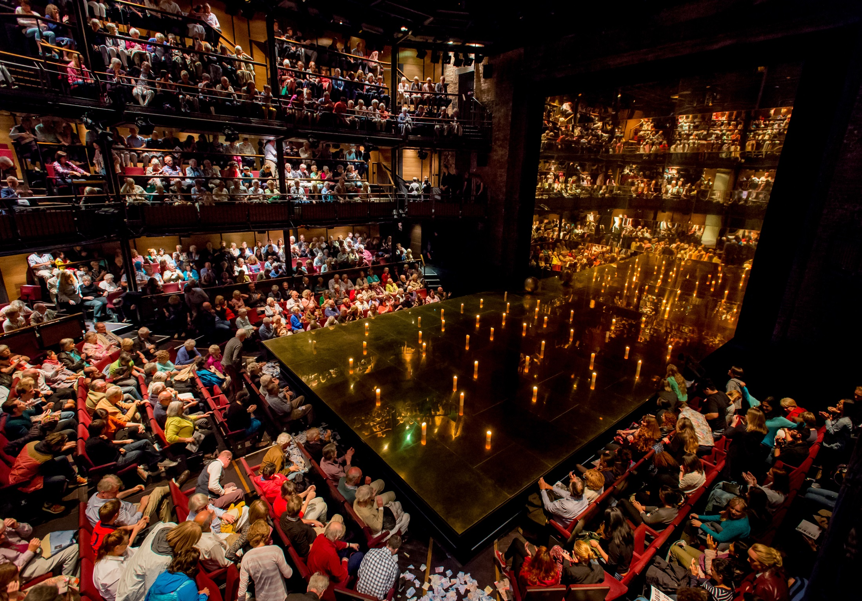

Theatre at its best, made in Stratford-upon-Avon and shared around the world.
We encourage everyone to enjoy a lifelong relationship with Shakespeare and live theatre.
In 2014/15 we:
Sold 1.8 million tickets
Reached 530,000 young people across the UK
Welcomed 570,000 day visitors to our buildings
Raised £3.6 million through fundraising in addition to our ACE NPO funding

Slide 44
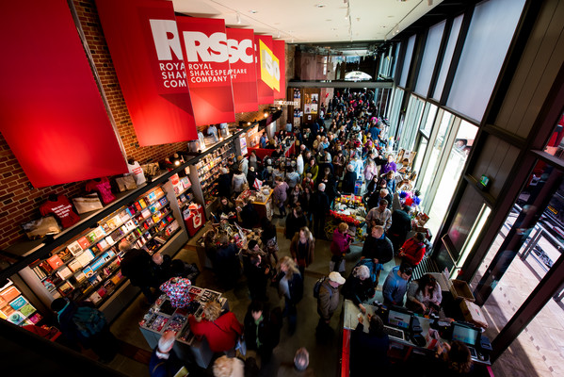
Why did we want to carry out a wealth screening exercise?
Our aim was to:
  Grow our US base of donors
  Explore potential for capital donations
  Explore potential for a legacy campaign

Slide 45

Who are Wealth Engine?
For more than two decades, WealthEngine has provided wealth intelligence solutions to help fundraising, marketing and business development professionals create strategies to extend their reach and build their prospect pipeline.
Based in the US but with an office in the UK.
Take you through the process using 11 key steps.
Notes:
11 key steps are:
Define quantifiable goals
Who should have access to the screening results.
Address any training needs of staff.
How will you integrate results within your CRM.
Develop a plan to validate data.
Develop an order of priority.
Develop a Timeline and Plan of Action for results.
Create buy-in among internal constituents.
Assign qualified prospects to fundraisers.
Measure results so you can assess progress.
Evaluate results.

Slide 46
Preparing for the wealth screen
We set clear goals before embarking on the wealth screening exercise and made sure the Wealth Engine were clear on these goals too.
Internal discussions helped us to decide our parameters – for example, we decided we were only interested in screening data for those who had seen at least one production in the last 5 years, excluding Matilda.
Following wealth engines 11 key steps, we decided to screen approximately 100,000 records on a database of 800,000 active records.
There was a mix of UK and US records.
Data preparation is key – providing accurate and good quality data meant we got much better results.

Slide 47

Interpreting the results
Wealth Engine knew our key goals so highlighted results which helped to achieve these.
We started with those identified as ‘quick wins’.
We focused on those with capacity to give a major gift first.
We spent too long questioning the validity of the results which meant a delay in actioning.
Customer performance diaries tell us who is coming in and when. That way we can prioritise research, approaches and resources.

Slide 48
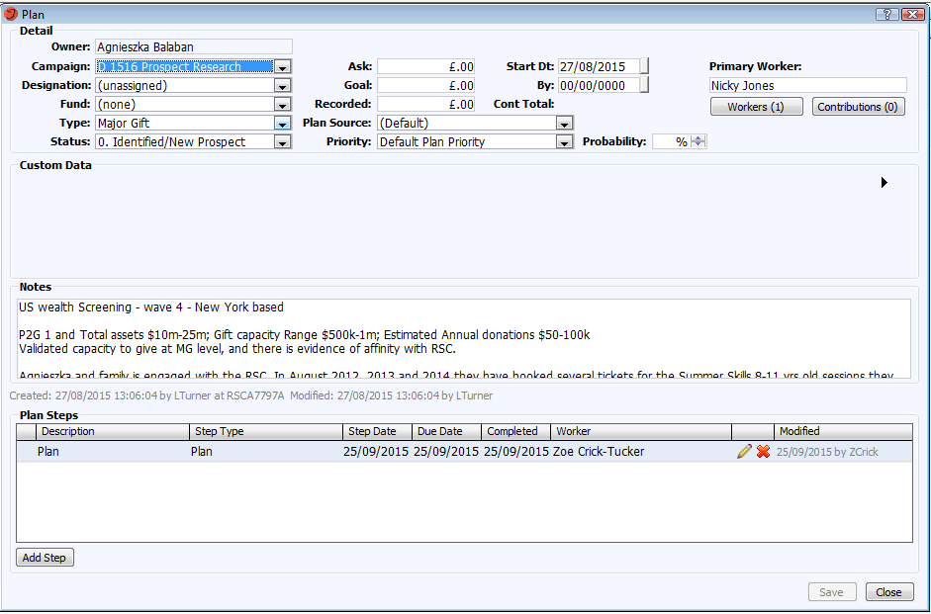
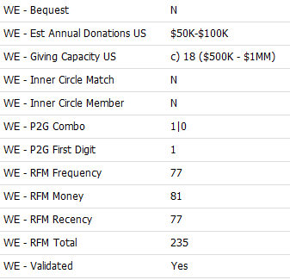
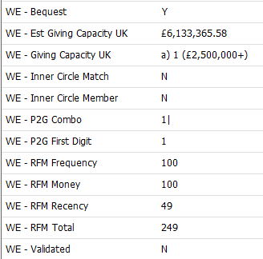
Actioning the results
New prospects and upgrades: Highlighted thousands of people we had not previously identified as potential prospects and led us to current donors who had capacity to increase their gift.
New donors: We received a £10k donation within 3 months of one prospect being identified. She had never previously donated to the RSC.
Potential new partnerships: We have started to build some relationships which we hope will lead to long term partnerships. A previous wealth screen connected us to someone which led to a £1m gift a few years later.
Importing results into Tessitura: All results are listed under attributes and then added plans for the top prospects.

Slide 49
Things to consider…
Who will be doing the work at each stage – from gathering the data to using the results for fundraising?
How will you release the results of the screening to different teams?
How accurate is your data that you are sending to be screened?
Find out who your contacts at the wealth screening company are – the people that sell the service may not be the people that work on the screening!

Slide 50

Next steps…
We have just begun a recruitment drive for our newly relaunched Patrons scheme.
We are building long term relationships with identified prospects – a previous wealth screen led to a £1 milliion gift.
We are tracking the success of the screening through source codes, prospect generation, declines and engagement.
We hope to use T-Stats to build something within Tess that recognises the patterns of a high level prospect and uses it to highlight others within the database.

Slide 51
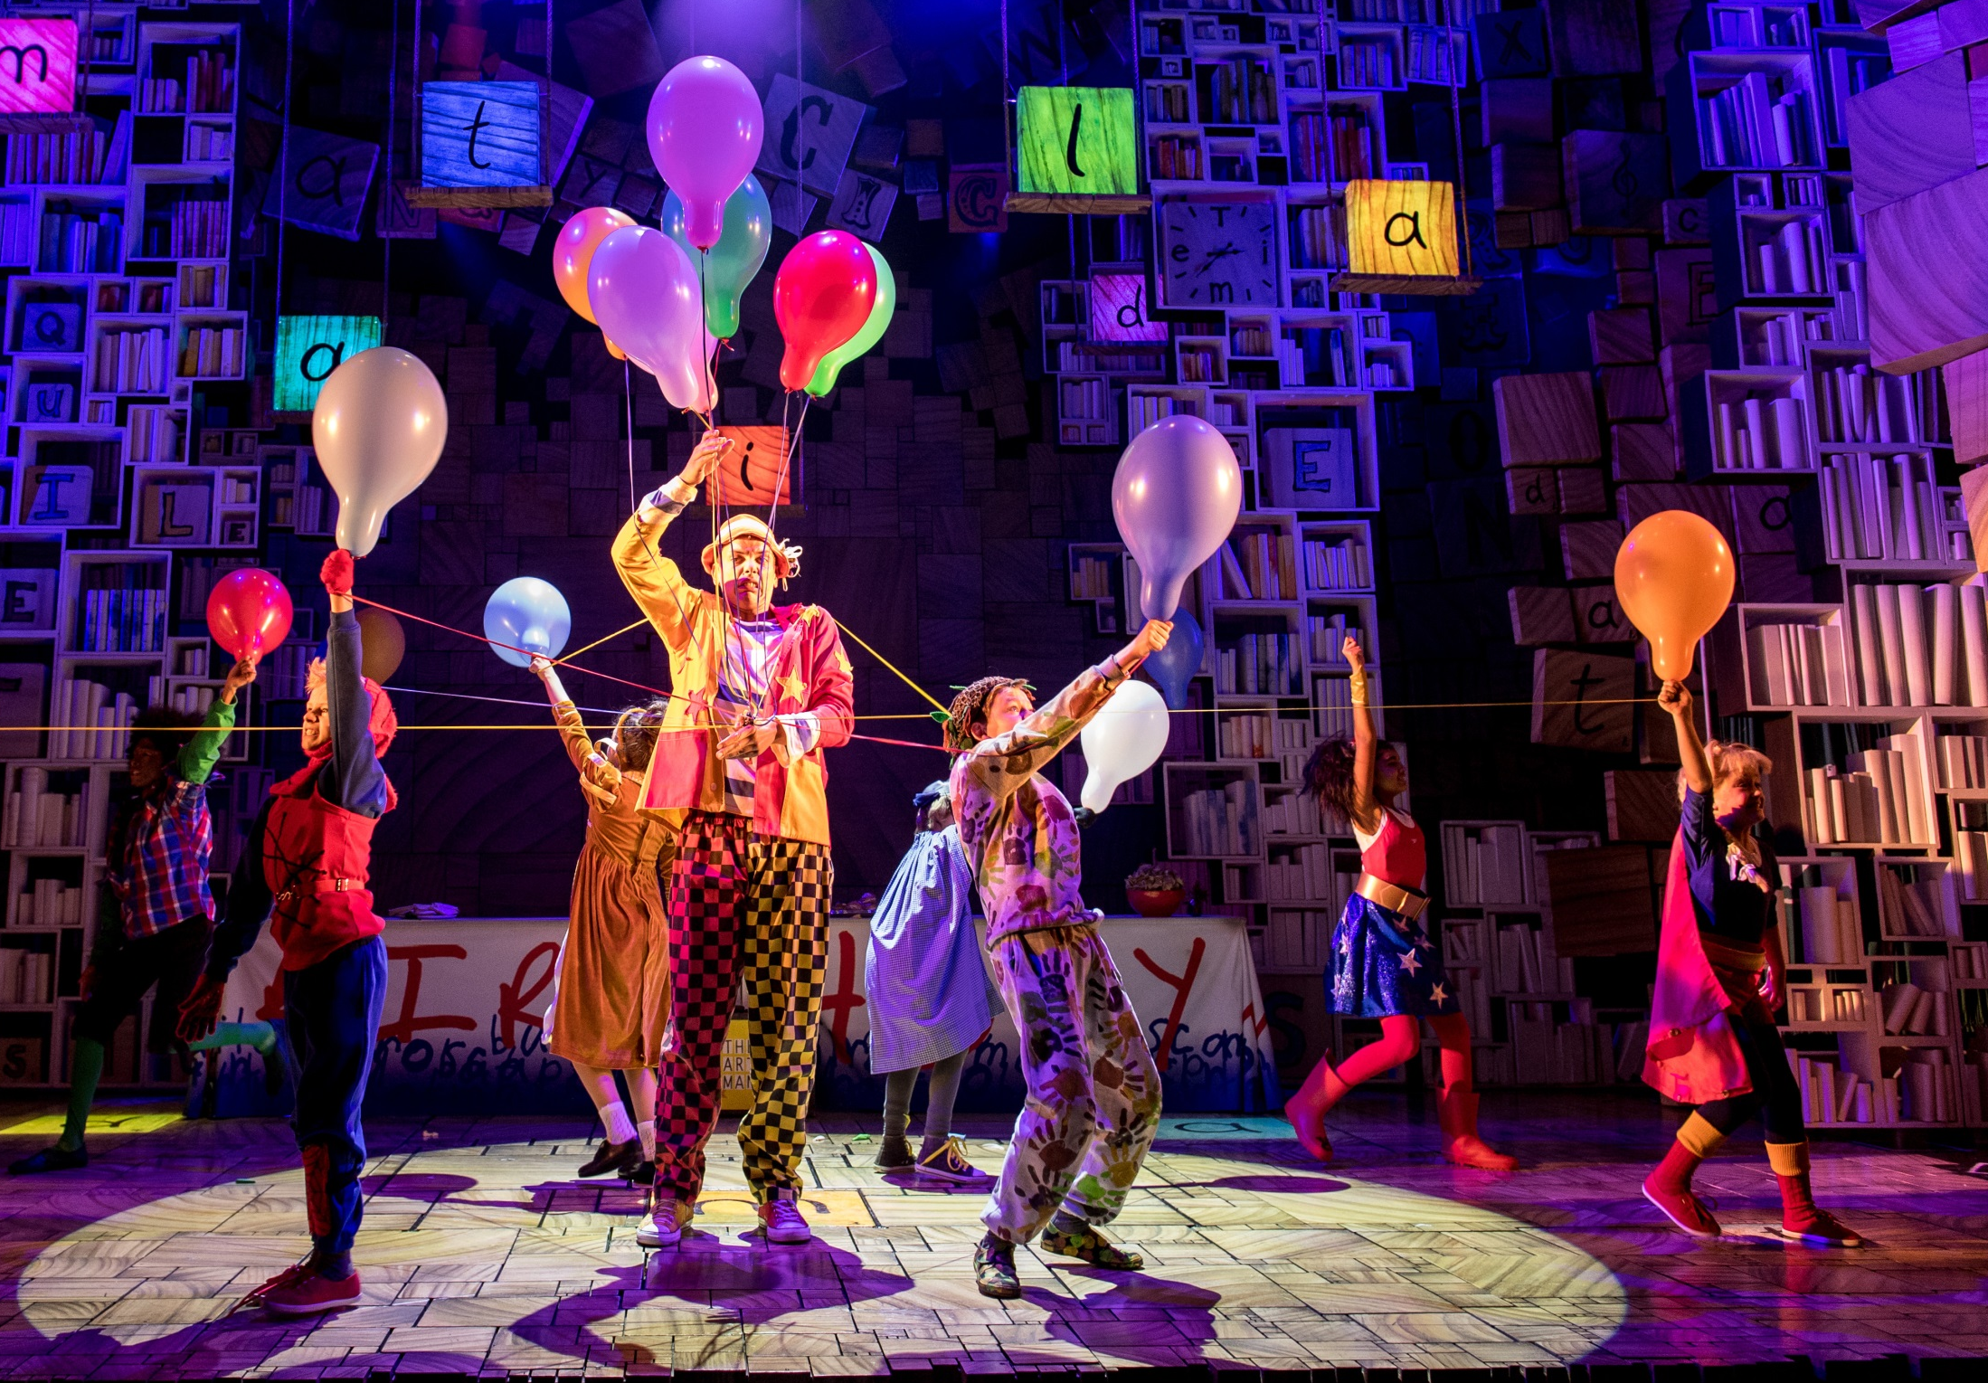
Contact
Jessica Hill
Major Gifts Officer
Royal Shakespeare Company
01789 272234
jessica.hill@rsc.org.uk

Slide 52
“There is man in his entirety, blaming his shoe when his foot is guilty.”
QUESTIONS?
Samuel Beckett, Waiting for Godot

Slide 53

WHAT’S NEXT?
BREAK 11.00-11.15
Hogan Foyer / Level 6 Foyer
BREAKOUT SESSION FIVE
11.15-12.15
Notes:
FRIDAY Breakout session 4 What’s next slide

