Slide 1

TESSITURA
EUROPEAN
CONFERENCE
DUBLIN 2016
Notes:
Welcome

Slide 2



PRESENTER
Becky Shephard : Tessitura Network
PROJECT MANAGEMENT FUNDAMENTALS
A LITTLE PLANNING GOES A LONG WAY
Share your favourite content and photos! #TECDublin16

Slide 3
Agenda
Introduction
Project Management Theory
Project Examples
  Small
  Medium
  Large
Portfolio Management
Tool Selection Tips and Tricks
Notes:
Today we'll be reviewing the theory of project management and how you can apply theory to actual projects at your organization, no matter the size. Then we'll talk about managing multiple projects as part of portfolio management; talk about tips for selecting the right tools for your organization; and will have plenty of time for questions about real-life project management hurdles.
But first of all - Who am I? Well, I’m relatively new to the Network, and although my job title is Application and Support Consultant like a number of my colleagues, I work specifically as a Project Manager. I joined the network from a Primary Ticket Agent, where I Project Managed box office installations from everything from glamourous stadium tours like Rod Stewart, to large scale Festivals as well as for a number of venues, and previous to that I have worked as a Project Manager in various organisations in the Arts and Cultural sector.
CLICK

Slide 4
Project Management Theory
Notes:
POLL THE ROOM
So… Before we dive into project management theory… Let’s poll the room
Who in the room acts a project manager for their organization?
Who has a PM within their organization?
Who is currently managing a project or multiple projects (whether or not it is in their job title)?
Who has not done any project management, but might be starting to?

Slide 5
What is Project Management?
  “Project management is the application of knowledge, skills, tools, and techniques to project activities to meet the project requirements.” – PMI
Why is Project Management important?
Notes:
So, what is project management? As defined by the Project Management Institute, project management is the application of knowledge, skills, tools, and techniques to project activities to meet the project requirements. Essentially the activities that help keep a project on track and ensure it’s successful.
CLICK
But why is project management important? Effective project management ensures that your project stays within budget, on time and accomplishes the scope outlined for the project. It gives you a way to quantify the current status of a project; and it gives you the tools for getting a project back on track when things start to slide off the rails. Effective project management is also scaled appropriately so that you don’t artificially add overhead to a small project; but have all the techniques needed to manage large and complex projects
CLICK

Slide 6

Project Management Triangle
Notes:
As most of us have experienced, all projects have constraints of some variety, typically some variation of budget or cost; time; and scope. In project management these three factors are commonly referred to as "the triple constraint“ and often represented as a triangle.
Unfortunately in project management—much like life in general—you can’t have everything you want, in exactly the time you want, and within the budget you want. So within these three constraints you have to have some give and take, all of the points on the triangle can’t be fixed; at least one of them needs to be movable in order to accommodate the constraints of the other 2 points.
For example,
CLICK
You can have everything you want in the timeframe you want with unlimited budget
CLICK
Or you can have everything you want on the budget you have if you are flexible on timing
CLICK
Or you can have some of what you want in a fixed time and a fixed budget
The constraints on your particular project help inform the project management activities that will be critical to the overall success of your project.
For example, if your timeline is constrained and your project must be finished quickly or by a particular milestone, then monitoring and tracking project schedule should be a top priority, and maybe budget or cost management becomes less of a priority. Conversely, if you have a limited budget, then you might flip that priority and make sure that you and your project team are paying special attention to budget management.
Once you have those priorities established you can determine which project activities are needed for your particular project.
CLICK

Slide 7
Project Management Theory:
Process Groups
Initiating
Planning
Executing
Monitoring and Controlling
Closing
Notes:
Within project management theory there are 5 process groups that make up the lifecycle. From the initial concept and planning of a project; through actually doing the work; watching and making sure the project stays on track; and ultimately closing the project. The executing, and monitoring and controlling groups are where the bulk of the project activities take place and they happen simultaneously so that as project work is executed the project manager is ensuring that the project is still on track.
CLICK

Slide 8
Project Management Theory:
Knowledge Areas
Scope
Time
Quality
Communications
Risk
Budget/Cost
Resource
What is the project requirements?
When does the project need to take place?
What are the success criteria?
How will the team communicate?
What on the project could go wrong?
How much will the project cost?
Who needs to be involved in the project?
Notes:
Along with your five process groups, there are seven knowledge groups. These are areas within project planning and management that need your attention as a project manager throughout the project lifecycle and they can help guide your project plan to ensure that things don’t fall through the cracks.
These areas include:
Defining and controlling the scope of the project; Understanding the milestones and timeline needed; determining what the success criteria are, and how you’re planning to test and confirm that a project deliverable is successful; Putting together a communication plan; Understanding where the project might go off track up front and watching for risky situations; Reviewing budget constraints; and understanding what resources will be needed on a project.
CLICK

Slide 9
Scope
Define Scope
Collect Requirements
Time
Quality
Execute Project
Control Scope
Confirm Scope Completed
Define Milestones
Develop Schedule
Control Schedule
Communications
Risk
Budget
Resource
Identify success criteria
Plan QA & QC
Perform QA
Perform QC
Confirm Quality Achieved
Identify Stakeholders
Define Communication Plan
Execute Communication Plan
Identify Risks
Define Risk Management Plan
Monitor and Control Risk
Define Budget
Confirm Budget
Control Budget
Report Final Budget
Define Roles & Responsibilities
Manage Project Team
Project Team Review
Phase
Initiating
Planning
Executing
Monitoring & Controlling
Closing
Notes:
When we put the process groups and knowledge areas together we get a grid that helps organize the various project management tasks.
In this grid view you can review the tasks needed either within a single process group
CLICK
Or you can review the tasks by a specific knowledge area across the project lifecycle
CLICK
In order to review and determine what is needed for your project.
CLICK

Slide 10
Small
Report
Project
Scope
Define Scope
Collect Requirements
Time
Quality
Execute Project
Control Scope
Confirm Scope Completed
Define Milestones
Develop Schedule
Control Schedule
Communications
Risk
Budget
Resource
Identify success criteria
Plan QA & QC
Perform QA
Perform QC
Confirm Quality Achieved
Identify Stakeholders
Define Communication Plan
Execute Communication Plan
Identify Risks
Deffine Risk Management Plan
Monitor and Control Risk
Define Budget
Confirm Budget
Control Budget
Report Final Budget
Define Roles & Responsibilities
Manage Project Team
Project Team Review
Phase
Initiating
Planning
Executing
Monitoring & Controlling
Closing
Notes:
This grid is also scalable based on project size, needs, and constraints; so the question to ask is: For my project, what activities do I need to make sure happen in each area on the grid to ensure my project is successful?
For a large project, maybe a website implementation, you would need to manage all facets of the project represented in the grid. But in the example of a small report writing project, with no budget constraint, you might be able to focus more on scope and time management; and perhaps eliminate or deprioritize risk and budget management.

Slide 11

Project Management Lifecycle
Initiating
What needs to be done?
Who will do what?
How will the team communicate?
Executing
Do the work
Monitoring & Controlling
Are we on track?
Are we doing the right work?
Is the project done?
When does it need to be done?
How will they do it?
What is the budget?
Planning
Review and test the work
Are we on budget?
Closing
Did the project go well?
Notes:
Once you have your list of project management activities, they can be grouped by process group to create a project management lifecycle that is tailored to your specific project.
CLICK

Slide 12
Project Roles & Responsibilities
Stakeholders
Project Sponsor
Project Manager
Project Team Members
Notes:
So – I promise that we are nearly at the end of the theory – but we have one last piece to consider before we dive into some examples; project roles and responsibilities. There are some key people to identify on all projects, no matter the size, so that you’re clear about who is doing what, and who you need to communicate with as a project manager.
Project Stakeholders are the specific people or groups who have a stake, or an interest, in the outcome of the project. This often includes management within the organization, but could sometimes includes external stakeholders, for example board members.
The Project Sponsor is the person who has ultimate authority over the project and oversees project funding and milestones; resolves issues and scope changes; approves major deliverables and provides high-level direction. They also champion the project within the organization ensuring that there is buy-in for the project to help ensure its success.
The Project Manager is responsible for planning the project, managing the budget, schedule, and all project management activities; and ensures that the project deliverables are completed according to the project plan.
The Project Team Members are the resources assigned to work on the deliverables of the project. These could be business users, programmers, designers, Tessitura Consultants...
They are responsible for:
Understanding the work to be completed;
helping to plan the assigned activities as needed;
completing assigned work within the budget and timeline
Testing and ensuring the quality and ultimate success of the deliverables
And Proactively communicating status, issues, scope changes, risk and other concerns to the project manager

Slide 13

Notes:
Now that you’ve learned some project management theory, let’s talk about how to apply it to real life projects.

Slide 14
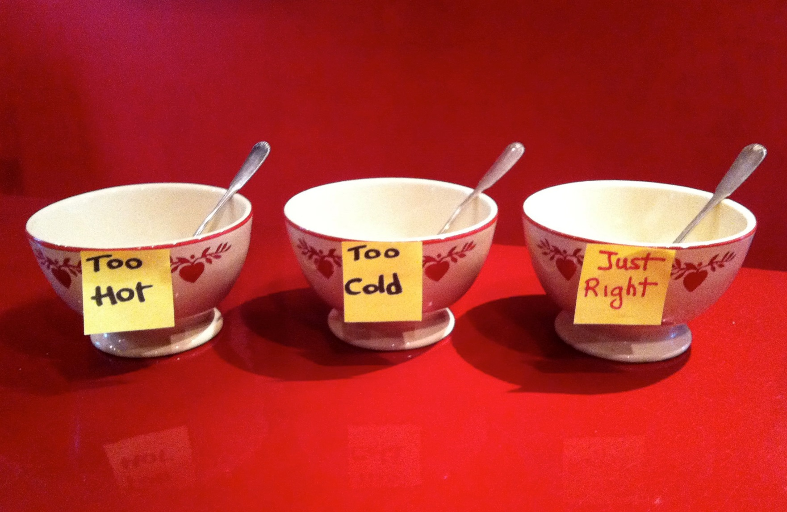
Be like Goldilocks
Notes:
There are lots of tools in the PM toolbox. An effective project manager has to learn which ones to use for the project at hand. Big projects do call for lots of tools and more formality. Smaller projects call for just a few well-selected tools to keep things on track.
I’m going to talk through 3 practical examples: small, medium, and large, to help you understand which tools and techniques provide the most value for each size of project.

Slide 15
Small Project: Custom Report
Notes:
*** TIME? ***
So let’s start with a small project. Our example here is the creation of a custom report, but a small project could also be a mailing that has to be sent or a meeting that has to be organized.
So how to figure out what tools to use?

Slide 16
Consider what you need to track:
Initiating
What needs to be done?
Who will do what?
How will the team communicate?
Executing
Do the work
Monitoring & Controlling
Are we on track?
Are we doing the right work?
Is the project done?
When does it need to be done?
How will they do it?
Planning
Review and test the work
Are we on budget?
Closing
Did the project go well?
What is the budget?
Notes:
When thinking about a small project I like to look at the project lifecycle and consider what I need to track.
Need to manage
Communication
Dates
Requirements
Don’t need to manage
Multiple resources
Dependencies
Executive level updates or budget

Slide 17
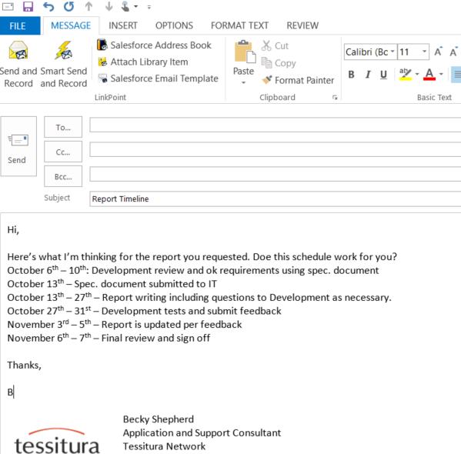
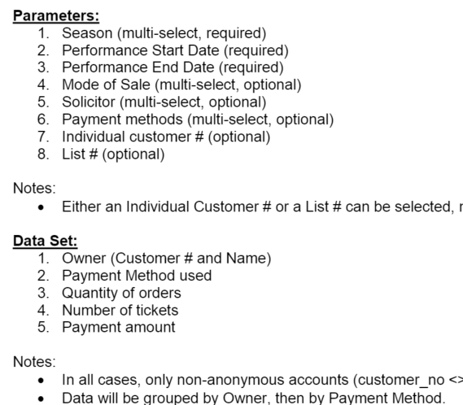
Small Project Tools
Notes:
For a small project such as a custom report all you may need is an email (communication) with a simple timeline (dates) and
CLICK
a specifications document (requirements). Depending on how formal your organisation is, it can be a good idea to ask the requesting department to ‘sign off’ on or initial the spec document to show agreement before proceeding. And of course make sure you update on progress throughout the project.

Slide 18
Small Project Summary:
Custom Report
Communication (Email)
Plan (List of Dates)
Scope (Requirements or Specifications Document)
Notes:
So to sum it up for our small project example (the creation of a custom report) the items I would use are: CLICK
An email to communicate
CLICK
Which would include a list of milestone dates
CLICK
And a document to define what the report should do, the parameters it should contain and any other information needed to build the report desired.
One last thing to leave you with – a good rule of thumb to keep in mind when deciding how much management a small project requires (and it sounds obvious but I’m going to say it anyway) is that it never makes sense to spend more time managing the project than it does to do the actual work involved.

Slide 19
Medium Project: Data Import
Notes:
Now let’s move to a medium project. A medium project could be training a set of new users on Tessitura or planning an onsale, but for our medium project example today let’s use a data import into Tessitura. This could be something like a new set of legacy data that needs to be formatted and imported into ticket history or a new set of constituent data that is too complex to import using the standard Constituent import utility. This work could be done in house or by using the Tessitura consulting department. Regardless, we would call this a medium sized project.

Slide 20
Consider what you need to track:
Initiating
What needs to be done?
Who will do what?
How will the team communicate?
Executing
Do the work
Monitoring & Controlling
Are we on track?
Are we doing the right work?
Is the project done?
When does it need to be done?
How will they do it?
What is the budget?
Planning
Review and test the work
Are we on budget?
Closing
Did the project go well?
Notes:
Here again
CLICK
Is our project life cycle.
You’ll notice that once you hit a medium sized project you really are managing all facets of the project. At this point it’s really just scale and balancing the amount of time spent managing vs. benefits you gain from it.

Slide 21
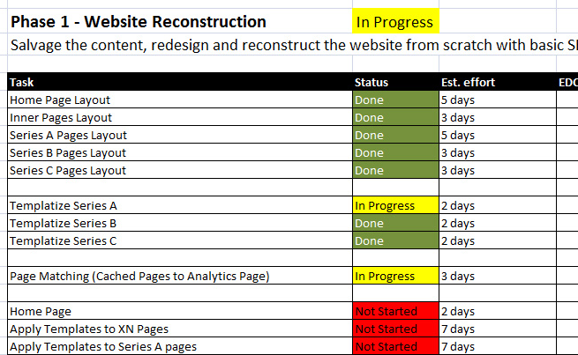
Project Plan Example
Notes:
For a medium sized project you will definitely need a project plan that lives somewhere other than in an email or on multiple post it notes stuck all over your desk. However you don’t necessarily need fancy or expensive tools. Excel works great for simple project plans especially if dates aren’t constantly shifting and you aren’t managing dozens of dependencies.

Slide 22

May Want to Also Consider
Holding kick off and wrap up meetings to appropriately set expectations and talk through plans
Putting a communication plan in place in order to send regular updates to stakeholders
Notes:
I’ve noted a few other things you might want to consider in a medium sized project. These include:
Holding kick off and wrap up meetings. This gives a nice formality to the project and helps to set expectations appropriately. Will talk in more detail about kickoffs when I discuss large projects
Putting a communication plan in place which is basically a fancy phrase for deciding who needs updates, how often, and via what medium

Slide 23
Medium Project Summary:
Data Import
Kickoff Meeting
Communication Plan
Project Plan
Regular Updates
Wrap-up Meeting
Notes:
So to sum up my data import project example I would recommend
CLICK
Holding a kickoff meeting which will help you put together your
CLICK
Communication plan and
CLICK
Project plan. Make sure to provide
CLICK
Project updates and
CLICK
Hold a wrap up at the end to be sure the completed project meets the needs of the stakeholders.

Slide 24
Large Project: TNEW Implementation
Notes:
And now on to our last example – a large project. A large project could be a hardware change – going to a new server or moving to the Tessitura RAMP environment or it could be a larger Tessitura version upgrade.
Today we’ll use a TNEW implementation for our large project. Not surprisingly, the larger the project the larger the toolbox you’ll need to employ to manage it effectively. As with the other projects it’s a judgement call as to which tools you’ll need for any given project and how much time and effort to spend with each of them but in general a large project means a lot of moving pieces, a larger project team and group of stakeholders, and more work to be done.

Slide 25
Consider what you need to track:
Initiating
What needs to be done?
Who will do what?
How will the team communicate?
Executing
Do the work
Monitoring & Controlling
Are we on track?
Are we doing the right work?
Is the project done?
When does it need to be done?
How will they do it?
What is the budget?
Planning
Review and test the work
Are we on budget?
Closing
Did the project go well?
Notes:
Ok, so back to our friend the life cycle.
Just like with a medium project – need to stay on top of everything
The things you’ll need to manage in a large project generally include:
Communication
Timeline
Requirements or scope
Multiple resources and dependencies (dependency means one tasks must follow another)
Also providing regular updates to a number of people including formal executive level updates and budget tracking

Slide 26

to define
Notes:
For a large project such as our TNEW implementation you will certainly want to do a formal kickoff. As part of this you’ll need to define timeline, budget, and requirements (PM triangle). There are a couple of standard documents often used for capturing this information (Project Definition Document, Project Charter, etc…). If you Google either of these terms you will find multiple template options available.
May want to get sign-off on this document when it is complete whether verbal, email, or of the document itself. This is especially helpful when you have a large number of stakeholders and project team members.

Slide 27
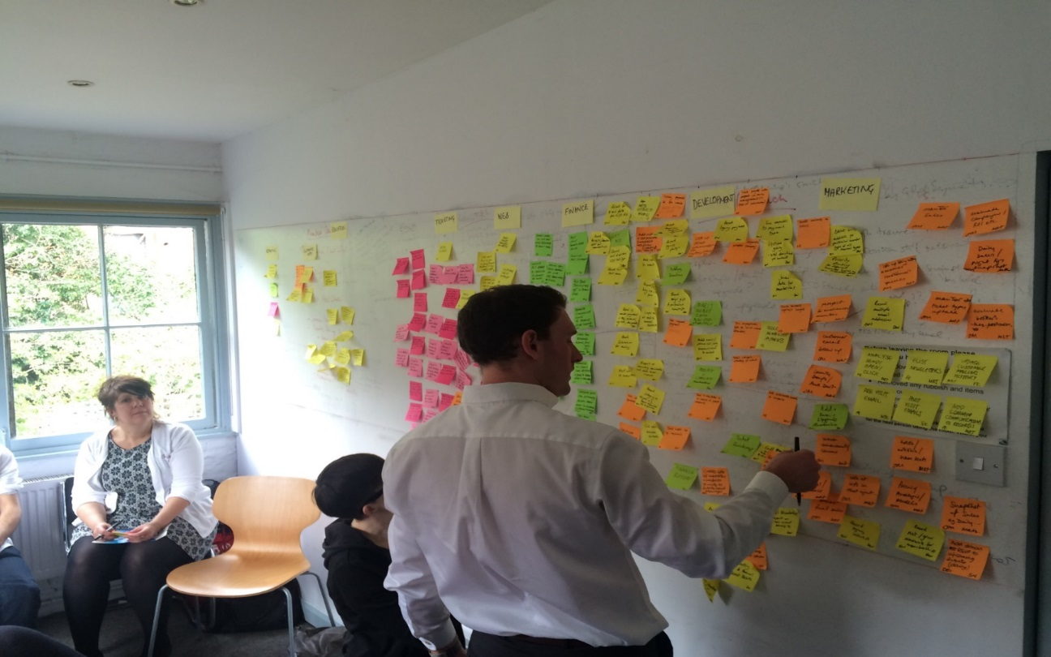
Post-it® Exercise
Notes:
While we don’t have time to go into detail on all the things a kickoff should include I do want to spend a few minutes talking about an exercise we at Tessitura love for setting a project timeline. We call it the Post It Exercise.
For this exercise, it’s important that all people linked to the Project are gathered together – As the Project Manager, you need to come armed with post its in a variety of colours –
Here, I am imagining specifically an Implementation project, but this will work just as well for any large scale project with lots of interested parties, where you need to establish a timeline.
Firstly, you are going to ask each department to write out their ‘Has to do’ items – the things that they are doing everyday, that they need to guarantee will continue.
Get every department to put these post its up on the board, and talk through them, so that they can see crossover between departments. We often find that this commonality is actually being considered for the first time. You can then remove the duplicates to establish your core project items
Secondly, you can go through the same exercise again, but this time the question is ‘Would like to do’. On this pass, there is probably more conversation, but again, visually assessing these items, to establish which features would be beneficial across the organization will also give you a list of additional project items.
Once you’ve got your tasks – You can then take these post its, and move them into the mapping part of the exercise. Write up the project timeline on the board, month by month – Take another colour post-it, and write down any time constraints that are going to pull focus from the project for each department. Then organize your tasks into the order that they will need to be achieved. In order to do this, you’ll need to start thinking about dependancies, and ultimately, you’ll create a visual representation, that allows everyone to see the correct navigation through the project.

Slide 28
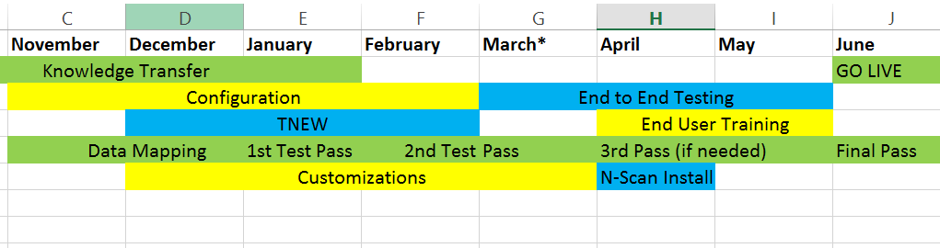
Post-it® Exercise End Result
Notes:
We feel this exercise is valuable for a couple reasons: 1) it’s interactive and gets the whole project team involved – people get a say which means you as a PM get buy in 2) it’s visual and easy to change so you can play what if? With several scenarios before committing to a rough timeline as a result.

Slide 29
May Include
Success criteria
Assumptions and constraints
Risk register
Risk | Probability | Impact | Strategy
Change in key staff | High | Medium | Mitigate – 2 people from each area are involved
Current site stops functioning | Low | High | Avoidance – ensure regular backups are scheduled
Notes:
Some other things your kickoff may include are:
Definition of success criteria. It sounds obvious but having well defined, measurable success criteria is a huge help in a large project. It not only generates agreement on scope at the beginning of the project but gives you something to ‘steer the ship’ towards as you go. When questions arise it can be useful to consult your success criteria and ask – which option gets me to where I need to go? So in our TNEW example you may have success criteria such as decrease time staff spend updating addresses. To that end it may make sense to decide that the login is highlighted and perhaps include a request to update address in any emails you send to your database, announcing the launch.
The second items is the definition of assumptions and constraints.
Assumptions are circumstances and events that need to occur for the project to be successful, but are outside the total control of the project team
Constraints are most commonly based on resources and time and can really help define a project trajectory.
And of course everyone’s favourite – risks. Risks are items that can happen and affect the project in some way. Risks can be both positive and negative - though we focus more on negative generally. When discussing risks you’ll want to assess probability and impact to steer project decisions.

Slide 30
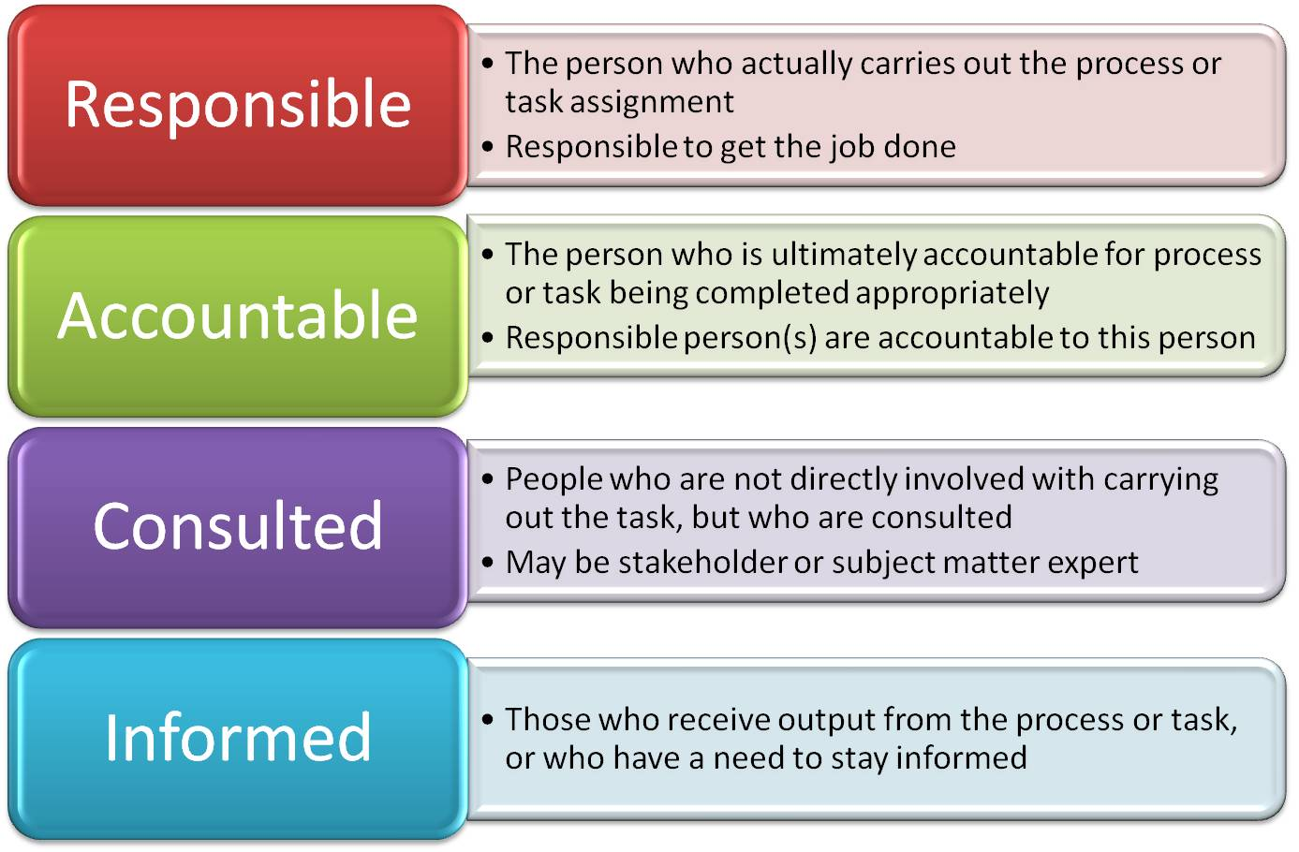
Other Large Project Tools
Communication Plan – including general updates and budget tracking
Definition of roles and
responsibilities
Notes:
A couple more tools for a large project are the communication plan as discussed earlier and a formal definition of roles and responsibilities. One nice way to do this (which I actually only came across when doing preparation for this presentation) is using the RACI matrix as shown on the screen – for each grouping of tasks it allows you to note who on your project team is Responsible, Accountable, Consulted or Informed.
Like assumptions, this removes misunderstandings and allows for greater clarity of roles.

Slide 31
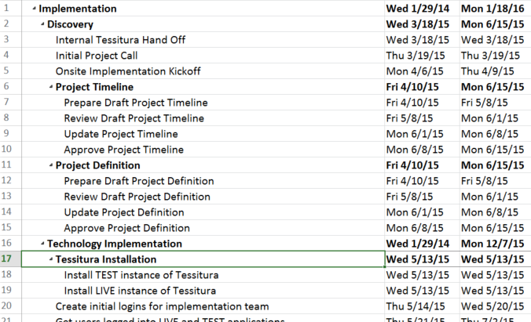
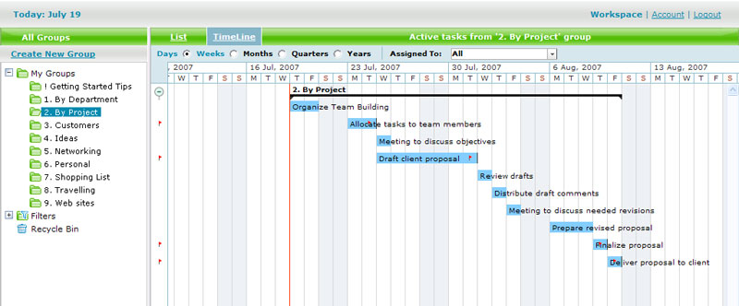
Other Large Project Tools
Notes:
Of course a project plan is a must. With a large project it is probably worthwhile to use a true project planning tool if you have one available. These have many benefits, but not least is the ability to produce a GANTT chart, which allows you to visualize and manage the Project Dependancies.

Slide 32
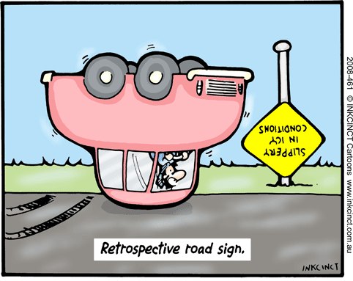
Other Large Project Tools
Retrospectives can take many forms:
  Keep doing, stop doing, start doing
  What worked well? What should we change? Puzzles?
  Drop, add, keep, improve
Notes:
The last tool I’d recommend for a large project is a retrospective. A retrospective is a chance to look back and assess. They are typically done at the end of large projects but can also be used at big milestones. They take many forms and I’ve listed some of the most common here, but generally take the form of questions to try to learn from the experiences during the project.

Slide 33
Large Project Summary:
TNEW Implementation
Kickoff Meeting
Project Definition Document
Project Plan
Regular Updates
Regular Retrospectives
Wrap-up Meeting
Notes:
So for our Large project – the summary is:
CLICK
Kickoff Meeting which leads to a CLICK
Project Definition Document which would include Communication Plan, risks, constraints, assumptions, success criteria and definition of roles and responsibilities CLICK
Project Plan CLICK
Regular Updates & Check-In Meetings as well as budget review CLICK
Regular Retrospectives CLICK
Wrap-up Meeting
The final thing I’ll leave you with is that the right level of management for any given project is always a judgement call on your part, as a project manager. And the more projects you manage the better sense you’ll have as to what is ‘just right’ to quote our friend Goldilocks.

Slide 34
When a Project Goes Off the Rails
Notes:
*** TIME?? ***
While the goal of PM is to have a smooth project all the time this is not always reality. There are often factors that influence the project and can run it off the rails. The real value of PM is that it allows you to see this before it’s too late to fix.
The first question is how do you know when a project is going off the rails?
CLICK

Slide 35
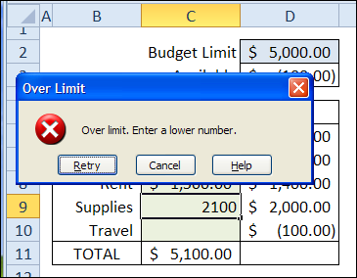
Now what?
Notes:
Indicators that your project could be in troubles could come from the project plan or schedule, your budget review, or in feedback from a regular project update or communication.
If you have properly prioritized your project management activities and tools based on your projects constraints and risks you should have the proper tools and indicators already at your fingertips.
For example, slippage in a project schedule, constantly missing milestones, or having to move milestones further and further into the future is a sign that your schedule is in trouble and you may not make your overall project timeline.
If you see this happening check in with your project team. Do they have competing priorities and therefore not enough time to accomplish the work in the current schedule? Do you need to consider adding additional resources to help finish the work on time?
Or, has the scope of the project crept away from the original requirements so there is now more work to be done? Do you need to regroup and review the current scope of the project and either bring it back in line with the agreed upon requirements or change your plan and schedule based on new scope items?

Slide 36

When in doubt…
Notes:
Chances are if your projects is headed off the rails then communication within the project team is not quite right. With proper team communication you can spot problems early, correct them quickly and keep your project headed in the right direction.

Slide 37
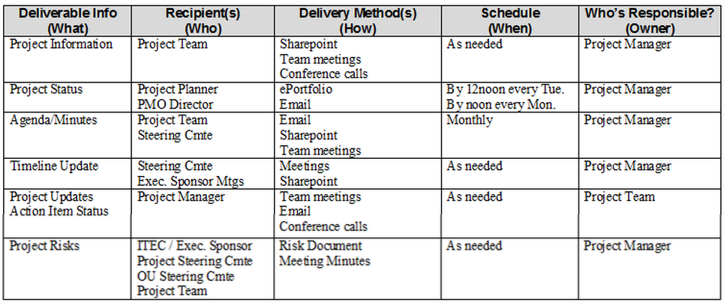
Sample Communication Plan
Notes:
Here is a sample communication plan. When preparing a communication plan think about all the roles and people on your project and their working style; and discuss with them preferred method and frequency of communication. Keep in mind that the project manager and project team members need to be in contact much more frequently about the details of the project than reports to project sponsors and stakeholders who will need higher level updates on overall project status.
As you are putting together your communication plan, be sure to document what will be communicated; who needs to be involved in the communication; how the communication will take place; how frequently it needs to be scheduled; and who owns the communication.
A well planned and well managed regular project check-in meeting is a critical tool in the PM toolbox. However we’ve all been in meetings that have not been well managed that end up being a waste of time instead of a help to the project. The key as project managers is to:
make sure that you always have a clear agenda that you share with participants in advance
take notes and distribute them promptly after the meeting
Take note of any action items with deadlines and make sure they are assigned to specific people
Watch the clock and make sure that you are guiding and managing the meeting to make sure that all key topics are covered. Have a sense in advance about what topics absolutely must be covered and what could be covered later or outside of the meeting so that if discussions start to monopolize time you can easily make a decision to either let the conversation go over time on an important topic, or table discussion on a less critical item
Don’t be afraid to put topics in an “ice bucket” for later discussion, just be sure to capture them in the notes and make sure to coordinate further discussion at the appropriate time

Slide 38
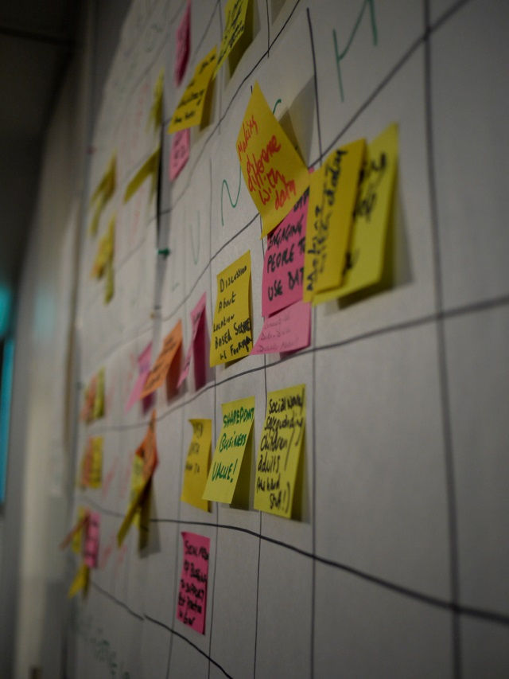
Consider tackling the problem visually
Notes:
There are times where representing a problem visually helps a project team work through it and find a solution—never underestimate the power of the Post-It!
For example, if you have a complex project schedule with lots of moving pieces and constraints, try using post its to visually untangle the schedule and plot out the best plan of attack.
Or if you’re dealing with complex requirements and scope definition issues, sometimes diagramming, drafting or wire-framing tools can help visually bring clarity.

Slide 39
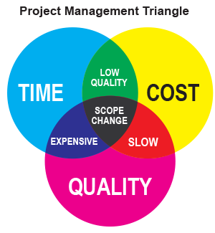
And, of course…
Don’t forget the Project Management triangle!
Notes:
There are no magical solutions unfortunately, but returning to the PM triangle will help you review your constraints and project priorities to help make difficult decisions that can help get your project back on track.

Slide 40
Portfolio Management
Notes:
*** TIME ***
So it’s almost time for some questions, but before we get there I want to talk about portfolio management. Of course it would be fabulous if we could only have 1 active project in our organization at any given time but that is not the reality. The reality is we often have many projects all running simultaneously that we need to keep an eye on. That’s where portfolio management comes into play.

Slide 41

Portfolio Management
Management of multiple projects
  Managing project competition:
    Priorities and Timelines
    Resources
    Budgets
Notes:
A portfolio is all your projects as a whole. The idea being that projects don’t exist in a vacuum. They draw from the same pool or resources and they compete for these resources and it is important to review them as a whole to make the right decision as to how to deal with this.
As you might imagine there are a plethora of tools to deal with this.
Our friend Goldilocks comes into play here as well.

Slide 42
Portfolio Management
Tool Selection
Small organization or organization with few projects
Word Document
Excel Spreadsheet
Medium-sized organization
Microsoft Project
Large Organization
Project Portfolio Management Tool
Notes:
For smaller orgs – Word or Excel might work just fine
For medium sized – Excel may still be fine or consider using your Microsoft Project GANTT views or other reporting to see multiple projects at once.
For large orgs – there are specific Project Portfolio Management tools you can invest in if needed. At the Tessitura Network we are now just starting to employ a tool called Eclipse to manage all consulting projects.

Slide 43

Regardless of tool… COMMUNICATE
Notes:
And of course in the end the tool is much less important than the overall goal of facilitating communication around projects and priorities.
So we are just going to run through some quick advice about selecting the right PM tools for your org and then we’ll take questions.

Slide 44
Tool Selection Tips and Tricks
Notes:
*** 4:25pm ***
COLLEEN

Slide 45
Tool Selection Tips and Tricks
Project Size
  Small/Medium/Large tracking needs
Access and Distribution
  Web-based vs Installed
  Single User vs Multiple User
Budget Management
Organisation Size
  Stand Alone Project vs Ongoing Project Portfolio tracking
Notes:
When selecting a tool think about…
Project Size: We’ve already talked about this – but your requirements will vary depending on whether you have Small/Medium or Large tracking needs
You also need to think about Access and Distribution. Do you want something online, that people just have to log in to – or a more formal piece of software that needs to be installed? Would that perhaps create more buy-in within the organization?
How many people are likely to use the system, will it simply be the single project manager, or multiple users, who might be using the system concurrently?
Do you also require budget management tools, or do you already have this within your existing organizational infrastructure?
Finally, you should think about your Organization Size and Status – Is the project a one off, stand alone project, or is this part of ongoing project work that is likely to run concurrently.

Slide 46
What do we use?
Project
Timeline
Eclipse PPM
Web based
Detailed
Tasks
Trello
Web-based
Project
Notes
OneNote
Microsoft Office Integrations
Date and resource management
Collaborative
Collaborative/centralized
User friendly
Flexible
Notes:
To help illustrate the tool selection process and what to consider during your search, I’m going to talk briefly through the tools that the Tessitura consulting team use, and how we have selected each one. This is not an official endorsement, I’m not suggesting you run out and start using these tools just because I do (except maybe Post Its!). However, hopefully this gives you some ideas for how we made our tool selection.
Because of the nature of our organization, we needed a way to track the high level project timeline so we know if a project is on track. We also needed something to help us track day-to-day tasks and homework assignments, including who on the project team was in charge of each item and any questions or discussions around each task. And last but not least, we were looking for a way to organize all the notes that each of the team members were taking pertaining to a project.
While investigating options we realized that there was no magic bullet that met all of our needs, however we did settle on a complimentary suite of tools that each meet a different need and compliment each other, giving us a comprehensive project management suite.
Lets look at each one in more detail CLICK

Slide 47
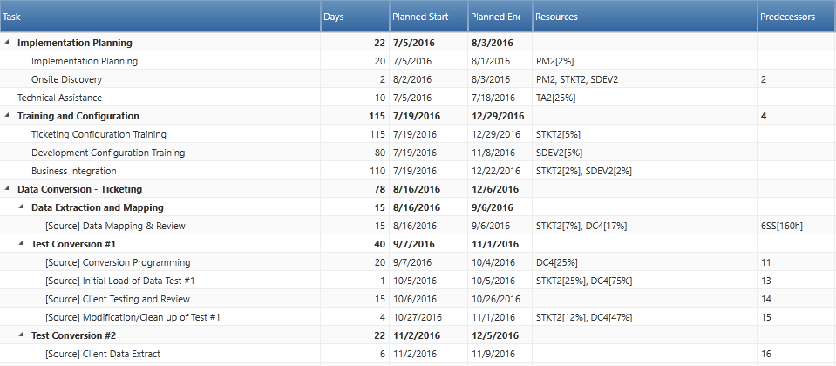
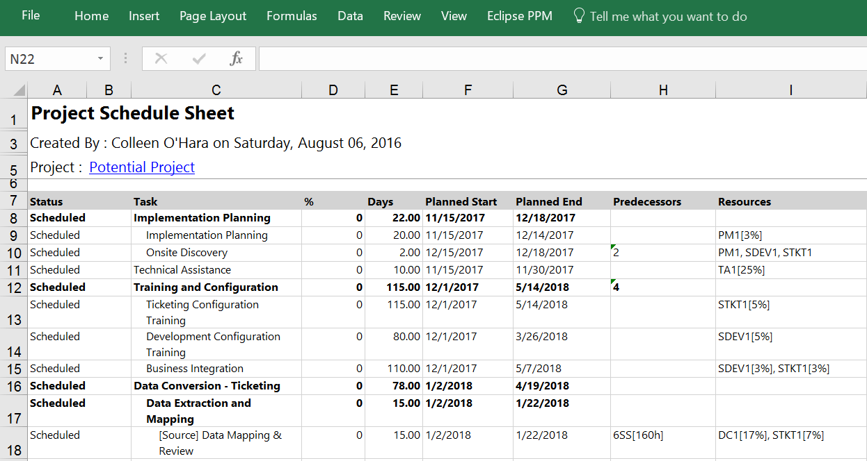
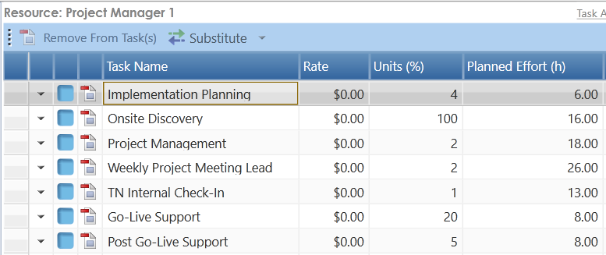
Project Timeline: Eclipse PPM
Notes:
Now I do just have a small disclaimer here – which is that for this first tool – Eclipse Project Portfolio Management - we are only very much in the infancy of using the software. It’s currently being piloted by the North American consulting team, and we are hoping to bring it to the EU team next year.
For our high level project timeline we’ve determined that we need to be able to track the major deliverables and milestones on a project and the resources assigned to them.
CLICK
Managing the workload for a consulting team of our size requires a tool that can track the projects each person is assigned to and the estimated hours for each part of the project, so we also need our timeline tool to provide us with robust resource management functionality.
CLICK
Given that the majority of our projects also involve all of you, in addition to having internal-facing functionality, we also a tool that easily allowed us to export project timelines.
And with a large pool of users, all working remotely we also determined that a web-based tool would be the most flexible for us.
Implementing this is going to put our Project Management skills to the test….
CLICK

Slide 48
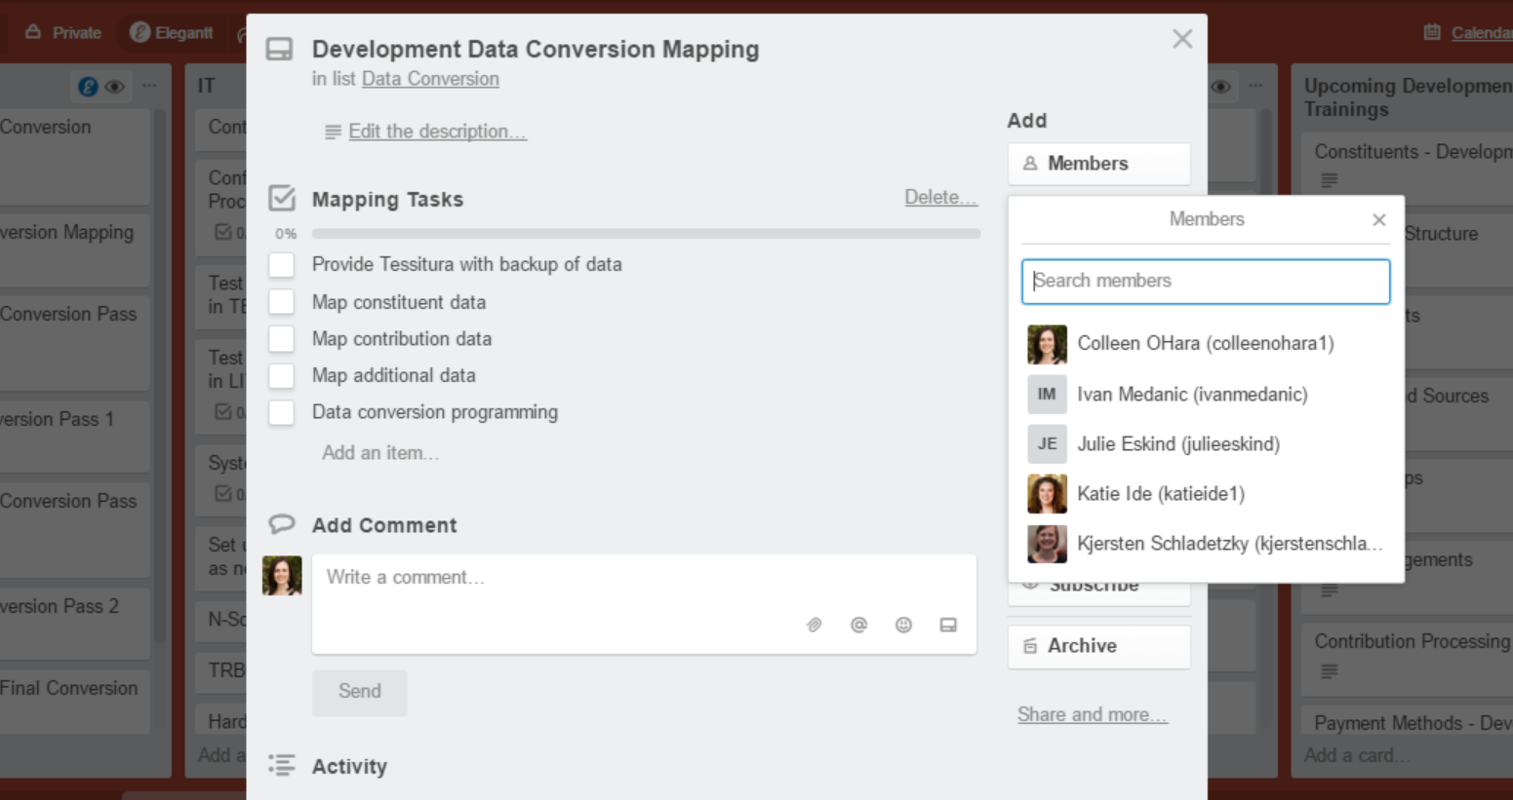
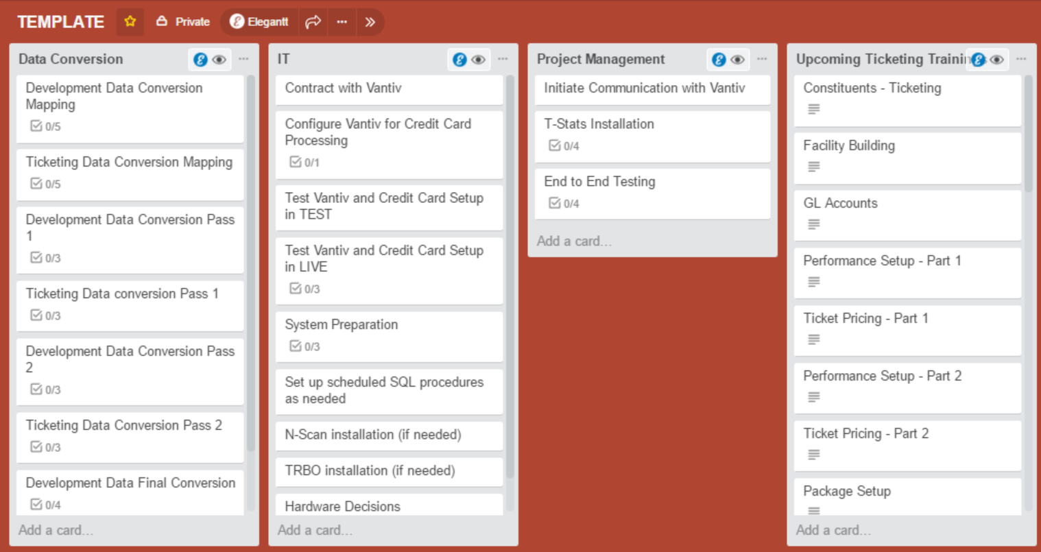
Detailed Tasks: Trello
Notes:
For day-to-day task management we knew we needed a flexible tool, that was easy for both Tessitura and Licensee teams to use, and that could be scaled for small to giant projects. We also realized that the emails that swirl around projects can get overwhelming and having a central location to keep track of discussions, questions and ultimately decisions would help control the email craziness.
With Trello we found a tool that is not only accessible to everyone, but can also be setup with whatever structure the project requires, and allows us to adapt that structure as project needs evolve,
CLICK
and allows us to track discussions, checklists, team member assignments and attachments all in a single place.

Slide 49
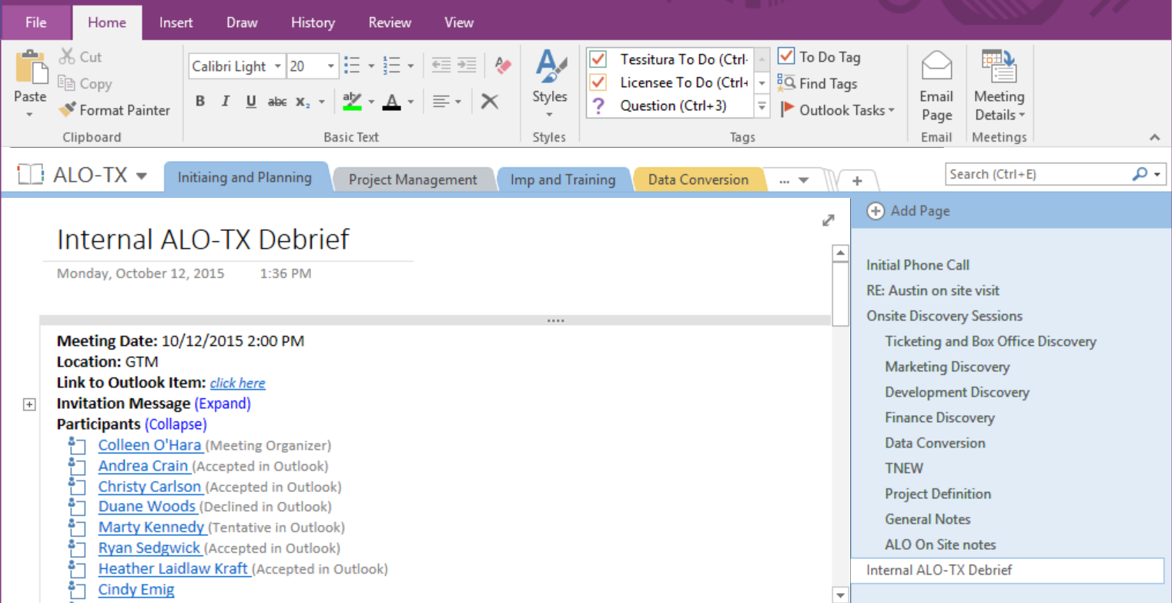
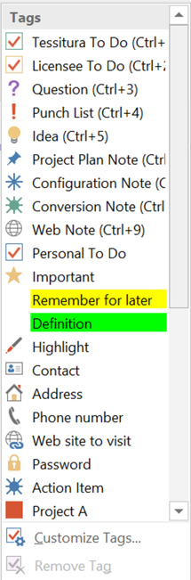
Project Notes: OneNote
Notes:
To complete our project management suite we have one of my favorite tools, OneNote. Part of the Microsoft Office suite, it was a tool we already had in house. Don’t forget to see what your organization might already own as you start your search, you may have great tools already in house waiting for you.
Given that we have multiple people assigned to each project, and we all work remotely, we needed a way to centralize notes and information about a project so that things were not scattered all over everyone’s individual laptops. With OneNote we’re able to group all project notes into a single Notebook, organize pages by project area, and then include individual pages of notes (similar to individual Word documents). OneNote also offers a whole host of other features that take basic note taking to the next level including
CLICK
great Outlook integrations
CLICK
flexible tagging options that allow you to flag and highlight different kinds of items,
And a whole host of other tools.
Again, I’m not recommending that your run out and start using these tools, however I hope this helps you think about your own needs and how they affect tool selection, and maybe gives you some ideas for tools of your own.

Slide 50
“The more people I meet the happier I become.”
QUESTIONS?
Samuel Beckett, Waiting for Godot

Slide 51
“The key person implementing membership and development has given her notice – how does this affect the project timeline?”
Notes:
Example One - “The key person implementing membership and development has given her notice – how does this affect the project timeline?”
Well the best course of action for this very much depends on a number of other factors:
Look at your other resources – Do you have another resource available that can take on this role, alongside their existing workload, and meet the existing timeline.
If not, does your project budget allow you to bring in an external party to complete that work?
If the answers to both of these questions are no, then it’s time to consider options – Do you need to reassess the scope of the Project, perhaps so that membership moves into the Second Phase? Or do we need to extend the Project timeline, to allow for recruitment of a replacement, or to factor in more time for the existing staff members to cover this work.
Key to this though, is early identification! So many times, people know that a key colleague is leaving, and wait until they are heading off to their leaving do to do anything about it. Communication and early communication is going to be the best way to address this issue successfully.
3:00ish—hand to them for questions

Slide 52
“We found out we need a customisation to make some key functionality work, but we hadn’t budgeted for it.”
“The front-line managers don’t feel comfortable enough with Tessitura yet, so they want Tessitura staff to handle end-user training, but we didn’t budget for that.”
Notes:
Issues Two and Three highlight the same issue -
“We found out we need a customisation to make some key functionality work, but we hadn’t budgeted for it.”
“The front-line managers don’t feel comfortable enough with Tessitura yet, so they want Tessitura staff to handle end-user training, but we didn’t budget for that.”
Budget shortages are often one of the harder constraints to recover from in a project. We always recommend that you build in some buffer or contingency into your budget—regardless of project size, it’s always nice to have a little bit of extra budget in your back pocket. We understand that that isn’t always possible though. If you know that you will not have any wiggle room in your budget, make sure that as you’re evaluating your triple constraints that budget management is one of your top priorities, and as the project progresses be sure to regularly check in on the status of your budget.
It is definitely easier to adjust budgets and react to changing budget needs earlier on in the project when more of your budget is still available to you. However if you find yourself towards the end of the project and with a budget issue what do you do? I would return to time and resources and see if there are any adjustments you can make there. For example, in this scenario, would adjusting the project schedule and giving the staff a little bit more time to get comfortable in Tessitura solve the problem. If that’s not an option, are there other internal resources that can help out—can you spread out the training load, are there internal people they can rehearse on to determine where they need some additional training or support? And if none of those are options, look at your budget and see if there are any other project items that can be adjusted to help open up some budget for this work. Is this training a higher priority than one of the less important custom reports and can that budget be reallocated to cover this surprise cost.
3:00pm—hand to them for questions

Slide 53
“I’m working on a server upgrade project. It’s nothing I or my team have ever done before. How can I set a realistic schedule and work around some outside time constraints that we have?”
Notes:
Issue Four - “I’m working on a server upgrade project. It’s nothing I or my team have ever done before. How can I set a realistic schedule and work around some outside time constraints that we have?”
First thing I would suggest here is talking to experts – whether it be on the Tessitura team, your own IT specialists, or amongst the community. Gather as much information as you need to feel equipped to tackle the project, and so that you are aware of what might occur.
The next thing I would say, is it’s a really good idea to break down the work into reasonable chunks to estimate. This is where a version of the post it note exercise might work really well. Perhaps one colour for key project task, one for the external time restrictions – then you can visually plan your project timelime, and you’ve boiled down each task to a single, manageable post it (which incidentally becomes one simple Trello card!) or, if you think you’ll get more buy in, it could go into Excel for circulating. From there it can go into Project Management software if you have it.
3:00—hand to them for questions

Slide 54
“My custom report project scope won’t stop shifting; there are new requirements that keep coming up almost daily. How do I know when I have all the project requirements, and how do I keep them from constantly changing?”
Notes:
And finally, issue five:
My custom report project scope won’t stop shifting; there are new requirements that keep coming up almost daily. How do I know when I have all the project requirements, and how do I keep them from constantly changing?”
Gathering requirements and performing project discovery can be tough; often people think they want one thing and they really want something totally different. Or sometimes assumptions are made during the process that mean that your project team is not actually speaking the same language and are actually talking about very different things. If you’re at the start of the project and gathering initial requirements, asking leading questions instead of questions that can be answered with a “yes/no” can help suss out what people really need and want. In the case of a custom report be sure your requirements documentation always includes samples of the way parameters will work, how the report will be laid out and what summary or groups are needed to make sure the business users and programmers are on the same page.
Determine if changes are really just nice to have or critical – and this can be a very difficult exercise in itself.
3:00—hand to them for questions

Slide 55
“The more people I meet the happier I become.”
QUESTIONS?
Samuel Beckett, Waiting for Godot

Slide 56

WHAT’S NEXT?
TRANSPORT TO
ABBEY THEATRE
Coaches depart now at entry level
Take any items from the cloakroom
Tea and coffee available at the Abbey
CONFERENCE KEYNOTE 16.00-17.00
EVENING NETWORKING EVENT 19.30
Notes:
THURSDAY Breakout session 3 What’s next slide

