Slide 1

TESSITURA
EUROPEAN
CONFERENCE
DUBLIN 2016
Notes:
Welcome

Slide 2



MODERATOR
Libby Papakyriacou : London Philharmonic Orchestra
GURU
Terry Cooper : Theatre Royal & Royal Concert Hall
FORECASTING
I WANT TO KNOW THE FUTURE!
CONTENT PLANNER
Thanos Gkofas : National Theatre
Share your favourite content and photos! #TECDublin16

Slide 3
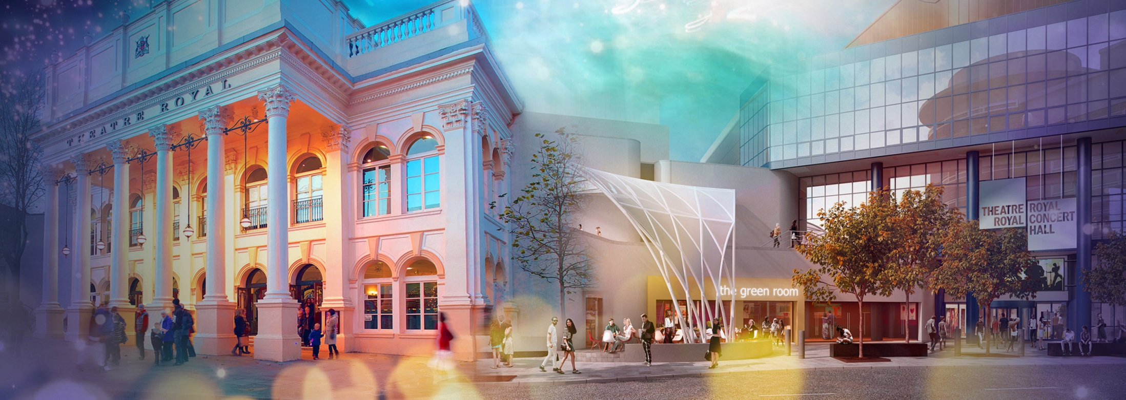
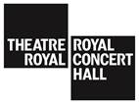
Terry Cooper – Business Performance Manager
Nottingham Theatre Royal + Royal Concert Hall
Notes:
2 auditoria, 2,500 seater concert hall & 150 year old 1,500 seater Victorian Theatre. Local Authority ran venue operating at Nil direct revenue subsidy. Next year we’ll be operating at a -200k net budget.
Bit of a disclaimer – we’re at early stages of developing our forecasting techniques, so the majority of my presentation is based on aspirations and current progress rather than achievements. Also as financial lead for TRCH, this all stems from a financial perspective.

Slide 4
Forecasting – Where we are now
Revenue Management Application – building comparators & dashboards
Establishing what data is most important to each departmental manager & in what format
Notes:
Show of hands – who’s got the RMA and who’s using it for forecasting purposes?
Quick explanation of what the RMA is and how the forecasting module works. Using past data and comparator groups to predict future gross sales of events. What’s produced can range from graphs, charts, data tables and dashboards, however you need this data.
Use of Income Budget within Tessitura – displayed on forecasting dashboards, perhaps a question to find out how other people are using this feature?
Conversations started with various managers across the business to establish their needs, a lot don’t know the RMA even exists or that this sort of thing is possible.

Slide 5
Forecasting – Where we want to go
All departments forecasting their own activity levels based upon the programme of events throughout the forthcoming year
Sales forecasting informing decisions on Front of House staffing levels, Marketing activity etc.
Notes:
Forecasting not just confined to the RMA and sales numbers & amounts
We want to see forecasting across all areas for their own activity levels, this will help inform staffing levels to cope with peaks and troughs of activity. Current scope of “forecasting” is too short-term, it’s fire fighting problems as they arise instead of identifying potential problems further down the line and acting to prevent issues arising where possible.
Highlight gaps in the programme where there is opportunity for new / another profit making activity
Data available to everyone who needs it, instigating more communication between departments

Slide 6
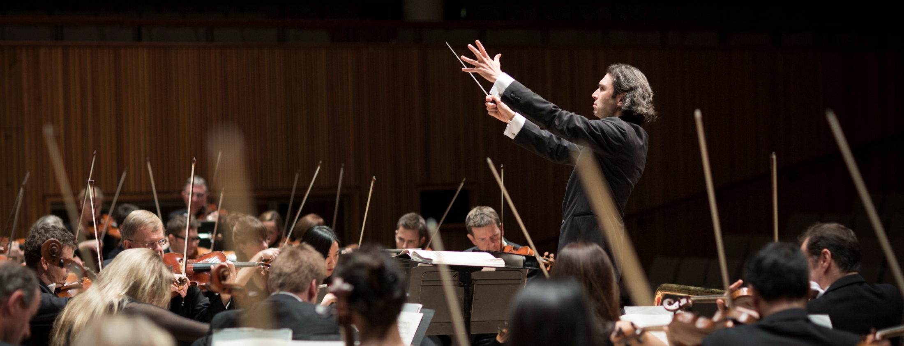

Libby Papakyriacou
Marketing Manager
London Philharmonic Orchestra
Notes:
We perform at Royal Festival Hall where we give around 35 concerts a year, running from September to May. The hall’s capacity is just over 2700.

Slide 7
Forecasting – Where we are now
Using the RMA’s forecasting module since February 2016, covering current season of concerts.
Forecasting used to help make decisions on marketing activity, targets, dynamic pricing decisions etc.
Notes:
We are currently using forecasting to help with our dynamic pricing decisions (which has made a net difference so far of £7.5k). It informs our financial targets and marketing decisions; it underpins decision making and helps provide a more evidence-based approach to likely results from artistic decisions, and helps us to explain to colleagues/artists how sales should go (calming the nerves!).
Some issues we have had to mull over in our first year of using the RMA’s forecasting process:
Trusting the system: our targets had previously been decided using extensive experience of the combination of day of week / programme / artist / external factors. We compared our manual targets to the RMA’s suggestions and while they differed on a concert-by-concert level, the overall income for the season was roughly the same so we went with the RMA.
Choosing comparators: our performances differ in many different ways. How to choose comparators?
We had put up our prices this season which led to some fiddly calculations to get the income trajectories accurate. Got there in the end!

Slide 8
Terry Cooper | Business Performance Manager
Nottingham Theatre Royal + Royal Concert Hall
0115 989 5504 | terry.cooper@nottinghamcity.gov.uk
Libby Papakyriacou | Marketing Manager
London Philharmonic Orchestra
020 7840 4228 | libby.papakyriacou@lpo.org.uk

Slide 9
“The more people I meet the happier I become.”
FORECASTING
QUESTIONS?
Samuel Beckett, Waiting for Godot

Slide 10

WHAT’S NEXT?
TRANSPORT TO
ABBEY THEATRE
Coaches depart now at entry level
Take any items from the cloakroom
Tea and coffee available at the Abbey
CONFERENCE KEYNOTE 16.00-17.00
EVENING NETWORKING EVENT 19.30
Notes:
THURSDAY Breakout session 3 What’s next slide

