Slide 1

TESSITURA
EUROPEAN
CONFERENCE
DUBLIN 2016
Notes:
Welcome

Slide 2



PRESENTERS
Dara Hogan : Abbey Theatre
Rachael Magson : Birmingham Hippodrome
Chris Campbell : Grange Park Opera
TESSITURA AS A PLATFORM
Single and Ready to Mingle
CONTENT PLANNERS
Sarah Stratton : Birmingham Hippodrome
Debbie Harland : Old Vic Theatre
Share your favourite content and photos! #TECDublin16

Slide 3

Abbey Theatre
Tessitura Integrations
Dara Hogan – Database Systems Manager
Notes:
Introduction – Introduce self.
8 years Abbey…before that RSC.

Slide 4
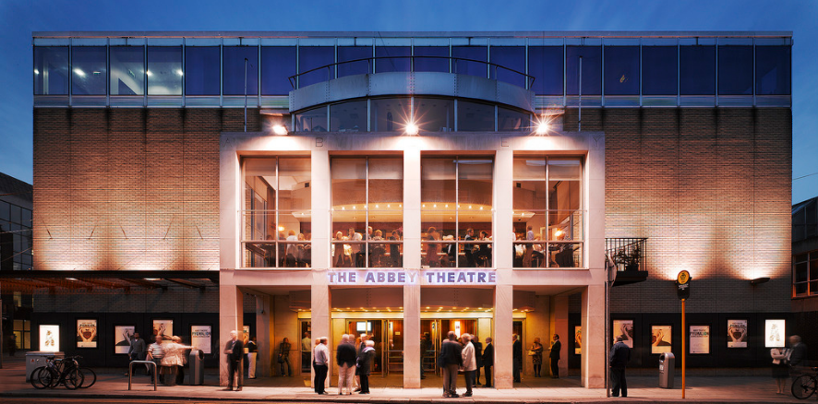
Abbey Theatre
National Theatre of Ireland
2 Spaces: 492 seats and 100 seats
Tessitura since 2008
Notes:
Firstly, a quick background on the Abbey.
National Theatre of Ireland
2 Spaces: 500 seats and 100 seats
Tessitura since 2008

Slide 5
Shared Data
Data in Tessitura relevant to other systems
Data in Other systems relevant to Tessitura
For efficient business process these need to be integrated.
Notes:
This is a really exciting time to be working on and thinking of Tessitura Integrations…..as Tessitura develops new features on the Roadmap.
Lot of data in Tessitura that is relevant to other systems are areas of business. E.g. Artists Info, Staff info, event info.
Data in other systems that is relevant to data in Tessitura.
In order to have Efficient business process, prevent duplicate data and data entry….need to integrate these system.
Talk about 2 different examples.
1 – with our HR System.
2 – one with our schedule system.

Slide 6


Example 1: HR System Integration
Can new staff automatically be in Tessitura
Hmmm…
Why not.
Notes:
Box Office manager asked: Can all new staff be automatically in Tessitura.
IT Person…..like a challenge………Hmmm, Why not.
REASON e.g. new staff. Avail of discounts at box office.....BO Know who they are.
Look up record….identify as staff…..verify entitled to discounts.

Slide 7




How:
HR System
Tessitura
dB
Stored Procedure
Creates a record
In Tessitura
SQL Server
Scheduled
Data Import
Notes:
How this works.
HR System (MitreFinch TMS) exports a text file each night.
SQL Scheduled Job……..Imports to staging Table.
Scheduled SP……Creates OR Updates a record in Tessitura.

Slide 8
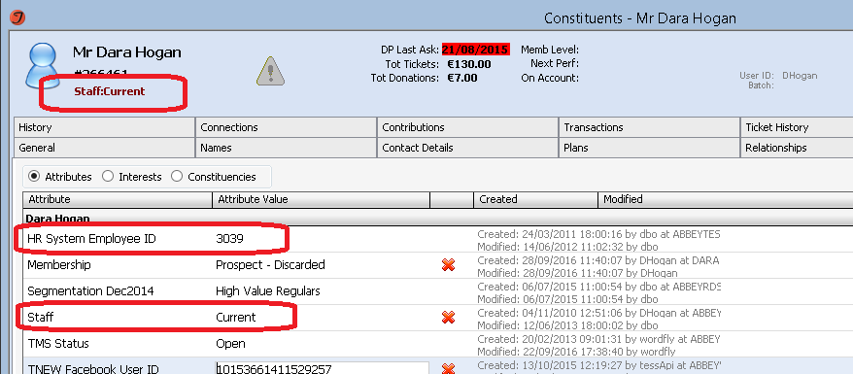
Result:
Notes:
Result: Box office staff can easily identify Staff.
HR System ID stored as a read only attribute…..to link back to HR.
SP Creates new record if HR ID not exists…….Uses c/o Abbey Theatre address.
Updates if exists.
Set’s STAFF Attribute to PAST for leavers.

Slide 9
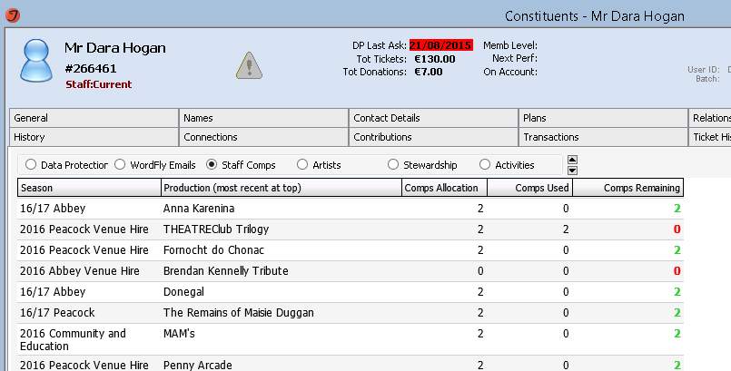
Staff Entitlement Management
Notes:
Custom screen to manage staff entitlements.
Shows Allocation…….Used (based on price type)……and remaining.
RECAP: Getting data from HR and bring into Tessitura.
Next Example is using data in Tessitura on our Intranet.

Slide 10
Example 2:
Tessitura Events in Schedule System
REASON: See all events in one central schedule system.
Notes:
Reason for this integration…….Be able to see everything that’s happening in the building in one central system.
This time I’m going to show you result and then how it was done.

Slide 11
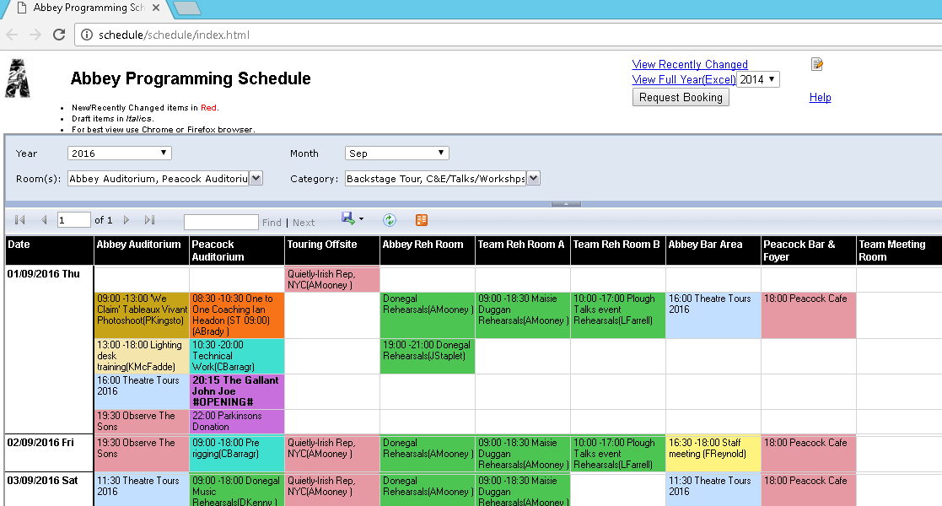
Notes:
We have a relatively simple in house – Schedule system.
Spaces across the top, dates on the left, events in the middle.
This is a combination of data from Tessitura and Schedule System.

Slide 12
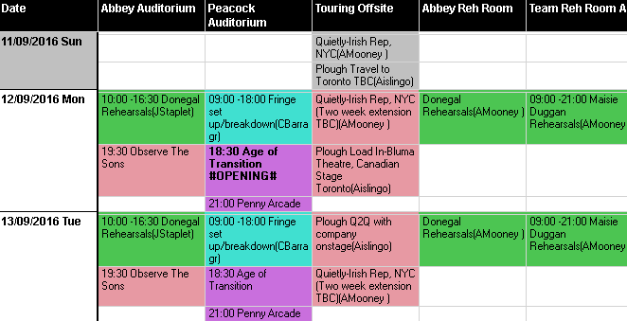
Detail
Notes:
If we zoom in a look at this in detail.
Tessitura Performances Circled
The Rehearsals and Touring are from Schedule system.
Items Circled are coming from Tessitura database.
Browser based system……Very quick and easy for everyone to see what’s on around the building.

Slide 13

How:
Schedule System
Tessitura Perf Tables
Notes:
How is relatively straight forward.
SP that retrieve's data get’s data from Tessitura and Schedule data table.
Displays both in the schedule system.

Slide 14
Future
Tessitura Development
  Continued feature development
  Tessitura REST Architecture
  Web Based Client
More opportunities for integrations
  More structured
  More robust
Notes:
As Tessitura continues to develop new features….Roadmap…..such as Resource Scheduling in v14.
More opportunities for integration.
Announcement at TLCC that the client will become web based…… Options to link in and out of client to other systems.
My examples here are based on SQL programming….that’s what I know.
REST services offer a more robust method of integration…..Won’t break with changes in versions.
Effectively creating Plug In’s.
Tessitura is developing into not just a CRM & Ticketing system but an Enterprise Platform.

Slide 15
Contact: Dara Hogan
Database Systems Manager
dara.hogan@abbeytheatre.ie
Notes:
Any Questions…..Contact me.

Slide 16

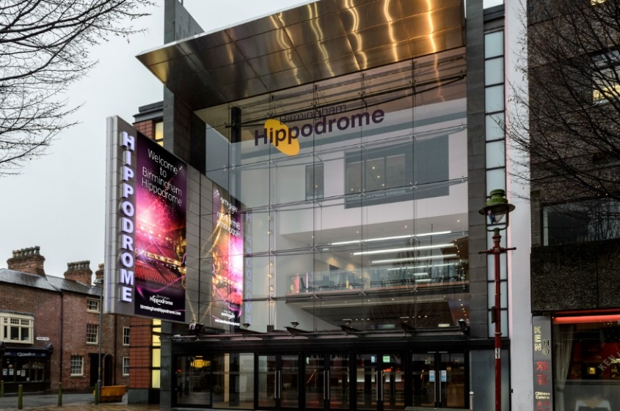
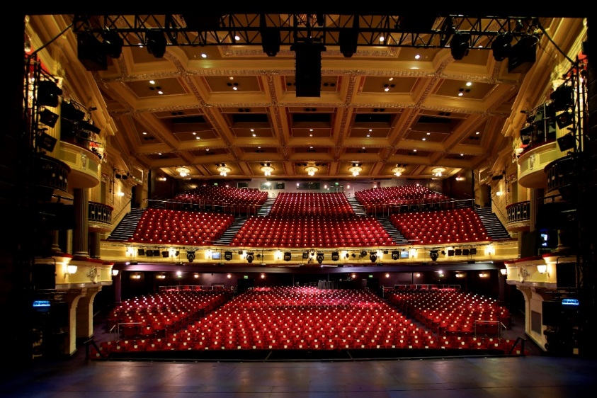
BIRMINGHAM HIPPODROME
A world-class Birmingham arts scene,
with the Hippodrome centre stage.
Rachael Magson
Fundraising Manager
Notes:
Into me

Slide 17
Our mission: To stage enriching, entertaining, unforgettable performances.
Our core belief: There’s nothing like a live performance.
Our purpose: To be a stage for life.
Our values:
Everyone’s welcome.
Nothing but the best.
Do it with flair.
Notes:
Fiona Allan new CEO
Revised mission, belief, purpose and values

Slide 18
Main Stage Stats
c.400 performances a year
500,000+ visitors
Main Stage: 1,843 seats
Patrick Centre: 206 seats
Hippodrome CREATIVE Stats
Artistic commissions
Strategic creative learning programme
300,000+ audiences and participants
100’s of volunteers
1000’s of discounted tickets for schools
Notes:
The organisation has a Fundraising team of two and a Business Development team of two.
The fundraising team is responsible for fundraising from grants, trusts, memberships, individuals and campaigns and the Bus Dev team from Corporates. Together we present 3 major fundraising dinners a year
This equates to around £1million in income (ringfenced for Hippodrome Creative and other campaigns/projects)
Org turnover c. 29 million
Hippodrome CREATIVE A broad programme of access, engagement and creative programme.
I.e. 2015 - Birmingham Weekender: produced by us for Culture Central
New Street Station, Grand Central, Rugby World Cup
100 volunteers
32 new commissions
511 artists/performers
Estimated audience of 150,000

Slide 19
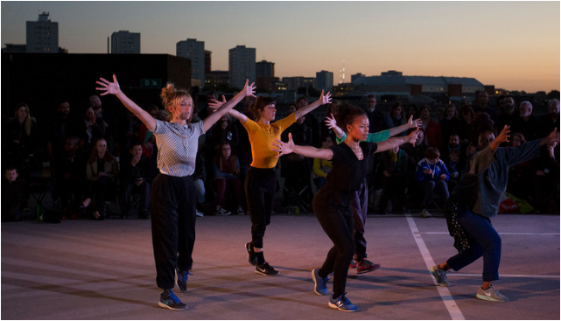
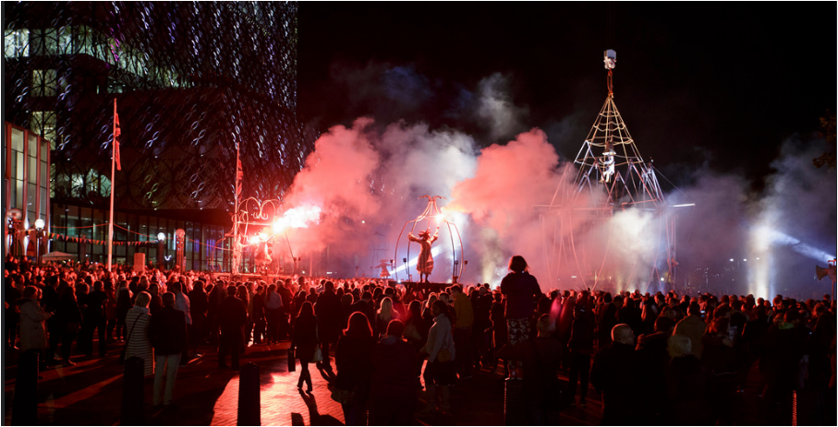
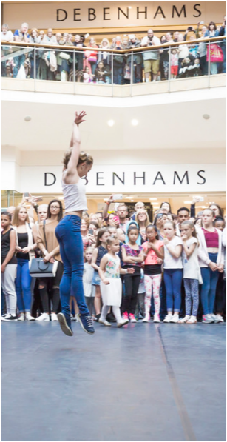

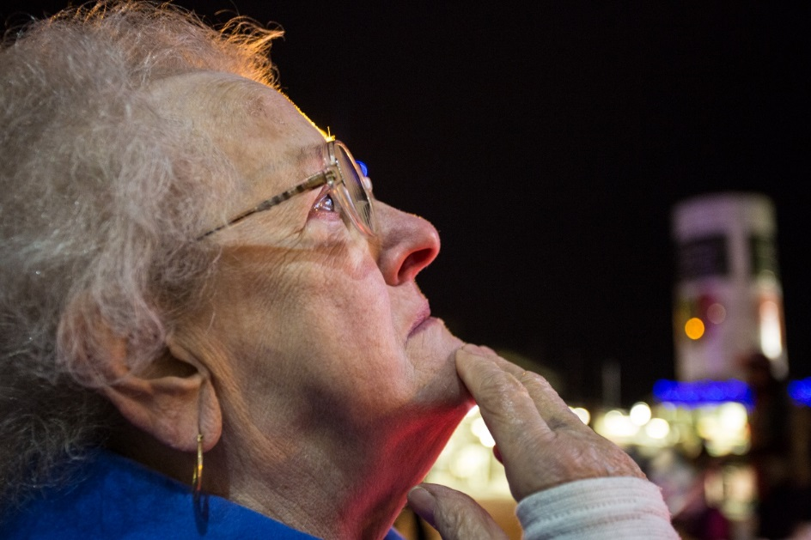
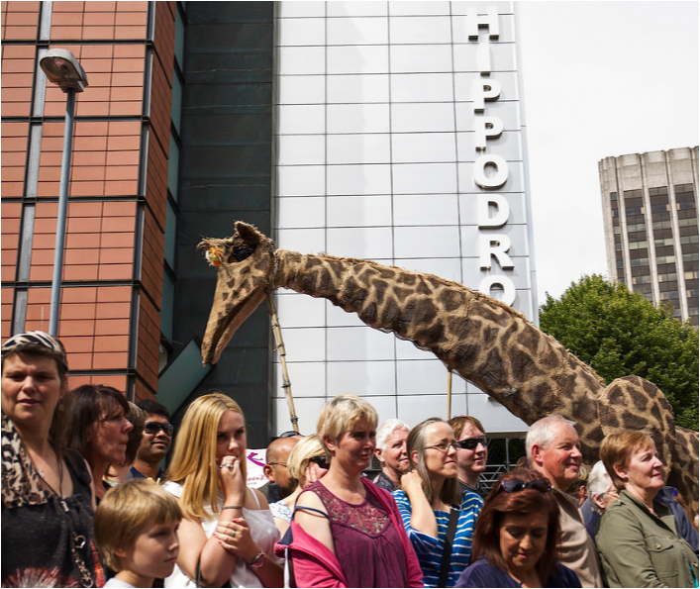
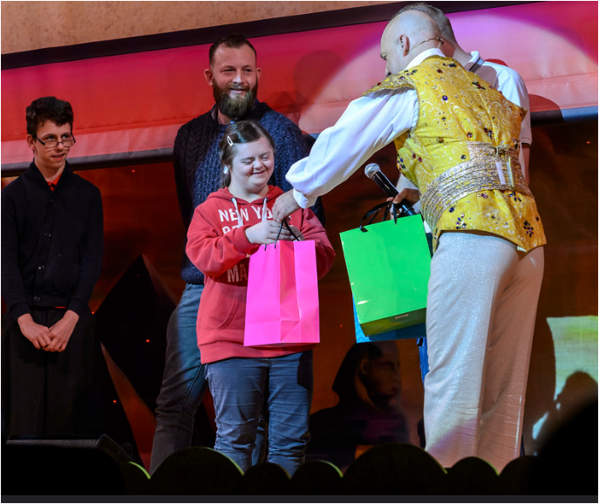
Notes:
Hippodrome CREATIVE ranges from work:
Indoors
Outdoors
On our main stage
Off our main stage
In festivals, fields, streets
With young people, disabled communities and the elderly
Aiming to engage those who do not traditionally engage with the arts through engaging and unexpected arts experiences
We have a specialism in outdoor arts and work with disabled young people and audiences

Slide 20


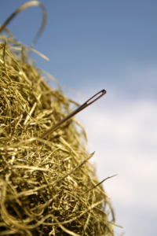
WEALTH SCREENING
Small team. Big Ambitions.
Working smarter, not harder
Notes:
Challenge – 2 people fundraising from individuals (amongst other areas). Large and v busy organisation. Big ambitions for the team
Only recently moved to v12.5
Some things you may hear
We’ve got Tessitura….surely its easy…..Trustees can bring their friends…
Surely supporters must be out there….. Grow the memberships!
Let’s have a cultivation event ….Where are our major donors?....Look at the Rich List
When you’re thinking:
There’s not enough hours in the day! It’s the proverbial needle in the haystack
Where do I start? …. What’s worked in the past?
What can help me? …..Will it work?...... Will it give me an ROI?....What’s a ‘result?’

Slide 21
DESIRED OUTCOMES
Intelligent use of data
Key tools
Targeting the right ask at right person
Strategic prospecting
Time efficiency
Changing perceptions
Better results
Locating potential major donors/future legators
Notes:
Key aims
Talk through these – esp changing perceptions/ populating schemes

Slide 22

WEALTH ENGINE
-One of several wealth mining tools
-Focuses on recency, frequency and propensity to give
-Each customer has a ‘P2G’ score
-Find Wealth Online tool – snap shot analysis
-Utilises an ‘inner circle’ function
-Screening and ‘Smart Segments’ functionality
-Ability to add custom fields – specific to your org
-Offer consultancy support/interpretation of your data
-used mainly in the US with a growing UK base
Notes:
When I joined 1.5 yrs ago we were already in a license agreement with Wealth Engine with some great work done by my predecessor…however we’d hit a bit of wall and with a 6 month gap between appointments not much had moved forwards.
Unique features – Propensity to Give score.
So my role was to pick up the tool and move it forwards again. We’d had one screen and were due a second screen of 55,000 records
For those who don’t know, WE is one of several tools (other include prospecting for gold, Donor Scope etc)
I won’t got through all it can do – but the WE team will be happy to help and offer good support
Important to note – a ‘screen’ is only accurate at the point of the screen – after this the data obviously becomes more historical.
However, WE also have a ‘Find Wealth Online’ portal which you search person by person. This looks at publically available data sets in ‘real time’ so is more up to date. But this can’t be done on a mass scale – consistent by constituent.

Slide 23
THE PROCESS
Identify inner circle – top 200 friends
Mass extraction to identify 55,000 suitable records
Screen!
Smart Segment analysis
Interpretation
Plan!
Notes:
Our database is c.500,000 people
I utilised the extraction function in Tessitura to ‘hone down’ my list
Utilising criteria such as…
-been to the theatre 5 or more times in past 3 years
-made a donation
-group booker
-Leading Ladies constituency etc
We did utilise the smart segment analysis offered by WE (additional costs)
I have found this helpful for analysing my data

Slide 24
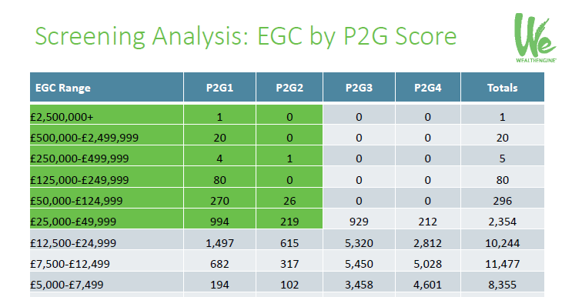
Notes:
Screening Results – helps you target based on propensity to give:
i.1. 20 people with P2G1 with a EGC of 500K+– you can hone straight in on potential major giving targets

Slide 25
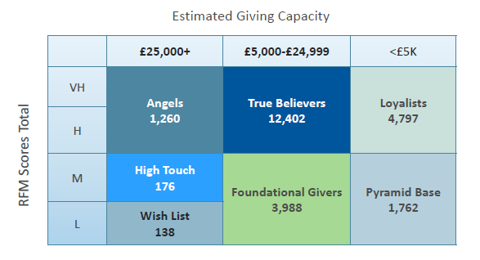
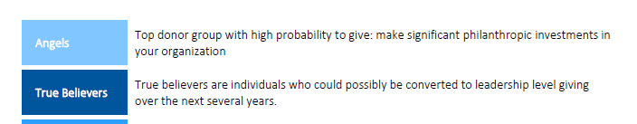
Notes:
Smart Segments
i.e. 1,260 ‘angels – top donor groups with high RFM scores and high giving capacity’ – characteristic based – an overlay on top of other WE data and a different way of ‘chunking down’ data/prospects

Slide 26
****** HERE COME THE SCREEN SHOTS! ******

Slide 27
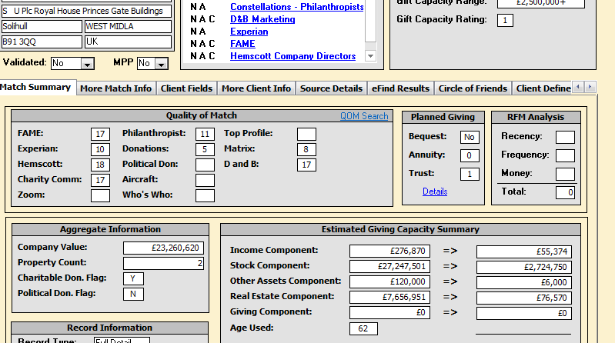
Notes:
Data comes back in a searchable, many tabbed access database
We decided to integrate back into Tessitura ASAP!

Slide 28
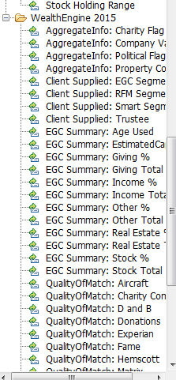
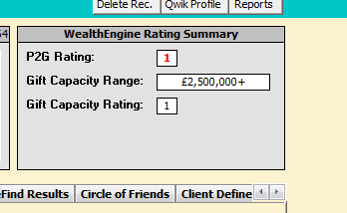
Top Tip!! – Selected Criteria from WE in List Builder
Notes:
One day of Tess consultancy support to select relevant items from the Access Database and get them put into List Building Function in Tessitura
i.e. Estimated Giving Capacity
P2G score
Smart Segment
This means I can utilise the screening data in list building, extractions etc
Most useful for ongoing targeting etc

Slide 29
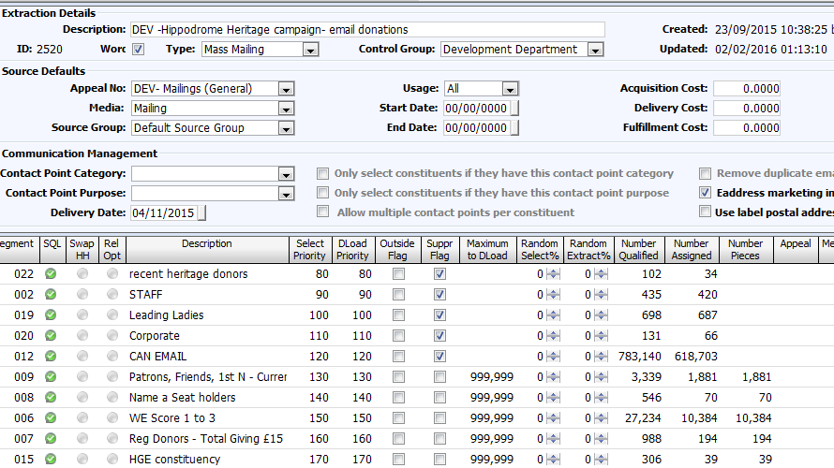
Notes:
Example of an extraction utilising WE as one segment of my extraction
Here you can see for a heritage campaign mailing, WE score 1-3 gave me 10,384 to target as part of a wider list

Slide 30
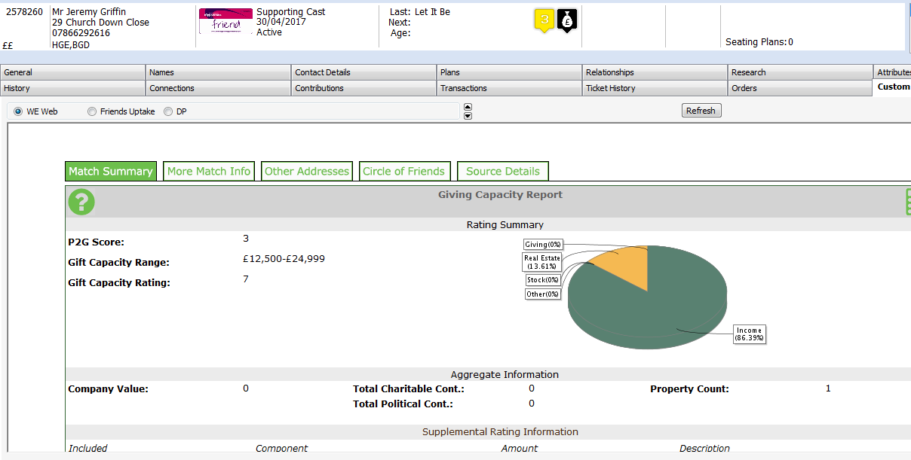
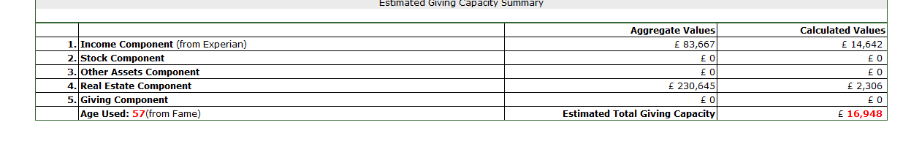
Tessitura Integrations
Notes:
The other integration we have is a custom tab which links to the Find Wealth Online function
Integrated into custom tab in Tessitura
Useful for looking at constituents on a case by case basis
‘speaks’ to the WE ‘find wealth online’ portal and searches made there or here all recorded for future reference – avoids double researching someone
Means you can jump around your constituent record – i.e. above I can see this person is a lower level Patron, they last came to see Let it Be, no current future bookings, has constituency tags relating to our heritage project and big give donation campaign, last gave £2 at point of sale (suggested next donation £3).
Then I can look at their match summary, p2g score and if I scroll down their rough age etc.
Important to note that the red figure circled – the available wealth and estimated total giving capacity – here £16,948 – is the person’s likely available wealth over the next 5 years.
So if I meet someone out networking and I want to find out more – this is where I come!
Great for a person by person analysis, integrated with their existing record.
This also updates real time with available databases – unlike a screen which is of a point in time (unlike WE screenings, which are of that moment in time and effectively become historical data)

Slide 31
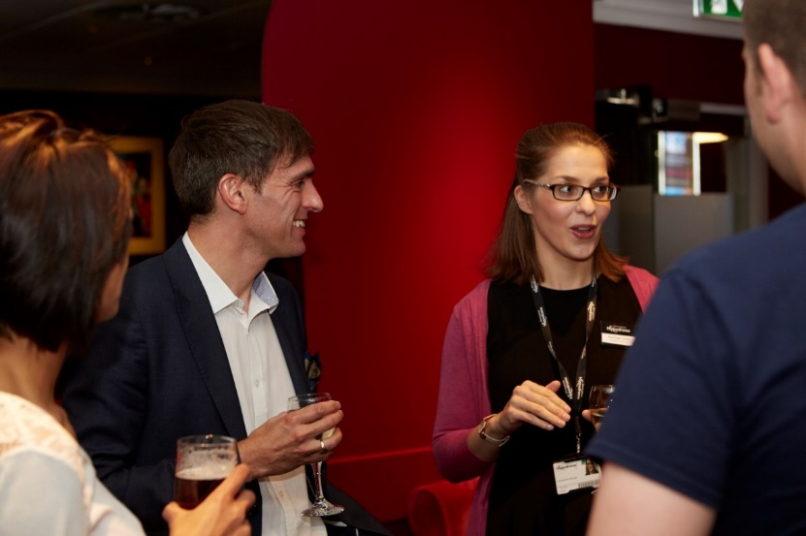
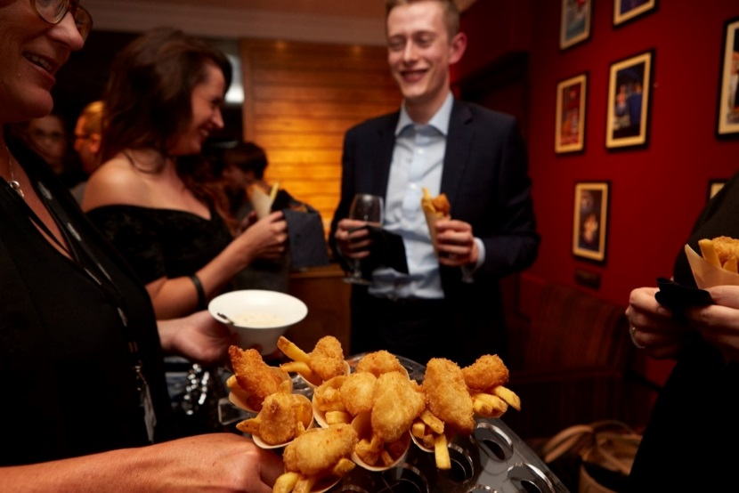
CASE STUDY: CULTIVATION EVENINGS
Notes:
I think cultivation evenings are one of our strengths here at Birmingham Hippodrome.
What I think we’re good at:
-advance comms
-RSVP process
-Event management
-lovely building
-great food done in house
-great service staff
-We work the room (look at me in action!)
-our trustees support us
-we have materials (films, slide shows, project participants…)
But we weren’t seeing results. People were having a great time. …. But that was it. They weren’t following through. They weren’t converting.
Which makes you wonder….
What are we doing wrong?
Instigated by our Wealth Engine work, we decided to review our entire events strategy.

Slide 32
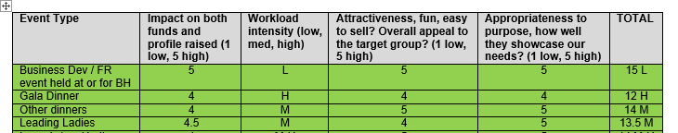
CASE STUDY: CULTIVATION EVENINGS
Notes:
Instigated by our Wealth Engine work, we decided to review our entire events strategy as a small department.
We took time as a team to ‘rank’ each type of event by:
Event Type
Impact on both funds and profile
Workload – low to high
Attractiveness, fun, easy to sell, appropriate appeal to target group?
Appropriateness to purpose
And this then have a total score
i.e. 15 with L workload = a winner
We ranked 20 types of events we regularly deliver (or could deliver) and found 8 were ‘green’ and working well, 7 were amber and could do with some improvement and the 5 were ‘red’ – needing serious consideration as to whether we continue to offer them or whether they need complete remodelling
What were our cultivation events (at this stage called Development Trust Guest Evenings) scored low on impact, attractiveness and appropriateness.
So we decided to remodel our events – driving them from our Wealth Engine Data, rather than relying on trustees to provide names, and with a more direct and tailored ask.

Slide 33
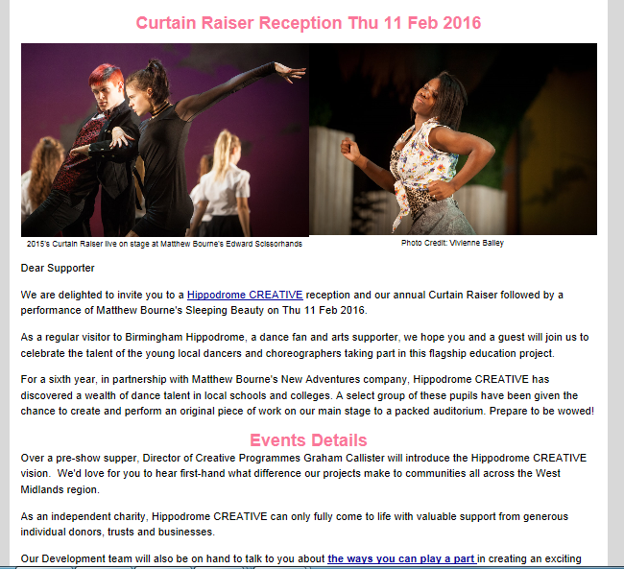
CURTAIN RAISER CULTIVATION
A lot was riding on this invitation!
Notes:
New approach…..WE data driven….. Clear ask
Feb 2016. Our first ‘new approach’ cultivation evening alongside Matthew Bourne’s Sleeping Beauty and our Curtain Raiser project (a Hippodrome CREATIVE project for talented young dancers)
We changed the language – with a clear indication in the email that this was about generating new supporters, and that we would tell them more on the evening about how they could get involved.
5 couples attended a small reception – all new to us. No trustee connections
They saw Hippodrome CREATIVE in action and a wonderful high quality production. We made a direct ask.
3 couples joined out Patrons Scheme the next week – a 60% conversion rate from the evening – and 100% improvement on the previous evening we had held.
Last week – one of these couples, in their first year of their Patrons membership, came to a Hippodrome CREATIVE project in Sutton Park, engaging with the work they are helping fund.
The next evening – informal 4 invitees met me for a drink. Outcomes… One joined our Leading Ladies network. One offered a meeting with a project partner.
So it seems this approach is yielding results. Early days.
We are now putting in a place of 5 events for the autumn of 2016 and driving the invite list from our WE data.
I will let you know the results!

Slide 34
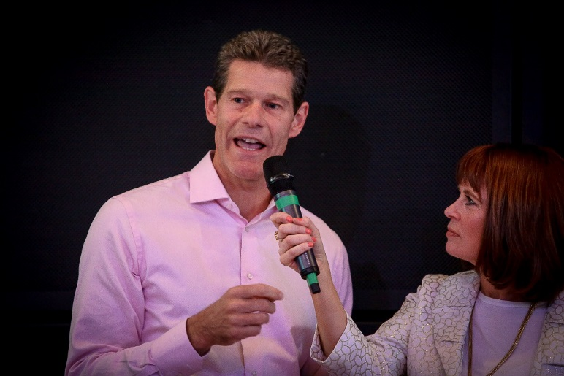
TRUSTEE INVOLVEMENT
A new way to engage
Sometimes surprised!
Confidence
Wealth Screening Driven
New conversations
Advance planning
Engaged across both boards
Notes:
Pictured here – Martin Guest (Chair of the Development Trust) and Joanne Malin (local TV presenter and trustee) at a recent dinner event
We have two boards of trustees –
BHTDT – solely tasked to help fundraising
BHTT – the overarching charity board.
In total 25 trustees with a wealth of experience and contacts
Primarily our BHTDT trustees were supporting our guest evenings– and we would ask for suggestions of names to invite.
Trustees were beginning to feel fatigued by this approach I think, not wanting to keep asking the same contacts or try and find new ideas.
WE approach has reinvigorated trustees
They are actively looking at lists of names and finding their own connections – sometimes in a surprising way when this throws up people they weren’t expecting to see on the list
Also lots of people they DON’T know - which means they never would have crossed our path without Wealth Engine.
It has offered trustees confidence – when I ask them to speak during an event they know they are talking to the right people who have the propensity and capacity to give, and the affinity to our organisation.
It is early days but both boards have been engaged in this process, so I am hopeful it will offer a new way to develop conversations with potential donors.

Slide 35
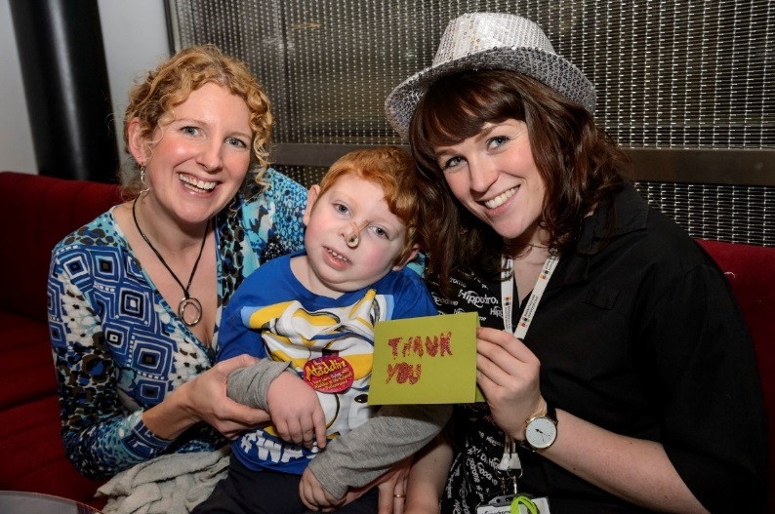

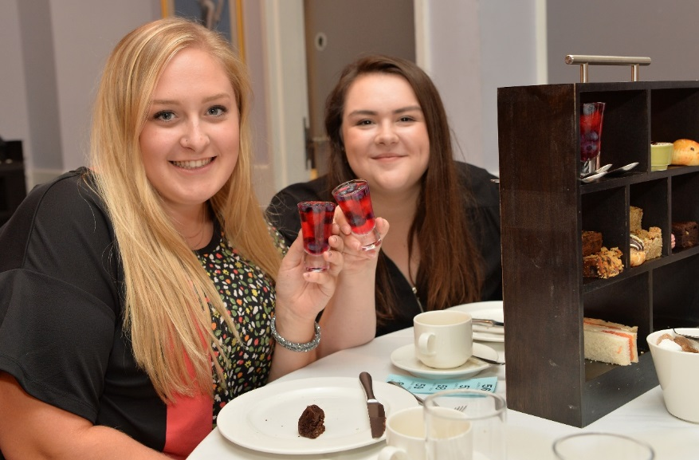

OTHER ROUTES TO RESULTS
Notes:
Other routes to results….
Interesting last week we had a joint event with another charity, Acorns, as we have been working with them on a Hippodrome CREATIVE project.
We had a small room of guests with 1/2 their major donors and ½ our major donors. One of their donors has been on our wealth screening prospect list for a while but hasn’t responded to traditional methods (eflyers, letters etc) As a result of this evening, he made an additional donation to the project AND is now joining as a Patron! So even working with anther charity has yielded results
Friends & Patrons Afternoon Tea – We recently hosted a Chitty Chitty Bang Bang Afternoon Tea Event – 60 guests, small fundraiser raising around £800. Lots of fun, chance to showcase our new Afternoon Tea restaurant offer and mingle with fellow supporters. One of our trustees hosted an Q&A with the cast.
My current Patrons did my job for me ! 2 new Patrons off the back of this event who were on our wealth screening list but previously only Friends Members – a step up in support of £200+!

Slide 36
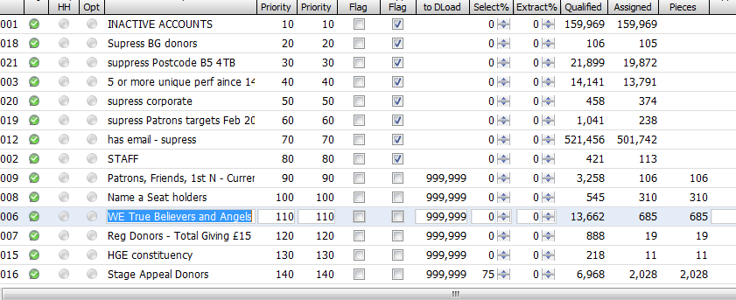
CASE STUDY: HERITAGE CAMPAIGN
Notes:
As part of a multifaceted campaign to raise funds for our heritage project (transforming over 120 years of Hippodrome History) I progressed a mail drop for an older audience demographic in the post. This went to two of the SMART segments – True Believers and Angels.
Built in an extraction, this pulled through 685 donors who met this criteria, who all received the mailing.

Slide 37
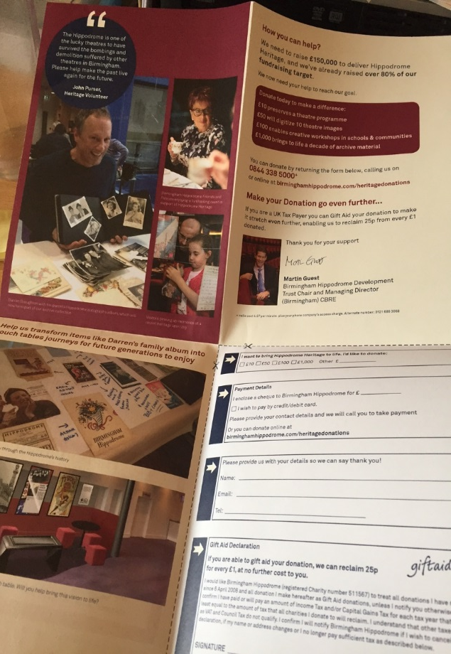
15% of all targets mailed were
Wealth Screen data targets
………………………………………………..
80% of all donors were from
the Wealth Screened data
Notes:
This fold out mailing was sent to just over 4,000 people and resulted in around 50 donations
This delivered c. £4,500 income, with donations ranging from £5 to £2,000 with most being in the range of £100 or under
Of the donors, over 40 ( 80%) were from the wealth screening target segments
Although not as successful as hoped in terms of generated income from a larger mail drop, it did show:
We targeted the right people. This mail drop went to people who did not have an email address on our system and all donations were received by cheque (unusual for us) meaning we targeted the right donor group (an older segment with long associations with the theatre) who wouldn't have responded to an ecampaign
Several returned mails due to bereavement – meaning we have now inactivated these accounts and are cleaning up our data
Useful piece of print in terms of an integrated campaign, which also included donations via The Big Give and email campaigns
Resulted in 10+ P2G1 potential major donor targets who were not known to us – who will be invited to future cultivation events

Slide 38
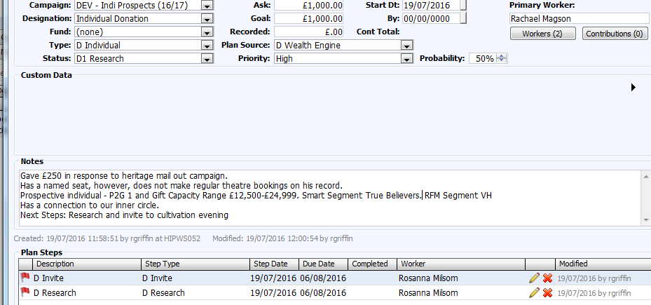
PLANS
Notes:
We are new to PLANS having only upgraded to 12.5 this year.
We are now at the beginning of formalising and improving our prospecting work – utilising WE leads and the PLANS function to improve our moves management.
For example, customer here made a £250 donation to our heritage campaign mentioned earlier. He also has a named seat in our auditorium purchased in the 1980’s but does not make regular theatre bookings from this record.
He is a P2G1 score with a Gift Capacity Range from £12,500 – £24,999 and falls into the ‘True Believer ‘ Smart Segment with a RFM VH score.
He also has a connection to our inner circle.
Next steps:
Research fully and invite to cultivation events.

Slide 39
NEXT STEPS
PLANS and moves management – the top 50
Wealth Screening data driving our cultivation events
Using WE data in targeted campaigns
Further work with trustees
Using wealth screening data to begin a legacy programme
Future screenings
Notes:
I hope from this presentation you will see we are really at the beginnings of our Wealth Screening journey.
I hope you have found us sharing our journey beneficial in some way.
Here are our next steps:
Really utilising our WE data and PLANS to improve our prospecting and moves management
We have 6 cultivation events planned for the next 6 months – populating these with wealth screening names
Further work with trustees – engaging them in this process, looking for inner circle connections, seeing how they can help
Ongoing use of WE data in campaign work – i.e. Big Give 2016
Utilising WE work to begin a legacy programme (currently underdeveloped here)
Future screenings (general advice I’ve heard is every 2 years)

Slide 40
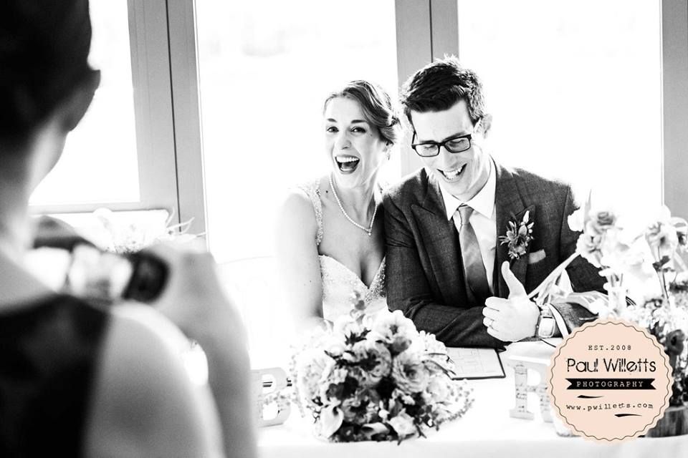
P.S….. I married a Tessiturian!
Notes:
I married a Tessiturian this year…. Ben Magson, European Team Applications and Support Consultant.
But it sure as hell doesn’t make me a Tessitura specialist!

Slide 41
Questions to ask? …….I’m happy to help
Advice to give?.............I’m all ears!
Want to visit? … ………We’ll give you a warm welcome
Contact Me!
Rachael Magson
Fundraising Manager
Birmingham Hippodrome
rachaelmagson@birminghamhippodrome.com
0121 689 3067
Twitter: @rjgriffin12

Slide 42
Integrating with Sage 50
…because life’s too short not to.

Slide 43
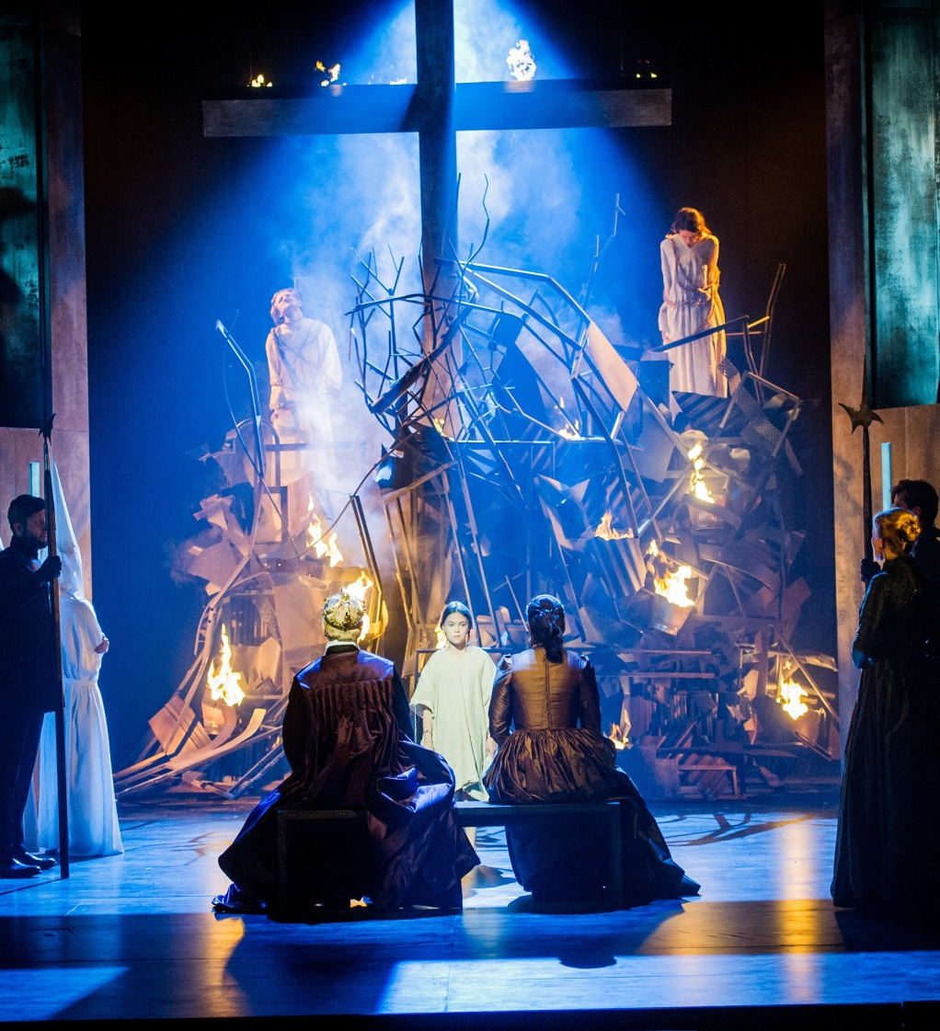
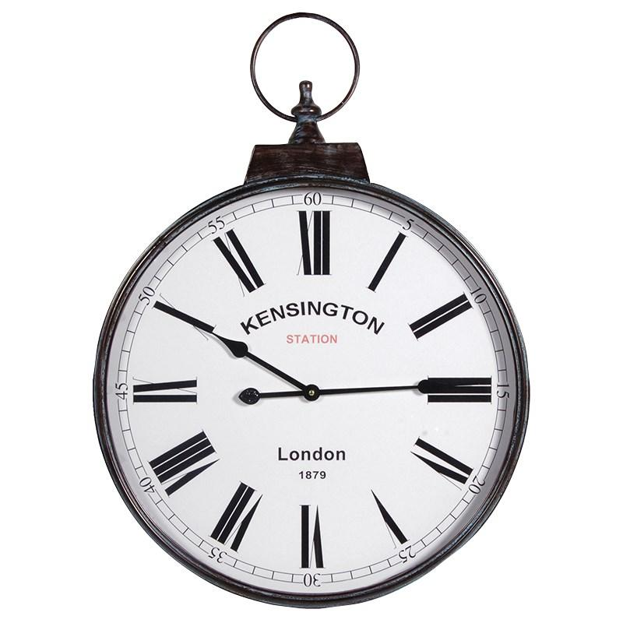

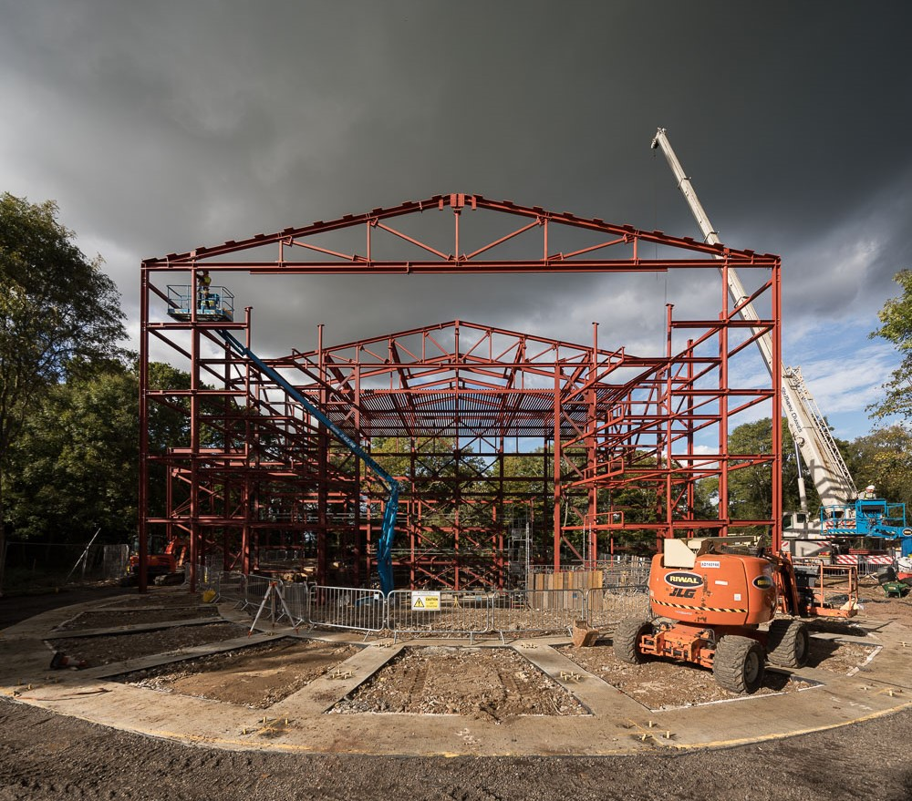
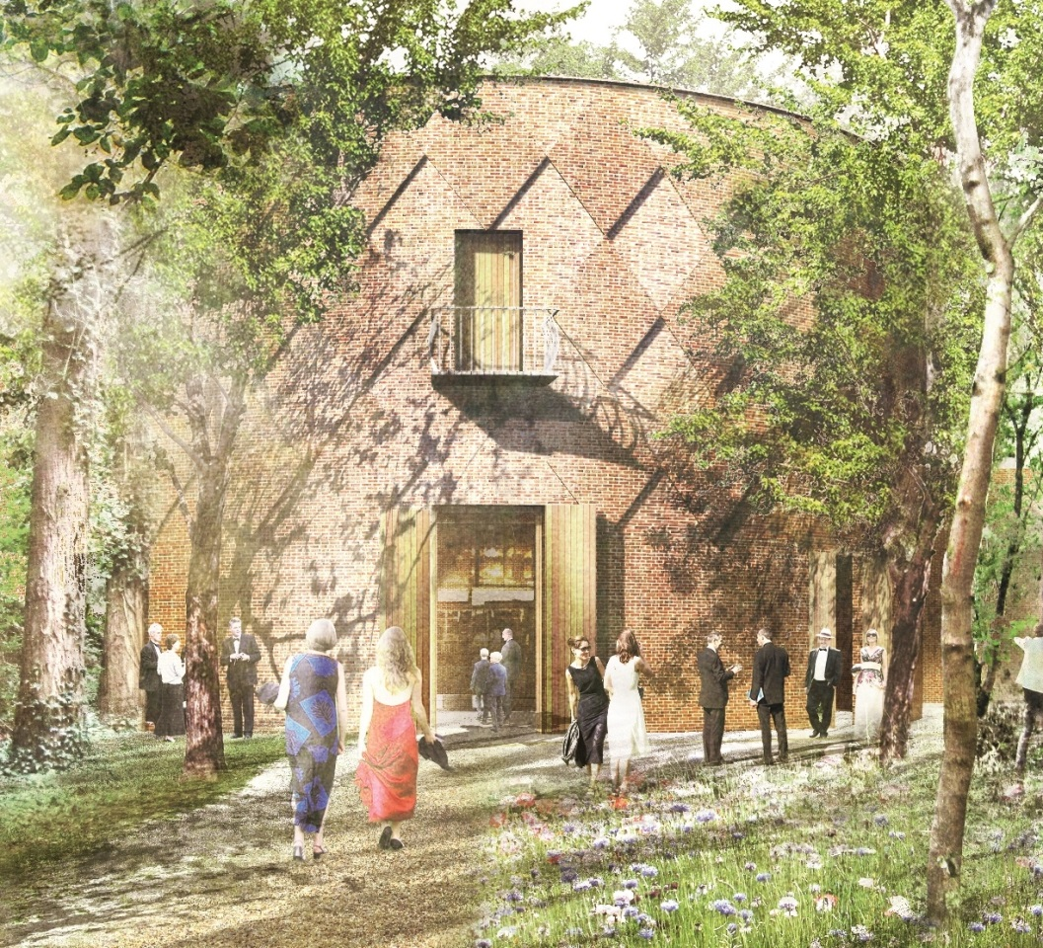


About us
Seasonal opera company for twenty years
Moving house – West Horsley Place in Surrey
Sister company
£3.5m turnover, £10m capital development campaign
Team of nine
One Finance Officer with limited time

Slide 44



What we’ll cover
Why we chose to integrate
The brief
Challenges we faced
Testing
What we learned

Slide 45




The inspiration
Coroner’s Report
Staging information through Excel
Possibility of human error
Time-consuming
Had to manually split Pimlico and GPO
Errors hard to identify and resolve
Cause of Death:

Slide 46

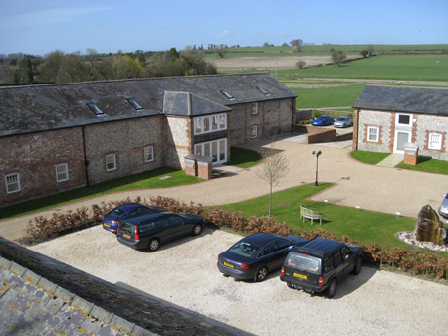
The brief
Use Sage’s import protocols
  .csv format
  Fixed columns
Manage our VAT processes
Split ticket income by show
Historical run
Manage two companies
Summarises by posting

Slide 47

Challenges
Single GL for all Productions

Slide 48
Single Production Income GL
Type | GL Code | Department Code | Net Amount
DEBIT | 4100 |  | £133.46
CREDIT | 4100 |  | £8,447.02
Type | GL Code | Department Code | Net Amount
DEBIT | 4100 | Tosca | £53.99
CREDIT | 4100 | Tosca | £621.87
DEBIT | 4100 | Die Walküre | £12.84
CREDIT | 4100 | Die Walküre | £3,476.04
DEBIT | 4100 | Jenufa | £41.00
CREDIT | 4100 | Jenufa | £1,238.28
DEBIT | 4100 | Bryn Terfel | £25.63
CREDIT | 4100 | Bryn Terfel | £3,110.83

Slide 49
Challenges
Single GL for all Productions
How to calculate tax

Slide 50
How To Calculate Tax
Not natively handled in Tessitura
We have existing workarounds in place
Rates may fluctuate
Different GLs incur different rates of Tax
Description | GL Code | Tax Code | Rate of tax
Ticket sales | 4100 | T1 | 0.200
Programmes | 4520 | T5 | 0.050
Annual membership | 4010 | T9 | 0.000
Ticket fees | 4103 | T1 | 0.200

Slide 51
Challenges
Single GL for all Productions
How to calculate tax
VAT has its own GL code
  Price layers
  VAT fund for Corporate Donors
  Ticketing fees

Slide 52
Working with our VAT processes
We’ve already accounted for VAT in the previous slide (How To Calculate Tax)
BUT…
VAT already exists in Tessitura: GL 2200 – we will double-count VAT. So:
SUPPRESS THIS GL
✓
Performance income
Advert income
Corporate Sponsorship
Fees
✓
✓
✗

Slide 53
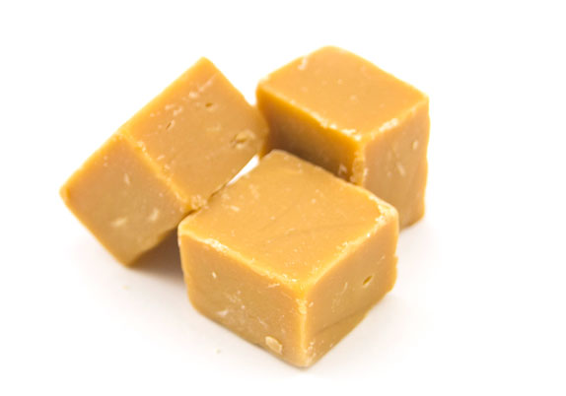
Working with our VAT processes:
Fees
Description | GL Code | Net Amount | Tax Code | Tax Amount
Booking Fee | 4103 | £1.50 | T9 | £0.30
FUDGE ALERT
Description | GL Code | Net Amount | Tax Code | Tax Amount
 | 4103 | =VALUE/(1 + Rate of tax)
Description | GL Code | Net Amount | Tax Code | Tax Amount
Booking Fee | 4103 | £1.25 | T9 | £0.25

Slide 54
Challenges
Single GL for all Productions
How to calculate tax
VAT has it’s own GL code
  Price layers
  VAT fund for Corporate Donors
  Ticketing fees
How to distinguish between companies?

Slide 55

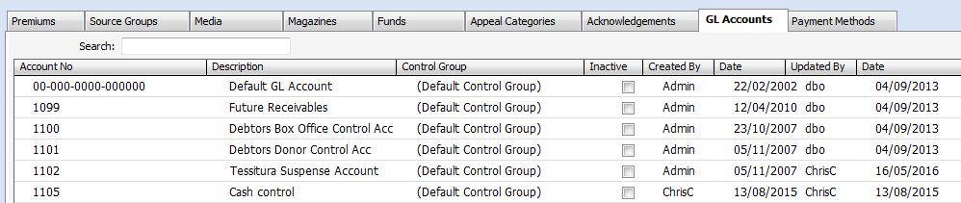
Distinguishing Between Companies
Ideally on the GL Code

Slide 56
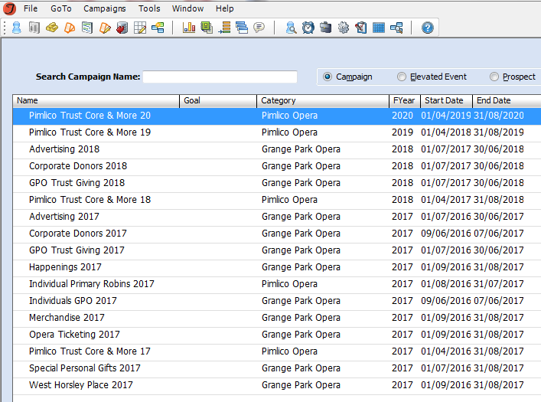
Distinguishing Between Companies
Campaign Category

Slide 57
Challenges
Single GL for all Productions
How to calculate tax
VAT has it’s own GL code
  Price layers
  VAT fund for Corporate Donors
  Ticketing fees
How to distinguish between companies?

Slide 58
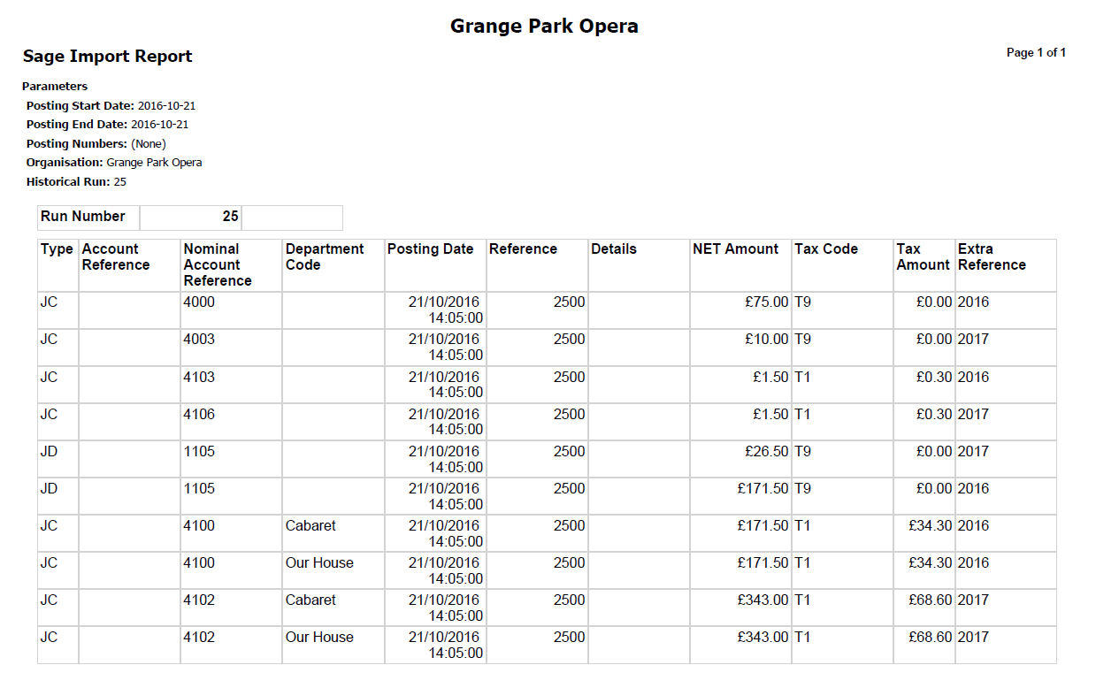
Testing
✓
✓
✓
✓
✓
✗
WORLD OF NO
✗
✓
✗

Slide 59
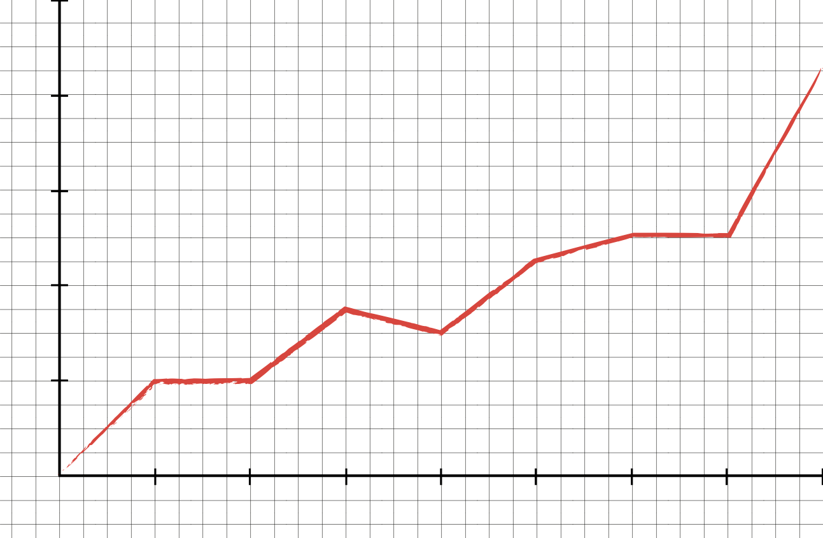
Conclusion
Finance Officer: Predicted Mortality Rate

Slide 60
What We Learned
This is important enough to do well
We’re still committed to it
VAT customisations can cause problems
Having one GL for ticket income is under review
Simplicity is key
There are benefits in the old method

Slide 61
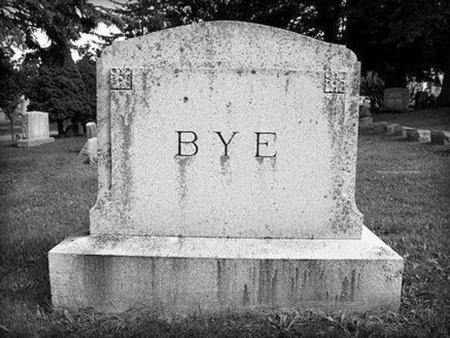
Contact
E-mail
chris@grangeparkopera.co.uk
Telephone
(01962) 73 73 75
Twitter
@chriscampbellX

Slide 62
“The more people I meet the happier I become.”
QUESTIONS?
Samuel Beckett, Waiting for Godot

Slide 63

WHAT’S NEXT?
TRANSPORT TO
ABBEY THEATRE
Coaches depart now at entry level
Take any items from the cloakroom
Tea and coffee available at the Abbey
CONFERENCE KEYNOTE 16.00-17.00
EVENING NETWORKING EVENT 19.30
Notes:
THURSDAY Breakout session 3 What’s next slide

