Slide 1

TESSITURA
EUROPEAN
CONFERENCE
DUBLIN 2016
Notes:
Welcome

Slide 2



PANEL
Emily Noakes : Theatre Royal & Royal Concert Hall
Claire Griffin : Roundhouse
Brendan Douglas : Liverpool Everyman and Playhouse
ACCESSING
(AND MASTERING) ACCESSIBILITY
No, Not That RAMP, the Other One!
CONTENT PLANNERS
Chloe Hearne : Wales Millennium Centre
Claire Griffin : Roundhouse
Share your favourite content and photos! #TECDublin16

Slide 3


Emily Malen
Front of House Manager
& Access Development
Notes:
Emily Malen – Front of House Manager / Access Development. TRCH in Nottingham. In late 2014, we introduced a free access requirement register to ensure a smooth and hassle-free customer journey right from the booking process through to watching the show. Membership of the Register lasts for three years with the option to update any information held on the system in this time if a customer’s circumstances change. Once registered customers are sent a registration card that they can present when booking tickets (or can be presented on their behalf by their carer). New easily identifiable icons were developed on the box office system meaning staff could see at a glance who was a member of the scheme and had logged access needs, resulting in the customer no longer having to explain their needs each time they made a booking. The ARR also enabled the correct discounts to be applied to the customers booking, such as a free personal assistant ticket. However, this was only possible to bookings made over the phone or in person at the box office which leads me nicely onto what I will be talking about today – developing online booking as an option for the free personal assistant ticket.

Slide 4
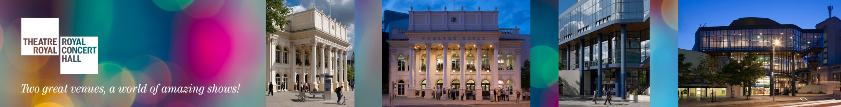

How do we make it possible for our Access Requirement Register customers to book online
through TNEW?
Notes:
We’ve had TNEW for a couple of years, but we haven’t had the facility to allow the customers on our ARR to book their free companion seats online through the ticketing path. We wanted to explore how we could give them, and our wheelchair users, the opportunity and freedom to book online. When we initially went live in 2014 with the ARR scheme many customers assumed this would allow them to book online with the discount, however at the time we were only on version 11 of Tessitura

Slide 5

Pricing Rules and Messaging in Tessitura was the answer!
Notes:
When we updated to Version 12.5.1 in June this year, we were still on version 5.5 of TNEW so rules and messaging is not available on this version of TNEW. However, we have just updated to version 6 in Test and this opened up new avenues to explore the use of pricing rules and messaging for our ARR customers online.

Slide 6
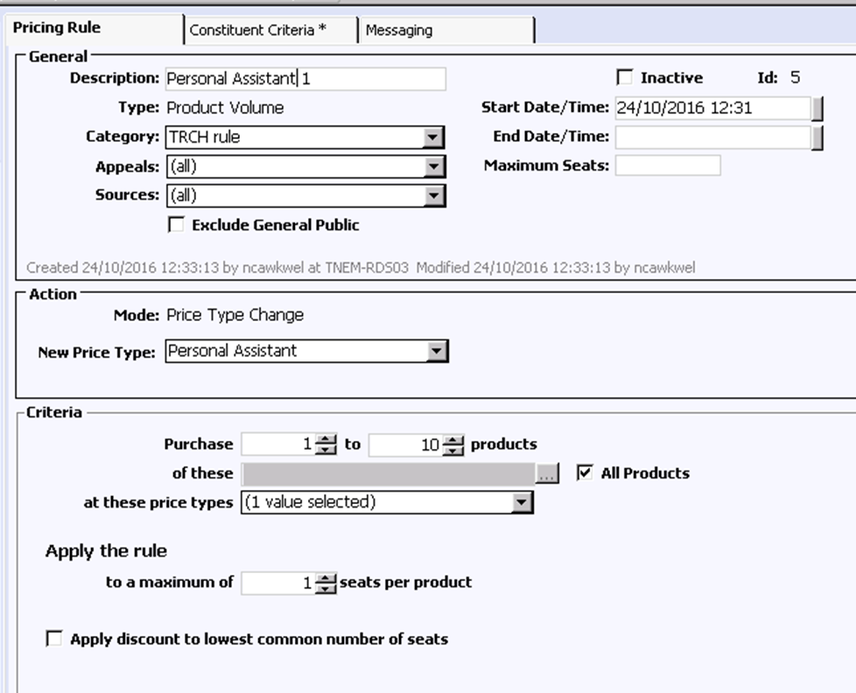
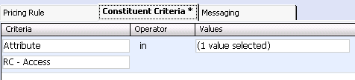
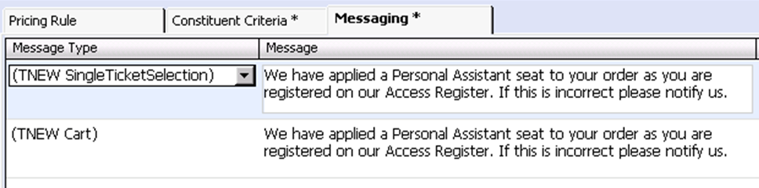
Setting up the rules & messaging
This value is
‘Personal Assistant’
Notes:
We have set up a product volume pricing rule with a price type change. If the customer purchases a number of products (i.e different performances) at the full price then it will apply a rule to change one of the full price tickets to a personal assistant ticket (which is free). The rule is triggered by an attribute added to the constituent record when they apply for the ARR and supply the appropriate documentary evidence to record that they require a PA. We have also set up messaging to notify them that personal assistant ticket has been added to the order.

Slide 7
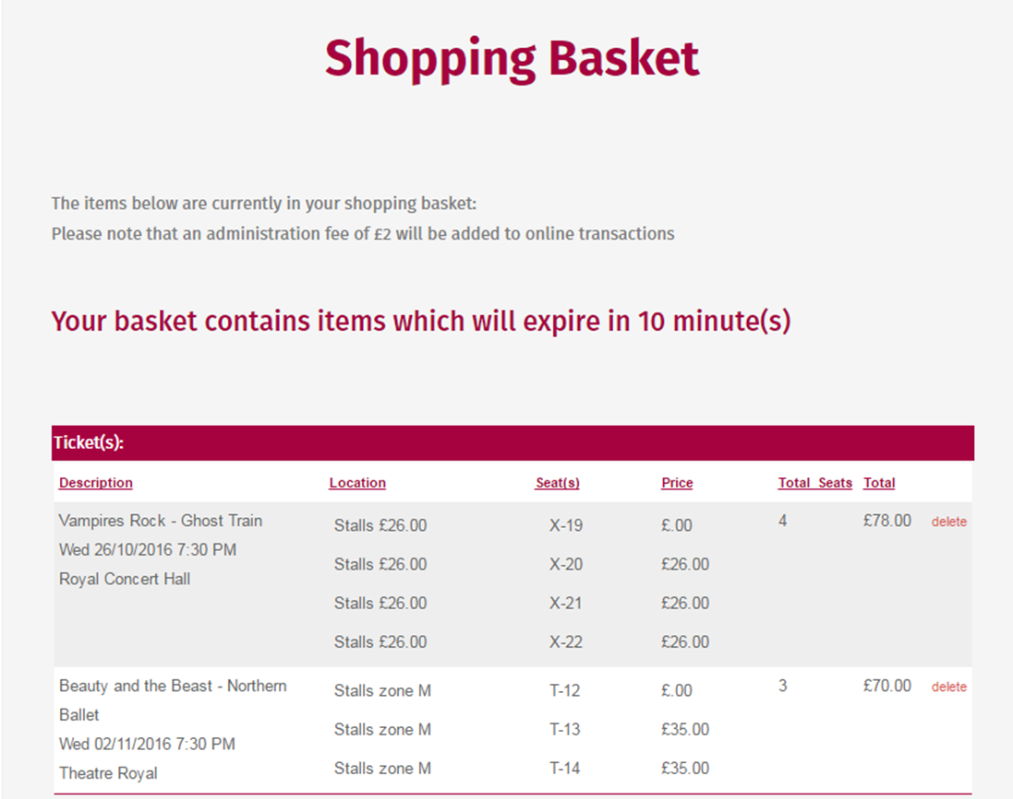
This details the Personal Assistant ticket at comp and the full price ticket plus any additional tickets below
Notes:
Here’s a screen shot from TNEW test system showing the free pa ticket and the one at full price (if customer is also a student they can apply the concession to the paid for ticket). You will also notice that there are additional tickets for the event. However the free pa ticket is only applied to one ticket per product.

Slide 8
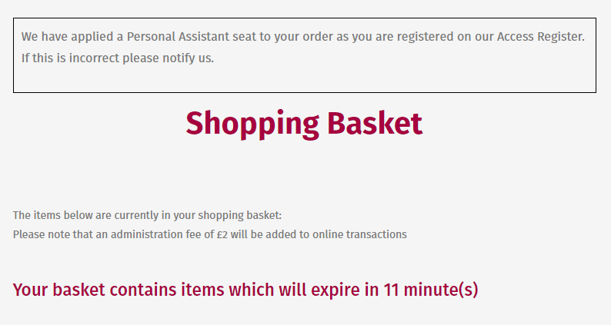
Notes:
Here you can see the message that appears for the customer to see. We can place this message at various points in the purchase process and this is set up in the messaging screen in the pricing rule. We can also set messages to appear in Tessitura for our box office team to notify them that a rule has been added. We are planning on contacting the customers registered on our ARR scheme to let them know that for some of them the facility to book online will be available. There are a couple caveats to this. For example, groups including care homes / specials schools will need to continue to book through our group sales team and we haven’t yet created a system for our assisted performances to allow customer to book in specific locations suitable for these performances – but this is being explored as part of Phase 2. Using out of the box functionality that exists in Tessitura and TNEW – it may be that further down the line we look at customisations to suit our requirements. We are in early stages of the project however we are hoping to implement soon.

Slide 9
If you have any questions then please contact me
Emily Malen
Front of House Manager & Access Development
emily.malen@nottinghamcity.gov.uk
0115 989 5609

Slide 10

Roundhouse
Access Bookings Online
Claire Griffin
Visitor Operations Manager

Slide 11

Create to Transform
………………………………………………………………………………………………………………………………………….
A former railway engine repair shed, Grade II* Listed building, transformed in to a ground breaking performing arts venue 50 years ago.
Reopened in 2006 after a £30m development which included the creation of a state of the art creative centre for 11-25 year olds.
We are a charity working with 3000 young people a year.
We’re here to transform. To create, agitate and excite.

Slide 12
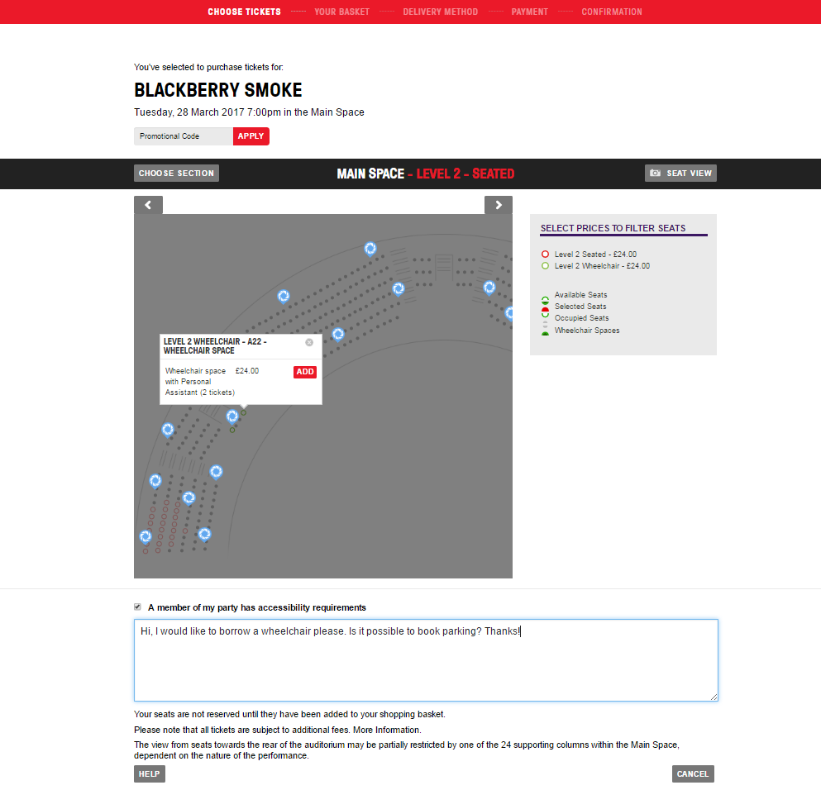
Customer selects 1 ticket on the screen
………………………………………………………………………………………………………………………………………….
Access Bookings Online
Customer can choose to see the seat view
They can add details of any accessibility requirements in the group

Slide 13
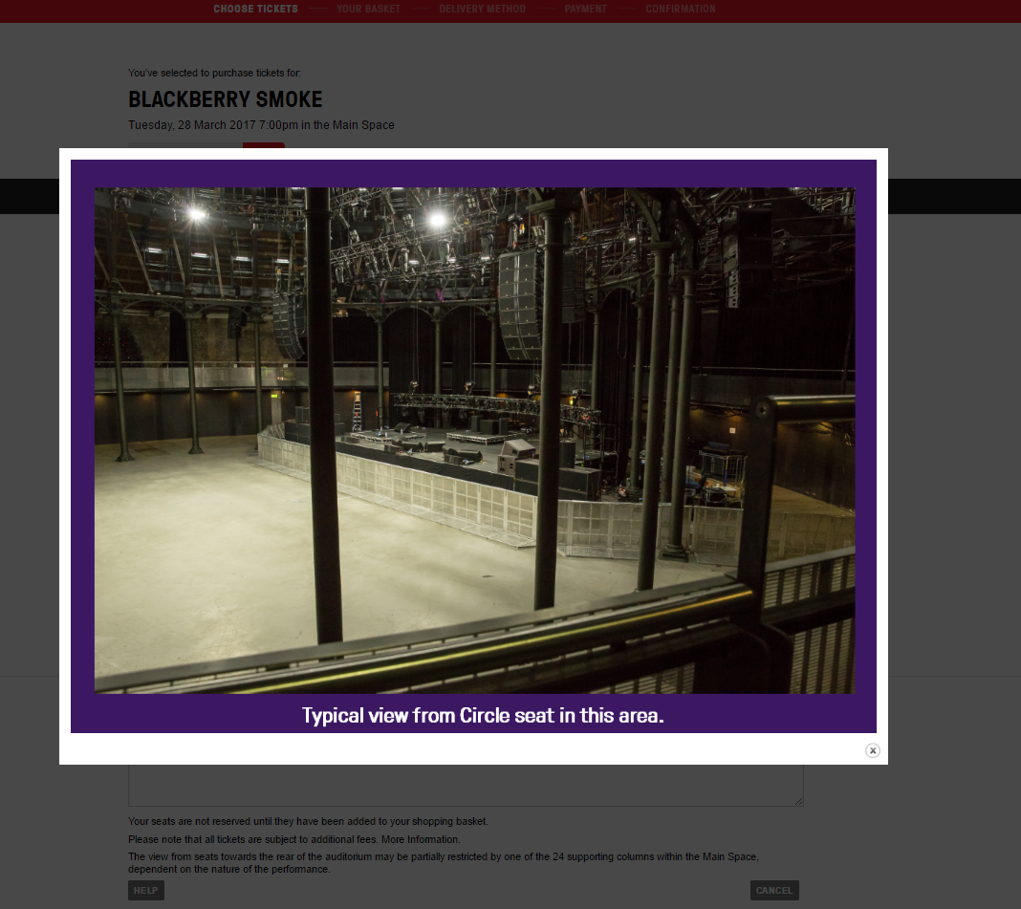
Access Bookings Online
………………………………………………………………………………………………………………………………………….

Slide 14
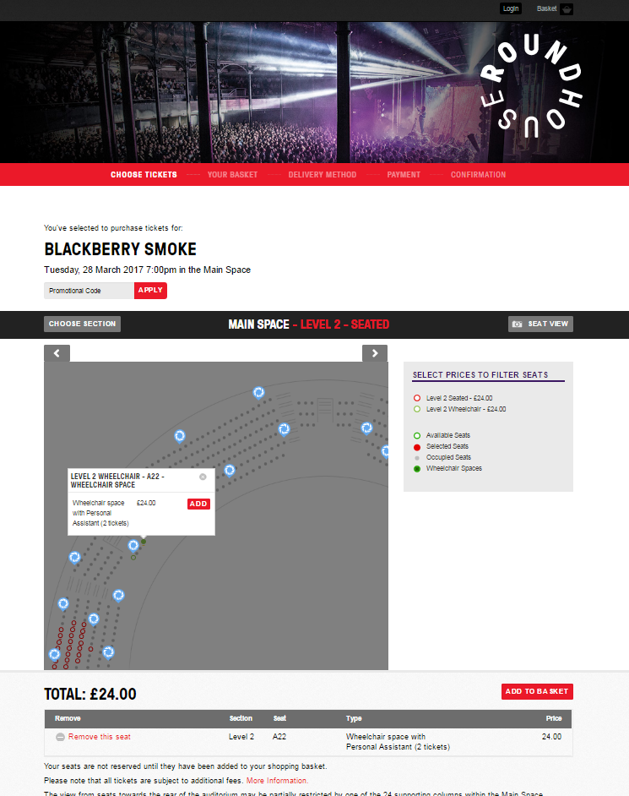
Access Bookings Online
………………………………………………………………………………………………………………………………………….

Slide 15
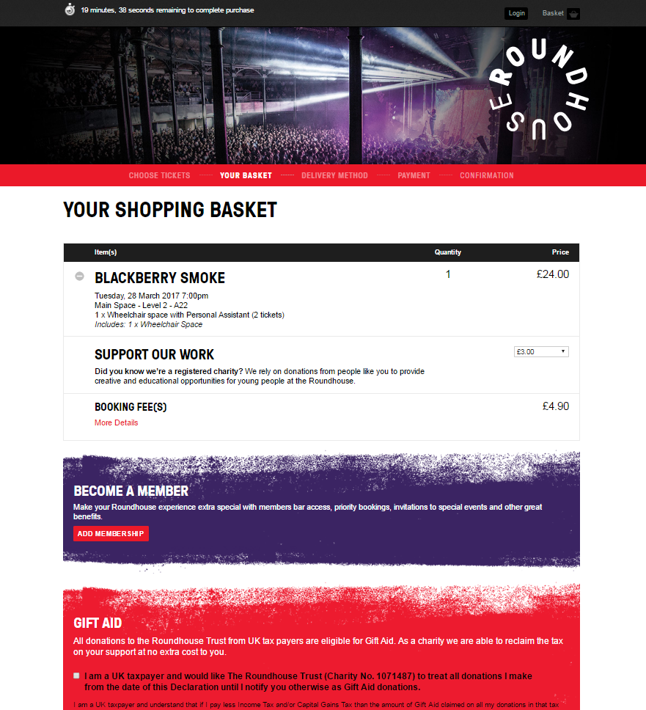
Access Bookings Online
………………………………………………………………………………………………………………………………………….

Slide 16

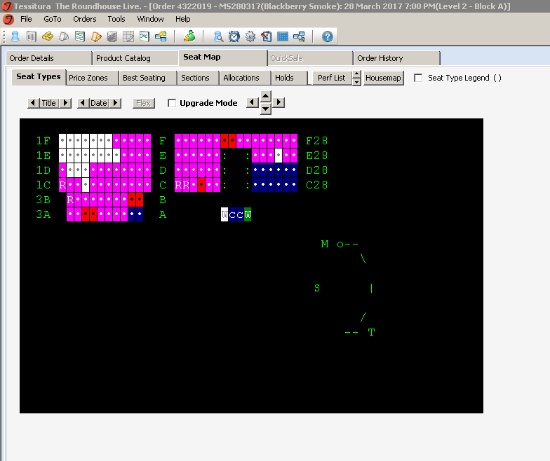
Access Bookings Online
………………………………………………………………………………………………………………………………………….

Slide 17
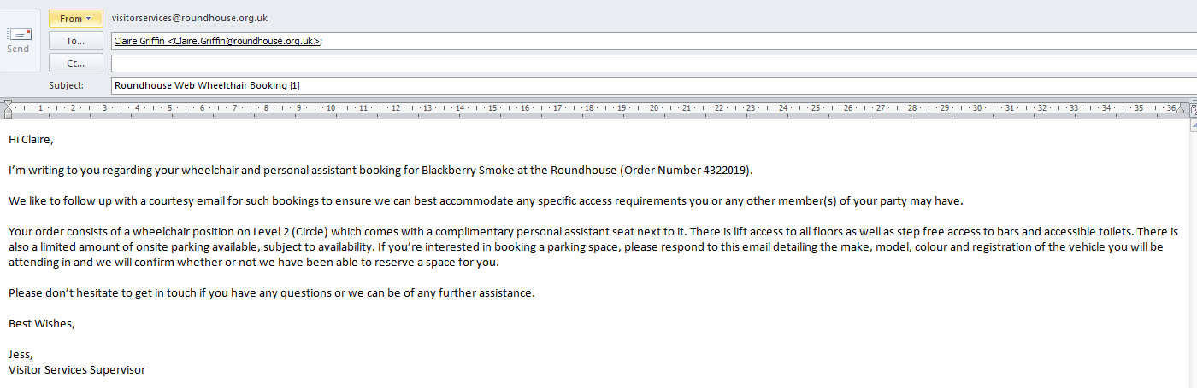
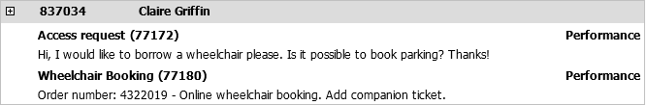
Access Bookings Online
………………………………………………………………………………………………………………………………………….
Access CSI report sent to VS each morning
Email sent to bookers to confirm what they have booked
Custom tab on the performance flags to VS on the day.

Slide 18
Access Starts Online
………………………………………………………………………………………………………………………………………….
Because of the nature of our audience – high percentage of 1 time bookers, booking for shows that announce late & sell out quickly we don’t operate an access register.
We work with Attitude is Everything and have been awarded a Gold Standard Award by them.
We are working towards improving the access information we have on our website to bring it in line with their Access Starts Online campaign.
Next steps – being able to allow patrons to book ambulant disabled seats online.

Slide 19

End slide
Thank You!
claire.griffin@roundhouse.org.uk
www.roundhouse.org.uk

Slide 20


Slide 21
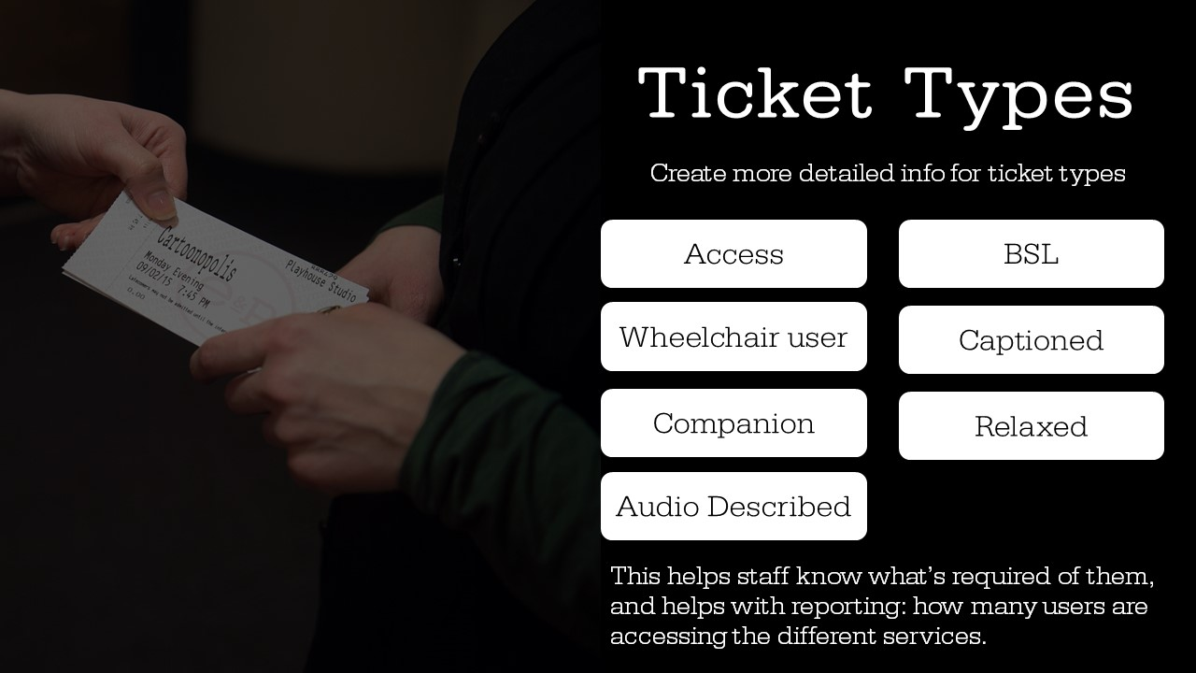

Slide 22
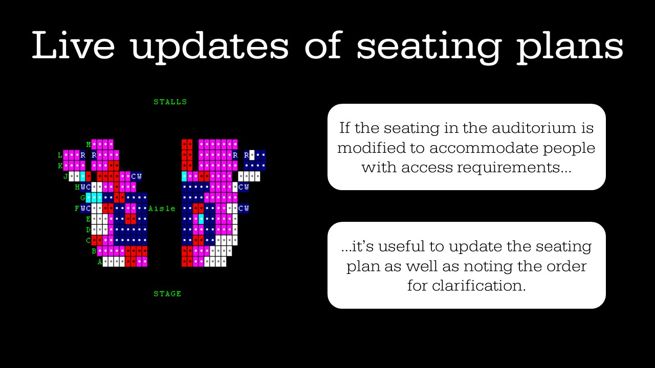

Slide 23
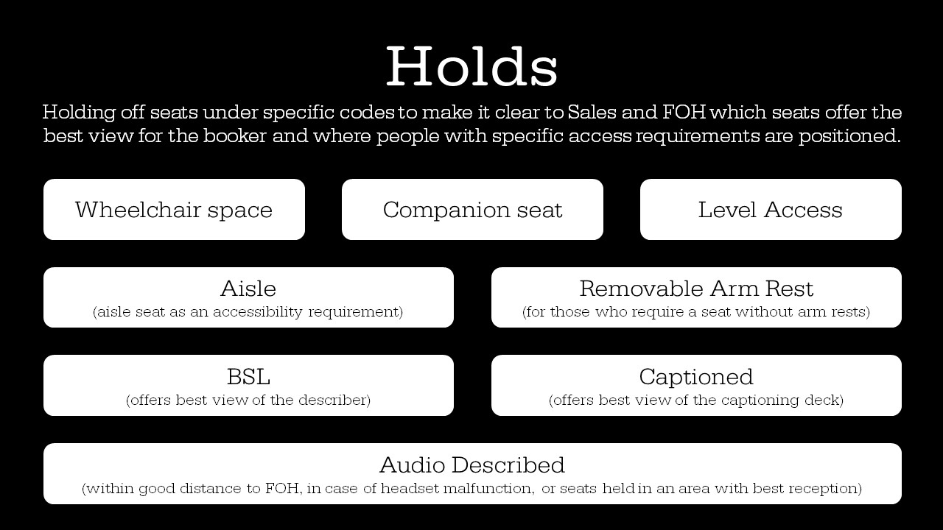

Slide 24
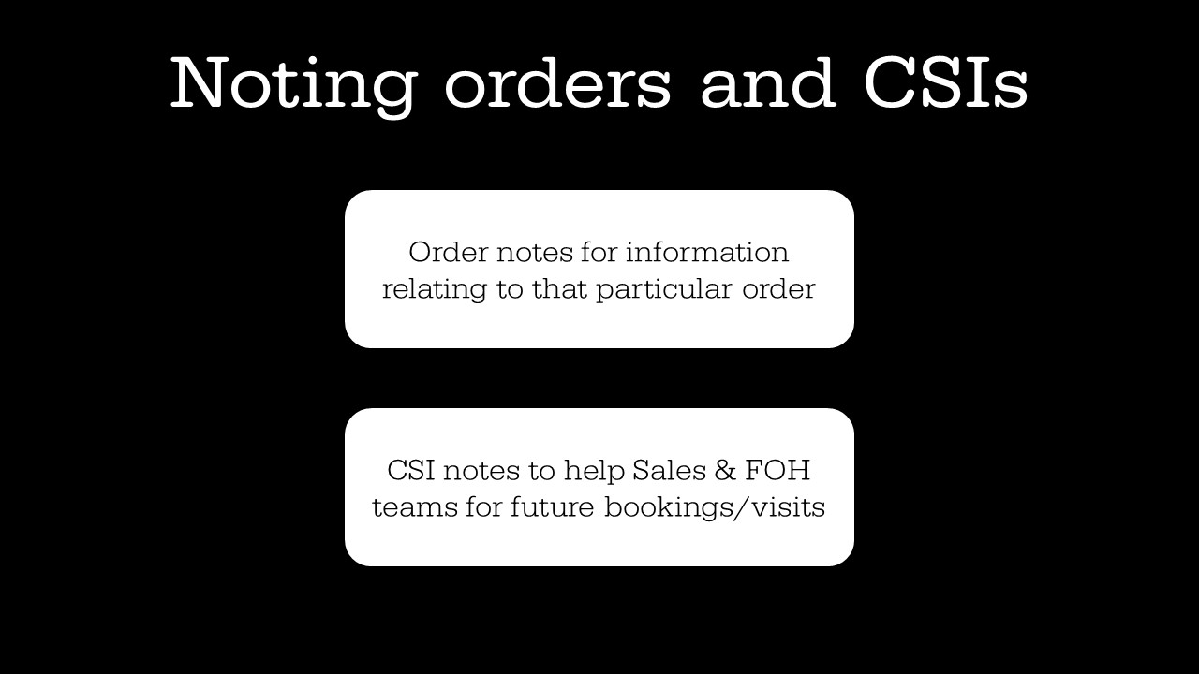

Slide 25
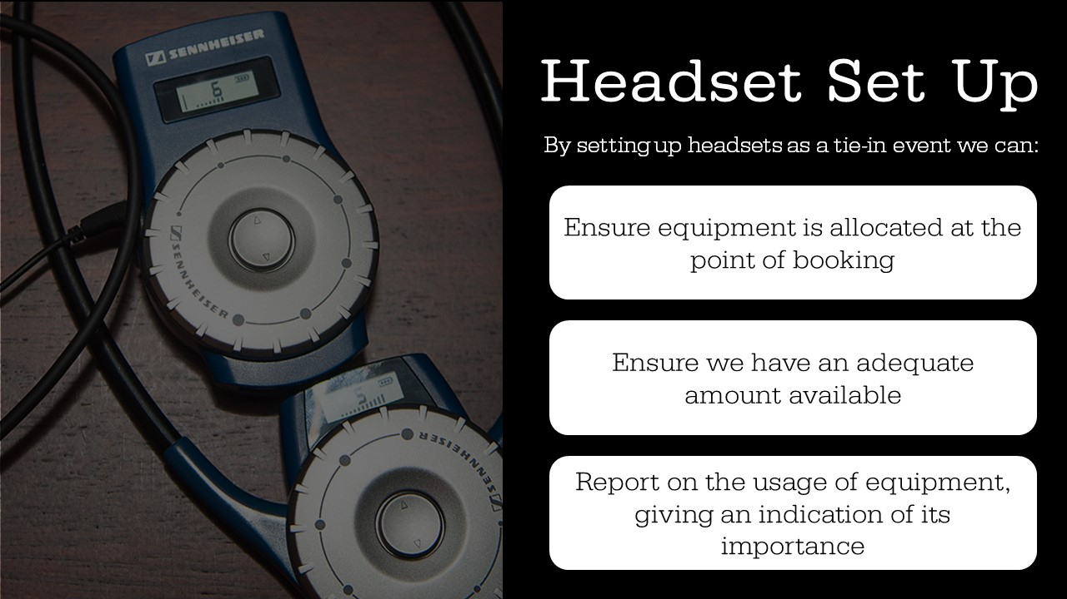

Slide 26
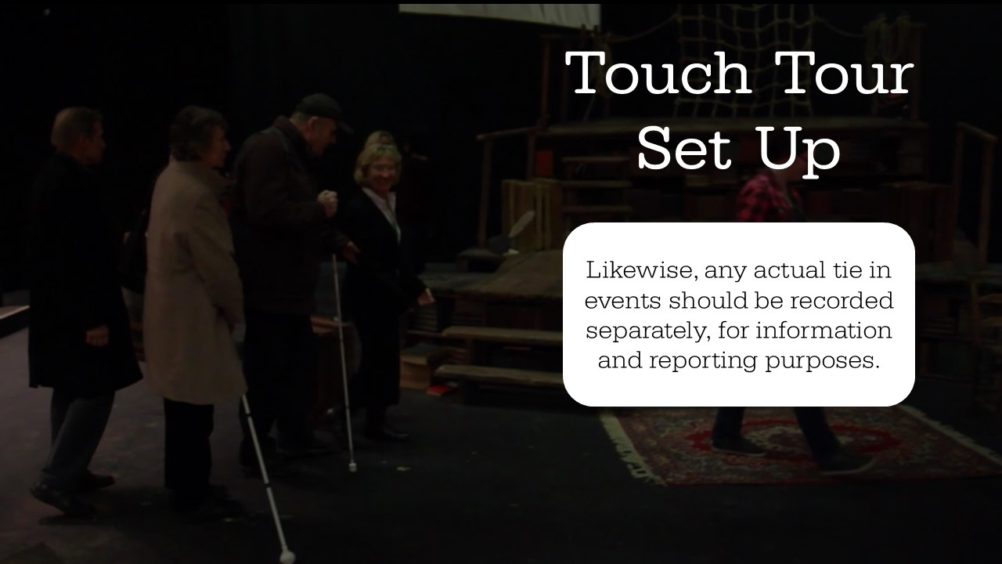

Slide 27


Slide 28
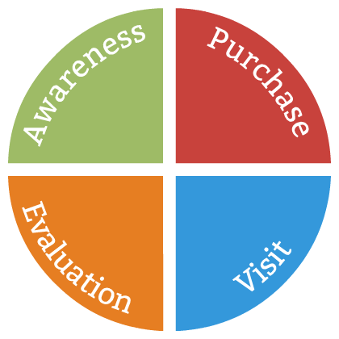

Slide 29
“The more people I meet the happier I become.”
QUESTIONS?
Samuel Beckett, Waiting for Godot

Slide 30

WHAT’S NEXT?
TRANSPORT TO
ABBEY THEATRE
Coaches depart now at entry level
Take any items from the cloakroom
Tea and coffee available at the Abbey
CONFERENCE KEYNOTE 16.00-17.00
EVENING NETWORKING EVENT 19.30
Notes:
THURSDAY Breakout session 3 What’s next slide

