Slide 1

TESSITURA
EUROPEAN
CONFERENCE
DUBLIN 2016
Notes:
Welcome

Slide 2



MODERATOR
Emma Larcombe : Tessitura Network
PANEL
Eve Vines : City of Birmingham Symphony Orchestra
Victoria O’Brien : Roundhouse
Rosie Milsom : Birmingham Hippodrome
TRICKS TO TRACKING BENEFITS
Monitoring Membership Benefits and Take Up
CONTENT PLANNER
Rosie Milsom : Birmingham Hippodrome
Share your favourite content and photos! #TECDublin16

Slide 3

TRACKING CORPORATE BENEFITS
Ellie Griffiths Eve Vines
Corporate Relations Manager Individual Giving Manager

Slide 4
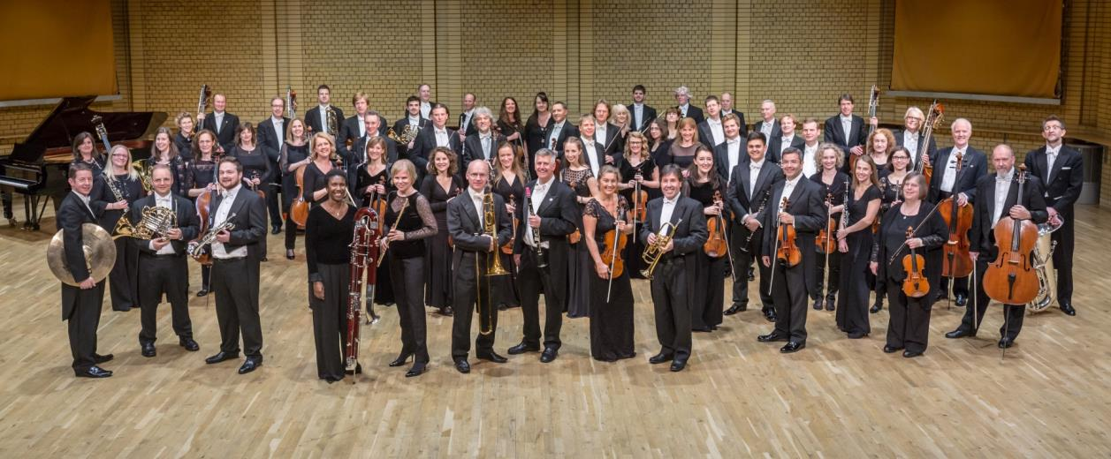
WHO WE ARE

Slide 5




















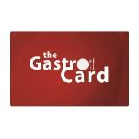

OUR PARTNERS

Slide 6

WHAT WE USED TO DO….

Slide 7


WHAT WE DO NOW….

Slide 8
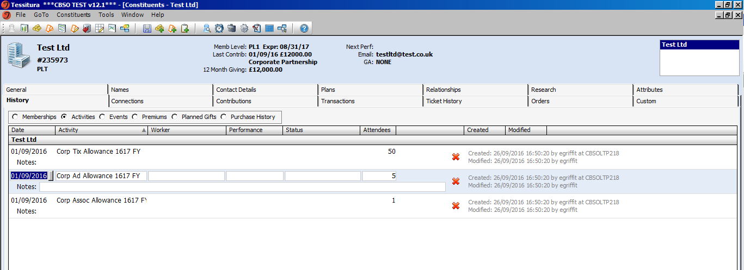
TRACKING ALLOWANCES

Slide 9
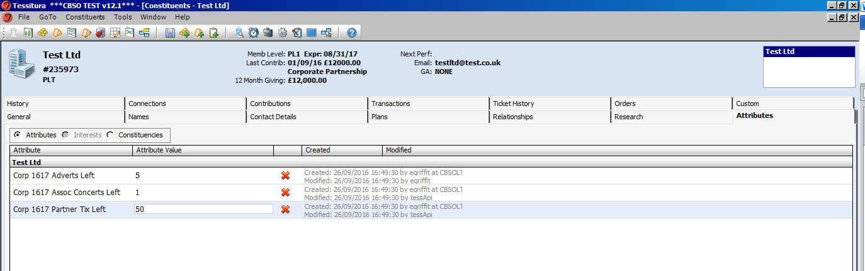
TRACKING ALLOWANCES CONTD…

Slide 10
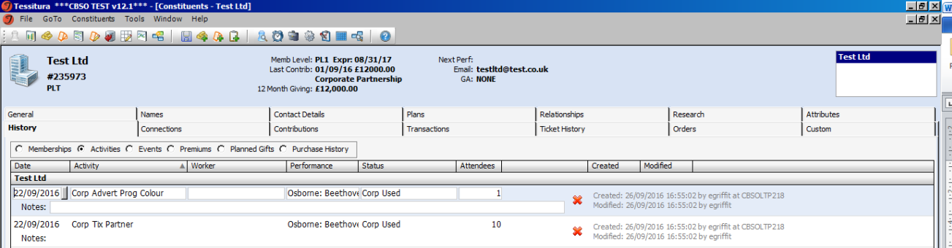
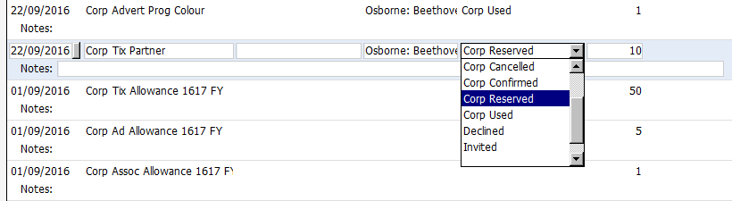
ACCOUNT MANAGEMENT

Slide 11
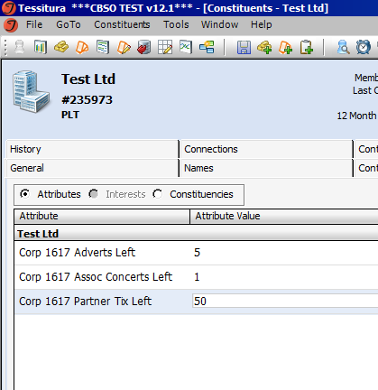
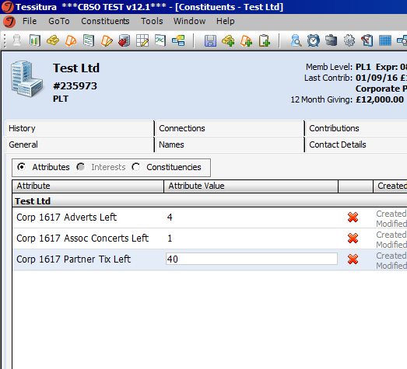
ACCOUNT MANAGEMENT CONTD

Slide 12
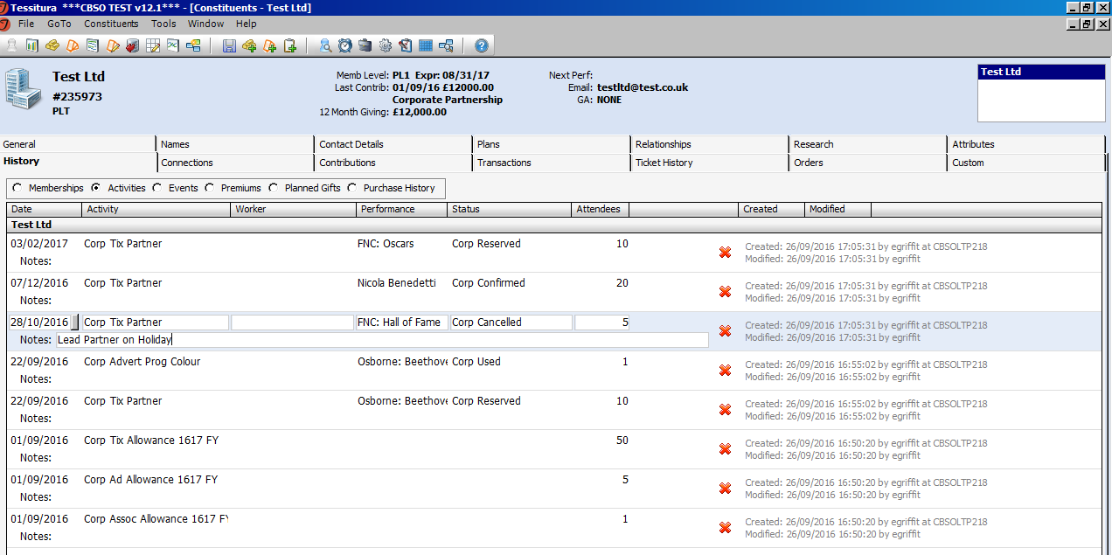
ACCOUNT MANAGEMENT CONTD

Slide 13
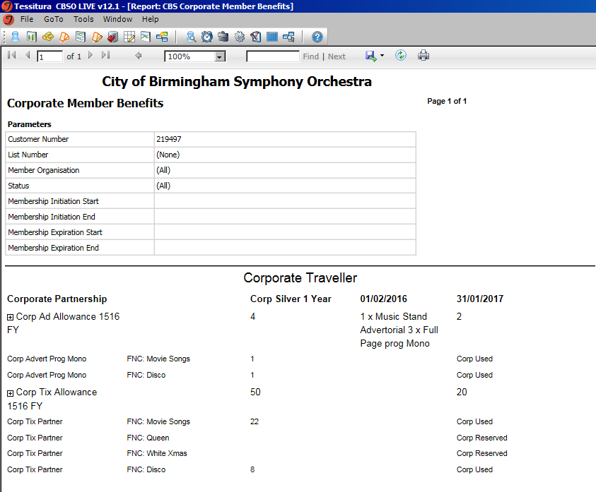
REPORTING

Slide 14
PROS
Why it works for us…
It’s the best way to track ticket history, as we don’t run our own Box Office
It’s manual, but we have the capacity to deal with this as the volume of Corporate Supporters is manageable
The Attributes and Activities tab are flexible enough to easily add items in the systems tables.

Slide 15
CONS
To think about…
We have had to create a custom report to pull out the info we want.
It’s manual!
It doesn’t track ALL corporate benefits

Slide 16
CONTACT FOR QUESTIONS
Ellie Griffiths
Corporate Relations Manager egriffiths@cbso.co.uk

Slide 17

Tricks to tracking benefits
Victoria Carlin O’Brien
Insights & Data Manager
Roundhouse Trust
formerly Data Analyst + Programmer National Theatre

Slide 18
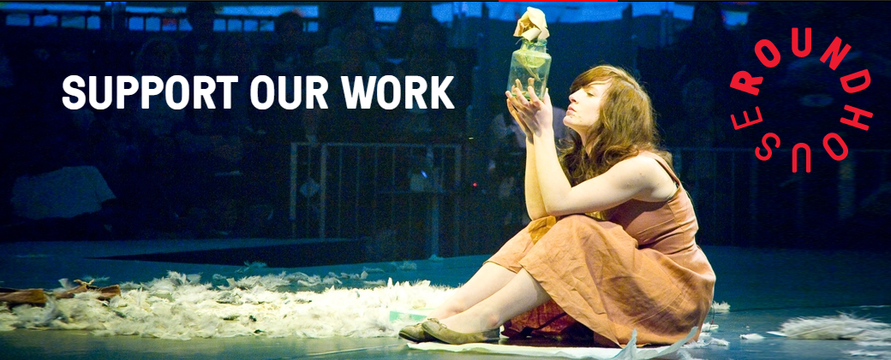
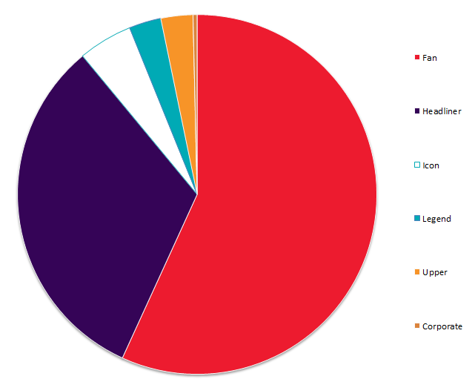
1k+ membership base
£50 - £1,500
Benefit cost ranging from £45 to £650
High proportion of 1st Time Bookers

Slide 19

Section title Option A
Designing Trackable Membership Benefits
Notes:
Four core levels of membership
Since 2009, updated and refreshed, benefit wise
Ran survey to work out what members wanted from their memberships
Streamlined membership rules & updated scheme. Pricing of benefits & ensuring everything is accurate for reporting to HMRC
Counter at top of constituent header for number of free booking fees remaining
Events pulled from events tab
What. Is easy way of showing how customer is using their benefits
Custom tracking tab, will see how member is using benefits and what, will list what had been used. Will be used in custom reporting so can be pulled upon & break off per level
To review habits, behaviours and to build a upon loyalty.
Custom bio report - will also pull through benefit usage
Are members using benefits or do they just want to donate?

Slide 20


What do you offer?
………………………………………………………………………………………………………………………………………….

Slide 21





What can you track?
………………………………………………………………………………………………………………………………………….

Slide 22
What can you track?
………………………………………………………………………………………………………………………………………….
Ticket History
First performance
Next performance
Fee Transaction Reports
Elevated events & activities
Constituencies
Ranking
Days Out Analysis
Source Codes
Clicks & Opens

Slide 23
Who can benefit?
………………………………………………………………………………………………………………………………………….
Does the benefit affect your cost/donation split?
Are the benefits based on financial year?
Membership dates?
What happens when you want to use a benefit as a renewal tactic?
Notes:
Use Yps as example

Slide 24
Tracking bespoke benefits
………………………………………………………………………………………………………………………………………….
Notes:
Use Yps as example

Slide 25
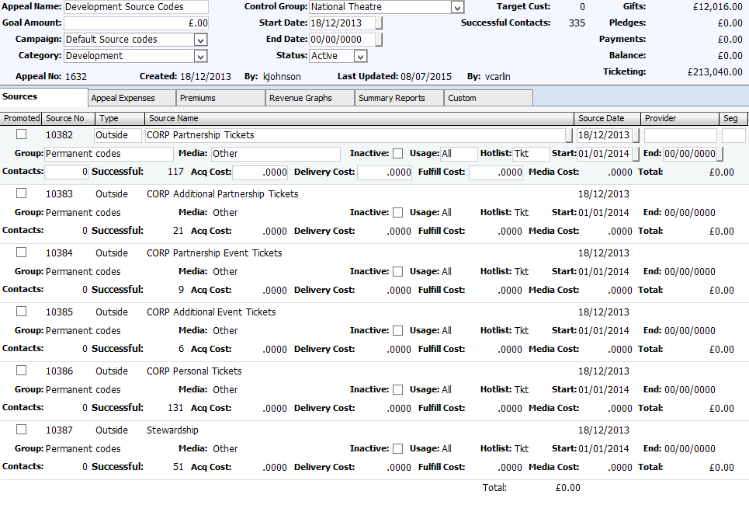
Tracking bespoke benefits
………………………………………………………………………………………………………………………………………….
Notes:
Use Yps as example

Slide 26
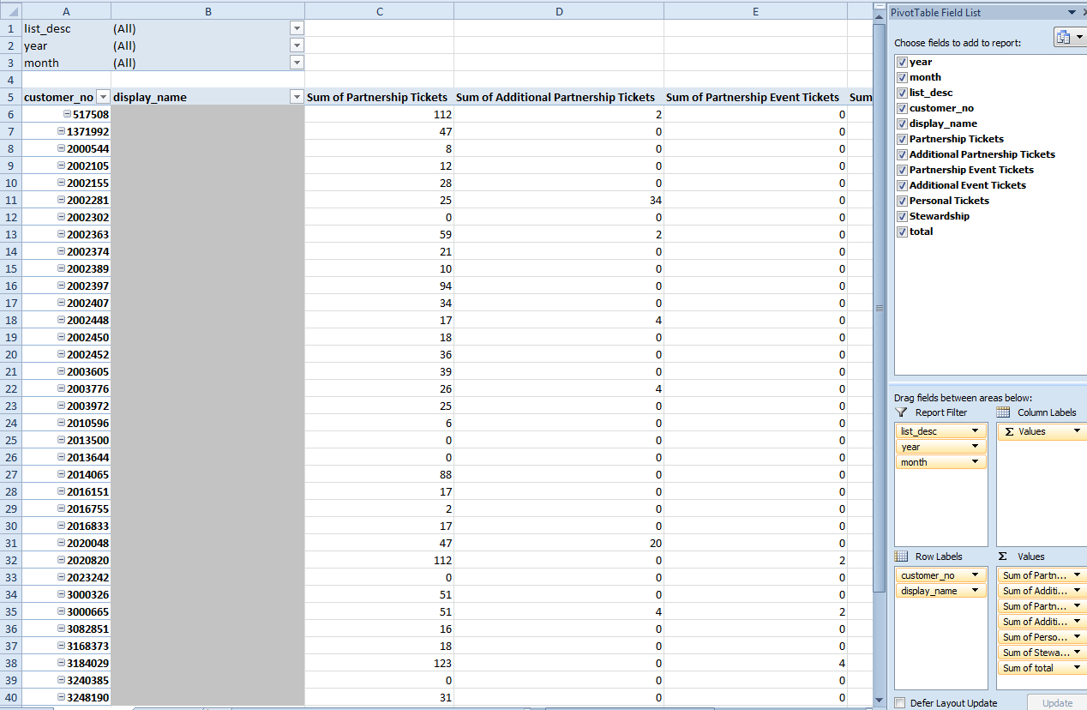
Tracking bespoke benefits
………………………………………………………………………………………………………………………………………….
Notes:
Use Yps as example

Slide 27
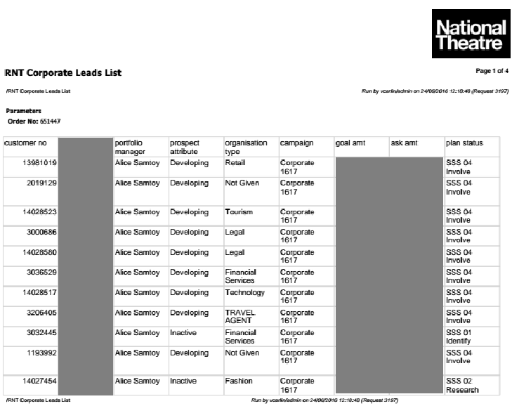
………………………………………………………………………………………………………………………………………….

Slide 28

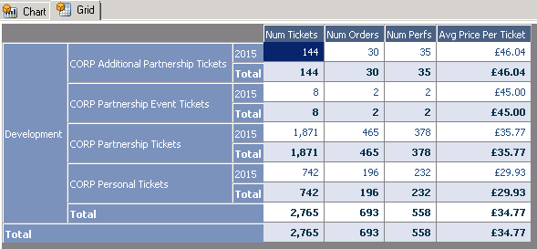
………………………………………………………………………………………………………………………………………….
T-STATS!

Slide 29

End slide
Thank You!
victoria.obrien@roundhouse.org.uk
www.roundhouse.org.uk

Slide 30

Tracking Benefits for
Individual Members
TEC 2016
Rosie Milsom
Fundraising Officer
Birmingham Hippodrome

Slide 31
Who We Are
Hippodrome CREATIVE Stats
Artistic commissions
Strategic creative learning programme
300,000+ audiences and participants
100’s of volunteers
1000’s of discounted tickets for schools
Main Stage Stats
c.400 performances a year
500,000+ visitors
Main Stage: 1,843 seats
Patrick Centre: 206 seats
Notes:
The organisation has a Fundraising team of two and a Business Development team of two.
The fundraising team is responsible for fundraising from grants, trusts, memberships, individuals and campaigns and the Bus Dev team from Corporates. Together we present 3 major fundraising dinners a year
This equates to around £1million in income (ringfenced for Hippodrome Creative and other campaigns/projects)
Org turnover c. 29 million
Hippodrome CREATIVE A broad programme of access, engagement and creative programme.

Slide 32

The Fundraising team of two service around 74 Patrons
Four membership levels - from donations of £250+ to £3,000+
Number of benefits increases as the membership/donation level
increases
A more philanthropic type of membership than our Friends members – a higher engagement with our Hippodrome CREATIVE work

Slide 33
The benefits of tracking benefits!
An at-a-glance view of what each member is entitled to
Allows you to monitor take up
Can be handy come renewal time
Allows you to track the value of the benefits they have
received
Notes:
An at-a-glance view of what each member is entitled to –
available for all staff to view
Allows you to monitor take up – useful for mid-year nudges or
to see what is popular for each customer
Can be handy come renewal time, for letting members know
what they have benefitted from
Allows you to track the value of the benefits they have received

Slide 34
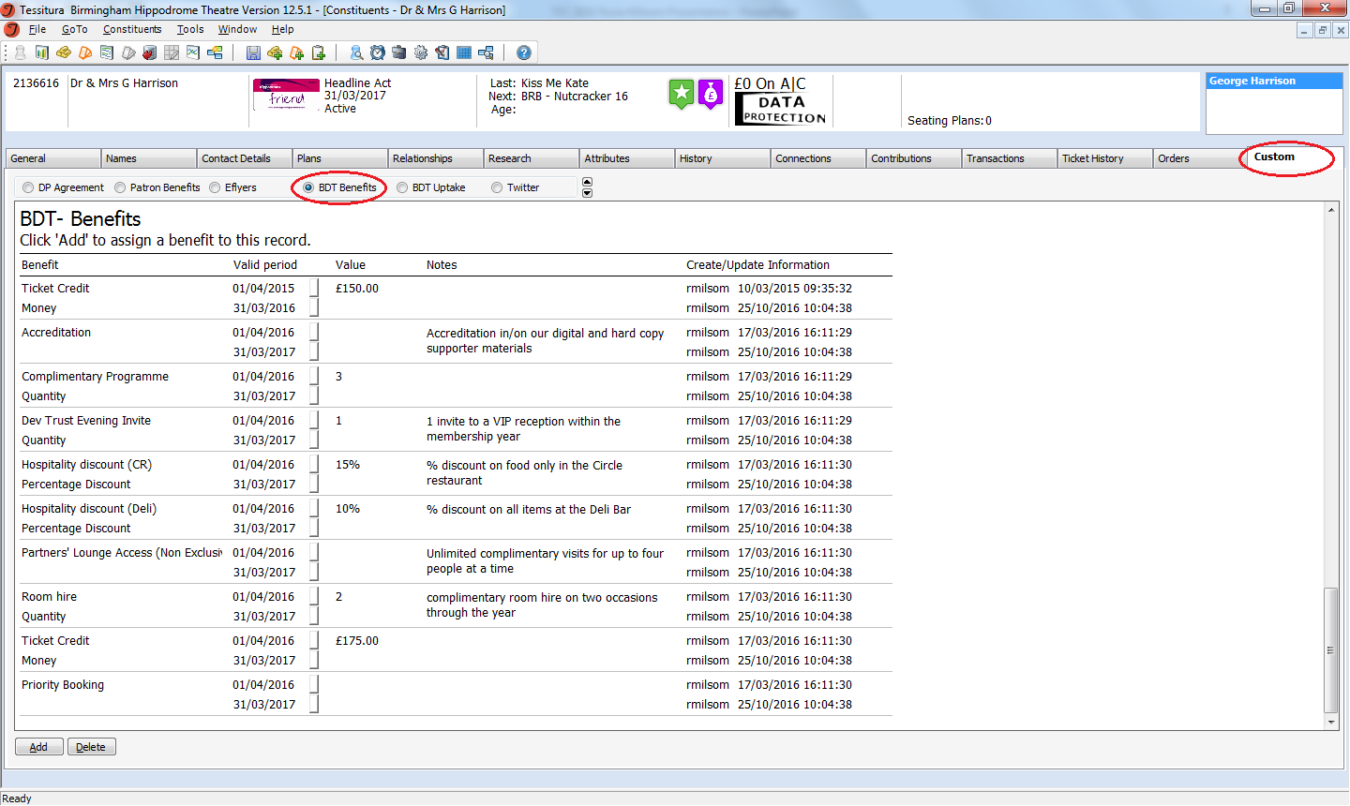
Notes:
We record both individual (Patrons) and corporate benefits under the Custom tab. To do this for individuals we use two tabs – one to list what each Patron is entitled to (BDT Benefits, circled here) and one that monitors what of these benefits they have claimed (Patron Benefits). Here you will see how we list the benefits each member is entitled to.

Slide 35
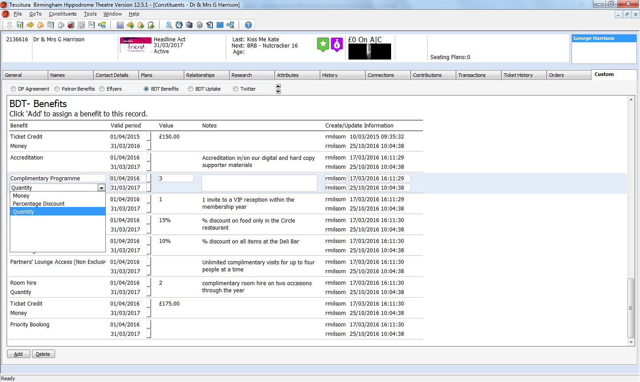
Notes:
A drop down box below each benefit allows you to choose whether it has a quantity, percentage discount or monetary value. You then enter the relevant figure in the Value column, and any relevant notes on the benefit in the Notes column

Slide 36
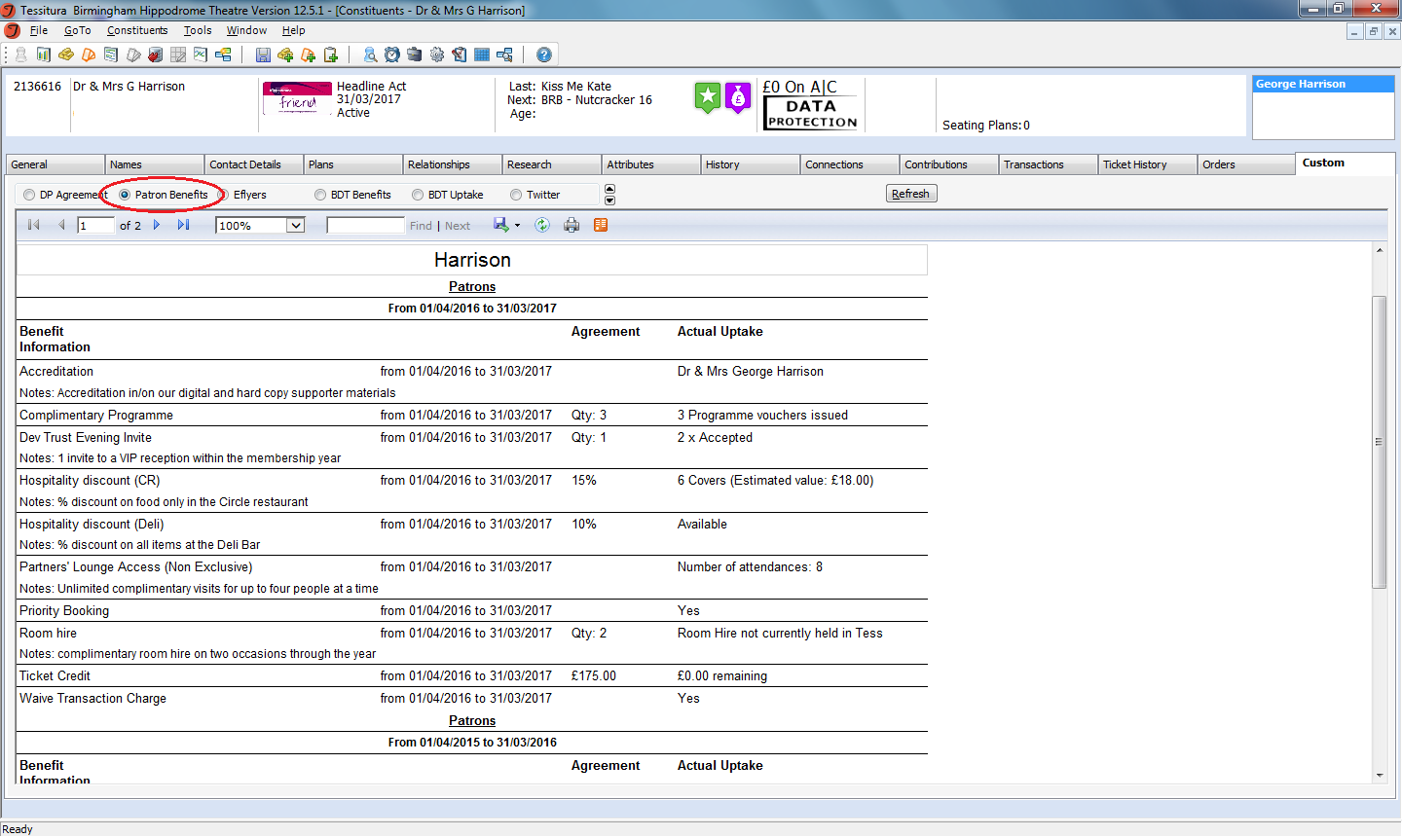
Notes:
On the Patrons Benefits tab – uptake is monitored via…..
Accreditation field – draws from Programme names on Names tab
Complimentary programme vouchers are an item in the product catalogue and issued via an order booking – so this benefit field looks to whether this type of voucher has been issued within the stated membership term
Dev Trust Evening Invite – Looks an specific entries on the Activities tab, where we record invitations to receptions, Hippodrome Creative sharings etc. It shows they have been invited and what they have engaged with, if anything. If they had Declined an invitation, or had been invited that would show too, although it doesn’t yet say which specific reception.
Hospitality Discount (CR) is for our Circle restaurant. This is built to look at the number of reservations made in the restaurant (via the Product catalogue/an order). We then take the average cost of a three course meal and apply the 15% discount based on number of visits, getting an estimated saving.
Partners’ Lounge Access –passes are booked for our members’ Lounge and issued like show tickets, so this field looks at the number of orders made within the membership dates, which should equal the number of visits made.
Ticket credit – this is loaded via an order, drawing payment from one payment type to credit on account, and this benefits field is built to look at this amount on account, drawn down as they use their credit.
This screens/reports have been built by our in house Tessitura IT specialist – we didn’t need to get a consultant to come in. Sarah Stratton is at the conference if you’d like to speak to her about it!

Slide 37
On our wish list
Monitoring the number of tickets they buy at member prices – and the value of money they save
Finding a way to track/record their use of priority booking
Tracking purchases made at the Deli Bar
Room hire currently needs to be manually updated – different
booking systems
Using it in relationship to Gift Aid claims on memberships

Slide 38
“The more people I meet the happier I become.”
QUESTIONS?
Samuel Beckett, Waiting for Godot

Slide 39

WHAT’S NEXT?
TRANSPORT TO
ABBEY THEATRE
Coaches depart now at entry level
Take any items from the cloakroom
Tea and coffee available at the Abbey
CONFERENCE KEYNOTE 16.00-17.00
EVENING NETWORKING EVENT 19.30
Notes:
THURSDAY Breakout session 3 What’s next slide

