Slide 1

TESSITURA
EUROPEAN
CONFERENCE
DUBLIN 2016
Notes:
Welcome

Slide 2



PRESENTER
Simon Davidson : Tessitura Network
ENHANCED TROUBLESHOOTING
IN TESSITURA
NEW TOOLS FOR YOUR TESSITURA TOOLBOX!
Share your favourite content and photos! #TECDublin16

Slide 3
Session Overview
Basic Troubleshooting Techniques
Overview of Tools
Real-World Scenarios
Other Resources

Slide 4
Basic Troubleshooting Methodology
Discovery – Ask questions and gather relevant clues about the symptoms, scope, nature and severity of the issue
Planning – Which tools will you employ?
Reproduction - Make it happen again
Isolation – Distill repro to fewest number off steps and find the source of the issue
Analysis – Determine potential causes and possible solutions or workarounds
Notes:
Here is a basic overview of the steps you might take in troubleshooting an issue. You can engage Network Support at any stage of the process, but the further you can get through these steps on your own, the quicker we’ll likely be able to help you to a resolution if you can’t arrive at it on your own.
Discovery: asking the right questions at the beginning of the process can save loads of time down the line. Common questions when presented with a user issue are:
Is it happening for just one user or all users
Is there an error message presented to the end user?
Did this ever work? If so, what has changed since then?
Is there anything unique about your environment that may be contributing to the issue (custom procedures/plugins/web code, stringent network securities, nonstandard server configuration, etc)
What exactly were you trying to do and what steps did you take to get there?
Planning: armed with information about the nature of the issue, which available tools are most appropriate for uncovering more clues? We’ll be spending more time on this topic shortly.
Reproduction: maybe the most important step. if you can reproduce an issue at will, chances are very good that either you or we will be able to quickly deduce the cause of the issue
Isolation: in this step, we eliminate as many of the variables at work to distill the issue down to its essence, ruling out possibilities until we can hone in on exactly the component that is at fault
Analysis: brainstorm solutions, test your hypothesis
Not shown here, of course are testing and implementing your solution, then documenting it.

Slide 5



Basic Troubleshooting
Work from the back-end to the front
Impresario
(SQL Server)
TessituraService
(REST Service)
Tessitura
(C#, .Net, PowerBuilder)
Seat Server, PGS
(NT Services; C#, .Net, Powerbuilder)

Slide 6
Overview of Tools
ServicesDashboard
Impresario
(SQL Server)
TessituraService
(REST Service)
Tessitura
(C#, .Net, PowerBuilder)
Management Studio
Profiler
Extended Events
Activity Monitor
Sp_blocked
Sp_who2
Sp_whoisactive
Rest Client
Service Log
Client Logs
Seat Server, PGS
(NT Services; C#, .Net, Powerbuilder)
Service Logs

Slide 7
Scenario 1:
Client is Slow or Hung
Notes:
1.
Questions to ask:
- slow for just you or everyone?
- is everyone hung on the same action?
- is network connectivity good?
Moving from front to back:
- are the services responding (Services Dashboard – if anything is marked with a red X, address it)
SQL Server
- sp_blocked or sp_who2
- kill ##
- Activity Monitor/ SQL Server utilization
To reproduce the situation, open a transaction in SSMS to update an address row, then do the same in Tessitura.

Slide 8
What Questions Do You Ask First?
Is it slow for just you or everyone?
Is everyone hung on the same action?
Is network connectivity good?
Are The Services Responding?
Services Dashboard
Respond to any entries with a red X
On to the SQL Server…

Slide 9
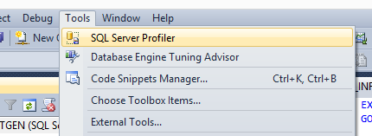
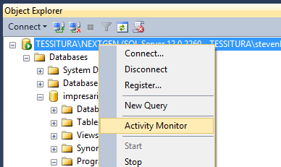
SQL Server Management Studio
Query tool for execution of diagnostic queries:
  Sp_blocked
  Sp_who2
  Sp_whoisactive
Access to additional tools:
  Profiler
  Activity Monitor
  Extended Events
  (SQL 2012+)
  Performance Dashboard

Slide 10
SQL Server Troubleshooting – What’s Running Hot?
sp_who2 – check for blocks and high CPU or I/O
sp_blocked – clear hierarchy of blockers/victims
Activity Monitor – check wait stats and recent expensive queries
If Activity Monitor turns up disproportionately expensive queries/processes, right-click to get more details.

Slide 11
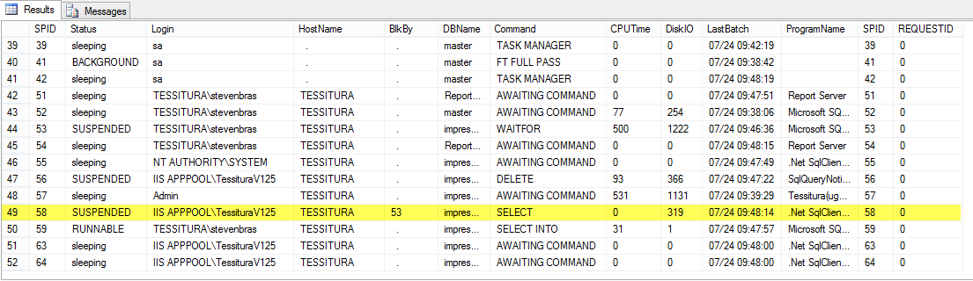
SP_WHO2
View of current processes w/blocks

Slide 12

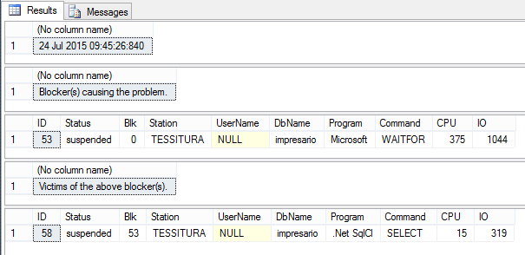
SP_BLOCKED
View of blocks only

Slide 13
Free Third-Party Tools
sp_whoisactive
  A third-party script written by Adam Machanic
      http://sqlblog.com/files/default.aspx
  Wraps SQL Servers DM views to provide a flexible, powerful view of active processes, the resources they’re consuming and what they’re waiting on
  Can be run on an interval and saved to a table for benchmarking
Brent Ozar’s “First Responder Kit”
  Scripts and checklists for triaging
  www.brentozar.com/responder

Slide 14
SQL Server Activity Monitor
View of current state of SQL Server
  Processes
  Resource Waits
  Data File I/O
  Recent “Expensive” Queries

Slide 15
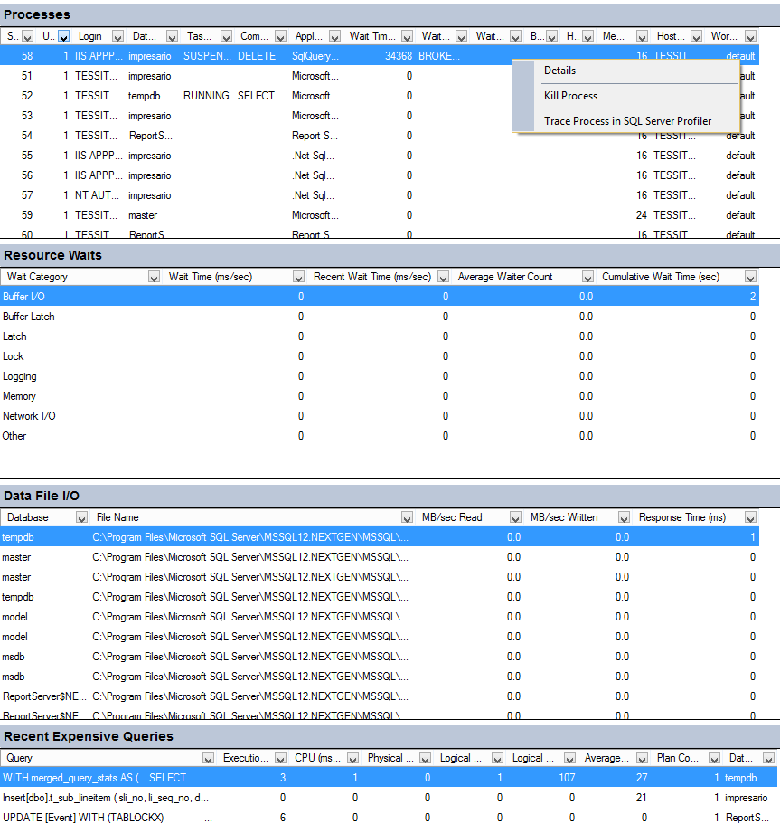
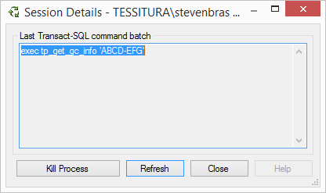

Slide 16
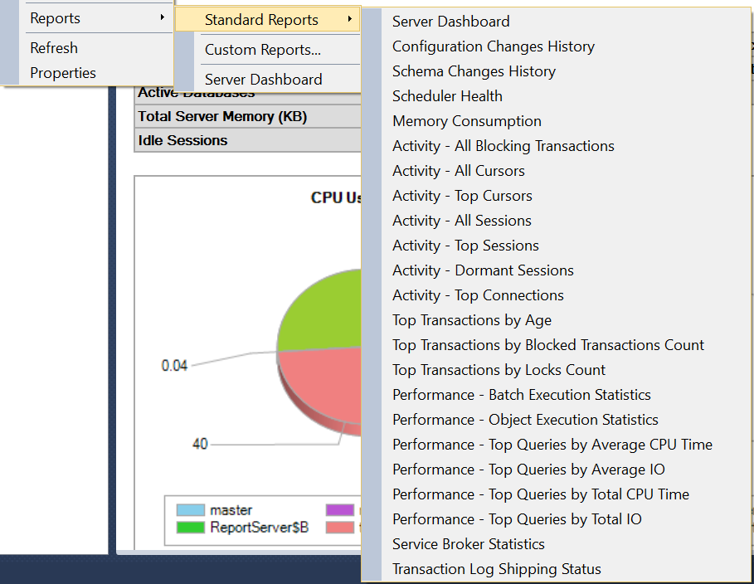
Performance Dashboard Reports
Built-in SSRS reports and graphs

Slide 17
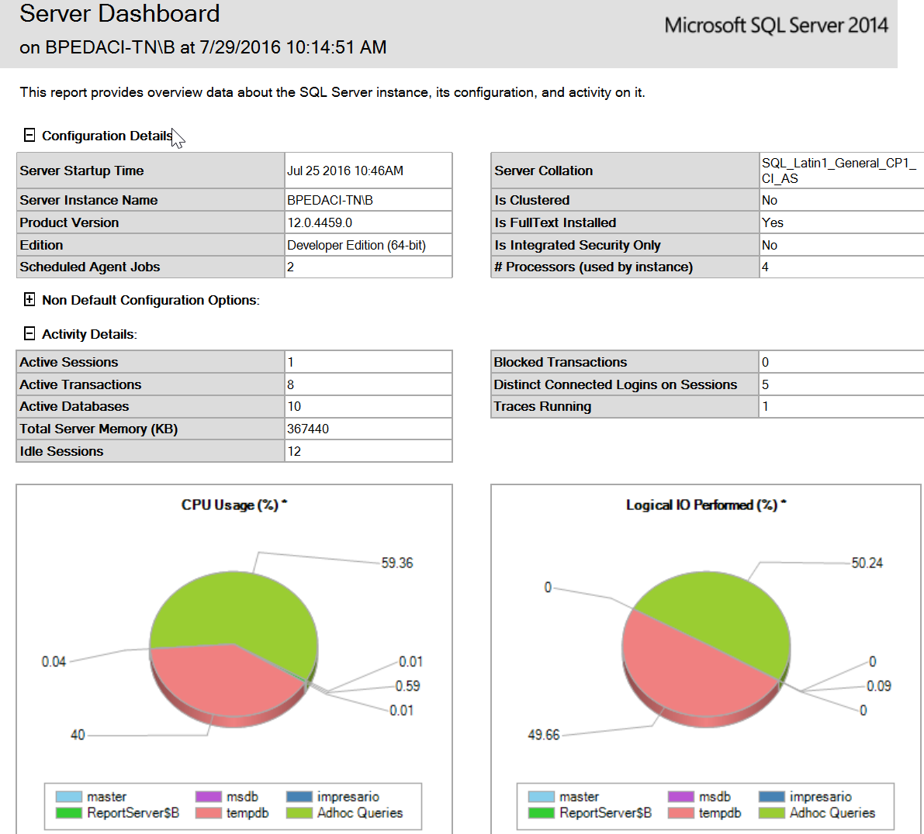
Server Dashboard

Slide 18
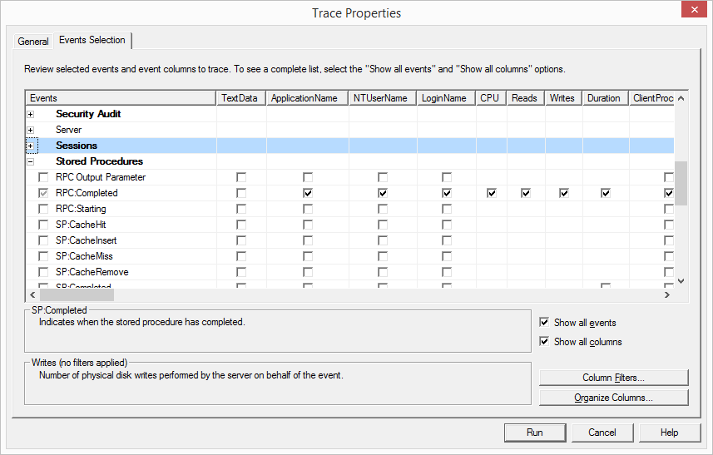
SQL Server Profiler
Configurable SQL logging
  By event and column

Slide 19
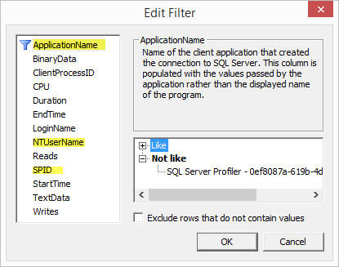
SQL Server Profiler
Configurable SQL logging
  By process, user, SPID

Slide 20
Extended Events
Extended Events is the evolution of Profiler
Faster, lighter, more traceable events
SQL 2012 and above includes a UI for working with/viewing
In SQL 2008, sessions must be scripted, but there is a built-in ‘system_health’ session that can be viewed as XML
Records events to a ring buffer or file

Slide 21
System_Health XE Session
SELECT CAST(xet.target_data as xml) from
sys.dm_xe_session_targets xet
JOIN sys.dm_xe_sessions xe
On (xe.address = xet.event_session_address)
Where xe.name = ‘system_health’
https://blogs.msdn.microsoft.com/psssql/2008/07/15/supporting-sql-server-2008-the-system_health-session/

Slide 22
System_Health XE Session
Includes:
  The sql_text and session_id for any sessions that encounter an error with severity >=20
  the sql_text and session_id for any sessions that encounter a "memory" type of error such as 17803, 701, etc (we added this because not all memory errors are severity >=20)
  A record of any "non-yielding" problems (you have sometimes seen these in the ERRORLOG as Msg 17883)
  Any deadlocks that are detected
  The callstack, sql_text, and session_id for any sessions who have waited on latches (or other interesting resources) for > 15 seconds
  The callstack, sql_text, and session_id for any sessions who have waited on locks for > 30 seconds
  The callstack, sql_text, and session_id for any session that have waited for an extended period of time for "external" waits or "pre-emptive waits".

Slide 23
Scenario 2:
XML Parsing Error When Searching
For a Constituent
Notes:
Possible scenario 1:
Alternate scenario: Controller_pricing_grid.gettemplates.10: Object reference not set to instance of an object on
Opening price templates screen when selecting zone map (referencing non-existent zone in T_TEMPLATE_PRICE, see TASK #58852)

Slide 24
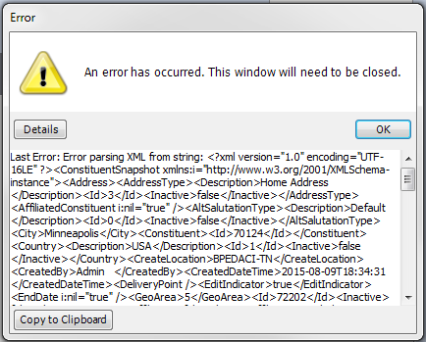
User Complaint:
“When I search for a customer with a particular last name, I get an error message and get kicked out”
When Reproducing, You See This:
Notes:
To reproduce, update T_CUSTOMER set mname = NCHAR(0x08) where customer_no = #####
(Vertical Tab character in Middle Name field)
Troubleshooting step candidates
REST client to pull snapshot for customer 70124 (See hex control character in mname field)
Request/Response service log (
Copy error message to Notepad++, Validate XML
To resolve:
- Fix field or run UP_FIND_INVALID_CHARACTERS @fix_data = ‘Y’

Slide 25
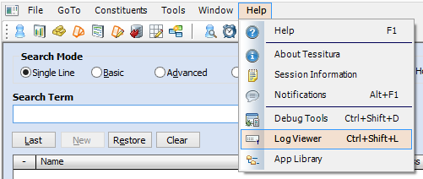
Tessitura Log Viewer

Slide 26
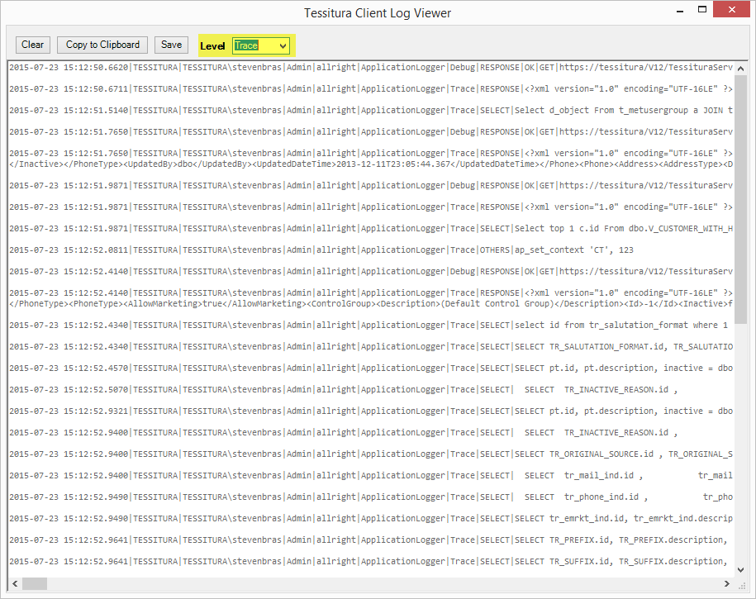
Tessitura Log Viewer

Slide 27
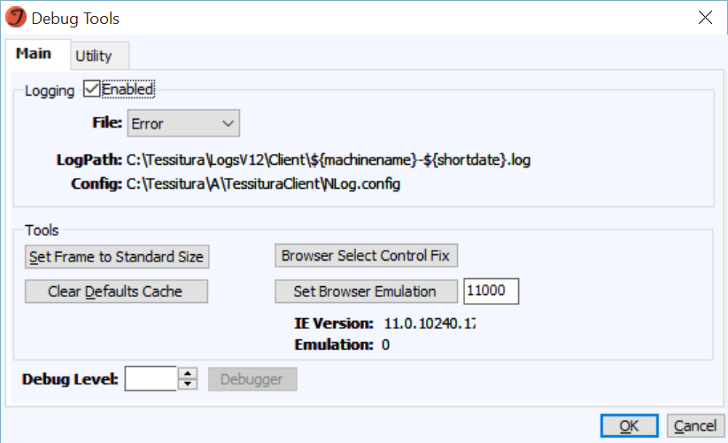
Debug Tools

Slide 28
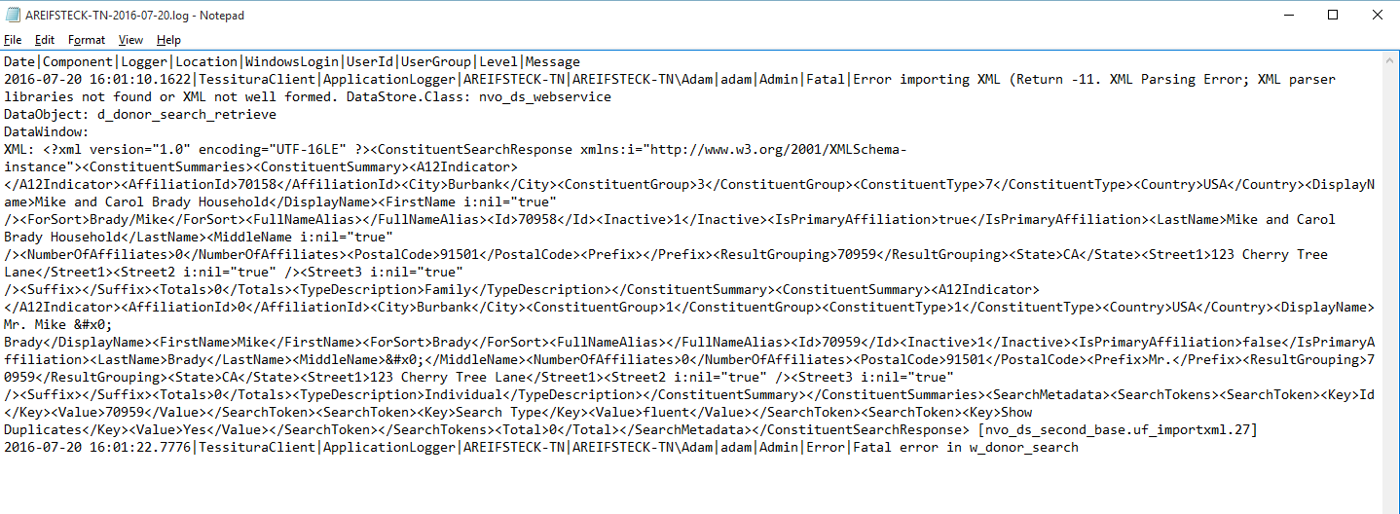
Client Logs

Slide 29
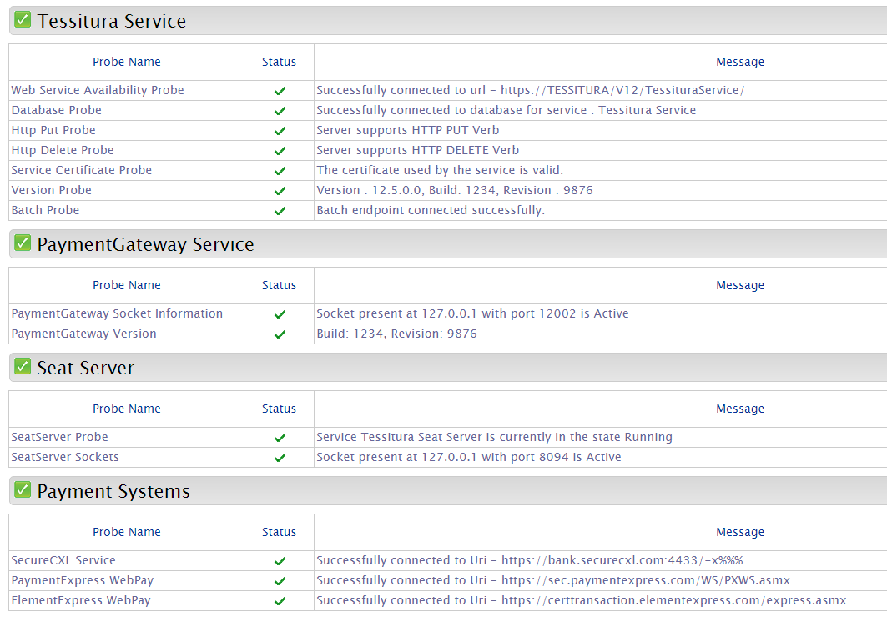
Services Dashboard
https://servername/.../servicesdashboard

Slide 30
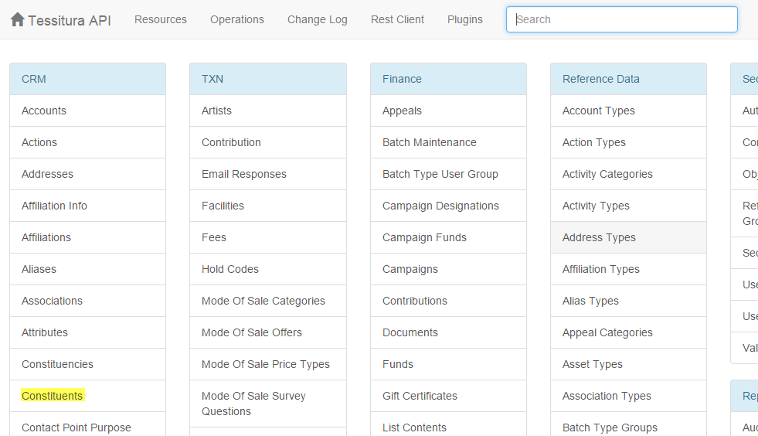
REST Client
Makes direct calls to service endpoints and displays results

Slide 31
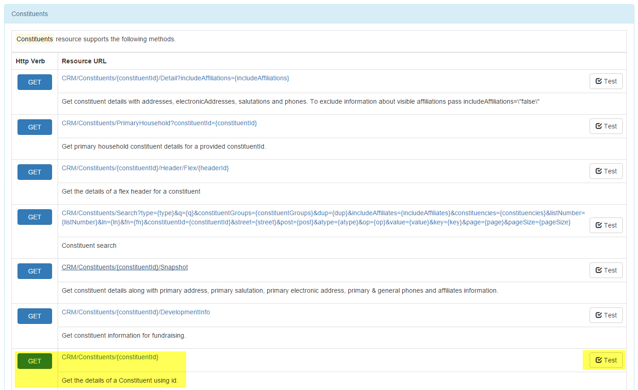
REST Client

Slide 32
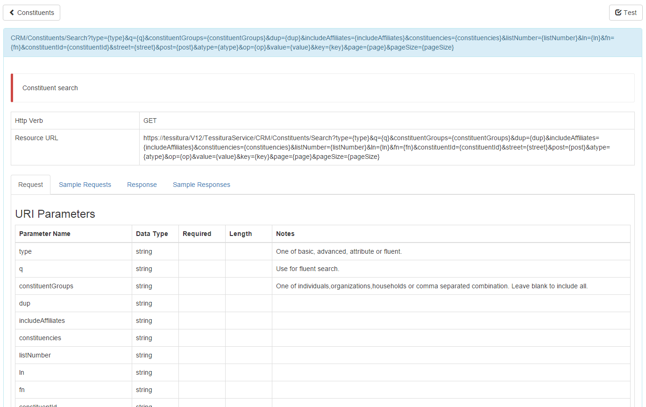
REST Client

Slide 33
REST Client

Slide 34
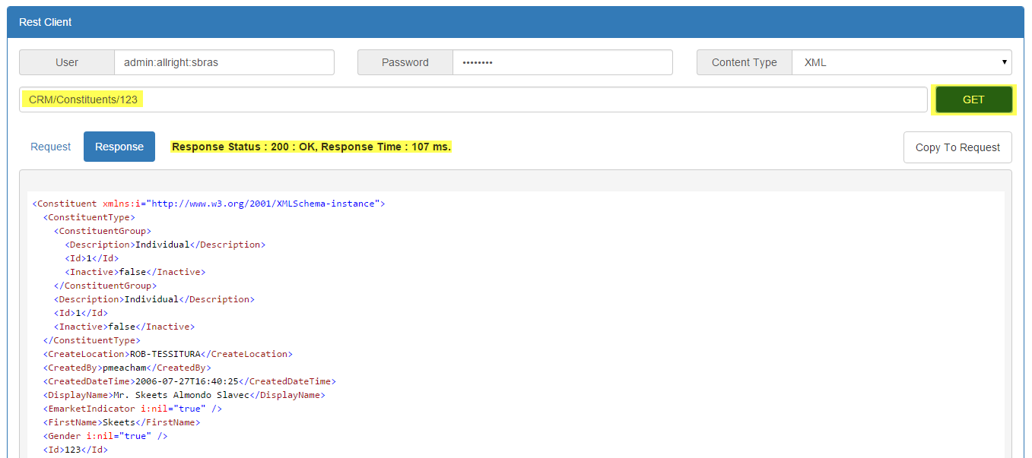
REST Client

Slide 35
Logs
Written by “Nlog”
  Tessitura REST service
  Payment Gateway Service
  PrintServer service
  Tessitura application
  Controlled by “Nlog.config” file
Non-Nlog
  SeatServer
  “TessituraSeatServer.exe.config”

Slide 36
Nlog.Config/Targets
<targets>
<target name="file" xsi:type="File" fileName="C:\Tessitura\Services\PrintServer\Logs\${shortdate}.log"
layout="${longdate}|${level}|${message}"
createDirs="true"
fileAttributes="Normal"
archiveFileName="C:\path\Logs\${shortdate}.{#####}.log"
archiveEvery="Hour"
maxArchiveFiles="200"
archiveNumbering="Sequence"
concurrentWrites="true”
keepFileOpen="false" />
</targets>

Slide 37
Nlog.Config/Rules
<rules>
<!-- minlevel could be one of Trace, Debug, Error or Fatal. Should be Error or Fatal for production -->
<logger name="*" minlevel="Trace" writeTo="file" enable="true"/>
</rules>
Notes:
Show XML validation in Notepad++

Slide 38
Scenario 3:
Scheduled Report Not Received

Slide 39
Report Logs
Batch Report Server log file
  Viewed within Batch Report Server or in ‘logpath’ from gsrbatch.ini
Gooesoft_request – result_code and result_text
T_log_report_email – send_status 0 is success, -1 failure
Msdb.dbo.sysmail_allitems – can show DBMail issues
TessituraWeb service log – can reveal more info on SSRS requests
For InfoMaker requests, check Sybase Datawindow PS Printer – log into Tessitura on Report Server and save a report as PDF to email folder

Slide 40
SSRS Logging
ReportServer.dbo.ExecutionLog3 View
  Scheduled requests will have ItemPath /Tessitura/ScheduledReports/lnk_{reportname}_{schedule_ID}
  Generally two lines – one for the data retrieval, one for the report rendering
SSRS Logs – In Program Files\Microsoft SQL Server\MSRS##\LogFiles
In T_DEFAULTS, set DELETE FILE = N to confirm attachment is being successfully generated in Email Report Folder

Slide 41
Scenario 4:
Payment Processing Errors

Slide 42
Troubleshooting Steps
Who? What? Where? When? Why?
Review Payment Gateway Service log from the time the transaction occurred
T_CC_SERVER_LOG
  Key fields are
    Transaction Type
        P (sometimes A) for Authorization
        B - Finalized/Complete
        V – Reversal (void when order cancelled)
        D – Refund requested
        C – Refund finalized/complete
        S – Refund Reversal
Notes:
Payments can

Slide 43
Troubleshooting Steps
T_CC_SERVER_LOG
  Types of Errors
    Timeouts
      The underlying connection was closed: A connection that was expected to be kept
    Communication issues
      Error retrieving response, resulting in communications/system reversal
Notes:
Payments can

Slide 44
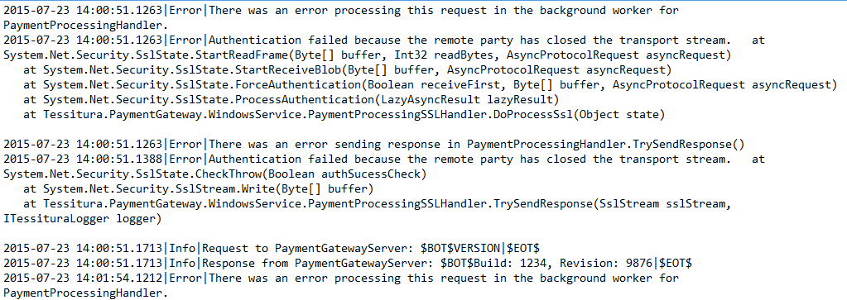
Payment Gateway Logs

Slide 45
Why Was There No Completion
(or Reversal?)
Did Tessitura crash before the order was saved (or did the user exit ungracefully?)
Check the T_APPLICATION_ERRORS table or run the Application Error Report
Compare the processor response in the log with a successful transaction.
  There may be a successful authorization matched with a processor response that caused the Payment Gateway to interpret it as a failure.

Slide 46
Resources
Knowledgebase
Technical Support & Escalation
Forums

Slide 47
QUESTIONS?
“If you can’t appreciate what you’ve got, you’d better get what you can appreciate.”
George Bernard Shaw, Pygmalion
Notes:
Welcome

Slide 48

WHAT’S NEXT?
BREAK 14.00-14.15
Hogan Foyer / Level 6 Foyer
BREAKOUT SESSION THREE
14.15-15.15
Notes:
THURSDAY Breakout session 2 What’s next slide

