Slide 1

TESSITURA
EUROPEAN
CONFERENCE
DUBLIN 2016
Notes:
Welcome

Slide 2



PRESENTERS
Paul O’Sullivan : Southbank Centre
Claire Baker : Royal Albert Hall
CONTENT PLANNER
Rog Hildreth : Royal Northern College of Music
THE RIGHT DATA TO THE RIGHT PEOPLE AT THE RIGHT TIME
From Day to Day Decision-Making to Reporting to the Very Top
Share your favourite content and photos! #TECDublin16

Slide 3

The Right Data to the Right People at the Right Time
P2P Presentation | Claire Baker
Thursday 17th November 2016

Slide 4
Claire Baker
Insights Manager
Royal Albert Hall

Slide 5
The Right Data to the Right People at the Right Time
From Day to Day Decision-Making to Reporting to the Very Top
How do you ensure that everyone’s getting the data they need in the most appropriate format?
What are the options available and how do you choose which is the best one?
Should you control information-flow and access to data or should data be truly democratised?
Notes:
Come and hear how others are answering these questions and managing data across their organisations. We’ll cover Tessitura reports, T-Stats, Dashboards and beyond.
What I am driving at is that the possibilities are limitless once you are able to get the right data made available to the right people at the right time and empowering your employees to make decisions that are right in that moment.
And this is something that can be done right away, without any additional information, just by tweaking the existing information and making it available.
What this also hints at is that before organizations like this airline start looking at big data and data mining, they should start with the small data that they already have and use it well.

Slide 6



Data, data everywhere!

Slide 7


Along come Lindsay and me!
Lindsay Smith
Application Support Manager
Claire Baker
Insights Manager

Slide 8
The answers people want
Who is booking which shows?
What uplifts do we see when comms go out? E.g. what happens to web visits when an email goes out? What happens to social when we get PR coverage?
What additional services are demanded? E.g. provisions in catering
How satisfied with their visit are customers?
What is the crossover between shows?
How often do people book?
When do people book? DoW, ToD, lag time
How much do people spend on merchandise?
Who should we target for which events?
What do people want to see at RAH?
Where are people when they buy? Mobile vs. desktop
How are people buying? Online vs. telephone vs. walk up
How much do people spend in the restaurants?
What should we communicate to different audiences? (content)
How much do people spend in the bars?
Why do people book?
Notes:
How do visitors want to experience the Hall?
We’ve started by gathering all the key questions that people from across the organisation want to know the answers to, prioritising them and working out what is achievable

Slide 9
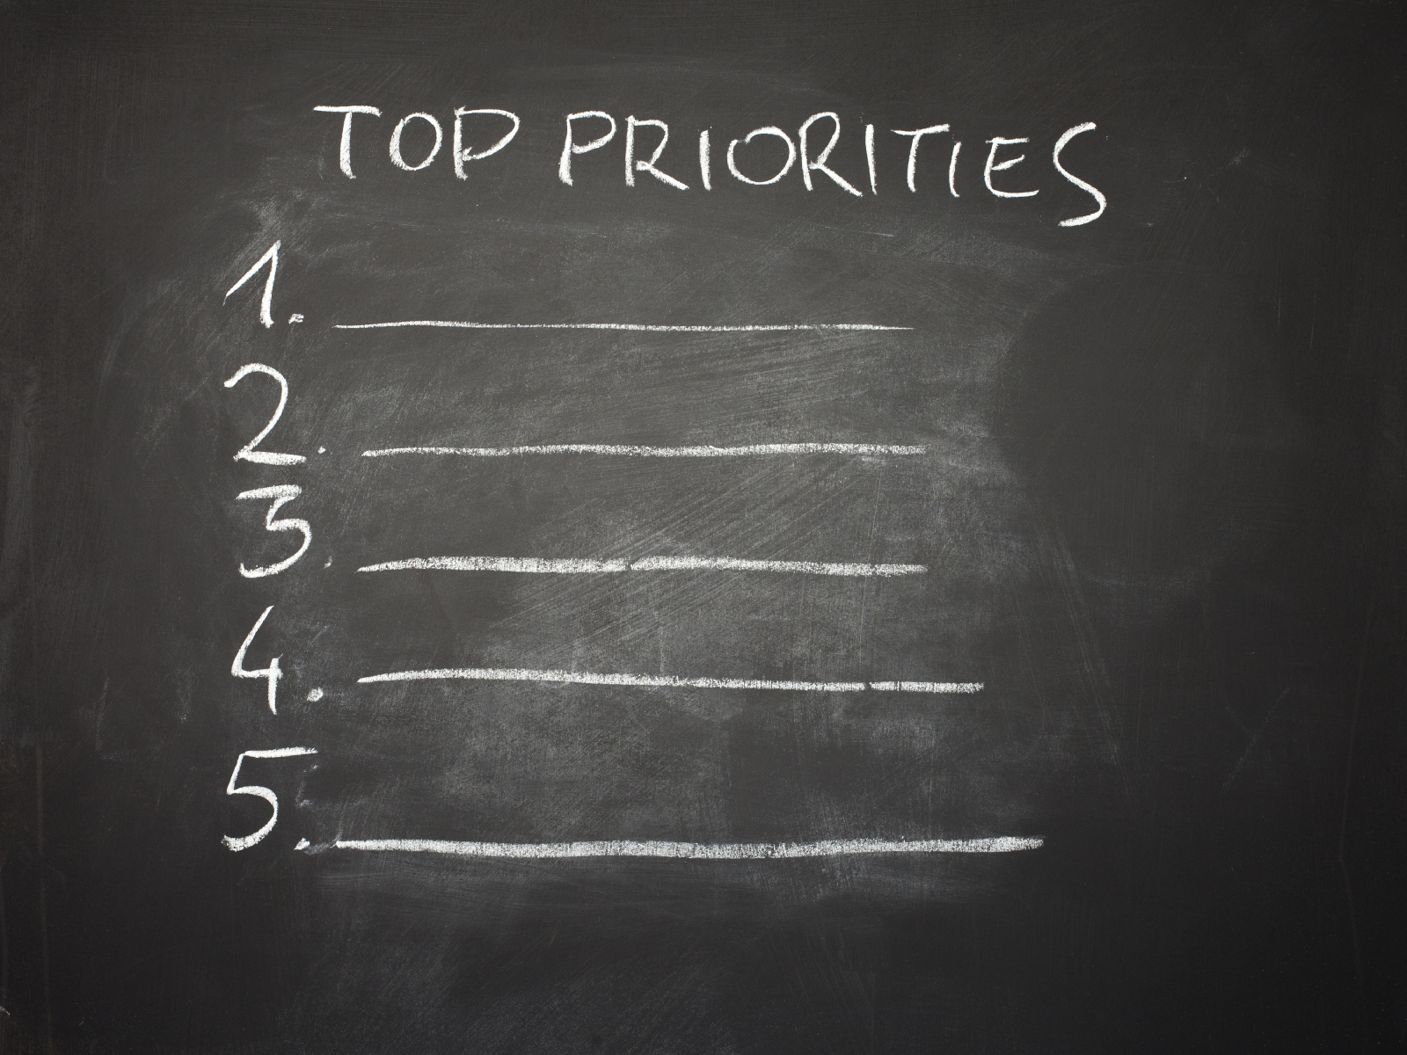
What do we do first?

Slide 10
So what have we done so far?

Slide 11
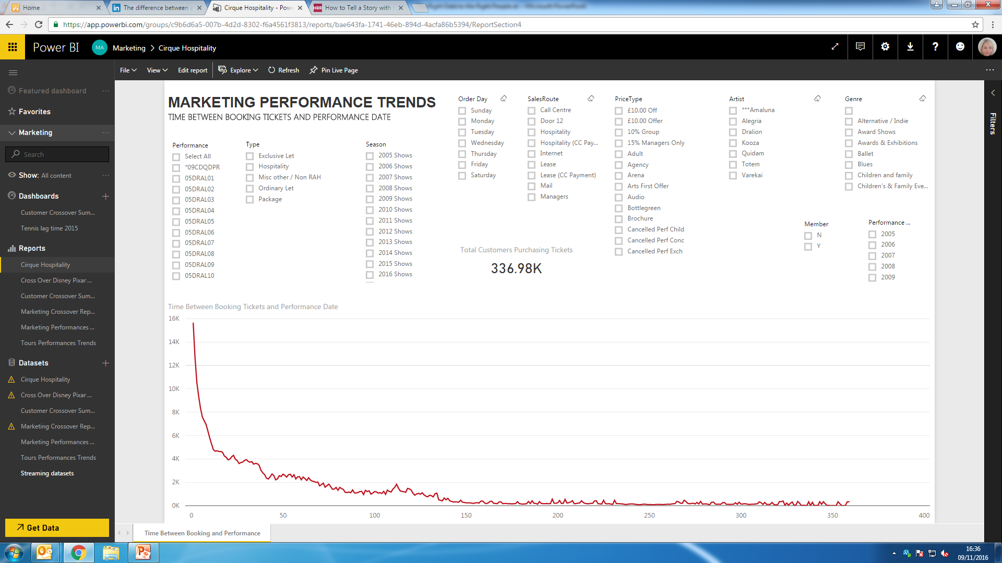
Total sales by year, genre, artist, season…

Slide 12
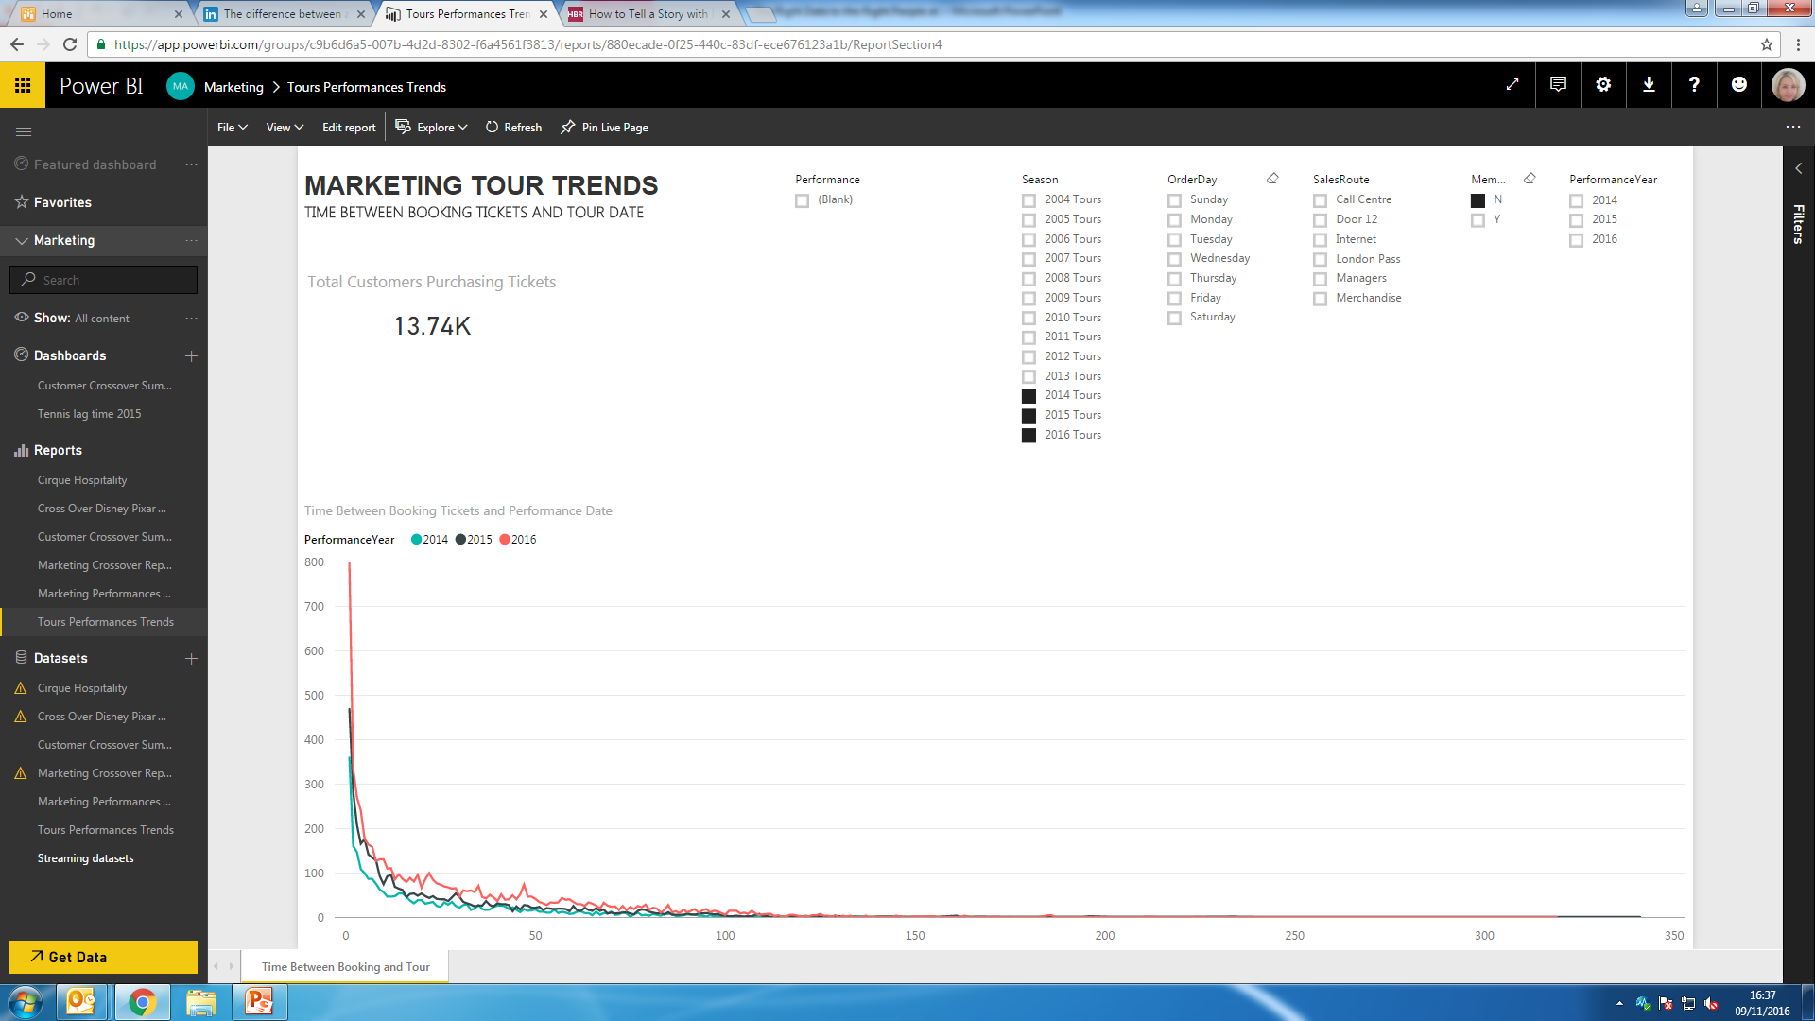
Lag time reporting

Slide 13
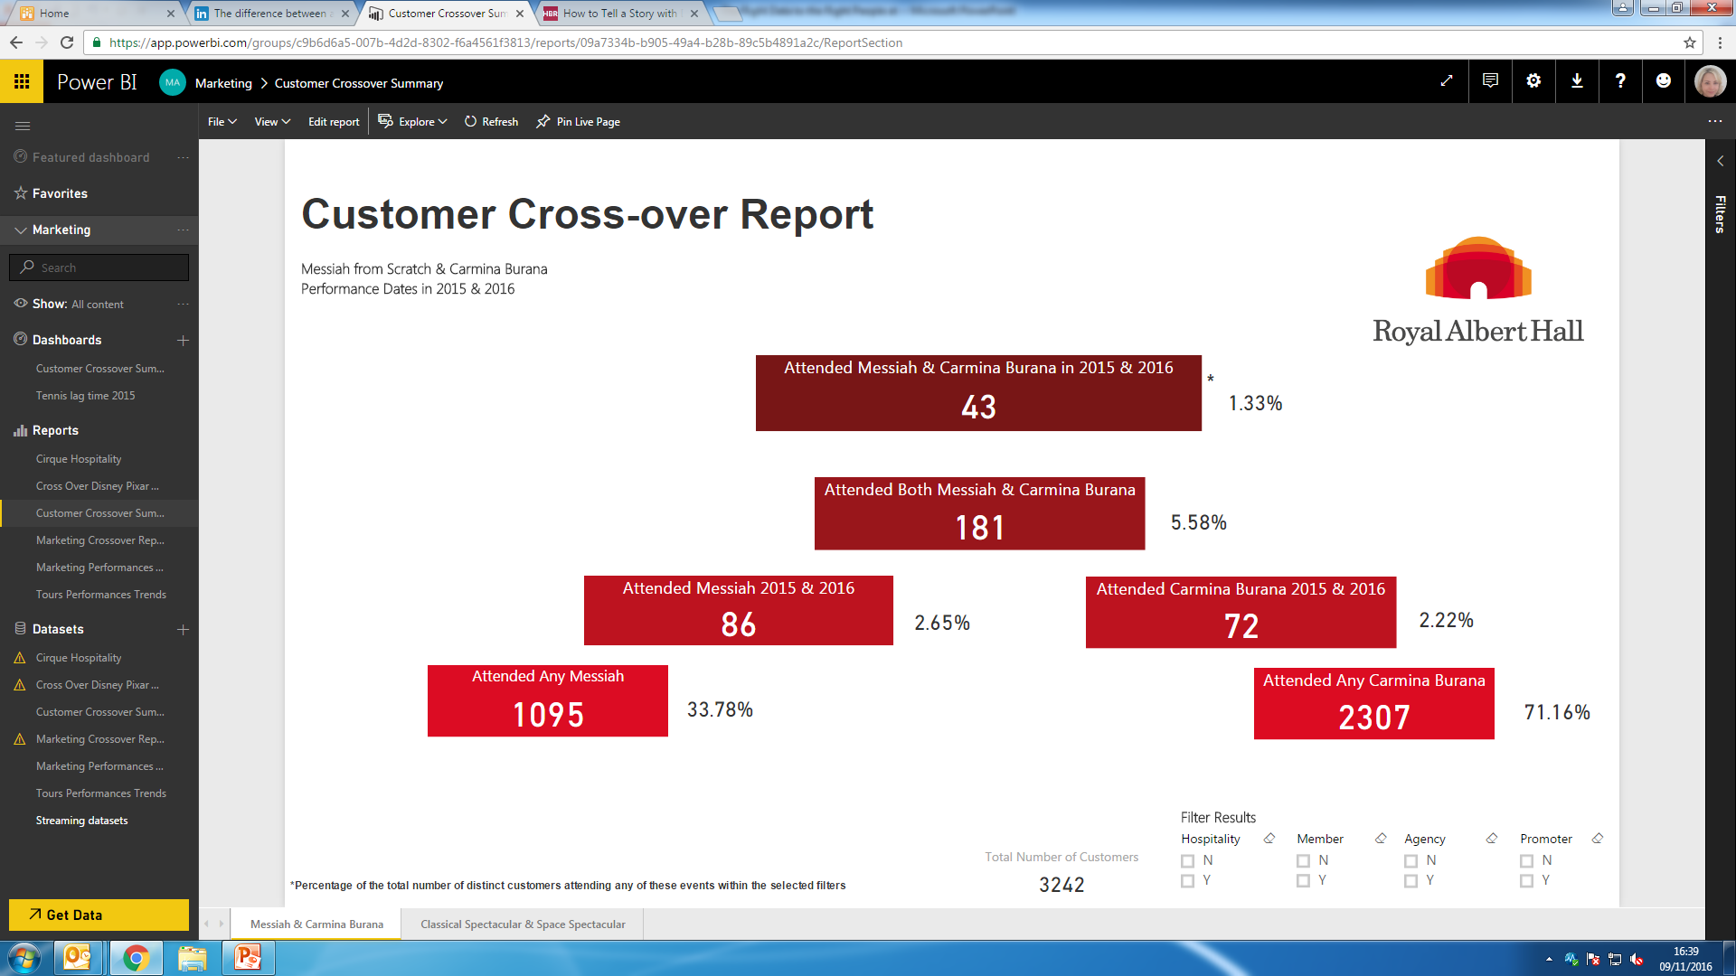
Crossover reporting
Both Show & Show 2 2015 & 2016
Both Show & Show 2
Show 1 2015 & 2016
Show 2 2015 & 2016
Show 1
Show 2

Slide 14
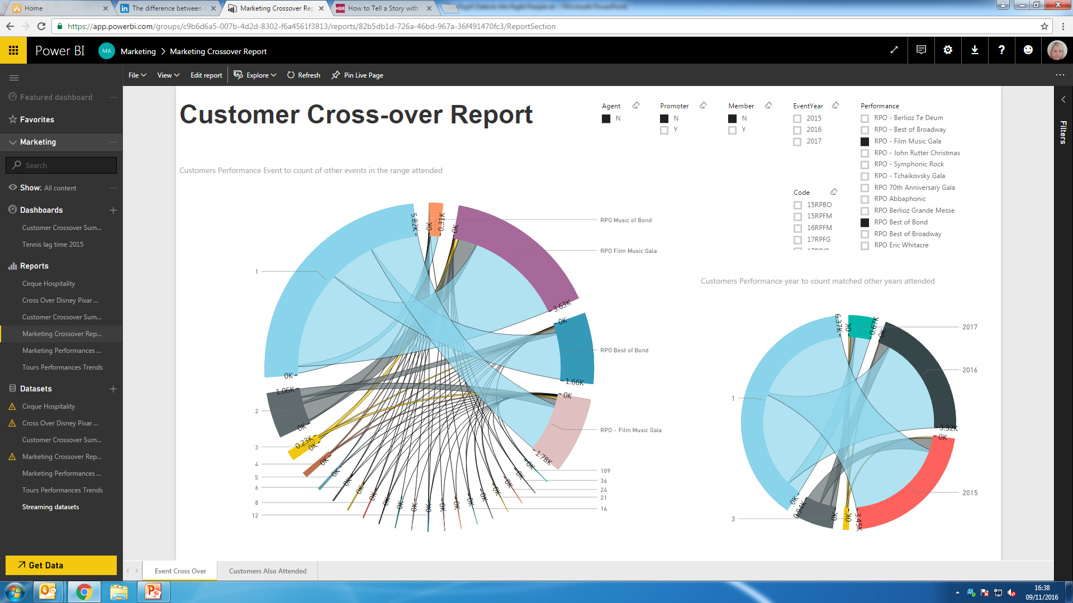
Crossover reporting

Slide 15
How do we plan to share all this?

Slide 16
Metrics, KPIs and insights
Objectives
KPIs
Metrics
Goals
Vision

Slide 17

Insights are built, not uncovered

Slide 18
Stories are more likely to be remembered
RETENTION RATE
=
5-10%
Statistics
65-70%
+
=
Statistics
Anecdotes
Source: Stanford
Notes:
Appropriate format
Dashboards vs reports vs storytelling
The link between memory and stories is tightly woven. You can’t understand story without understanding memory. Our evolution has gifted us with some interesting memory quirks including our natural urge to preference a complete story over one where essential parts are missing.
http://www.anecdote.com/2015/01/link-between-memory-and-stories/
Studies show that we are wired to remember stories much more than data, facts, and figures. However, when data and story are used together, audiences are moved both emotionally and intellectually. Aaker demonstrates the importance of stories in shaping how others see you and as a tool to persuade. Harnessing the power of stories will enable you to be more persuasive, move people to action, and progress into your career.

Slide 19
Audiences and what turns them on
“Prove it makes a difference”
Board
Senior
“Give me something to manage with”
Frontline
“What do I need to differently tomorrow?”
Notes:
Firstly, understanding that different audiences internally want and need different things.
Reporting to the very top means keeping data focussed, relevant and concise, and showing how it has made or can make a difference. So going to the board and
From Day to Day Decision-Making to Reporting to the Very Top

Slide 20
So how do we deliver data and insights?
 | 1 | 2 | 3
Jan | 93 | 85 | 67
Feb | 102 | 40 | 49
Mar | 99 | 78 | 130
Controlled
Information
Democratised
Data

Slide 21
In conclusion…
From Day to Day Decision-Making to Reporting to the Very Top
How do you ensure that everyone’s getting the data they need in the most appropriate format? Constant conversation, testing and refinement
What are the options available and how do you choose which is the best one? We have found the dashboard interface to be most useful to extract data, however, there are different dashboards for different uses and users
Should you control information-flow and access to data or should data be truly democratised? As usual in life, it’s all about striking a balance and knowing your audience

Slide 22
Thank you

Slide 23
QUESTIONS?
“If you can’t appreciate what you’ve got, you’d better get what you can appreciate.”
George Bernard Shaw, Pygmalion
Notes:
Welcome

Slide 24

WHAT’S NEXT?
BREAK 14.00-14.15
Hogan Foyer / Level 6 Foyer
BREAKOUT SESSION THREE
14.15-15.15
Notes:
THURSDAY Breakout session 2 What’s next slide

