Slide 1

TESSITURA
EUROPEAN
CONFERENCE
DUBLIN 2016
Notes:
Welcome

Slide 2



PRESENTERS
Elaine Mannion : Abbey Theatre
Donna Scott : Birmingham Hippodrome
Fiona Joseph : National Theatre
Branding and Promoting your Membership Scheme Internally and Externally
CONTENT PLANNERS
Helen Fahey : Abbey Theatre
Victoria O’Brien : Roundhouse
Share your favourite content and photos! #TECDublin16

Slide 3
Transactional Membership
Elaine Mannion - Sales & Ticketing Manager
Email: elaine.mannion@abbeytheatre.ie
Phone: 00353 1 879 7212

Slide 4
DeVos Model
Great Art
Marketing
Family
Revenue
Abbey Theatre

Slide 5
Institutional Marketing
In January 2014, the Abbey Theatre closed its doors for three Mondays, and took its production of The Risen People, a play about the 1913 Lockout, into various communities
around Dublin.
Of note, the work was performed for inmates at Wheatfield Prison, the first such performance in Abbey Theatre history. This performance was also a prime example of what the Institute would signify as an institutional marketing event; it was a performance, yes, but also a strategy designed to drive home the Abbey Theatre’s commitment to stimulating debate and engagement through work of social relevance.
The startling and uncommon undertaking of a performance in this setting was enough for the marketing and development departments to turn the moment into their advantage.

Slide 6
The Result
This coordination of the marketing and fundraising efforts represented a major turning point in the productivity of these two essential functions. For the first time in the institution’s history, the two departments are thinking as one, with the ultimate goal of expanding its “family” of donors and sponsors.
The event showcased the quality and relevance of the Abbey Theatre programming to its invited guests, but also presented potential donors with an exclusive opportunity to see the impact of the Abbey Theatre’s mission in action in an unconventional community setting.

Slide 7
Rethinking our existing individual schemes
We surveyed existing members and non members and asked them what they wanted
We redesigned our individual giving schemes based on audience feedback
We were mindful of membership benefits; they should never exceed the cost of becoming a member
We brought transactional membership under the box office umbrella; point of sale interactions with customers is where the majority of our membership sales comes from

Slide 8
Making membership truly special
Abbey Theatre Membership is about engaging with our audience (family) so they become advocates for our work
With discounted tickets making our stages more accessible and the opportunity to attend special members’ gatherings and gain behind-the-scenes insights, we are opening up the doors and inviting our audience to connect with us in a way that is more personal.
We have a wide and varied range of memberships which include access to talks, workshops, demonstrations, dress rehearsals amongst other benefits
We organise 6-8 members’ events per year, normally to coincide with an Abbey stage preview so our members can avail of their half-price tickets. These members’ events include
props department tours
costume department tours
voice workshops
drama workshops
talks from our production and stage management teams
a talk from our casting director

Slide 9
Transactional membership from €10 - €500
Seniors Club €10 – senior citizen /retired – new membership scheme with a focus on selling at the box office.
Cameo Club €10 – student / U26 membership /equity members – we spend a great part of the month of September targeting colleges and sending out packs to lecturers to share with their students, many of our student members come from the drama colleges/courses around the city. We also send out information to agencies to pass on to their actors.
Chorus €25 – whilst this doesn’t include very much engagement with monthly newsletters only, we are making the Abbey accessible by offering €10 tickets and bar and cafe discounts to this particular group.
Ensemble €60 – with this membership we are opening the doors and inviting our members in to see what we do and how we do it with a members event for every show as well as discounted tickets. (Joint membership also available.)
Company €150 – at this level members get 2 complimentary tickets and a drinks reception with our artistic director, with this offering we tend to attract people who are very much interested in the history and future programming of the Abbey. (Joint membership also available.)
Leading Role €500 – this membership includes some of our greatest supporters, this level is comprised of passionate and invested theatre lovers. We invite our Leading Role members in to see our dress rehearsals where they get to mingle with the creative teams and see the work in its final stages of production before it opens to the general public.

Slide 10
Tangible Benefits…..
 | Seniors Club (over 65/ retired) (€10) | Cameo Club (Student / U26) (€10) | Chorus (€25 ) | Ensemble (+ 1) (€60/€120) | Company (+1) (€150 / €280) | Leading Role (€500 )
½ price (€9 or €10) preview tickets |  | Yes | Yes | Yes | Yes | Yes
10% discount at the bar or coffee shop. | Yes | Yes | Yes | Yes | Yes | Yes
Members’ Updates | Yes | Yes | Yes | Yes | Yes | Yes
Invitations to Members’ Evenings. | - | - | - | Yes | Yes | Yes
Priority booking | Yes | - | Yes | Yes | Yes | Yes
Up to 15% off tickets | - | - | - | Yes | Yes | Yes
Special senior discounts | Yes | - | - | - | - | -
Seniors tea & coffee events | Yes | - | - | - | - | -
Name featured in selected programmes | - | - | - | - | Yes | Yes
2 Complimentary tickets | - | - | - | - | Yes | Yes
An evening with the Director | - | - | - | - | Yes | Yes
Access to selected dress rehearsals |  |  |  |  |  | Yes

Slide 11
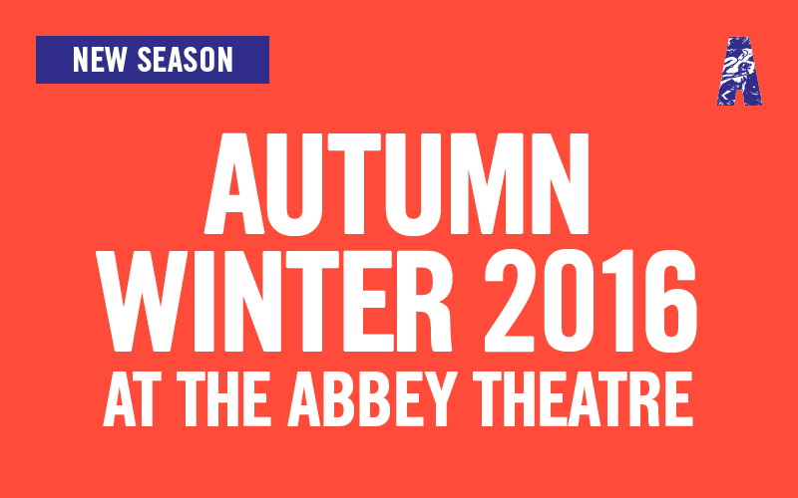
Sample priority booking message
Dear Elaine,
I am delighted to announce to you our Autumn Winter programme for 2016.
Fiach Mac Conghail's final season as director of the Abbey Theatre includes new plays by Carmel Winters, Frank McGuinness and Marina Carr.
Alongside these world premieres we present exciting performances from Penny Arcade, Aoife McAtamney, THEATREclub and An Taibhdhearc.
Members' priority booking is now open so be sure to get the best seats first!
I look forward to seeing you at the Abbey soon.
Warm regards,

Slide 12
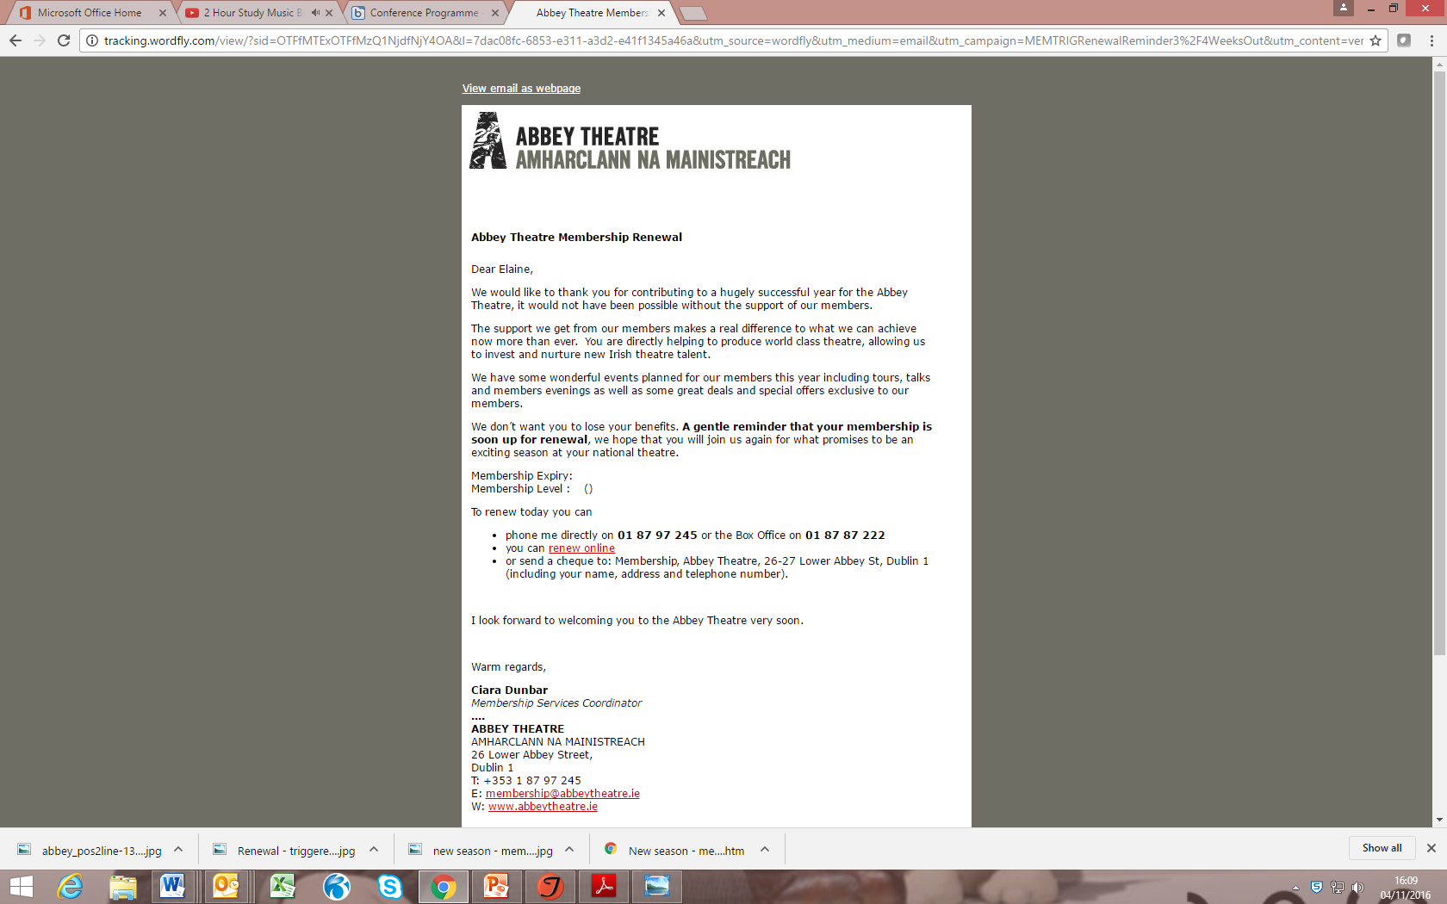
Triggered renewal reminders
Gives us time to engage with our audience by automating a repeat task

Slide 13
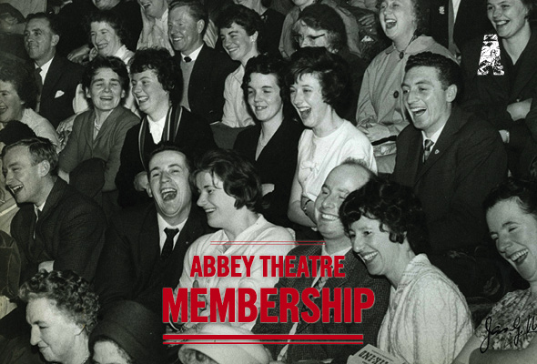
Triggered email - repeat visitor
Dear Elaine,
As a regular visitor to the Abbey Theatre we would recommend taking out a year long membership that will save you money and give you more access and engagement.
Click here to see a full list of memberships.
Membership can be purchased online via the link above or over the phone.
For queries phone 01 87 87 222 or 01 87 97 245.
Warm regards,

Slide 14
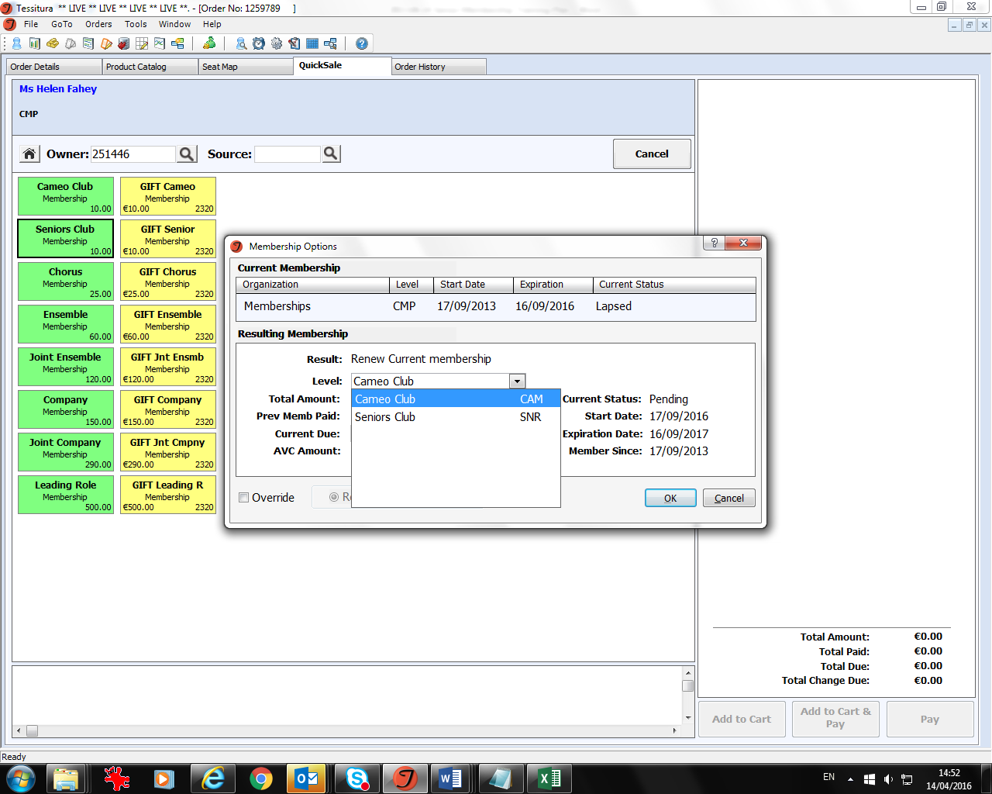
Set up our membership schemes on Quick Sale

Slide 15
cross selling membership at box office
We add a member prospect attribute in the order header so the box office staff can start a conversation about getting the best seats during priority booking and value for money ticket prices throughout the year
Our seniors and cameo club memberships in particular are easy asks on the door
Our box office team are multi-skilled and often conduct backstage tours. If there’s a cross selling opportunity about the story of our venue, we’ll take the time to explore it.
During priority booking, we upsell membership to general bookers
At Christmas, we cross sell membership when a customer enquires about gift vouchers
For the month of December, the membership coordinator works from box office to support the team in identifying membership sales opportunities
Staff flag potential new higher level donors to the development team for further engagement

Slide 17
If you’d like to get in contact….
Elaine Mannion - Sales & Ticketing Manager
Email: elaine.mannion@abbeytheatre.ie
Phone: 00353 1 879 7212
Notes:
S & CS and Communications team work together so strategies complement sales and marketing objectives

Slide 18


Friends Memberships
Donna Scott
Information & Sales Manager
Ryan Allen
Information & Sales Supervisor (Systems)
Notes:
Good morning/afternoon everyone, I’m Donna Scott, Information & Sales Manager for Birmingham Hippodrome. I’d like to introduce to my drinking buddy Ryan Allen who is our Systems Supervisor.
Ryan will say hello
Today we’d like to cover;
Overview of our memberships.
Communication and teamwork
Upselling.Incentives and team motivation.
How we use Tessitura
The future of our membership up selling
We promise it won’t be death by PowerPoint!...

Slide 19
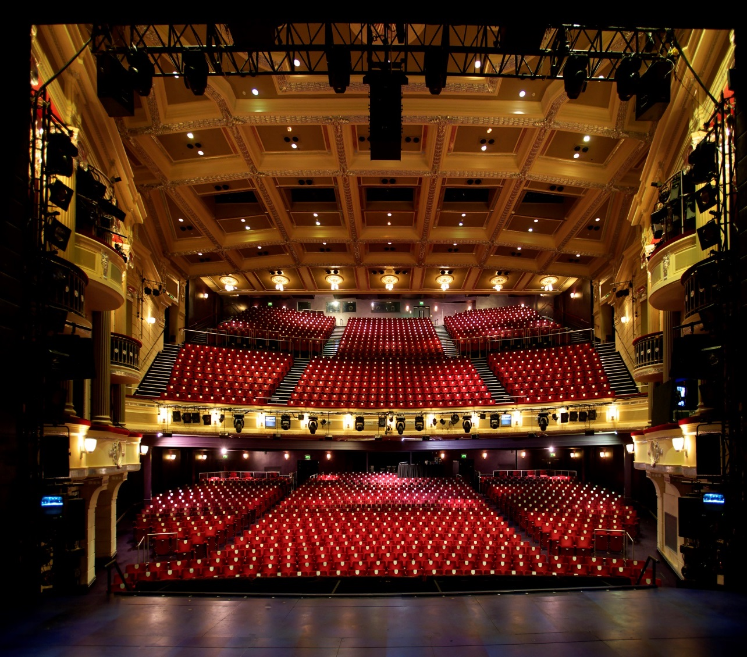
Notes:
We are lucky to work for Birmingham Hippodrome
Busiest single theatre in the UK
We Welcome around half a million attendees annually for musicals, Ballet, Opera, Dance, Comedy, panto and for our off site events
We are a independent, not for profit, registered charity
Our main auditorium seats 1847
Our building also houses the 200 seat Patrick centre for the performing arts, as well as extensive in house conference and our own restaurant.

Slide 20
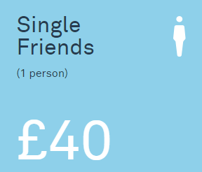
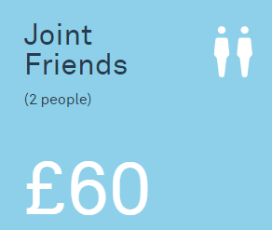
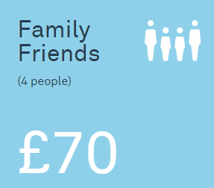
Friends Memberships
Notes:
As a charity with no public revenue funding, Birmingham Hippodrome receives generous support from the business community through sponsorship and other partnerships; from individuals through donations and also our memberships;
Three levels of membership
Single 1 person, joint 2, family/friends 4 people
We currently have 3095 constituents in our friends scheme
Why become a friend of Birmingham Hippodrome
Our Benefits include:
Save over £400 on tickets and dining (4 tickets for every show and CR and fee saving)
Priority Booking
Friends Hotline
Great Ticket savings
2 for 1 offers on opening nights where possible for specific shows
£5 £A+A & £6 B – D
We do at points have to impose ticket limits on friends discounts – not always popular
We add free additional months as an incentive to customers to increase memberships at times to help with any queries/complaints
No transaction charge ‘where a friends discount is applied’
Newsletter

Slide 21
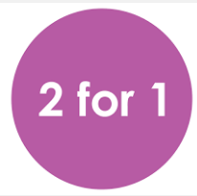
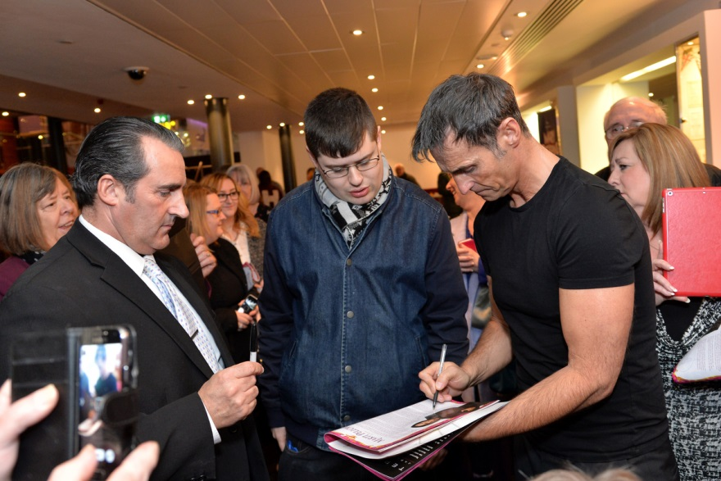
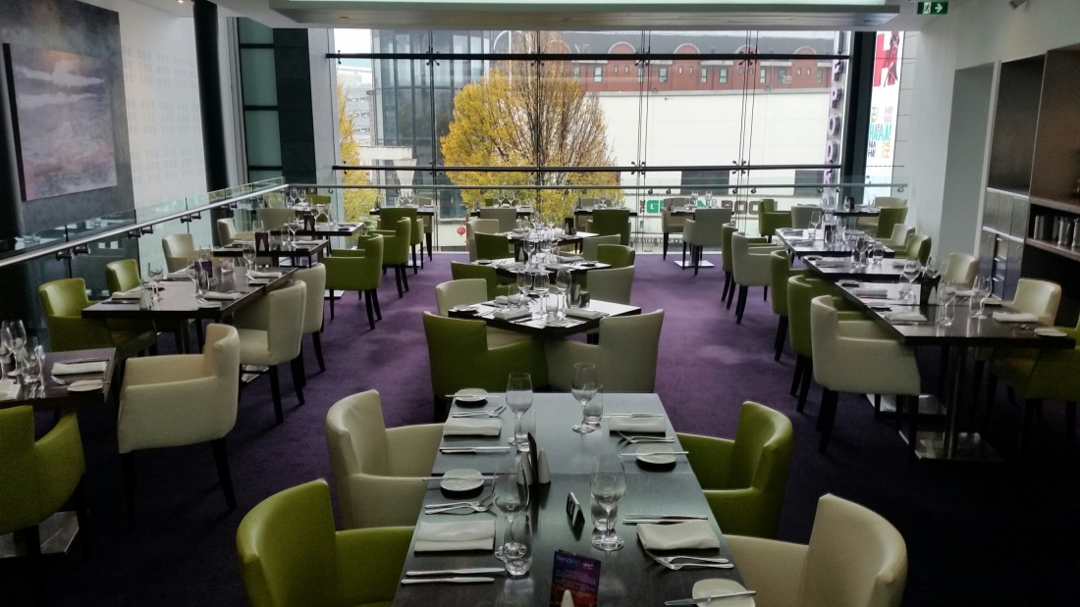
Notes:
Special invitations;
Panto launch - Recent events included our launch for Dick Whittington and new season launch, always popular events with our friends
(Marti Pellow happily meeting some friends and patrons at last years panto launch)
Discounted Dining
2 for 1 voucher on joining
15% off for future visits (on food)
10% discount on food at our deli bar (light snacks, sandwiches – excluding ice-creams)

Slide 22
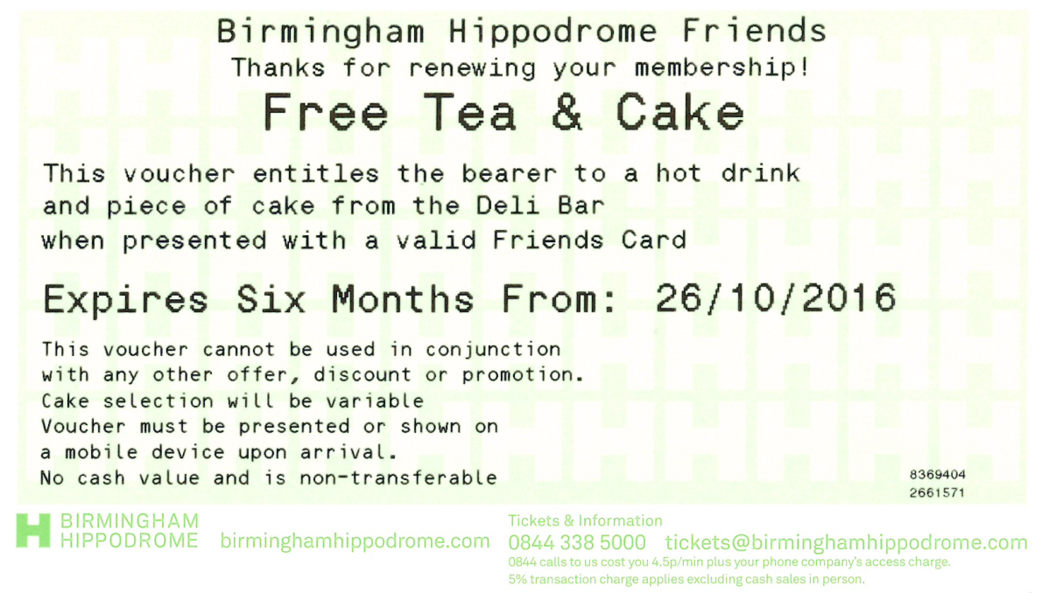
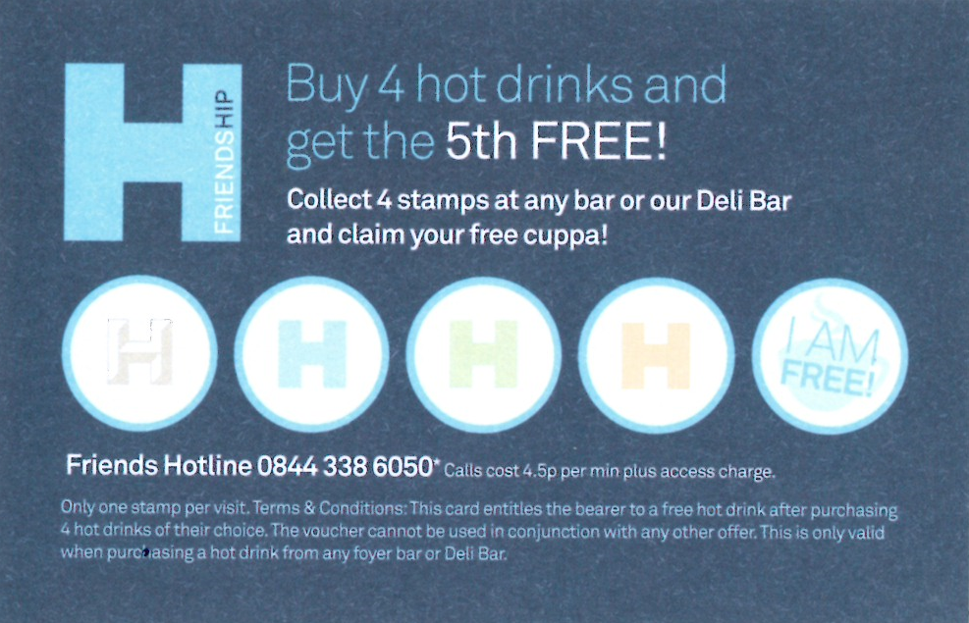
Notes:
If that’s not tempting enough they also get free use of the cloakroom (yay!)
We also want to thank our friends for renewing their memberships
We’ve recently introduced a hot drink and cake voucher, sent with renewal card
We also have a Loyalty card for hot drinks, buy 4 and get 5th drink free
started 3 months ago…
As Marina our Membership Supervisor would say - ‘Who doesn’t like a hot drink and piece of cake?!’

Slide 23

Notes:
Great internal communication and Teamwork
Working together- firstly we work very closely with the marketing team:
Good communication is essential, our marketing team are invited to our ticket sales supervisor weekly meetings, keeping us in the loop with email campaigns and new show on sales; we proof read all show web pages, promotional targeted emails and the season brochures.
Ticket Sales:
We send a copy of all emails going out to the team prior to sending them
Communicate to the team via briefing sheets
staff intranet
white board
informal communication is key talking to the staff on the ground keeping them informed, especially on a big on sale day where we prompt the team to check discount limits and capping reports.
Fundraising:
We invite the fundraising team to regular team briefings to keep the team updated about any changes or to talk about forthcoming friends and patron events.
Network of communication
I truly believe that this great team work makes our network of communication successful

Slide 24

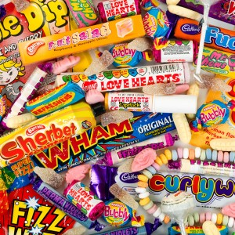
Notes:
However communication is just one element, how do you motivate a team to do this?
We want our ITS team to Upsell at every opportunity, on the phone, face to face on the front counter and also via email correspondence.
Team incentives
Prior to a show going on sale we’ll do a big push on membership upselling
Periodically we have an internal competition to see who can sell the most memberships
We are currently running an incentive for the in tickets sales for who sells the most memberships in Nov & Dec
Offering 13 months for the price of 12 for new memberships issued in this time
A Prize will be awarded to the assistant who sells the most - A wrapped gift box on view to all staff in our phone room, sits under our office Christmas Tree,
filled with lovely surprise treats, Matilda merchandise, chocolates, bubbly…
We’ve done this previously for Easter – the prize was a huge thorntons Easter egg – this was kept in view and really created a buzz and a bit of fun in the office
We’ll also buy team treats too – as we’d be nothing without the rest of the team!
We keep a goodie box in the office full of treats (good for the team - not so good for my waistline)
The biggest motivator and the most important one is free, any ideas?
Praise and thanks!
Useful Tools
Brochure insert and leaflets, this is very helpful when upselling memberships on the counter
Remind the customer how much they can save over the year, more often than not the membership can pay for itself, especially with 2 for 1 offers
We flag constituents that would benefit from a membership in Tessitura (Ryan will cover this in more detail shortly)
Special occasions, we upsell our gift memberships on social media and by sending targeted emails for Christmas and mothers day etc.
Foyer Advertising – our digital screens are very eye catching and can’t be missed
Performance and monitoring
We send a daily task list to the team which will list that days upselling priorities
Our daily task list also lists the top three staff sales from previous day
We monitor on the phones
emails
discuss in One to ones and appraisals
review sales monthly and record in our KPI’s
-renewals
-new memberships
-gift memberships
All combined have developed our approach to membership sales and for improving sales

Slide 25
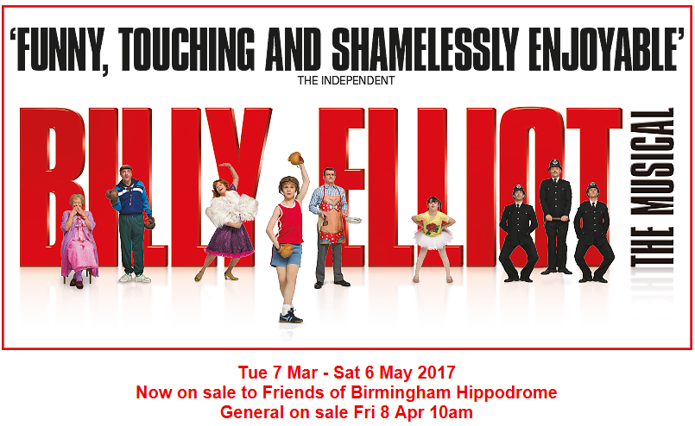
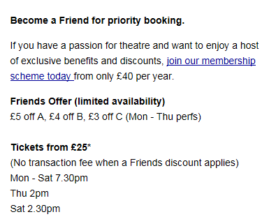
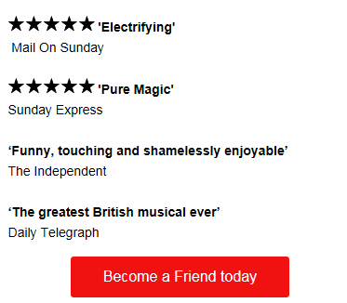
Notes:
So we motivate the team have good communication but on top of that you have to have a great product, our big musicals bring in the largest revenue for friends memberships. Some of the results we have had for these approaches are
Results.
Boosting friends sales with a long priority period.
Significant stats for example
Stats –
Best Ever Year – was 2012/13 with a significant increase in memberships due to a priority booking period for The Lion King. On top of that within that year, we had The Phantom of the Opera, and War Horse within the same year. We saw a 58% increase in memberships, but we see in our historical data, significant increases always peak around large on sales – due to us offering priority booking and discounted tickets. For The Lion King and War Horse – we ran a significant priority on sale from Mid-October – Mid-January with a significant uptake in memberships (due to the phenomenal demand for tickets). Similarly for Lion King and Wicked– Friends had 1 month of priority booking. We find this quite hit and miss recently – with the introduction of severe discount limiting on major productions and performances booking 12 months in advance, we find the demand isn’t always there for a large priority period – however I do feel this is dependant on the show!
More recently with our recent Miss Saigon on sale, we saw a spike in memberships with a significant increase of 112 new members taking advantage of our priority booking period and discounts.

Slide 26
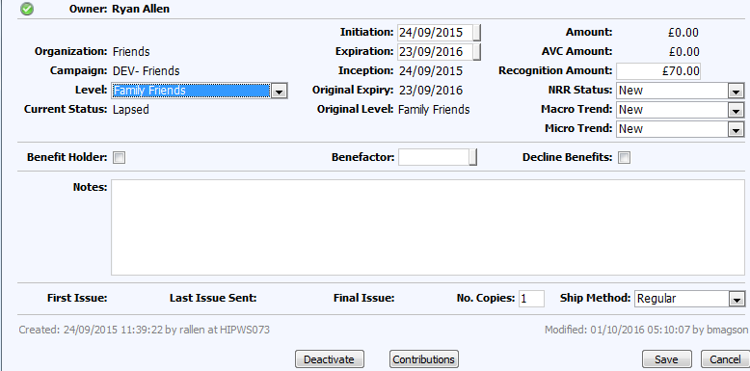


Notes:
How are we doing? How do we use Tessitura specifically?
Flagging in Tessitura
How? – Using the membership function (taking payment as a ‘Contribution’ to a membership fund, this flags our friends with a logo – and use their constituent ID as their ‘membership number’ and printing that on their card.
SSRS: custom Tessitura membership report – We also use a special customisation which flags potential new members based on their booking pattern. Overnight we run a ‘Manage Constituency’ report based on a series of lists we have created which are designed to find customers where an upsell could potentially benefit them. This looks at someone who books Hippodrome shows, within certain price bands, excluding anyone who already has a membership and groups. This then correlates to a procedure which creates the blue arrow (in the info maker) to display on specific constituents. Our Box Office can then use this information to try and either upsell the membership there and then, or just to plant the idea of becoming a ‘Friend’ as we try not to do a hard sell.
Dashboards – We also have on our sales dashboard a memberships section, with graphs showing a 2 year breakdown, and membership figures broken down by membership level (as we offer 3 separate).
Our Fundraising team take a key role on top of the Box Office with dealing with our high level donor’s/patrons. We have a custom ‘wealth screening’ plug in to Tessitura, which feeds of publically available data and constituent data which we hold, to assess the levels of disposable income a person has, and the potential to maybe move them up onto the next membership level. Basically checking to see if there is anything we can do to see if our members are at the correct level, and to try and encourage them to move up to the next membership level. The fundraising team also invite random selections of Friends to their specific events (which are usually only open to our high level Patron’s), to see if there is potential for them to get chatting to Patron’s where they can use other peoples experiences to maybe move them up to the next level.

Slide 27

Notes:
The Future
What’s our next step….
Convert First Night to friends
Covert our high value friends to patron scheme
Use Quick sale for quicker upselling on the front counter
Upsell on the web – messaging rules
Review our gift memberships – sell with branded merchandise ‘H’ branded bag etc to give the wow factor, not just a letter

Slide 28

Notes:
Thank you for your time today
If anybody has any questions – please don’t hesitate to get in touch!

Slide 29
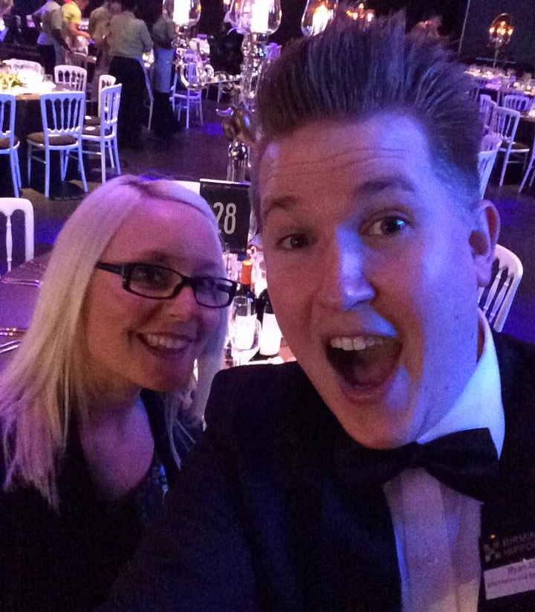
Donna Scott
Information & Sales Manager
@donnascott0711
0121 689 3131
donnascott@birminghamhippodrome.com
Ryan Allen
Information & Sales Supervisor (Systems)
@rallen91
0121 689 3196
ryanallen@birminghamhippodorme.com
Notes:
Contact details

Slide 30
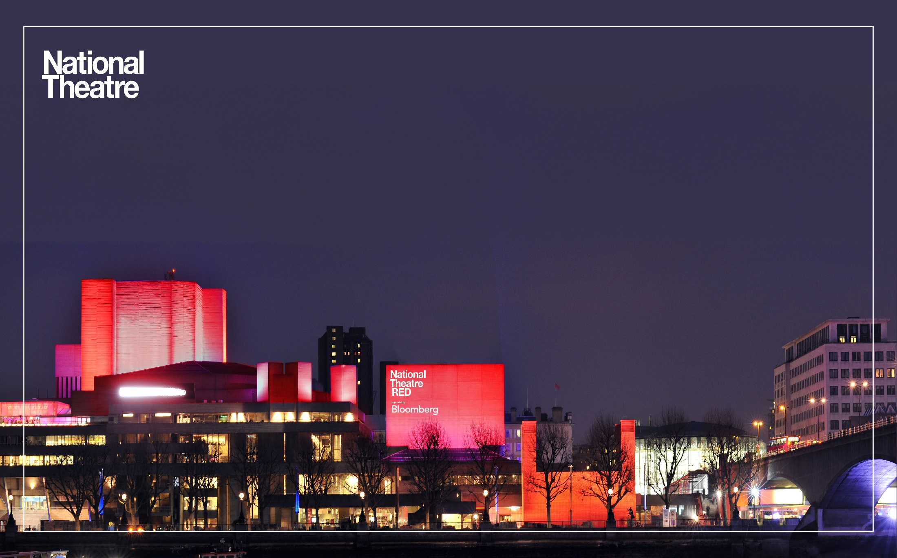
Branding and Promoting your Membership Scheme:
Getting everyone on board!
Fiona Joseph
Development projects Officer (Data & Digital)

Slide 31

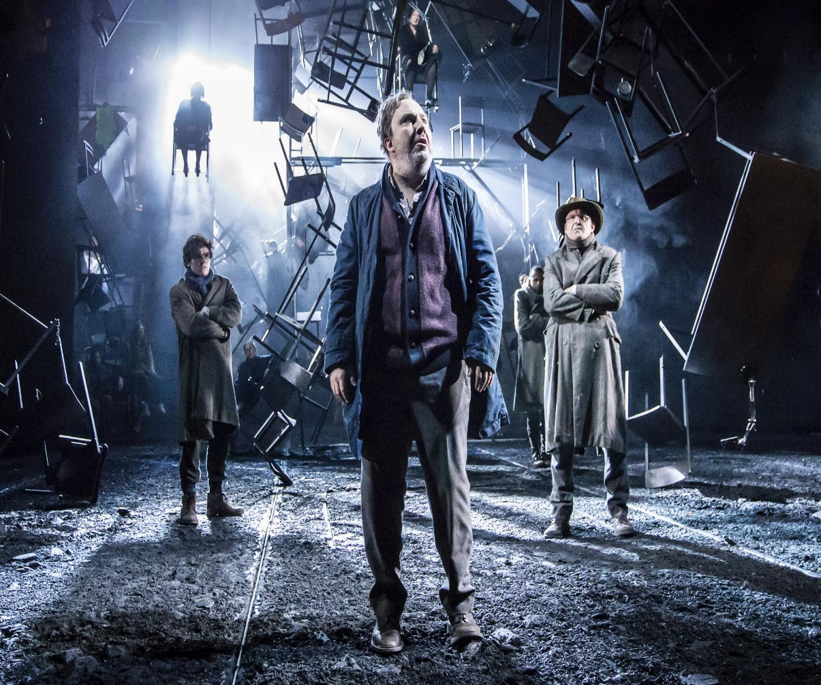
4 Auditoria
  Olivier: 1,125 seats
  Lyttelton: 898 seats
  Dorfman: 300-450 seats
In 2015/16
  34 productions – 1,276 performances
  781,000 tickets – 88% capacity

Slide 32

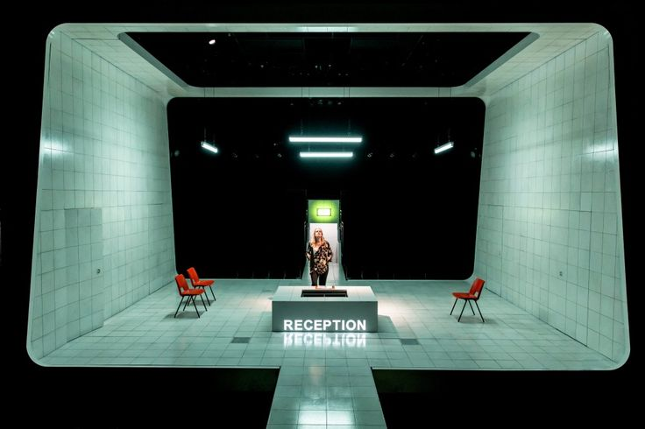
The NT elsewhere:
665,500 tickets in the West End
280,000 tickets for UK touring productions
557,000 tickets for International productions
1.45m tickets for NT Live broadcasts

Slide 33
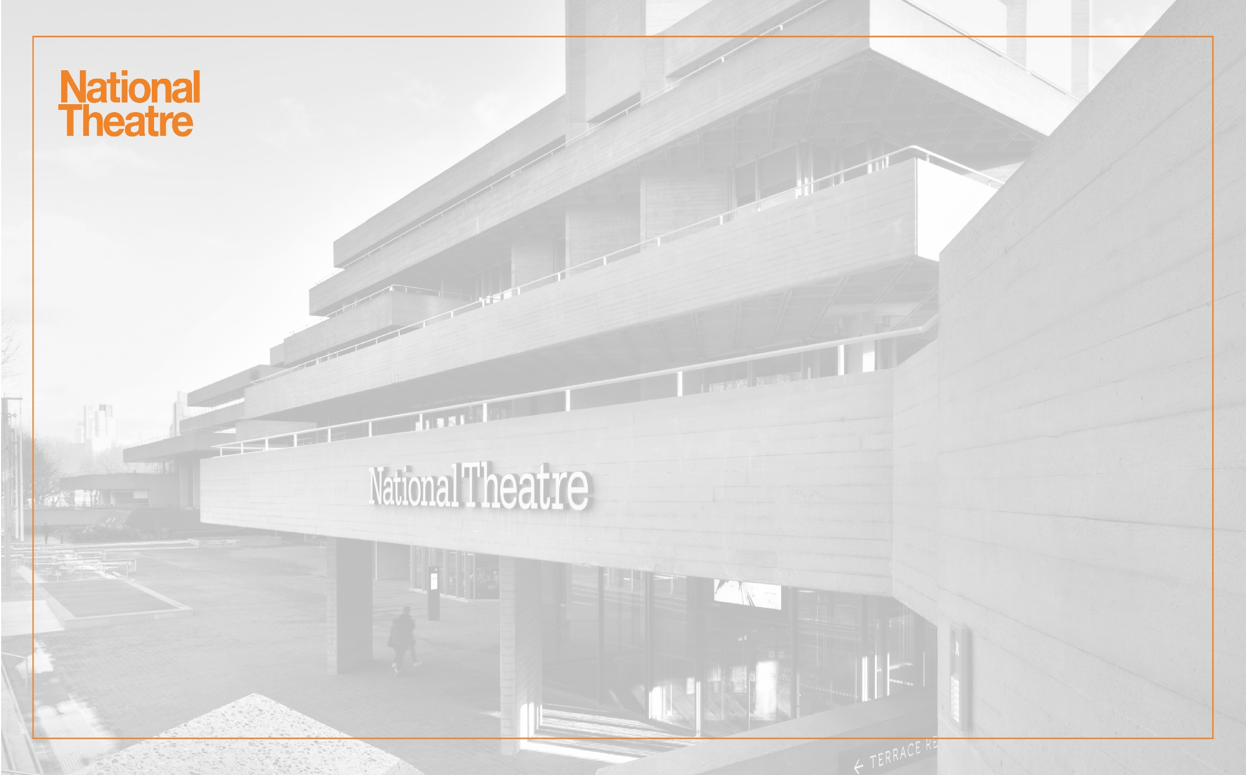
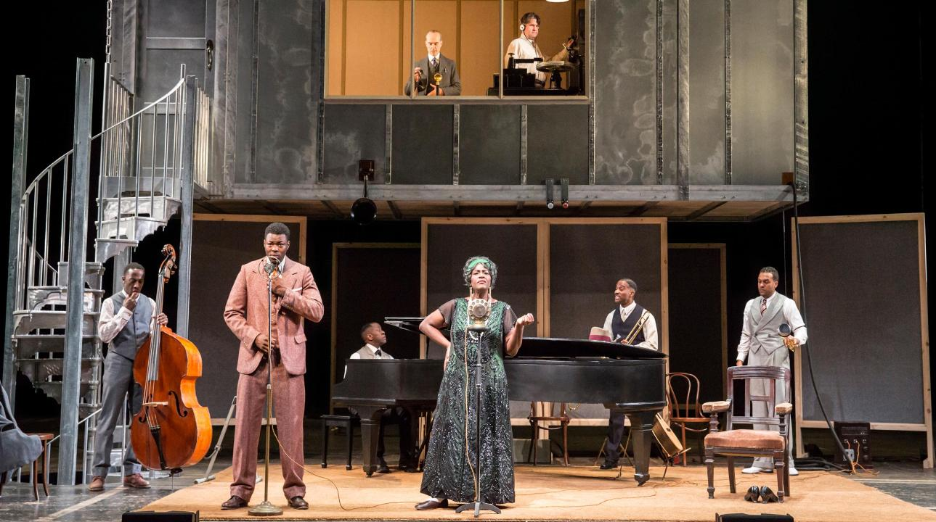
11,400 donating members in UK and Overseas
Priority Members: from £80 p.a
Patrons: £600- £12,000 p.a
Young Patrons: £100-£1,000 p.a
  21-45 years
Notes:
Branded logos for each membership ladder
Making clear distinction between Young Patrons & usual patron options

Slide 34

Agenda
Website Support Us Pages
Social media
Email promotion
Renewal Process
In the building
Rebranding

Slide 35
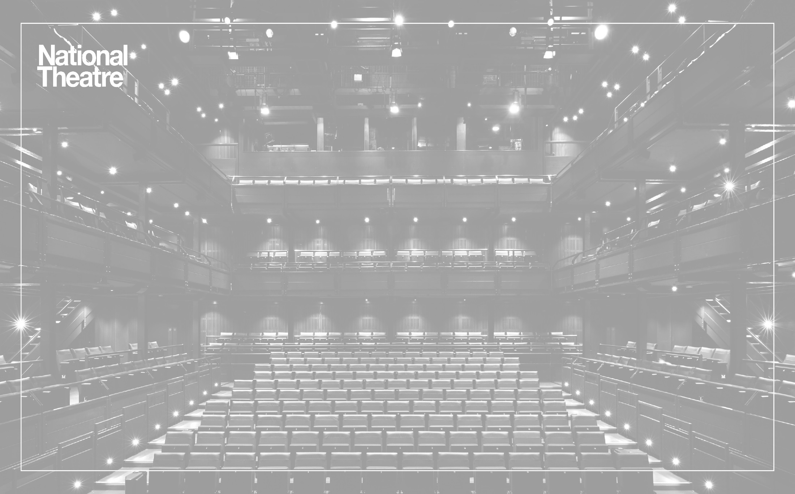
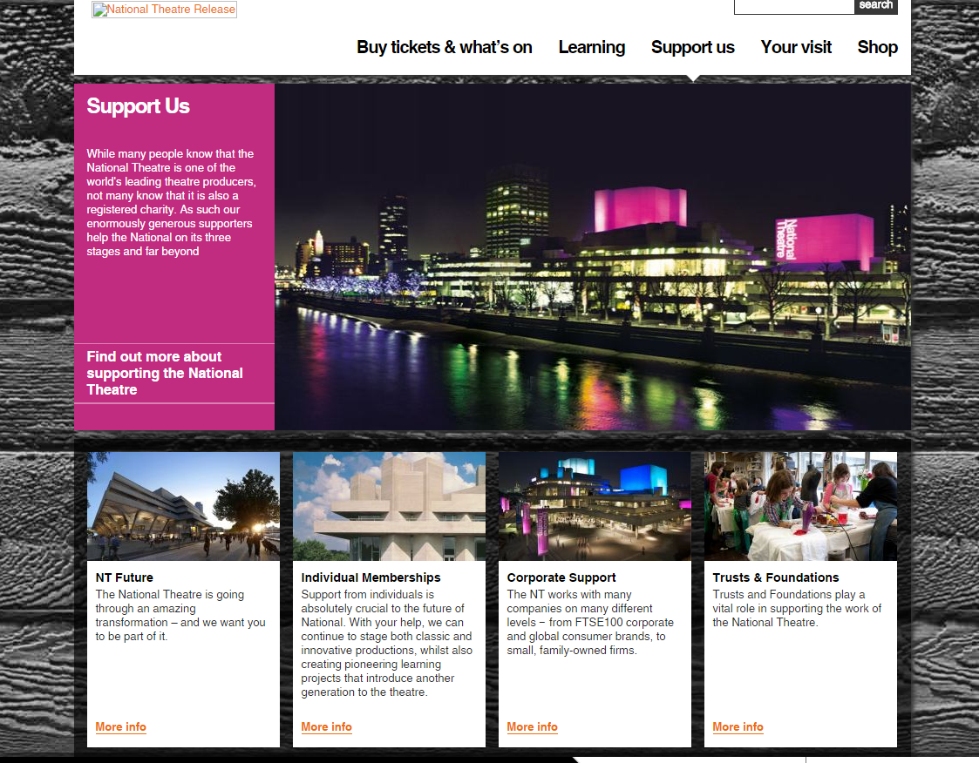
Notes:
Upgraded our website in April 2016, allowed us to have more exciting content
This is previous Support Us landing page

Slide 36

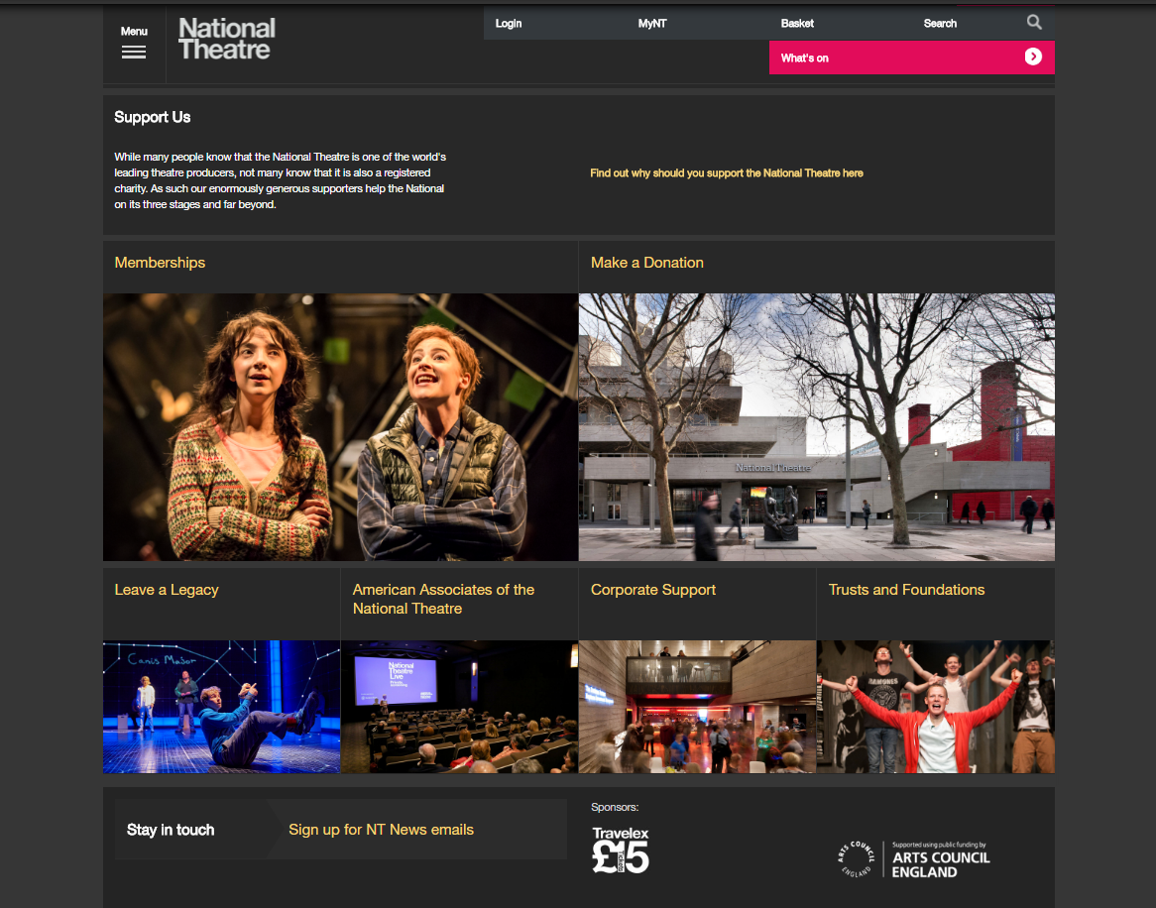
Website: Support Us
Notes:
Top section of the landing page
From a user point of view, first thing eyes land on

Slide 37
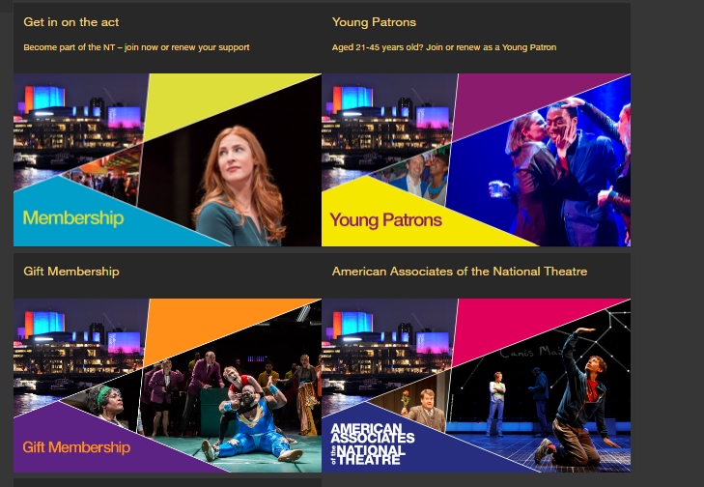
Notes:
Branded logos for each membership ladder
Making clear distinction between Young Patrons & usual patron options
Update images with more recent productions

Slide 38
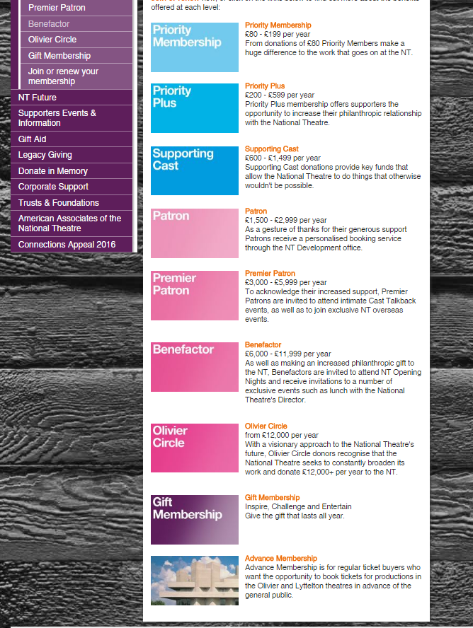
Notes:
Previously was too wordy, listy, not exciting images, and Young Patrons got less attention

Slide 39

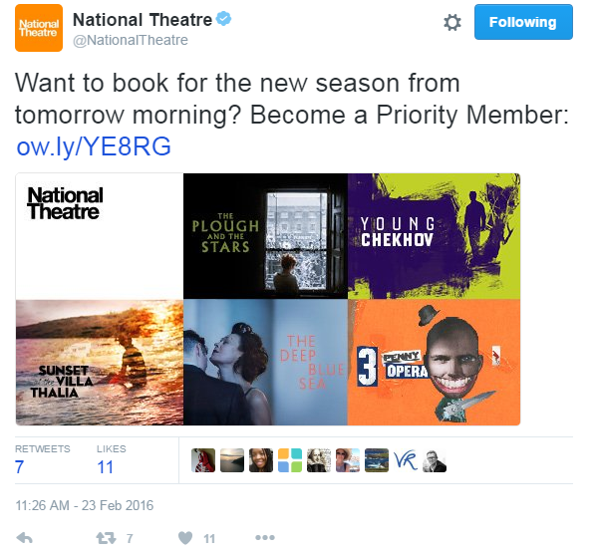
Social Media
Focused around booking periods, when new season goes on sale

Slide 40
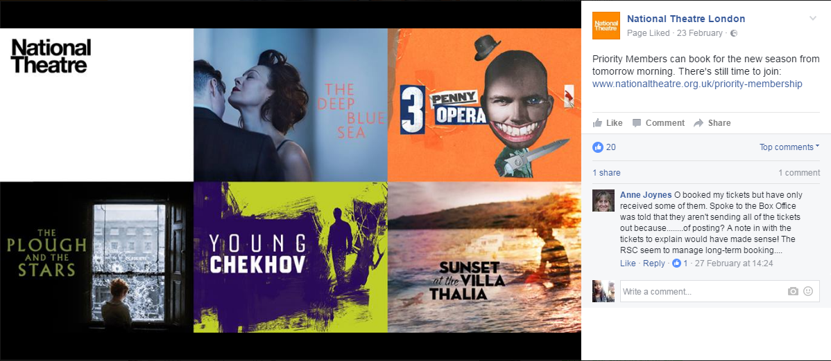
Notes:
Most universal benefit to being a member is booking before the public does
Use this to our advantage by using the Production branding – planned in advance for the brochure
Can see the big names

Slide 41
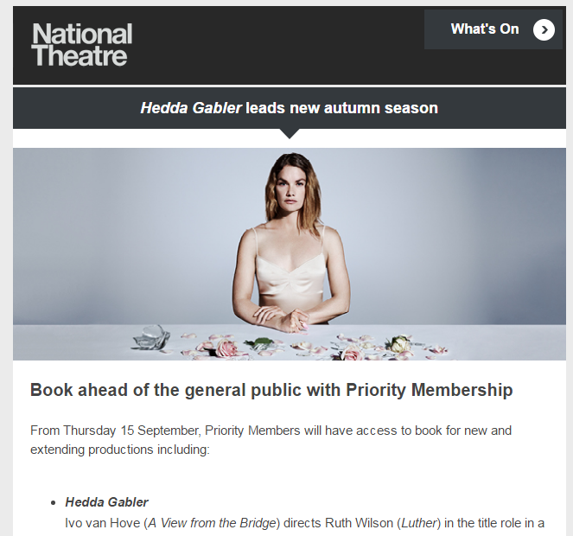
Email Campaigns
Around new season booking:
Core Audience segments (have attended 4 times in the last year)
Web-tracking data
Those who are “super-lapsed”
Notes:
Using Silverpop we target:
people who clicked the find out more about membership link the previous NT News newsletter
those that have browsed the Priority membership page within the last month window.
Checking firstly they need to be opted in to receive NT emails of course as well.

Slide 42
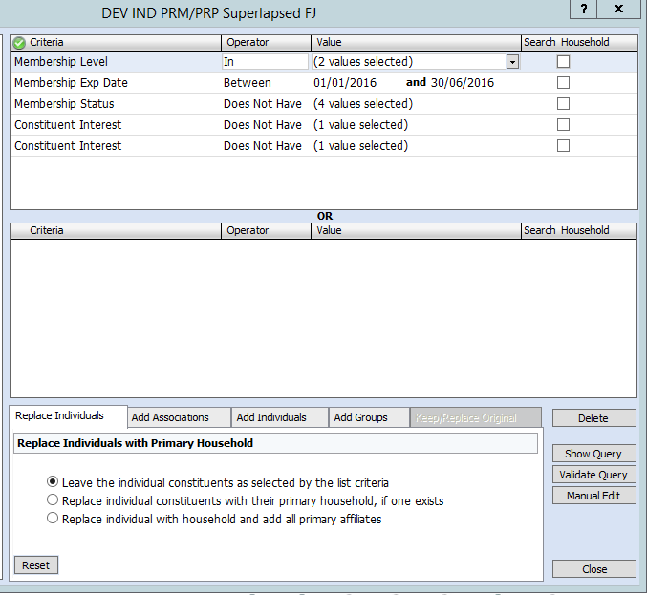
Member level = Priority
Exp date = Beginning of year – end of prev month
Status ≠ Active, Cancelled, deactivated
Interests ≠ Does not want to renew and NO emails!
Notes:
Branded logos for each membership ladder
Making clear distinction between Young Patrons & usual patron options
Always checking their DP preferences too

Slide 43
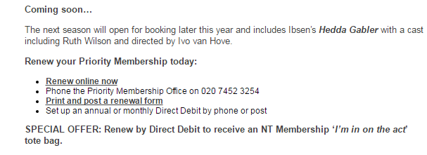
Renewal Process
Members receive 3 reminders as standard
Additions to encourage renewals:
  - New season highlights
  - Special offer for Direct Debits
Notes:
We are focusing on encouraging Direct Debit renewals to boost our overall renewal rate
TBH the tote bag offer hasn’t directly created a huge uptake but it helps to draw attention to the option.
DD uptake has increased but more so since bringing in online DDs
By November the new ADV levels will be in place so you could briefly talk about the reduced price option for DD renewals.

Slide 44
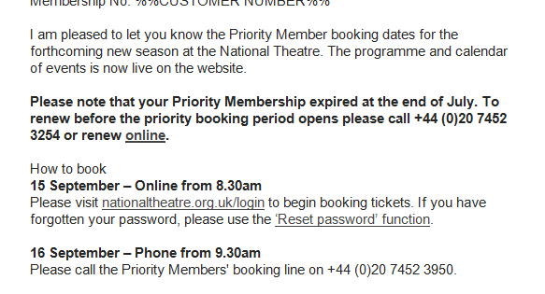
Renewal Process
Reminders within new season communications
Notes:
Renewal reminder if only recently lapsed within new season comms (a line includes a reminder to renew giving the impression that they can’t book unless they renew)
Although they are expired we have a 2 month lapse period – technically they can still book.
We communicate with them in a way that we’re assuming they are going to renew in time to book.

Slide 45
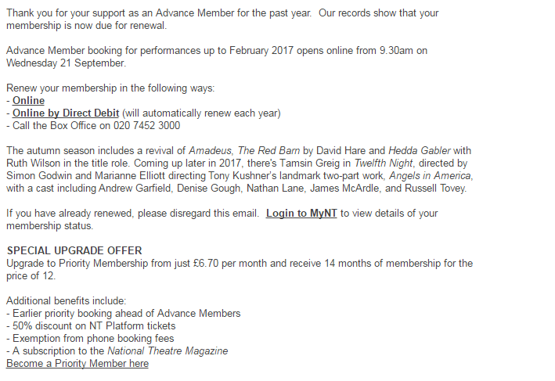
Encouraging Upgrades
Advance Members
  - Close to expiry
  - Upgrade offer
Notes:
Lists the additional benefits
And direct link to the join page

Slide 46
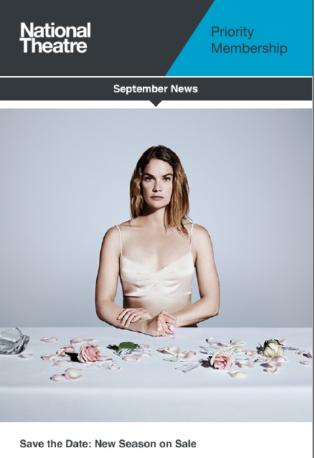
Newly launched Member News
Tailored version of monthly Newsletter
Positioned as part of member benefits
Can include more membership related content where necessary.
Can include renewal reminders
Designed to provide a more frequent reminder of their membership
Notes:
- Our aim with this email is to create a more regular reminder for members that they are receiving benefits and to help them to feel more valued and ‘in the know’

Slide 47
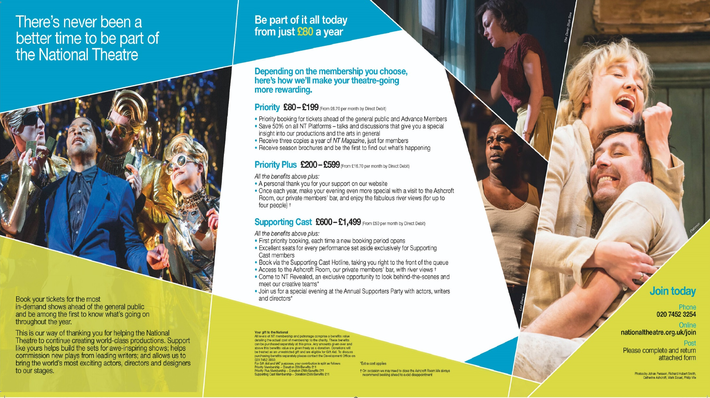
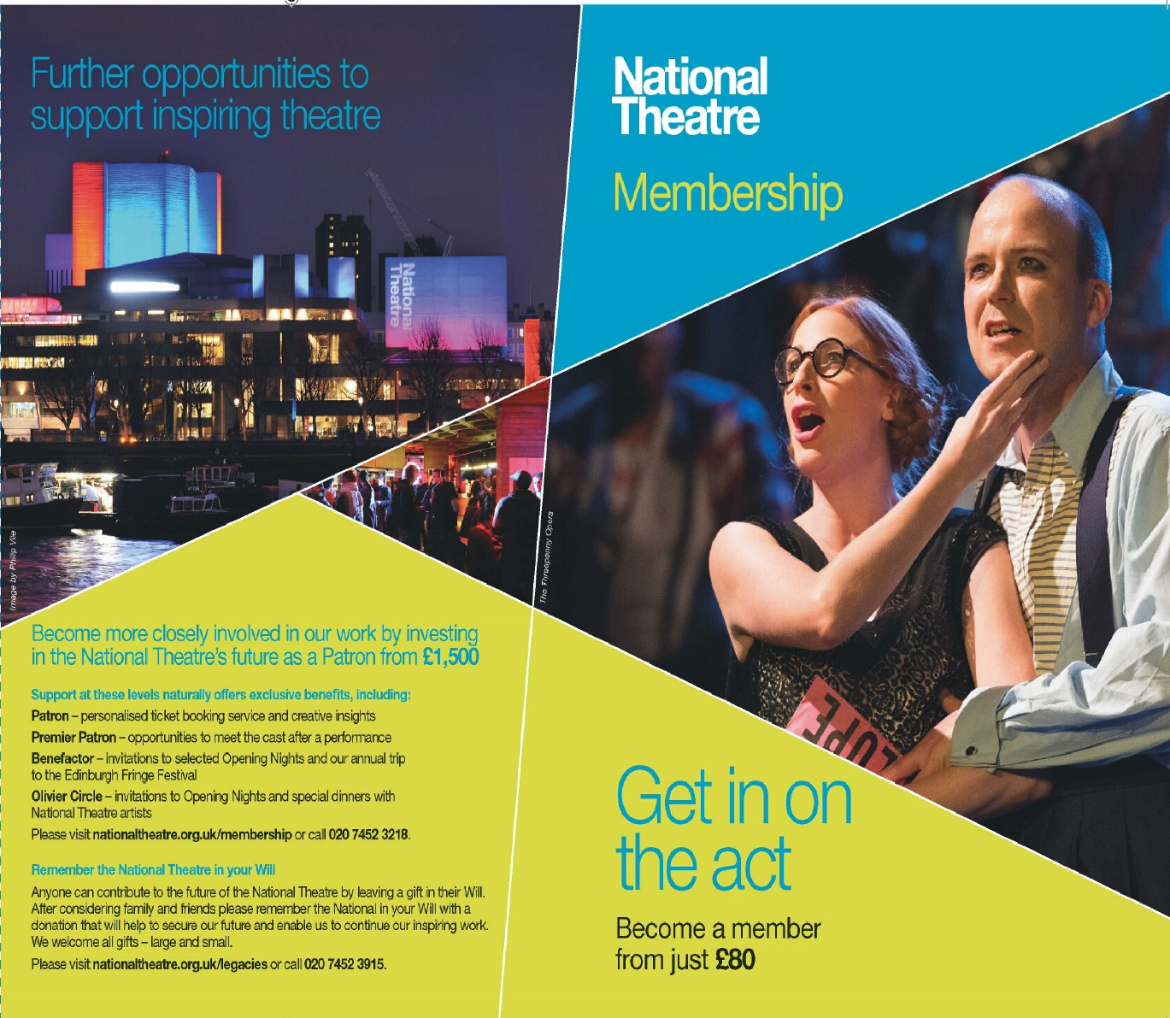
Notes:
Rebranded our leaflets in 2014 alongside price increases – more current/inspiring/happy production images
Brought in a copywriter to help build more inspiring/exciting language around our memberships (we were then able to use this across all of our membership communications)
Colour codes for different memberships: Blue for Priority/ Pink for Patrons+ / Purple for Young Patrons

Slide 48
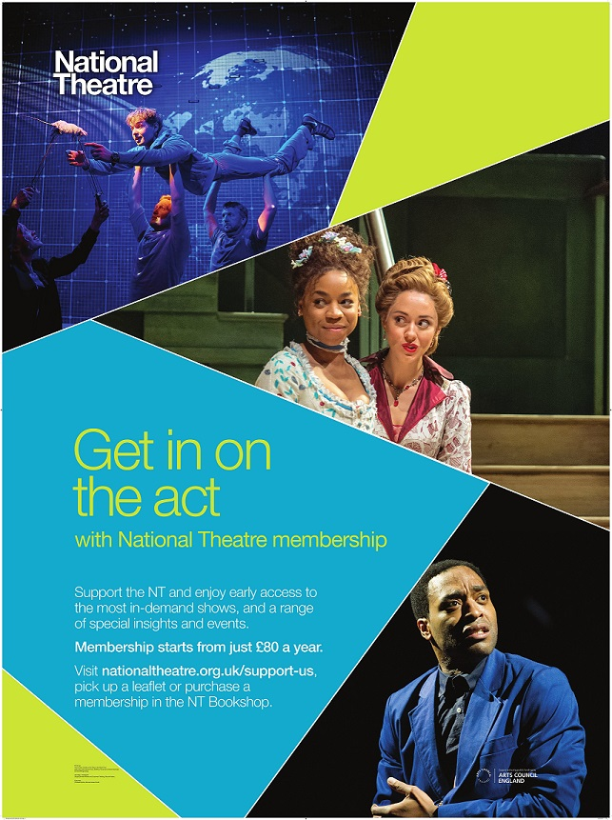
Notes:
Leaflet stands are attached to this poster
Thinking about creating a unique URLs so we can monitor effectiveness of different posters/leaflets etc.

Slide 49
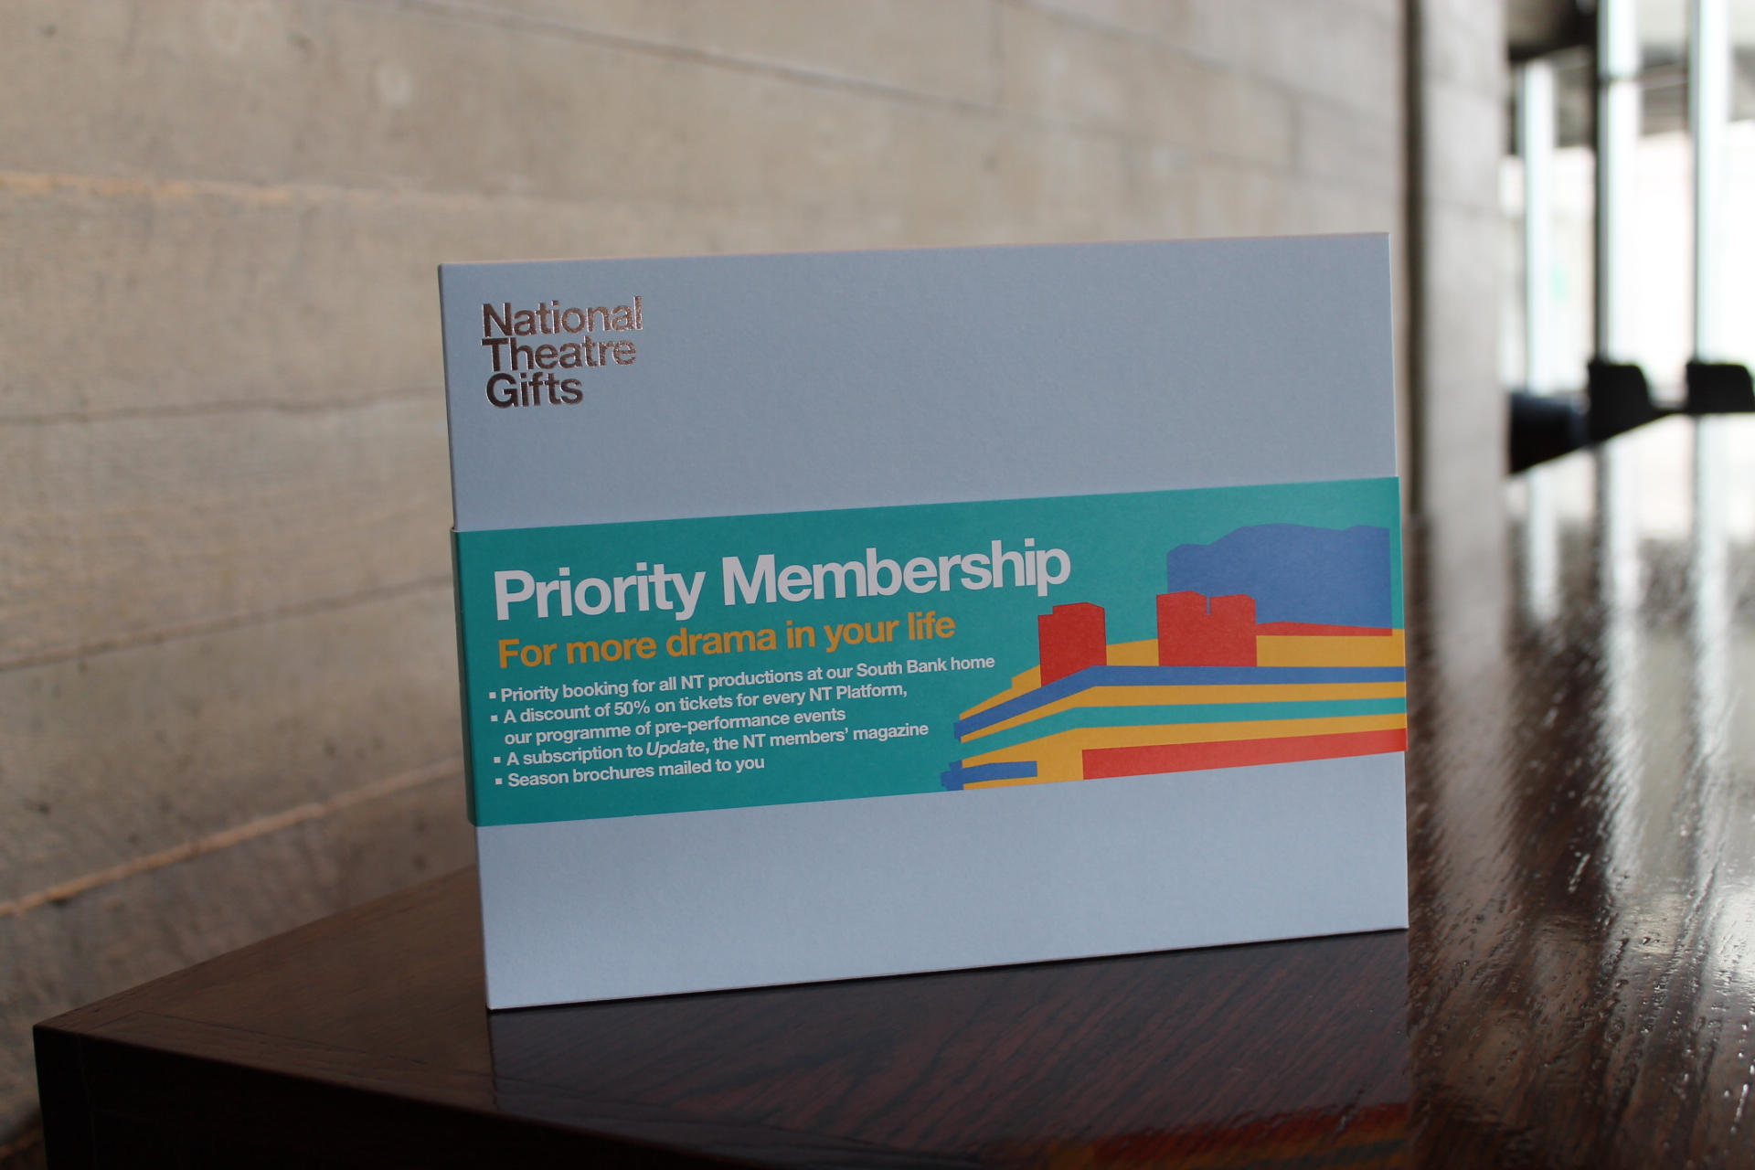
Notes:
Gift membership
Great for Bookshop displays
Boxes and belly bands are expensive so we only really offer gift boxes in the bookshop or on request
Gift Membership is available to purchase online

Slide 50
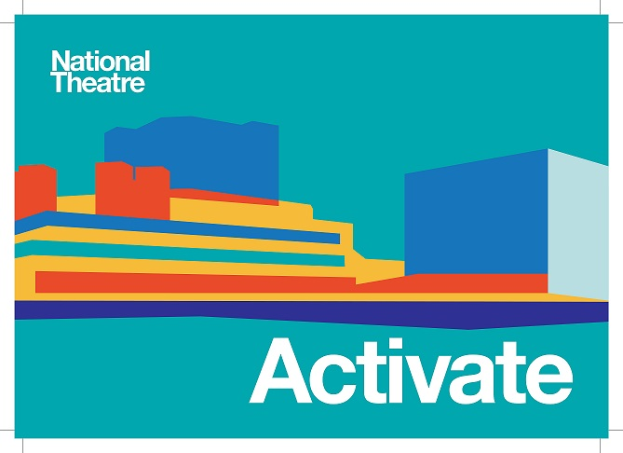

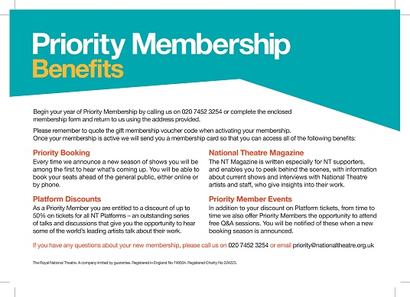

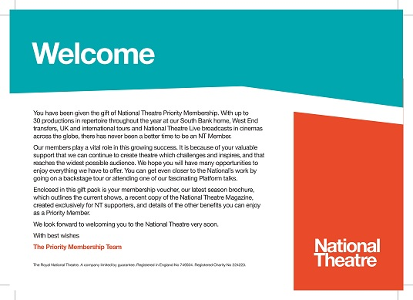
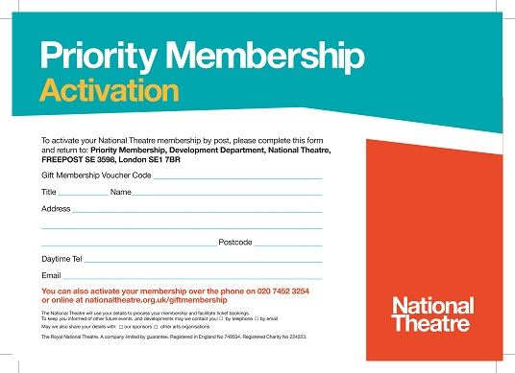

Slide 51
Rebranding Advance Membership
Increase £15 booking membership to £35
Discount to £25 applied when paying by Direct Debit
Reduces price gap between Advance and Priority
Notes:
Reduction in price gap create more opportunity to push for upgrades
Advance is now Gift Aidable and therefore can sit on the ‘Support’ pages
Advance and Priority used to sit quite separately but now there is more opportunity to collaborate on the membership campaign

Slide 52
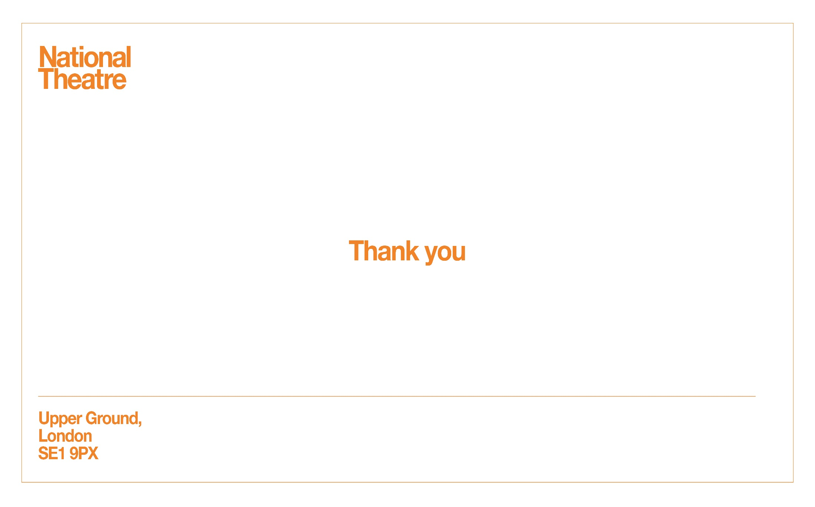

Slide 53
QUESTIONS?
“If you can’t appreciate what you’ve got, you’d better get what you can appreciate.”
George Bernard Shaw, Pygmalion
Notes:
Welcome

Slide 54

WHAT’S NEXT?
BREAK 14.00-14.15
Hogan Foyer / Level 6 Foyer
BREAKOUT SESSION THREE
14.15-15.15
Notes:
THURSDAY Breakout session 2 What’s next slide

