Slide 1

TESSITURA
EUROPEAN
CONFERENCE
DUBLIN 2016
Notes:
Welcome

Slide 2



PRESENTER
Emma Larcombe : Tessitura Network
VISITOR SERVICES FOR ADMISSIONS
THE NEED FOR SPEED!
Share your favourite content and photos! #TECDublin16

Slide 3
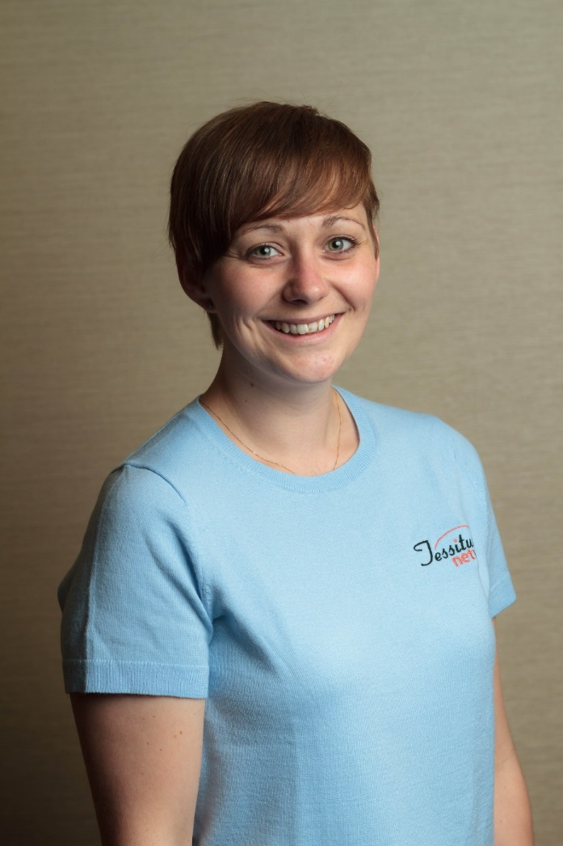
Application & Support Consultant
Tessitura Network

Slide 4
Agenda
General Admission Sales
  Line Items
  QuickSale
  Tessitura Roving Box Office (TRBO)
Tessitura Configuration & Setup
  Facilities, Fees, Flex Packages & More!
Visitor Flow
Cross-Department Communication
Notes:
This is a training session. We’ll focus on the many ways you can use Tessitura to support ticket sales and visitor flow in a museum or attraction environment.
We’ll start with the front end - the sales process - and then look under the hood at setup and wrap up with some pieces around the management of visitor flow as well as communication across areas.

Slide 5
General Admission Sales in Tessitura
Notes:
One quick note about vocabulary – I will use the word Performance quite a bit even though it’s not completely relevant to the admissions market. A performance could be an exhibit, a museum or zoo admission, a dolphin show, a movie, a lecture, a class or more. I use performance because it is the word you will find within the Tessitura application and the standard documentation so it will make it easier to look things up after this session. Just imagine it in quote whenever I say it.
Now let’s talk admission sales.

Slide 6
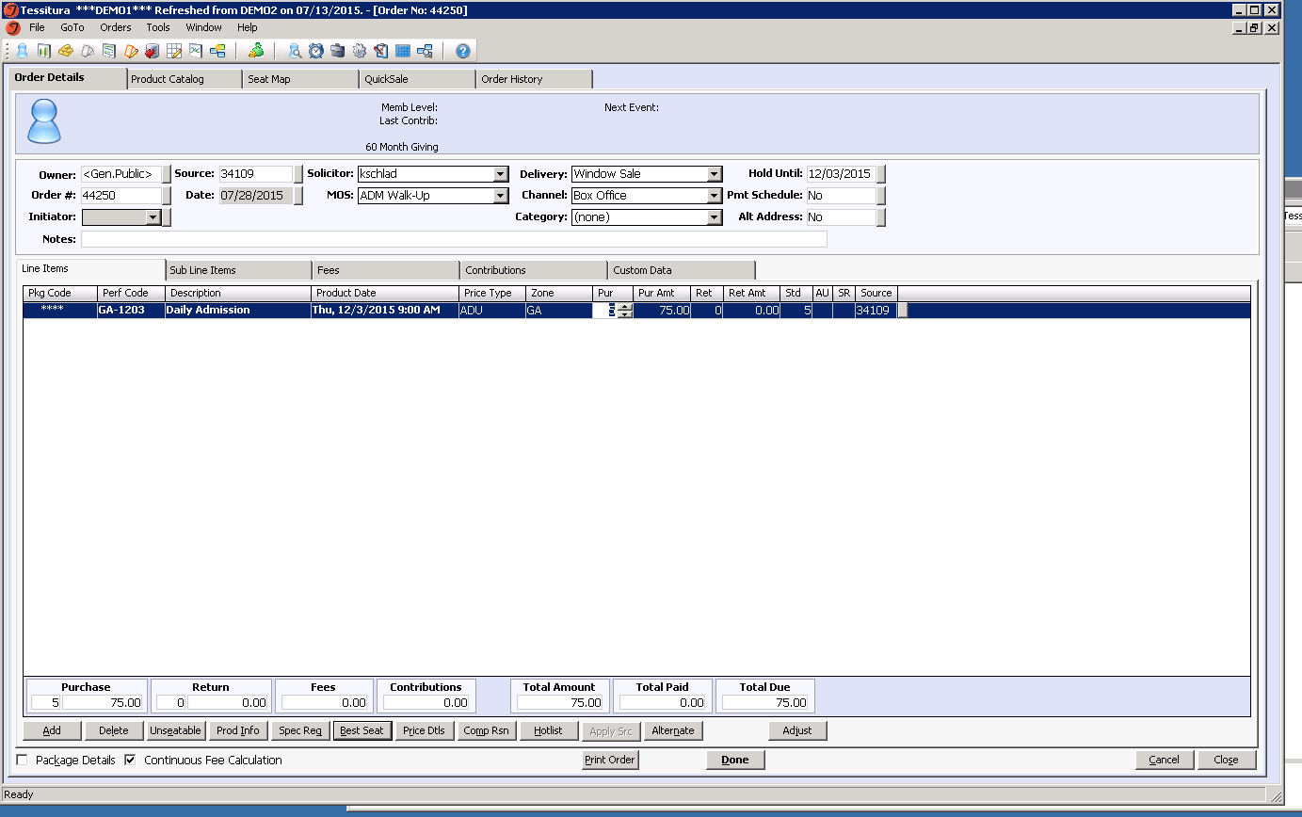
Ctrl+P = pay
Ctrl+K= add same
Alt+ A = add line item
Alt+ B = best seat
The Original: Line Items
Notes:
In the beginning there was line items…
This is the original sales screen and the one we still return to for complex sales, returns or adjustments.
Keep in mind that keyboard shortcuts can make it quite a speedy experience.
I’ve noted a few popular shortcuts on the screen.
CLICK
Alt-A to add line item CLICK
Alt-B to best seat CLICK
Ctrl-K to add the same again CLICK
Ctrl-P to pay

Slide 7
Basic Keyboard Sales Sequence
Add a line item - Alt+A
Move from one field to the next - TAB
Perf/Pkg Code – know thy formula
Best Seat - Alt+B
Payment - Ctrl+P
Type in payment method
Finish - Alt+F
Notes:
Borrowed from the amazing Anna W.
Talk about naming conventions for ‘performances’

Slide 8
Making Quick Changes
Notes:
As I mentioned earlier Line Items is often where you go when you need to make changes to an order.
Return by Ticket No and Adjust are a couple of my favorite ways to make this process quicker. Let me show you what they do.

Slide 9
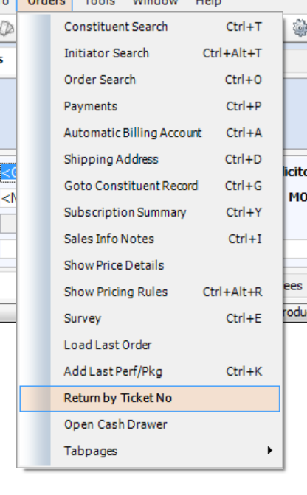
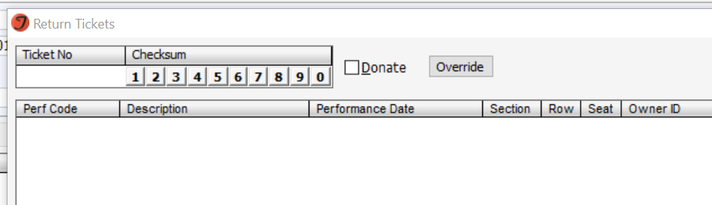
Return by Ticket Number
Notes:
Return by Ticket No can be found on the Ticket Orders menu as seen here
CLICK
Can type or scan the Ticket Number into this field and can then either process the refund or grab something new to exchange into.
Speaking of scanning one of best ways to speed order changes is barcoding various pieces of information to avoid having to key them in
Think about barcoding a constituent ID or order number to quickly find these things in Tessitura – basically any value you’re typing over and over should be considered for barcoding.

Slide 10
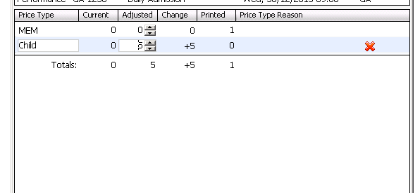
Adjusted
Line
Item
Notes:
Moving onto the Adjust button:
For those who haven’t tried it changing ticket numbers on a line item with multiple price types or, even worse, a flex package with multiple price types used to be a bit of nightmare. No more! Adjust lets you do this very easily.
When you click the button…

Slide 11
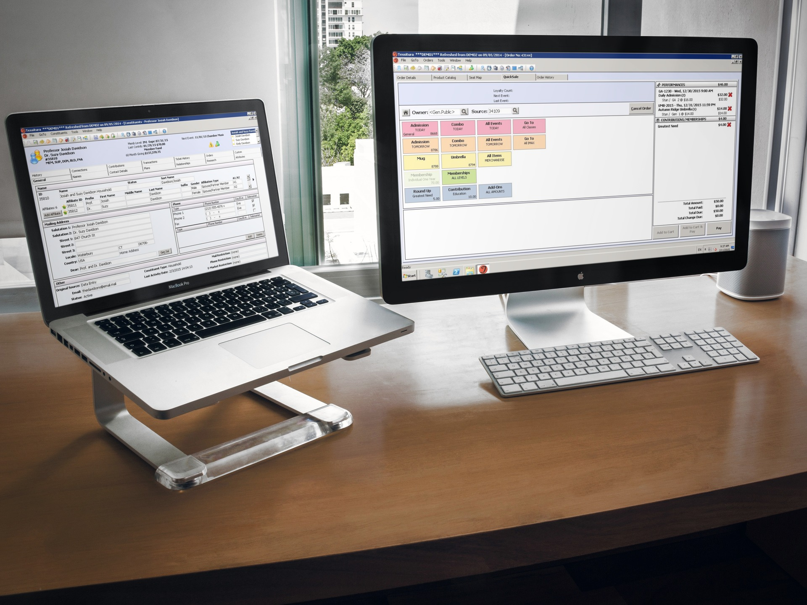
The Lean and Mean: QuickSale
Notes:
Ok, soooooo…. Line items is great.
New in v12.1 – QuickSale is even better.

Slide 12
What is QuickSale?
Graphical sales interface for streamlined order processing
Works with both mouse and touchscreen monitors
Ideal for sales that don’t require selecting seats from a seating chart
QuickSale layouts are tied to Mode of Sale so buttons can be specific to needs
Easy drag and drop setup allows for customizable screens
Notes:
So what is Quicksale?
Graphical sales interface for streamlined order processing.
Of course quick sale works with the mouse but it is also compatible with a touchscreen monitor for even faster processing.
Tailor made sales that don’t require selecting specific seats - generally museum type admissions or general admission lectures and movies as well as timed exhibits, but can work well even in a seated venue – consider for student rush
Will show set up in a bit but wanted to call out that quicksale layouts are tied to the Tessitura mode of sale so you can have many for different purposes.
For each of those layouts you design content, position, color, etc… for all buttons
Buttons represent ‘performances’ (can be admission, program, class, even a time for an exhibit), packages, memberships, donations, As you progress through the sale buttons will represent price types and payment methods.

Slide 13

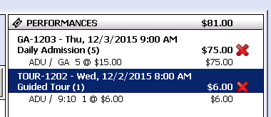
Navigation Tips
Home button gets you back to the start
You can change quantities after items are in your cart
You can even access Print Details from the QuickSale screen (v12.5)
You can always flip over to Order Details/Line Items (Ctrl+L) and then Ctrl+Q to get back
Notes:
Here are a few of my favorite tips and tricks for navigating quicksale:
Home button
Changing quantities
Print details – this is great if you need to email a confirmation or print an acknowledgement
And going back to line items

Slide 14
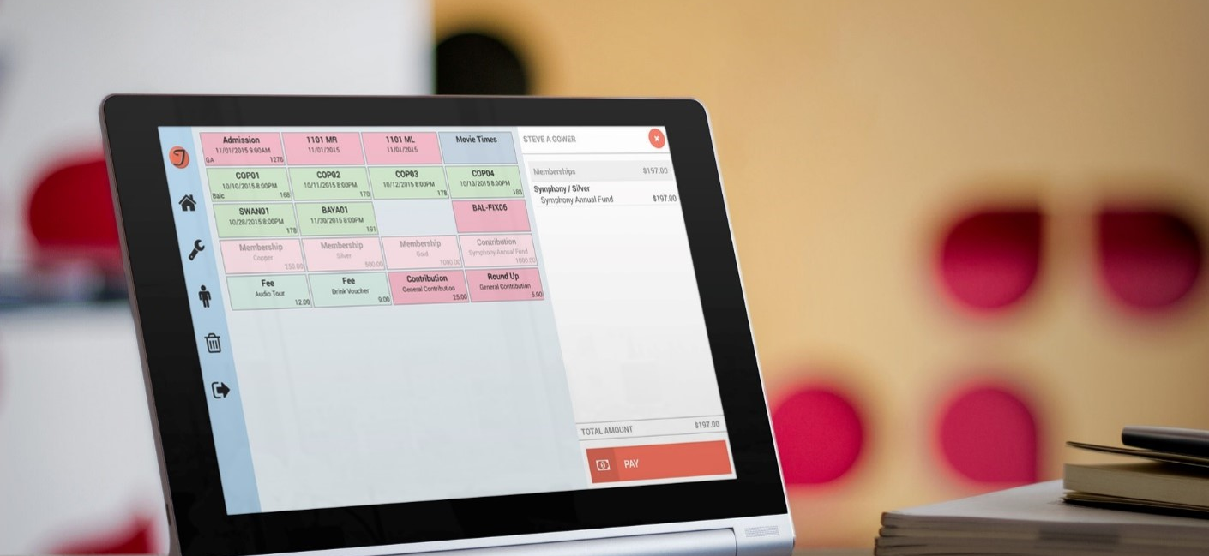
The New and Shiny: TRBO
Notes:
Note that TRBO stands for Tess Roving BO and what TRBO does is take sales out from behind the admissions desk
Android app – no additional charge to use it
We have hardware recommendations both consumer and business grade – see me after the presentation and I can point you to where those are. Or come see me this afternoon in the Technology Petting Zoo and see some TRBO tablets in action.
TRBO uses quick sale layouts which are built in Tessitura.

Slide 15
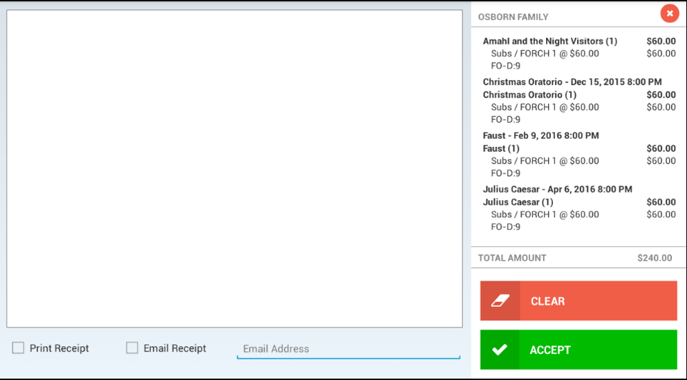
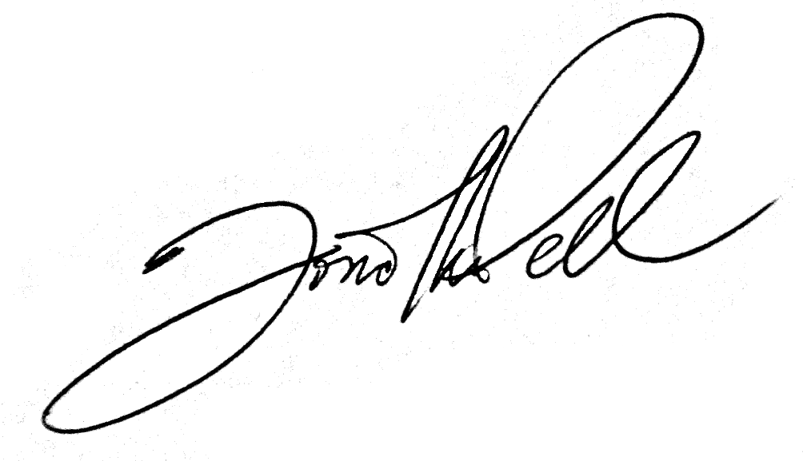
Notes:
Signature capture for credit card sales
Think Apple store experience for your admission or membership sales
Talk about how you can print to Bluetooth receipt printer or email receipts and tickets,
TRBO also allows you to enter new constituent records and edit limited constituent data
So now I’ve walked you through the sales tools in Tessitura and how they support general admission sales
CLICK

Slide 16
Tessitura Configuration & Setup
Notes:
**11:05am**
Let’s take a look at the Tessitura configuration and setup to support the sales processes you’ve just seen.

Slide 17
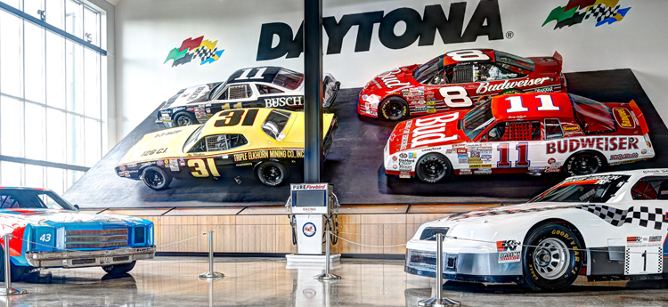
Now it’s time to look under the hood.
Notes:
*** 10am ***
In other words, let’s look under the hood
Photo from World of Speed – appropriate since the museum uses Quick Sale to sell museum admissions

Slide 18
Facility Setup
# of “Performances” Per Day
Single Lecture
Use Performance Time
Exhibition with entry every 15 minutes
Use Zones for Times
Decision:
Do you want to use the performance time to denote time or do you want to use the price zones?
Variety of Content
Imax Theater Movies
Use Performance Time
Various themed tours offered multiple times per day
Discuss
Notes:
Ok, when building general admission sales in Tessitura even if it seems a bit out place
You first need a facility
Of course a facility can be an actual venues with seats you are selling but a facility can also represent a pool of admissions.
When designing your admission structure and building a facility one of the biggest decisions you’ll need to make is whether you want to build a single facility to represent multiple timed entries throughout the day or whether you want to build a performance for each entry, movie, etc…

Slide 19
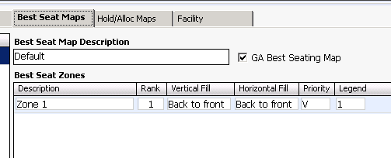
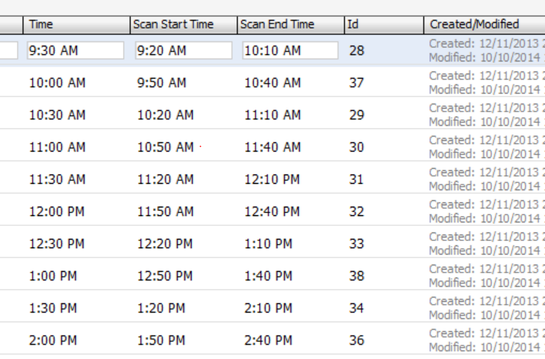
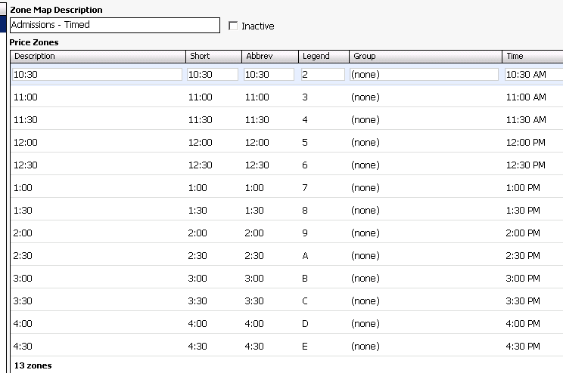
* On GA Indicator
Facility Setup Notes
Notes:
If you make the decision to build a single facility for a day’s worth of entry times this is done using Price Zones.
Each time is set up as a price zone. There are even scan start and end times available.
Times can be on any scale you’d like – I’ve seen it range from every 5 minutes to every 60 minutes.
One quick note on the GA indicator CLICK
This checkbox serves 2 purposes: 1) It itells Tessitura it doesn’t have to worry about things like finding seats together and selling in a particular order – it knows any spot will do. 2) It tells TNEW to not display zones for selection so if you are a TNEw user…

Slide 20
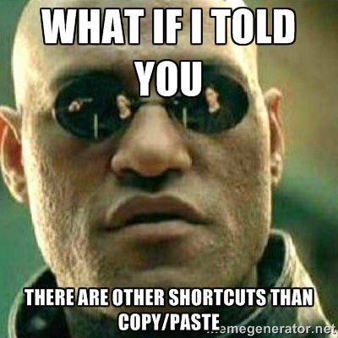
When configuring ‘performances’…
Notes:
Ok, so now you have a facility – it’s time to start building your events.
Templates and mass updates are your friends.
This means that the majority of setup steps only need be done once for any particular exhibit or admission.

Slide 21
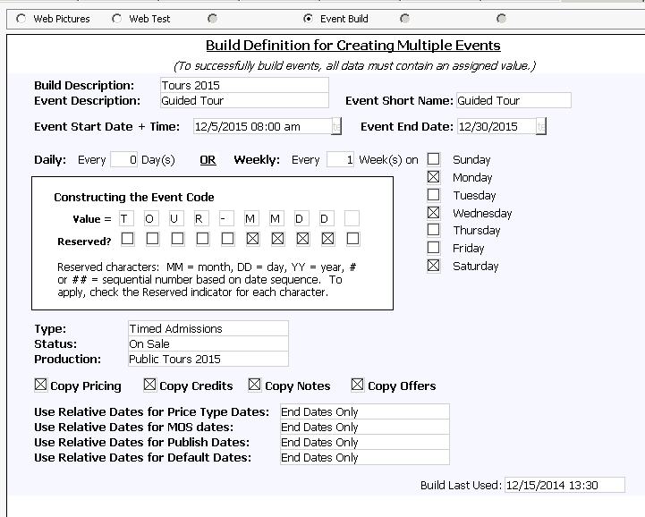
Multi-Event Build Utility
Components:
  Performance Custom Screen
  Utility
Request via a TASK ticket
Notes:
Talk through how to use
Don’t forget you can use Season Maintenance for mass updates, make price templates and hold code maps

Slide 22

Pricing Rules
Discounts
Promo Codes
Pricing – Which tool to choose?
Notes:
So now you’ve built your performances let’s talk about pricing.
Of course there are standard prices, but often there are also some special prices. Tessitura offers a lot of tools for this so let’s talk about when and where you might use each. The 3 tools I’ll be discussing are: Pricing rules, Discounts And promo codes

Slide 23
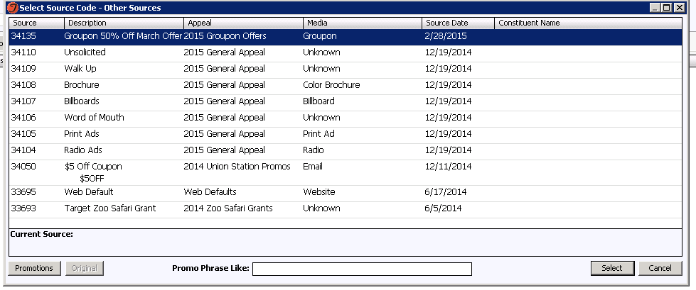
Offers with Promo Codes
Price Types tied to sources are unlocked when the source / promo code is entered
Works very well online
Notes:
First are promo codes
Promo codes are tied to sources and when that source is entered or that promo code selected or typed in online they unlock a new price type
Standard TNEW functionality – can even imbed the source code into the URL for auto-unlock
Since it’s a different price type, reporting is easy and you have very direct tracking to your promotions since the order is now tied to the source

Slide 24
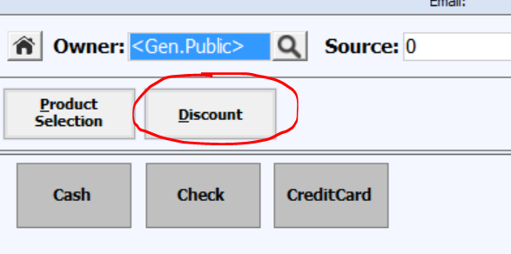
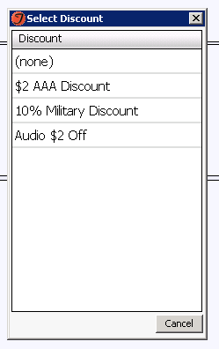
Discounts
Less clutter on the sales screen
Can be applied en masse
Available as a button in the QuickSale screen (v12.5)
Also available in the Tessitura API (but not standard TNEW functionality)
Notes:
The second options is Discounts with a capital D.
Discounts in Tessitura are applied to a price type or multiple price types and are great for changing a number of prices en masse.
I like to use discounts when I have something like a AAA discount that will take money off several standard admission prices so if you have…
Discounts have been available in line items for a long time and are now also available as a button on the Quick Sale screen in v12.5.
In terms of reports, Performance Revenue Breakdown and Gain-Loss show Discounts as does TNEW.

Slide 25
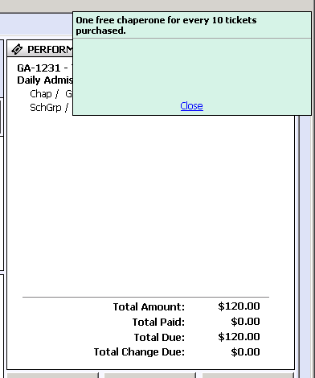
Pricing Rules
New and shiny! (v12.5)
Automatically applied based on other items in cart, constituent criteria and more!
Available via the web API and out of the box on TNEW
Notes:
Finally the newest addition to our pricing toolbox is called Pricing Rules.
I won’t go into too much detail as there are whole sessions and webinars dedicated to pricing rules, but the general gist is that pricing rules change the price of items in your cart based on several things so they are great for automatic member discounts, buy 2 things and get your parking for free, BOGO, etc…
Pricing rules can also message based on the contents of cart.

Slide 26
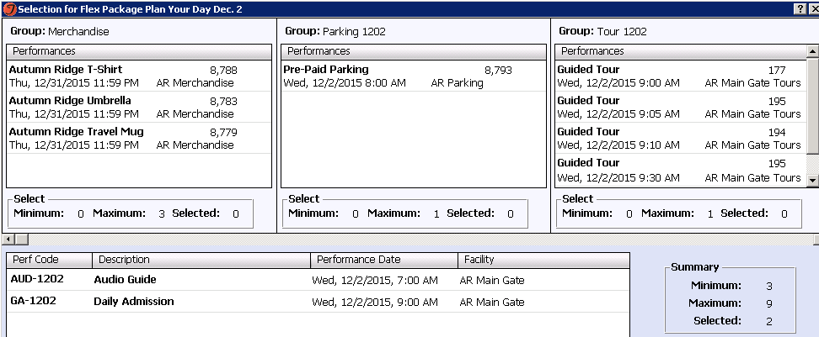
Flex Packages
Easy control of rules (e.g. - min/max number of performances)
Pricing assigned by Tessitura
Work with performance times or zones as times
Notes:
So you’ve got your events built and pricing applied, now what about groupings of events or admissions. Flex packages is the perfect tool for this. Flex packages let you set rules such as you have to buy 1 of these things and 2 of these things.
They work with performances that have a standard start time or times represented as price zones.
And of course as I mentioned earlier packages can be a button on the quick sale or TRBO screen.
Another benefit of flex packages is the ability to use what is called a composite ticket – 1 ticket and 1 barcode that represents all items in the package.

Slide 27
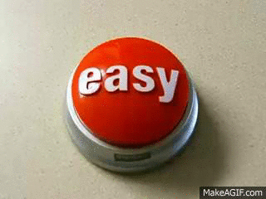
Fees
Simple setup
Ideal for selling items that have minimal reporting needs and no inventory control
Examples include stroller rental or coat check
Fees can be QuickSale buttons as well
Notes:
Finally, a quick plug for Fees.
Simple setup
Great for no capacity things
Can be quick sale buttons

Slide 28
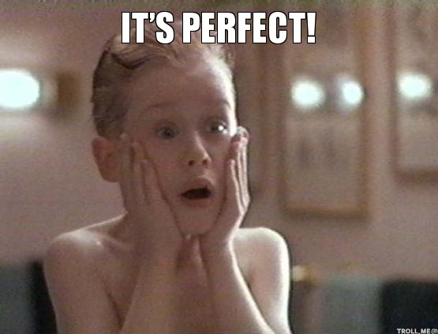
Setting up Sales Layouts
Notes:
So now let’s talk about the really fun part – arranging your sales layouts for QuickSale and TRBO
Ticketing Setup / Sales Layout Setup

Slide 29
Sales Layout Button Types
Performance Static or Relative
Package Static or Relative
Membership
Contribution / Contribution Roundup
Fee
Navigator
Notes:
Can even point to a specific zone within a performance

Slide 30
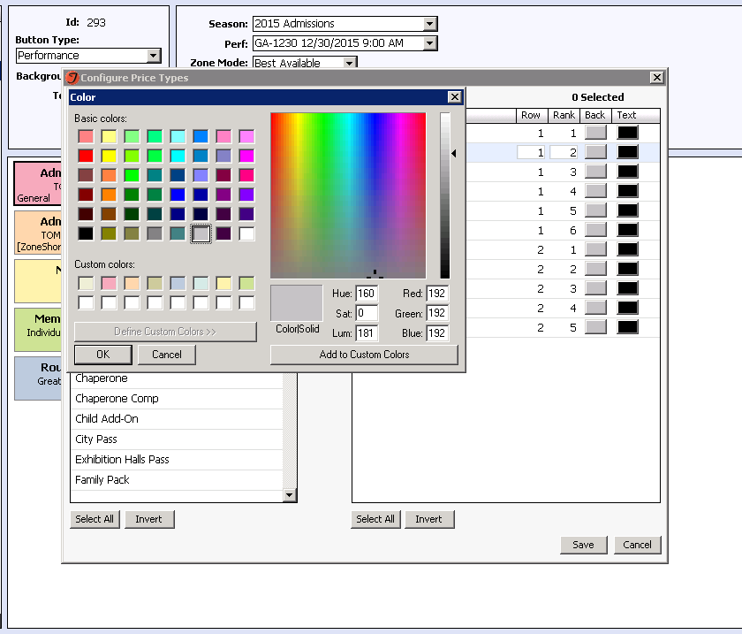
Think about…
Button placement
Number of layouts
Colors – for products, price types and payment methods
Notes:
Mention options like discounted price types a different color, also using ranked price types
Remember – it’s about speed – use whatever tricks you can to make the transaction flow.
New in v12.5 – up to 5 rows of price type buttons
Copy button saves time!

Slide 31
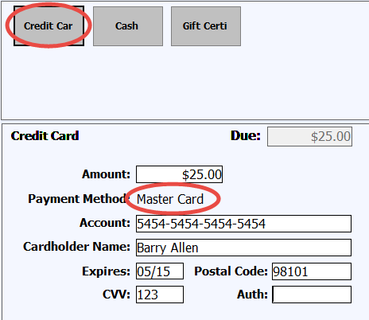
And a personal favorite: the Credit Card payment method!
Allows quicker payment with any credit card
Tessitura selects & processes correct card type
Notes:
Another thing that quick sale allows for is setting up a single Credit Card payment method that auto-selects the right card time when the card is swiped or keyed in.

Slide 32
Visitor Flow
Notes:
***** 11:25am ****
So now that you know how to sell and have your setup done let’s talk about a few ways Tessitura can help you manage your operations and visitor flow

Slide 33
Advance (Online) Sales
Consider using a Price Event to incent
Bonus: You get additional customer data without effort on your part
Notes:
So of course the best visitor is one you never have to talk to, right? Just kidding, but really….
Whether you use TNEW or have a custom site, advance (ideally online) sales are one of the best tools you have in managing visitor flow.

Slide 34
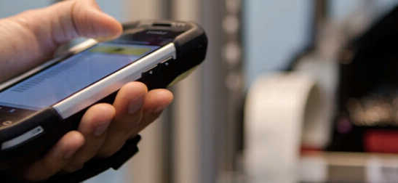
N-Scan Access Control
Notes:
Once the ticket has been sold and a barcode is generated this opens up the opportunity to use Tessitura’s N-Scan access control product.
You generally think of access control for fraud control and reporting purposes which are great things, but using it can also improve visitor flow and experience

Slide 35
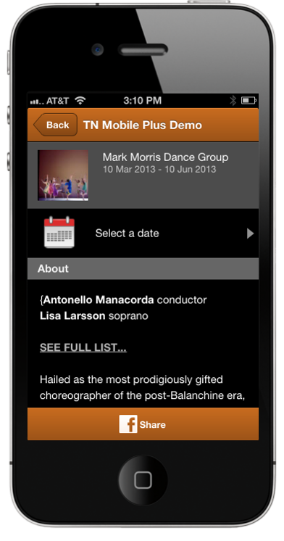
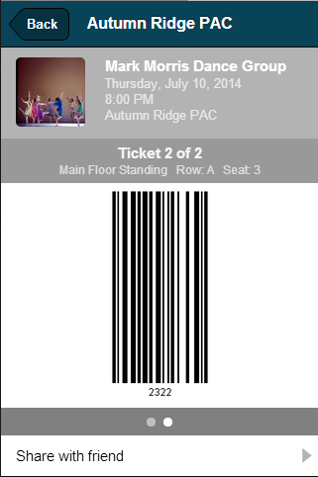
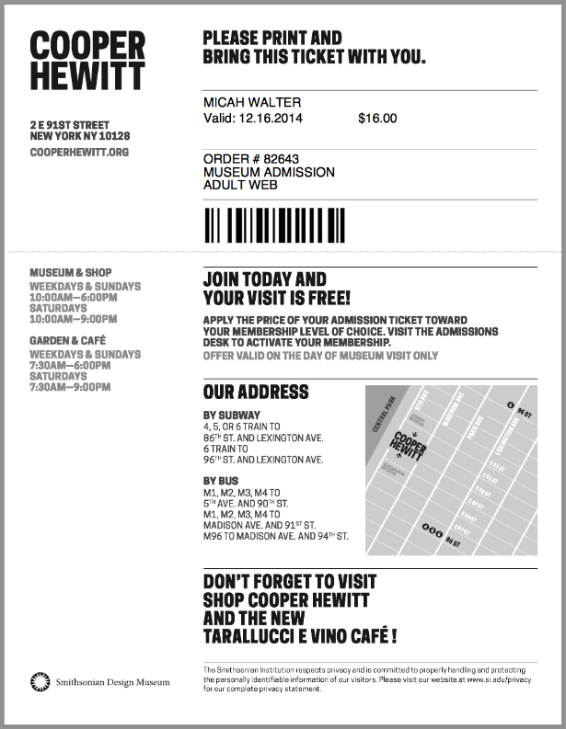
Print at Home and Mobile Ticketing
Notes:
Back on the theme of the less hands on you have to be with an order the better, print at home or mobile tickets let the customer show up with everything they need in hand which reduces the amount of will call and staff time
Consider a separate line or path so these folks don’t get mixed in with those who need to purchase tickets.
On TNMP there is a Forward ticket / barcode to friends
Reduces will call

Slide 36
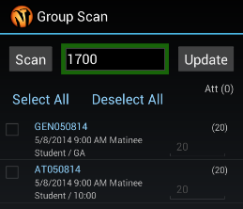
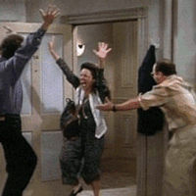

Group Entry
+
=
Notes:
Group entry
Scan order # barcode to allow entry for full or partial order
CLICK
CLICK

Slide 37
N-Scan Messaging
Can alert staff when a VIP or other person of interest has a ticket scanned
Can also prompt staff to deliver a message when a ticket is scanned
Notes:
N-Scan messaging
Messaging 2 ways

Slide 38
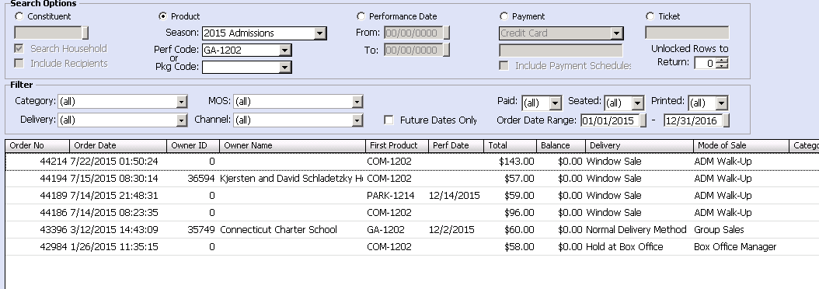
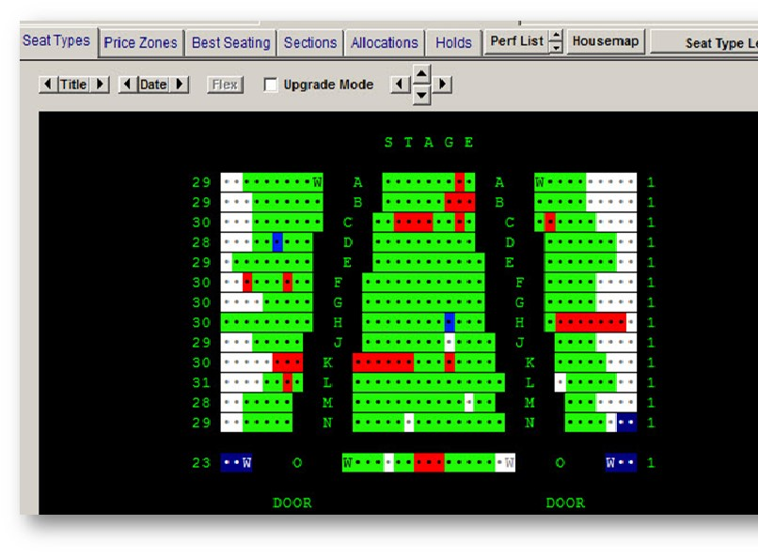
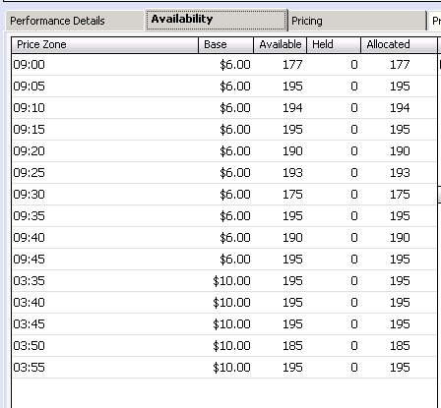
Tactical Reporting
Notes:
Lots of great sessions about analytical reporting which Tessitura does a great job of as well, but want to cover a couple tactical actionable reporting tools you may find useful.
Availability within Tessitura CLICK
Order search CLICK
Scanned tickets

Slide 39
Cross-Departmental Communication
Notes:
**11:40am**
One of the major reasons to love Tessitura is because it is an incredibly robust CRM. So don’t forget about these cross-departmental ways to streamline your Visitor Services operation.

Slide 40
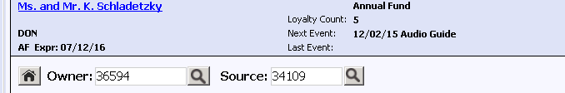

Actionable Header
Notes:
The HEADER
Reminder that information in the header should be actionable and convey relevant details about the constituent which cross many departments.
Whether it’s a missing email address, a membership about to expire or the fact that there is a CSI for the next event
As a reminder, the Flex Header setup tables mean you don’t have to be a SQL guru to customize headers to meet our orginizations needs.

Slide 41
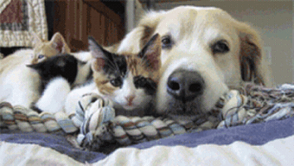
Cross-Departmental Sales
It’s easy to switch mode of sale as needed
OR
Consider offering products from multiple departments in a single blended Mode of Sale
Notes:
Cross-departmental cart
New functionality such as pricing rules and virtual constituencies (applied as a membership is in the cart) make it easier than ever to transact appropriately with a wide variety of constituents in a seamless manner – better for the customer and ultimately better for you.

Slide 42

Managing Visitor Services for Admissions
Questions.
#TECDublin16
What are your takeaways?
Notes:
11:45am

Slide 43


WHAT’S NEXT?
LUNCH 12.00-13.00
Hogan Foyer / Hogan Suite
Sponsored by:
BREAKOUT SESSION TWO
13.00-14.00
Notes:
THURSDAY Breakout session 1 What’s next slide

