Slide 1

TESSITURA
EUROPEAN
CONFERENCE
DUBLIN 2016
Notes:
Welcome

Slide 2



PANEL
Ben Dart : Sadler's Wells
Peter Jervis : Wigmore Hall
Tony Barnes : Tessitura Network
CONTENT PLANNERS
Laura Scott: Southbank Centre
Ben Dart: Sadler's Wells
FUTURE FINANCE
Simple, Streamlined, Secure
Share your favourite content and photos! #TECDublin16

Slide 3

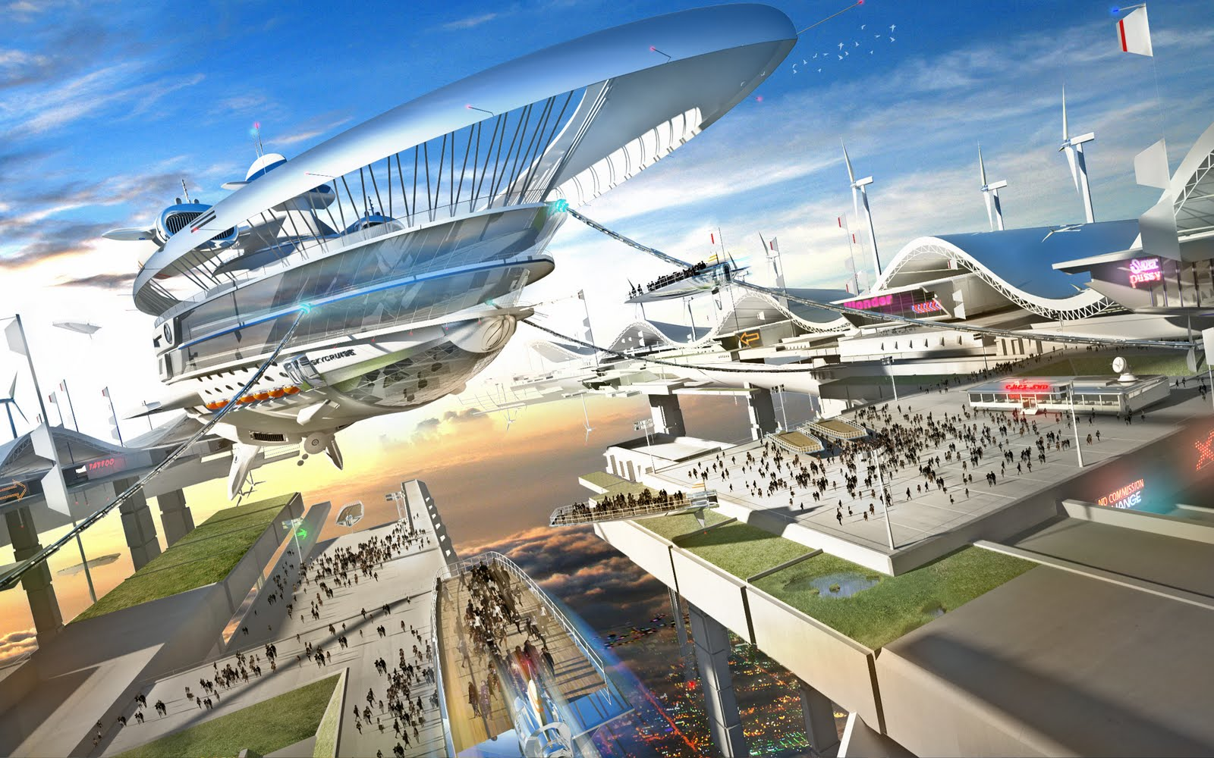
Future Finance
Finance Innovators

Slide 4
Thursday 17th November – 11am
Finance Innovation
11.00am: Introduction
11.05am: Sadler’s Wells – Developing Integration between the Finance function and the ticketing solution. Presented by Ben Dart
11.20am: Wigmore Hall – Paypal as a payment solution. Presented by Peter Jervis
11.35am: Tessitura – Version 14 preview. Presented by Tony Barnes
11.45am: Q&A and discussion

Slide 5

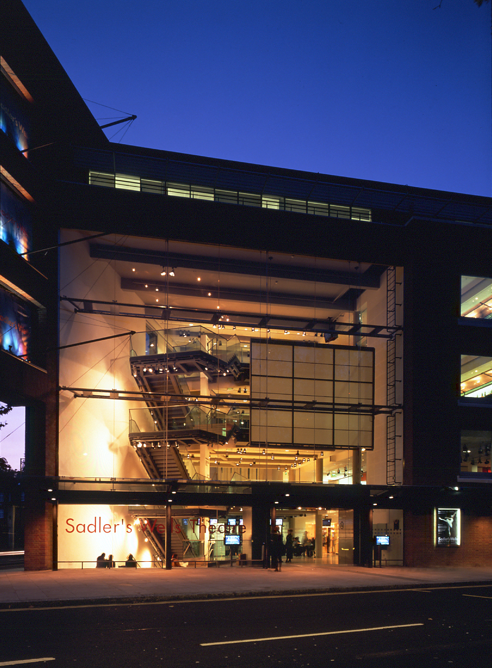
2015-16 Financial Year – over 600 performances over 3 stages, selling 463k tickets, over 500k people watched perfs
Supports 16 associate artists, 3 resident companies and an associate company - English National Ballet.
And 2 international associate artists
International Touring and Producing
in excess 100 performances worldwide
Creative learning – local community and UK wide. Main stage productions including the Elixir festival and National Youth Dance Company
Turnover – £25m –Centrally funded £2.5m, Ticket sales £20m – Fundraising £1.5m, Trading income £3m; Expenditure on productions £20m

Slide 6
Our aims:
To develop integration between our ticketing solution and our finance package
To automate routine tasks to allow staff to work more effectively and efficiently on tasks that add more value to what we do
To reduce staff input to decrease the risk of human error
To allow agents to access our website via API so their customers can select seats directly, and to avoid time spent issuing allocations to agents. (This will be covered in more detail in a later session)
To design processes that allow us to work more sustainably

Slide 7

Dmitrij Zille
How many I help you??

Slide 8
What have we done? – Part 1
Developed a stand alone invoice report which summaries weekly sales for each agent/visiting company/internal client. The report includes a detailed breakdown of sales by seat to allow the client to cross check what they are being charged for!!
Reports are scheduled to run at a given time at the end of the reporting period and are saved as PDF’s ready to be issued
An additional report is also ran which summaries sales so that invoice totals can be crossed checked and any discrepancies investigated before invoices are issued
The invoice is rendered as so:

Slide 10

Invoice No: 373243
Issued: 05/09/2016
Order Date
Customer Name
Order no
Performance
Details
31/07/2016
Ingresso
1271421
Matthew Bourne's The
Stalls
N
18-19
1366978
Red Shoes
2@ -
16/12/16 19:30
68.00
Ticket Agent Fees
GenAd
PV
63-64
Notes:
25/12/16 01:05
2@ 1.00
Linda Hudson (T000-0000-7GN8-5806)
Initiator:
moved to #1305828 - fees charged
01/09/2016
Ingresso
1305551
Programme A
Second
Q
24-25
Notes:
1366978
06/09/16 19:30
2@
Jacob Eggay-Muhammad (T000-0000-7KD3-P768)
Initiator:
01/09/2016
Ingresso
1305673
iD
Stalls
V
23-24
Notes:
1366978
07/10/16 19:30
2@
Beata Kepics (T000-0000-7KE0-9C26)
Initiator:
01/09/2016
Ingresso
1305684
Matthew Bourne's The
Second
N
9-10
1366978
Red Shoes
2@
Notes:
Sarah Arnall (T000-0000-7KE5-W78F)
07/12/16 19:30
12.00
Initiator:
01/09/2016
Ingresso
1305690
The Peony Pavilion
Second
N
16-17
Notes:
1366978
30/11/16 19:30
2@
Alicja Cielniaszek (T000-0000-7KE7-Z2EF)
Initiator:
01/09/2016
Ingresso
1305698
Programme C
First
K
18-19
Notes:
1366978
13/09/16 19:30
2@
Anu Karessuo (T000-0000-7KE9-A0BF)
Initiator:
01/09/2016
Ingresso
1305723
Matthew Bourne's The
Stalls
R
28-29
1366978
Red Shoes
2@
Notes:
06/12/16 19:30
47.00
Catherine Matthews (T000-0000-7KEG-5F0F)
Initiator:
01/09/2016
Ingresso
1305736
Swan Lake/Loch na
Second
O
18-22
1366978
hEala
5@
Notes:
26/11/16 19:30
12.00
Alicja Cielniaszek (T000-0000-7KEI-HC11)

Slide 11
What have we done? – Part 2
We are working towards automatic downloads of daily transactional data via a CSV file which is then uploaded onto our accounts package
Currently having to manually intervene given the complexity of calculating the VAT element of membership income
But systems are in place for the above to happen!!
Very important from an internal control and audit perspective
Allows financial data to be updated on a daily basis, to help provide better quality business information to be provided.

Slide 12
What have we done? – Part 3
In association with the ticket agents Ingresso we have developed an APPLICATION PROTOCOL INTEFACE – or API – which allows customers to book via their website but where seats are chosen directly from Sadler’s Wells website.
We are also working with London Theatre Direct to enable their customers to do the same.
This reduces the need for agents to be given ticket allocations, and allows us to drive sales through the agents as required.

Slide 13

Our gift to you!!!!

Slide 14
Thank you!!!!!!
Ben.dart@sadlerswells.com
Dmitrij.zeile@sadlerswells.com

Slide 15
Paypal
Wigmore Hall
2016

Slide 16
About Wigmore Hall
Internationally renowned intimate setting for small ensembles and soloists
The largest song recital series in the world
Un-paralleled programme of new commissions and important support structure for young artists
Incredible acoustic
Sector-leading Learning programme
Award-winning live record label
55% of our ticket sales happen online

Slide 17
Why PayPal?
Secure method of payment
Customers expect it
Inspires confidence (particularly amongst younger audience)

Slide 18
Number of transactions

Slide 19
Overview
What the customer sees
How it works
Tessitura
Administration
Setup, charges & charity rates

Slide 20
What does the customer see?

Slide 21
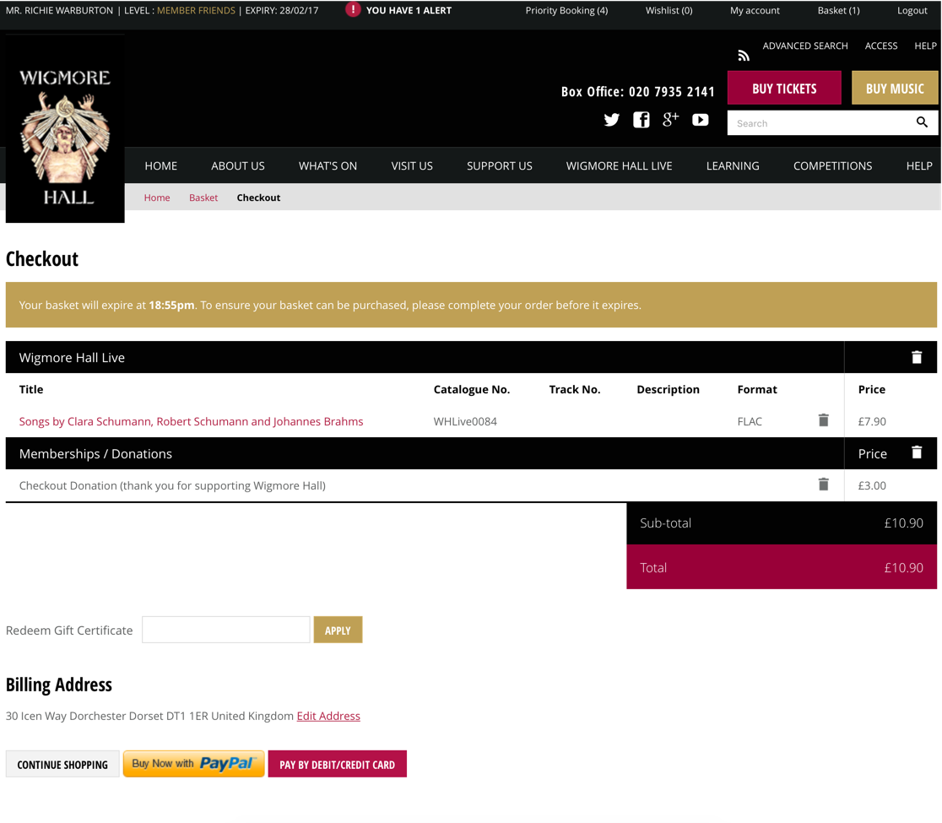
PayPal button as payment option

Slide 22
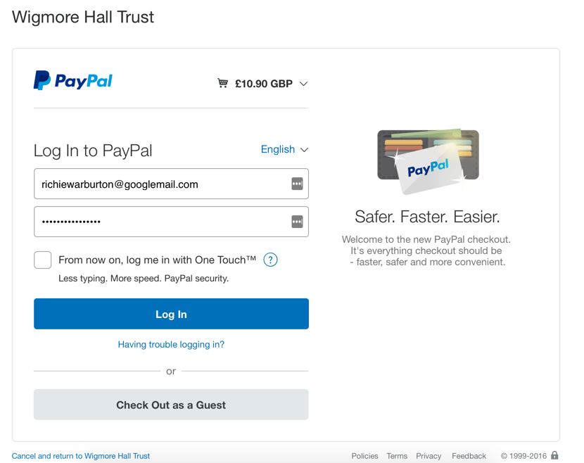
Redirected to PayPal login

Slide 23
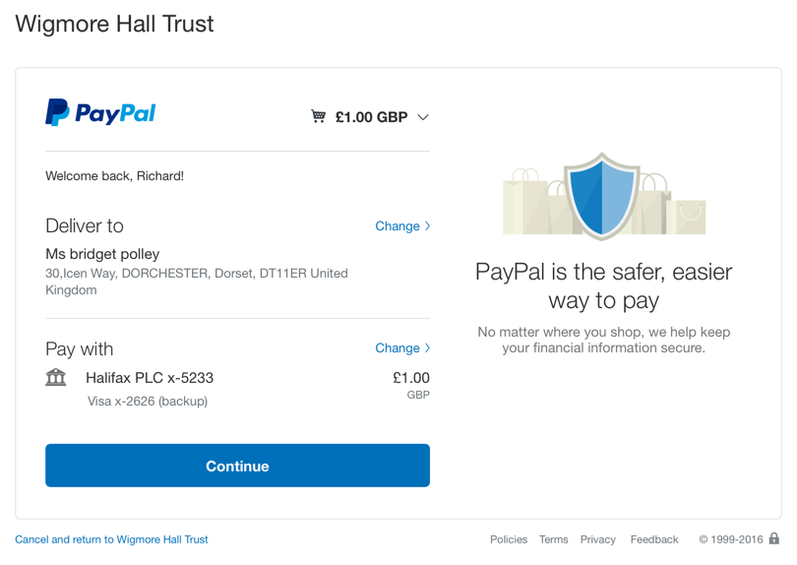
PayPal confirms purchase

Slide 24
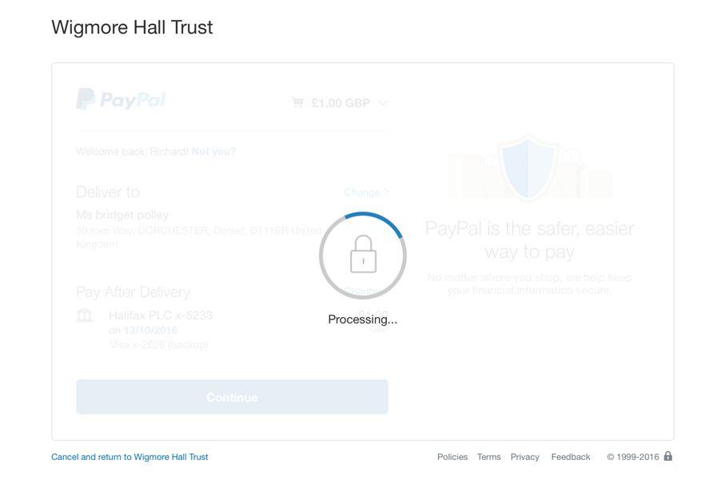
PayPal processes transaction

Slide 25
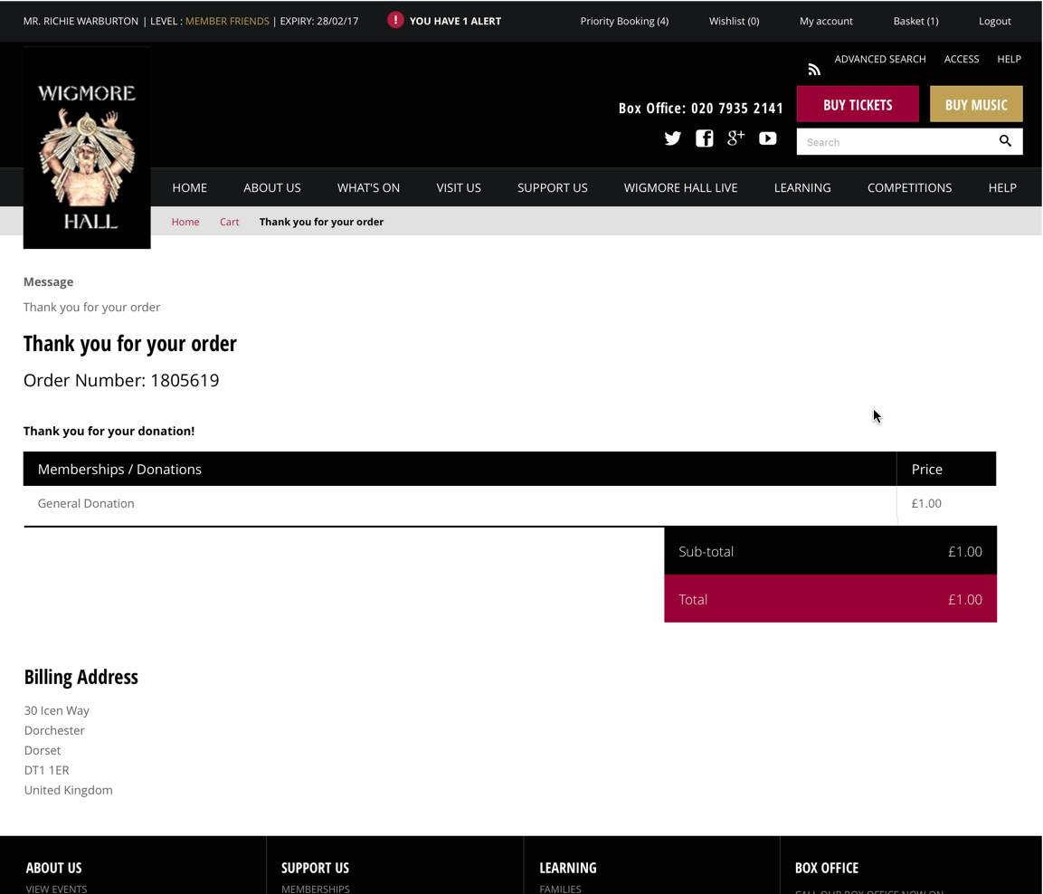
We confirm completion as usual

Slide 26
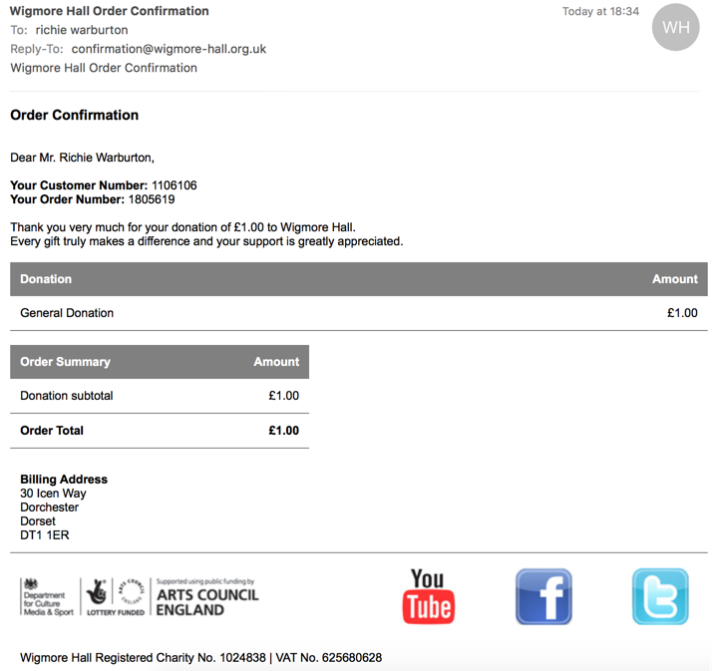
We send out a normal email confirmation

Slide 27
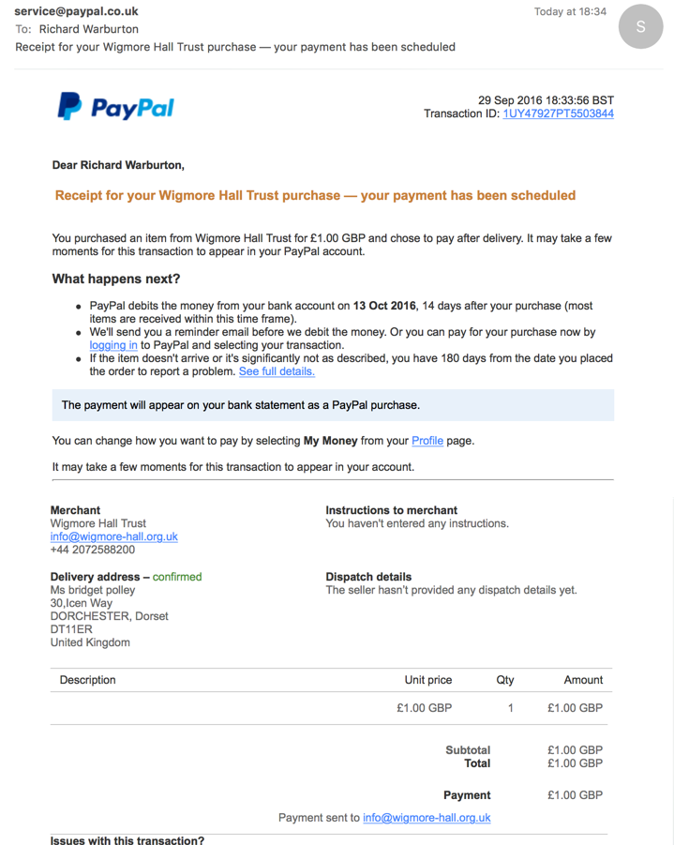
PayPal do too!

Slide 28
In all the ways PayPal like to comfort us..

Slide 29
How does it work?

Slide 30
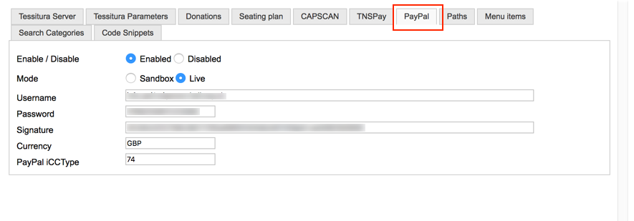
Website connection to PayPal
Website needs to be able to talk to PayPal’s API.
Just some parameters to enable communication
We asked for ours to be configurable. Not essential.

Slide 31
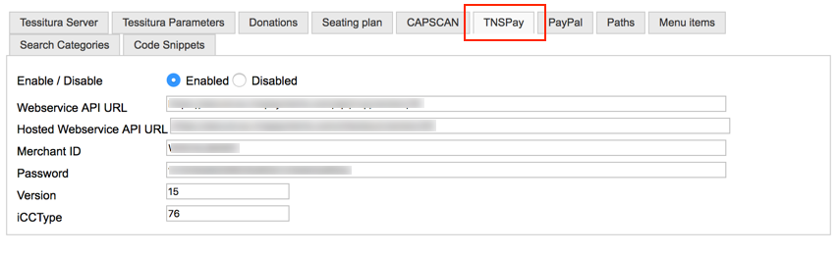
It’s a copy of the Credit Card parameters!
It’s really not that different
Web developers know how to do this

Slide 32
Checkout API method looks after everything
Amount and other essential data sent to PayPal
Re-direct to PayPal’s site
Return of data and completion of order
Normal order confirmation procedures happen after that
Just like a credit card transaction

Slide 33
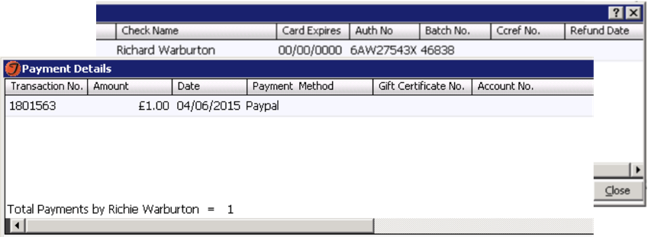
Transaction data in Tessitura
Transaction has PayPal’s authorisation code

Slide 34
Administration
All done online via PayPal account
Finance log in and transfer funds into the bank
Box Office log in and process refunds
Search, reporting and detective work all supported

Slide 35
Reconciliation
Report export from PayPal site
Comparison with Tessitura

Slide 36

Tell PayPal you’re a charity
Charity setup done online via PayPal account
They ask for loads of stuff; you never really know if they are paying attention
Took about a week (once we figured out where to look)
Rates are OK.
  You’re paying for your customer’s confidence and peace of mind

Slide 37
Thanks!
Peter Jervis – Deputy Director
  pjervis@wigmore-hall.org.uk
  020 7258 8254
Richie Warburton– Director of Technology
  rwarburton@wigmore-hall.org.uk
  020 7258 8258
David Taylor – IT Manager / Database Developer
  dtaylor@wigmore-hall.org.uk
  020 7258 8256

Slide 38
Version 14 preview
Click here to start timer
Presenter
Tony Barnes, Tessitura Network

Slide 39
Version 14
  Payments Window
  Refund Prior Payment
  Tokenisation
  BI – Dashboards

Slide 40
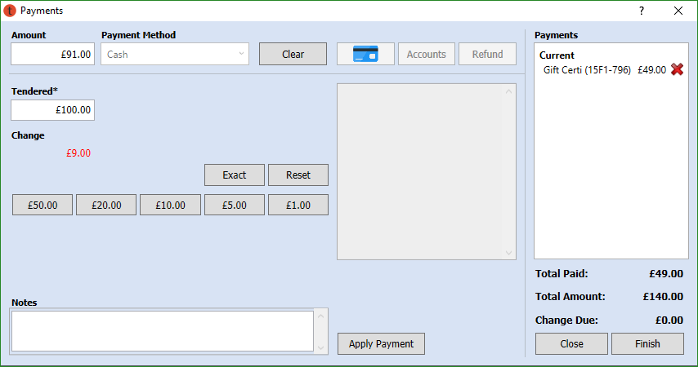
  Cash Payment
Notes:
Payments is such a critical area and we wanted the code to be more easily testable and maintainable. This means a complete rewrite of the Payments window, using much of what we learned by designing QuickSale.
One of the User Interface goals was to make the Interface payment type specific so there isn’t so much junk on the screen.
Cash Payment – we moved the Quick Sale buttons (Exact etc.) to the Cash UI and now the payment window is the same for QS as everywhere else.

Slide 41
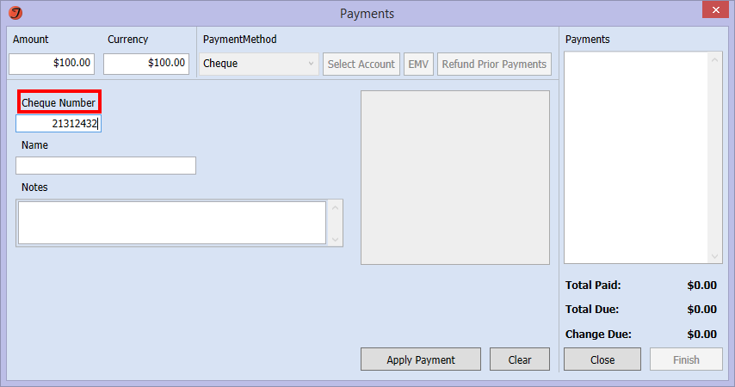
  Cheque
Notes:
.

Slide 42
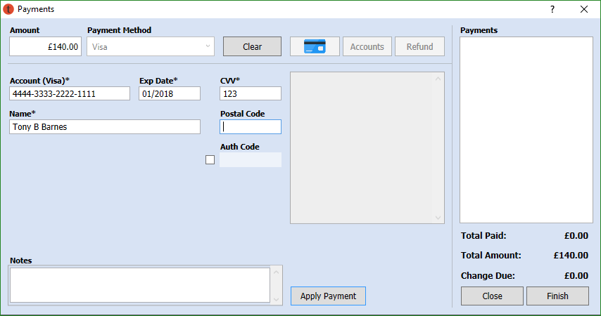
  Credit Card
Notes:
.

Slide 43
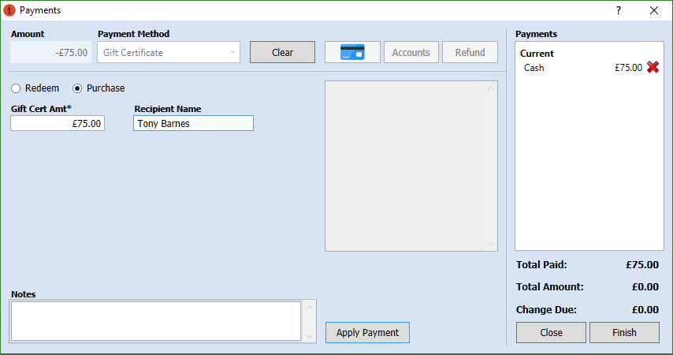
  Gift Certificates
Notes:
Gift Certificate purchase - we did not change that this gets logged as a liability (which it is) but we did make the UI so the user doesn’t have to be faced with the negative amount when making a purchase.

Slide 44
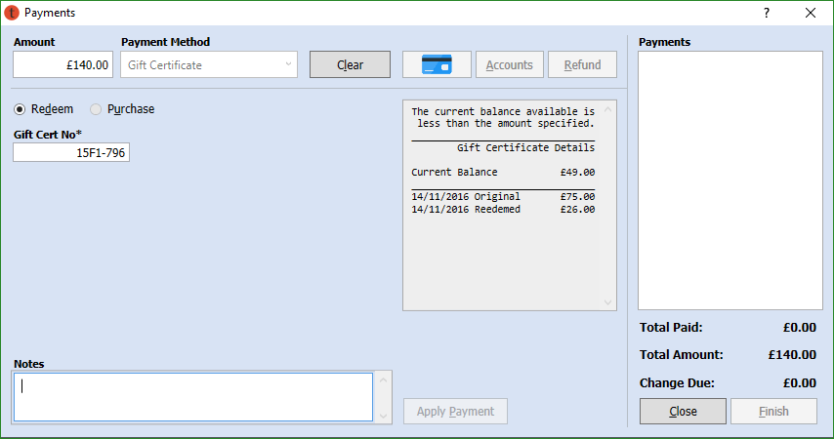
  Gift Certificates
Notes:
GC underpay – We had added a message pane which notes the status of the payment and in this case notes the GC details right on the screen.

Slide 45
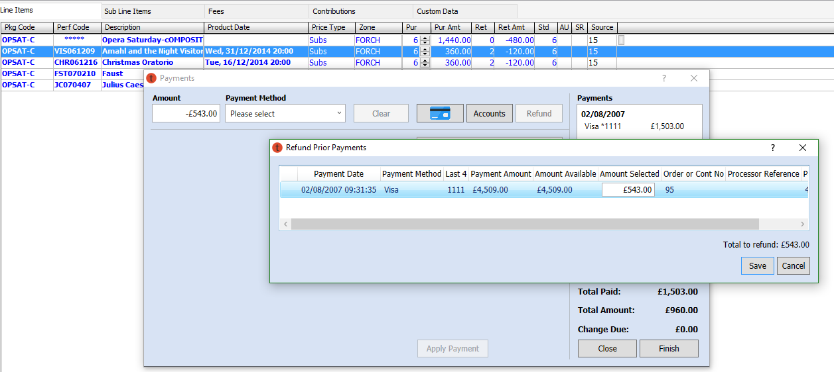
  Refund prior payment
Notes:
There is no connection between tokenization and the Refund Prior Payments function. The Refund Prior Payments function allows you to process refunds to the credit card used to make the original payment without having to reenter the credit card account number or keep that account on file. A reference number is provided by credit card processors for each credit card transaction, and that transaction reference number is used by the Refund Prior Payments function.
The Refund Prior Payments window displays all credit card payment amounts for the current order and orders tied to the sub line items (SLIs) being returned in the current order

Slide 46
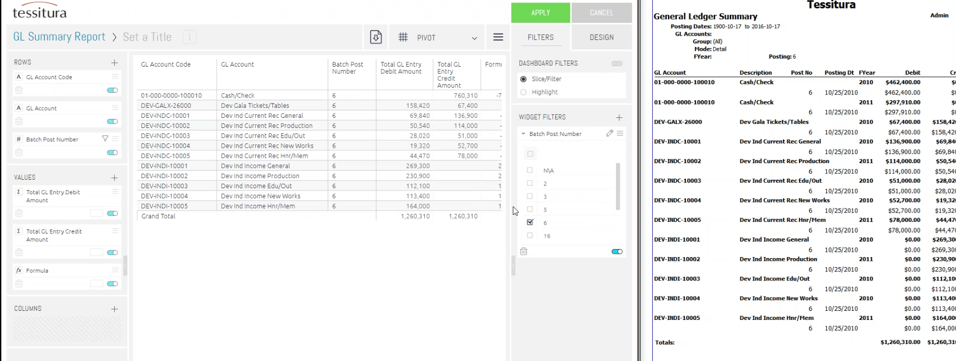
  BI Initiative
Notes:
Finance cube built off transactions table – auditing against some Tess standard reports
GL Summary report - replicated in BI dashboard – but editable and can be manipulated

Slide 47
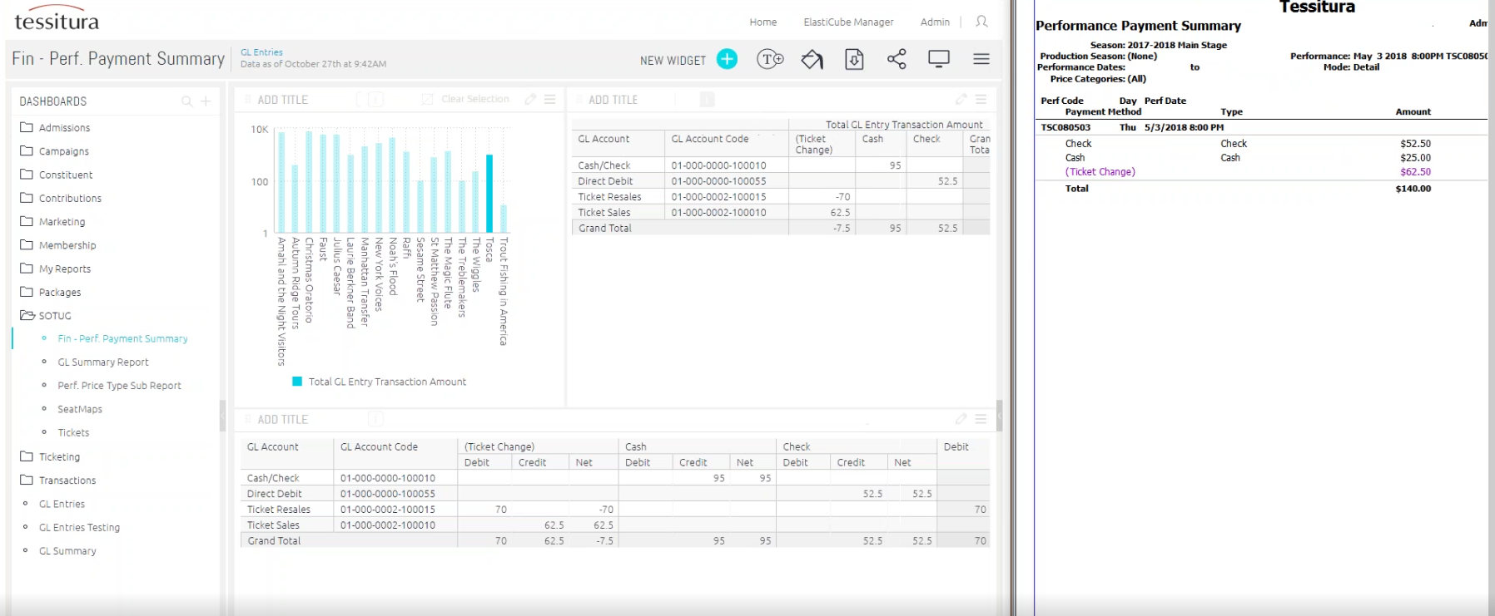
  BI Initiative
Notes:
Payments by performance summary - Tosca

Slide 48
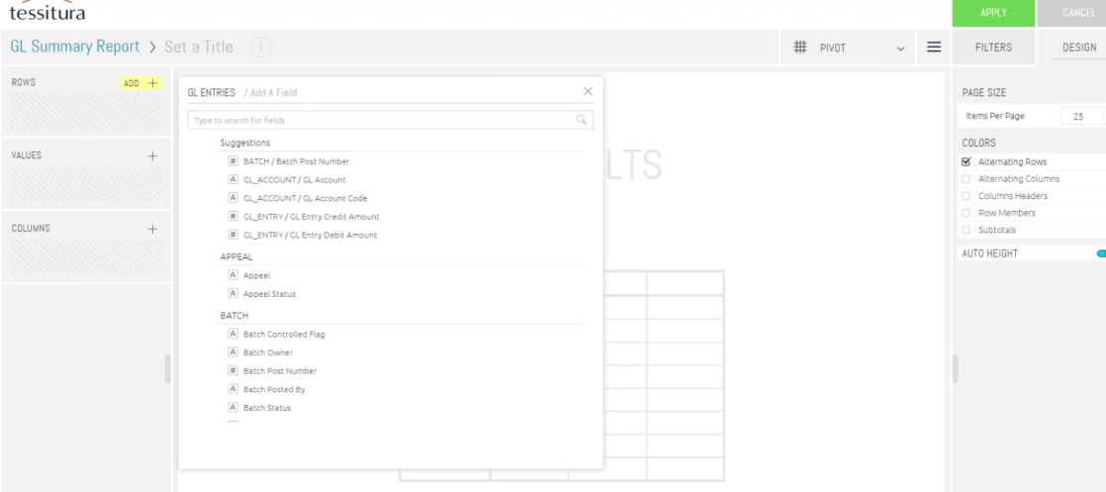
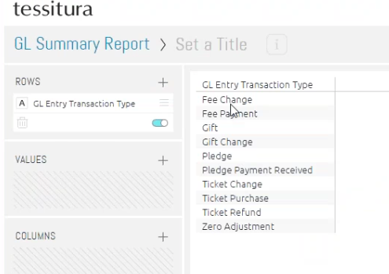
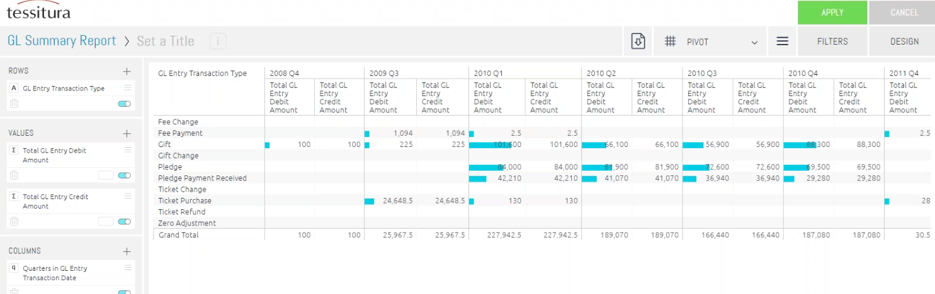
  BI Initiative
Notes:
Drag and Drop – add a widget – pivot table based on transaction types – add pivot by date, group by year/quarter

Slide 49
“We are all in the gutter, but some of us are looking at the stars.“
QUESTIONS?
Oscar Wilde, Lady Windermere’s Fan

Slide 50


WHAT’S NEXT?
LUNCH 12.00-13.00
Hogan Foyer / Hogan Suite
Sponsored by:
BREAKOUT SESSION TWO
13.00-14.00
Notes:
THURSDAY Breakout session 1 What’s next slide

