Slide 1

TESSITURA
EUROPEAN
CONFERENCE
DUBLIN 2016
Notes:
Welcome

Slide 2



MODERATOR
Giulia Cubattoli – Roundhouse Trust
Panellists
Lizzie Rawlinson – Royal Shakespeare Company
Janna Ellis – Yale Rep
Claire Griffin – Roundhouse Trust
Daisy Swift & David Taylor – Wigmore Hall
Tessitura as an Education CRM
CONTENT PLANNER
Giulia Cubattoli - Roundhouse Trust
Share your favourite content and photos! #TECDublin16

Slide 3
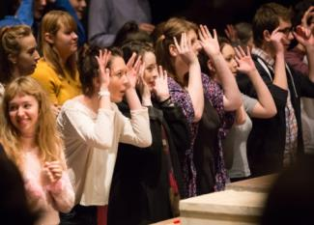
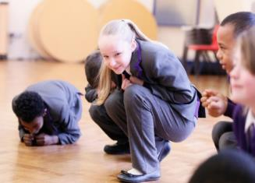
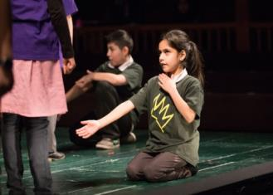
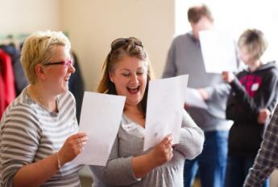
Tessitura as an Education Customer Relations Manager
Lizzie Rawlinson
RSC Education
Notes:
Lizzie Rawlinson
Coordinator in RSC Education
Work on PD Programme and national partnership programmes

Slide 4
About RSC Education
We reach over 530,000 young people and 2,000 teachers in the UK and overseas each year
Our Aim – to make early encounters with Shakespeare’s work vivid, accessible and enjoyable so children and young people can form a lifelong relationship with Shakespeare, theatre-going and theatre-making.
Our priorities:
  The professional development of teachers so more young people’s experiences are rooted in the real world of the rehearsal room
  Working with schools and theatres in areas of relatively high socio-economic deprivation
  Partnerships with schools, universities, theatres and corporate supporters nationally and internationally to influence formative experiences of Shakespeare’s work
  Enabling young people and their teachers to engage with Shakespeare’s plays and the work of other writers as artists
  Influence policy makers so young people can access the full extent of their cultural inheritance

Slide 5
Recording Education work on Tessitura
  We use Tessitura for managing a range of interactions with schools and teachers
  Ticket sales – performances and events for both young people and teachers
  Tracking relationships within our long-term partnership programmes
  Recording participation in other projects
    Schools’ Broadcasts
    RSC Dream Team
  Maintaining information about schools to help us meet our engagement targets
Notes:
Broad range of activity and information that we need to record on Tessitura
Need to be able to record participation in both free and paid for events

Slide 6
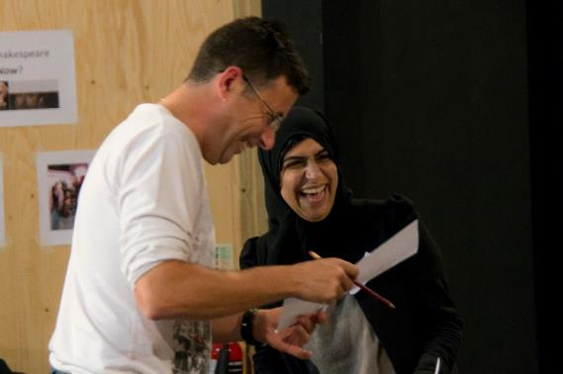
Ticket sales – CPD Outreach project
  As well as using Tessitura to ticket the events we host, we are also trying to record participation in our CPD outreach programme
  Professional Development courses can be booked by schools or organisations anywhere in the country
    Usually one booker (school, local authority or other organisation) who hosts participants from lots of different schools
  Previously only recording the booker, which limited our understanding of who was taking part
Notes:
Retros

Slide 7
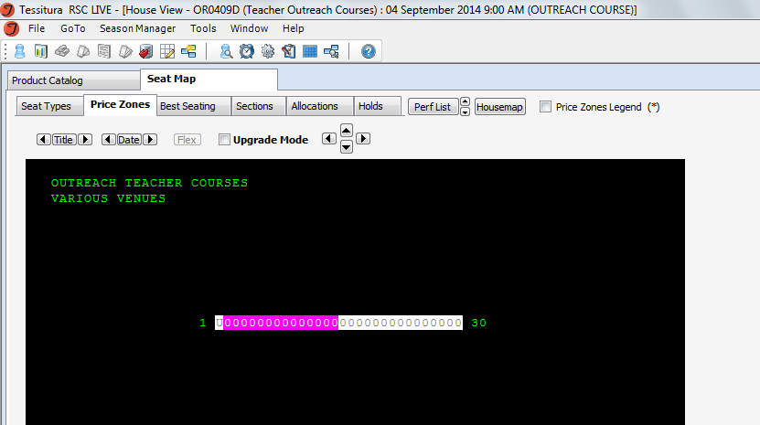
Ticket sales – CPD Outreach project
  Now set up as a general admission plan within ticketing
    1st seat sold to the booker at full price and invoiced accordingly
    Remaining seats sold retrospectively as comps to individual participants, who are affiliated to their respective school records

Slide 8
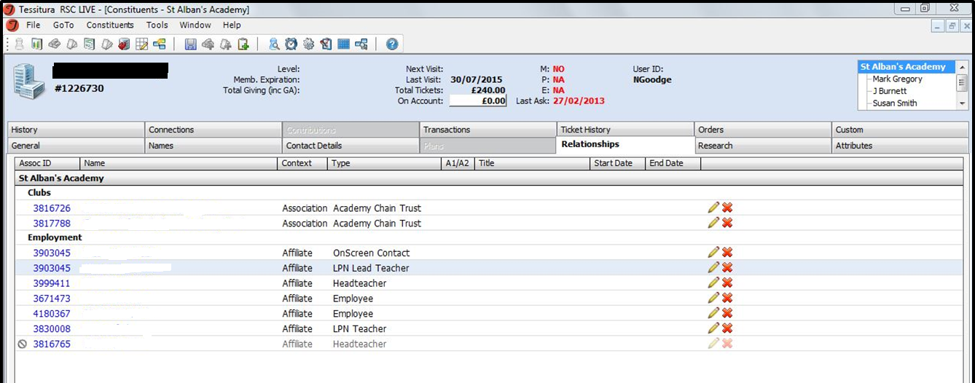
Tracking relationships
  We use affiliations to record relationships between teachers and schools
Notes:
Useful for marketing as we always get better responses when mailing or emailing individual teachers rather than generic school addresses
Also allows us to track teachers throughout their careers

Slide 9
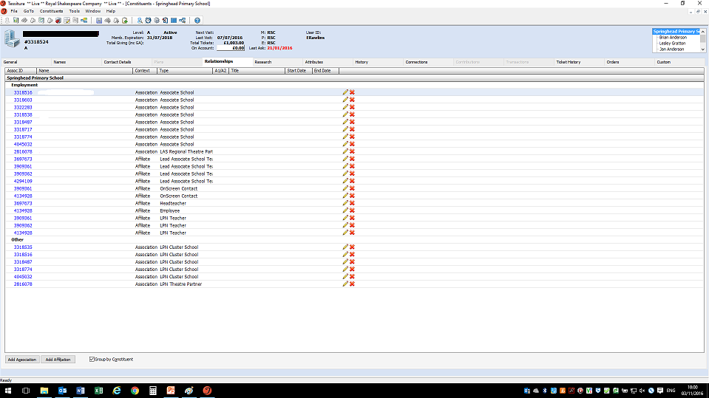
Tracking relationships
  Recently launched the RSC Associate Schools programme, a long term partnership between RSC Education, regional theatre partners and schools
    Required a new approach to relationships, using both affiliations and associations
Notes:
Different cohorts - Attributes
Record relationships between organisations – LAS to RTP/ AS to RTP/ LAS/AS
Record relationships between organisations and individuals – Teachers to LAS & AS

Slide 10
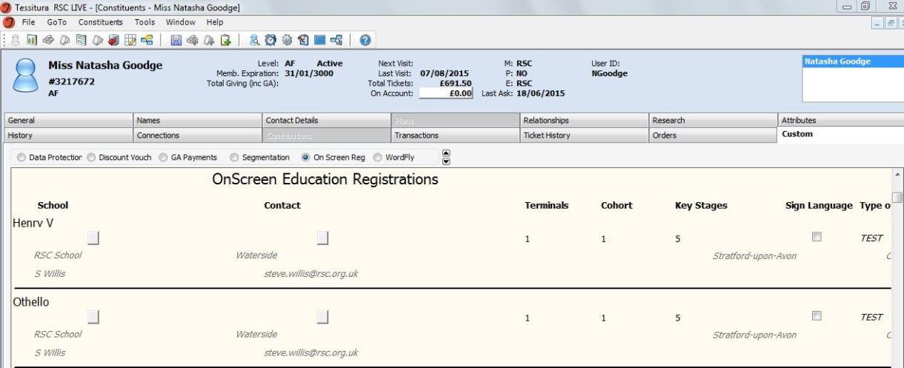
Recording participation
  We have lots of other projects which are not ticketed but which we want to keep records of on Tessitura
  Free Schools’ Broadcast Series allows schools to watch RSC productions from their classrooms
  Online registration form adds information to a custom screen which allows us to match against existing records or create new ones.
Notes:
System was developed because first broadcast was hugely popular Richard II with David Tennant – lots of people who were not schools tried to register and we needed a manual process to identify genuine schools
Time consuming to process but does give us much better quality data and avoids duplicate records which could be created by an automated system

Slide 11

Recording Participation
  We use attributes to record participation in lots of our projects
  Schools Broadcasts
    As well as recording registrations, we are able to tell who logs on to watch on the day – this is recorded as an attribute
  RSC Dream Team 2016 participation as attributes
    Schools could register online to receive a free Playmaking Pack to help them put on their own production of A Midsummer Night’s Dream and perform in our Playmaking Festival in Stratford-upon-Avon
Notes:
Once set up attributes are easy to add to lists of records using ‘Manage Attributes’ report

Slide 12
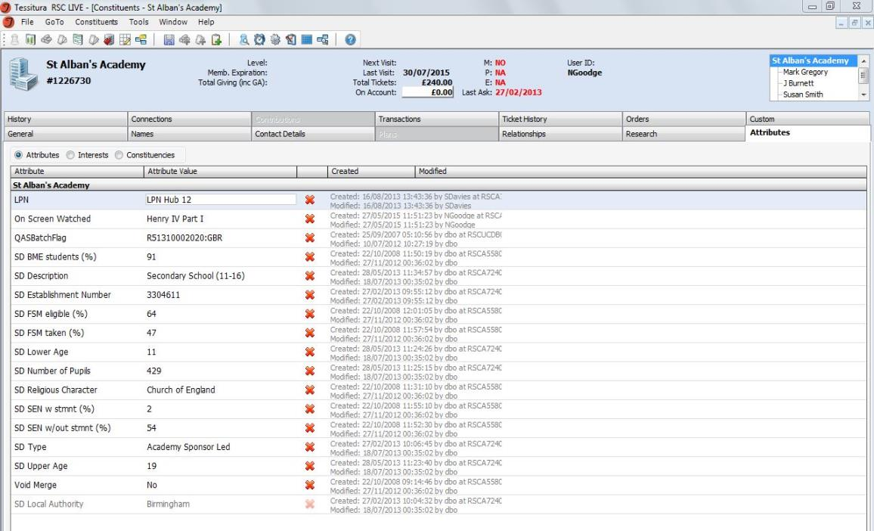
Reporting on our reach
    We use imported government data to report on against key statistics for the schools we work with – recorded as attributes
Notes:
As an Arts Council funded organisation, reporting is hugely important for us. By importing key statistics on UK schools into Tessitura constituent records, we are able to give a much more accurate idea of the demographics of the schools, teachers and young people we work with
We get this data from the .gov.uk website – search online for ‘UK Schools and their characteristics’ and look for the link called ‘underlying data’ – updated yearly

Slide 13
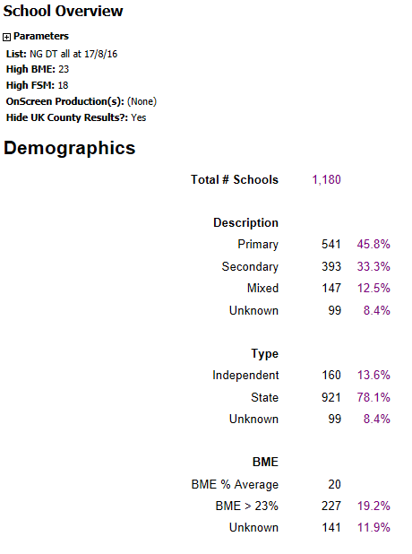
Reporting on our reach
    We created a bespoke report which draws on this information to help us quickly access this information for any given list of schools
    Runs from a user defined list
    Allows us to determine average BAME figure and FSM figure
Notes:
This report has massively cut the amount of time we spend collating information for our Arts Council reporting. Previously we were limited to using multiple (nearly 100 one year!) lists to get this information – now we just need one list for each group of schools we are reporting on and the report gives us all the key information in an easy to read format.

Slide 14
Future projects
  Recording data from younger participants
    Keeping in touch with young people who have experienced our work over several years
    Upcoming talent pathways project will see us having more independent relationships with young people
    Need to develop a system which adheres to all safeguarding policies but still allows us to maintain data
Notes:
We would like to make sure that we try to keep in touch with the young people who have been involved in our longer-term projects, so that their relationship with the RSC goes from being just something they do at school to an independent choice. From September 2017 we will also be developing more routes for young people to work with RSC Education as individuals through a talent pathways system and need to be able to record participation.

Slide 15
Thank you.

Slide 16
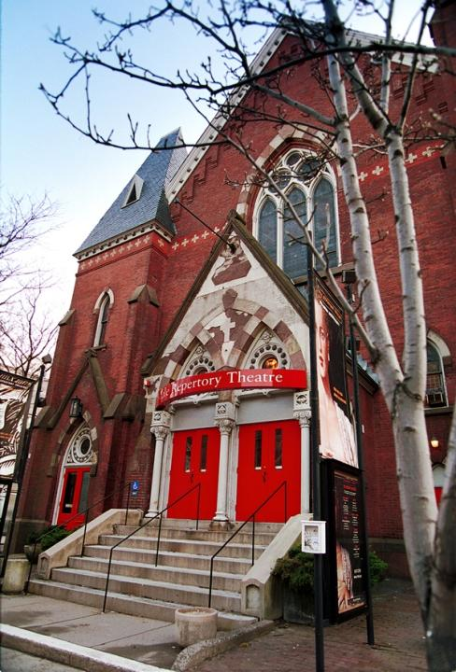
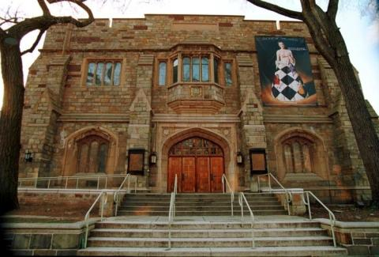
Education Constituent
Relationship Management
Yale Rep’s WILLPOWER!
School Group Management

Slide 17
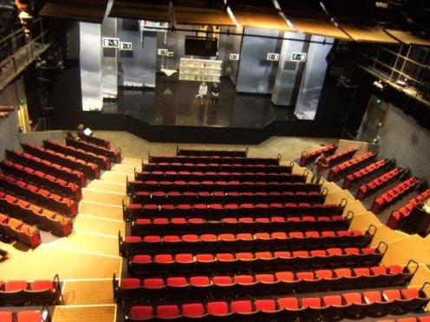
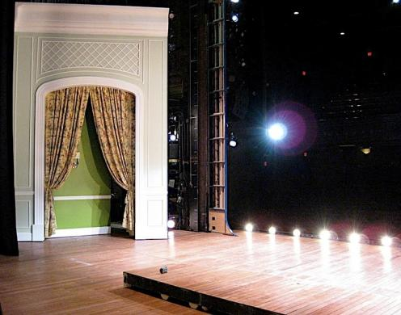

Season: Sept-May
  2 theaters
  5 productions/season
  22 performances/production
  Capacity : 10,000-13,000/ production
Tony Award Winning
New Haven, CT
  → Population ~1 million
Nearby theaters:
  Long Wharf Theater
  Shubert Theater
  Hartford & Westport
  New York City (1.5 hrs)
Notes:
Yale Rep is dedicated to New Plays and Bold re-interputations of Classics

Slide 18
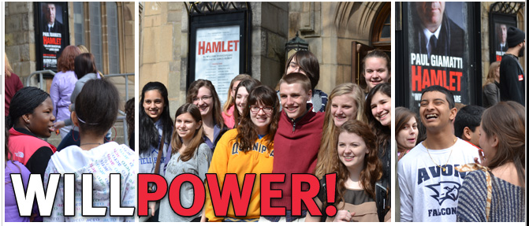
WILLPOWER! Program
3 Performances a year
~1000 Middle to High School students
Specially Priced Matinee Performances ($5-$10)
Post Performance Discussions with Creative Team and Actors
Teacher Workshops and Study Guides
Notes:
WILL POWER! is Yale Repertory Theatre's annual educational initiative in conjunction with one of its productions.

Slide 19
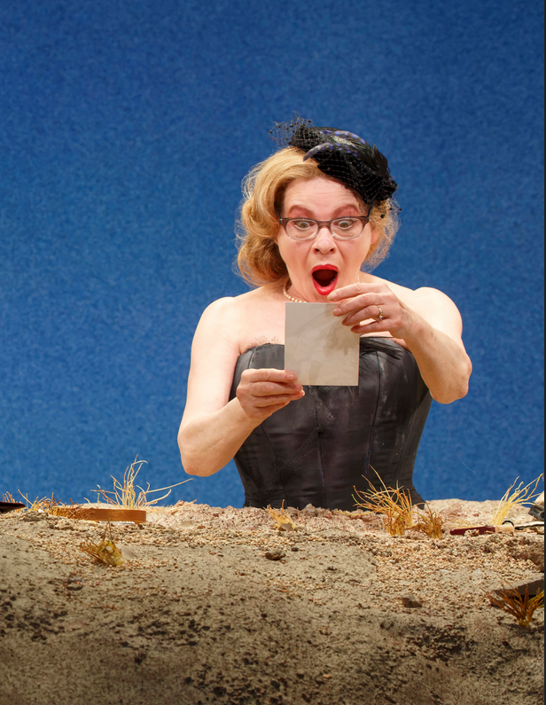
What we had been doing:
Education Contact
Box Office
Contact
School Contact
House Manager
Happy Days (2016)
Notes:
All Communication went through the Education Contact (one person, one very busy person) We wanted that person doing other things like working in the schools.
Lots of paper
Lots of missed communication
Lots of people with pieces of puzzle
Lots of time between receiving payments and payments being submitted
LOTS OF CONFUSION

Slide 20
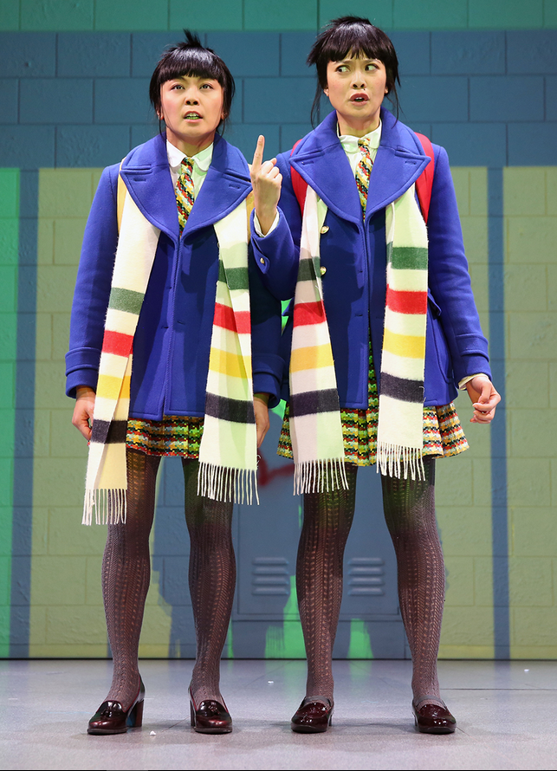
Solution = Tessitura
Box Office becomes main Contact
Create Custom Tab
  # of Stud and Teachers
  Talkback Attendance
Create Reports
  Automatic Contract
  School Transaction Report
Peerless (2015)

Slide 21
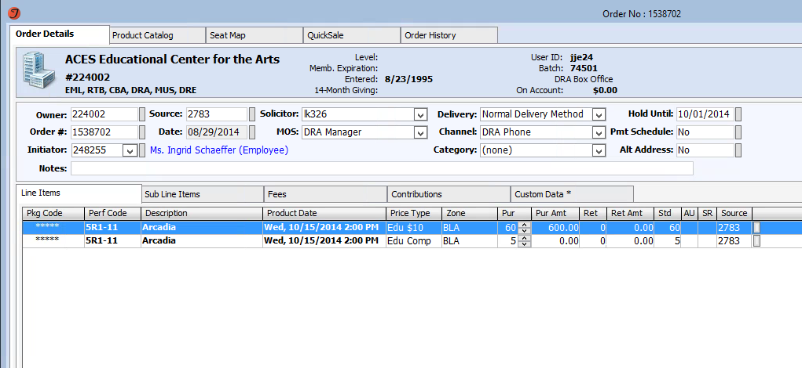
Order Under School/Organization Name
Teacher/Leader is Initiator
Notes:
This also helps to keep the teacher’s personal record more organized.

Slide 22
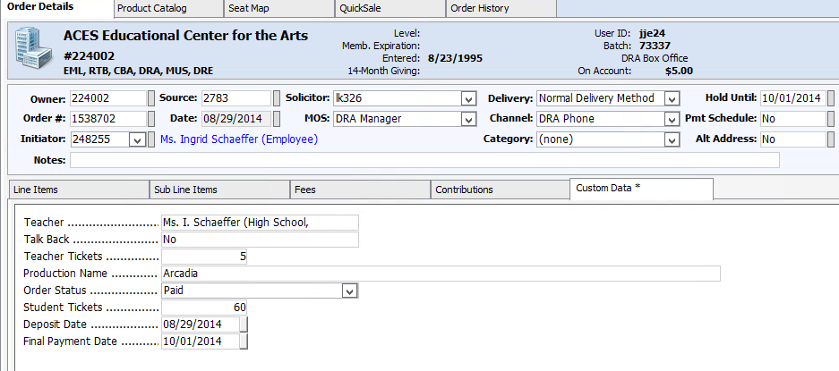
Talk Back Attendance
# of Teacher vs Student Tickets
Order Status
Deposit Date
Final Payment Date
Notes:
Box Office Records all info in custom tab
Once the order is in Tessitura we can run the Group Contract from the Report Menu

Slide 23
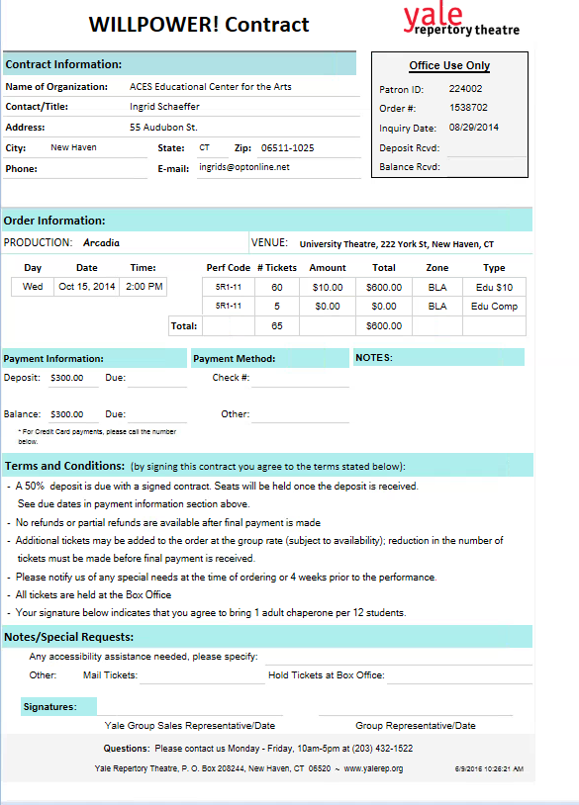
Notes:
Complete Contract generated from Tessitura with all info including Terms and Conditions.

Slide 24
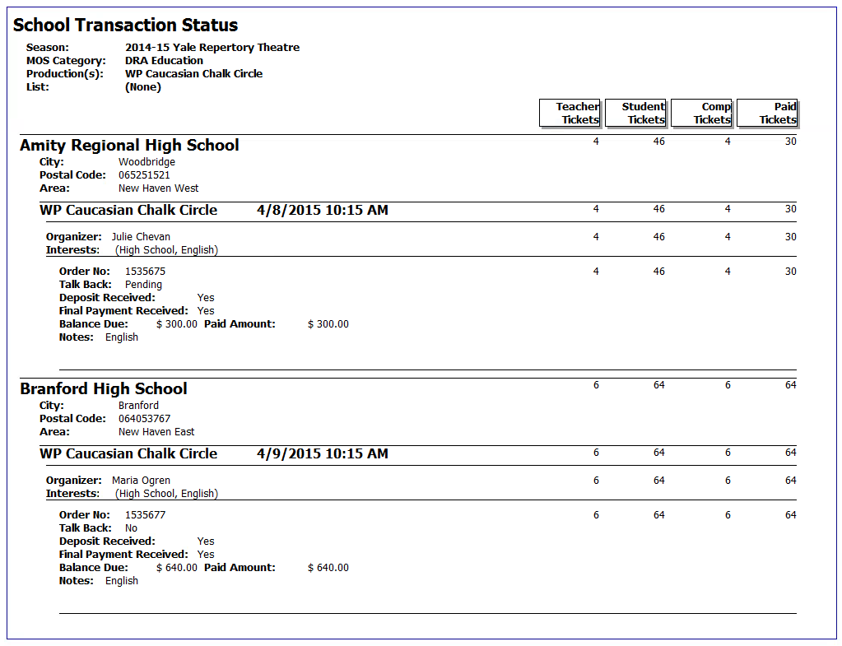
Standard School Group Reporting
Box Office follows up with Schools for deposits and Final Payments
Education Contact quickly monitors up to date info on schools
House Manager monitors and prepares ushers for performance
Notes:
Easily Access info for all Groups coming to a performance or a production

Slide 25
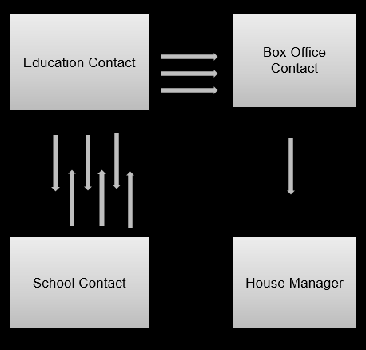
Old Process:
New Process:
Box Office
Contact
Education Contact
Tessitura
School Contact
House Manager
Notes:
New Process
Much more efficient with Tessitura in the middle allowing everyone in our Organization to monitor up to date info

Slide 26
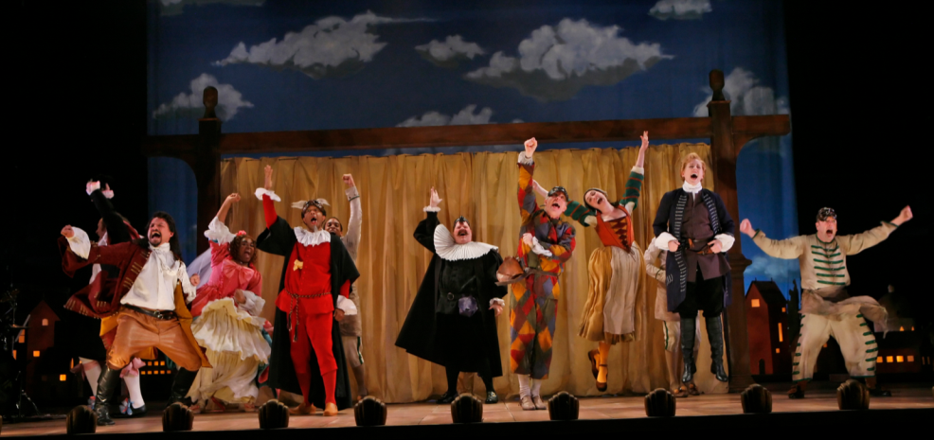
Janna Ellis
Yale Repertory Theatre janna.ellis@yale.edu

Slide 27

Roundhouse
Tessitura as a CRM tool for individual Young People
Claire Griffin
Visitor Operations Manager

Slide 28

Create to Transform
………………………………………………………………………………………………………………………………………….
A former railway engine repair shed, Grade II* Listed building, transformed in to a ground breaking performing arts venue 50 years ago.
Reopened in 2006 after a £30m development which included the creation of a state of the art creative centre for 11-25 year olds.
We are a charity working with 3000 young people a year.
We’re here to transform. To create, agitate and excite.

Slide 29
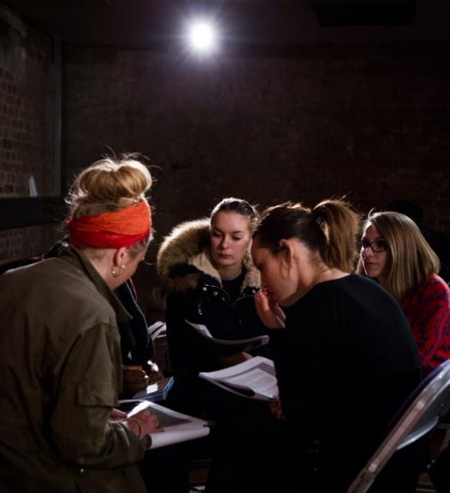
Tessitura as a CRM Tool
………………………………………………………………………………………………………………………………………….
Visitor Services man the front desk as an initial contact point of contact for young people but information needs to flow through to the Youth Strategy Team, Project Coordinators, Tutors & Youth Support Workers allowing us to give the best service to young people with a complex range of needs.

Slide 30
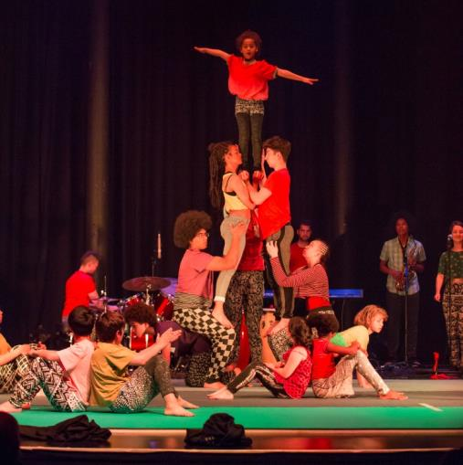
Studios Specific CSI’s
………………………………………………………………………………………………………………………………………….
Visitor Services
Accessibility –Project Specific
VS Admin – Projects
VS Admin – EAM
Emerging Artist Gift Membership
VS Admin – Bursary

Slide 31
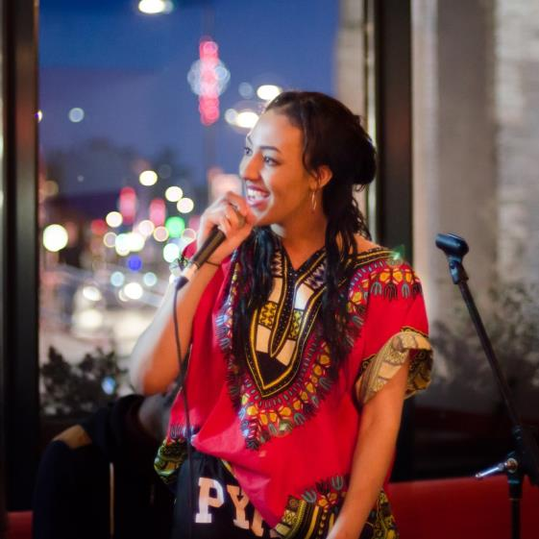
Studios Specific CSI’s
………………………………………………………………………………………………………………………………………….
Studios
Concerns about a YP
Behaviour of a YP
Equipment lost/stolen
YP Complaint
Bursary Issues

Slide 32

End slide
Thank You!
claire.griffin@roundhouse.org.uk
www.roundhouse.org.uk

Slide 33

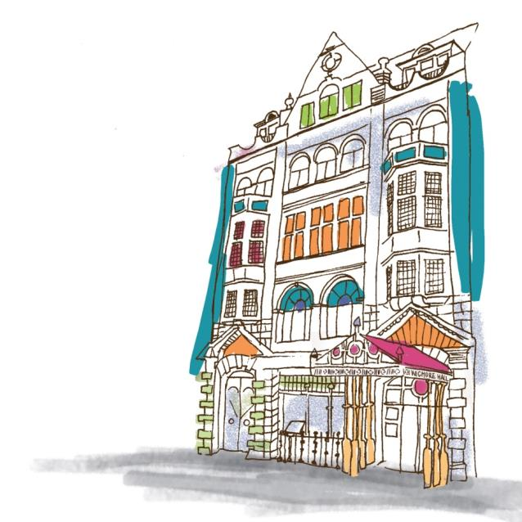

Connecting
people
through
music
Notes:
Intro:
Me
WH – big part of that is WHL
Talk a bit about that, then Globe

Slide 34
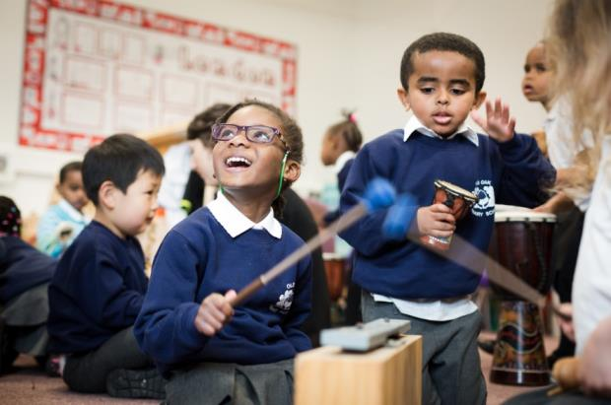
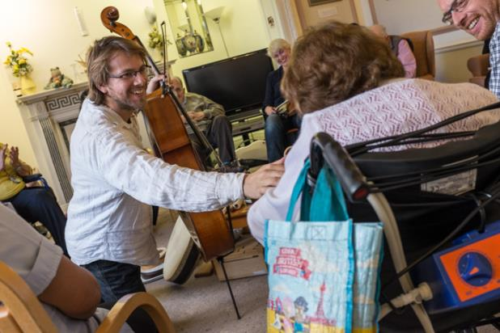
What we do…
Creative music-making
with
  Schools and early years
  settings
  Community groups
  Families
  Young people
  Adults
Chamber music at the
heart – a group of people
making music together,
with every voice heard and
equally valued
Singing, composition and improvisation
Notes:
(Nearly) everyone has a singing voice, and everyone has a creative voice
No prior musical knowledge assumed where possible
Limit barriers to access – inclusive
Schools EY – hear more about
Community: vuln adults and children/yp in challenging circumstances
Fam, yp, adults

Slide 35

Current Engagement with Tessitura…
Historically minimal / superficial
Taskforce!
  Contacts
  Events
  Tracking progression pathways
  Plans
Notes:
Broad overview on topics we’re tackling (DT to talk in more detail):
Mailing lists / user groups / reporting on events at Wigmore Hall
DT, DS, RW – meet every other week
Contacts: Excel spreadsheets – schools, associates
Events: Projects outside of WH – ongoing partnerships so not always clearly defined times
Progression: Wouldn’t be appropriate to put all ind details in when working with a whole school, so how do we track their progression?
Plans: Working with Development to track funders’ support
Challenge of small org – time/staffing, but means we can be well connected across depts. – can do holistically, why we’re both here!

Slide 36
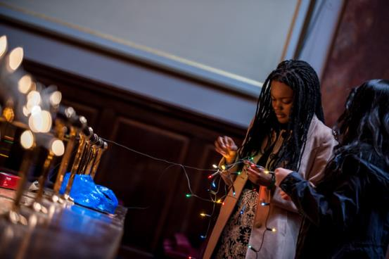
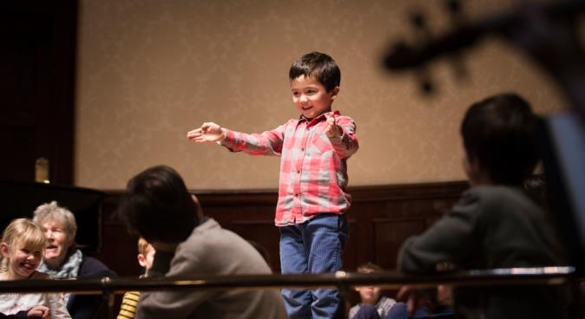
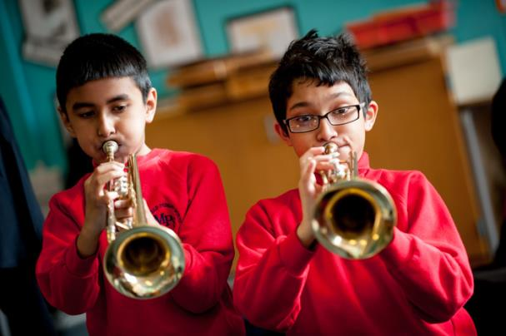
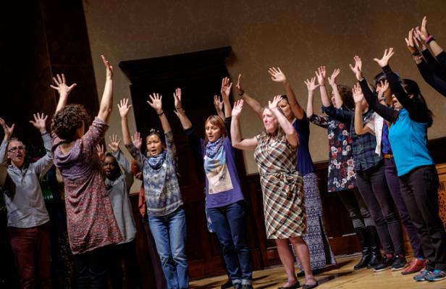

Slide 37
Contacts and Tessitura…
How to import
  LP_CONSTITUENT_IMPORT is your friend
Where to store everything
  Cust Type
  Research Notes
  Attributes
  Relationships
Notes:
Why bring in to Tessitura – Contact info in one place, and up to date for everyone
Can reference for marketing (Wordfly)
Reporting on Ticket purchase using I/O/R
How to import – Constituent Import
For additional info use LP_CONSTITUENT_IMPORT
Where to store additional Info –
Attributes – great for dropdown lists, or yes/no options
Research Notes – can store almost unlimited information here
Cust Type – useful for salutation and schools
Relationships – for School records, most important. Store teacher links and job titles. Then pulled through in extractions for marketing, or ticketing orders by Box Office
ONS Geography – Postcode Directory

Slide 38
Events and Tessitura…
Which events to track
  Start with manageable groups
  How much information to store
Where to store everything
  Performance custom screen
  Customer custom screen
  Ticketing history with I/O/R
  Reporting
Notes:
Events – the ones not at the Hall
Do we track all of them – start with a small manageable group of performances
What information to store – monitoring, securable data.
Who has access to which part
How to store all of this
CSIs
Information which is performance specific v’s customer specific
Custom Screens for very targeted work
Ticket Ordering I/O/R can help with a great deal of attendance work – Also NSCAN
How can you report on all this information.

Slide 39
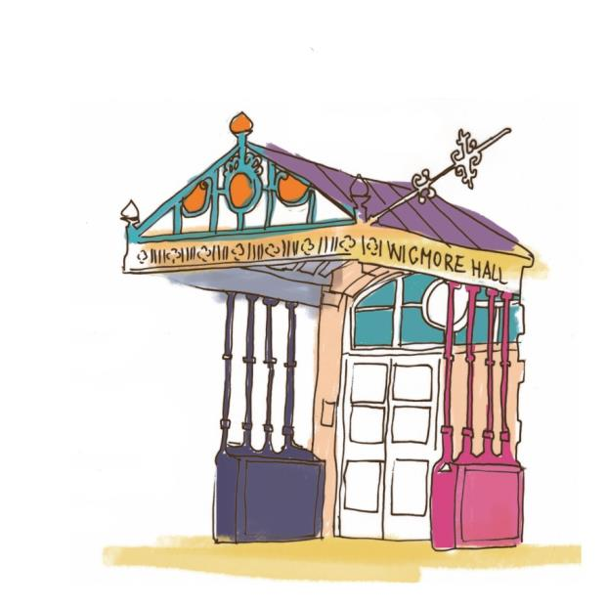
Thank you
Daisy Swift
Head of Learning
Wigmore Hall
dswift@wigmore-hall.org.uk
@WigmoreLearning
David Taylor
IT Manager
Wigmore Hall
dtaylor@wigmore-hall.org.uk

Slide 40
“We are all in the gutter, but some of us are looking at the stars.“
QUESTIONS?
Oscar Wilde, Lady Windermere’s Fan

Slide 41


WHAT’S NEXT?
LUNCH 12.00-13.00
Hogan Foyer / Hogan Suite
Sponsored by:
BREAKOUT SESSION TWO
13.00-14.00
Notes:
THURSDAY Breakout session 1 What’s next slide

