Slide 1

TESSITURA
EUROPEAN
CONFERENCE
DUBLIN 2016
Notes:
Welcome

Slide 2



MODERATOR
Eve Parker : Roundhouse
GURU
Becky Loftus : Royal Shakespeare Company
CONTENT PLANNER
Eve Parker : Roundhouse
SURVEYING YOUR MEMBERS
Asking the right questions at the right time to the right people
Share your favourite content and photos! #TECDublin16

Slide 3
RSC Membership Survey
Seeking the opinion of our biggest fans and harshest critics

Slide 4

Notes:
Based in Shakespeare’s home town of Stratford-upon-Avon
Perform throughout the year in Stratford-upon-Avon, with seasons of work in London, and also touring nationally and internationally
Broadcast live to cinemas around the world and free to UK schools
Our two thrust stage auditoria (the Royal Shakespeare and Swan theatres) we believe give the best possible setting to experience live theatre
We also have a new flexible studio theatre space called The Other Place
We perform works by Shakespeare, Shakespeare’s contemporaries, new work and work for families
We’re not just a theatre. Visitors can enjoy the stunning views from the Tower, explore backstage on a Theatre Tour, learn theatrical secrets at our new permanent exhibitions The Play’s The Thing, or enjoy freshly prepared, locally sourced food in the Rooftop Restaurant and Bar

Slide 5

Members and Supporters
The Most Vocal Group?
The 24k RSC Members and Supporters are vital to the success of the RSC, purchasing around a third of all tickets
They are often the most vocal group, being quick to contact us when they are unhappy about something and yet also the first to praise and recruit others into attending or even becoming Members
However not all Members are the same:
  6% have never attended and 20% have not attended in the past 5 years, yet keep paying for their Membership
Without seeking their opinion specifically, only those most vocal members have their voices heard

Slide 6
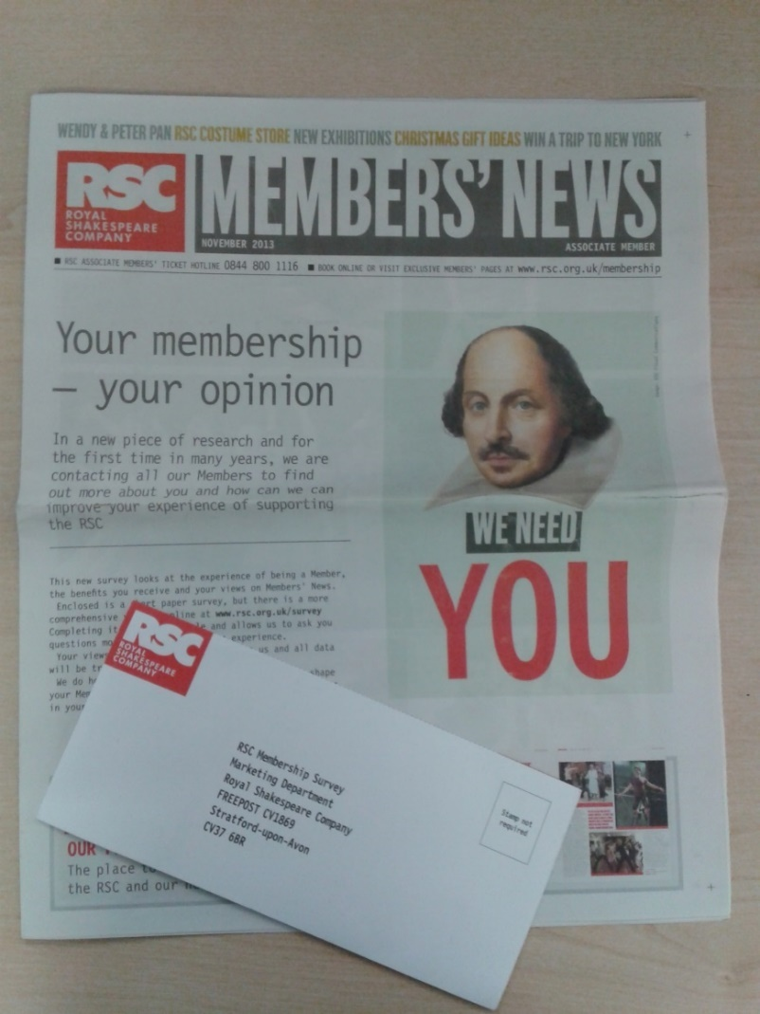
How we gathered their opinions
Paper and online survey of all Members (2013)
Too many responses, so a random sample were data entered and coded (around 1000 in total)
Short online survey of lapsed members and hot prospects who are not members (book early, book often)
Paper and online survey of all Supporters (2015)
Follow up qualitative focus groups with Supporters
Notes:
Membership survey was conducted with help from an agency to data enter and code up but supporters was entirely in house with focus groups conducted in house. Data all selected from Tessitura. If you did entirely online you could conduct with a random sample only but we wanted to give everyone a chance to have their say about the scheme.

Slide 7




What we found and what we did as a result
Finding | Action
Members are a lot older than the rest of our audience (10 years on average!) and only 5% have children in the household | Introduce family benefits such as Family Fridays with £5 tickets for under 18s on Fridays along with extra discounts in the restaurant
53% are also members of the National Trust, the highest other membership | Worked more closely with the National Trust on mutual offers
9/10 members rate the scheme positively and it is felt to be great value for money | Put prices up! N.B. There had not been a price rise for 5 years
Only a few of the benefits of the scheme have widespread awareness and usage | Benefits streamlined and made clearer
Notes:
Here are just a few of the key learnings from the different research and what we did as a result of each finding

Slide 8



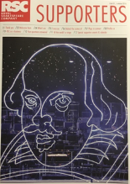
What we found and what we did as a result
Finding | Action
Priority booking is vital, with most of the (very low levels of) dissatisfaction coming from problems during priority booking | Put further actions in place to smooth the technical process on priority booking days along with clearer messaging
Some felt they didn’t get ticket offers that they saw others getting elsewhere (i.e. social media) | Create more bespoke offers for members and ensure members informed about wider ticket offers
Supporter scheme naming unclear | Rename and revamp scheme (Bronze, Silver and Gold Patrons)
Supporters’ newsletter format not in keeping with their expectations | Bespoke Patrons’ newsletter created in desired format

Slide 9
“We are all in the gutter, but some of us are looking at the stars.“
QUESTIONS?
Oscar Wilde, Lady Windermere’s Fan

Slide 10


WHAT’S NEXT?
LUNCH 12.00-13.00
Hogan Foyer / Hogan Suite
Sponsored by:
BREAKOUT SESSION TWO
13.00-14.00
Notes:
THURSDAY Breakout session 1 What’s next slide

