Slide 1
Data Cleaning
Tilly’s Top Tips

Slide 2
1. DON’T LET YOUR DATA GET DIRTY
Notes:
It’s never too late to implement protocols: meet with all people relevant – data inputters (box office) and users (marketing/development) to agree what needs collecting and how. If everyone who contacts box office by phone or in person has their details updated, eventually a huge proportion of the data will be clean without actually having done any cleaning! Data cleaning by stealth!

Slide 3


Slide 4
2. Plan Plan Plan Plan Plan Plan Plan Plan Plan Plan Plan Plan Plan Plan Plan Plan Plan Plan Plan Plan Plan Plan Plan Plan Plan Plan Plan Plan Plan Plan Plan Plan Plan Plan Plan Plan Plan Plan Plan Plan Plan Plan Plan Plan Plan Plan Plan Plan Plan Plan Plan Plan Plan Plan Plan Plan Plan Plan Plan Plan Plan Plan Plan Plan Plan Plan Plan Plan Plan Plan Plan Plan Plan Plan Plan Plan Plan Plan Plan Plan Plan Plan Plan Plan Plan Plan Plan Plan Plan Plan Plan Plan Plan Plan Plan Plan Plan Plan Plan Plan Plan Plan Plan Plan Plan Plan Plan Plan Plan Plan Plan Plan Plan Plan Plan Plan Plan Plan Plan Plan Plan Plan Plan Plan Plan Plan Plan Plan Plan Plan Plan Plan Plan Plan Plan Plan Plan Plan Plan Plan Plan Plan Plan Plan Plan Plan Plan Plan Plan Plan Plan Plan Plan Plan Plan Plan Plan Plan Plan Plan Plan Plan Plan Plan Plan Plan Plan Plan Plan Plan Plan Plan Plan Plan Plan Plan Plan Plan Plan Plan Plan Plan Plan Plan Plan Plan Plan Plan Plan Plan Plan Plan Plan Plan Plan Plan Plan Plan Plan Plan Plan Plan Plan Plan Plan Plan Plan Plan Plan Plan Plan Plan Plan Plan Plan Plan Plan Plan Plan Plan Plan Plan Plan Plan Plan Plan Plan Plan Plan Plan Plan Plan Plan Plan Plan Plan Plan Plan Plan Plan Plan Plan Plan Plan Plan because
Notes:
If you do embark on data clean, do not underestimate the importance of planning. Spend a long time on this to save time later. Work out every step and brainstorm every outcome, because it is like a big jigsaw puzzle/domino run – if one piece doesn’t fit, or one domino doesn’t fall right, the rest will never work.

Slide 5

Notes:
Because you can’t turn back time...

Slide 6
3. Don’t try to interfere with the space/time continuum
Notes:
Related to previous point... You will lose members of staff, and in under-resourced arts companies this is something we can all ill afford.

Slide 7
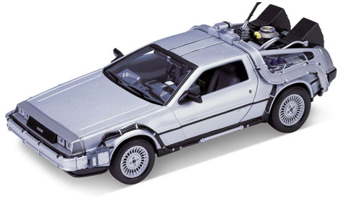

Slide 8
4. One for all and all for one!
Notes:
Get buy-in from all colleagues in all departments. This is vital to success. Includes box office and their understanding of why clean data is so important. Calculating savings that might be incurred through clean data gets senior manages on board. Overall with all the data clean work in the last two months, we have culled about 7000 people, representing a significant saving in mailing costs.

Slide 9


Slide 10
5. BRAINSTORM
Notes:
Use a team of people, especially in planning stages, it is so much better to have more than one head working out the complexities. One person will see the flaw in the time-line that another won’t.

Slide 11


Slide 12
6. Don’t underestimate the time it’ll take
Notes:
We all have full-time jobs, so assuming it that nobody’s got a post called Data Cleaner either make sure it’s a secondment, get a free-lancer in to project manage or be realistic about how long it’s going to take.

Slide 13


Slide 14
7. USE TOOLS AVAILABLE
Notes:
We’ve used QAS to check addresses and make adjustments. Plus to run data through National Change of Address, Mortascreen etc.

Slide 15
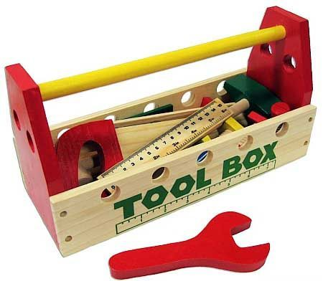

Slide 16
8. Expect people to rise from the dead.
Notes:
Tools are not infallible. People haven’t moved when NCOA says they have. People haven’t died when mortascreen says they have. Weigh up pros and cons.

Slide 17


Slide 18
GOOD LUCK!

