Slide 1
“Cleaning Your Data”
Paul Callas
Information & Sales Manager
Birmingham Hippodrome

Slide 2
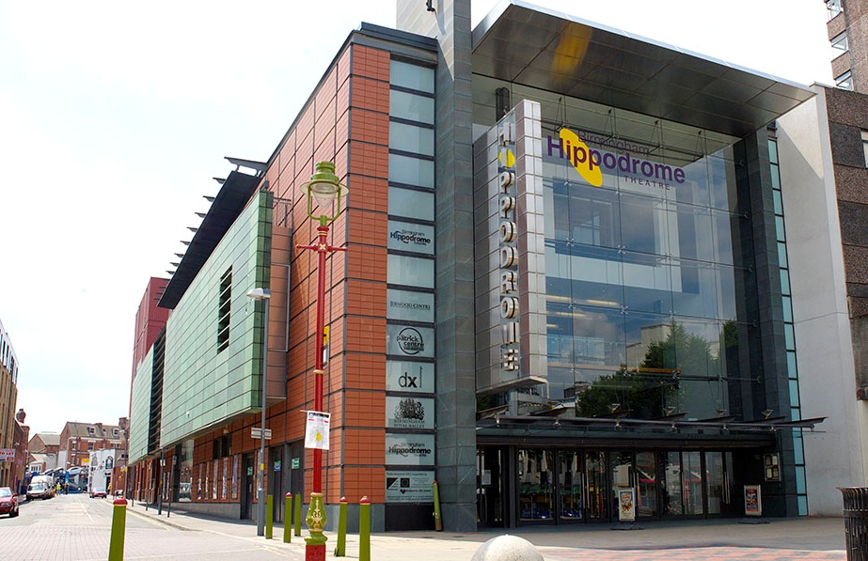
BH is the busiest single theatre in the UK
  500,00 paying visitors every year
  Contribute over £40m to local economy every year
  The busiest visitor attraction in the City Centre
  One of the top 20 in the UK
BH is the busiest single theatre in the UK
  500,00 paying visitors every year
  Contribute over £40m to local economy every year
  The busiest visitor attraction in the City Centre
  One of the top 20 in the UK
The busiest independent theatre in the UK
  500,000 paying visitors every year
  Contribute over £40m to local economy every year
  Part of BAIT Network (Shared Ticketing System)
  Moved to Tessitura January 2008
  Migration of all Hippodrome Data (Good & Bad)

Slide 3
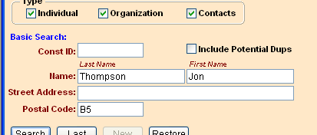
Basic Constituent Search

Slide 4
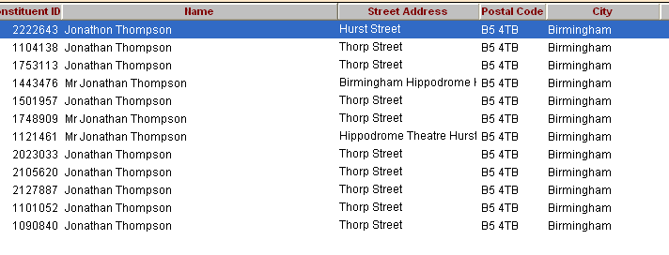
Why are duplicates a problem??
12 Duplicate Records
We had over 150,000 duplicate records

Slide 5
What is the Solution?
UK Changes
  De-Dupe Your Entire Database
  Clean all of your data
  Costly – Quoted over £35K
QAS
  Similar Service
  Cheaper than UK Changes but still costly
Do It Yourself
  Cheaper but time consuming
  No Facebook!
  Quality Control

Slide 6
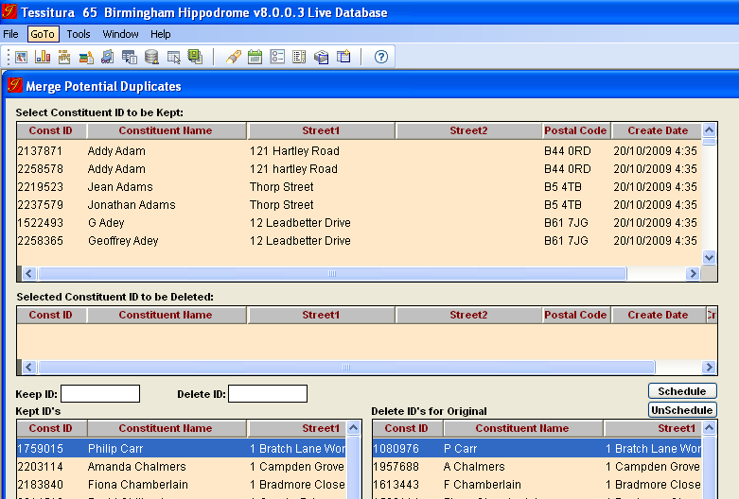
Data Merging

Slide 7
Course of Action
Started merging records Jan ’09
Everyone in Box Office was assigned a few letters in the alphabet
During quiet periods they go through and schedule duplicate records to be merged

Slide 8
How Successful was it?
Started with over 150,000 duplicates
Currently we only have 36,000 duplicates
Since Jan ‘09 we have reduced our duplicate records by 76%
We aim to have all duplicate records out of the system by Jan ‘10

Slide 9
What should we do next...
Is our data Clean?
What about data protection?
Do we need to worry about duplicate records anymore?

Slide 10
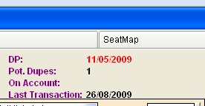
Do we need to worry about duplicate records anymore?
Potential Duplicate Records
Quick tool for I & S Assistants to schedule a record for merging
It is possible to have more than one record...

Slide 11
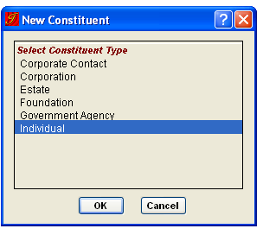
Something to think about....
Ask yourself the question...
“What type of contact is this?”

Slide 12
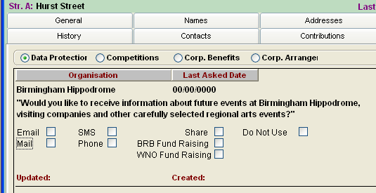
Data Protection

Slide 13
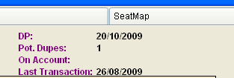
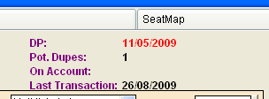
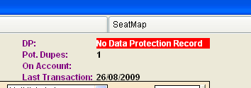
Data Protection Cont.
Good Record
Question Out of Date
Sales Opportunity?
Bad Record!!!

Slide 14
Is our data clean?
The simple answer is
...NO!
All extractions go to UK Changes
Looking at sending our database for cleaning
With each record we de-dupe in-house we save money
All databases need to be actively be managed and maintained. The moment you stop working on them they are out of date.

Slide 15
Technical Queries:
Ben Magson – Systems Administrator
Benmagson@birminghamhippodrome.com
All Other Queries:
Paul Callas – Information & Sales Manager
PaulCallas@birminghamhippodrome.com

