Slide 1

Standard Tessitura Gift Aid Functionality
Richie Warburton
Application Specialist
Tessitura Network
UK User Group Meeting, Gateshead 2009

Slide 2
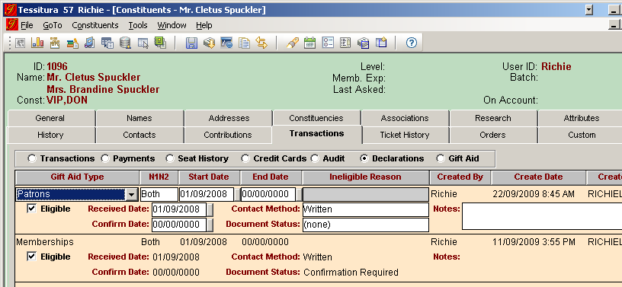
New Screens in Constituent Record > Transactions Tab
Gift Aid Declarations
UK User Group Meeting, Gateshead 2009

Slide 3
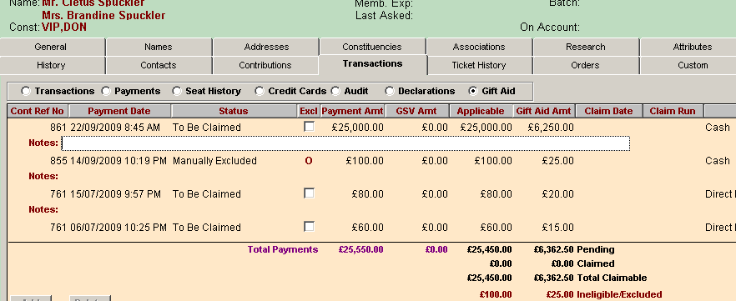
New Screens in Constituent Record > Transactions Tab
Gift Aid
UK User Group Meeting, Gateshead 2009

Slide 4
New Reports
Six New Reports:
Gift Aid Claims o
Gift Aid Claims R68 o
Gift Aid Claims Reversal o (yayy!!)
Gift Aid Declarations o
Gift Aid Payment Status
Gift Aid Payment Update o
UK User Group Meeting, Gateshead 2009

Slide 5
Setup & Configuration
6 Reference Tables
T_DEFAULTS
TR_GIFT_AID_TYPE
TR_GIFT_AID_CONTACT_METHOD
TR_GIFT_AID_DOCUMENT_STATUS
TR_GIFT_AID_INELIGIBLE_REASON
TR_GIFT_AID_RATE *(base tax rate, not claimable amount)
<<Get latest documentation from tessituranetwork.com >>
UK User Group Meeting, Gateshead 2009

Slide 6
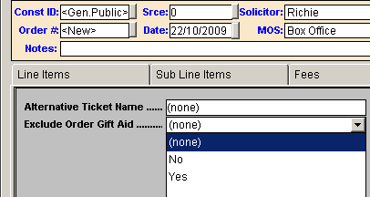
Setup & Configuration
Exclusion Custom Fields:
Ticket Orders:
T_KEYWORD:
UK User Group Meeting, Gateshead 2009

Slide 7
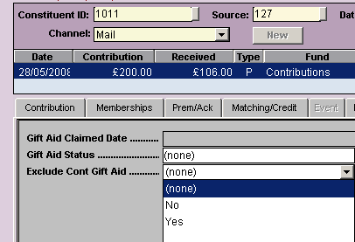
Setup & Configuration
Exclusion Custom Fields:
Contributions:
T_KEYWORD:
UK User Group Meeting, Gateshead 2009

Slide 8
Processing
Demo -
Pick a constituent, add a declaration & process a gift
Look at Gift Aid Payment tab
Confirm unconfirmed declarations using Gift Aid Declarations report
Look at Gift Aid Payment Status Report
Run Gift Aid Claims Report
Look at Gift Aid Payment Status report again
UK User Group Meeting, Gateshead 2009

Slide 9
Migration
System Tables entries
Declaration Migration
Payment Update Report
Payment Data clean-up
UK User Group Meeting, Gateshead 2009

Slide 10
Migration
Set up as usual
Ensure mappings from custom tables for
    TR_GIFT_AID_CONTACT_METHOD
    TR_GIFT_AID_INELIGIBLE_REASON
UK User Group Meeting, Gateshead 2009

Slide 11
Migration
Convert Declaration data:
  LT_GIFTAID_DECL >> T_GIFTAID_DECLARATION
Run Gift Aid Payment Update Report to create payment data
Update payment statuses
  LT_GIFTAID_PAYMENT >> T_GIFTAID_PAYMENT
UK User Group Meeting, Gateshead 2009

Slide 12
Migration
Declaration Data
  Populate staging table for Declaration data from custom Declaration table, based on business rules
  Check data in staging table – start / end dates
  Remove triggers from T_GIFTAID_DECLARATION
  Insert into T_GIFTAID_DECLARATION from staging table
  Update T_NEXT_ID for T_GIFTAID_DECLARATION (type = ‘GD’)
  Re-create triggers on T_GIFTAID_DECLARATION
UK User Group Meeting, Gateshead 2009

Slide 13
Migration
GA Payment data
  Once declaration data conversion is complete..
  Run Gift Aid Payment Update Report
  Update T_GIFTAID_PAYMENT
  (join LT_GIFTAID_PAYMENT on ref_no)
    Set conversion payments to Manually Excluded (Status = ‘10’) and add ‘Conversion’ to Notes fields
    Set Claimed rows to Claimed status (Status = ‘1’)
    Set Adjusted Post Claim rows to Adjusted Post Claim (Status = ‘7’)
    Set Manually Excluded rows to Manually Excluded (Status = ‘10’)
    Set Manual Calculation rows to Claimed status (Status = ‘1’)
UK User Group Meeting, Gateshead 2009

Slide 14
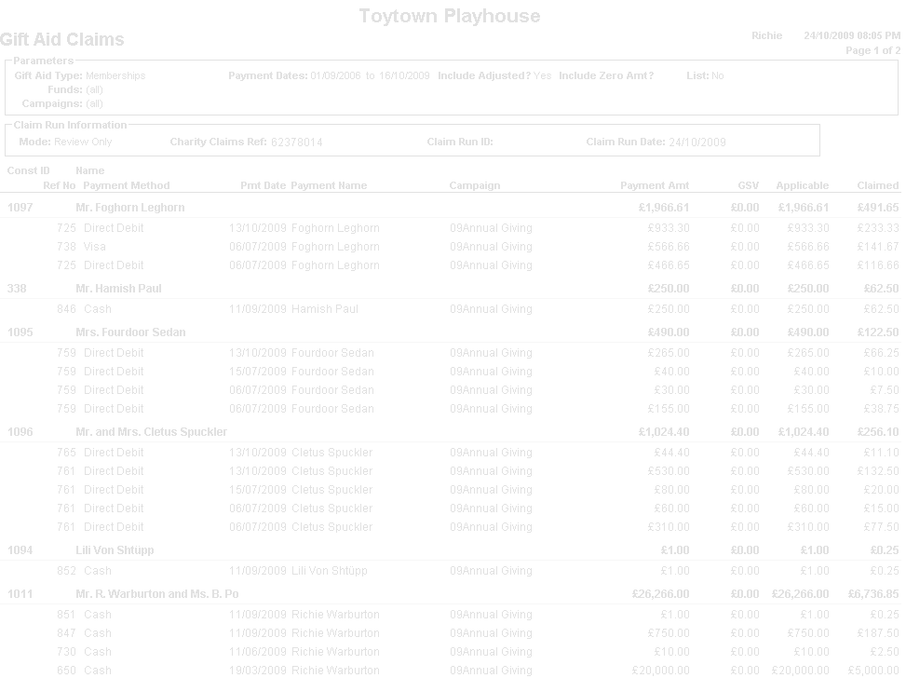
Questions?
UK User Group Meeting, Gateshead 2009

