Slide 1
Introduction to Core Tessitura Reports
UK Tessitura Conference 2009
Natalie Threlfall

Slide 2

Introduction
Notes:
Natalie Threlfall
Worked for TN since June 2009

Slide 3
Overview of this session
Overview of Help system (for reports)
Highlight 5 “canned” reports
Scheduled reports
Other resources – custom & shared reports
Notes:
Ticketing / Marketing / Finance Reports

Slide 4
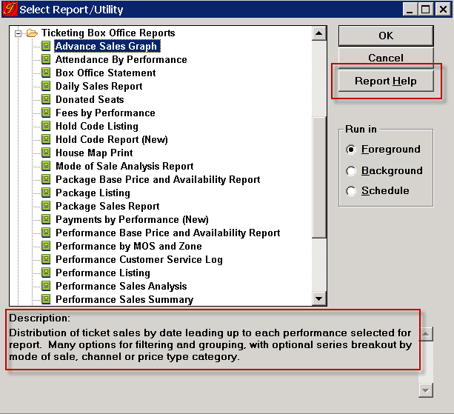
Report Help
Notes:
Report Help is available as a button for many of the standard reports
Report description at the bottom also can help

Slide 5
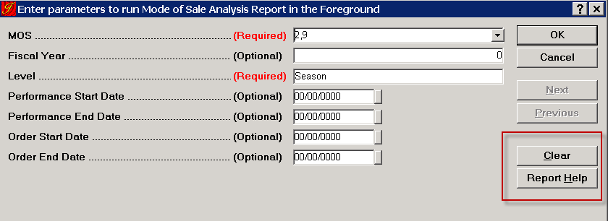
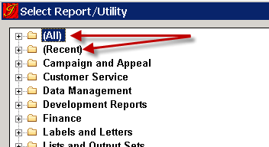
Other helpful report tools
Notes:
Report help is also in the parameters window.
Another useful button is the “clear” which removes all of the parameters
Sometimes the hard thing is finding a particular report.
In the report window we now have the (All) and (Recent) to help locate reports
Most of the reports we’re highlighting today are in the Ticketing Box Office Reports Folder

Slide 6
Reports highlighted today
Ticket Sales by Period
Payments by Performance (New)
Performance Sales Analysis
Performance Sales Summary by PT Category
Box Office Statement

Slide 7
1. Ticket Sales by Period
New report for v9.0
Re-write of Daily Sales Report
Analyse sales trends over time
Review and project staffing needs
Analyse performance sales volume by sales channel and time period

Slide 8
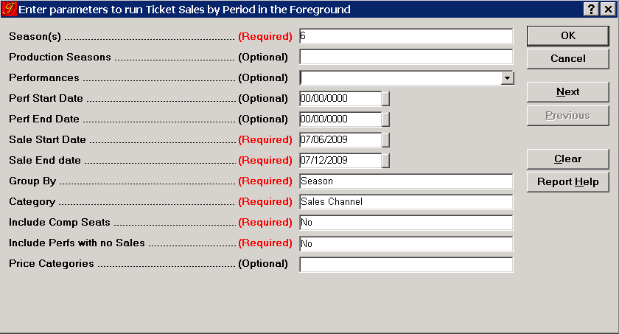
1. Ticket Sales by Period (cont)
Notes:
This report can be run for all shows in a season, or limited down to a production season, or even a single performance
Can use a performance date range
I am looking at the sales for a particular week in July
Grouping by Season (other choices are Production Season or Week)
Category - either MOS Category (comes from TR_MOS_CATEGORY) or Sales Channel
Include Comp Seats (or not)
Show performances with no sales
Limit the price categories (maybe you only want to see “ticket’” price category)
Click the NEXT button – important!

Slide 9
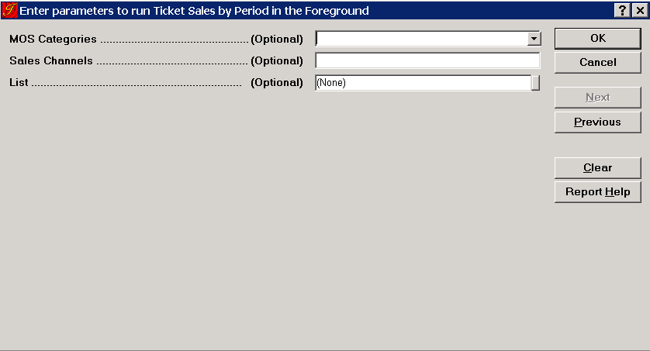
1. Ticket Sales by Period (cont)
Notes:
Can Limit it by MOS Categories (Subscription, Group Sales etc)
Limit by Sales Channels (Mail, In person, Internet)
Or Limit it to a list of people (maybe you want to see if any of your subscribers bought this week, and what did they buy?
Or limit it to a list of people who received a specific promotion….

Slide 10
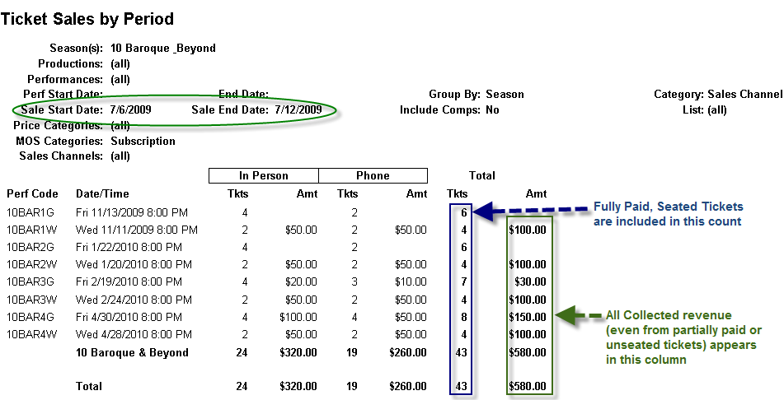
1. Ticket Sales by Period (cont)
Notes:
This is showing that particular week in July
I can see what shows sold for the season I selected
Note: TKT amount is only counted if it’s fully paid, seated
All money is shown, regardless of seat status
This is looking at all Sales Channels for the Subscription MOS Category (so how did my subs come in this week?)
Can also be run to look at the MOS used for sales

Slide 11
1. Ticket Sales by Period (cont)
First day of week is defined in T_DEFAULTS (EIS_FIRST_DAY_OF_WEEK)
  1 = Sunday; 2 = Monday, etc
Financial information is reported from T_TRANSACTION
Seat counts are reported from T_ORDER_SEAT_HISTORY

Slide 12
1. Ticket Sales by Period (cont)
Can be helpful to have a MOS for exchanges, so that they are easily separated
  If exchanges occur in the original order then it is attributed to the original MOS
  If it’s exchanged in a new order it will use the MOS from the new order
  Returns count as a -1; Sales are a +1
Notes:
For the last point: This means that if a show is cancelled and all the seats are returned, then you’ll see a bunch of negative numbers in there

Slide 13
1. Ticket Sales by Period (cont)
Troubleshooting
  No data on the report
    There were no sales for the selected performances and time period and the Include Perfs with No Sales parameter was set to “No.”
    One of the optional filter parameters (MOS Category, Sales Channel, or List) is excluding sales for performances in the selected time period

Slide 14
2. Payments by Performance (New)
For chosen performances, breaks out payments by Payment Method
Good for reconciliation
Can be run for one performance, or a date range
Can only be run for performances where all activity has taken place in v6.0 or later
Notes:
Breaks out payments by payment method
Can run for 1 perf, all perfs in a date range or all perfs of a production in a date range.
Often run by finance / Box Office for reconciliation

Slide 15
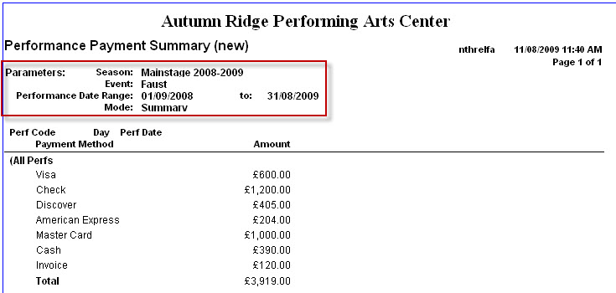
2. Payments by Performance (New) (cont)
Notes:
This report run in Summary Mode
All it shows is totals for each payment method for all performances within selected date range
Allows finance dept to reconcile with expected amounts from credit card processors / other reports.

Slide 16
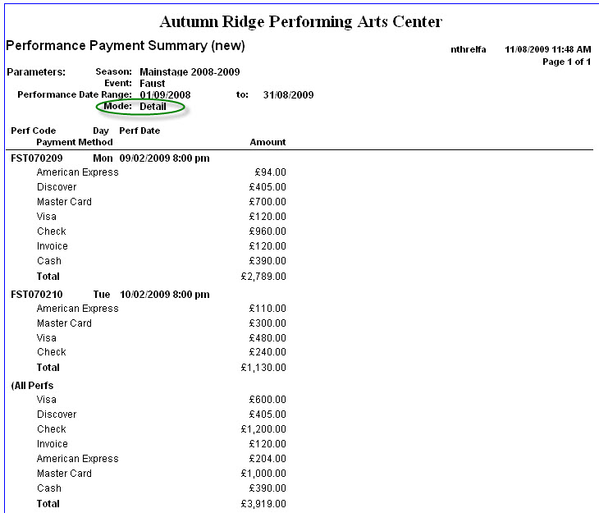
2. Payments by Performance (New) (cont)
Notes:
This report run in Detail Mode
For each individual performance breaks out payments by payment type, then shows summary at the end
Useful if need to see figures for each performance – if need to give the amounts to a promoter

Slide 17
3. Performance Sales Analysis
This report analyses sales with a variety of layouts
Useful to see at which price zones and/or price points performances sell from several perspectives – per price type, MOS, and/or sales channel
Notes:
Variety of layouts – can choose different columns and rows – like having about 12 different reports
Good for looking at sales from different perspectives

Slide 18
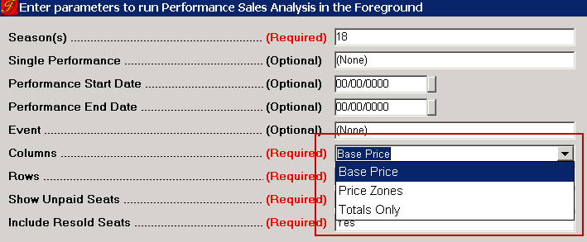
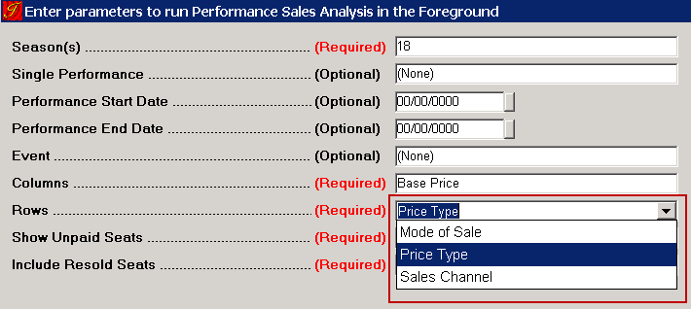
3. Performance Sales Analysis (cont)
Columns:
Base Price
Price Zones
Totals Only
Rows:
Mode of Sale
Price Type
Sales Channel

Slide 19
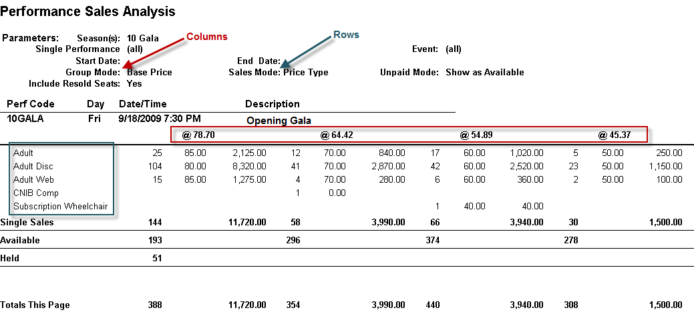
3. Performance Sales Analysis (cont)
Notes:
Can also be run with Price Zones across the top (columns)
And for rows:
Mode of Sale
Sales Channel
Example: Seeing that Phone orders tend to go for the more expensive price zones, but internet buyers are going for the cheap seats;
Can also be run with just totals

Slide 20
3. Performance Sales Analysis (cont)
Troubleshooting
  The ticket count and/or revenue totals appear low.
    The {Include Resold Seats} parameter is set to ‘No’; so donated seats that have been resold are not included as sold seats, and those that have not been resold are not counted as available.
    The {Show Unpaid Seats} is set to ‘Show as Available’; so any reserved, unpaid or reserved, partially paid seats are not included in the Single Sales or Package Sales sections of the report as sold seats.

Slide 21
4. Performance Sales Summary by PT Category
Ticket counts and amounts by Price Type Category
Shows % of budget and capacity sold
Balances to the Box Office Statement
Used for analysis and forecasting
Notes:
Report shows number of tickets sold and amount taken, broken down by price type category
Report includes all performances within chosen date range and, optionally season.
Good for analysing how many tickets are being sold at full price, how many at a discount etc.

Slide 22
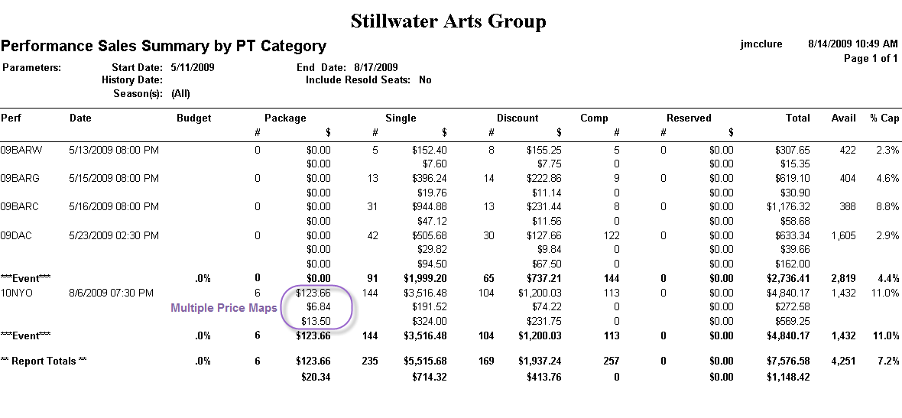
4. Performance Sales Summary by PT Category (cont)
Notes:
Can see ticket counts and amount taken
Price type category across the top, performance down side.
When have multiple price maps on a performance, amount for each price map is broken out – useful if use multiple price maps for tax etc
PT_CATEGORY
Package tickets: 1 Subscription
Single Tickets: 2 Standard
Discount: 3 Discount
Comp: 4 Complimentary or 5 Press
Reserved Tickets: seats in an order, but are unpaid or partially paid
Will look at how tickets categorised on next slide

Slide 23
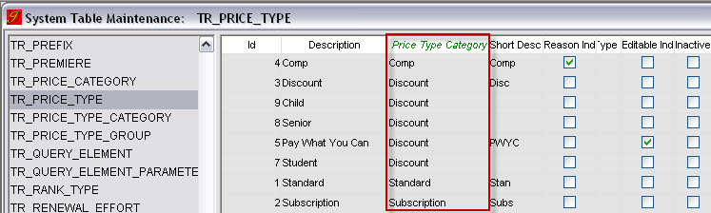
4. Performance Sales Summary by PT Category (cont)
Price Type Categories pre-defined in TR_PRICE_TYPE_CATEGORY
Assign each Price type in TR_PRICE_TYPE to a Price Type Category
Notes:
Price Type Category selected in TR_PRICE_TYPE determines which category the tickets and revenue appear in.
1 Subscription
2 Standard
3 Discount
4 Complimentary
5 Press
If add any more categories to TR_PRICE_TYPE CATEGORY, tickets in these categories don’t show up

Slide 24
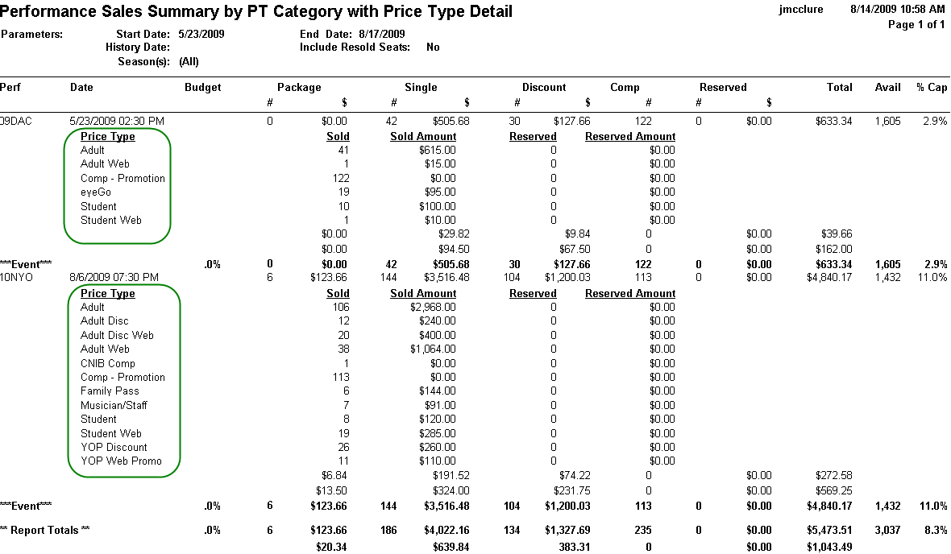
4. Performance Sales Summary by PT Category (cont)
Notes:
Can be run in price type detail mode: Shows ticket count and dollar amount broken out into all price types
Useful for seeing how popular particular price types are

Slide 25
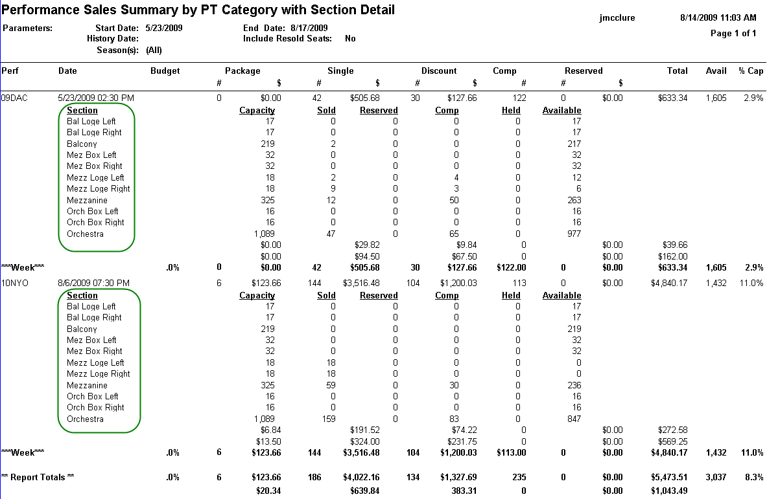
4. Performance Sales Summary by PT Category (cont)
Notes:
Can be run in section mode so can see which areas of the house have sold most / have spaces
This one grouped by week (Sunday – Saturday)

Slide 26
4. Performance Sales Summary by PT Category (cont)
Can be run in historical mode, to show report as if it was run on that day
Needs to be scheduled
Can only be run in summary mode, historically
Unseated paid, unseated partially paid tickets not included in this report
Notes:
Can only be run historically for dates the report was actually run on, so best to schedule.

Slide 27
4. Performance Sales Summary by PT Category (cont)
Troubleshooting
No data returned
  No performances in date range/criteria selected
  Report is being run in historical mode for a date on which it was not originally run
Totals are very low
  Additional price type categories have been created
  “Include Resold Seats” set to “No”

Slide 28
5. Box Office Statement
Details ticket sales for single performance
Used on a daily basis for sales monitoring or performance settlement
Matches Performance Sales Summary by Price Type Category Report
  Only includes predefined price type categories
Notes:
Sister report to Performance Sales Summary by Price Type Category Report
Details all ticket sales for a single performance
Any tickets in price type categories added will not be included.

Slide 29
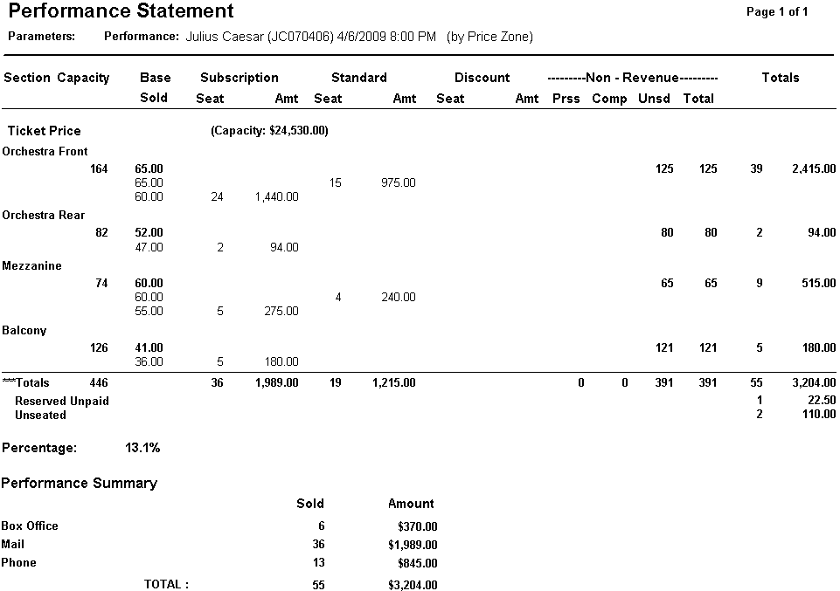
5. Box Office Statement (cont)
Notes:
Can group by section or price zone – here grouped by price zone. Price zones down side.
Can see how many tickets sold at each price, again broken down by same price type categories. PT categories across top
Eg can see in Orchestra Front zone, 24 seats sold @ $60 in subscription category. 15 seats sold @ $65 in Standard category
“Ticket Price” price map category and summary listed for all price zones
Other price map categories shown if tickets sold i that price zone.

Slide 30
5. Box Office Statement (cont)
Troubleshooting
Number of seats exceeds capacity
  Report run with “Include Resold” seats = “Yes”
Subscription numbers differ from Performance Sales Summary / Season Overview
  This report looks at PT category of “Subscription”
  Others look at PKG_NO in T_SUB_LINEITEM and FIXED_SEAT_IND in T_PKG

Slide 31
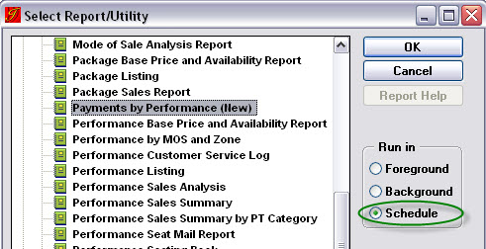
Scheduling/Emailing Reports
Any report can be scheduled to run automatically
Useful for reports which are run regularly
Notes:
Scheduled reports can be run to run at any time in the future
To create a schedule, select Schedule radio button, then click OK.

Slide 32
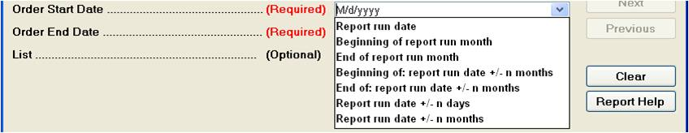
Scheduling/Emailing Reports
Enter parameters as usual
Dates can be relative
Notes:
Enter parameters to be used when schedule is run
Can select relative dates
Report Run Date
Beginning/end of report run month
Report run dates +/- months/days

Slide 33
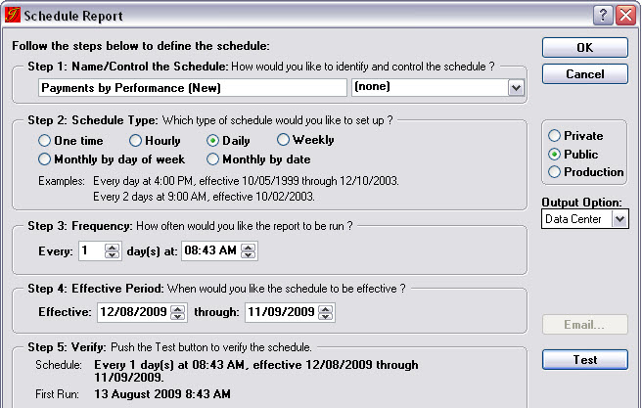
Scheduling/Emailing Reports
Notes:
Schedule window opens
Give it a name / select control group
Select type: one time, hourly, daily, weekly etc
Select Frequency: how many days, at what time etc
Effective period: when schedule is active
Test button shows when it will be next run

Slide 34
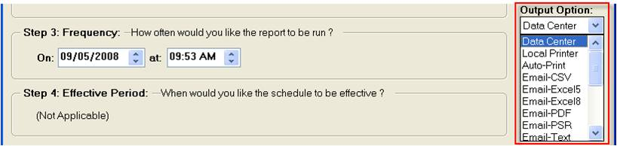
Scheduling/Emailing Reports
Select “Data Center” to save report within Tessitura only
Select “Email” options to automatically email report when it is run
Notes:
All reports available to view though Tessitura in “View Reports” screen.
Select Email option and type of attachment the report will be included as

Slide 35
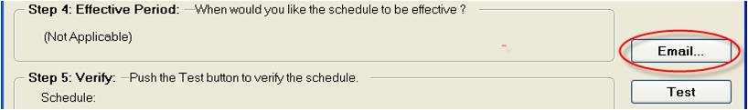
Scheduling/Emailing Reports
If email is selected, click Email button to enter recipients
Notes:
Click email button to set email settings

Slide 36
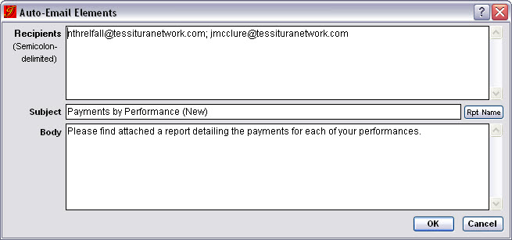
Scheduling/Emailing Reports
Enter recipients, subject and body – new in v9.0
Notes:
Enter recipients, subject and body of email.
Then click OK and OK to the schedule and the report is scheduled.

Slide 37
Customising Standard Reports
All standard reports are included with Tessitura Upgrades (or on the CD)
Each standard report is tied to a SQL Stored Procedure
These can be copied as local procedures and reports then modified – do NOT modify the standard SQL procedures
Many resources on www.tessituranetwork.com on customisation (including webinars)

Slide 38

Shared Reports
We are a community! And we SHARE!
Shared reports are located in TASK
  Link via www.tessituranetwork.com > Software Support > left hand side >TASK Login
Over 100 Shared reports – definitely worth a look

Slide 39
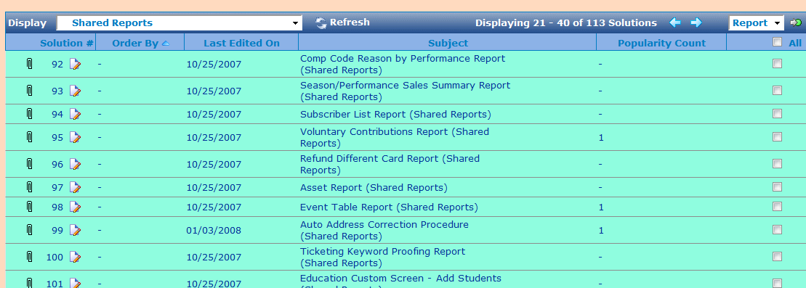
Shared Reports (cont)

Slide 40
Questions?

Slide 41
Bonus Reports
If we have the time and inclination...

Slide 42
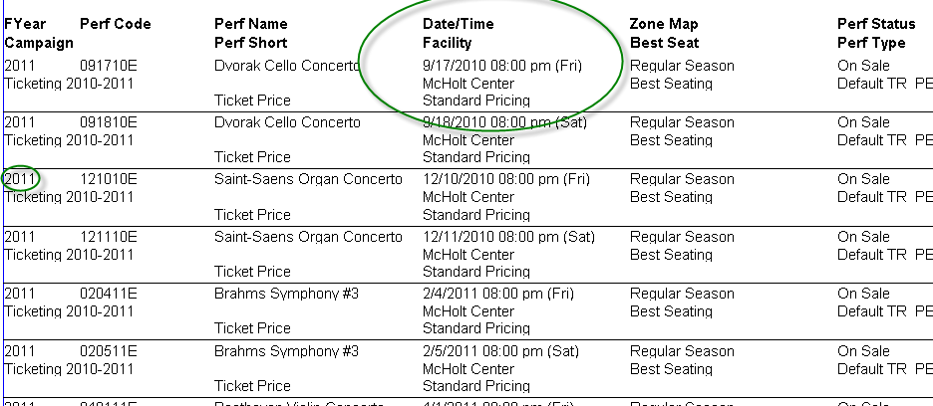
1. Performance Listing
Used for proofing set up prior to on sale
Notes:
I cut off Time Slot and Rank type to get it to fit, but those also appear on this report
Can run it for different price types to see which price maps are associated (i.e. Ticket Price = Standard Pricing in the example)
Can check perf codes, Fiscal Years, spelling in the perf names

Slide 43
1. Performance Listing (cont)
Troubleshooting
  There is no data on the Report – Check your parameters
    There are no performances within the date range you selected
    There are no price types assigned to the performance selected
    There are no performances in the status selected (on sale, cancelled, etc)

Slide 44
2. Advance Sales Graph
Plots:
  % seat capacity sold vs. # days prior to performance
Shows the pace of sales accelerating / decelerating as performance date is approached
Allows comparison of sales trends
Notes:
Great for Marketing depts / easy to see what is happening without having to delve into figures.
I like graphs

Slide 45
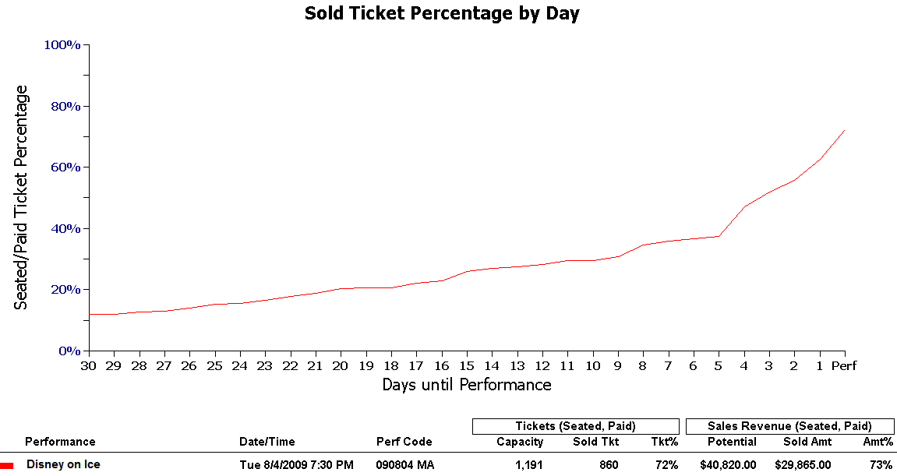
2. Advance Sales Graph (cont)
Notes:
Run for single performance
Visually : Easy to see general trend
X-axis: % of capacity sold
Y-axis: days until performance
Below graph is summary for each group showing actual figures

Slide 46
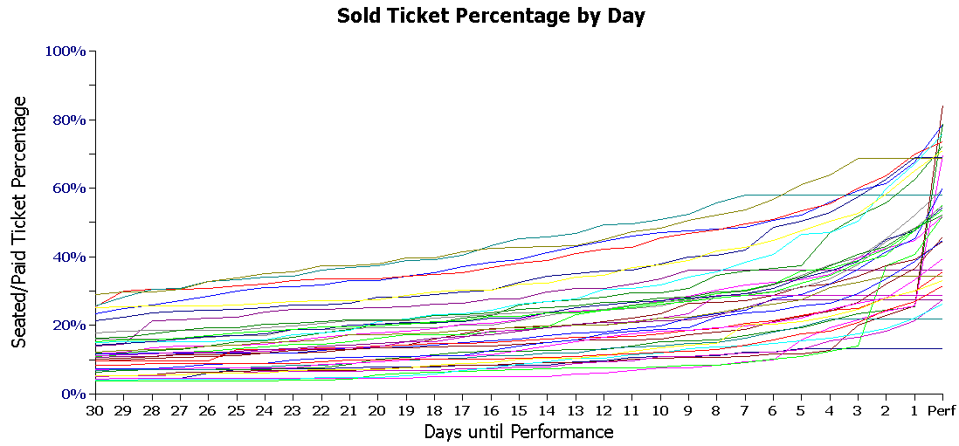
2. Advance Sales Graph (cont)
Notes:
Can run over whole season/production/date range so can identify general sales patterns across difference performances
Some performances might sell very late, others activity might trail off.

Slide 47
2. Advance Sales Graph (cont)
Used to identify sales trends
Predict where sales are headed
High-level view of peaks/troughs in marketing activity
Only seated, paid and ticketed seats included
Uses order date in T_ORDER
Remember “Next” page of parameters
Notes:
Can compare graphs from previous shows to see how ticket sales compare – identify trends
Predict where sales are going to get to
Early warning that things are/aren’t going well
Should be able to identify where marketing activity happened - if not, something to investigate!

Slide 48
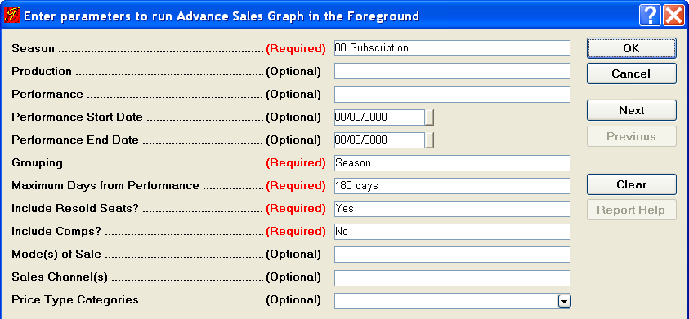
2. Advance Sales Graph (cont)
Notes:
Lots of parameters to choose
Run over whole season / production/performances – or enter date range
Can group by Season / production /performance
Select “maximum days from performance” is # of days to be listed – 30, 60, 90, 120, 180, 240, 360
Choose to include re-sold/comps
Can filter by mos / sales channels / pricetype categories – so can compare
Can run against a list to only include sales from constituents on list – on “Next” page

Slide 49
2. Advance Sales Graph (cont)
Troubleshooting
Sales show over 100% capacity
  Including resold seats
Sales start above 0% capacity
  Tickets sold further in advance than “maximum days before” selected

Slide 50
3. Mode of Sale Analysis
Summarizes # orders, # seats, total due and fees for selected mode(s) of sale
Can enter Fiscal year to include all performances or enter date range
Can enter order date range
Used to determine how orders originated
Notes:
Great for Marketing analysis to see how people are buying tickets
Can compare different modes of sale to track trends – looking at performance dates or order dates

Slide 51
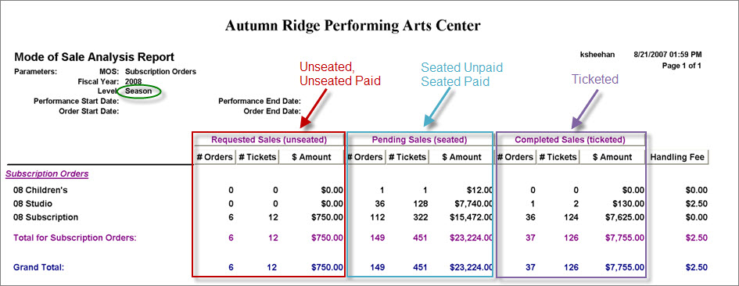
3. Mode of Sale Analysis (cont)
Notes:
Here run in season mode for subscription mos – shows totals for each season for mos selected
Tickets split into
Requested: unseated, unseated paid
Pending: Seated unpaid, Seated Paid
Completed: Ticketed

Slide 52
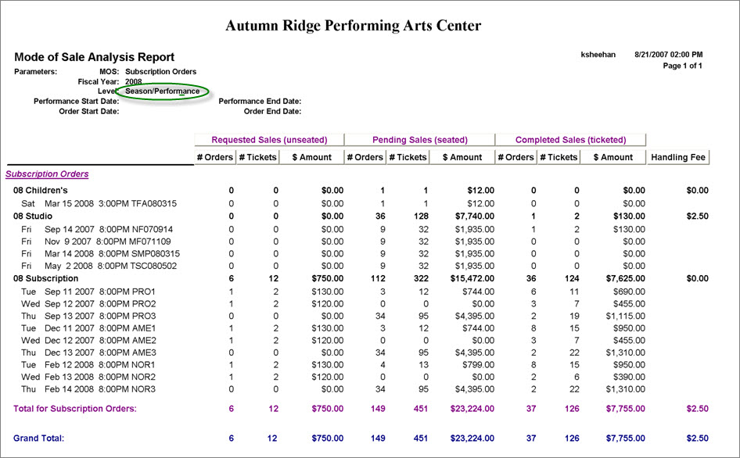
3. Mode of Sale Analysis (cont)
Notes:
Run in season/performance mode for subscription mos – shows totals for each performance and season for mos selected
Again, tickets split into
Requested: unseated, unseated paid
Pending: Seated unpaid, Seated Paid
Completed: Ticketed

Slide 53
3. Mode of Sale Analysis (cont)
Troubleshooting
Handling Fee totals appear low
  Fee only calculated for ticketed seats
# Orders appears high
  If an order contains more than one type of sale it is counted once for each type
Requested and Pending totals appear high
  Report includes unpaid and partially paid orders

Slide 54
4. Single sales order listing
Great for finding “Needle in the haystack” orders
Can be used to spot check problems a few days before a show
Sister report to Package Order Listing

Slide 55
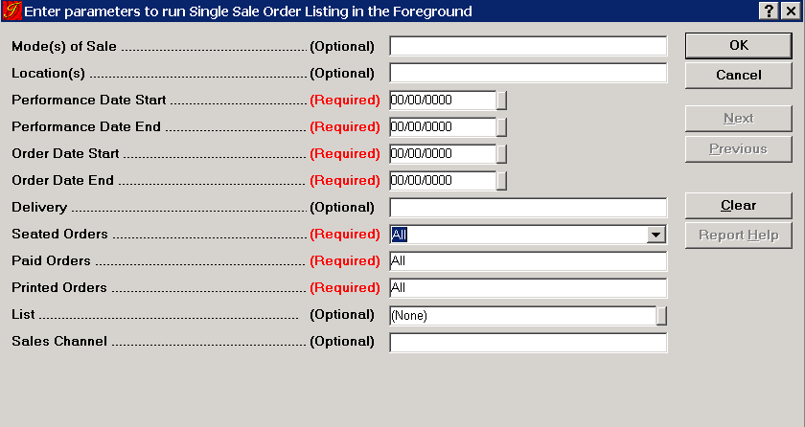
4. Single Sale order listing (cont)
Notes:
Great for finding unseated orders, unpaid orders, unprinted orders
Limit it by sales channel or list (so I need to find all unprinted orders sold via web for x date range)
Hint: Make the order date start/order date end a wide range!

Slide 56
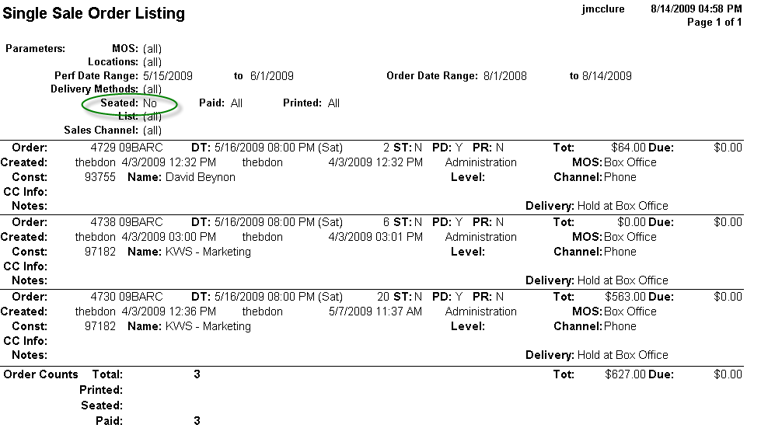
4. Single Sale order Listing (cont)
Notes:
In this example I was looking for unseated orders for a particular performance within my date range. There were 3 paid unseated orders.

Slide 57
5. Package Order Listing
Sister report to Single Sale Order Listing, but this one shows package orders
In Ticketing Subscription Reports Folder

Slide 58
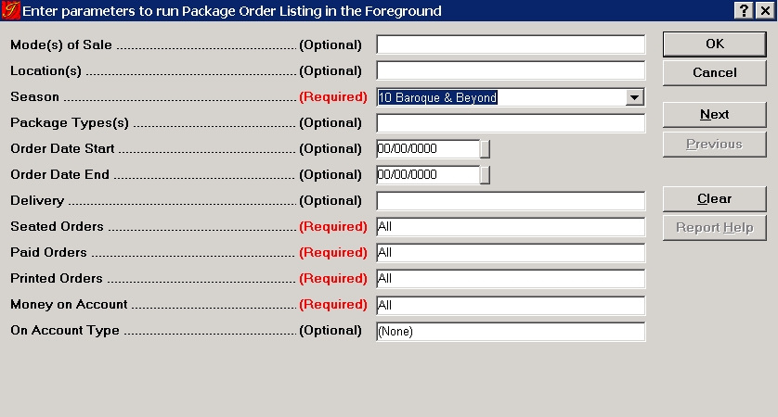
5. Package Order Listing (cont)
Notes:
Very similar options to Single Sale Order Listing, except this one requires Season
Can limit by Package types
Can Also see if there is money on account and the On Account Type

Slide 59
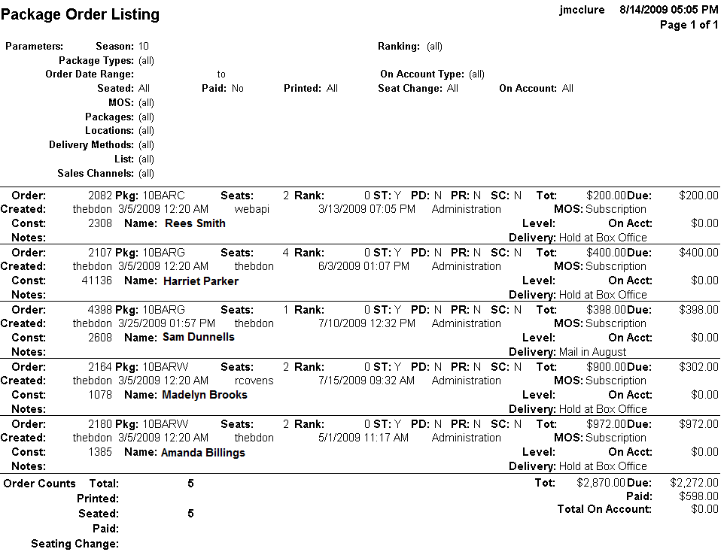
5. Package Order Listing (cont)
Notes:
For this example, I was looking for unpaid (or partially paid) orders for a particular season. I could then send reminders to these patrons, or take other actions

Slide 60
6. House Map Print Report
Produces printed seating map
Performance / Package / Date Range
Can show Hold Codes
Can show upgrades
Useful for night of performance if Duty Manager needs a paper seating map
Notes:
Allows you to print off a paper version of the seating map
Can show hold codes / upgrades
Useful for House manager or duty mamnger to easily be able to see which seats are available/held without having direct access to Tessitura

Slide 61
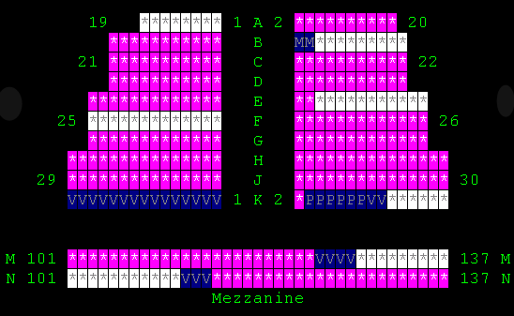
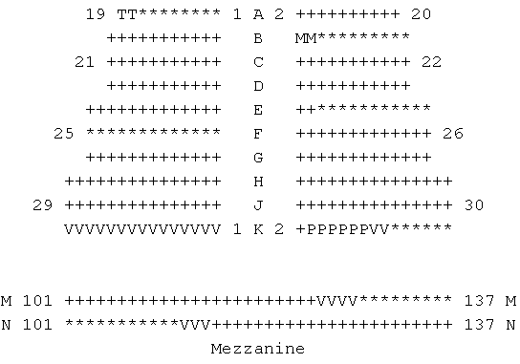
6. House Map Print Report (cont)
House View
Report View
Notes:
Can see both Hold Codes and lots of tickets in this screenshot (JGM)
*Show available seats
Manager would need to know hold codes

Slide 62
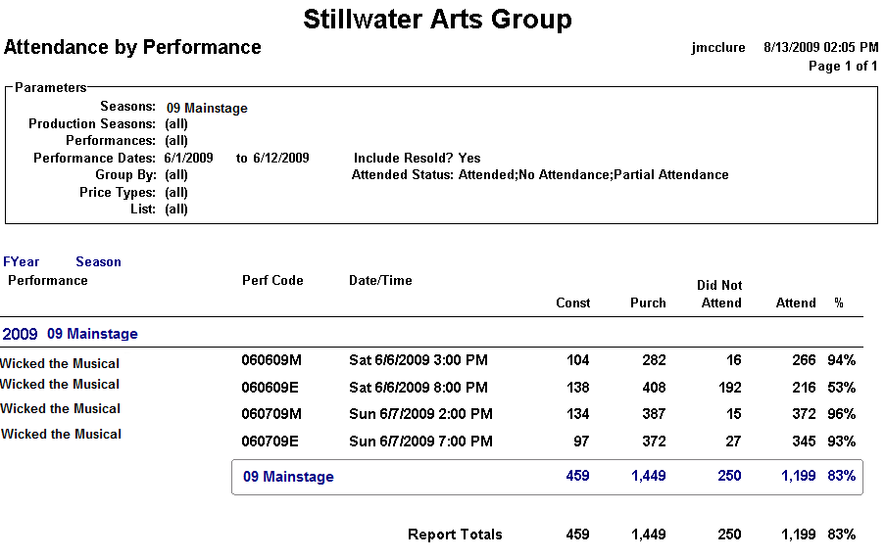
12. Attendance by Performance

