Slide 1
#tlcc2013
Creating Popup, Flex and Custom Constituent Headers
Two Headers are Better Than One
Presenters
Jon Dickey, Tessitura Network
Ben Magson, Tessitura Network

Slide 2
Session outline…
Creating & Customizing Flex Constituent Headers
Creating & Customizing Popup Headers
Creating InfoMaker Headers
Additional Resources
Q&A

Slide 3
Creating and Customizing Flex Headers

Slide 4
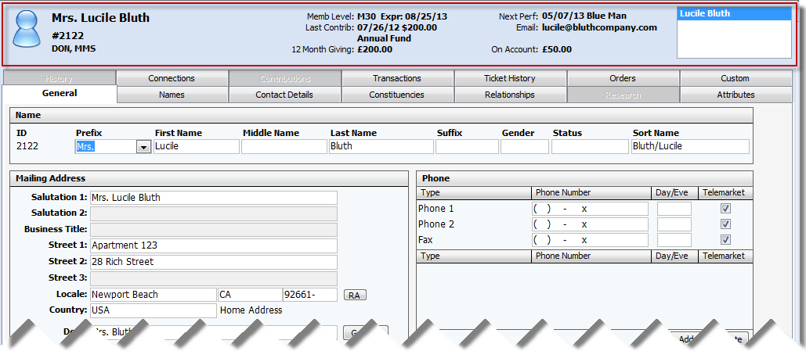
What is a constituent header?
Displays at top of record in constituent record…

Slide 5
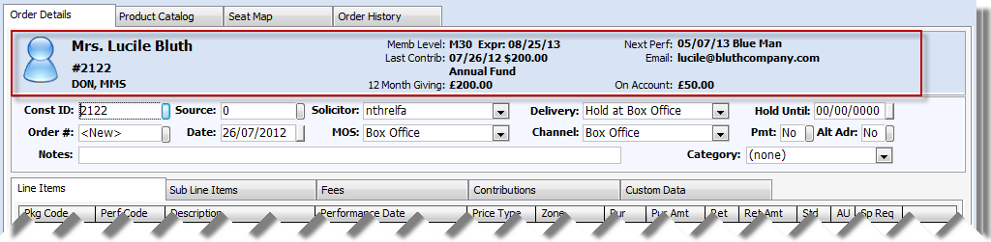
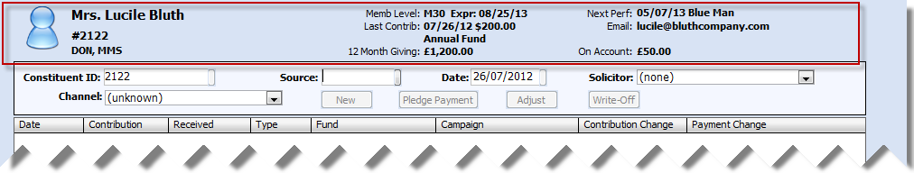
What is a constituent header?
… and order…
… and contribution

Slide 6
So?
They are everywhere!
You can change what data appears here depending on:
  Which constituent is loaded
  Which user is logged into Tessitura
Pre v11 custom headers were created in infomaker
Now – Flex Headers!

Slide 7
Off the top of your head(er), give me some use cases…
My Constituent Header was installed during implementation and hasn’t changed in 1000 years
I’d like to be able to make some quick changes; updating the InfoMaker Object and Stored Procedure is onerous

Slide 8
Off the top of your head(er), give me some use cases…
We have a limited IT staff, and / or don’t have the skills in-house to make changes
InfoMaker is *&%$£ !!!

Slide 9
Is it really that straightforward?
All configured within Tessitura
No need for 3rd party software
Minimal SQL knowledge is required*
Mostly configured within System Tables
It’s easy peasy lemon squeazy!
  *SQL = Scary Query Language

Slide 10
Tell me more about Flex Headers!
2 layouts are available:
Flex Header format
  up to 8 definable text data elements
Flex Header Icons format
  up to 6 definable text data elements
  up to 4 icons

Slide 11
Flex Header format
Flex Header format
  up to 8 definable text data elements
Name, ID, icon and constituencies on every flex header
Constituent navigator when in the constituent record
8 definable text data elements - can be any data from anywhere in Tessitura

Slide 12
Flex Header Icons format
Flex Header Icons format
  up to 6 definable text data elements
  up to 4 icons
Name, ID, icon and constituencies on every flex header
Constituent navigator when in the constituent record
6 definable text data elements
4 icons
can be any data from anywhere in Tessitura

Slide 13
How do I get started?
TR_FLEX_HEADER_ELEMENT
  Code to retrieve data
  File location for Icons
TR_FLEX_HEADER
  Element positions
  Labels

Slide 14
How do I get started?
T_FORMAT_INFO
  Give your header a logical name
Security Module
  Assign headers to user groups

Slide 15
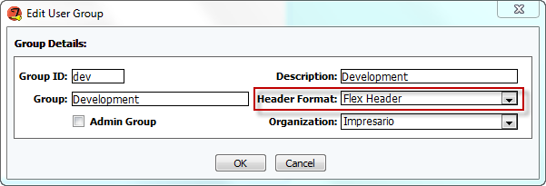
Try it out
V11 has one Flex Header format and one Flex Header Icons format pre-configured
Just change the Header format in the security module for a user group

Slide 16
Create your own Flex header
Can create your own header
Use the supplied standard elements, so no need for SQL
All elements can be used without (m)any changes

Slide 17
Standard Elements
Create Date
Total Giving
Membership
On Account $
Next Perf
Last Perf
Birthdate
12 Month Giving
Primary Email
User
Urgent CSI
Last Contrib
Last Fund

Slide 18
Create a copy of the flex header
T_FORMAT_INFO
Insert a new row
Include “Flex header” or “Flex Header Icons” in description
Gooesoft Report ID - Constituent Header
D Object - d_flex_header or d_flex_header_icons
Save

Slide 19
Select elements for your header
TR_FLEX_HEADER
Add/copy one row per element
Hdr No – select your header
Element No – select the desired element
Label – this appears on the header

Slide 20


Positions in TR_FLEX_HEADER
Flex Header – text positions 1-8
1
2
3
4
5
6
7
8
Flex Header Icons – text positions 1-6 icons positions 9-12
1
2
3
4
5
6
9 10 11 12

Slide 21
Create your own elements
TR_FLEX_HEADER_ELEMENT
Type
  Currency
  Date
  Number
  String
Description

Slide 22
SQL code – eeek!
Any data from within Tessitura
  Use secure views to respect control groups
Uses @customer_no parameter
Must return 1 row
  SELECT TOP 1
  Aggregated data
    SELECT SUM()
    SELECT COUNT(*)
    SELECT MAX()
    SELECT MIN()
Look at supplied elements for examples

Slide 23
Icon File
Can add icon
Displays icon if data is returned
Icon file value
  Application directory (T:\Impresario Client)
    Filename only – eg Email.jpg
  Another directory
    File path and filename – eg T:\FlexHeaderIcons\Email.jpg
No larger than 100x100 pixels

Slide 24
Custom Element Examples
2 Year Giving
  Currency
  Select sum(cont_amt) From [dbo].vs_contribution WITH (NOLOCK) Where customer_no = @customer_no and (cont_dt between dateadd(mm, -24 , getdate()) and getdate())
  Based on supplied 12 month giving

Slide 25
Custom Element Examples
Data Protection last asked date
  Date
  select max(asked_dt) from lvs_privacy_act where customer_no = @customer_no
  Selecting a date from a local table

Slide 26
Custom Element Examples
No Email Address
  String
  select CASE WHEN not exists (select top 1 address from VS_EADDRESS where ISNULL(inactive, 'N')='N' and customer_no = @customer_no) then 'Address' else NULL END
  Returns something if no email address exists
  Use icon to display @ in header

Slide 27
When I said (m)any changes…
Supplied date elements display in US date format
To change format:
  CONVERT(varchar,perf_dt,1)=mm/dd/yyyy
  CONVERT(varchar,perf_dt,3)=dd/mm/yy
  CONVERT(varchar,perf_dt,103)=dd/mm/yyyy
  CONVERT(varchar,perf_dt,111)=yyyy/mm/dd

Slide 28
When I said (m)any changes…
Symbols for currency type elements show £ if default country is 209, otherwise $
For string elements containing currency amounts may need to change the symbol
  Select top 1 CONVERT(varchar,c.cont_dt,1)+' $'+CONVERT(varchar,cont_amt) from VS_CONTRIBUTION c where customer_no = @customer_no order by c.cont_dt desc

Slide 29
Creating and Customizing Popup Headers

Slide 30
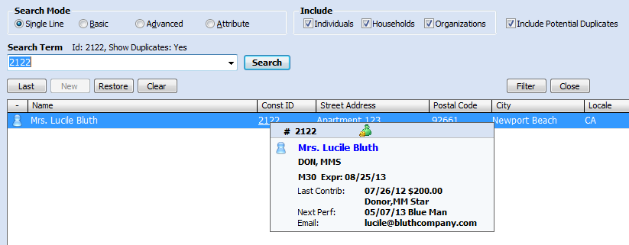
What is a popup header?
New in v11
Pops up when hover over constituent ID

Slide 31
Sounding familiar?
All configured within Tessitura
No need for 3rd party software
Minimal SQL knowledge is required*
Mostly configured within System Tables
It’s easy peasy lemon squeazy!
  *SQL = Scary Query Language

Slide 32
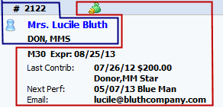
Popup Header format
Popup Header format
  up to 6 definable text data elements
  up to 4 icons
Name, ID, icon and constituencies on every popup header
6 definable text data elements
4 icons
can be any data from anywhere in Tessitura

Slide 33
Popup Header System Tables
TR_FLEX_HEADER_ELEMENT
TR_FLEX_HEADER
T_FORMAT_INFO
Set up in exactly the same way as the Flex Headers, using the same elements

Slide 34
Try it out
V11 has a Popup Header format pre-configured
Just hover over the constituent ID in constituent search screen to see it.

Slide 35
Customize the Popup Header
Every user in an organization has the same popup header
Add rows to TR_HEADER_FORMAT to add data to the popup header

Slide 36
Popup Headers in a Consortium…
To create a popup header for a consortium organization:
Insert a row in T_FORMAT_INFO
Enter a description
Gooesoft Report ID - Constituent Header
D Object – leave blank
Save

Slide 37
Popup Headers in a Consortium
Insert a row in T_DEFAULTS
Parent Table – Organization
Field Name – POPUP_HEADER
Default Value – Popup Header ID from T_FORMAT_INFO
Save
Configure the header in TR_FLEX_HEADER

Slide 38
Creating and Customizing Infomaker Headers

Slide 39
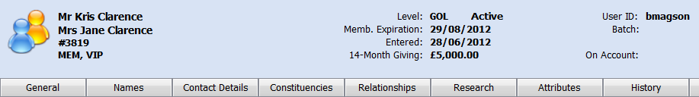
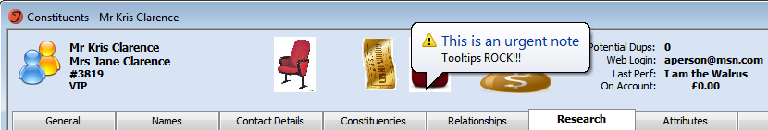
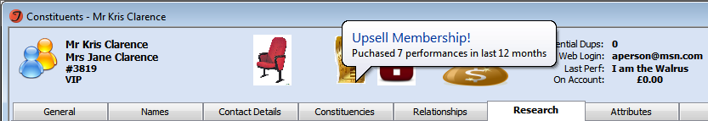
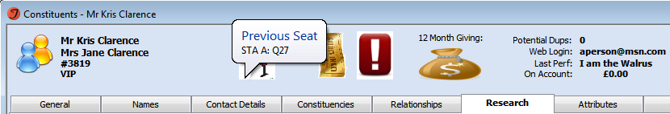
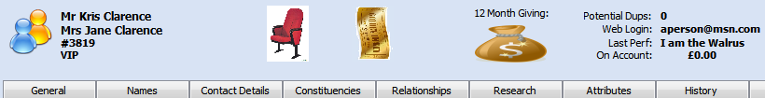
Custom Headers
“Vanilla” header
Customized header

Slide 40

Custom Header - Pros
Limitless data elements (…or as many as you can fit in the header!)
Data can be positioned wherever
Add graphics / images
Tooltips, Tooltips, Tooltips!!!
Conditional formatting & dynamic controlling
  TEXT
  TEXT
  TEXT

Slide 41
Custom Header - Cons
Additional software required
  InfoMaker (IM)
SQL Knowledge is (fairly) essential
IM is fiddly…
…and often frustrating!

Slide 42


InfoMaker versions
Tessitura V11 + = IM 12.1
Tessitura V10 (what?) = IM 10.5

Slide 43
Custom Headers – IM terms
InfoMaker (IM)
    3rd party reporting tool
  Objects
    Header (or Report or Custom Screen) design and definition
    Tools to prettify data
  Libraries
    Contain many Objects
    .pbl file extensions

Slide 44
Custom Headers - main components
SQL (SP) Stored Procedure
  Extracts data from the database
  Based on a customer number
IM object
  Displays the data

Slide 45
Tessitura Sample
Custom Header

Slide 46
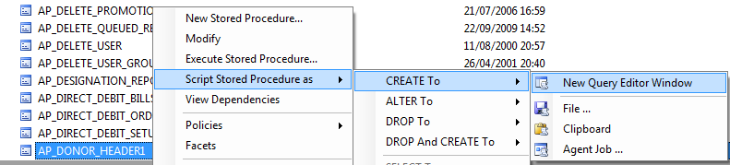
Custom Headers – DIY (SQL)
Copy standard Stored Procedure
  AP_DONOR_HEADER1

Slide 47
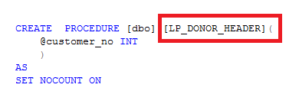
Custom Headers – DIY (SQL)
CREATE a new SP
  LP_DONOR_HEADER_%
  GRANT EXECUTE permissions

Slide 48


Custom Headers – DIY (IM)
TessituraSampleLibrary_v11.zip
  Solution # 32 in TASK
  Pre v11 = Solution # 7

Slide 49
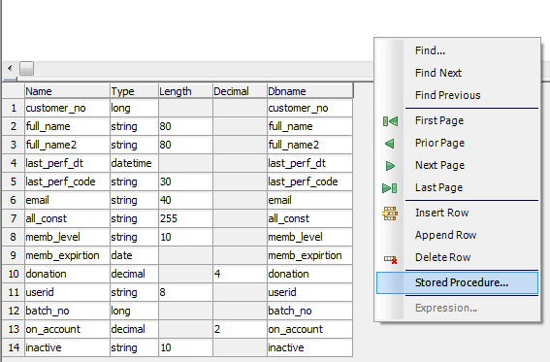
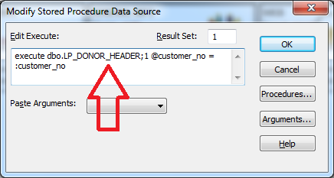
Custom Headers – DIY (IM)
IM Menu, View → Column Specification
  Right-click in grey area → Stored Procedure

Slide 50

Custom Headers – DIY (Tessitura)
T_DEFAULTS
  LOCAL_LIBRARY_LIST
    File location of IM LIBRARY

Slide 51

Custom Headers – DIY (Tessitura)
T_FORMAT_INFO
  Description
  Gooesoft Report Id = Constituent Header
  D Object = IM Object name

Slide 52
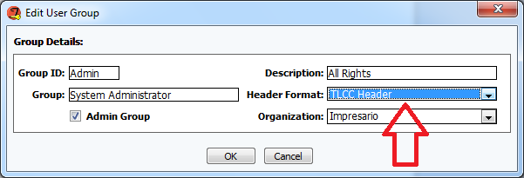
Custom Headers – DIY (Security)
Security Groups
  Header Format: = description from T_FORMAT_INFO

Slide 53
Customizing

Slide 54
Customization Steps
Step 1: Update SP to return required columns
Step2 : Add the new column(s) to your IM object
Step 3: Add the column(s) to IM design
  Formatting
  Dynamic Controls

Slide 55

Customization Steps – example:
Step 1 – Update SP
Declare a new variable
Set the variable

Slide 56
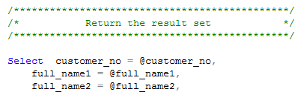
Customization Steps – example:
Step 1 – Update SP
Select the final Results

Slide 57

Customization Steps – example:
Step 2 – Add column to IM
Add row to IM column specification
  IM Menu, View → Column Specification

Slide 58

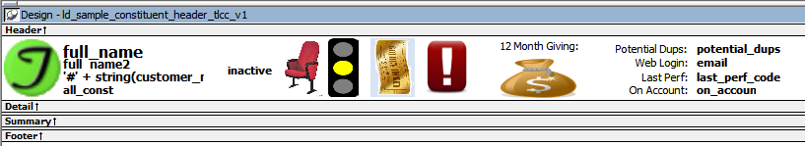
Customization Steps – example:
Step 3 – Add to Design and Format
Add element to IM design
    IM Menu, Insert→ Control → Column

Slide 59

Customer # 0 considerations
Ticket Orders
Contributions

Slide 60
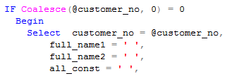



Customer # 0 considerations
Use ‘blank’ columns
  Avoids erroneous data
  Maintains correct column output

Slide 61
Custom Header Considerations
Must ALWAYS return
    Customer_no
    Full_name
    Full_name2
Must ALWAYS return 1 row
    SELECT TOP 1
    Aggregated data
      SELECT SUM()
      SELECT COUNT(*)
      SELECT MAX()
      SELECT MIN()

Slide 62
Custom Header Considerations
If Tessitura cannot “see” your IM library / object it will display the default header
Test your customized SP in SQL before referencing in IM
Test your customised Constituent Header in your Test system first(!)

Slide 63
Useful IM Controls

Slide 64
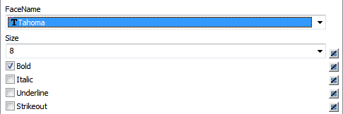
IM - Expression dialogue boxes
Buttons next to various property values in the “Properties” windows in Infomaker
Allow you to add dynamic controls over properties of a particular IM custom screen element

Slide 65
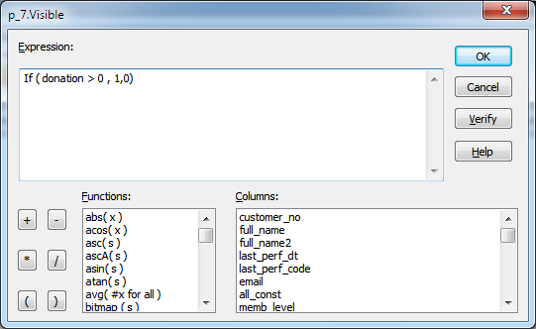
IM - Expression dialogue boxes
Click on the Expression button to add / amend element property

Slide 66
IM - Expression dialogue boxes
When an expression is added to an element property value this button changes:
→
What is an expression?
  A combination of data, operators, and functions that, when evaluated, results in a value.

Slide 67
IM - Useful functions: IF
“IF” - Evaluates a condition and returns a value based on that condition
  IF(boolean, truevalue, falsevalue)
Example:
  Computed Column:
    IF(salary > 100000, "Boss”, "Employee”)
  Colour definition:
    IF(income > 50000, RGB(255,0,0), RGB(255,255,255))

Slide 68
IM - Useful functions: CASE
“CASE” - Tests the values of a column or expression and returns values based on the results of the test
  Case (column WHEN value1 THEN result1 WHEN value2 THEN
  result2... ELSE value3)
Example:
  Computed Column:
    CASE(salary WHEN 100000 THEN "Boss” WHEN 75000 THEN “Manager” ELSE “Staff”)
  Colour definition:
    CASE(income WHEN 50000 THEN RGB(255,0,0) WHEN 25000 RGB(0,255,0) ELSE RGB(0,0,255))

Slide 69
Examples
Ooo…

Slide 70



Membership Traffic Light System
What?
  Red Light = Membership has expired
  Amber Light = Expiring within 30 days
  Green Light = Membership is active
Why?
  Clear visual indicator replaces expiry date
  Encourages users to upsell renewals

Slide 71

Membership Traffic Light System
How?
  Membership data returned by standard SP
  Conditional visibility to show traffic light:
    Current_status
    Memb_expiration

Slide 72
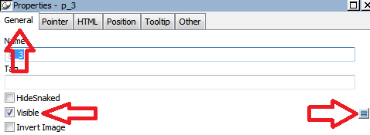
Membership Traffic Light System
  If Condition on Image visibility
If((current_status = 'Active' or current_status = 'Pending')
and daysafter( today() , memb_expirtion )> 30
,1,0)

Slide 73
Membership Traffic Light System
  If Condition on Image visibility
If((current_status = 'Active' or current_status = 'Pending')
and daysafter( today() , memb_expirtion )< 30
and memb_expirtion > today()
,1,0)

Slide 74
Membership Traffic Light System
  If Condition on Image visibility
if( memb_expirtion < today(), 1,0 )

Slide 75



12 Month Giving Money Bag
What?
  Money bag increasing in size based on donation amount
Why?
  Dev. Dept. would like all users to see who is donating…
  …but not how much they are donating

Slide 76
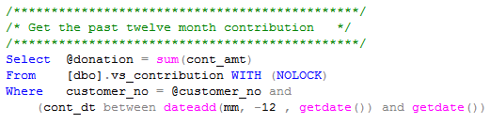
12 Month Giving Money Bag
How?
  SP calculates SUM of donations

Slide 77
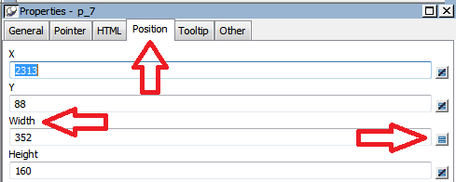



12 Month Giving display
  Case Statement Control on image width
case( donation
when is > 1000 then 350
when is > 500 then 200
when is > 0 then 100)

Slide 78

Membership Upsell
What?
  Ticket icon to display if 3 or more performances purchased in last 12 months
Why?
  Customer would benefit by becoming a member
  Upselling is good!

Slide 79
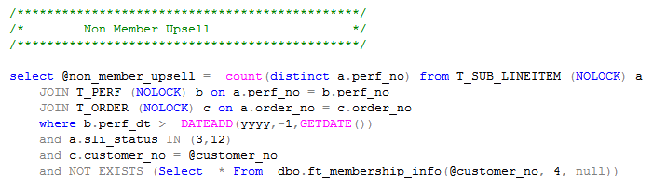
Membership Upsell
How?
  SP counts performances attended in previous 12 months…
  …if customer does not have a current membership

Slide 80
Membership Upsell
How?
  If Condition on Image visibility
  Displays if 3 or more performances purchased
  if (non_member_upsell > 2, 1,0)

Slide 81
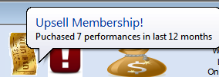
Tooltips!
What?
  Popup information by hovering over fields / images
Why?
  Why not! And you can easily impress colleagues…
  Explanatory information
  Saves a lot of space

Slide 82
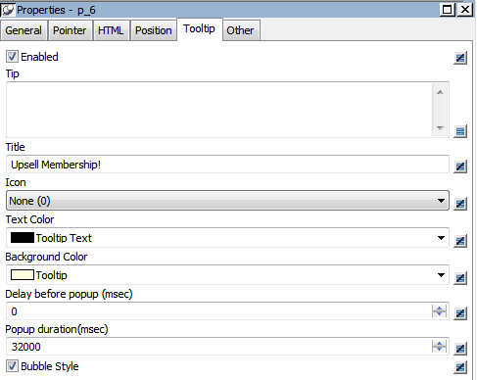
Tooltips!
How
  Enable Tooltip tab
  Tip = message
  Title
  Icon
    Info / Warning
  Bubble style
    Ahh…

Slide 83
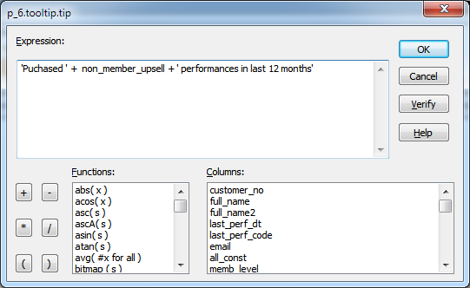
Tooltips!
  Tip

Slide 84

Test Database Icon
What?
  An icon to display that this is TEST
Why?
  Because we are only human…
  It’s simple and effective

Slide 85

Test Database Icon
How?
  Check in SP whether this is TEST
  T_DEFAULTS.title bar text
  Conditional visibility to show icon

Slide 86


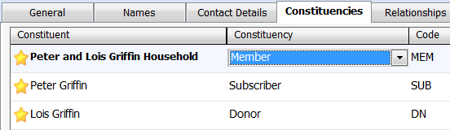
Constituencies & Primary Affiliates
SQL Function, FS_CONST_STRING_NEW
  @include_affiliates = ‘Y’

Slide 87


Constituencies & Primary Affiliates
SQL Function, FS_CONST_STRING_NEW
  @include_affiliates = ‘N’

Slide 88
Additional Resources
Tessitura Help: Flex Headers
  http://www.tessituranetwork.com/Help_System/Content/Constituent%20Records%20Basic%20Features/Flex%20Headers.htm
Tessitura Help: Popup Headers
  http://www.tessituranetwork.com/Help_System/Content/Constituent%20Records%20Basic%20Features/Popup%20Headers.htm
Tessitura Network Forums: Flex Headers
  http://www.tessituranetwork.com/Community/search/SearchResults.aspx?q=flex+header
Tessitura Help: Custom Headers
  http://www.tessituranetwork.com/network/Learning/Documentation/Customization/Custom%20Constituent%20Headers.aspx

Slide 89


Creating Popup, Flex and Custom Constituent Headers
Please ask for a microphone and introduce yourself when you are ready to speak.
#tlcc2013
What are your takeaways?

Slide 90
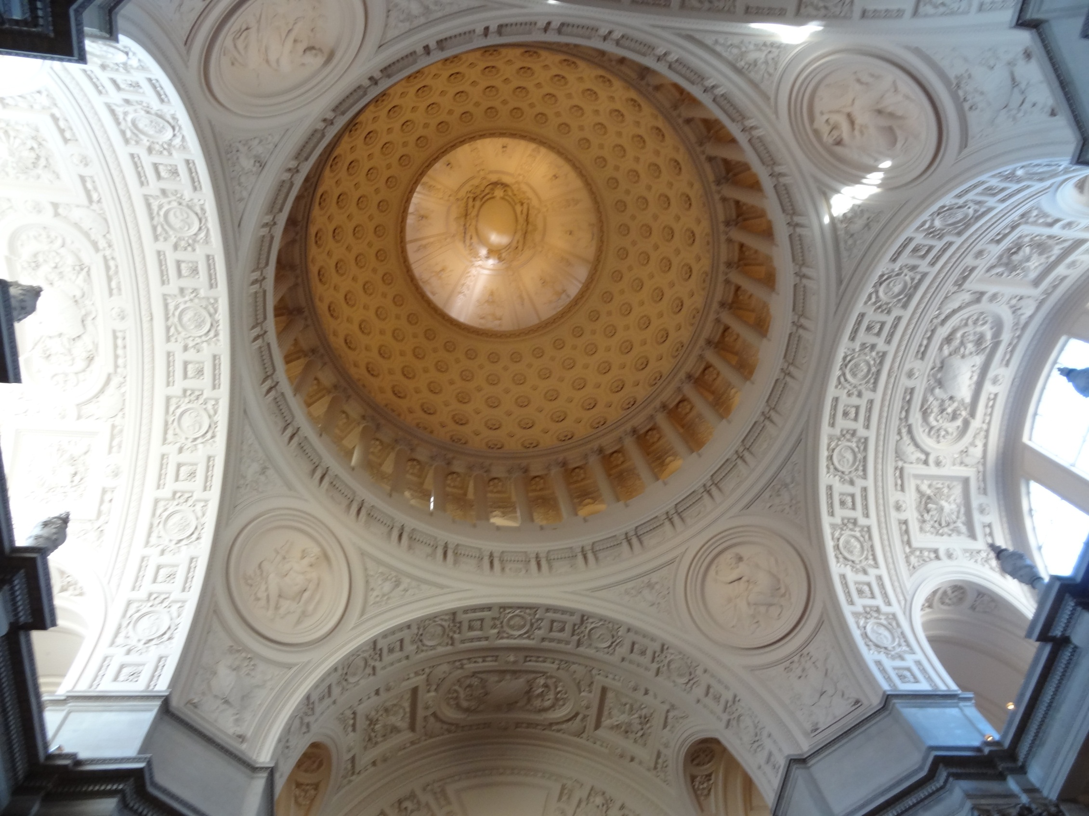

Buses from 4:00-4:30

Slide 91
Where do we go from here …
Prep for tonight
  Download RedLaser or inigma QR code readers
Chorus Rehearsal at Davies
  Not too late to join the group!
  Bus leaves at 3 sharp.
Networking Break is next
  Grand Assembly, Golden Gate Foyer, Atrium

Slide 92
New to the Network?
“TLCC and tessituranetwork.com”
Get a head start on learning about the Community
Breakfast Tomorrow is for you
Golden Gate B, B2 Level

