Slide 1

“Facts are stubborn things, but statistics are more pliable.”
T-Stats and Dashboards
Notes:
Opening slide

Slide 2
Who am I?
Ben Magson, Tessitura Network
Application Support Specialist
bmagson@tessituranetwork.com

Slide 3
Today’s Session
T-Stats overview
T-Stats in the real world
Dashboards overview
Dashboard examples

Slide 4
What is T-Stats?
T-Stats is a Business Intelligence application that complements and enhances Tessitura Software reporting and query capabilities.
T-Stats allows a savvy, functionally-capable, but non-technical Tessitura end-user to browse the data and create their own reports in seconds in order to do analysis, track successes, uncover opportunities and much more.

Slide 5
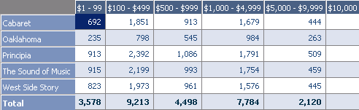
What is T-Stats?
Ad-Hoc Tessitura reporting at the drop of a hat!
Supplemental reporting tool for Tessitura, enhancing the standard Tessitura reporting module
Allows users to easily report on (complex) data with minimal IT involvement
Application developed and supported by JCA

Slide 6
What Can T-Stats Do?
Provides a data “sandbox” to view and manipulate data
Allows you to drag and drop recognisable fields and see results
Gives you the ability to filter, group or drill down on data as necessary

Slide 7
What Can T-Stats Do?
Provides visualisation of your data (charts, graphs, maps)
Saves constituents back to Tessitura to allow you to take action
Outputs analysis to Excel to share with others

Slide 8
How is this Different from a Report?
It is Dynamic
It is Fast
It Can Chart on the Fly
Gives you the “IMAX” Version of your Data

Slide 9
So I No Longer Need Reports?
You still need reports
T-Stats adds another tool in your Tessitura Armoury
T-Stats is about trends, reports are about detail

Slide 10

30 Second Tech Overview
PART 1: Populate Warehouse
Tessitura DB (Impresario)
TStats Data
Warehouse

Slide 11
30 Second Tech Overview
PART 2: Create Cubes
TStats Data
Warehouse
Analysis Services Data Cubes

Slide 12

30 Second Tech Overview
PART 3: View and Browse Cubes
Analysis Services Data Cubes
T-Stats Browser

Slide 13
T-Stats Resources
T-Stats Overview
  http://www.tessituranetwork.com/network/Products/Network%20Products%20Services/T-Stats.aspx
T-Stats T-Cast
  http://www.tessituranetwork.com/network/Learning/Webinars%20Archive/T-Stats/Introduction%20to%20T-Stats%20T-Cast.aspx

Slide 14
Dashboards

Slide 15
What are Dashboards?
A single page collection of widgets (we’ll come to these in a moment)
They provide an executive view of your key performance indicators
They are a high-level snapshot the most important information
Provide a succinct way to measure your strategies and lead you to act

Slide 16
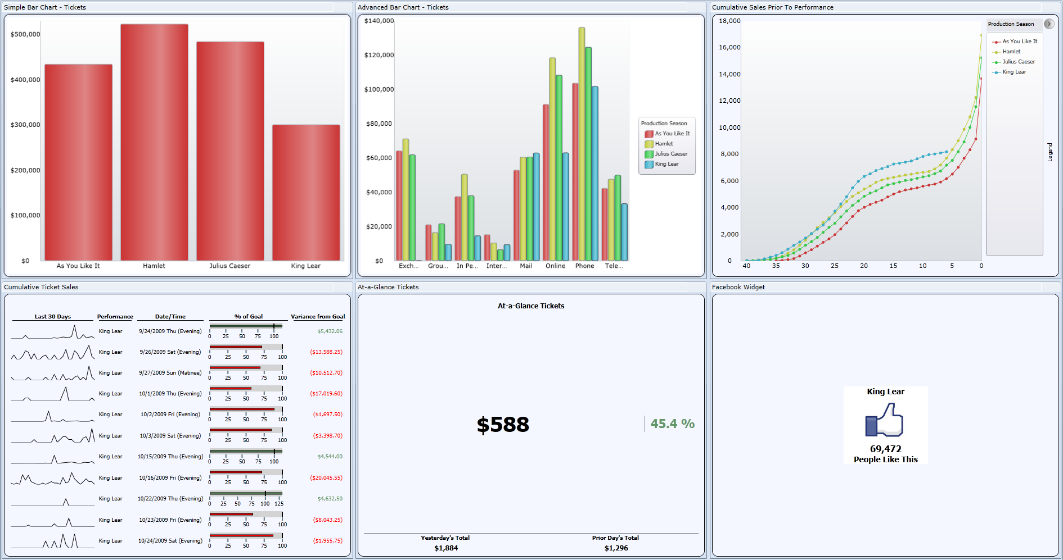
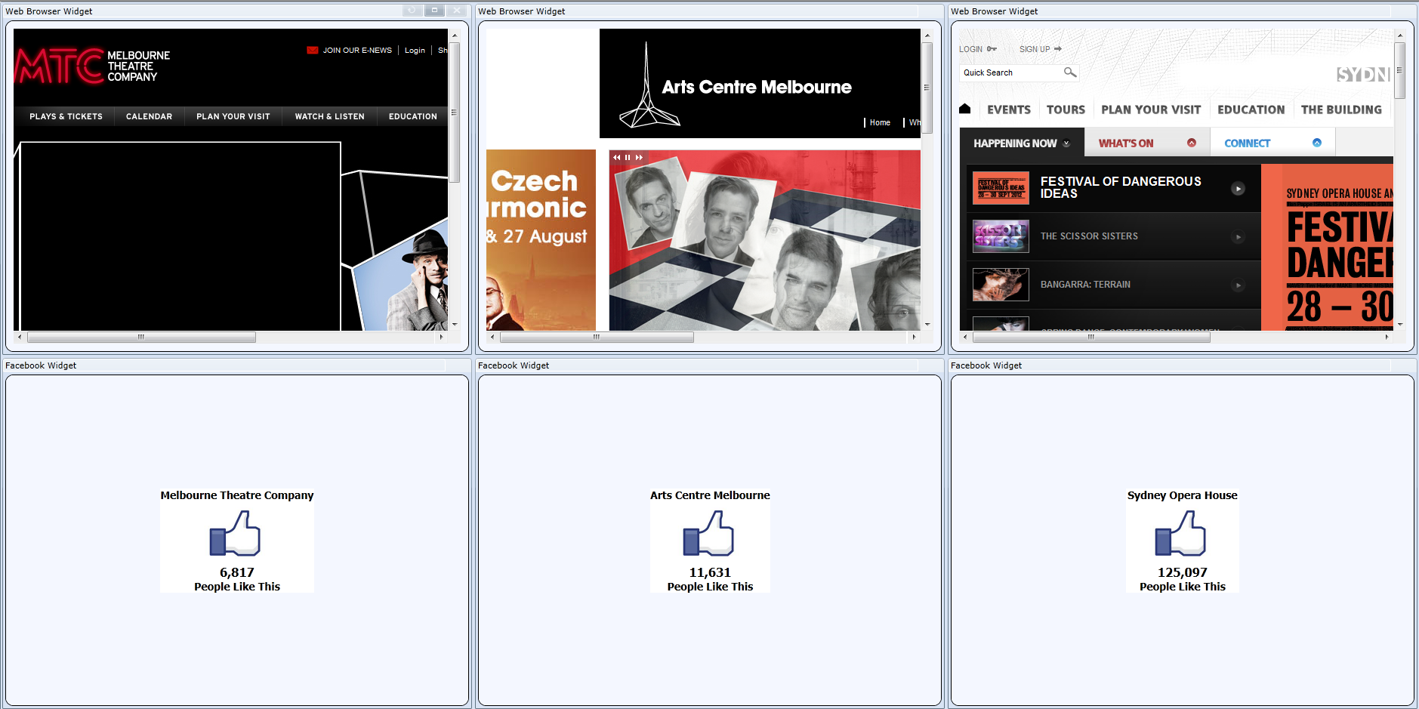
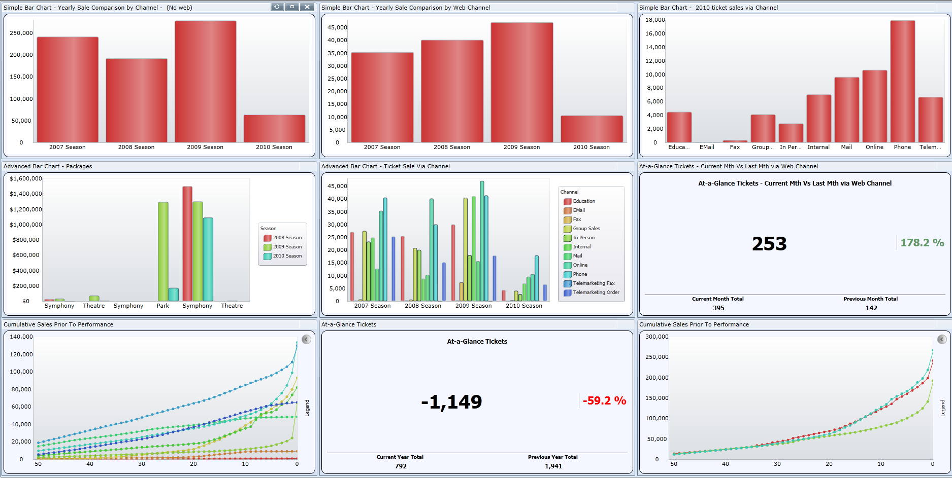

Slide 17
Widgets
Widgets are the building blocks of Tessitura Dashboards
A tiny, action-packed report that can be configured to tell a specific story you are interested in tracking
19 highly flexible standard widgets

Slide 18
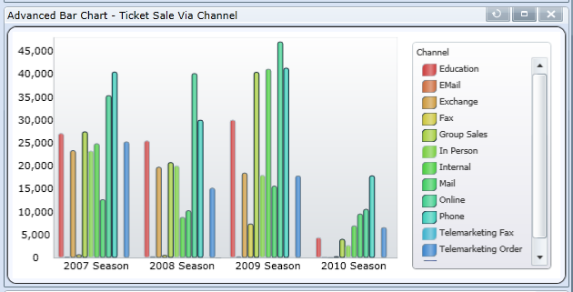
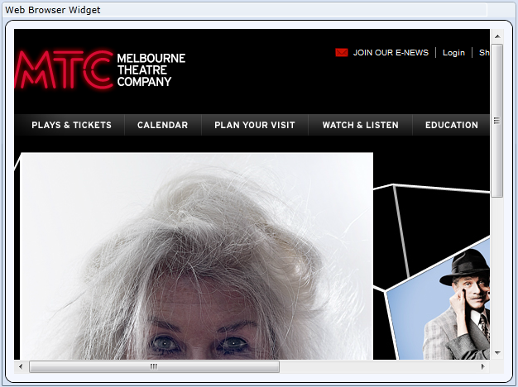
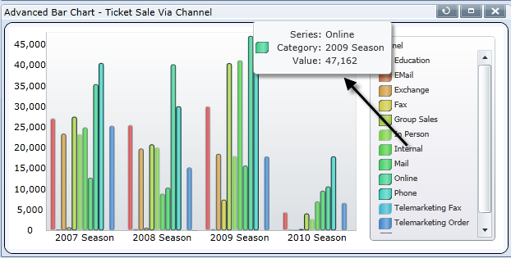
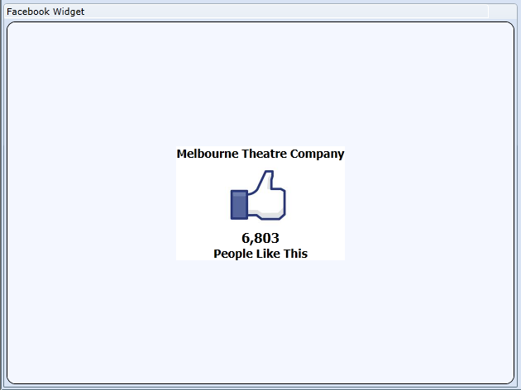
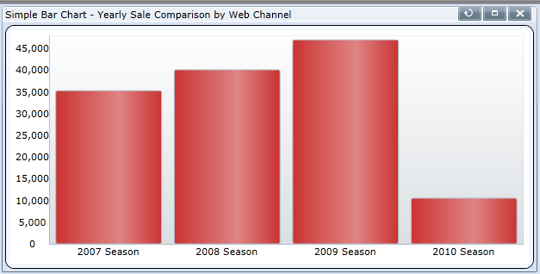
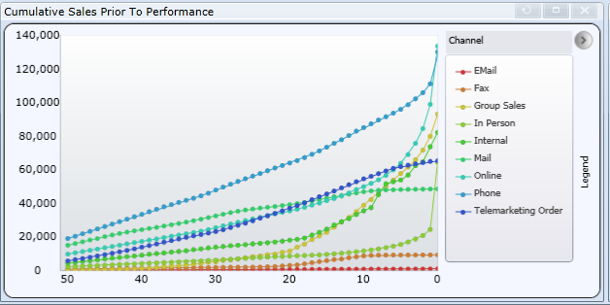
Widget

Slide 19
What they are not…..
They are not designed to replace Tessitura reports
They are not designed to replace T-Stats
They are not designed for granular, in-depth reporting
But they are designed to work with the above to complete the BI stack

Slide 20
19 highly flexible standard widgets
Cumulative Sale prior to performance
Cumulative Ticket Sales
Simple Bar Chart
Advance Bar Chart
At-A-Glance
At-A-Glance Choose query Widget
Facebook Widget
Most Recent Contributions
Select A Report
Web Browser

Slide 21
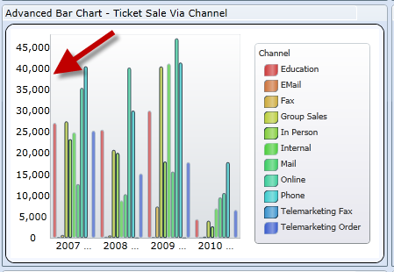
Some Definitions…
Measure: An item of data that can be calculated: Number of Tickets, Contribution Amount, Number of Memberships, Ticket Amount, Number of Contributions, Membership Amount.
Provide numerical results in the output.
Become your Y axis

Slide 22
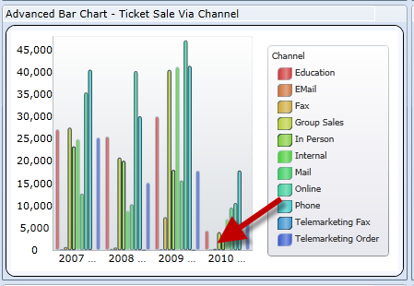
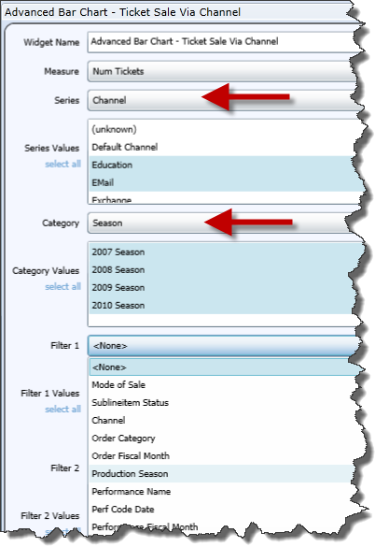
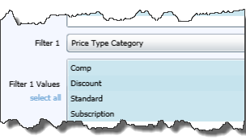
Some Definitions…
Series:
Category:
Become your X axis
Filter: Filters the
information

Slide 23
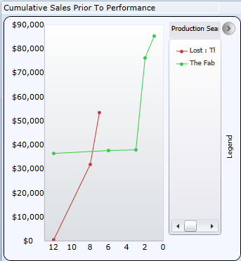
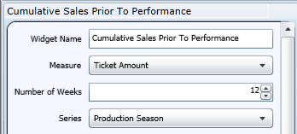
Cumulative Sales Prior to Performance
Measures:
  Tickets Sold
  Ticket Amount
Configurable Number of weeks

Slide 24
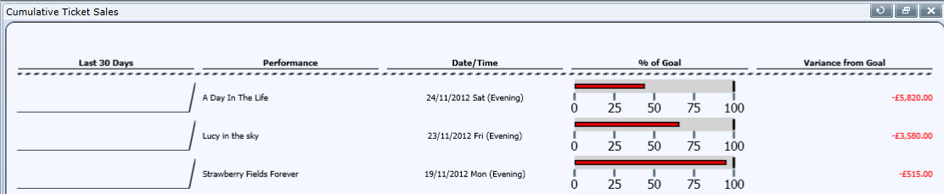
Cumulative Ticket Sales

Slide 25
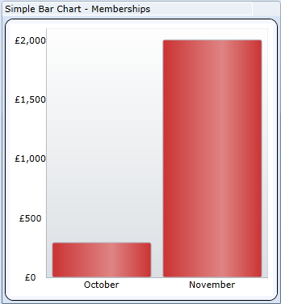
Simple Bar Charts
Measures:
  Tickets
  Packages
  Memberships
  Contributions

Slide 26
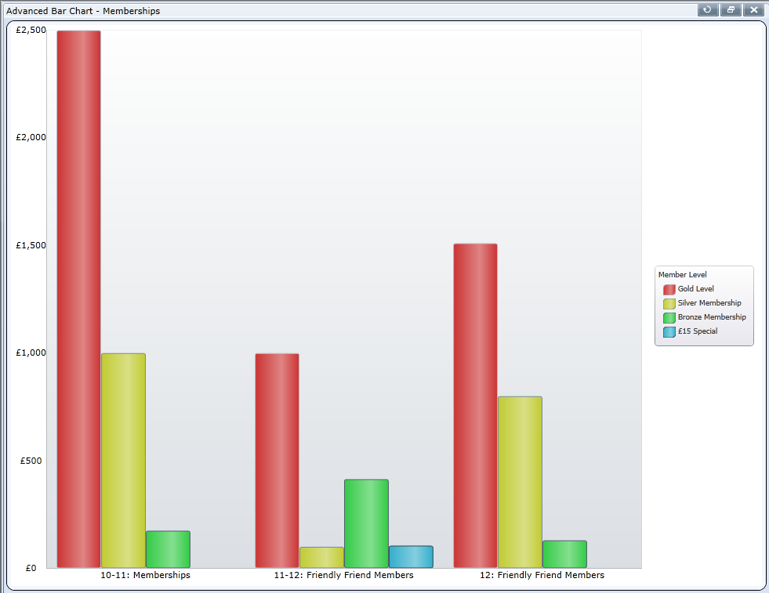
Advanced Bar Charts
Measures:
  Tickets
  Packages
  Memberships
  Contributions

Slide 27
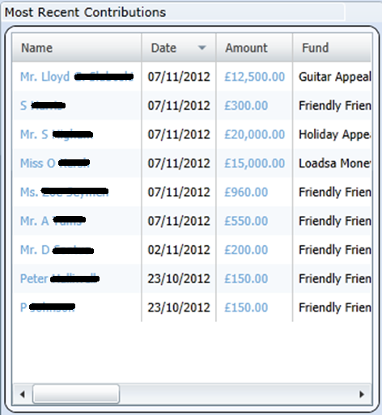
Most Recent Contributions
Configurable Number of days
Configurable Minimum Contribution Amount
Click-through
  Constituent
  Contribution

Slide 28
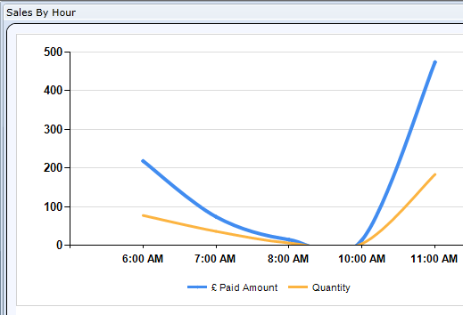
Select a Report
Any SSRS URL Report
  TR_DASH_WIDGET_PARM_VALUE

Slide 29
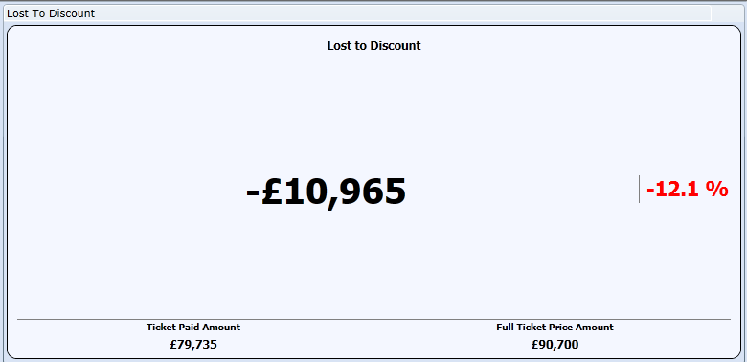
At-A-Glance Query Widget

Slide 30
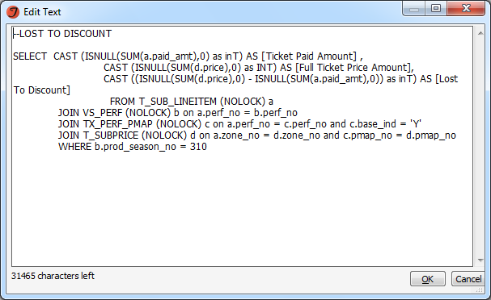

At-A-Glance Query
TR_DASH_ATAGLANCE_QUERIES
  In Query column add SQL select
  If results are money set IsCurreny to Yes

Slide 31
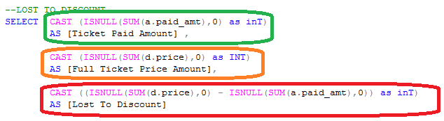

At-A-Glance Query
TR_DASH_ATAGLANCE_QUERIES - SQL SELECT

Slide 32
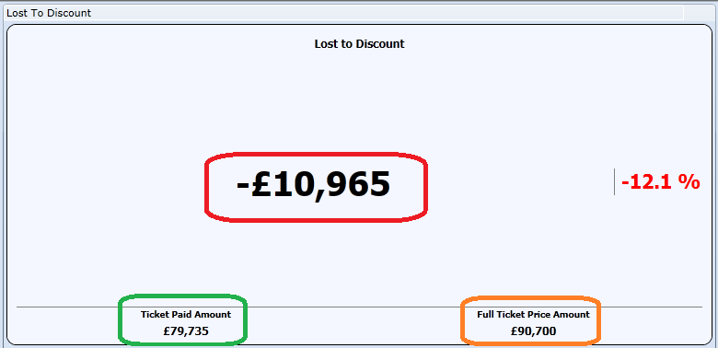
At-A-Glance Query

Slide 33
At-A-Glance Query
SQL Sample
--LOST TO DISCOUNT
SELECT CAST (ISNULL(SUM(a.paid_amt),0) as inT)
AS [Ticket Paid Amount] ,
CAST (ISNULL(SUM(d.price),0) as INT)
AS [Full Ticket Price Amount],
CAST ((ISNULL(SUM(d.price),0) - ISNULL(SUM(a.paid_amt),0)) as inT)
AS [Lost To Discount]
FROM T_SUB_LINEITEM (NOLOCK) a
JOIN VS_PERF (NOLOCK) b on a.perf_no = b.perf_no
JOIN TX_PERF_PMAP (NOLOCK) c on a.perf_no = c.perf_no and c.base_ind = 'Y'
JOIN T_SUBPRICE (NOLOCK) d on a.zone_no = d.zone_no and c.pmap_no = d.pmap_no
WHERE b.prod_season_no = 310

Slide 34
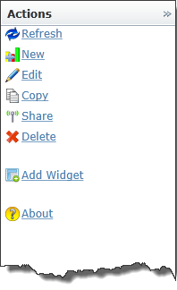
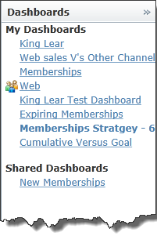
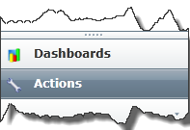
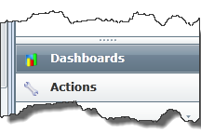
Sharing/Copying/Edit Dashboards

Slide 35
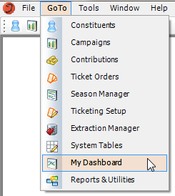
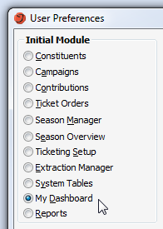

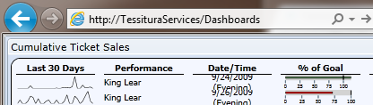
Accessing Dashboards
GoTo My Dashboard
Start in My Dashboard
My Dashboard Icon
Web Browser

Slide 36
Dashboard Resources
Help system
  http://www.tessituranetwork.com/Help_System/Content/Dashboard/Tessitura%20Dashboards.htm
TLCC 2012 Archive
  http://www.tessituranetwork.com/en/network/Conference/Conference%20Materials%20Archive/2012%20Conference%20Materials.aspx

Slide 37
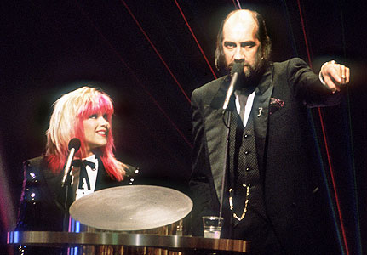
Q&A

