Slide 1
Tessitura UK Conference
9 November 2012
RSC - Stratford-upon-Avon
GHCZR9

Slide 2
TLCC2013
Tessitura Learning & Community Conference 2013
Don Youngberg
VP, Community & Learning Resources

Slide 3


TLCC2012 – Thank You UK/IE!
Planning Committee Members (10)
Presenters/Moderators/Panelists/Gurus (26)
Attendees (82)

Slide 4
TLCC2013
San Francisco, CA

Slide 5
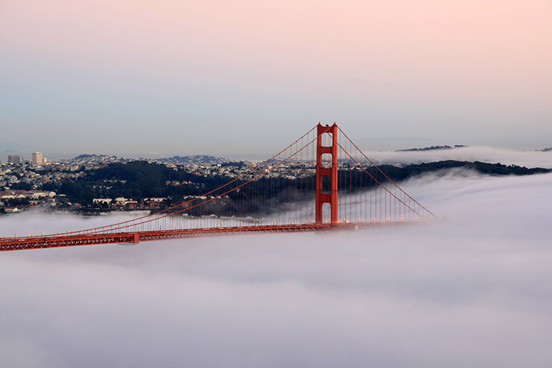

Slide 6
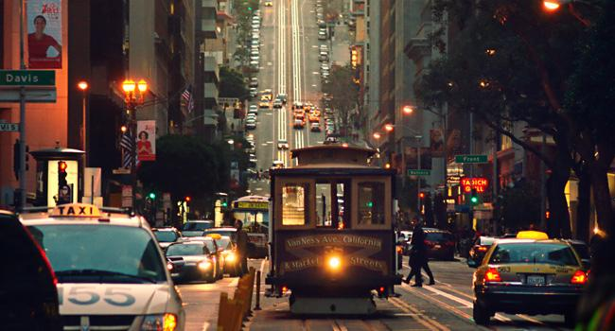

Slide 7
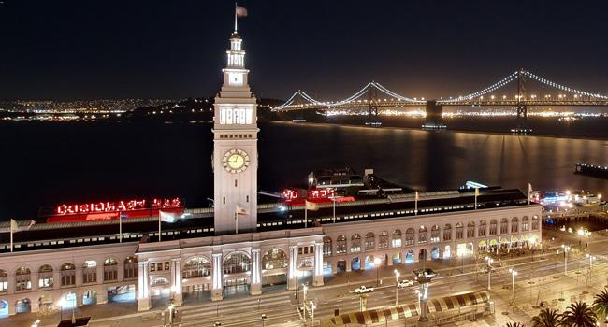

Slide 8
TLCC2013 - San Francisco, CA
Tessitura Learning & Community Conference
Sunday-Thursday July 14 – 18, 2013
  A full month earlier than TLCC2012
How many people expected? 1200+?
San Francisco Marriott Marquis Hotel
  (BOOK NOW!)

Slide 9
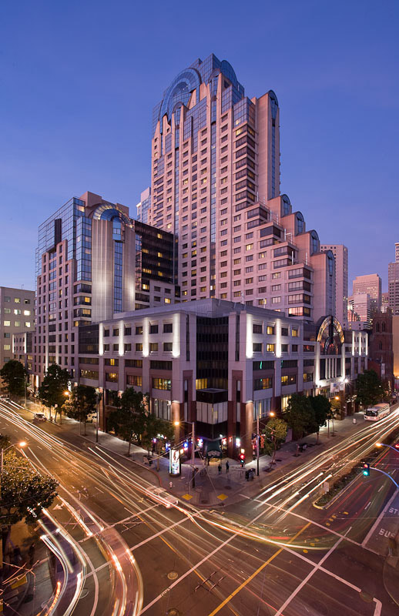
San Francisco
Marriott Marquis

Slide 10
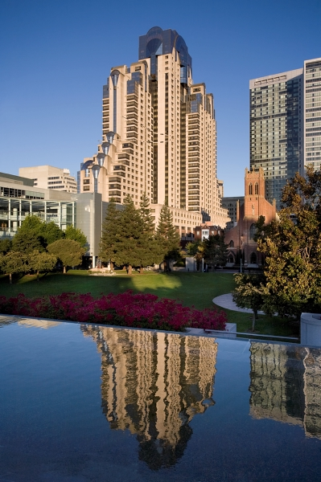

Slide 11
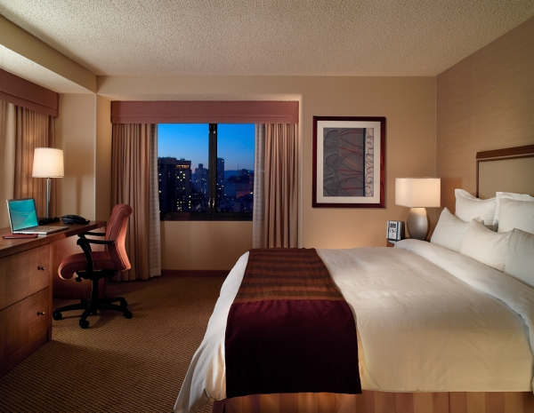
$184 per night (includes internet)

Slide 12
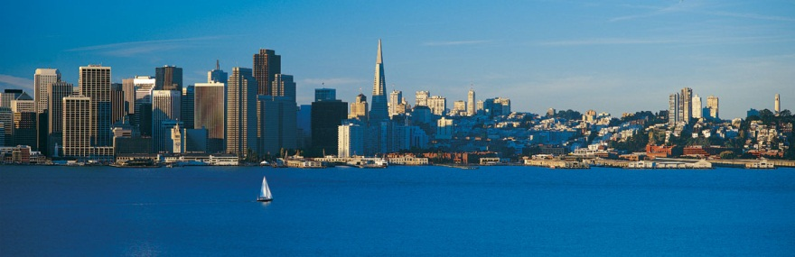


Slide 13

TLCC2013
Sunday, July 14 – Thursday, July 18
Reservation link is on tessituranetwork.com
Or call 888-575-8934

Slide 14
How to help determine content for TLCC2013?

Slide 15
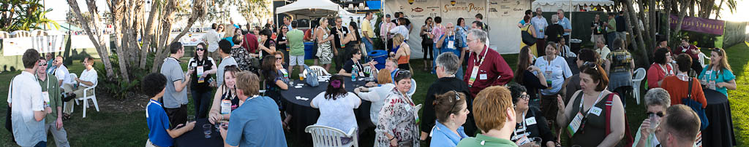
TLCC Planning Committee
Who are we?
~100 Tessitura staff and users
Representing ~70 licensee organizations
Brilliant example of virtual group process

Slide 16
What do we do?
Plan content sessions
  Soup to Nuts
Peer-to-Peer Presentation
  Choose Topics/Recruit Presenters
Discussions
  Choose Topics/Suggest Moderators

Slide 17
When do we get started?
First meeting in December
Full schedule complete by end of January!

Slide 18
Do you want to be involved?
Just let me or Tina Hatch know
dyoungberg@tessituranetwork.com
thatch@tessituranetwork.com
More info coming in late November

Slide 19


Slide 20
What’s New with Web Products
Steve Geahry
Manager of Client Services, Web Products

Slide 21
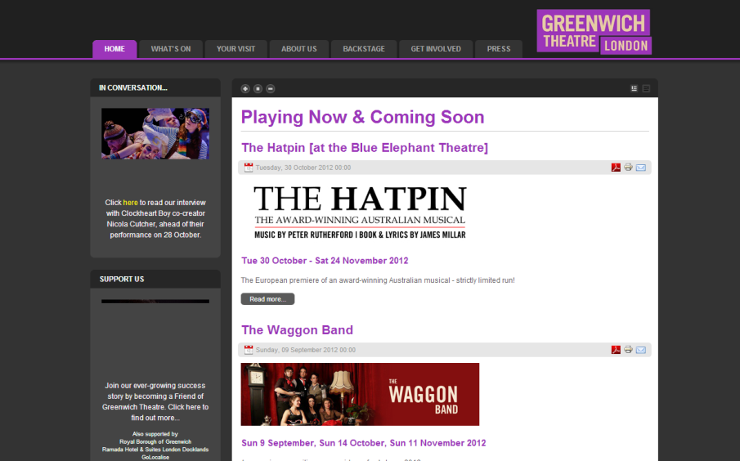
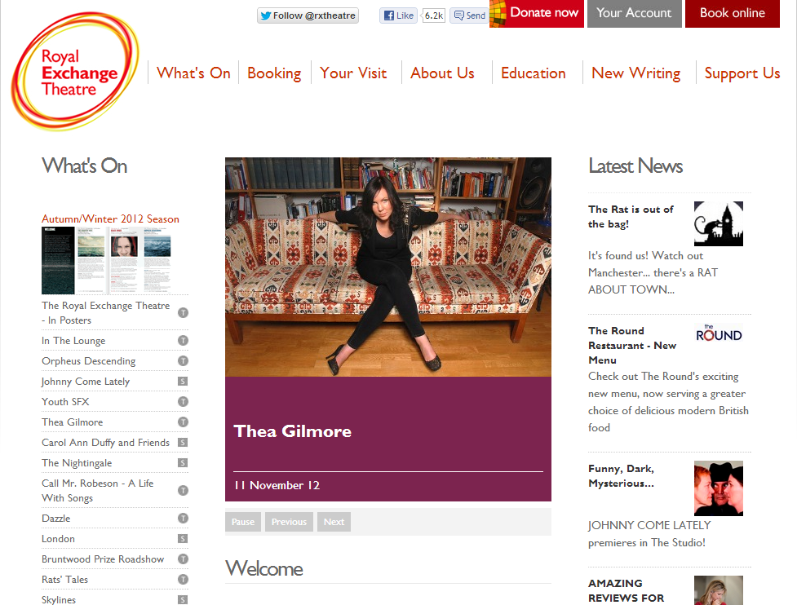
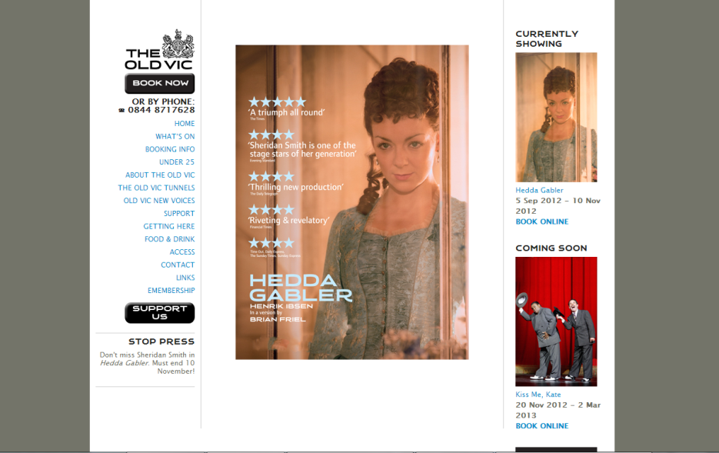
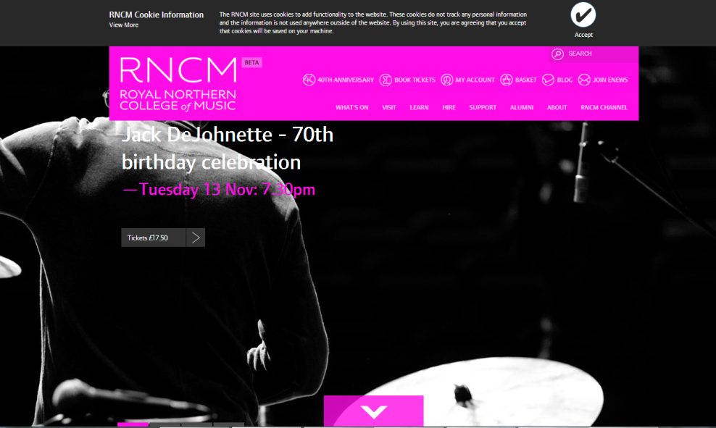
TN Express Web

Slide 22
TNEW Today
V3.5 released mid-2012 with many new features including Tessitura v11 support
We have over 100 organisations LIVE
More than 125 organisations have JOINED
And continuing to grow…

Slide 23
What’s Next? V4 in Late 2012
Some highlights include:
  Gift voucher sales, look-up, and redemption
  Enhanced MyAccount page with ticketing, subscription, and membership/contribution history
  Improved integrations with web analytics tools
  Additional page to sell Memberships
  Allow patrons to set the order source code and take mini-surveys at checkout

Slide 24
What’s Next? V4 in Late 2012
Additional highlights include:
  Optional CAPTCHA integration at checkout and registration
  Offer-based promo codes will be able to update prices after seats have been added to the cart
  And more…significant site-wide code optimisation, more audit data, updated API integration, etc, etc

Slide 25
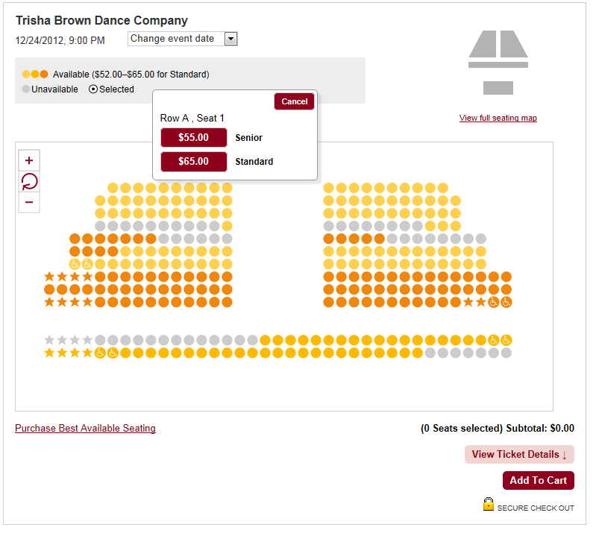
…And Then What? V4.5!
This upgrade will include additional new features, most notably HTML5-based SYOS
TOP SECRET

Slide 26
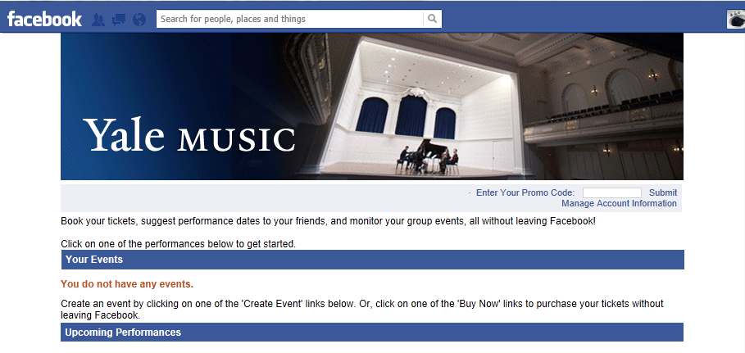
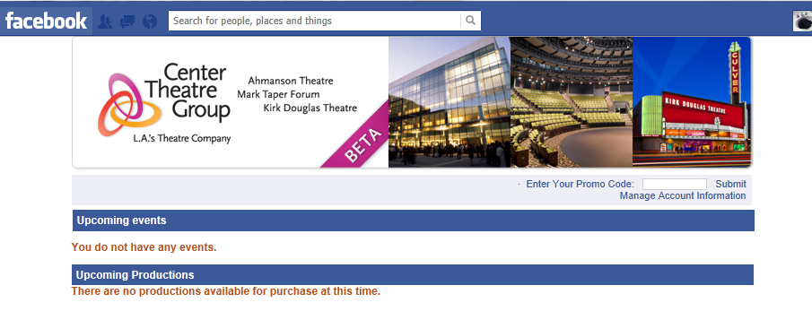
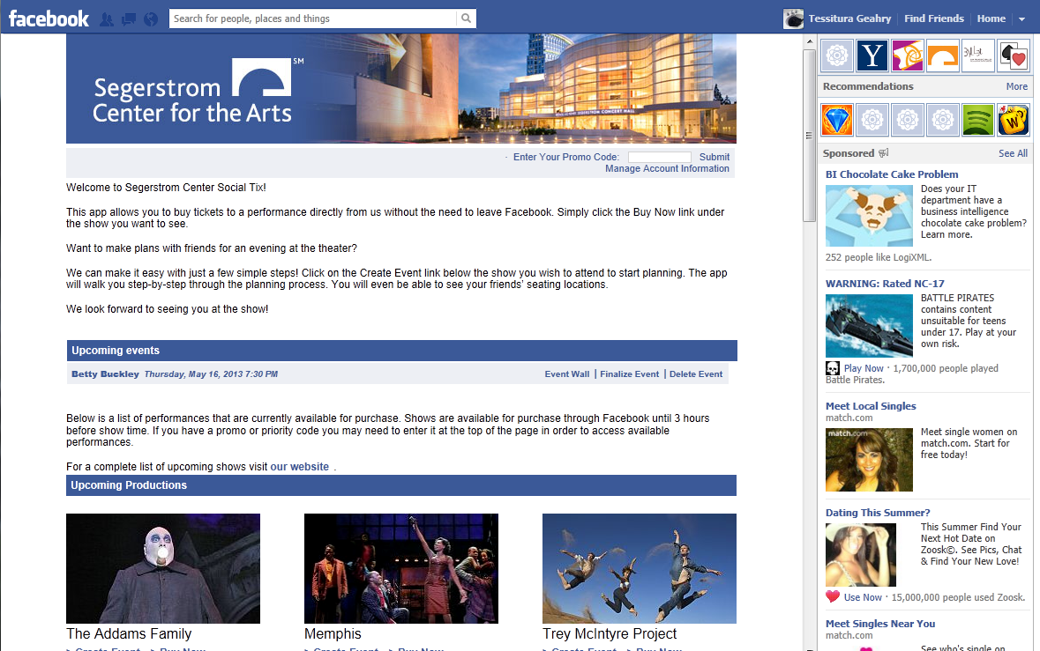
TN Social Ticketing

Slide 27
Version 12 in 12 minutes
(and a quiz)
Andrew Recinos
Executive Vice President

Slide 28
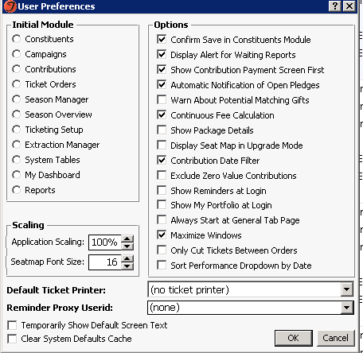
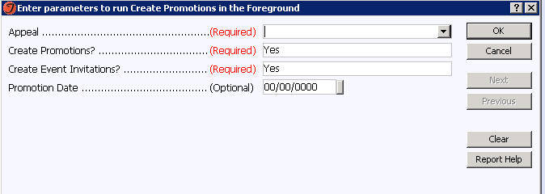
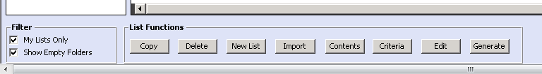
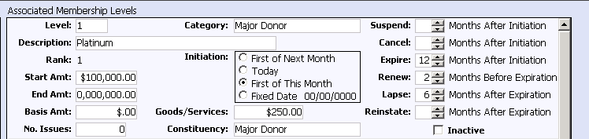
What do we have in common?

Slide 29
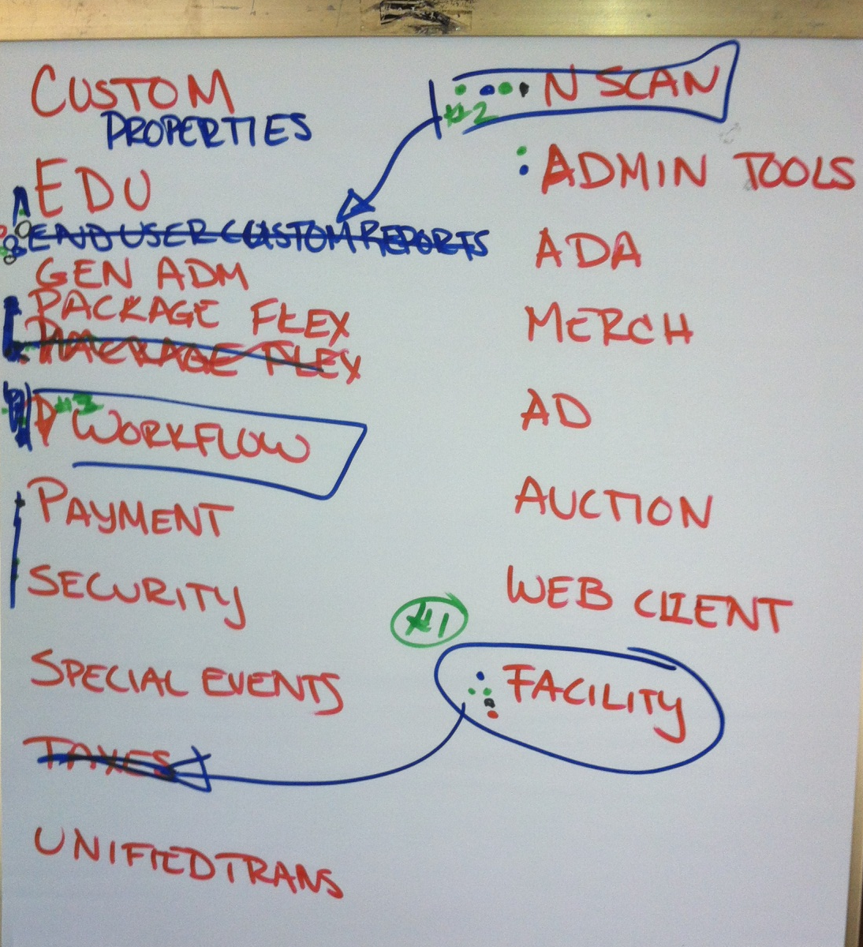
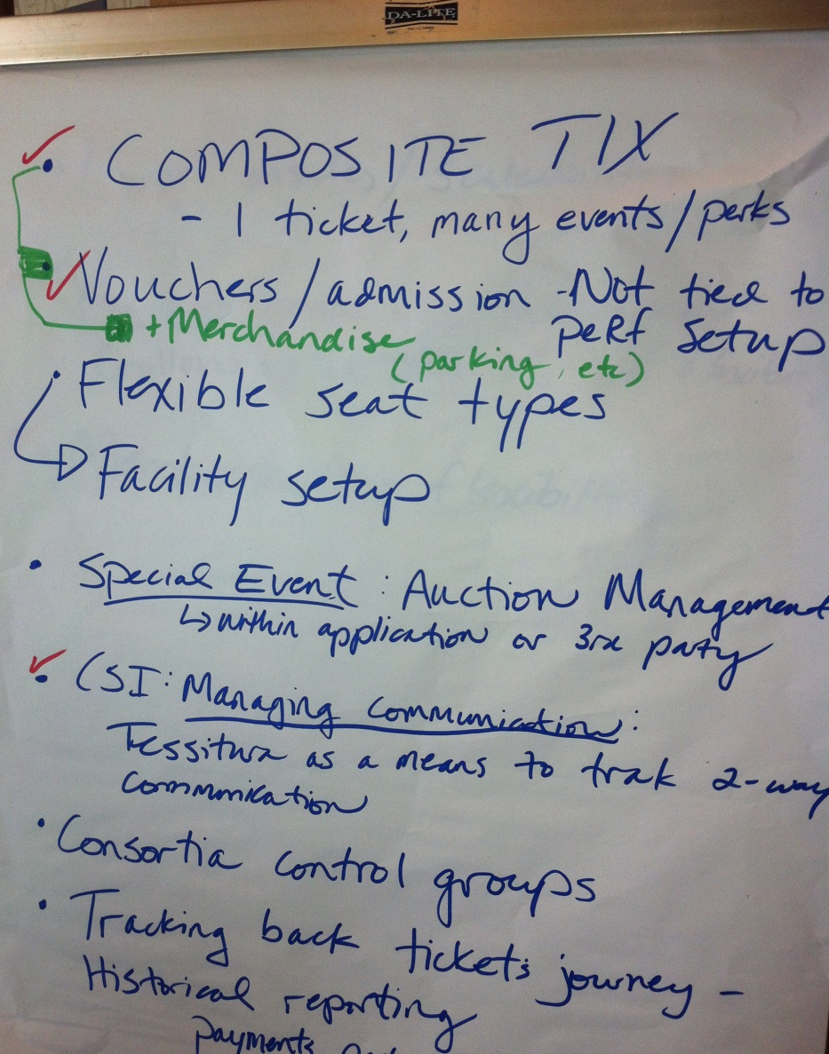
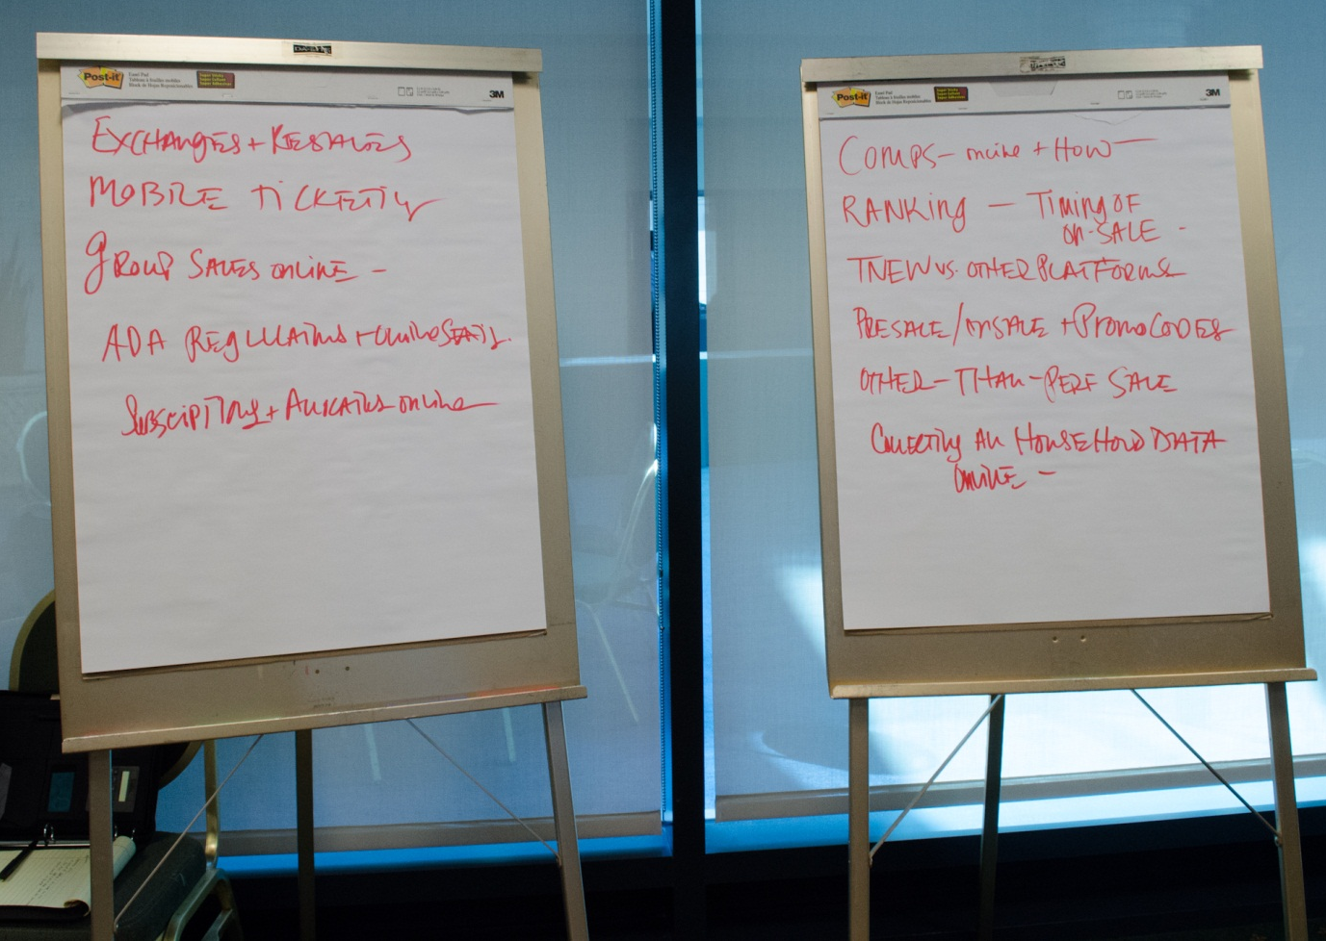
Roadmap

Slide 30
V12 Roadmap:
What are we working on right now?
Moves Management “Plans” – 80% Complete
Pricing Setup – 50% Complete
Ticket Order “QuickSale” – 25% Complete
Pricing Rules Engine – Final Analysis

Slide 31
Plans

Slide 32
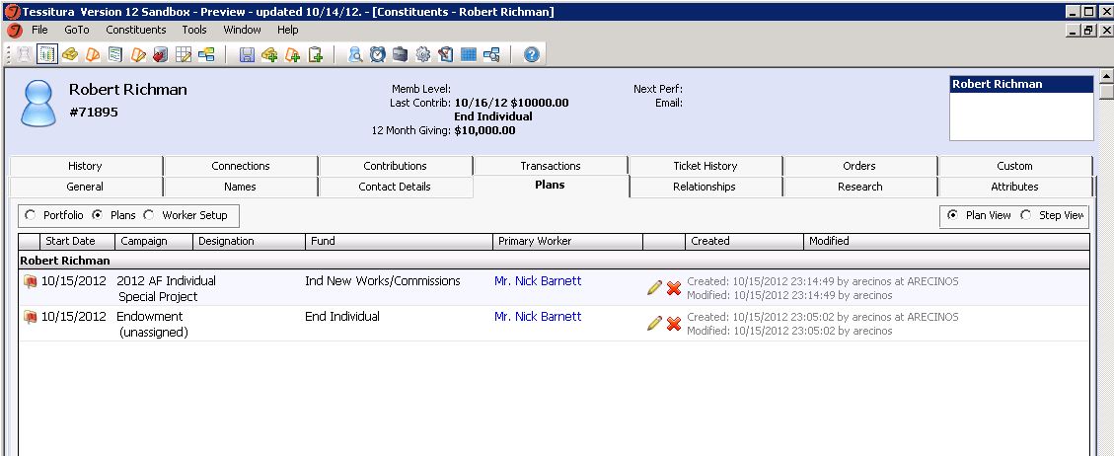

Slide 33
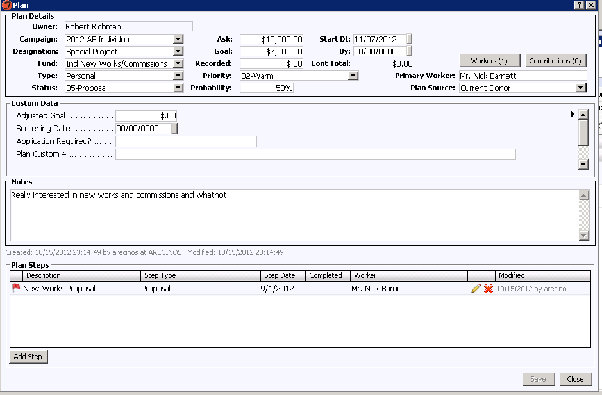
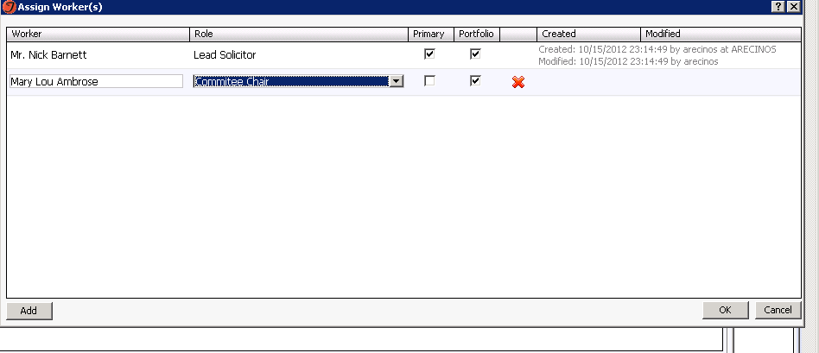

Slide 34
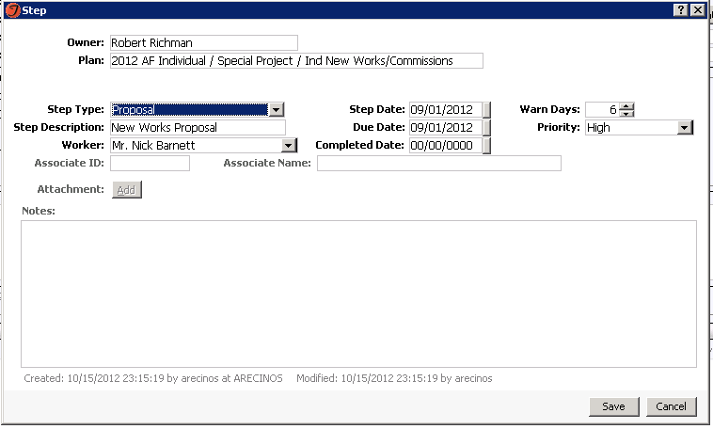

Slide 35
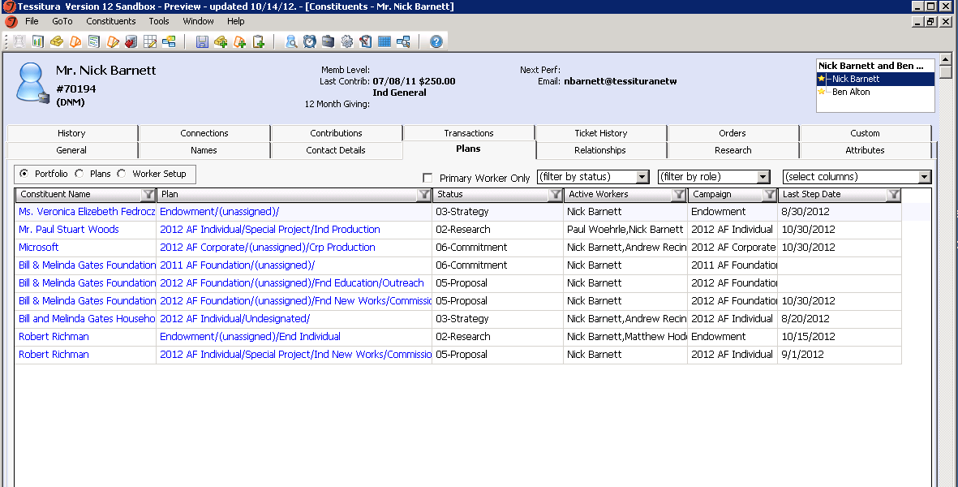

Slide 36
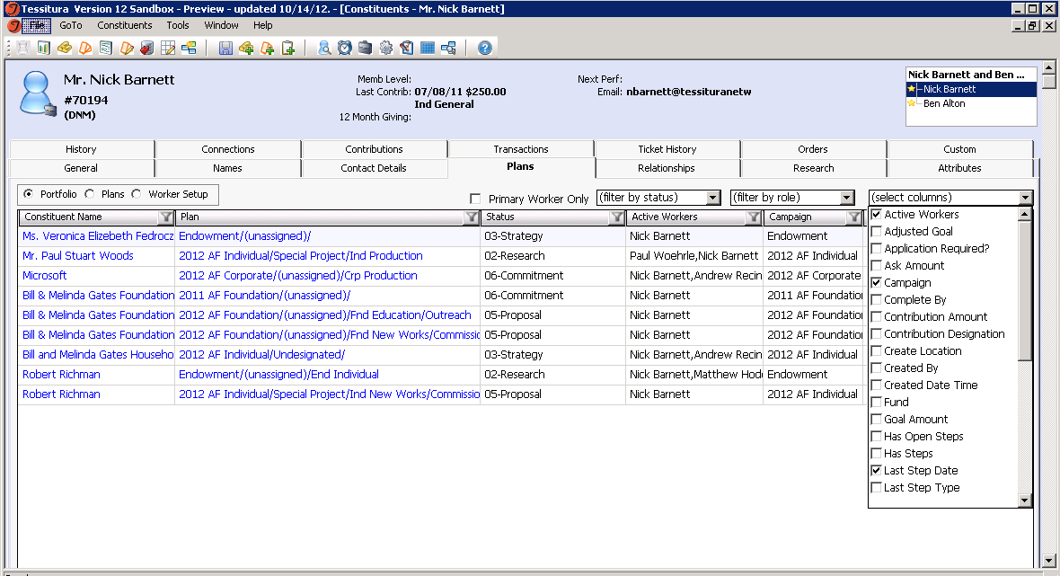

Slide 37
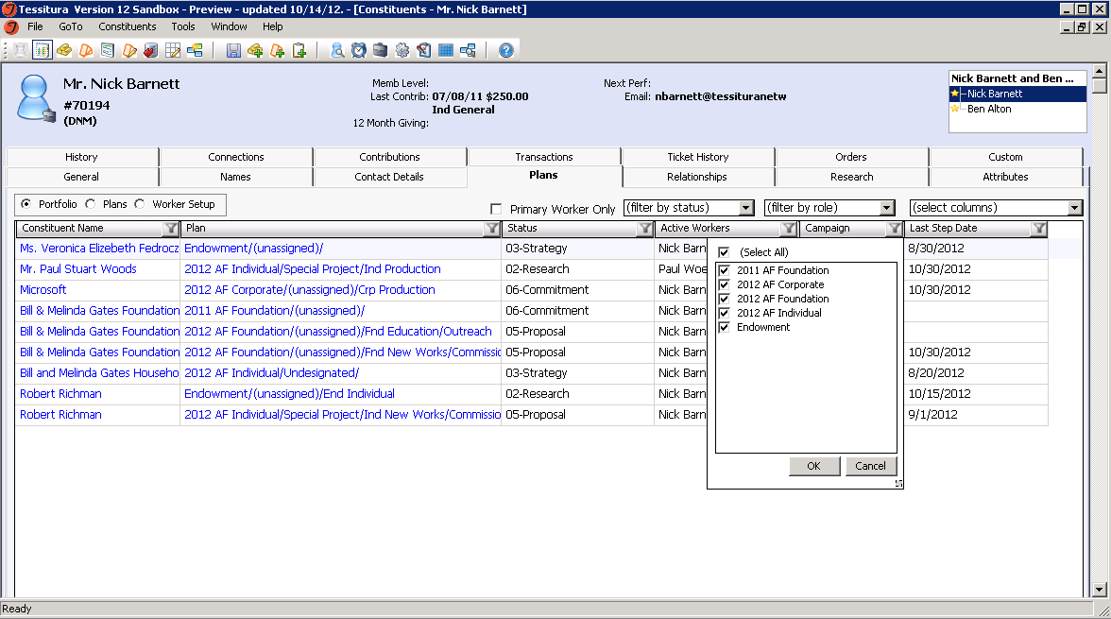

Slide 38
Pricing Rules Engine

Slide 39
Pricing Rules Engine
Most Popular Roadmap Item!
Automatically change price based on who they are
  Members get 10% off
Automatically change price based on what they are buying
  Buy two or more performances and get $5 off

Slide 40
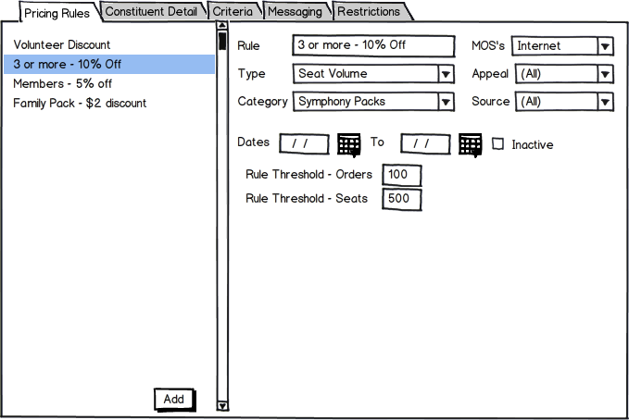
Main Pricing Rules Page

Slide 41
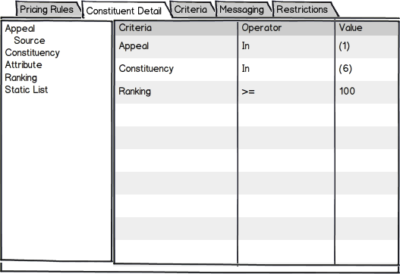
Constituent Detail Page

Slide 42
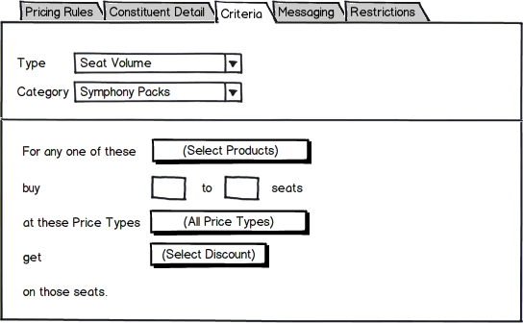
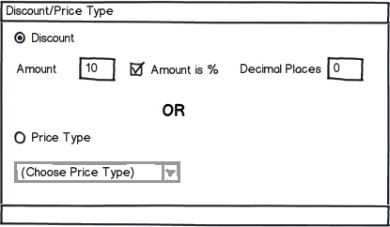
Rule Criteria Page

Slide 43
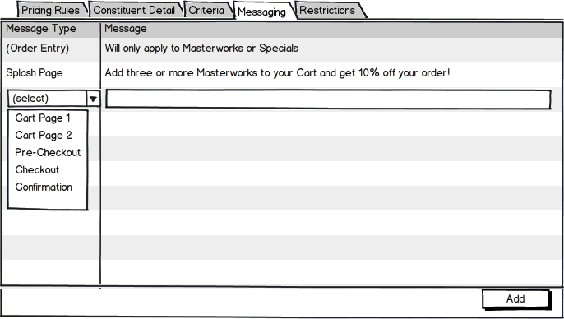
Messaging Page

Slide 44
What do we have in common?

Slide 45
HINT

Slide 46
Pricing Setup

Slide 47
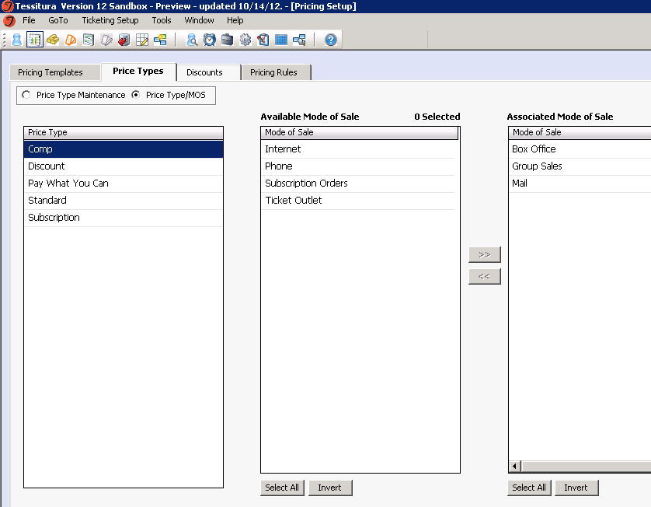

Slide 48
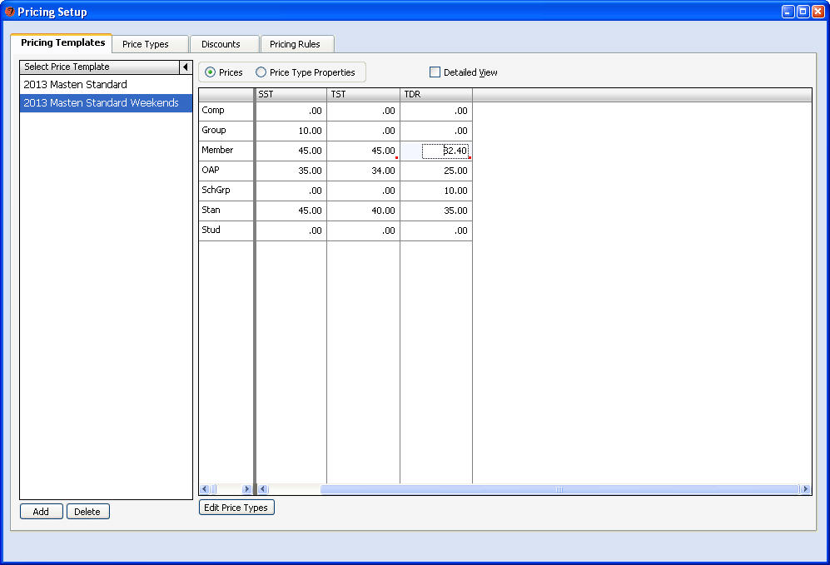

Slide 49
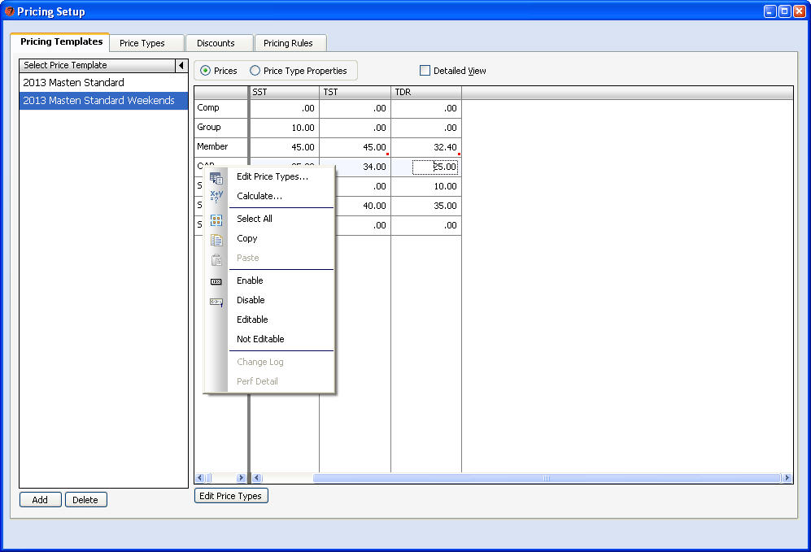

Slide 50
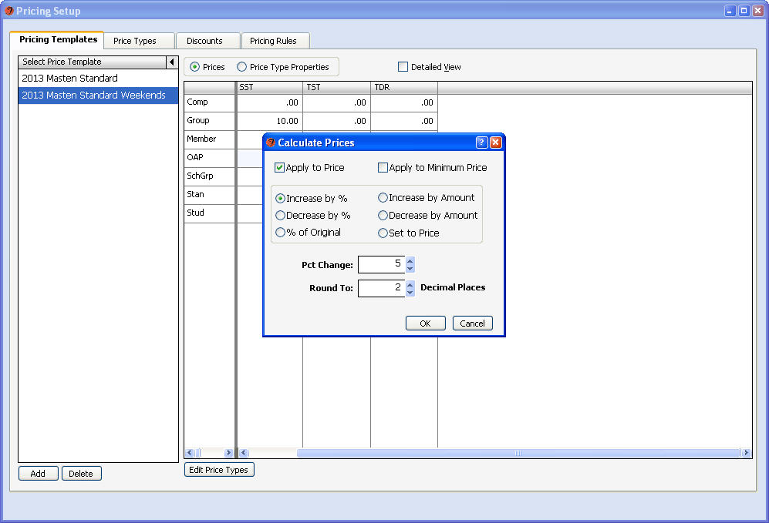

Slide 51
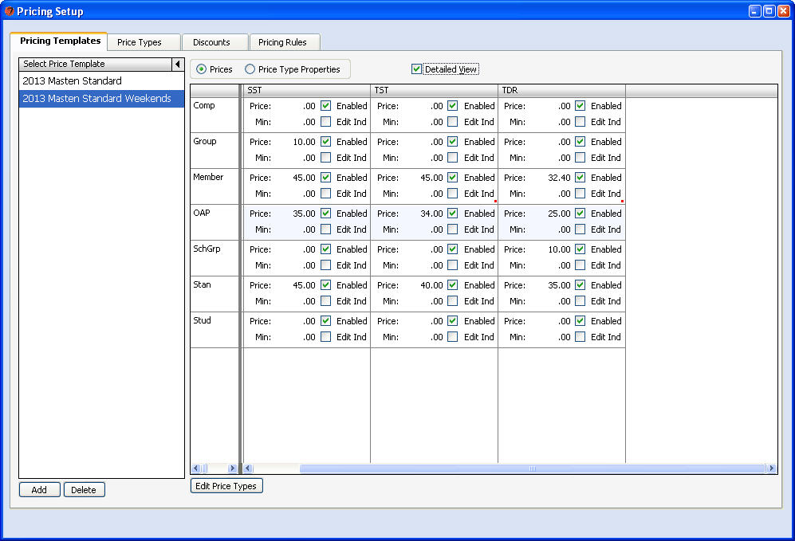

Slide 52
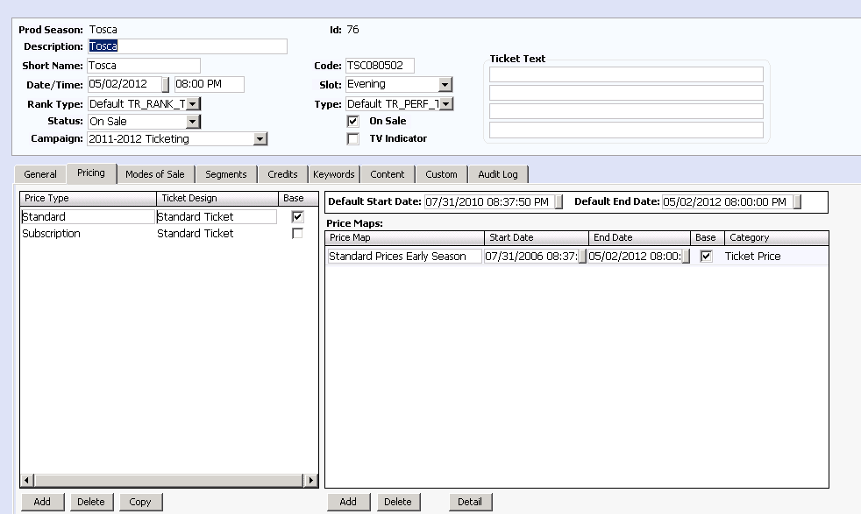
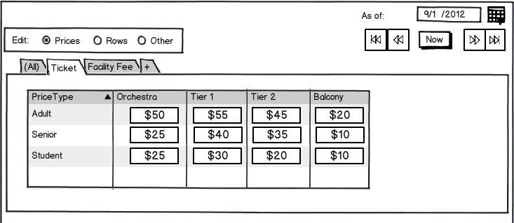

Slide 53
QuickSale

Slide 54
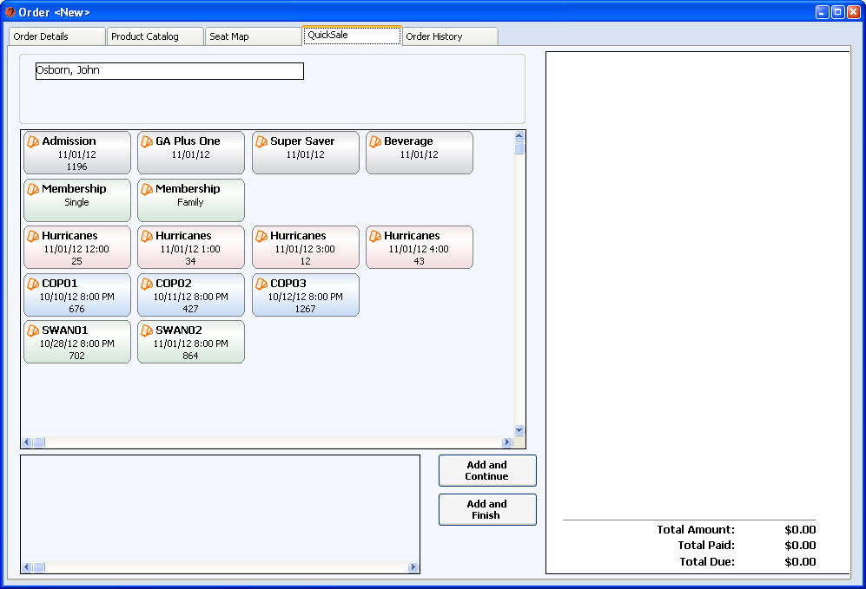

Slide 55
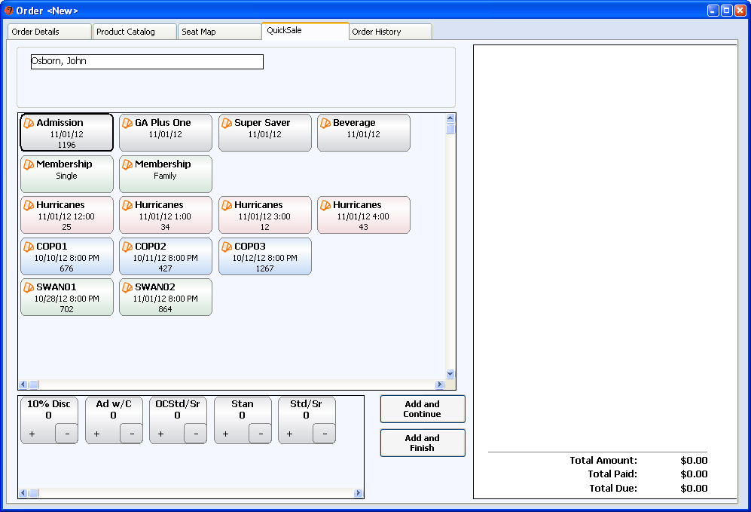

Slide 56
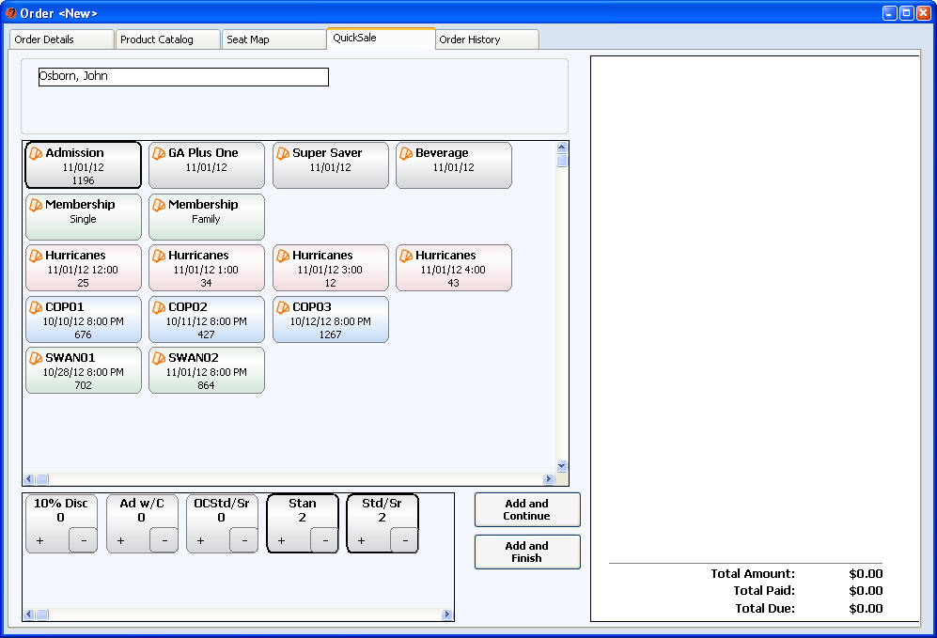

Slide 57
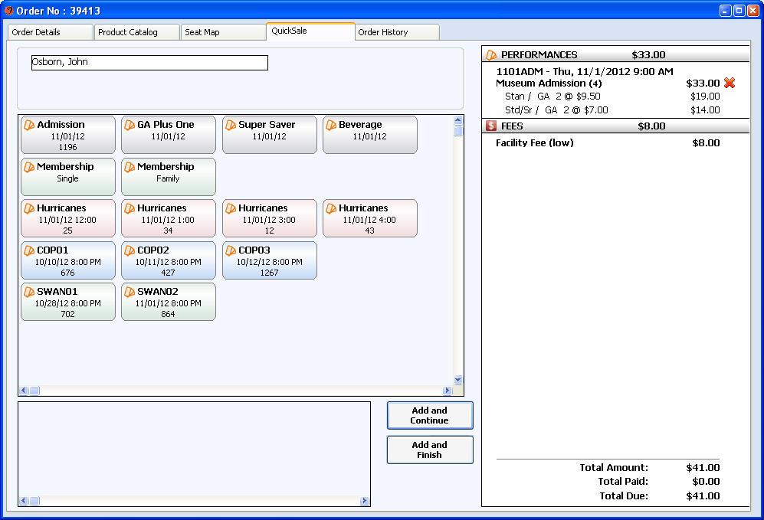

Slide 58
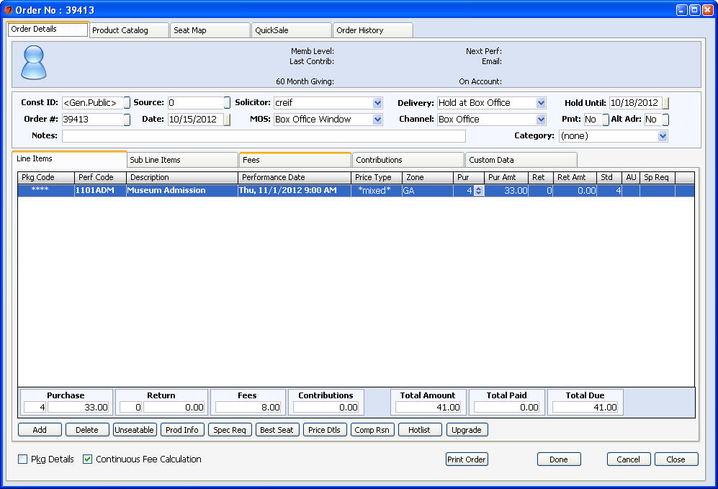

Slide 59
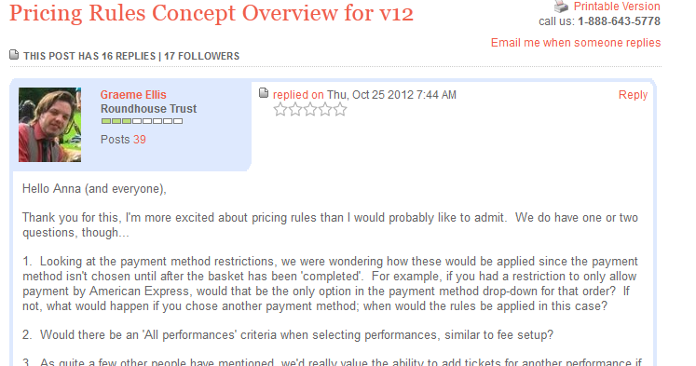
Get Involved!!
Epic Story Committees:
  Currently for Plans and Pricing Rules
  NextGenFeedback@tessituranetwork.com

Slide 60
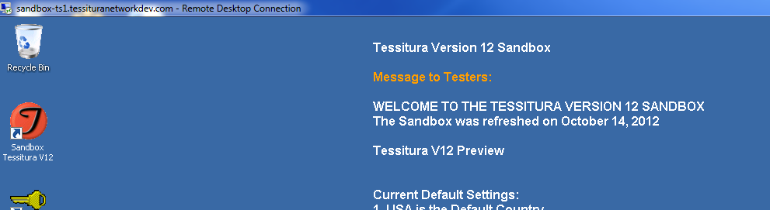
Get Involved!!
V12 Sandbox
  Open for Business!
  NextGenFeedback@tessituranetwork.com

Slide 61
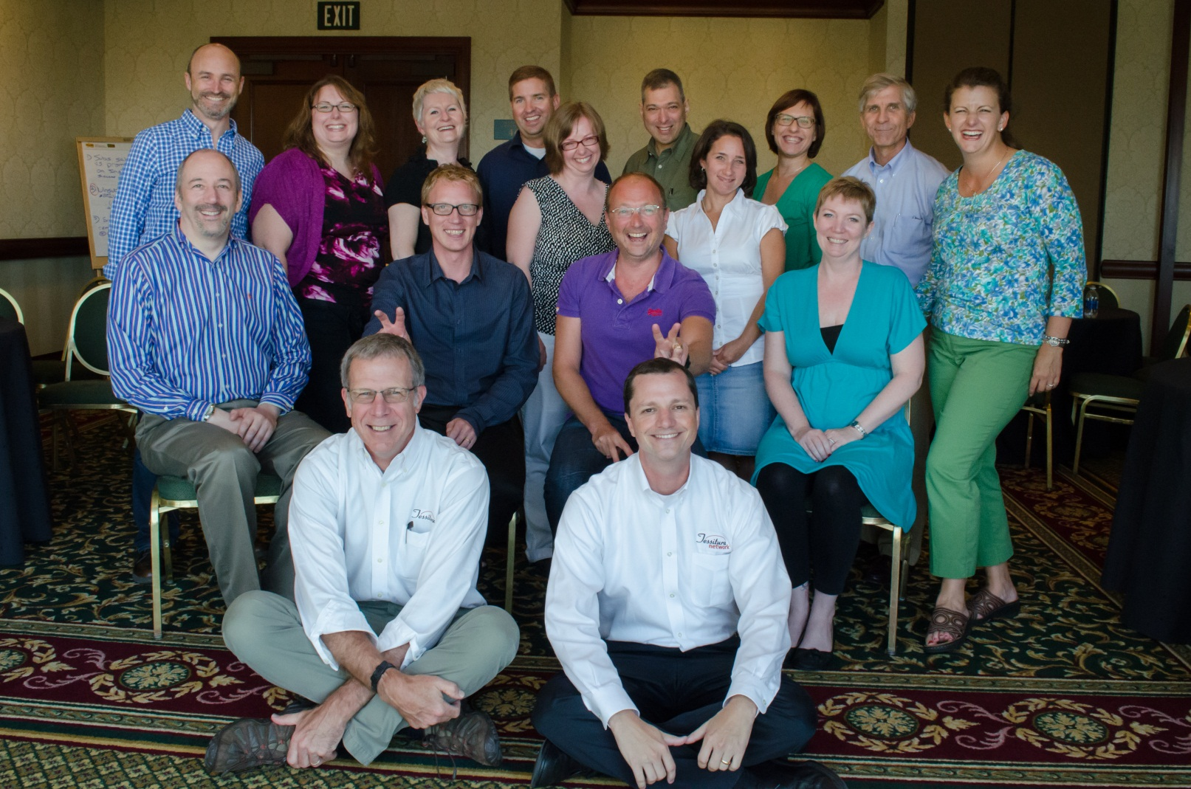
Get Involved!!
Member Advisory Committee:

Slide 62
HINT

Slide 63

FINAL HINT

Slide 64

Thank You, RSC!!!

