Slide 1

Notes:
Opening slide

Slide 2
Education department in context
The work of the RSC's Education Department is to deepen the understanding and enjoyment of Shakespeare for young people, up to the age of 19, regardless of ability and background.
Our work is targeted at:
  Young people aged 8-19 years in education in the UK
  Teachers and lecturers in the UK education sector
Notes:
Title and content

Slide 3
Education department in context
Our key objective for the use of Tessitura is:
To increase numbers of schools who have the best possible experience of Shakespeare and the RSC.
We aim to work in partnership with other departments across the organisation to raise awareness of and develop the subsequent take up of a variety of different offers including:
  Schools as audiences for performances
  Education activities for teachers and students
  Resources and curriculum support products
Notes:
Title and content

Slide 4
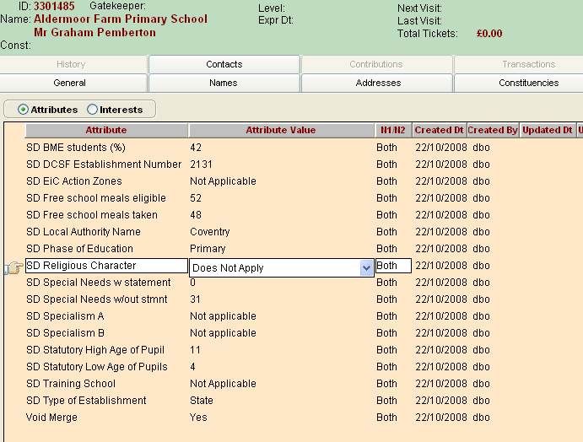
TITLE AND BACKGROUND PICTURE
Notes:
Title and background picture

Slide 5
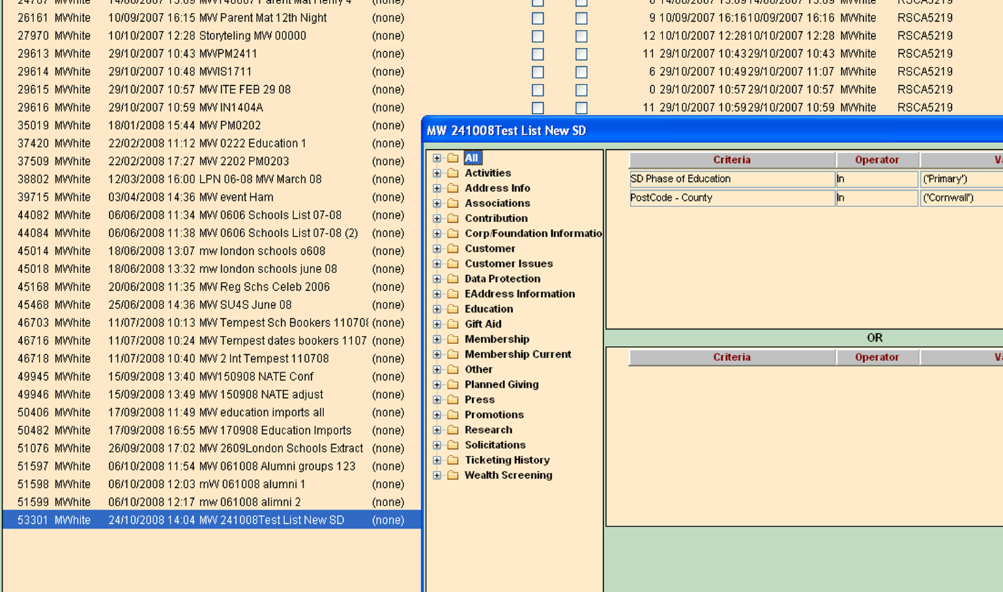
TITLE AND BACKGROUND PICTURE
Notes:
Title and background picture

Slide 6
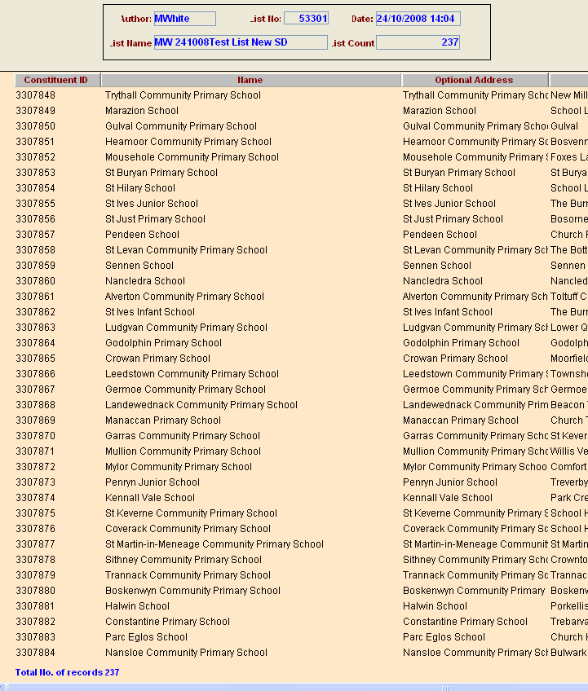
Notes:
Title and content

Slide 7
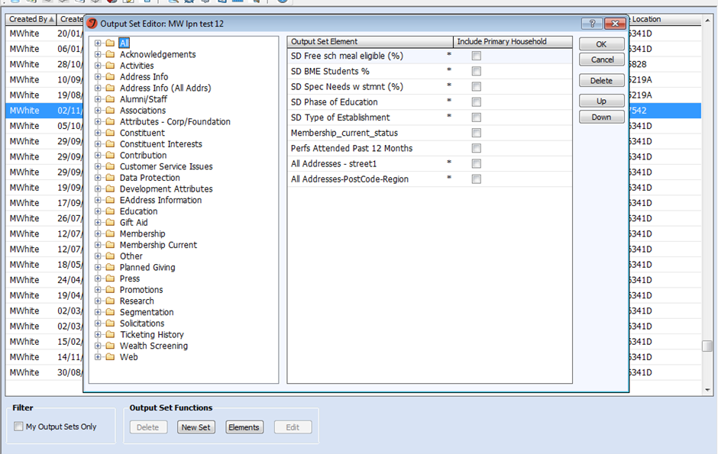
TITLE AND BACKGROUND PICTURE
Notes:
Title and background picture

Slide 8
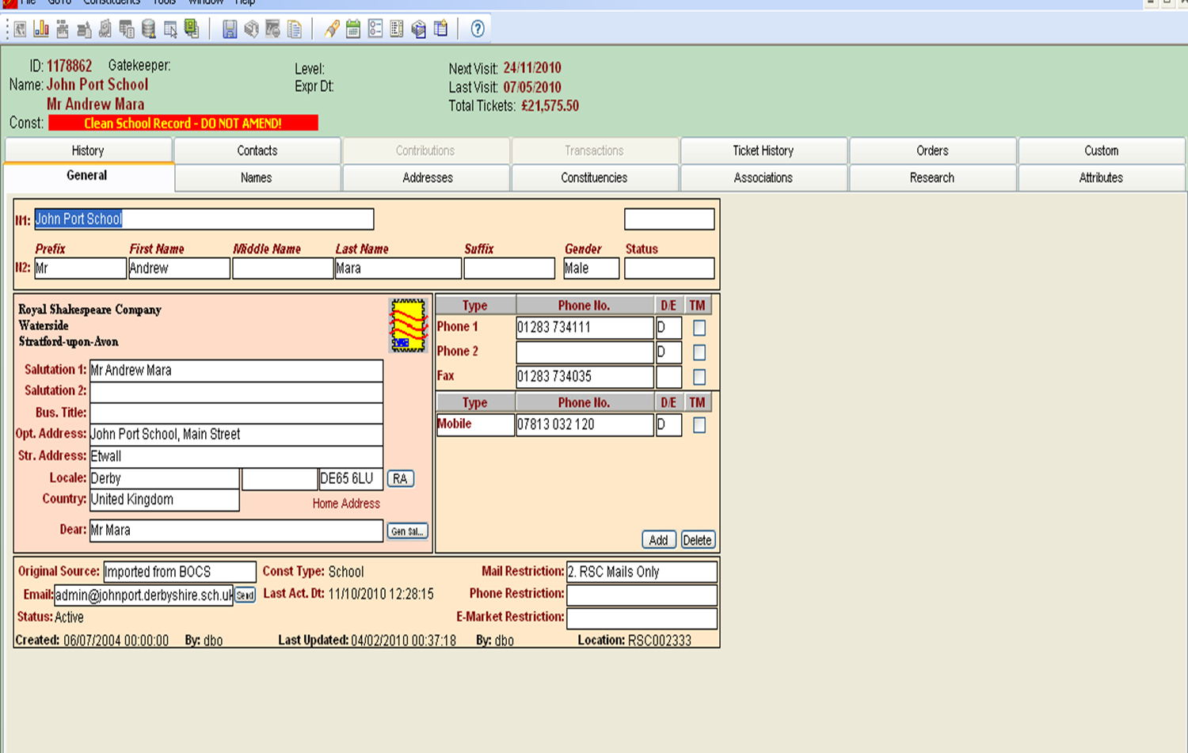
TITLE AND BACKGROUND PICTURE
Notes:
Title and background picture

Slide 9
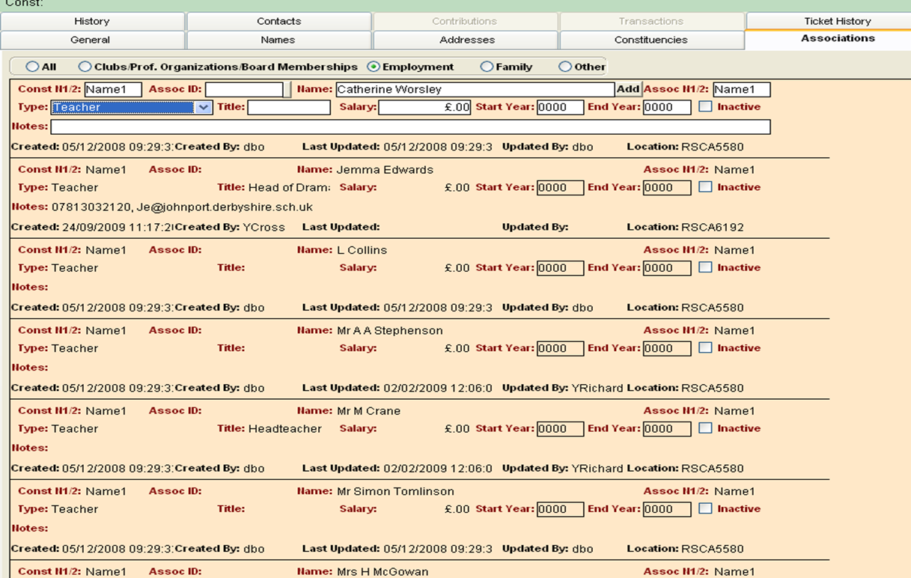


TITLE AND BACKGROUND PICTURE
Notes:
Title and background picture

Slide 10
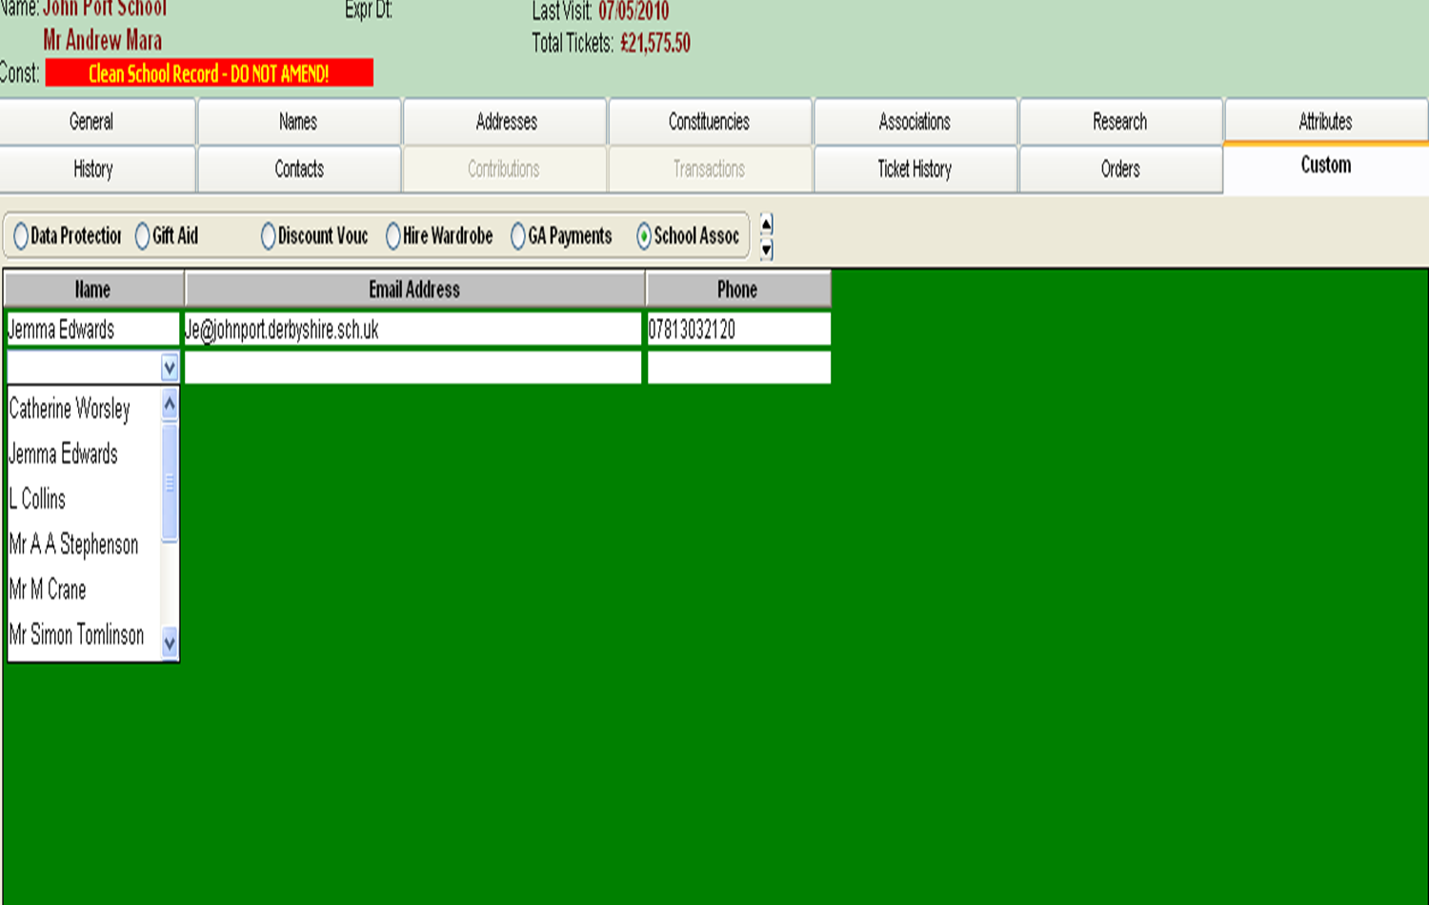

TITLE AND BACKGROUND PICTURE
Notes:
Title and background picture

Slide 11
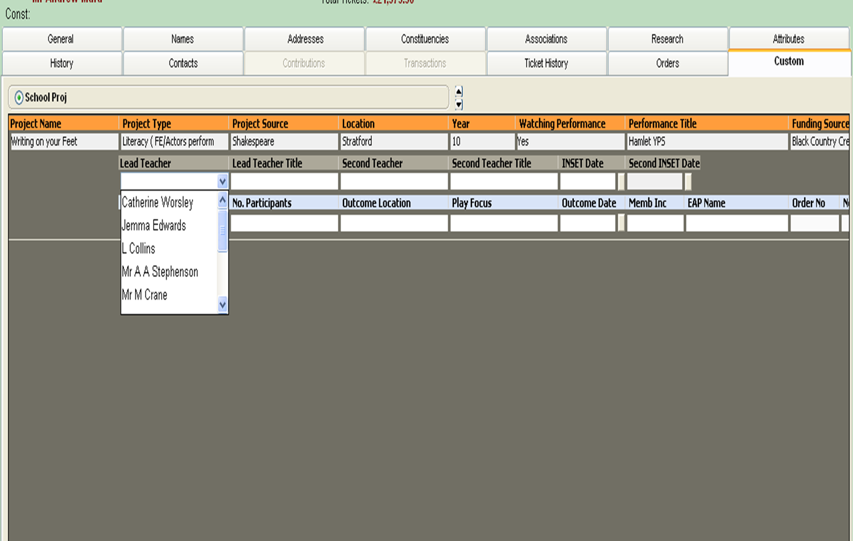



TITLE AND BACKGROUND PICTURE
Notes:
Title and background picture

Slide 12
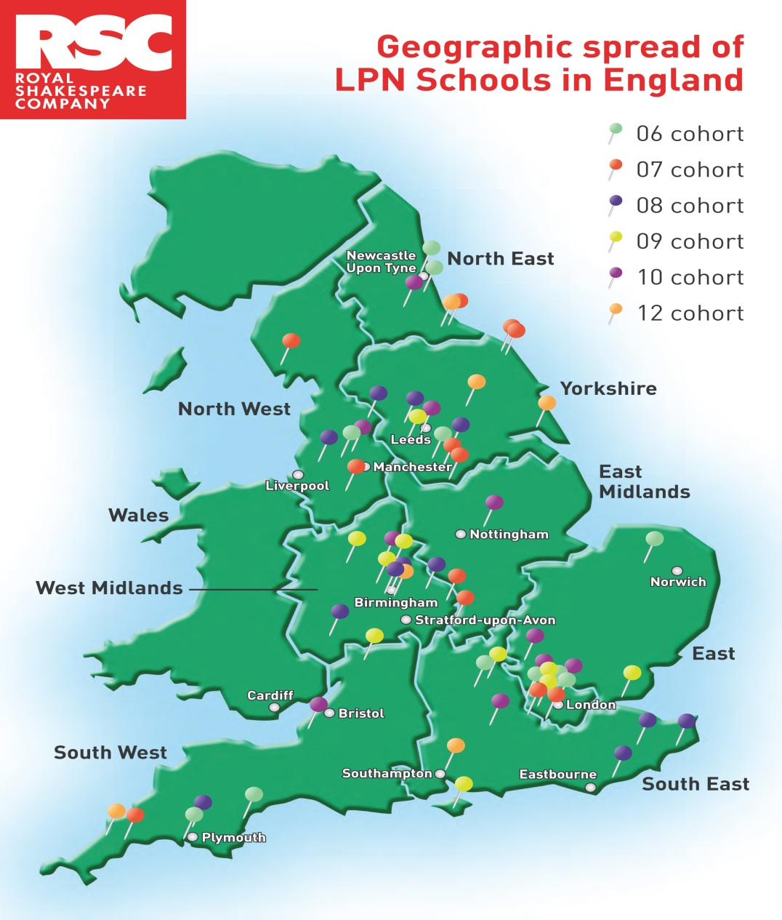
Notes:
Title and background picture

Slide 13
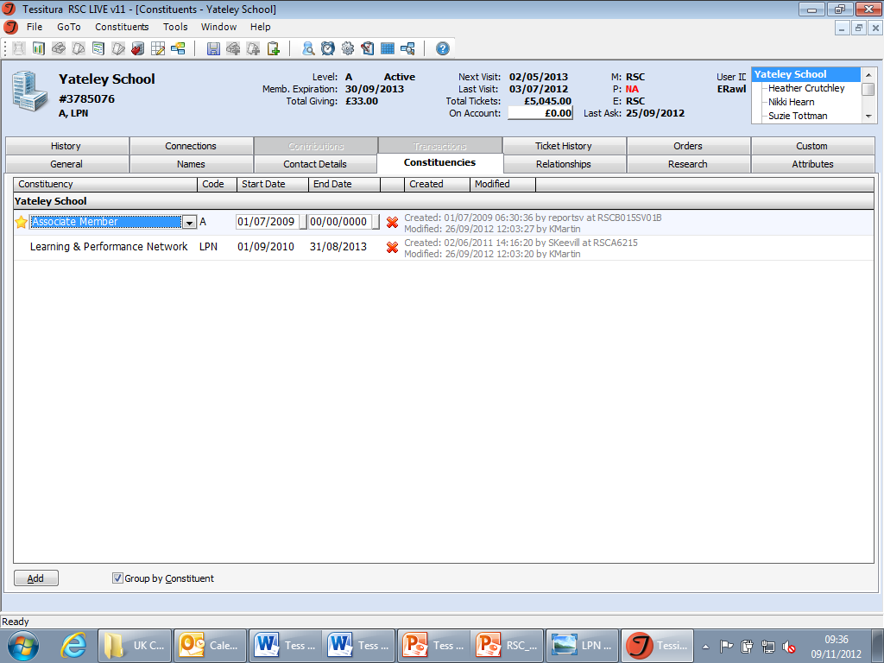

TITLE AND BACKGROUND PICTURE
Notes:
Title and background picture

Slide 14
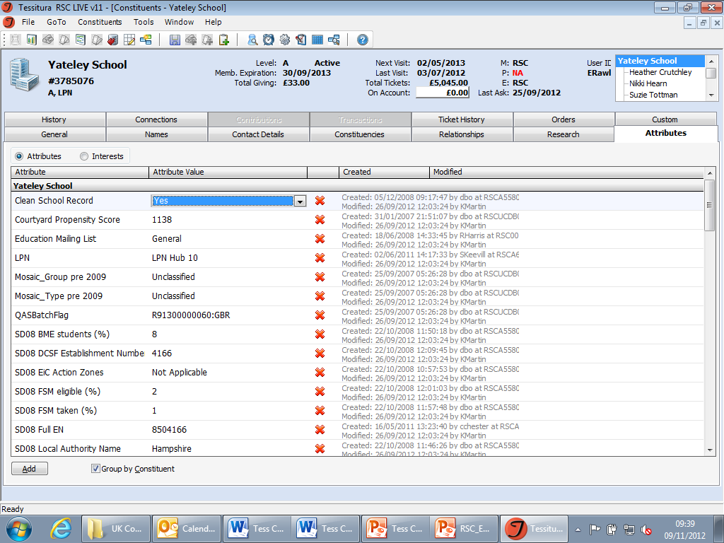
TITLE AND BACKGROUND PICTURE
Notes:
Title and background picture

Slide 15
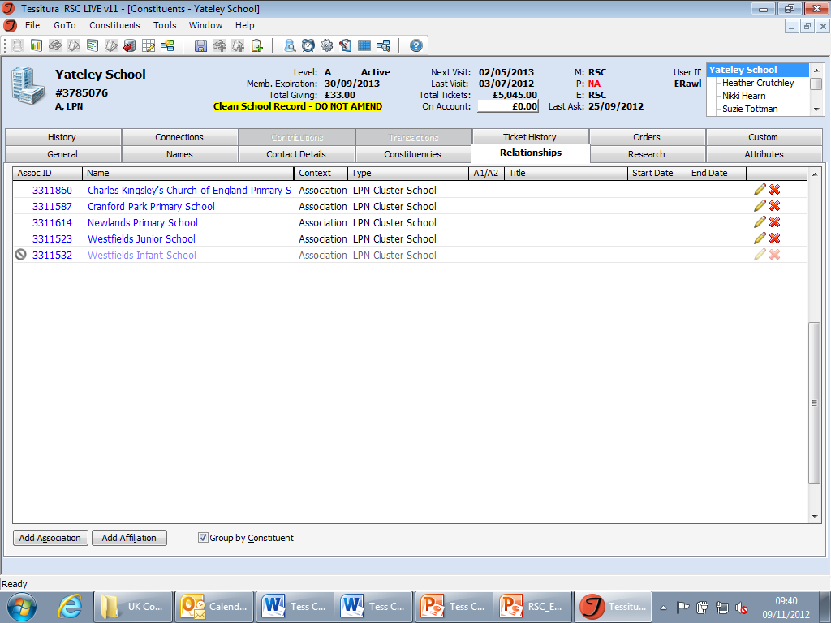
TITLE AND BACKGROUND PICTURE
Notes:
Title and background picture

Slide 16
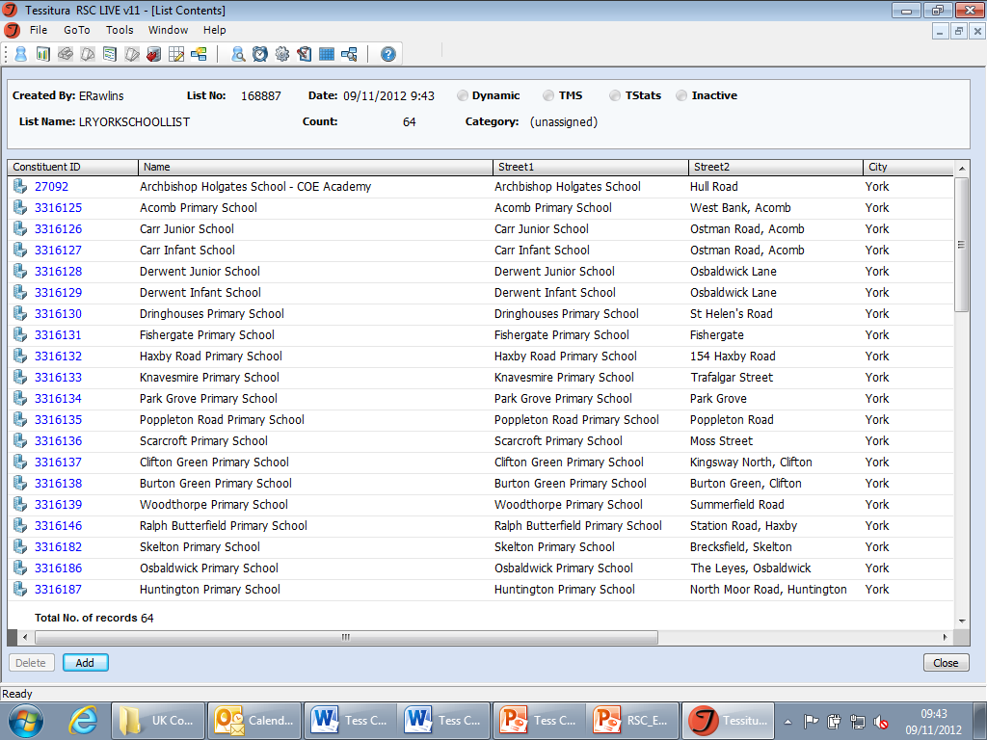
TITLE AND BACKGROUND PICTURE
Notes:
Title and background picture

Slide 17
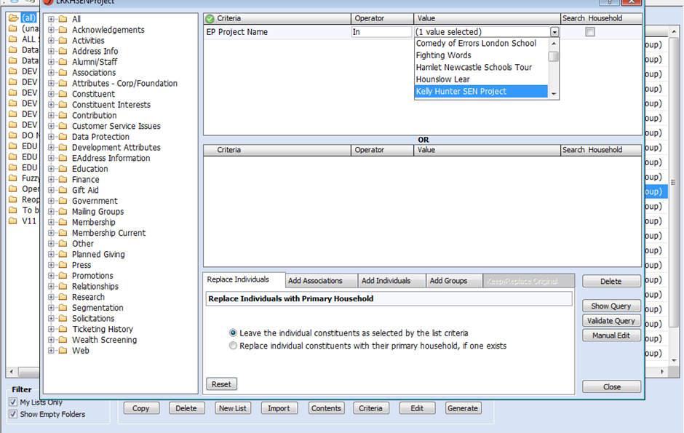
TITLE AND BACKGROUND PICTURE
Notes:
Title and background picture

Slide 18
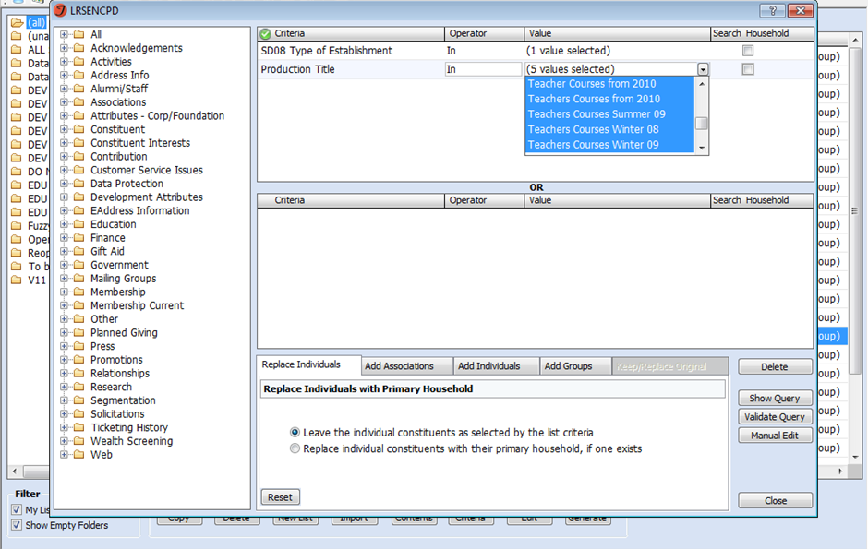
TITLE AND BACKGROUND PICTURE
Notes:
Title and background picture

Slide 19
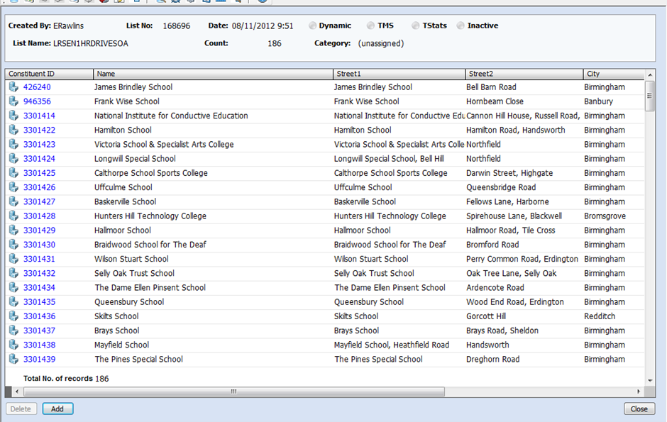
TITLE AND BACKGROUND PICTURE
Notes:
Title and background picture

Slide 20
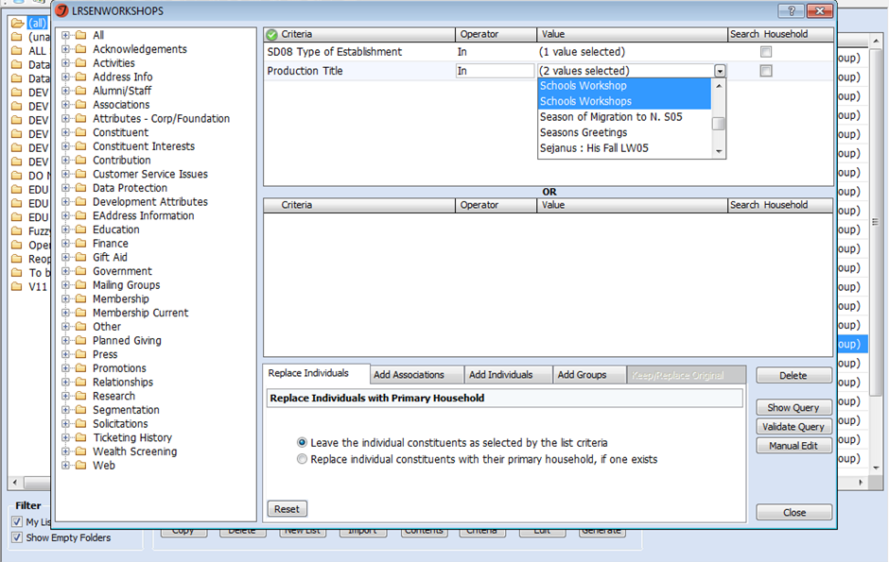
TITLE AND BACKGROUND PICTURE
Notes:
Title and background picture

Slide 21
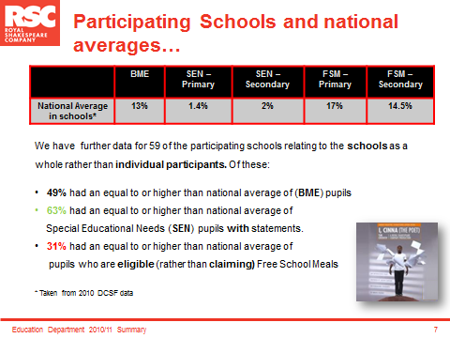
Notes:
Title and content

Slide 22
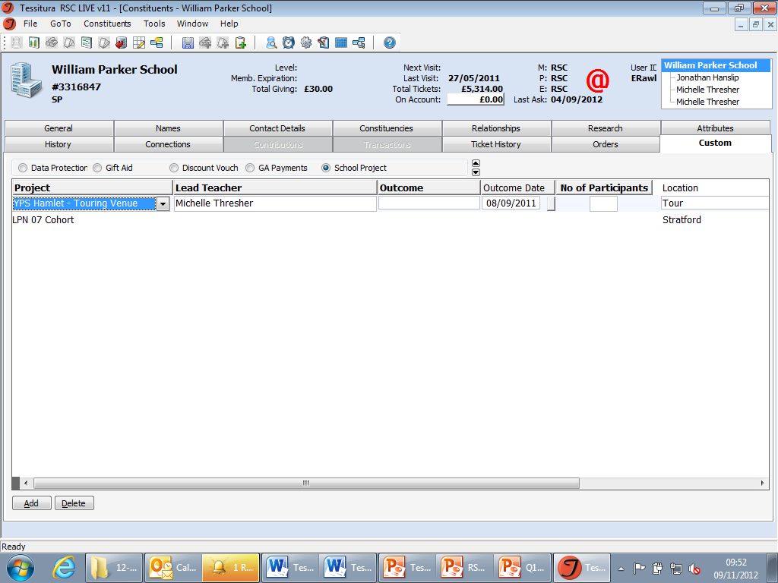
TITLE AND BACKGROUND PICTURE
Notes:
Title and background picture

Slide 23
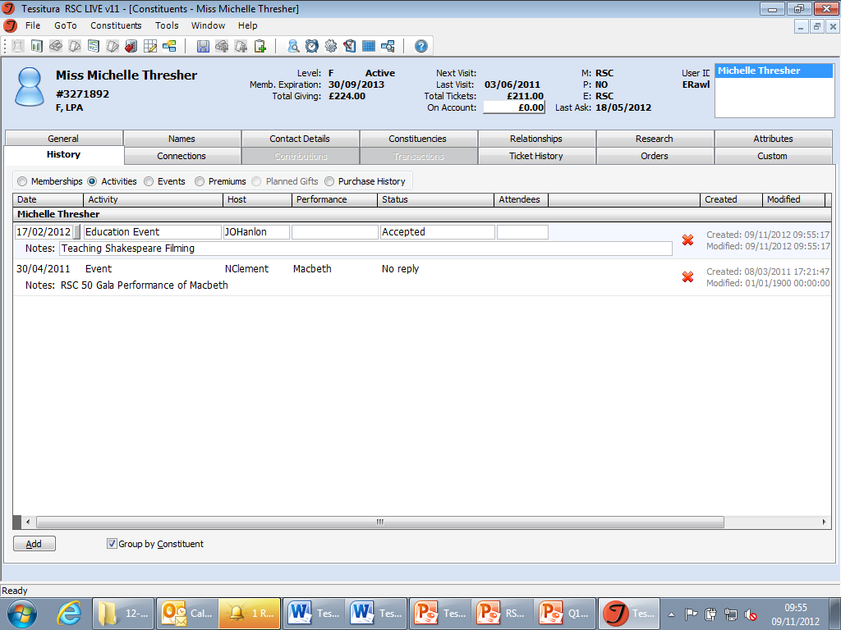
TITLE AND BACKGROUND PICTURE
Notes:
Title and background picture

