Slide 1

“Facts are stubborn things, but statistics are more pliable.”
T-Stats and Dashboards
Notes:
Opening slide

Slide 2
T- Stats and Dashboards
An Introduction by Ben Magson from Tessitura Network
Notes:
Opening slide

Slide 3
T- Stats
A real life example by Becky Loftus
Royal Shakespeare Company
Notes:
Opening slide

Slide 4


Numbers in the arts
We all live in a world of creativity where ideas and inspiration are valued above all else and instinct is often a key factor in decision making
This world lives in the moment – a play is here for a few weeks and months and then we’re on to the next one
But increasingly, within this magical world, numbers are recognised as vital currency for decision-making
The appetite for evidence in the form of numbers grows as does our need to deliver numbers and insight in the moment
Numbers need to be
Numbers are a

Slide 5



Answering those tricky questions
Head of Audience Insight, a.k.a. the person to answer all those numbers questions that aren’t financial (and sometimes ones that are!)
Level = Easy!
Time = 2 mins
How many tickets did we sell last year?
How many tickets did we sell to Americans last year?
Level = Straightforward
Time = 5 mins (report]
We’re opening Matilda, The Musical in New York soon….how many people with a US address are there on our database who we can email to tell about this?
Level = Medium
Time = 15 mins [extraction]
Of all the Americans on our database:
  How many came to see RSC work in the UK?
  When and what did they see and how much did they spend on tickets?
  How many are RSC Overseas Members and how many are RSC donors?
  Oh, and I need it for a meeting tomorrow
Becky Loftus, Audience Insight
Notes:
Single column

Slide 6

Who do you think I am?!
Becky Loftus, Audience Insight
Notes:
Two column option 1

Slide 7

Luckily, I had just got….
and here is what I did with it...
Becky Loftus, Audience Insight
Notes:
Two column option 1

Slide 8
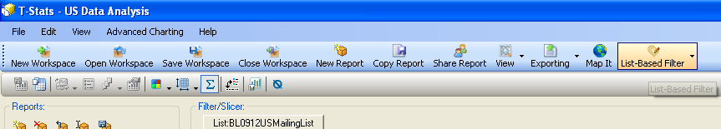
Step 1 – Who are the people I want to look at?
To start I created a list of all those who could be mailed and imported it as a list based filter...
I did have to talk nicely to my IT team to extend the “List based filter limit” from the recommended 10,000 to 50,000!

Slide 9
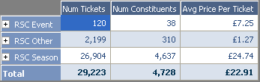
Step 2 – Start with the basics...what did they buy tickets for
Firstly, I looked at what they had come to see in the past so why they were on our database
I went to the ticket cube and...
  Dragged the Season Hierarchy into the categories
  Selected a few ticket measures such as Num tickets in the series
I could then expand the RSC Season list with the little cross and look at the season they had attended
After this I used the Memberships cube and Contributions cube to answer the other questions
Of the 42,757 people on the list, only 4,728 (11%) of them have attended the RSC in the UK...the rest were imported data from US touring or sign ups online so sadly not available to look at in T-Stats ☹

Slide 10

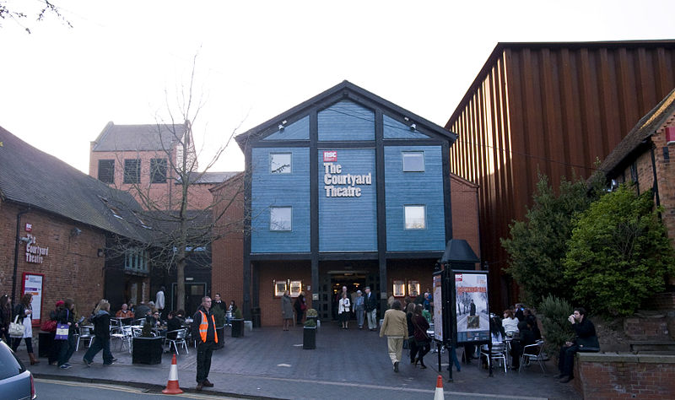
I used this method again the next time I had a tricky question…
Who are the people that came to “The Other Place” theatre and what have they been doing since it shut in 2005?
The Other Place (TOP) was a 150 seat studio theatre on the site of the Courtyard Theatre
It was home to some of the company's most exciting small-scale and experimental work both in classical productions and in productions of work from contemporary writers
Notes:
Title and content

Slide 11
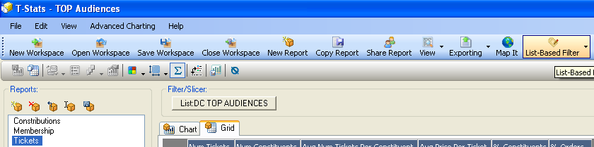
Easy as 1
STEP 1: In Tess, create a list of those who had The Other Place in their booking history and import as a list-based filter
Becky Loftus, Audience Insight
Notes:
Single column

Slide 12
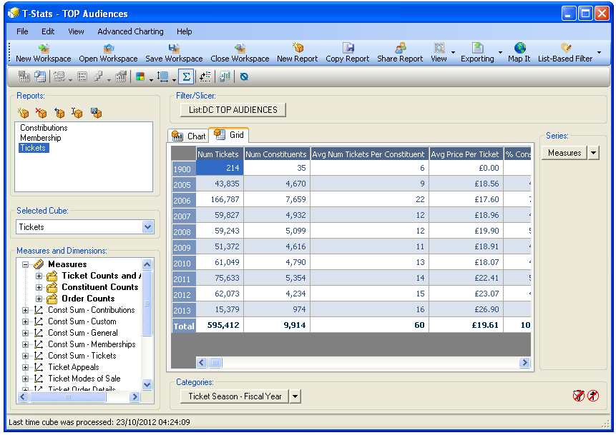
Easy as 1, 2
STEP 2: In the tickets cube, add your MEASURES to the column headers (series) and your TIMEFRAME or SEASON to the rows (categories)… I then export to Excel and chart in PowerPoint
Becky Loftus, Audience Insight
Notes:
Single column

Slide 13
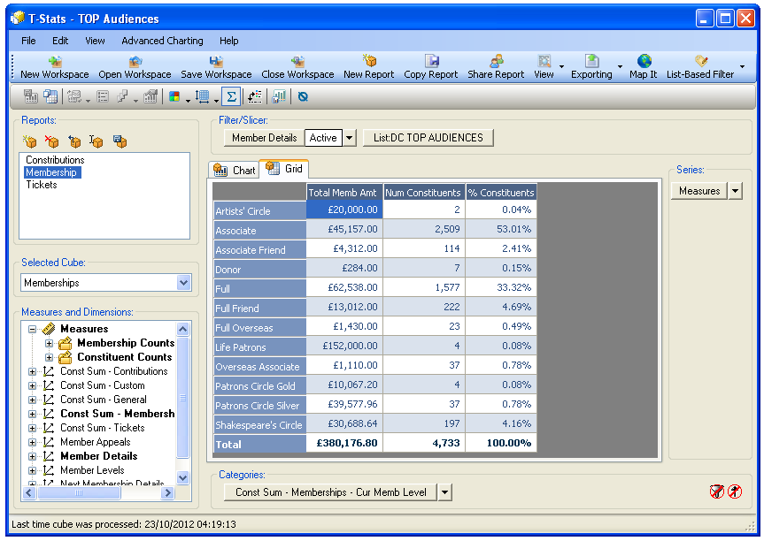
Easy as 1, 2, 3
STEP 3: Save workspace and use the list-based filter in the Memberships and Contributions cubes to find out about these
Becky Loftus, Audience Insight
Notes:
Single column

Slide 14

The Results

Slide 15


‘The other place’ Bookers
We have 18,670 records for people who attended The Other Place
  9,628 (52%) who can be mailed
  Only 2,194 (12%) who can be emailed
  9,891 (53%) of them have bought 574,318 tickets since 2005 spending an average of £19.46 per ticket

Slide 16


Ticket buying PEAKED FOR THE COMPLETE WORKS FESTIVAL BUT ASIDE FROM THE REOPENING OF THE THEATRES HAS TAILED OFF MORE RECENTLY
Top 5 Seasons | % Constituents | Num Tickets
RSC Season - 0607 Courtyard CW2 | 47% | 30,426
RSC Season - 0607 RST CW2 | 44% | 25,118
RSC Season - 0607 RST CW1 | 40% | 36,233
RSC Season - 0809 Courtyard Summer | 40% | 35,686
RSC Season - 0607 Swan CW1 | 39% | 28,799
The Complete Works Festival was the peak of their recent attendance although the reopening also attracted a few more to attend

Slide 17

THE Most tickets Per BOOKER were bought for the Complete Works although for recent seasons spending per ticket has increased
Avg price per ticket
Avg num of tickets

Slide 18
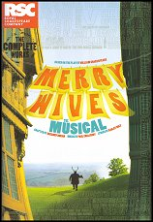



The top productions seen by these people includes a mix of Shakespeare and other work
All Above 20% | % Constituents
Merry Wives The Musical CW2 06 | 35%
King Lear CW2 06 | 32%
The Seagull CW2 06 | 27%
The Tempest CW1/06 | 27%
The Winter's Tale S09 | 27%
Hamlet S08 | 26%
As You Like It S09 | 26%
Great Expectations - W05 | 24%
Antony and Cleopatra CW1/06 | 24%
Henry VI Part I CW1/06 | 24%
Henry VI Part II CW1/06 | 24%
Henry VI Part III CW1/06 | 23%
The Merchant of Venice S11 | 23%
Henry IV Part I 07/08 | 23%
Twelfth Night W09 | 22%
Macbeth S11 | 22%
Coriolanus CW2 06 | 22%
Richard III CW2 06 | 21%
Henry V 07/08 | 21%
The Canterbury Tales 1 W05 | 21%
Romeo and Juliet S10 | 21%
Henry IV Part II 07/08 | 21%
Cardenio S11 | 21%
King Lear S10 | 21%

Slide 19
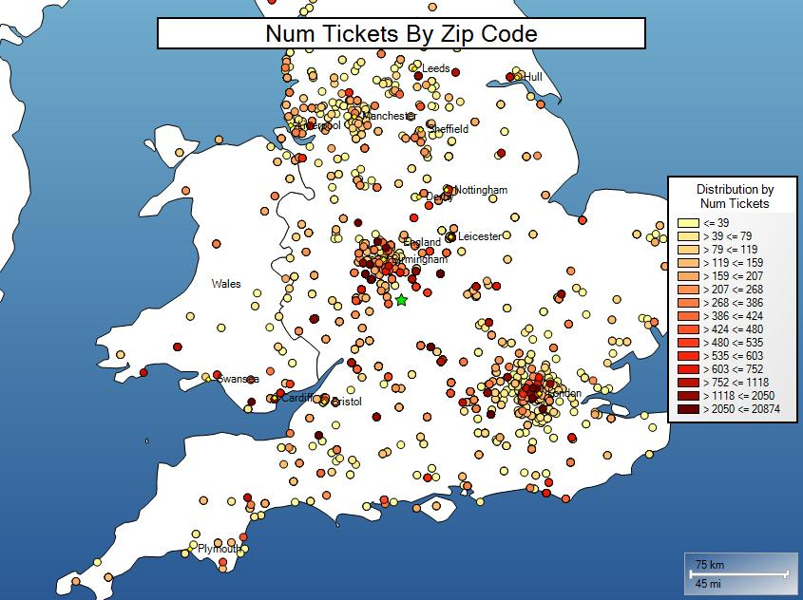
TOP Audiences who have bought tickets are from a widespread geography concentrated in London and the Midlands

Slide 20
Memberships and Contributions
8,537 (46%) of the 18,670 TOP attendees have been RSC Members and 4,787 (26%) are current RSC members
  Half (53%) of those with a Membership are Associate
  A third (33%) are Full
  5% are Friends
  4% are Shakespeare’s Circle
702 (4%) have donated (includes SC Memberships) a total of £3.7M
  £2M was for Capital campaigns

Slide 21
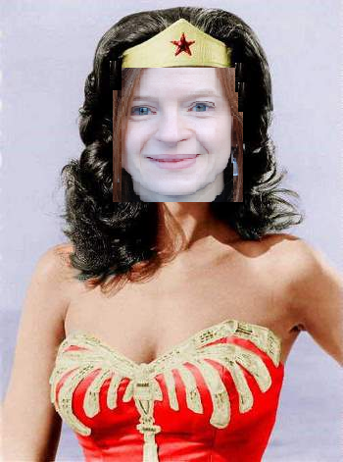
The Results

Slide 22
To sum up
Why is T-Stats useful?
If I have a group of people on Tessitura and want to know about them, what do I do?
To get answers to those tricky questions, quickly and make us look like superheroes!
Get T-Stats installed!
Create a list of the people you’re interested in and import this as a list-based filter
Use this in the Tickets, Memberships and Contributions cubes to quickly access some information about these people

Slide 23

THANK YOU
Notes:
Thank you slide

