Slide 1

Setting up and targeting email offers
Natasha Goodge
Royal Shakespeare Company
Notes:
Opening slide

Slide 2
That performance isn’t looking great… can we send an email?
Using targeted ticket offers on emails
What should I send?
Promo codes vs direct links
Who should I send it to?
People most likely to respond
People you want to encourage to attend
Ticket offers vs. papering
Pros and cons
Natasha Goodge, RSC Marketing
Notes:
Single column

Slide 3
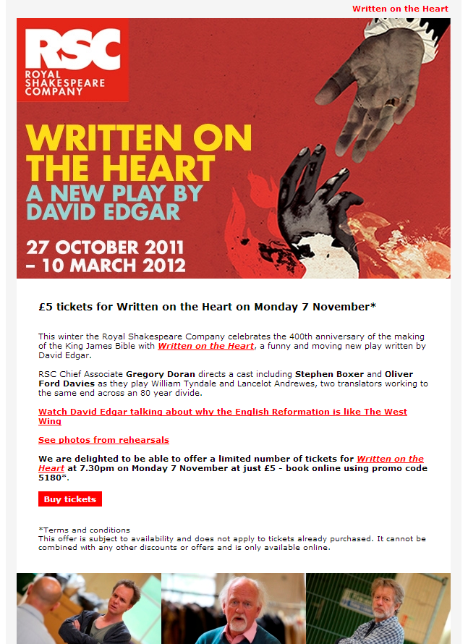
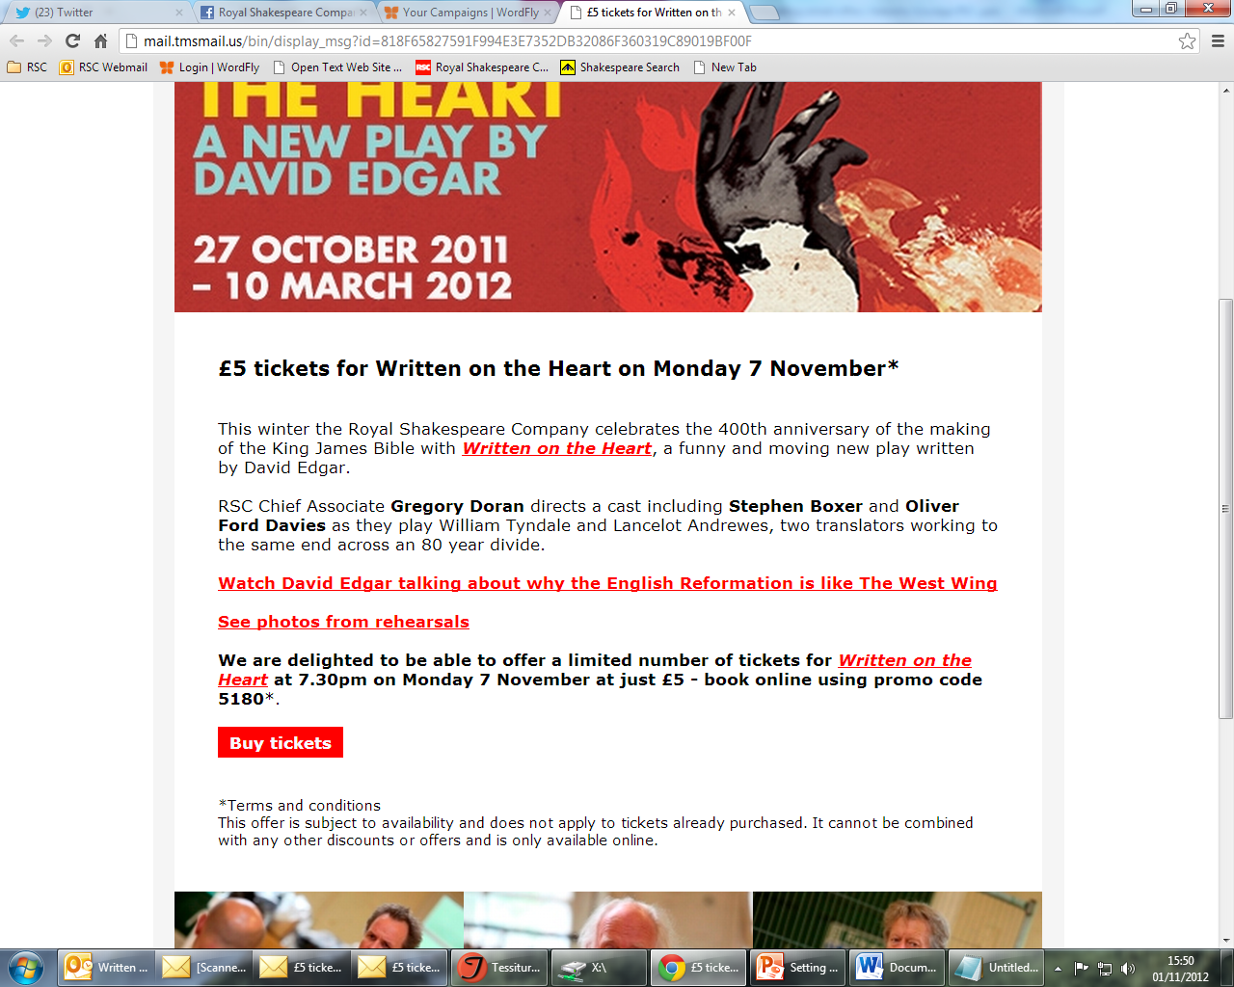
Promo Codes Vs Direct Links

Slide 4
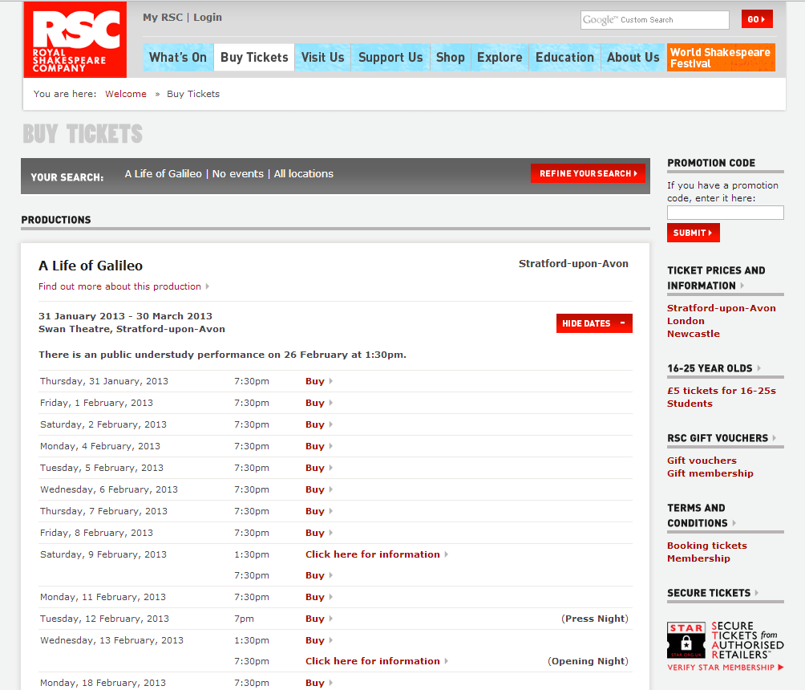
Promo Codes Vs Direct Links
Pros
  Familiarity
  Opportunity to use the same discount on offer multiple performances
Cons
  Multiple steps and decisions can put people off
  Difficulty finding promo code box

Slide 5
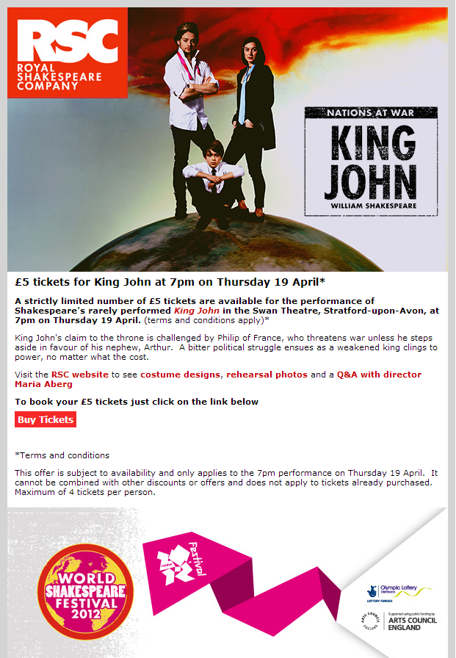
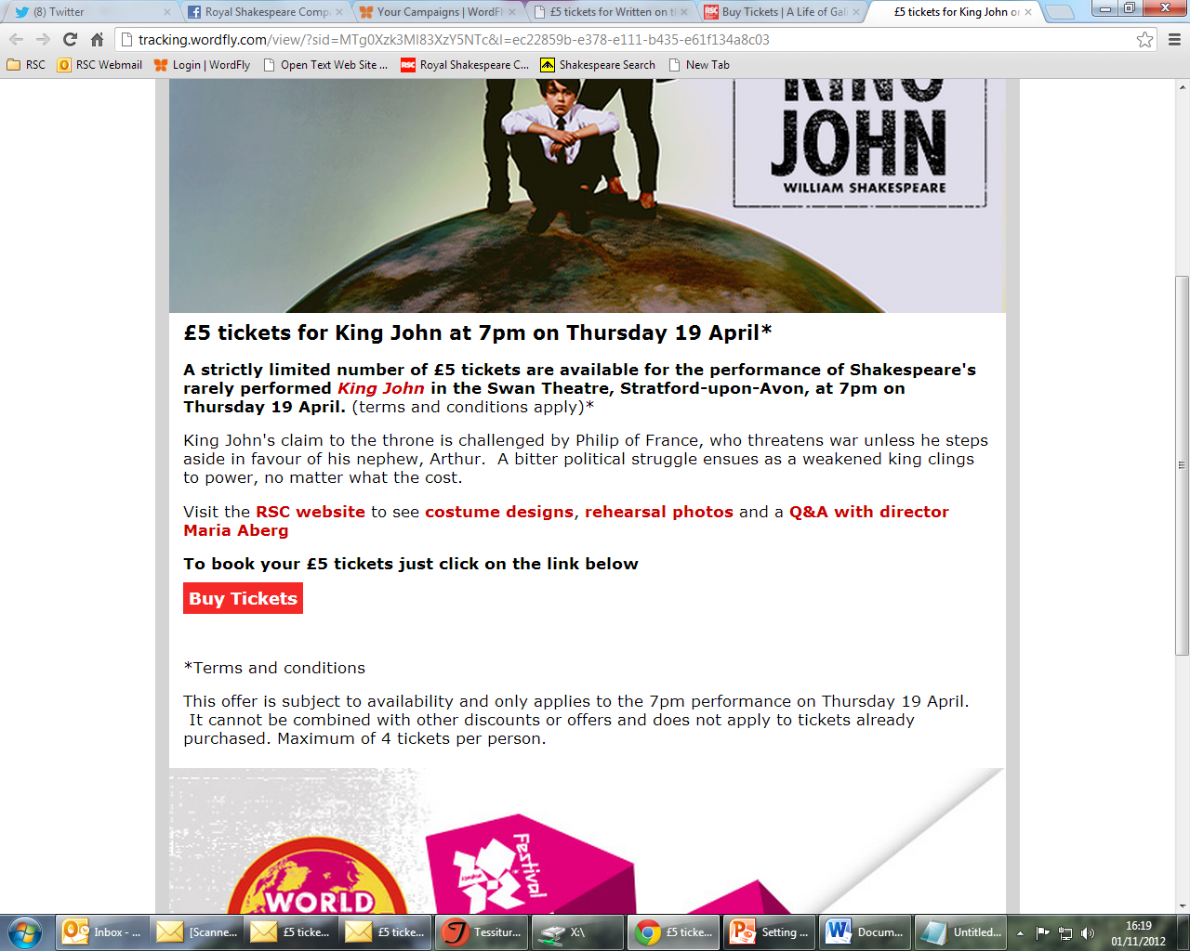
Promo Codes Vs Direct Links

Slide 6
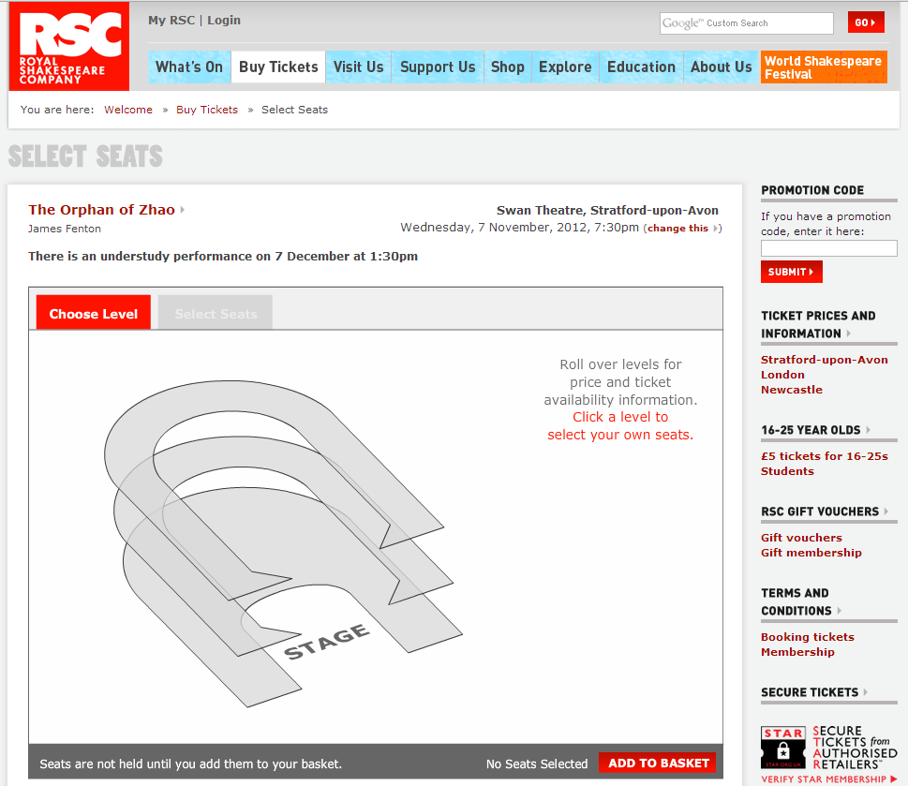
Promo Codes Vs Direct Links
Pros
  Much better response rate
  Makes decision making easier so responses tend to be faster
Cons
  Single performance only
  Needs to be carefully targeted to get the best response
    People most likely to respond
    People you would like to respond

Slide 7
Maximising response rates
Different strategies for maximising ticket offer take-up and speed of response
Based on ticket booking history
  Day of week
  Lag days
  Single ticket amount
Based on response to previous email marketing
  Email open/click through

Slide 8
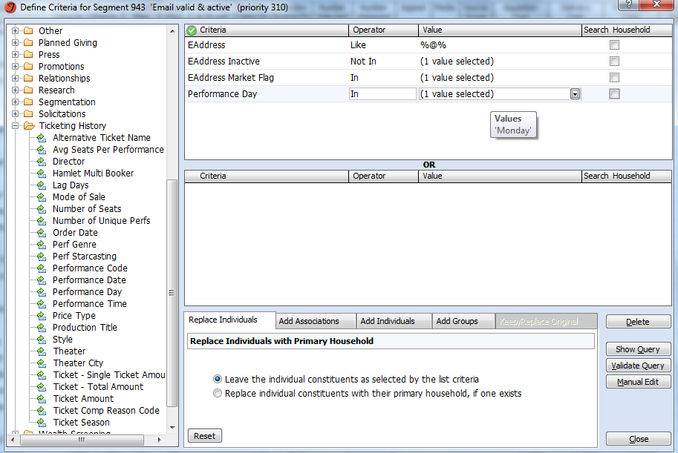
Maximising response rates
Targeting by day of week

Slide 9
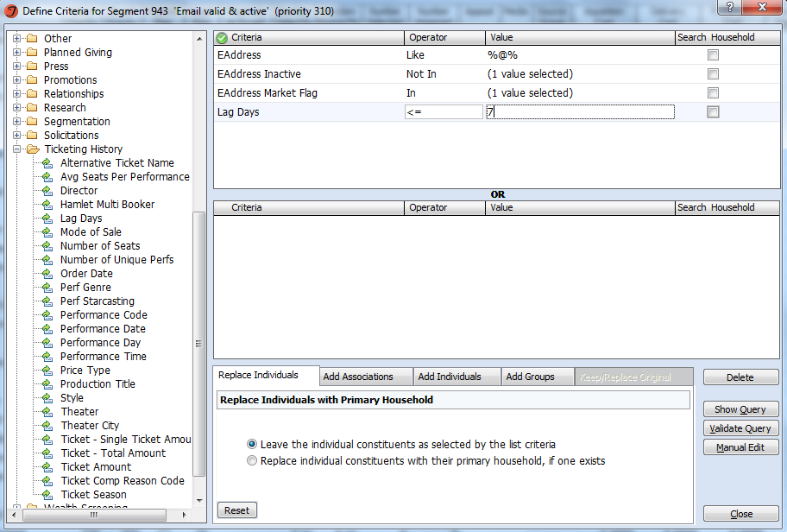
Maximising response rates
Targeting by lag days

Slide 10
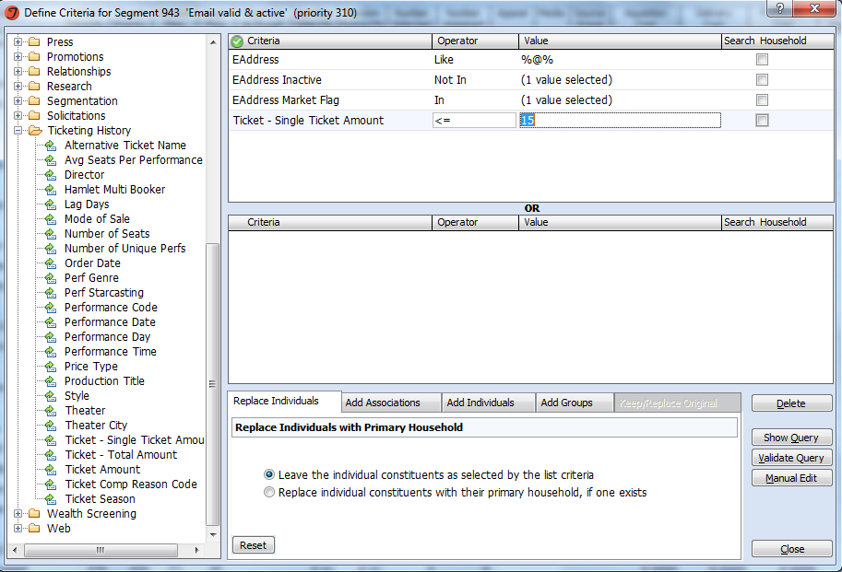
Maximising response rates
Targeting by single ticket amount

Slide 11
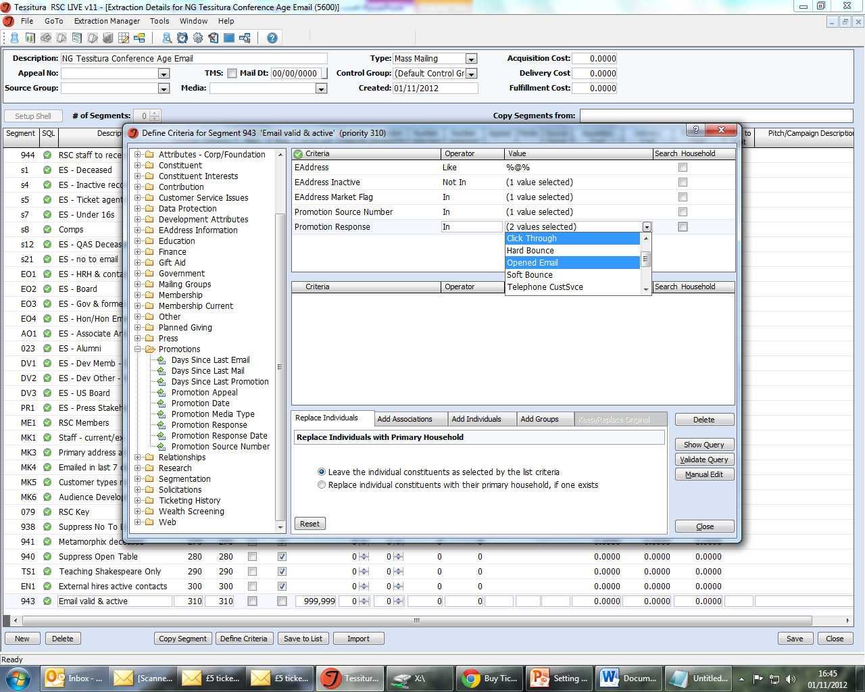
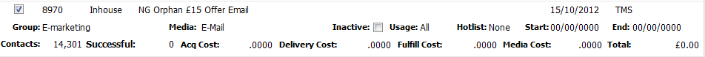
Maximising response rates
Targeting by email open/click through – only possible when using an email system which links to Tessitura

Slide 12
Ticket offers and audience development
Targeting selected groups for email offers through Tessitura
Our aim is to have an audience which reflects the UK population in age, ethnicity and socio-economic status. Under-represented groups we try and target:
  16-44 year olds
  Black and Minority Ethnic communities
  C2DE communities
We use ticket offers to target
  16-44 year olds based on age as collected on sign up within an hour’s drivetime from Stratford-upon-Avon
  BME communities based on postcodes within an hour’s drive time from
  Stratford-upon-Avon that have significant BME populations according to census data
By selecting data this way, rather than based on ticketing history, we can also target people who have signed up for email but who have yet to buy a ticket

Slide 13
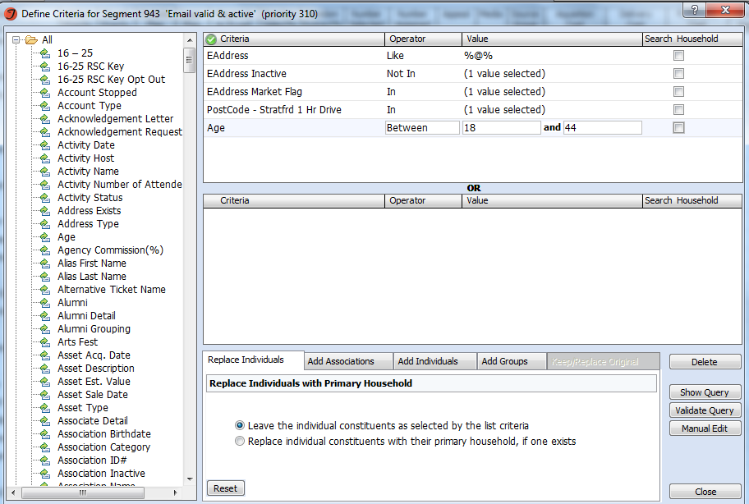
Ticket offers and audience development
Targeting selected groups by age

Slide 14
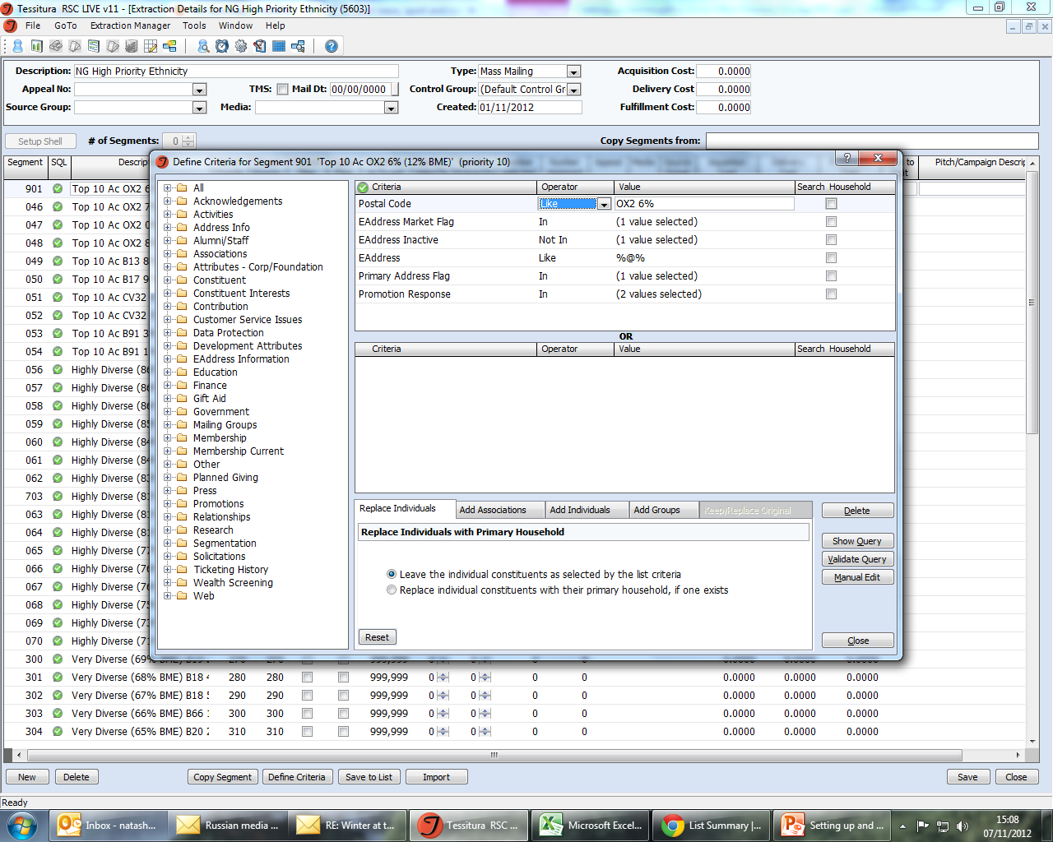
Ticket offers and audience development
Targeting selected groups by postcode

Slide 15
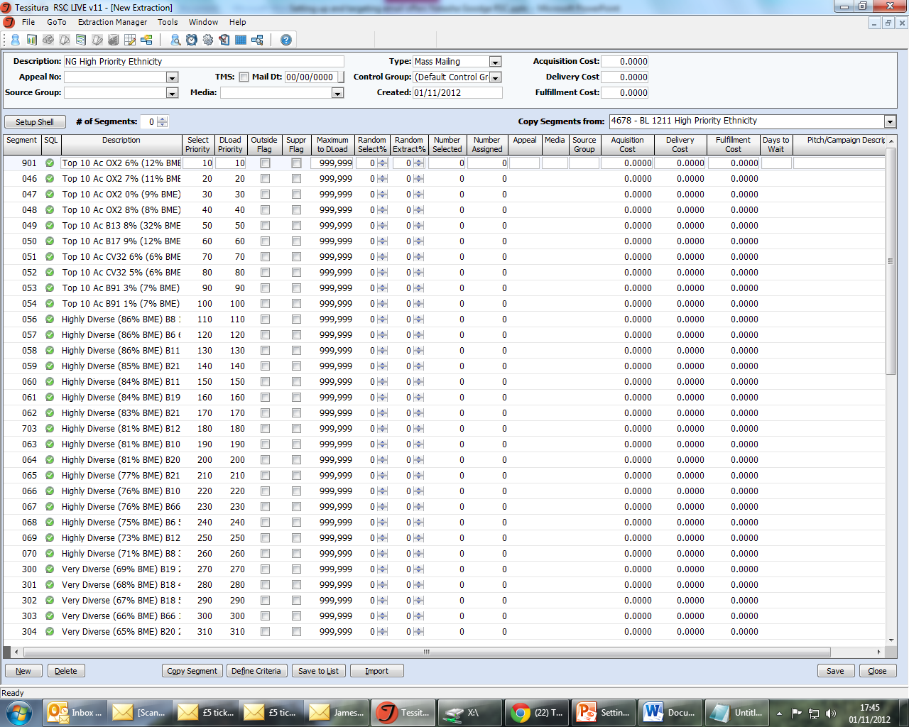
Ticket offers and audience development
Targeting selected groups by postcode

Slide 16
Ticket offers vs. papering
Advantages of ticket offers
  High value ticket offers done earlier can sometimes fill houses which would otherwise need papering
  Income
  Far fewer no-shows
  Less administration
  Opportunity to encourage people who have engaged with you via email to make their first booking
Word of warning
  Important to balance advantages of having a group who always respond to offers with creating a sense of expectation
    Vary groups of people you target with each offer

Slide 17
Getting the best from email ticket offers
Three things to think about
Choose the most appropriate type of offer to suit your needs
Promo codes vs direct links
Target your data carefully
People most likely to respond
People you want to encourage to attend
Vary your target groups
Try to avoid creating a segment who are reliant on ticket offers
Natasha Goodge, RSC Marketing
Notes:
Single column

Slide 18
Any questions?

Slide 19
Thanks very much!
    Natasha Goodge
    Royal Shakespeare Company
    natasha.goodge@rsc.org.uk
    01789 272559

