Slide 1
Creating Popup and Flex
Constituent Headers
Two Headers are Better Than One
Natalie Threlfall
Tessitura Network

Slide 2
Session outline…
Creating & Customizing Flex Constituent Headers
Creating & Customizing Popup Headers
Popup & Flex Header Q&A

Slide 3
Creating and Customizing Flex Headers

Slide 4
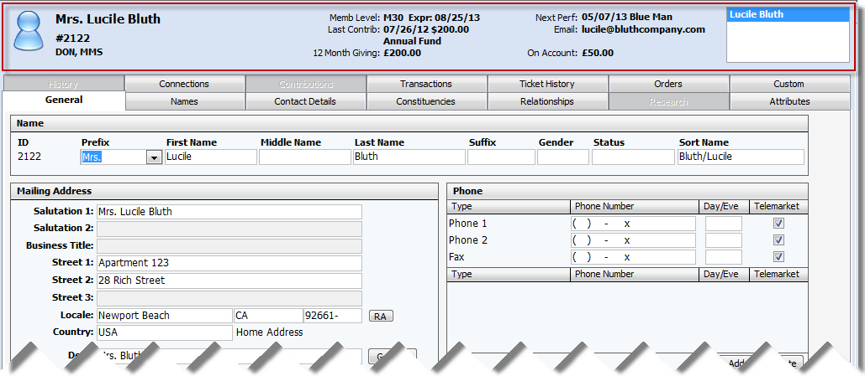
What is a constituent header?
Displays at top of record in constituent record…

Slide 5
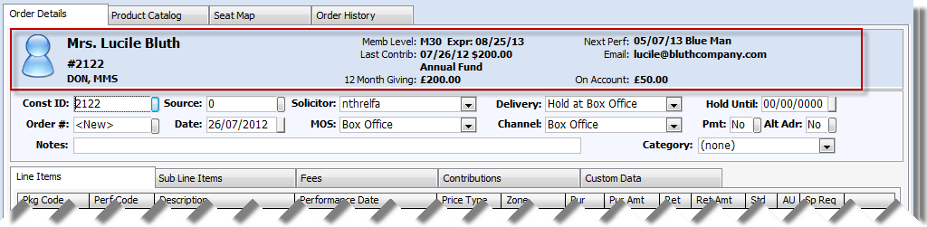
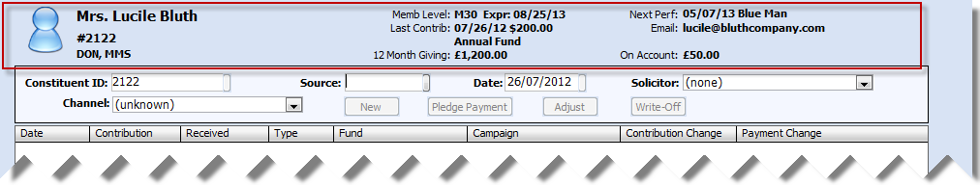
What is a constituent header?
… and order…
… and contribution…
Notes:
They are everywhere!
You can change what data appears here, depending on which constituent

Slide 6
So?
They are everywhere!
You can change what data appears here depending on:
  Which constituent is loaded
  Which user is logged into Tessitura
Pre v11 custom headers were created in infomaker
Now – Flex Headers!

Slide 7
Off the top of your head(er), give me some use cases…
My Constituent Header was installed during implementation and hasn’t changed in 1000 years
I’d like to be able to make some quick changes; updating the InfoMaker Object and Stored Procedure is onerous

Slide 8
Off the top of your head(er), give me some use cases…
We have a limited IT staff, and / or don’t have the skills in-house to make changes
InfoMaker is *&%$£ !!!

Slide 9
Is it really that straightforward?
All configured within Tessitura
No need for 3rd party software
Minimal SQL knowledge is required*
Mostly configured within System Tables
It’s easy peasy lemon squeazy!
  *SQL = Scary Query Language

Slide 10
Tell me more about Flex Headers!
2 layouts are available:
Flex Header format
  up to 8 definable text data elements
Flex Header Icons format
  up to 6 definable text data elements
  up to 4 icons

Slide 11
Flex Header format
Flex Header format
  up to 8 definable text data elements
Name, ID, icon and constituencies on every flex header
Constituent navigator when in the constituent record
8 definable text data elements - can be any data from anywhere in Tessitura

Slide 12
Flex Header Icons format
Flex Header Icons format
  up to 6 definable text data elements
  up to 4 icons
Name, ID, icon and constituencies on every flex header
Constituent navigator when in the constituent record
6 definable text data elements
4 icons
can be any data from anywhere in Tessitura

Slide 13
How do I get started?
TR_FLEX_HEADER_ELEMENT
  Code to retrieve data
  File location for Icons
TR_FLEX_HEADER
  Element positions
  Labels

Slide 14
How do I get started?
T_FORMAT_INFO
  Give your header a logical name
Security Module
  Assign headers to user groups

Slide 15
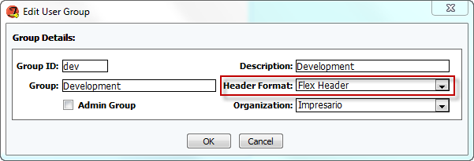
Try it out
V11 has one Flex Header format and one Flex Header Icons format pre-configured
Just change the Header format in the security module for a user group
Notes:
Try using one of the pre-configured formats to see what is looks like
Demo in client

Slide 16
Create your own Flex header
Can create your own header
Use the supplied standard elements, so no need for SQL
All elements can be used without (m)any changes

Slide 17
Standard Elements
Create Date
Total Giving
Membership
On Account $
Next Perf
Last Perf
Birthdate
12 Month Giving
Primary Email
User
Urgent CSI
Last Contrib
Last Fund
Notes:
Can use any of these standard elements without many changes

Slide 18
Create a copy of the flex header
T_FORMAT_INFO
Insert a new row
Include “Flex header” or “Flex Header Icons” in description
Gooesoft Report ID - Constituent Header
D Object - d_flex_header or d_flex_header_icons
Save
Notes:
Demo in client

Slide 19
Select elements for your header
TR_FLEX_HEADER
Add/copy one row per element
Hdr No – select your header
Element No – select the desired element
Label – this appears on the header

Slide 20


Positions in TR_FLEX_HEADER
Flex Header – text positions 1-8
1
2
3
4
5
6
7
8
Flex Header Icons – text positions 1-6 icons positions 9-12
1
2
3
4
5
6
9 10 11 12
Notes:
Choose where you want the data to appear in TR_FLEX_HEADER
Notice you can leave gaps to create space
Demo in client

Slide 21
Create your own elements
TR_FLEX_HEADER_ELEMENT
Type
  Currency
  Date
  Number
  String
Description

Slide 22
SQL code – eeek!
Any data from within Tessitura
  Use secure views to respect control groups
Uses @customer_no parameter
Must return 1 row
  SELECT TOP 1
  Aggregated data
    SELECT SUM()
    SELECT COUNT(*)
    SELECT MAX()
    SELECT MIN()
Look at supplied elements for examples

Slide 23
Icon File
Can add icon
Displays icon if data is returned
Icon file value
  Application directory (T:\Impresario Client)
    Filename only – eg Email.jpg
  Another directory
    File path and filename – eg T:\FlexHeaderIcons\Email.jpg
No larger than 100x100 pixels
Notes:
Demo in client

Slide 24
Custom Element Examples
2 Year Giving
  Currency
  Select sum(cont_amt) From [dbo].vs_contribution WITH (NOLOCK) Where customer_no = @customer_no and (cont_dt between dateadd(mm, -24 , getdate()) and getdate())
  Based on supplied 12 month giving

Slide 25
Custom Element Examples
Data Protection last asked date
  Date
  select max(asked_dt) from lvs_privacy_act where customer_no = @customer_no
  Selecting a date from a local table

Slide 26
Custom Element Examples
No Email Address
  String
  select CASE WHEN not exists (select top 1 address from VS_EADDRESS where ISNULL(inactive, 'N')='N' and customer_no = @customer_no) then 'Address' else NULL END
  Returns something if no email address exists
  Use icon to display @ in header

Slide 27
When I said (m)any changes…
Supplied date elements display in US date format
To change format:
  CONVERT(varchar,perf_dt,1)=mm/dd/yyyy
  CONVERT(varchar,perf_dt,3)=dd/mm/yy
  CONVERT(varchar,perf_dt,103)=dd/mm/yyyy
  CONVERT(varchar,perf_dt,111)=yyyy/mm/dd

Slide 28
When I said (m)any changes…
Symbols for currency type elements show £ if default country is 209, otherwise $
  (bug in 11.0.4 with £ sign)
For string elements containing currency amounts may need to change the symbol
  Select top 1 CONVERT(varchar,c.cont_dt,1)+' $'+CONVERT(varchar,cont_amt) from VS_CONTRIBUTION c where customer_no = @customer_no order by c.cont_dt desc

Slide 29
Creating and Customizing Popup Headers

Slide 30
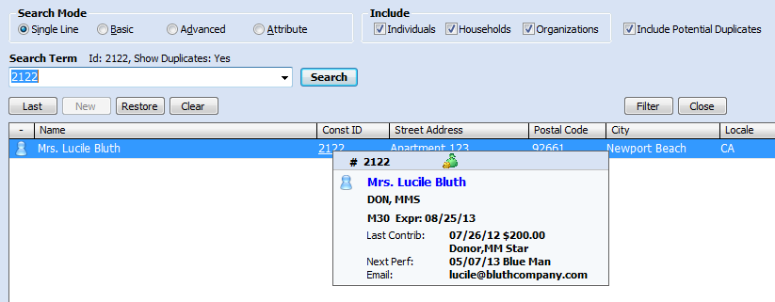
What is a popup header?
New in v11
Pops up when hover over constituent ID

Slide 31
Sounding familiar?
All configured within Tessitura
No need for 3rd party software
Minimal SQL knowledge is required*
Mostly configured within System Tables
It’s easy peasy lemon squeazy!
  *SQL = Scary Query Language

Slide 32
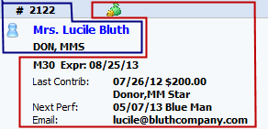
Popup Header format
Popup Header format
  up to 6 definable text data elements
  up to 4 icons
Name, ID, icon and constituencies on every popup header
6 definable text data elements
4 icons
can be any data from anywhere in Tessitura

Slide 33
Popup Header System Tables
TR_FLEX_HEADER_ELEMENT
TR_FLEX_HEADER
T_FORMAT_INFO
Set up in exactly the same way as the Flex Headers, using the same elements

Slide 34
Try it out
V11 has a Popup Header format pre-configured
Just hover over the constituent ID in constituent search screen to see it.
Notes:
Demo in client

Slide 35
Customize the Popup Header
Every user in an organization has the same popup header
Add rows to TR_HEADER_FORMAT to add data to the popup header
Notes:
Demo in client

Slide 36
Popup Headers in a Consortium…
To create a popup header for a consortium organization:
Insert a row in T_FORMAT_INFO
Enter a description
Gooesoft Report ID - Constituent Header
D Object – leave blank
Save

Slide 37
Popup Headers in a Consortium
Insert a row in T_DEFAULTS
Parent Table – Organization
Field Name – POPUP_HEADER
Default Value – Popup Header ID from T_FORMAT_INFO
Save
Configure the header in TR_FLEX_HEADER

Slide 38

Creating Popup and Flex Constituent Headers
Natalie Threlfall

