Slide 1
Data quality – capture, deduplication and merging
Sinead Nash, Experian QAS

Slide 2
Agenda
Data Quality Research
Address Capture
Data Cleansing
Accurate Data
Capture in a Digital World
RSC Data Cleanse

Slide 3
Global Research White Paper
Experian and Dynamic Markets
89% of Companies believe departmental budgets are being wasted through inaccurate data
The average proportion of departmental budgets lost from bad data is 15%
57% of data inaccuracy is found to come from human error
48% of those companies use manual checking to remedy
What is your acceptable level of data inaccuracy?

Slide 4
Sources of Data
Customer Database
Box Office
3rd Party Bookings
Walk In
Website Bookings
Research suggested a median of 6 databases per company
Varied levels of capture at each data source

Slide 5
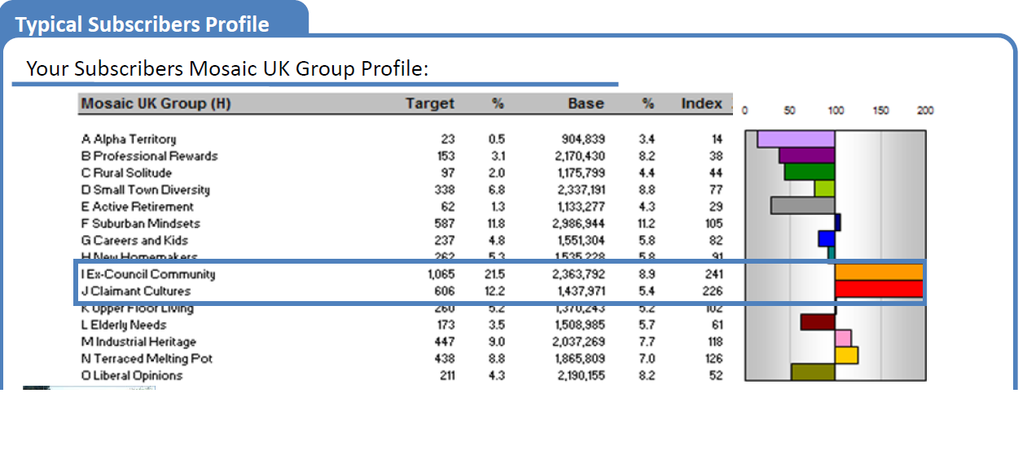
Address Capture
Validated data at source of entry ensures a consistent level of data accuracy

Slide 6
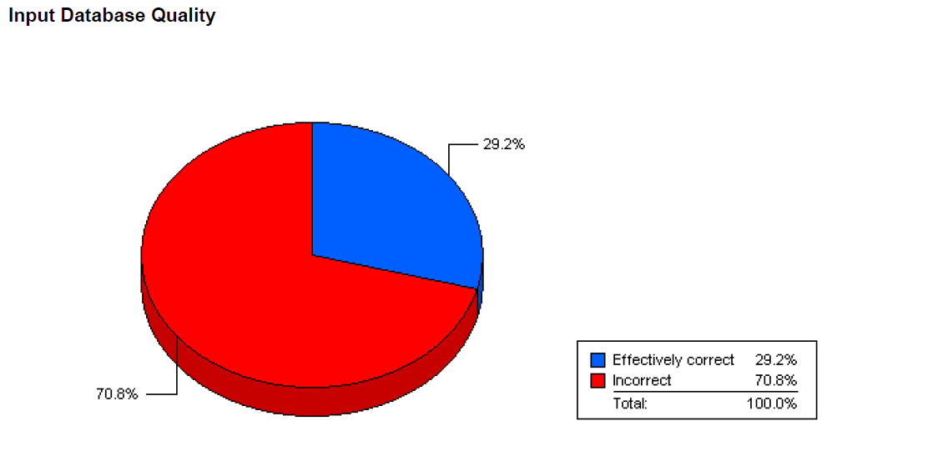
How dirty is your Data?
To gain this insight Experian can perform a free data healthcheck

Slide 7
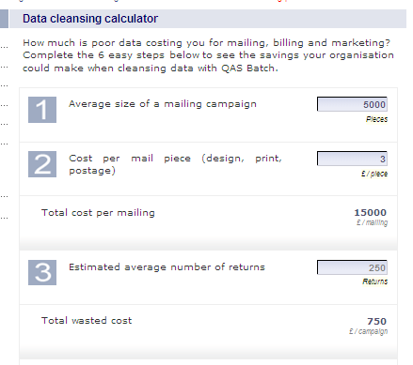
Cost of Inaccurate Data

Slide 8
Capture vs Cleanse?
Capture
  Correct Data entering your database
  Fully Validated Information
  Information can be used for profiling
  Reporting Statistics
  Direct Marketing Campaign Efficiencies
Cleanse
  Database Degeneration
  100,000 changes to the Royal Mail address file each week
  All data sources correctly formatted
  More “useful” data
  Suppression
    Keep in touch with Patrons
    Todays Study Buddies could be tomorrows Alpha Territories?

Slide 9
Power of Accurate Data
Reduced number of returned mailings
  Increase the identification of duplicates
Greater Customer Insight
    Understand tomorrows “big-spenders”
    Single Customer View
Remain compliant – Data Protection Act
  “Personal data shall be accurate and, where necessary, kept up to date”

Slide 10
Validation in a digital world
Are we moving to an Email Only world?
  Why?
    Cheaper
    Reach a wider audience quicker
Manage the customer journey – improve interactions with customers through their preferred channel
Increase ROI – improve digital campaign effectiveness and conversion
Improve efficiency – reduce effort wasted on manually resolving invalid email address and mobile numbers.

Slide 11

Data Management – Capture
and de-duplication
ROYAL SHAKESPEARE THEATRE • STRATFORD-UPON-AVON
Christine Chester
Database Developer
Royal Shakespeare Company
christine.chester@rsc.org.uk
Notes:
Welcome slide

Slide 12
Data Management
QAS used for all new GBR & USA constituent creation (web and client)
Data Imports from external organisations
  1-2 each month, ~43k constituents in 2012
    Partner theatre companies
    Restaurant bookers
  Individuals and organisation constituents
  Ticket data
  Templates, tools and processes
Regular De-duplication cycle
  Scheduled and manual tasks

Slide 13
Size of the database
Customer Type | Count
Individual | 1,074,140
School | 52,296
Corporation | 7,262
Household | 5,238
Trust/Foundation | 835
Group | 493
Government Agency | 40
(as at 23rd October 2012)

Slide 14
Data Import Differences to standard
Tessitura | RSC
Import Individuals | Import Individuals plus DP flags, attribute, constituency
 | Import Organisations & Affiliates plus DP flags, attribute, constituency
Import Contributions
Import Orders | Import Ticket History
 | Import Dummy Ticket History

Slide 15
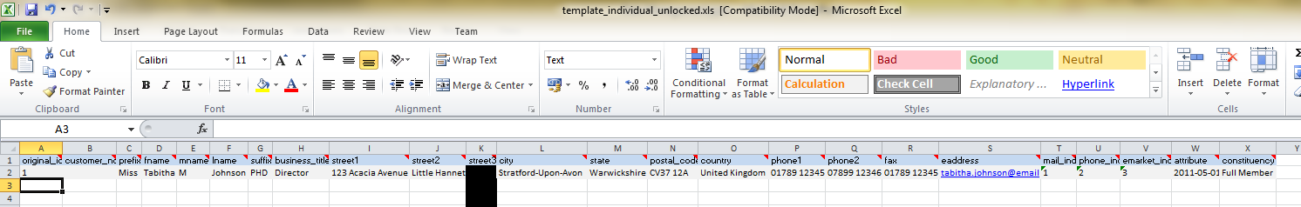
Data Import Templates - Individual
Each column has a tooltip to guide external organisation on what is expected
Sample row of data
Guide tab to introduce template and provide more assistance
Reference tabs for prefix, country, constituency etc

Slide 16
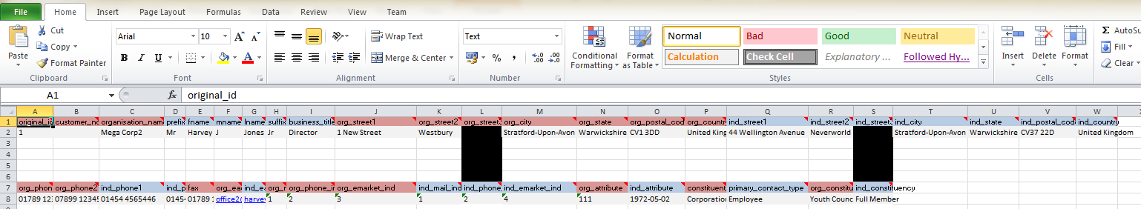
Data Import Templates - Organisation
Different colours on column headings to clarify what is for organisation, what is for affiliate
Guide tab
Reference tabs

Slide 17
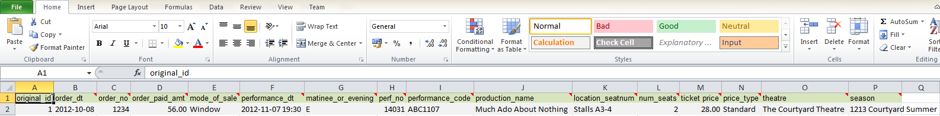
Data Import Templates - tickets
Sample row
Guide tab
Reference tabs

Slide 18
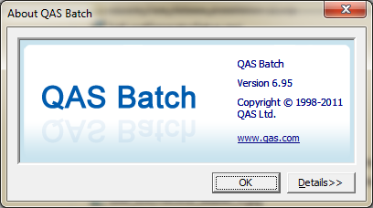
Data Import steps
tab delimited
raw data
Sample checking
excel template
Import to LIVE
SSIS package
Import to TEST

Slide 19
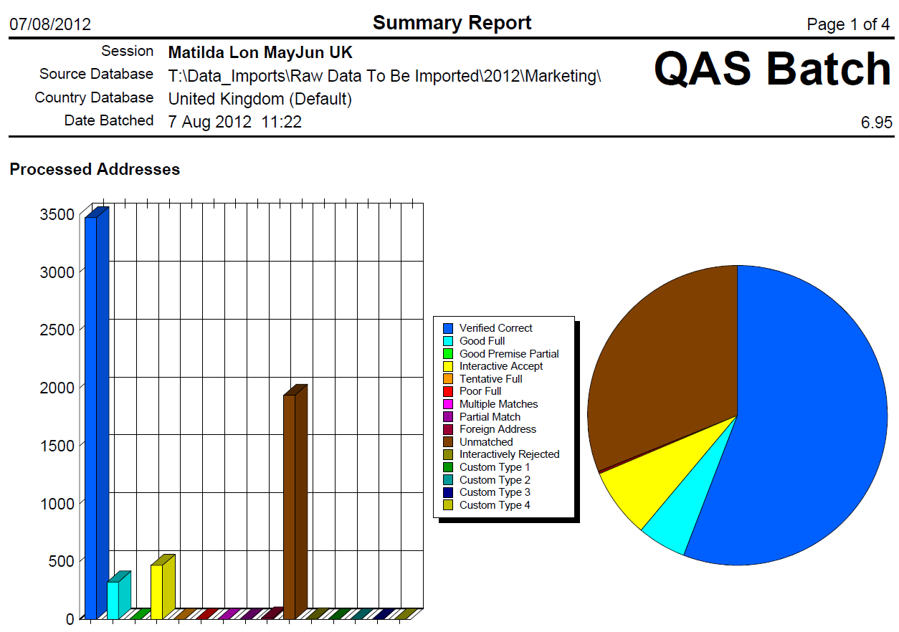
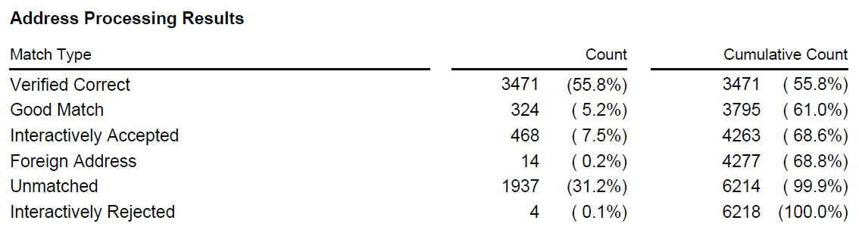
QAS Batch
Cleans address data and output
into correct columns for import
template.

Slide 20
De-duplication CYCLE
Time | Step | Objects
06:00 | Identify Duplicates for Merge | AP_IDENTIFY_DUPLICATES
06:30 | Report on overnight successful and failed merges | Duplicate Merge Results* (SSRS)
During the day | Duplicates are scheduled for merge within client | Merge Constituents panel
As required | Duplicates are scheduled by report | Duplicates By Email - Schedule Merge* (SSRS)
As required | Merge the scheduled duplicates | Duplicate Merge* (Infomaker) that runs LP_MERGE_EXECUTE_AND_REPORT
As required | Fuzzy Matching against a list | Fuzzy Matching Against Reference Table (SSIS)
00:35 | Merge scheduled duplicates | LP_MERGE_EXECUTE_AND_REPORT
01:00 – 03:30 | Fuzzy Matching on separate server and merge | Tessitura Overnight Fuzzy Match (SSIS) LP_MERGE_EXECUTE_AND_REPORT

Slide 21
Tools used to De-Duplicate
SQL Server
  Stored Procedures
  SQL Agent for scheduled jobs
SQL Server Integration Services
  Data Transformation
  Fuzzy Grouping module
SQL Server Reporting Services
  Reporting on results

Slide 22
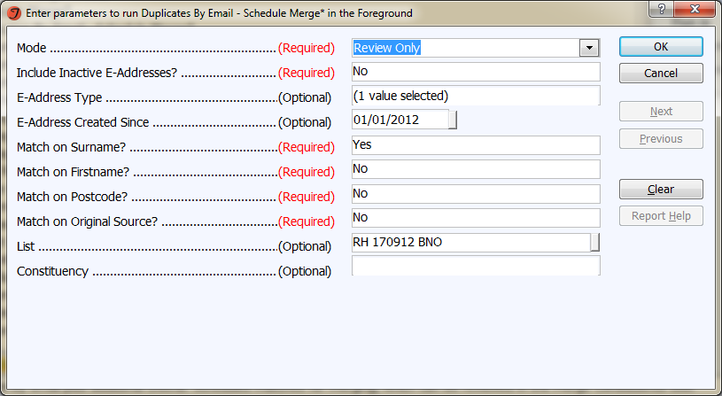
Duplicates BY Email – Schedule Merge

Slide 23
Overnight Fuzzy matching
LIVE
Prefix 0.7
Firstname 0.3
Lastname 0.5
Street1&2 0
Postal Code 0
Overall 0.7
copy all active individuals
FUZZY MATCH
Engine
(takes about 2:30 hours)
LIVE
Schedule Matches
Execute Merges

Slide 24
Fuzzy matching against a list
LIVE
Prefix 0.7
Lastname 0.9
Street1&2 0.6
Postal Code 0.9
Overall 0.5
list of constituents
copy all
active individuals
B
Engine
FUZZY MATCH
A
LIVE
Fuzzy Match SSRS

Slide 25
Sharing Ideas and best practice
All the code and objects mentioned in this presentation is available for sharing
How do other companies manage data imports and cleaning?
Developer forum for sharing ideas
  http://developer.tessituranetwork.com/display/devportal/Welcome+Developers%21

Slide 26
Thank you

