Slide 1

“Lies, damned lies and statistics”
Audience Research and Insight
Notes:
Opening slide

Slide 2
Audience Research
How and why we do it by Becky Loftus
Royal Shakespeare Company
Notes:
Opening slide

Slide 3
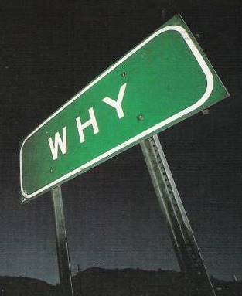

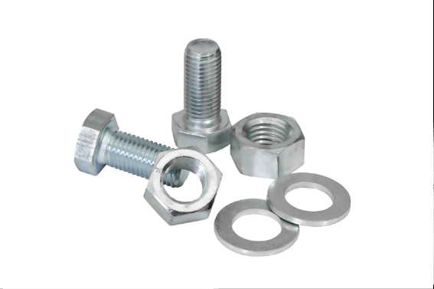
content
WHY bother with audience research?
WHAT we do at the RSC – 4 real life examples of research findings and their “light bulb” moments
HOW to get started using Tessitura and a few tips

Slide 4
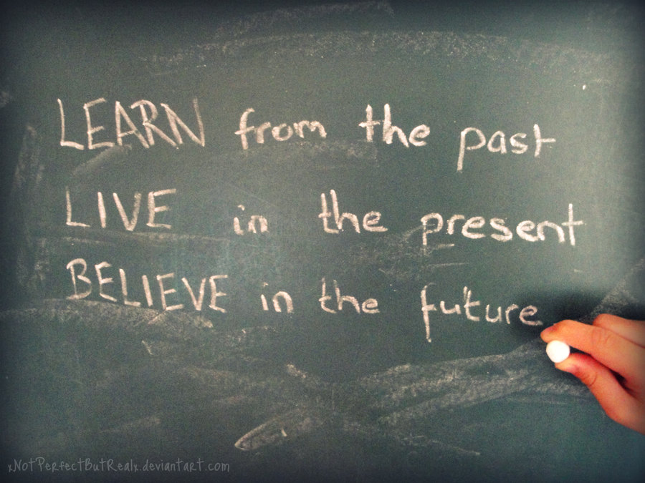
WHY RESEARCH OUR AUDIENCES?
With a million and one other things to do, why bother with research when we know what people think from the audience response at the time and from the reviews?
Understanding the audiences we are trying to sell to
Learning from past mistakes and successes
  Our gut feeling can get us so far, but is based on guesswork rather than evidence
  If something was not well received, why was that? The audience will tell it to us straight
  The next time we have a similar show to sell, we know who best to target and how
Looking for new opportunities and testing out new ideas, e.g. Gauge interest in an idea before investing heavily
Reporting to Arts Council and other funding bodies
Evidence for fundraising efforts, e.g. How many people are aware of a corporate partnership?
Helps to improve our service
Becky Loftus, Audience Insight
Notes:
Single column

Slide 5

Driving without mirrors

Slide 6
WHO we Survey and how often
Audiences
Visitors
The RSC
The General Public
RSC Staff
Teachers & Pupils
Season by season
Season by season
Every 3 years
Every 3 years
Notes:
A core of key questions remain the same for each survey but we rotate other questions to answer specific questions that are about that season only or a specific topic of debate at the time.

Slide 7

Here are some examples of research findings from recent years…
Becky Loftus, Audience Insight
Notes:
Two column option 1

Slide 8





Annual Demographics assessed vs. arts Council “Taking part” survey
1
7% of our audience consider themselves or someone in their party to have a disability (~45,500) vs. 25% of play / drama attendees nationally
24% of bookers attended with an under 16 (~153,700)
  40% for Matilda
  50% for The Heart of Robin Hood
  66% for The Taming of the Shrew (YPS)
62% of bookers were female vs. 58% of play/drama attendees nationally
95% of bookers rated our work as good, very good or excellent
  64% gave an excellent rating vs. our target of >50% (Matilda particularly excellent at 87%)
97% would consider seeing another RSC production
N.B. 30% of play/drama attendees have a child in the household
Notes:
The location of the theatre can prove difficult to those with a disability but during the redevelopment of the theatre we improved access dramatically and we’re currently working with the Vassall centre to further research our audiences with a disability and particularly our provision of audio described and captioned performances

Slide 9

Annual Demographics assessed vs. arts Council “Taking part” survey
1
7% of our audience consider themselves or someone in their party to have a disability (~45,500) vs. 25% of play / drama attendees nationally
24% of bookers attended with an under 16 (~153,700)
  40% for Matilda
  50% for The Heart of Robin Hood
  66% for The Taming of the Shrew (YPS)
62% of bookers were female vs. 58% of play/drama attendees nationally
95% of bookers rated our work as good, very good or excellent
  64% gave an excellent rating vs. our target of >50% (Matilda particularly excellent at 87%)
97% would consider seeing another RSC production
Conclusions
Our more regular family programming combined with Matilda in the West End are working well in reaching family audiences
Our work as a whole is appreciated by our audiences and generating repeat business
We need to look further into our provision for disabled audiences and communicate better the many access improvements that have been put in place and the captioned and audio described performances available
N.B. 30% of play/drama attendees have a child in the household
Notes:
The location of the theatre can prove difficult to those with a disability but during the redevelopment of the theatre we improved access dramatically and we’re currently working with the Vassall centre to further research our audiences with a disability and particularly our provision of audio described and captioned performances

Slide 10

We asked a new set of questions based on research by the Arts Council into measuring engagement: “Here are some phrases that people might use to describe the experience of watching a piece of theatre. For each pair, please mark a point on the scale towards whichever is closest to your experience of watching [PRODUCTION].”
2
Arts Council Name... | Question wording...
Engagement and concentration | It felt like time was passing slowly | ❍ | ❍ | ❍ | ❍ | ❍ | I hardly noticed the time passing
Fun and enjoyment | I didn’t really enjoy myself | ❍ | ❍ | ❍ | ❍ | ❍ | It was a lot of fun
Energy and tension | I felt tired and uninterested | ❍ | ❍ | ❍ | ❍ | ❍ | I felt lively and enthusiastic
Personal resonance and emotional connection | There wasn’t really much that touched me | ❍ | ❍ | ❍ | ❍ | ❍ | I found aspects of the performance very moving
Shared experience and atmosphere | I didn’t feel much connection with other audience members | ❍ | ❍ | ❍ | ❍ | ❍ | It felt good to be sharing the experience with other people
Learning and challenge | I was mostly in my ‘comfort zone’ | ❍ | ❍ | ❍ | ❍ | ❍ | I felt challenged and provoked
RS11A: Here are some phrases that people might use to describe the experience of watching a piece of theatre. For each pair, please mark a point on the scale towards whichever is closest to your experience of watching [PRODUCTION]
Base: All respondents attending season (n=2,022)

Slide 11




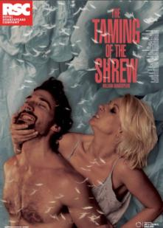
Written and Heresy both outperform the season overall in terms of ‘personal resonance and emotional connection’ and ‘learning and challenge’ which were the weaker areas for the season, whilst Robin Hood and Shrew provide the ‘fun and enjoyment’ for the season
2
Arts Council Engagement Measures
(Top Box)
✓
✓
✓
RS11A: Here are some phrases that people might use to describe the experience of watching a piece of theatre. For each pair, please mark a point on the scale towards whichever is closest to your experience of watching [PRODUCTION]
Base: All respondents attending season (n=2,022)

Slide 12
Written and Heresy both outperform the season overall in terms of ‘personal resonance and emotional connection’ and ‘learning and challenge’ which were the weaker areas for the season, whilst Robin Hood and Shrew provide the ‘fun and enjoyment’ for the season
2
Arts Council Engagement Measures
(Top Box)
Conclusion
Some of the work which proved challenging from a sales perspective was really appreciated by the audience and had immense value at creating a more rounded season, providing learning and challenge and an emotional connection for the audience
✓
✓
✓
RS11A: Here are some phrases that people might use to describe the experience of watching a piece of theatre. For each pair, please mark a point on the scale towards whichever is closest to your experience of watching [PRODUCTION]
Base: All respondents attending season (n=2,022)

Slide 13




Interest, recall and influence OF Trailers amongst the general population
3
4% of total population have seen a theatre trailer and then purchased a ticket
Video trailers have great potential in developing new audiences for theatre amongst the wider population. Interest is highest amongst BME groups and influence the greatest amongst younger audiences.

Slide 14
Interest, recall and influence OF Trailers amongst the general population
3
Conclusion
Trailers are worth investing in and should be tailored for new and younger audiences rather than existing theatre goers
4% of total population have seen a theatre trailer and then purchased a ticket
Video trailers have great potential in developing new audiences for theatre amongst the wider population. Interest is highest amongst BME groups and influence the greatest amongst younger audiences.

Slide 15

Diners’ experience at the RSC rooftop restaurant
4
 | Excellent
 | Very Good
 | Good
 | Neither good nor poor
 | Poor
 | Very poor
 | Extremely poor
Summer 12
Sig different vs.
Winter 2011/12
Sig different vs.
Summer 2011
Base: Total Summer 2012 Visitors (n= 717), Winter Visitors 11/12 (n=506) Reopening Research sample (n=1110)

Slide 16
Diners’ experience at the RSC rooftop restaurant
4
Conclusion
The catering team took on board research feedback on areas such as portion sizes and choice of side orders and have seen the restaurant excellent ratings increase over time alongside increased repeat business
 | Excellent
 | Very Good
 | Good
 | Neither good nor poor
 | Poor
 | Very poor
 | Extremely poor
Summer 12
Sig different vs.
Winter 2011/12
Sig different vs.
Summer 2011
Base: Total Summer 2012 Visitors (n= 717), Winter Visitors 11/12 (n=506) Reopening Research sample (n=1110)

Slide 17

That all sounds great, but where do i start?

Slide 18


How to get started
A vast majority of our surveys are conducted online amongst bookers with permission to email (ENTER TESSITURA!!!)
However, some surveys such as our touring research is often conducted by good old-fashioned seat slipping of paper questionnaires
For some surveys we use an inexpensive survey software – free solutions are also available but with more limited functionality. This route can be more time-consuming but costs very little.
For our main surveys we use research agencies to conduct the fieldwork and add value by being involved at the analysis stage

Slide 19
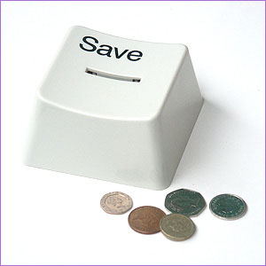
tips for cheaper research
Save money at the quote stage by not having open-ended questions coded
  Get the comments sent to you in Excel to look through instead
  Consider using closed questions
Not having the agency come to you to give the presentation saves some money if you’re prepared to present yourself
If you’re prepared to write your own presentation based on delivery of data tables only this will also save significant amounts – but don’t underestimate how long it takes!
Shorter questionnaires have better response rates so for smaller productions consider a mini-version of the survey with just the key tracking questions and use the bigger surveys to get the “nice to know” questions answered

Slide 20
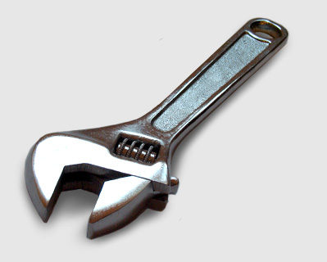
The technical bit

Slide 21
Who to send the (production) survey to?
Here is my approach…
Quick calculations in Excel –
  Take your budgeted tickets for a season
  Divide by 3 to get approx number of ticket buyers
  Divide by 4 to get approx number who give permissions to email
  We expect our response rates to be between 20% and 33%
If your season is already complete, instead of budgeted tickets you can use actual ticket sales (or actual numbers of ticket buyers)
PRODUCTION | Ticket Capacity | Budgeted Tickets | Ticket Buyers (33%) | Permission to email (25%) | 20% response rate | 33% response rate | Target sample size
Twelfth Night | 50,400 | 44,289 | 14763 | 3691 | 738 | 1230 | 350
The Tempest | 50,400 | 44,573 | 14858 | 3714 | 743 | 1238 | 350
Dream (As You Like It) | 9,450 | 7,833 | 2611 | 653 | 131 | 218 | 200
 |  |  | =C/3 | =D/4 | =E/5 | =E/3
or
Becky Loftus, Audience Insight
Notes:
Single column

Slide 22
But the same people may have seen more than one of these?
Take the smallest show first, e.g. Dream (As You Like It)
In Tessitura, extract those who can be emailed and save as a list
Suppress this list from the next largest show
Repeat...
PRODUCTION | Ticket Capacity | Budgeted Tickets | Ticket Buyers (33%) | Permission to email (25%) | 20% response rate | 33% response rate | Target sample size
Twelfth Night | 50,400 | 44,289 | 14763 | 3691 | 738 | 1230 | 350
The Tempest | 50,400 | 44,573 | 14858 | 3714 | 743 | 1238 | 350
Dream (As You Like It) | 9,450 | 7,833 | 2611 | 653 | 131 | 218 | 200
 |  |  | =C/3 | =D/4 | =E/5 | =E/3
or
Becky Loftus, Audience Insight
Notes:
Single column

Slide 23
How do I only select some of the people, e.g. for the larger shows?
Run the extraction first to see how many are eligible
  Say Twelfth Night has 3,500 actually eligible after suppressions
We are aiming for 350 completes
Assuming a lower response rate (20%), this would mean we need to extract 1,750 people for the survey (350 / 20% = 1,750)
1,750/3,500 = 0.5 of the available sample so use the “random select” and set to 50%
PRODUCTION | Ticket Capacity | Budgeted Tickets | Ticket Buyers (33%) | Permission to email (25%) | 20% response rate | 33% response rate | Target sample size
Twelfth Night | 50,400 | 44,289 | 14763 | 3691 | 738 | 1230 | 350
The Tempest | 50,400 | 44,573 | 14858 | 3714 | 743 | 1238 | 350
Dream (As You Like It) | 9,450 | 7,833 | 2611 | 653 | 131 | 218 | 200
 |  |  | =C/3 | =D/4 | =E/5 | =E/3
or
Becky Loftus, Audience Insight
Notes:
Single column

Slide 24
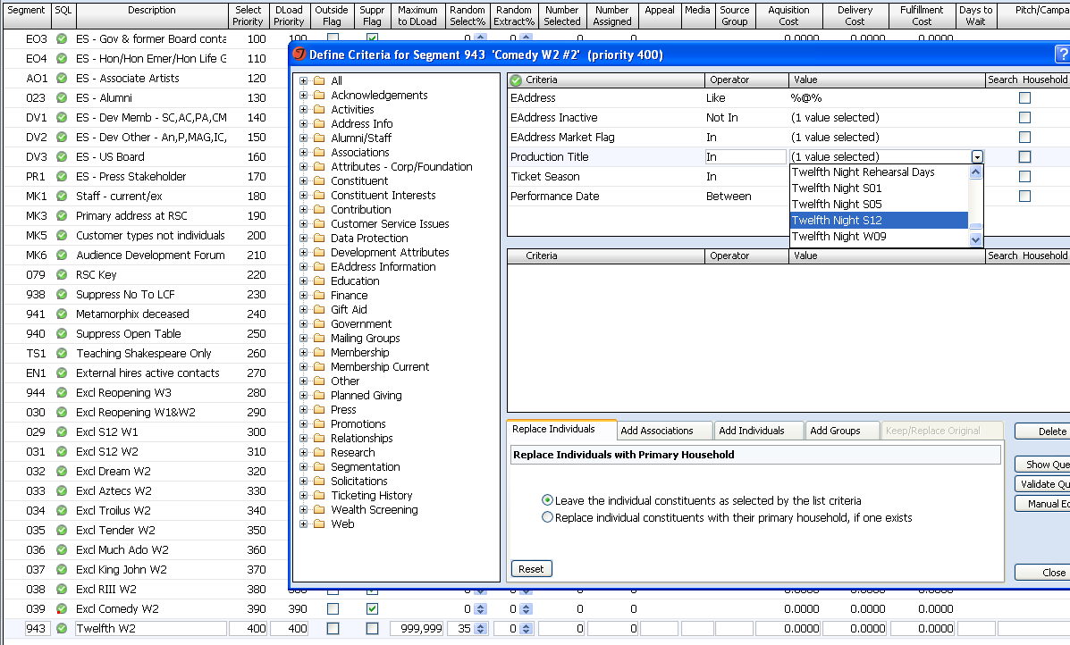
Ensure they have an email address and permissions to email and then select the production of interest and date range
Exclude all other research / productions
Each time I create an extraction, I create a list of those people I selected which I add in as a suppression so they are only selected to answer for one production
Random select of 35% of all available
This is what I calculated will give me enough responses to analyse (n≈350)

Slide 25



What happens next?
I send the extractions to the research agency show by show
  This means each survey starts with a personalised statement “Regarding your recent visit to the Royal Shakespeare Theatre to see Twelfth Night...”
They send the invite to take part which is incentivised with the chance to win £100 of Amazon vouchers
1 reminder is sent approximately 10 days to 2 weeks after the initial send to anyone who hasn’t completed the survey on those surveys where we have not hit the target

Slide 26


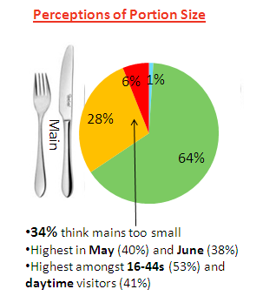
The results
The agency provide me with a draft presentation
BUT it’s up to people like us to add the magic ingredient as only through really understanding our business can we:
  Highlight and draw out the key figures
  Make it memorable
  Make the leap to what we could DO with the information
This was a problem in Summer 2011. It has now been improved along with increased satisfaction for the Rooftop Restaurant.

Slide 27


To sum up...
Audience / visitor research gives you the best information so you can learn from the past and move forward with confidence
There are many ways to conduct research and these can be scaled depending on both budget and resource
Tessitura enables us to carefully manage who receives which surveys and we can use lists in our suppressions to ensure people don’t receive surveys too frequently
It’s up to US to add the magical ingredient of insight as no agency will know our business as well as we do

Slide 28
THANK YOU
Notes:
Thank you slide

