Slide 1
Learning and Participation in Tessitura
Katherine Leadbeter
Head of Fundraising and Major Gifts
The Sage Gateshead
katherine.leadbeter@thesagegateshead.org
+44 (0) 191 443 4563

Slide 2
A bit of Background...

Slide 3
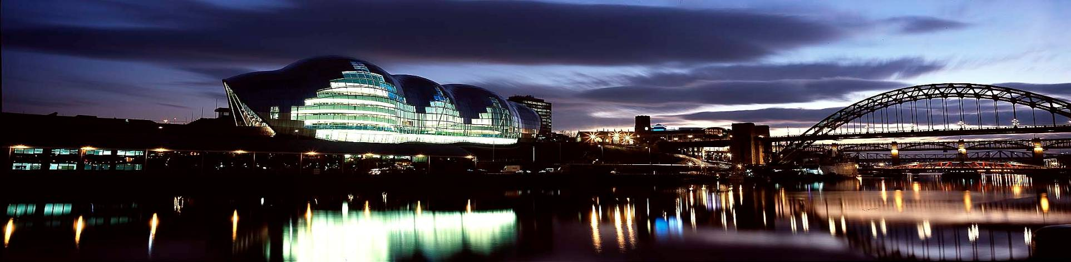
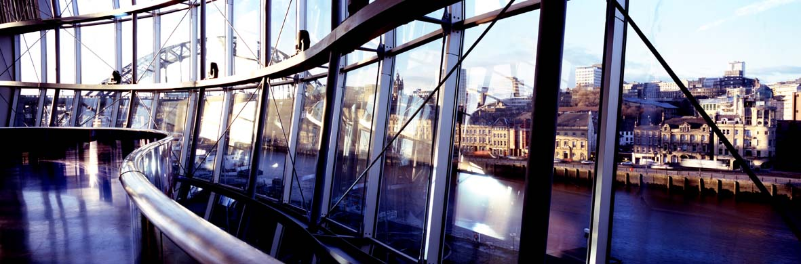
Opened 17th December 2004
Notes:
A building which incorporates 3 main halls – 2 mainly for performance and 1 mainly for rehearsals and workshops, plus a Music Education Centre, with rooms for tuition, teaching, practise, workshops and more.

Slide 4
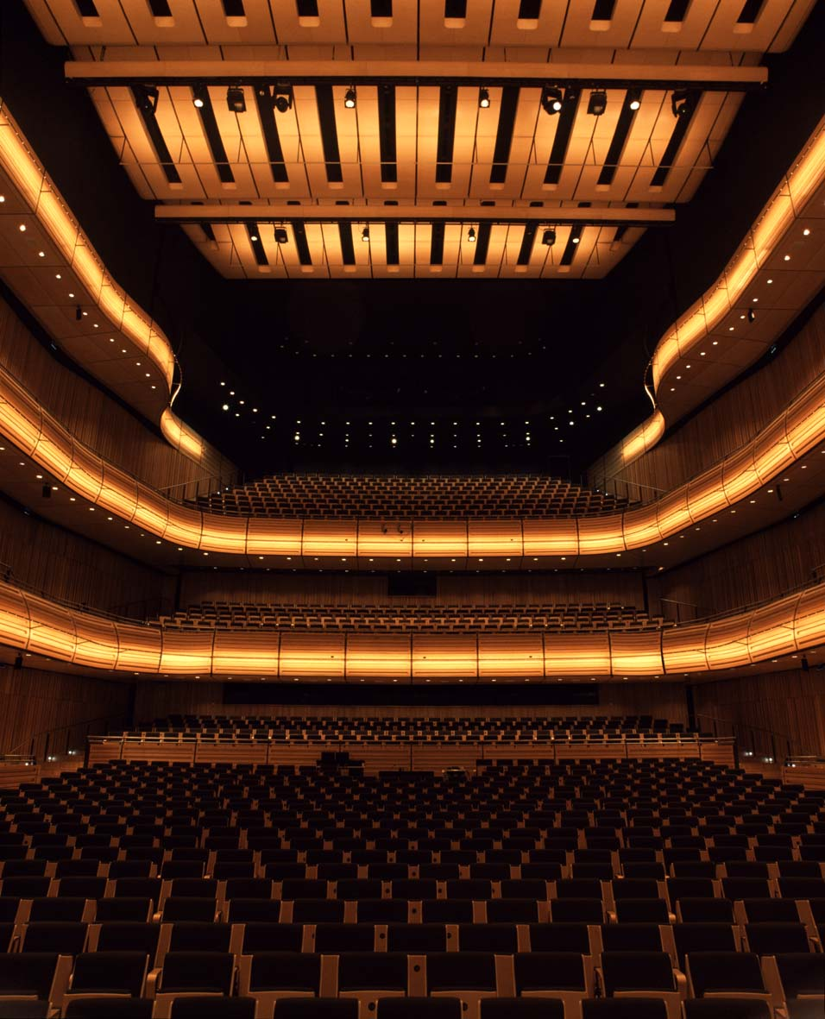
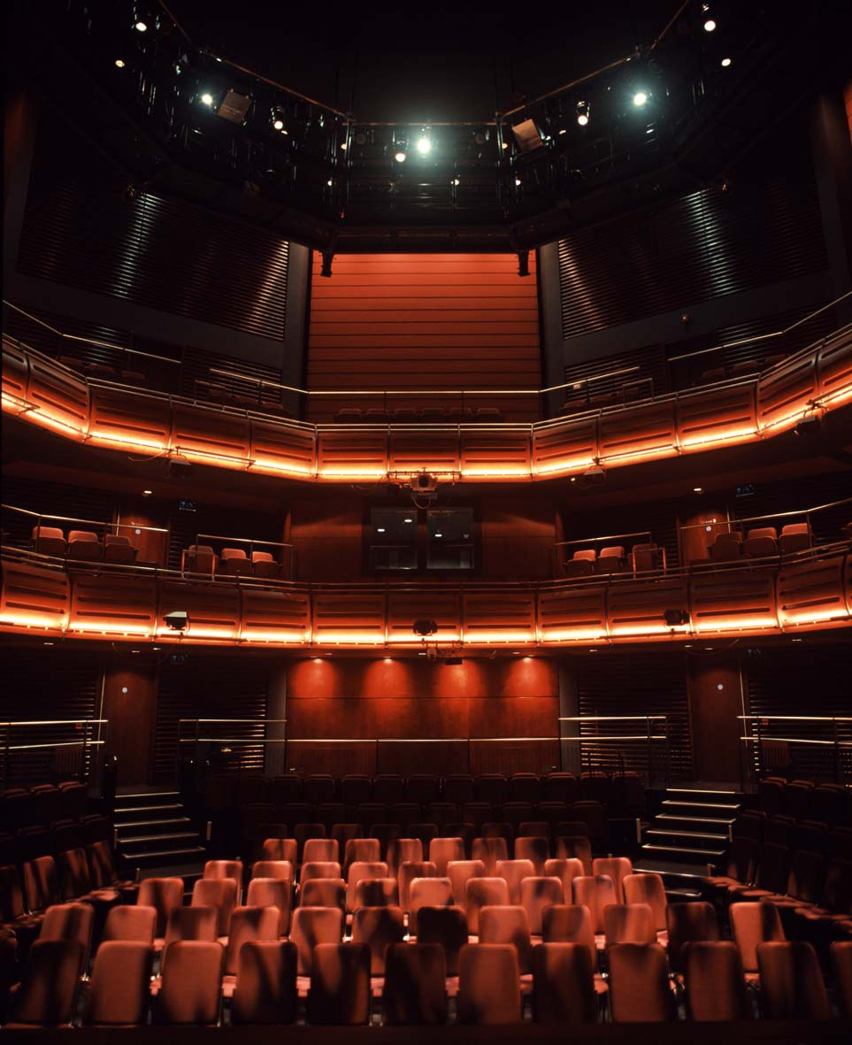
Notes:
Hall One – 1700 seats ‘shoe-box’ shape
Hall Two – 400 seats decagon

Slide 5
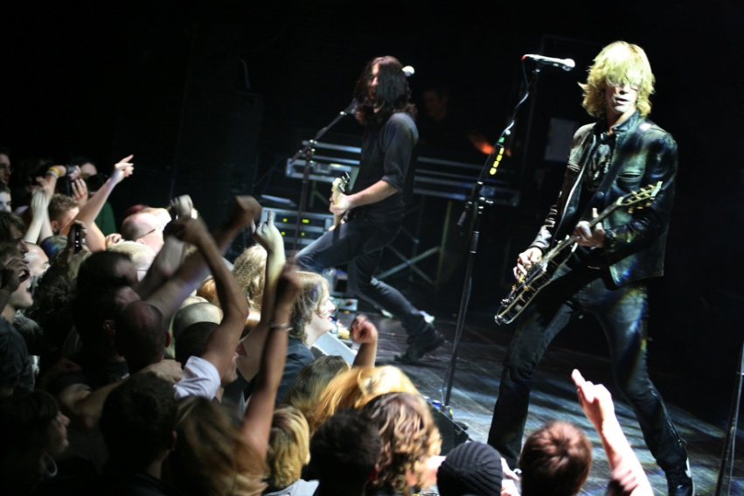
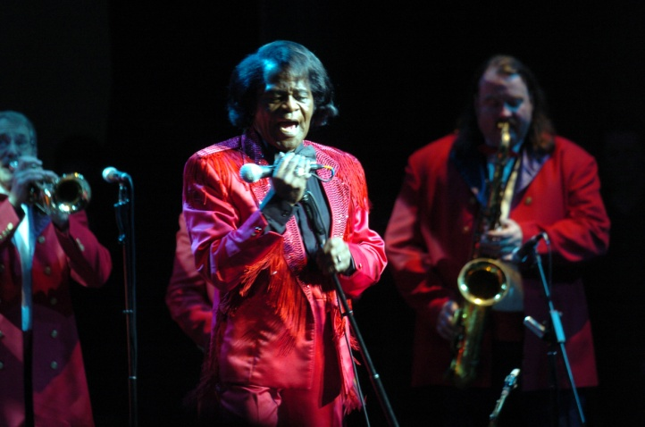
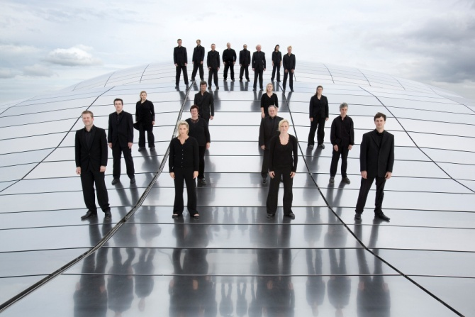
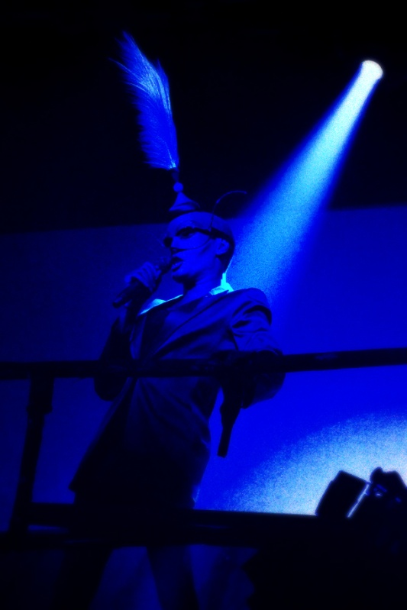
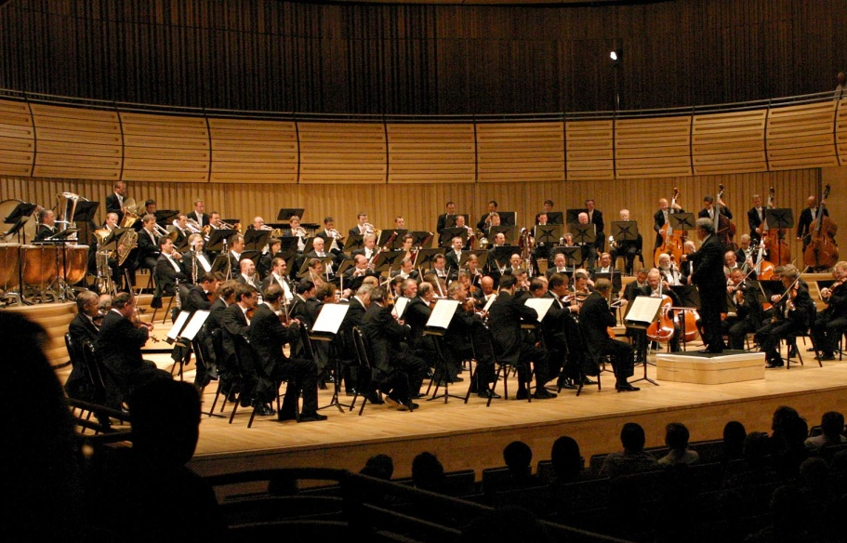
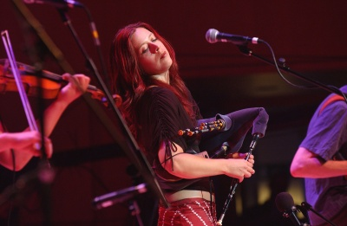
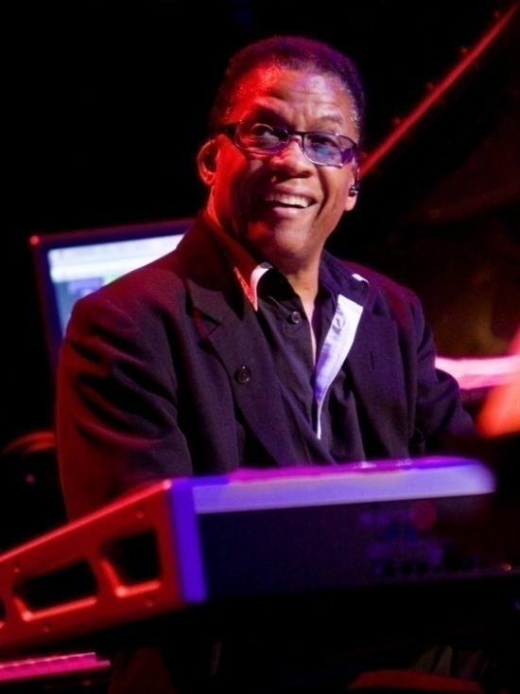
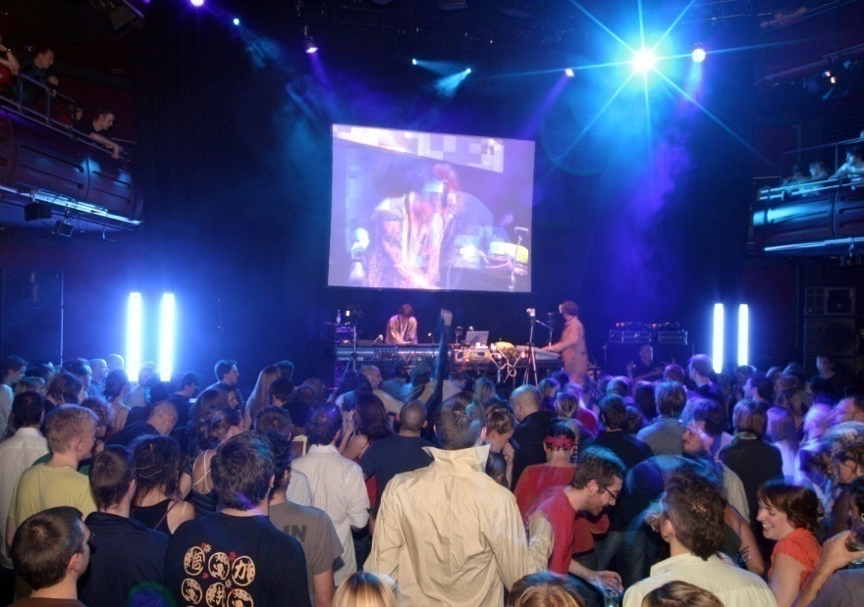
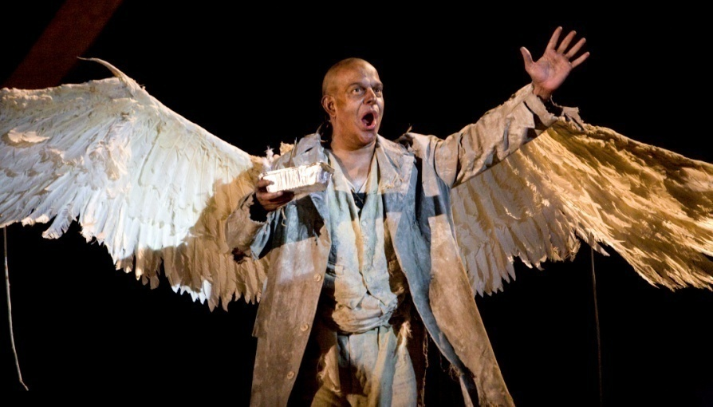
Notes:
All different types of music: Duff McKagan, James Brown, James Brown, Northern Sinfonia, Kathryn Tickell, Grace Jones, Vienna Phil, Skellig, Jamie Lieddell, Herbie Hancock
Over 400 shows a year
Reached our 2000th show at 4 ½ years

Slide 6
Our Learning and Participation Programme pre dates the building and began in February 2001

Slide 7
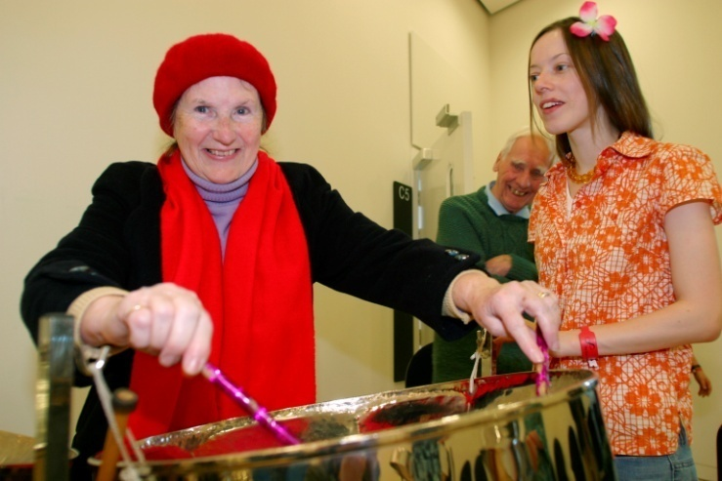
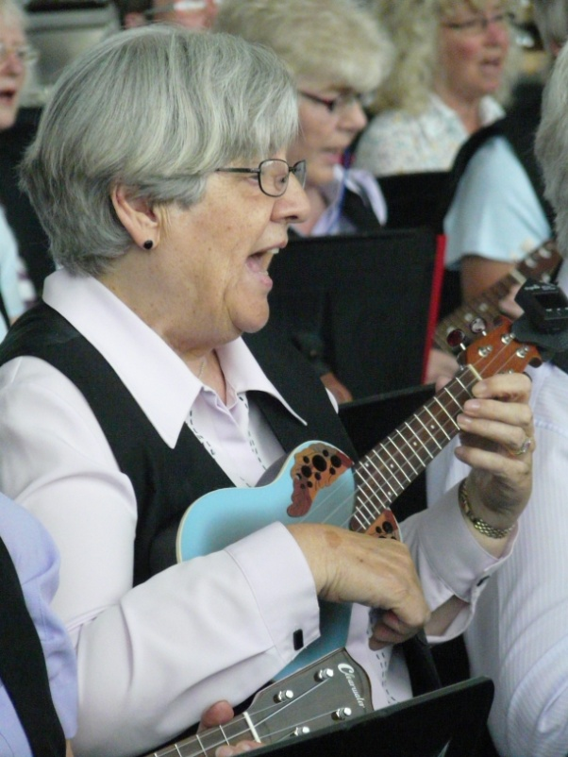
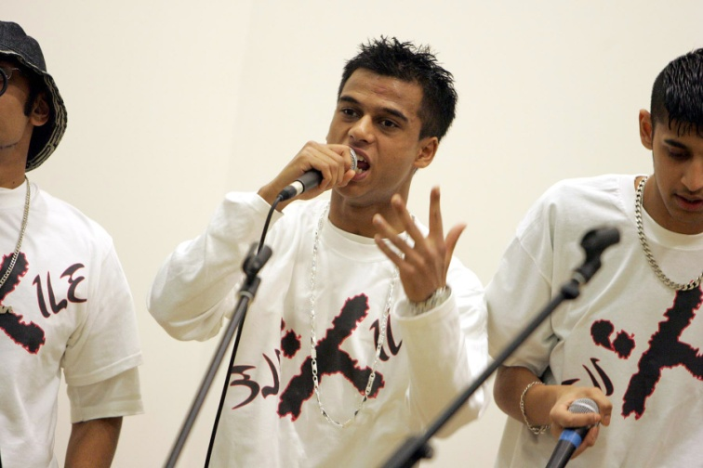
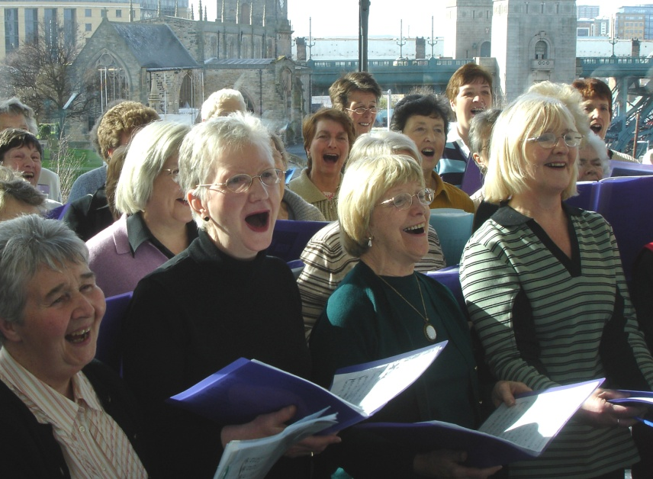
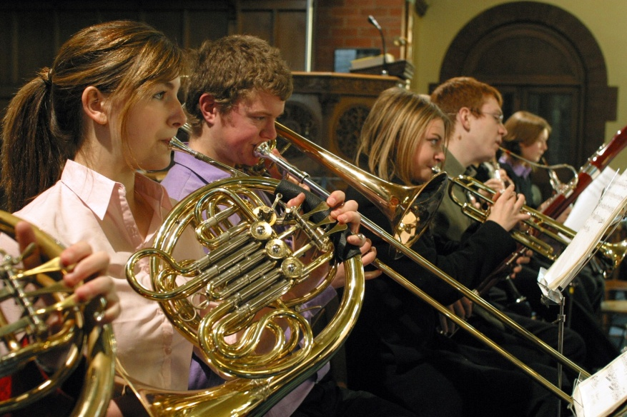
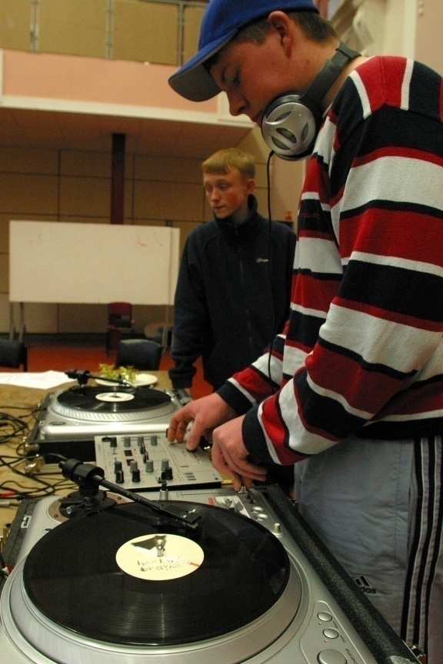
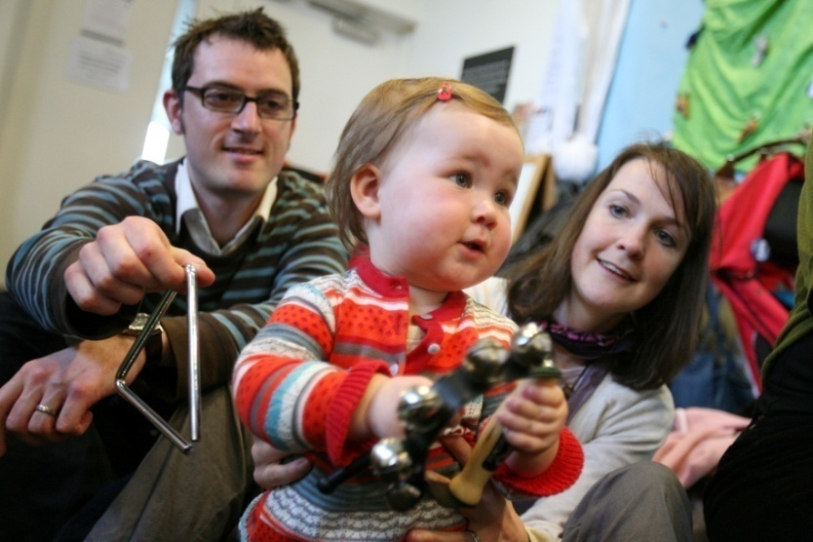
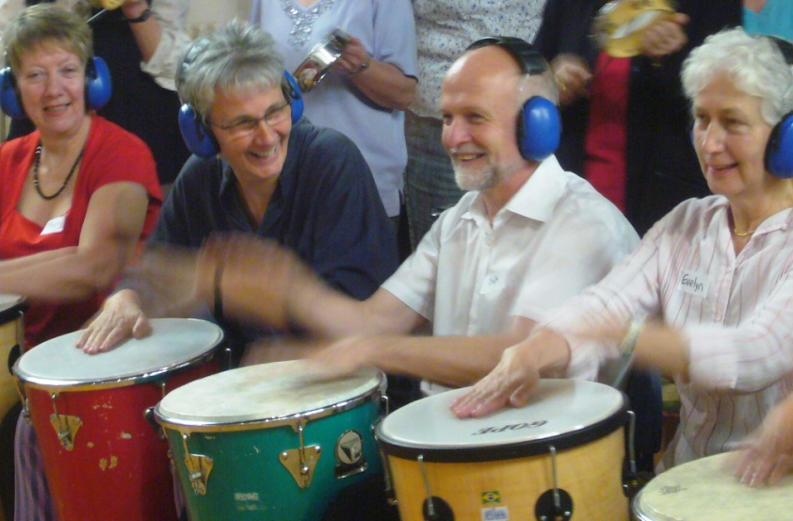

Slide 8
Work with all ages across a range of musical activity
Musical Bumps
Under 5s programme
Work in schools
Weekend School
Degree programmes
Adult programme
Silvers

Slide 9
We deliver approximately learning 38,000 sessions each year
Covering an area of 10,000 square miles

Slide 10
Where are we now ?

Slide 11
Ticketed in Tessitura:
Early Years
Adult Programme
Summer Schools
Other Workout Days
Not Ticketed in Tessitura:
Silver Programme
Weekend School
CoMusica
Youth Ensembles
Other activities e.g. Open Studio

Slide 12
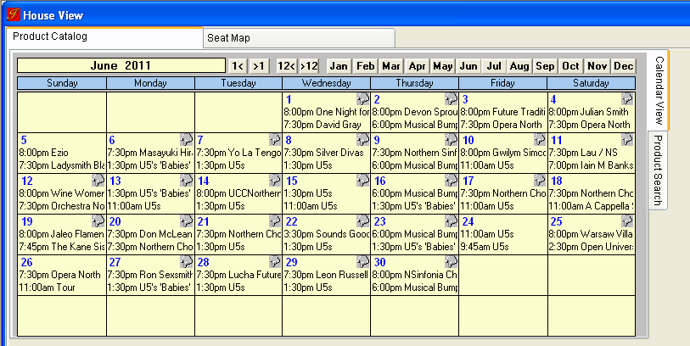

Slide 13
Information held on participants in Tessitura is minimal and doesn’t include:
Instrument played
Consents
Emergency contacts

Slide 14
Overview of the L&P project
To use one central database for all ticketing, fundraising and educational data
Transferring 65 existing databases into Tessitura
Designing new data fields and functionality for new enrolments
Extending the areas of the programme that use Tessitura
Notes:
L&P = Learning & Participation
From original Tessitura project proposal:
They are interested in migrating approximately 65 existing Education systems and the legacy data
(contained in Access databases, Excel spreadsheets, Word Documents, etc.) from their
Learning and Participation department into a single unified System designed specifically to
support the Education programmes at The Sage Gateshead and housed within the Tessitura
Software.
Ticketed in Tessitura:
Early Years
Adult programme
Summer Schools
Other workout days
Not ticketed in Tessitura:
Silver programme is extensive but separate registration and payment is in operation, although many of these participants are actually on the Tessitura database as they take part in activities that are ticketed via Tessitura/buy concert tickets
Weekend School
CoMusica
Youth Ensembles (some of these things were half-heartedly set up to track in the system e.g. constituency codes but never properly implemented)

Slide 15
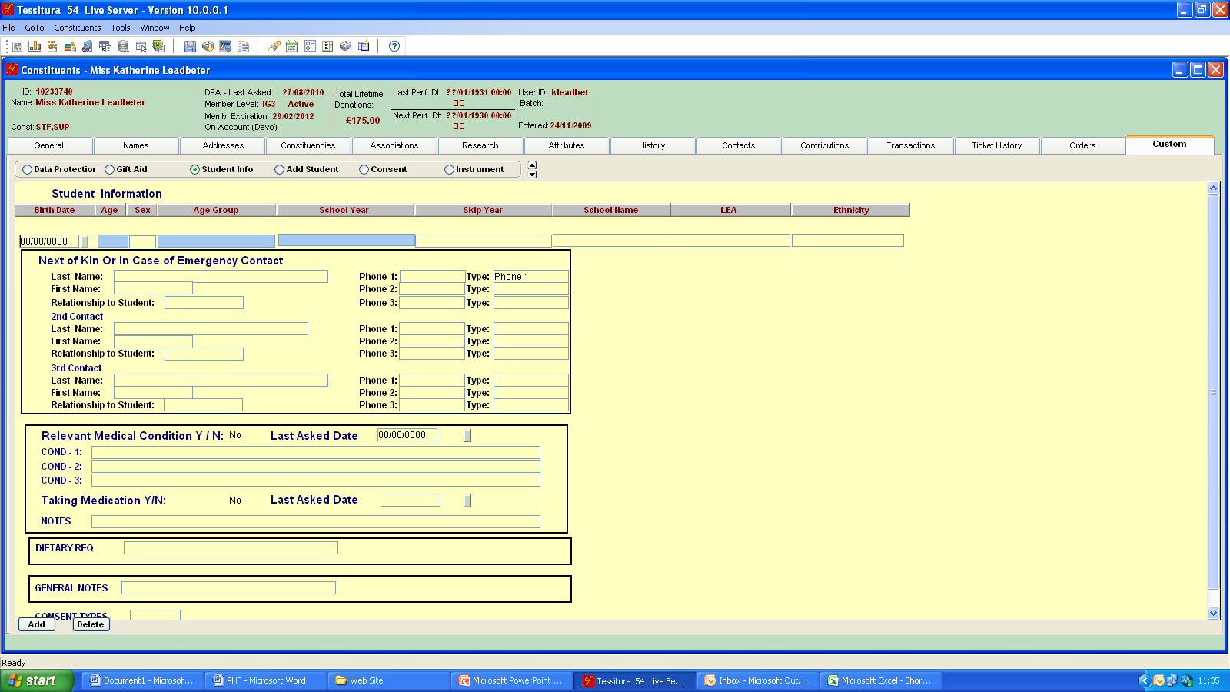

Slide 16
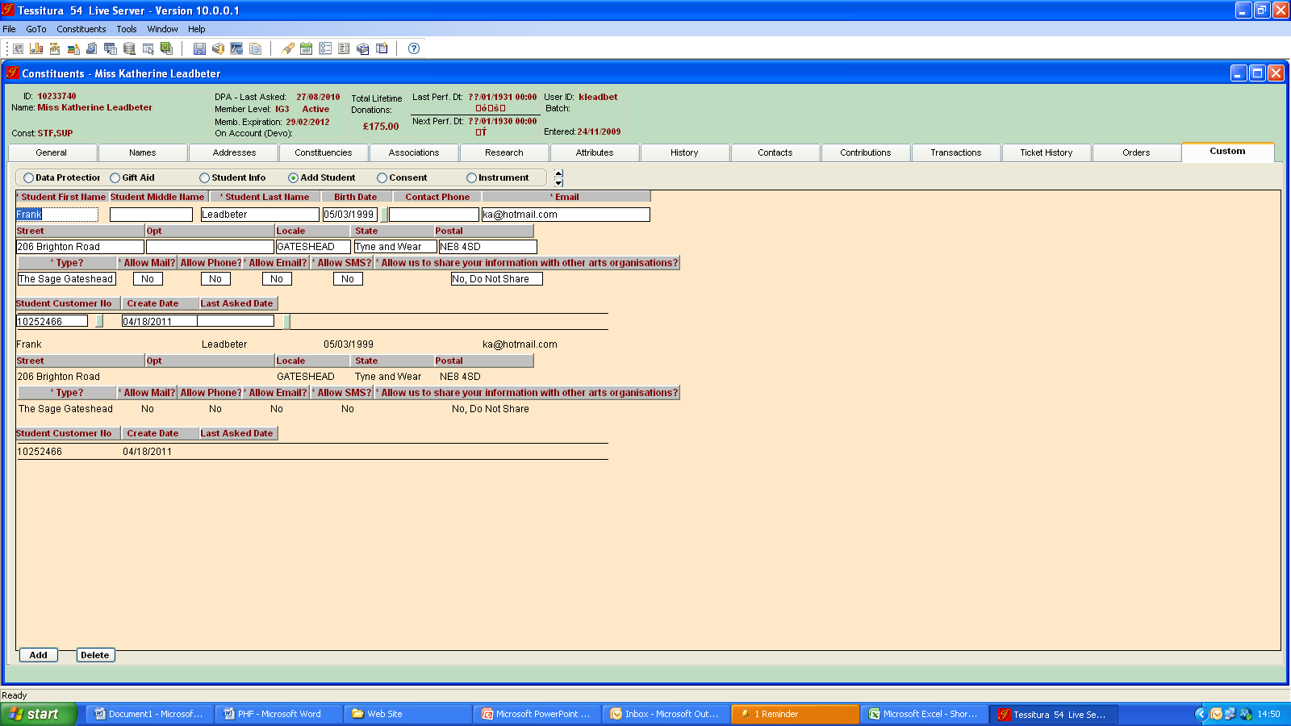

Slide 17
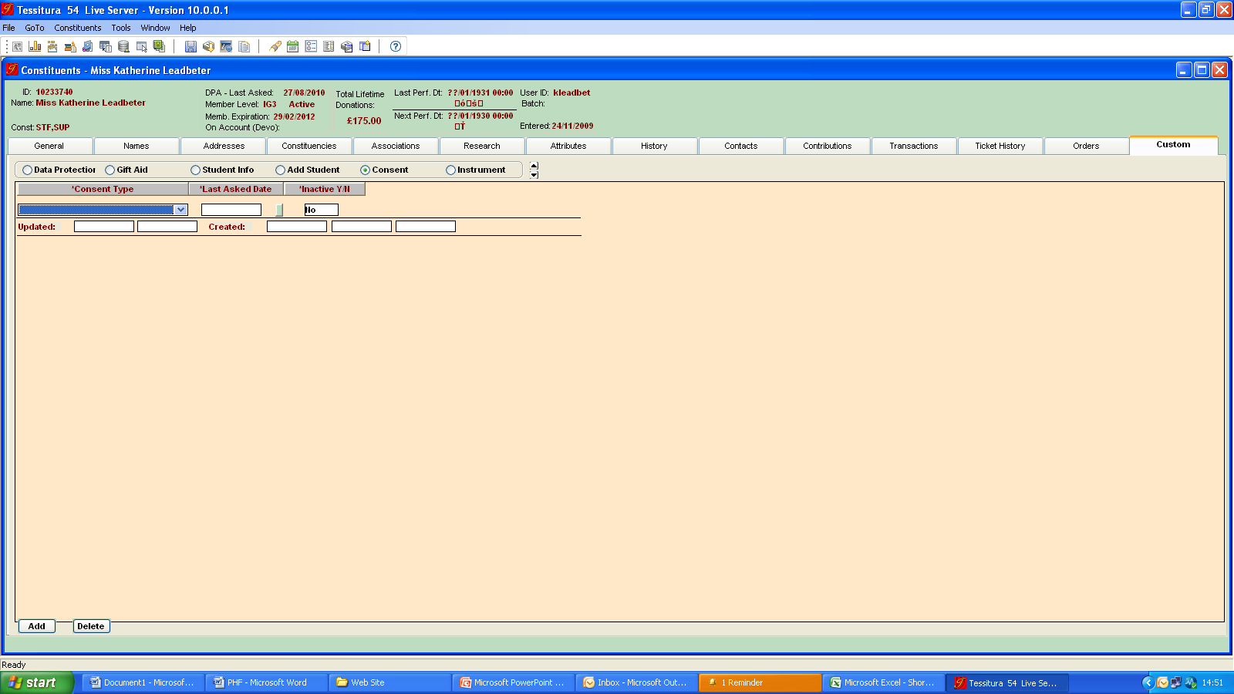

Slide 18
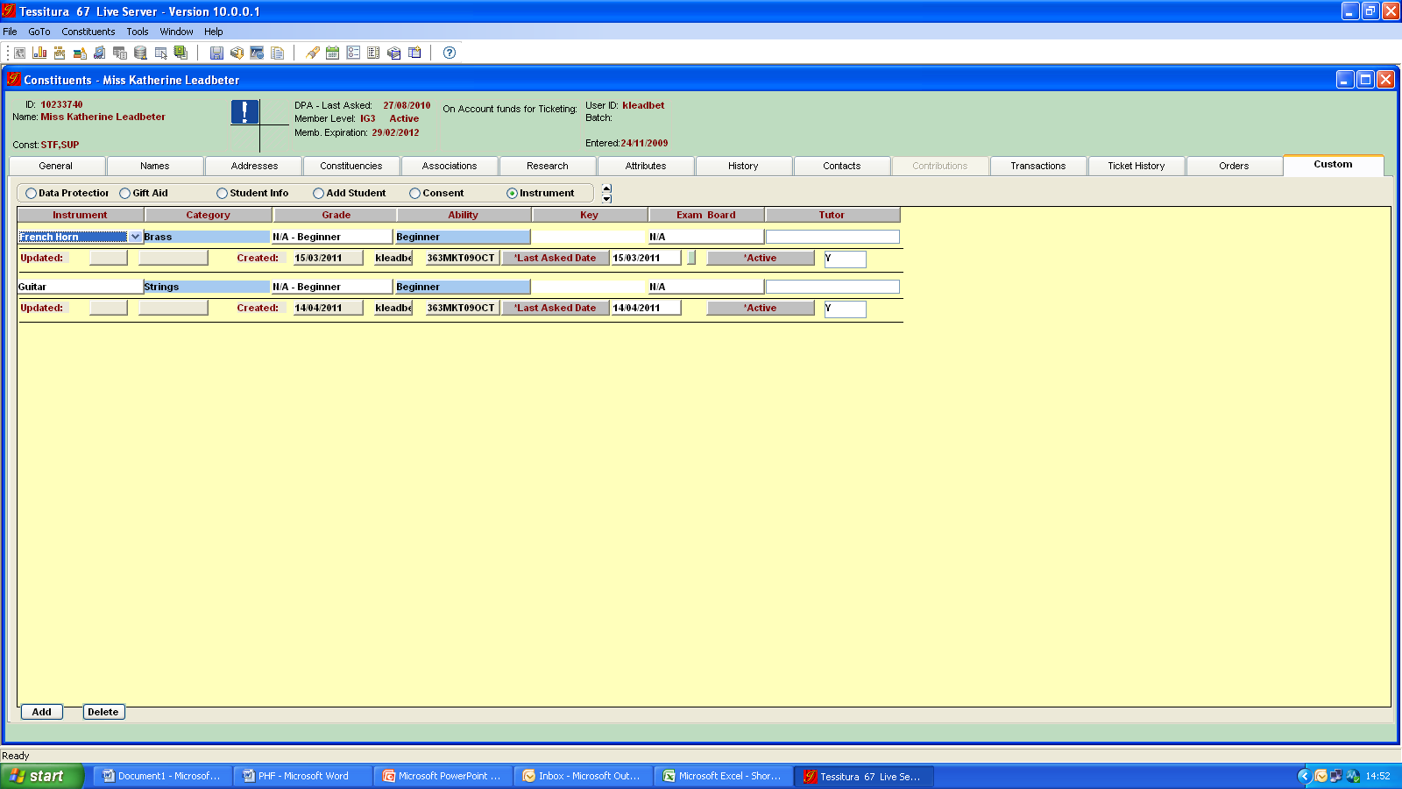

Slide 19
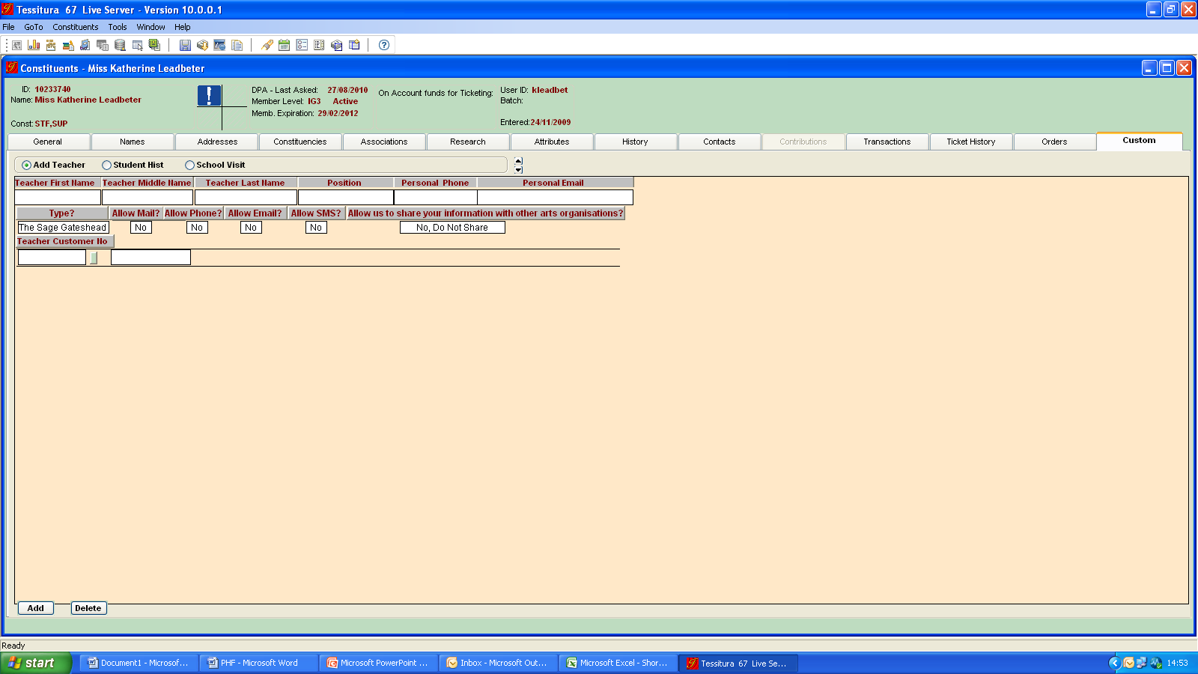

Slide 20
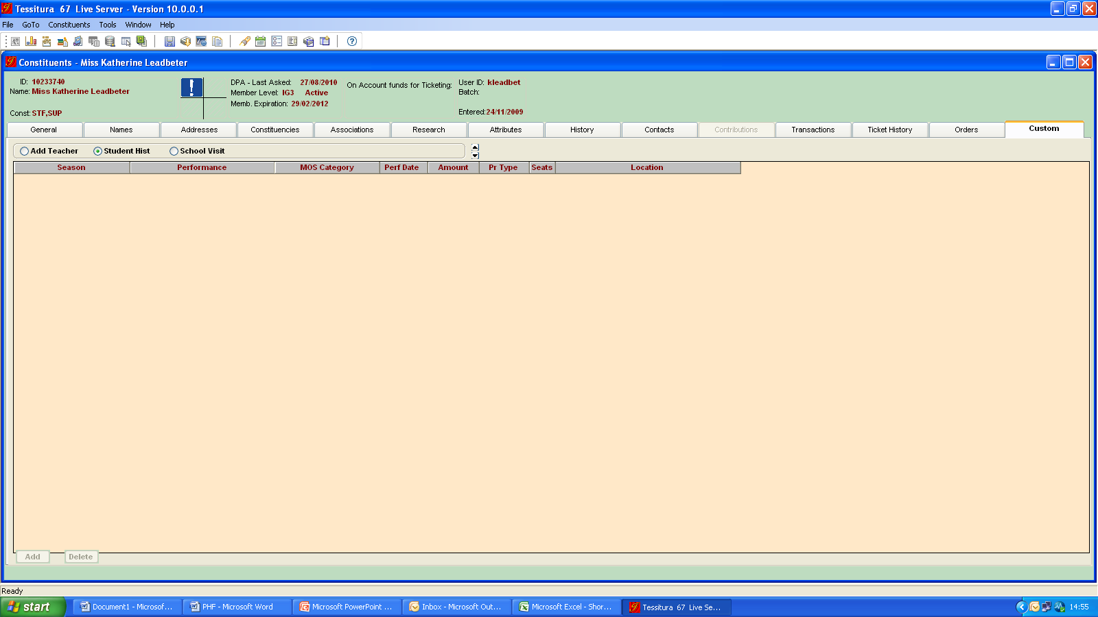

Slide 21
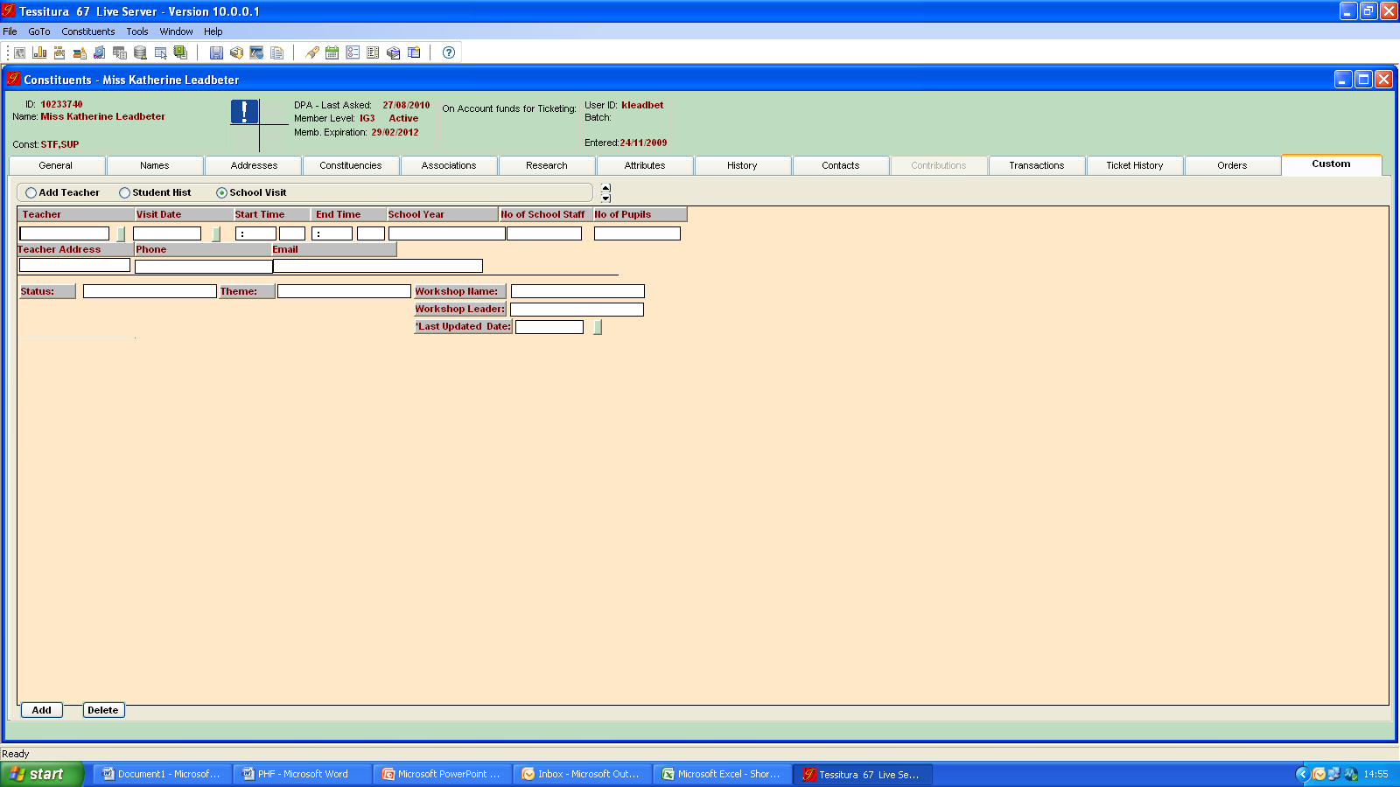

Slide 22
Summary of new screens/new functionality
New student records
New version of Ticket History called Student History
New teacher records
New custom screens with education-specific information
New student/teacher records can be created quickly and automatically associated with parent/school records
Notes:
Student History is populated via the order process, where a Special Request function is used to assign a ticket to a particular record, even if that person is not paying for the order (this functionality is linked to events categorised in specific Seasons).
Student History which separates payment data from attendance data – this will allow reporting on attenders rather than bookers
Custom screens:
Student Info screen (holds age, school year, ethnicity, next of kin and medical information)
Add Student screen (allows a student record to be quickly created from within a parent record and automatically associated)
Consent screen (lists the types of consent we hold for that person e.g. consent to be photographed/filmed – can also use Research tab to link to documents)
Instrument screen (instrument, instrument category, grade, exam board, general ability level)
Add Teacher screen (allows a teacher record to be quickly created from within a school record and automatically associated)
Student History screen (holds ticketing information based on registration rather than payment – works via the Special Request function as outlined above)
School Visit screen (date and time of visit, status, number of children, school year, workshop if applicable, teacher contact details)
Some information is entered manually and some is automatically populated based on other entries.
We can specify the options in most of the drop down fields.

Slide 23
Reporting on and analysing L&P data
Can be pulled through List Manager
Criteria available in Output Set Builder
Can be exported into Excel
Further work being done on custom L&P reports
Notes:
List Manager functionality e.g. lists of customers attending specified events, lists of customers who play certain instruments at a specific ability level, and lots of combinations of these types of information.

Slide 24
Moving towards a world where Tessitura is the place to find the full 360° picture of all of our constituents

