Slide 1


Slide 2
Yale Data Migration - Mapping
Data Management Work Group (standing committee)
Completed mapping ahead of time
Reviewed questions with the group
Focus on making a decision (ANY decision!) to review in TEST when we got stuck
Use time to review data, not discuss hypothetical situations

Slide 3
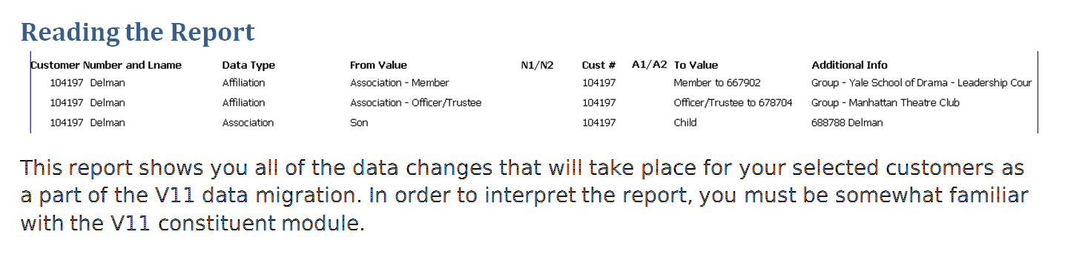
Yale Data Migration – Staging Review
Pull a list of important customers
Run the report
Review the data using the guide

Slide 4
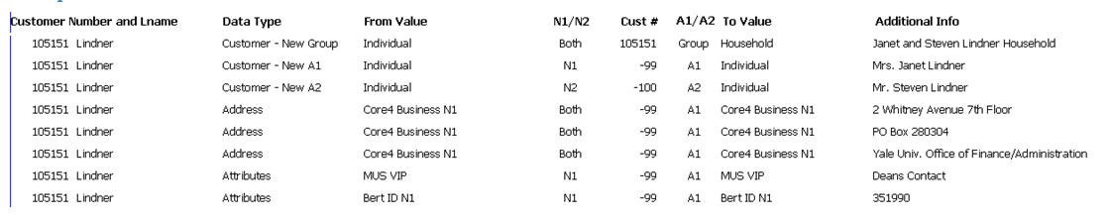
Yale Data Migration – Staging Review

Slide 5
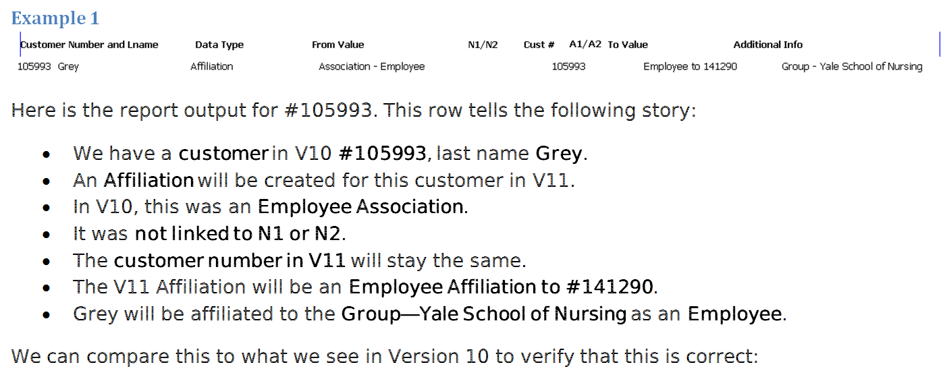
Sample Customers for Staging Review

Slide 6
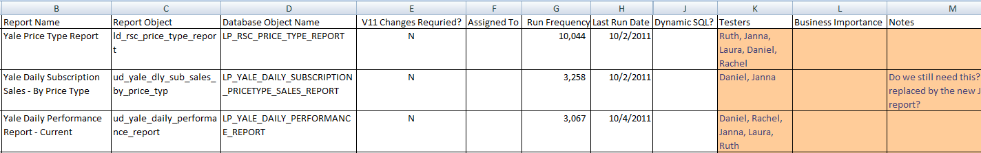
Yale Customisation Review
Tessitura Webinar – Highly recommend!
Cross Reference Tessitura Reports
  Customisation Review
  Custom Report Run Frequency
Yale Customisation Worksheet

Slide 7
Worksheet Columns
Report Category
Report Name
Report Object
Database Object
V 11 Changes Require? (Y/N)
Assigned To
Run Frequency

Slide 8
Worksheet Columns
Last Run Date
Run Recency (# of months since last run)
Testers
Business Importance
Notes
Sort on Recency (most recent first) and Frequency (most frequent to least frequent) to determine priorities

Slide 9
Worksheet Tabs
Need Research
  Trying to match Database Objects to Reports, or vice versa
Need Rework
  Database Object appeared on Tessitura V11 Customisation Review Report
  OR Report Failed During Testing

Slide 10
Worksheet Tabs
Ready to Test
  Database Object did NOT appear on Tessitura V11 Customisation Review Report
  OR Rework is Complete
Tested OK
  Report has been tested and it works!
Decommission
  Report is no longer needed

Slide 11
Yale Alpha Testing
Regularly scheduled testing sessions—every two weeks for two hours.
Specific tasks and goals for each session.
Users can come test in person or test on their own at their desks—provides flexibility and increases feedback.
Central gathering place for testing feedback—Wiki page.

Slide 12
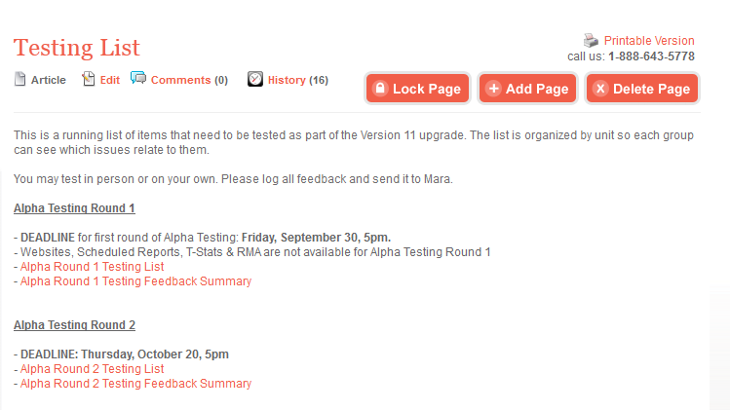
Yale Wiki (TN.Com)

Slide 13
Testing Session Goals
Review Staging Data (prior to V11 upgrade)
Review Migrated Data, Explore New Constituent Model, Test Standard Reports & Functions
Review Custom Reports, Test Lists & Extractions
Website Testing
Etc., Etc., Etc.

Slide 14
Yale Testing Feedback
Provide Simple Ways for Users to Give Feedback
In-Person Testing—I can see for myself
Error Logs
Test
Collect Feedback
Correct Issues

Slide 15
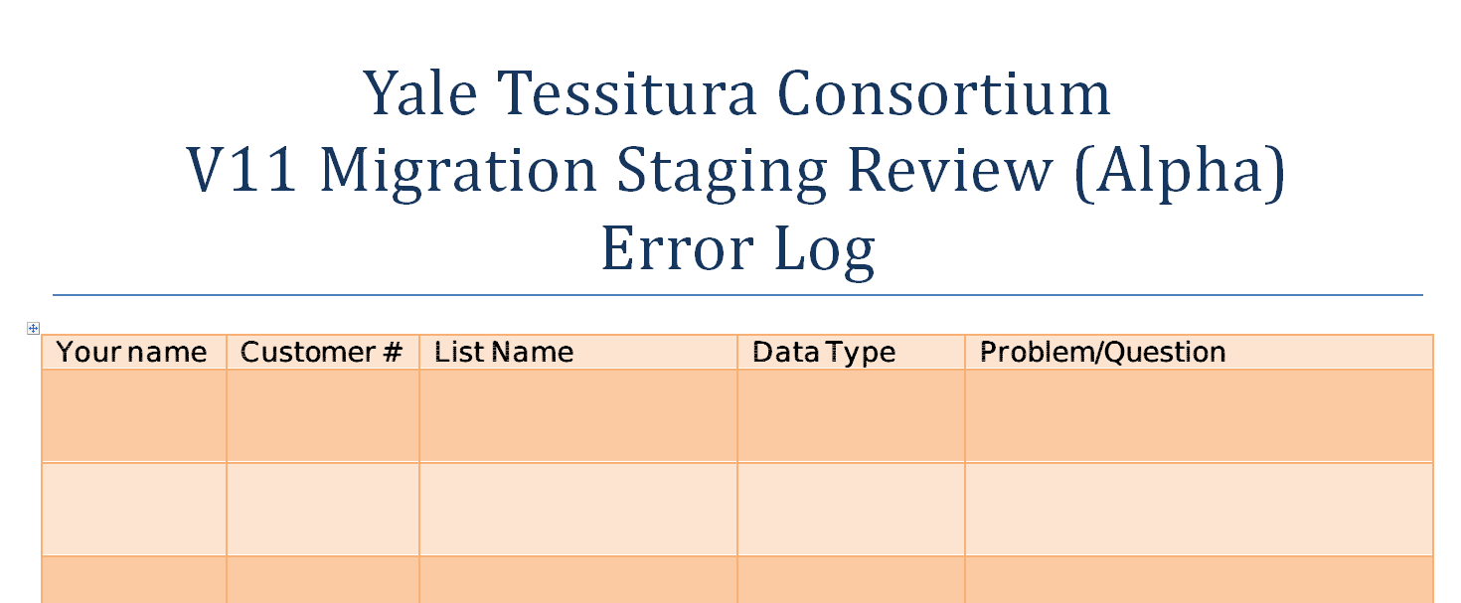
Yale Staging Review Error Log

Slide 16
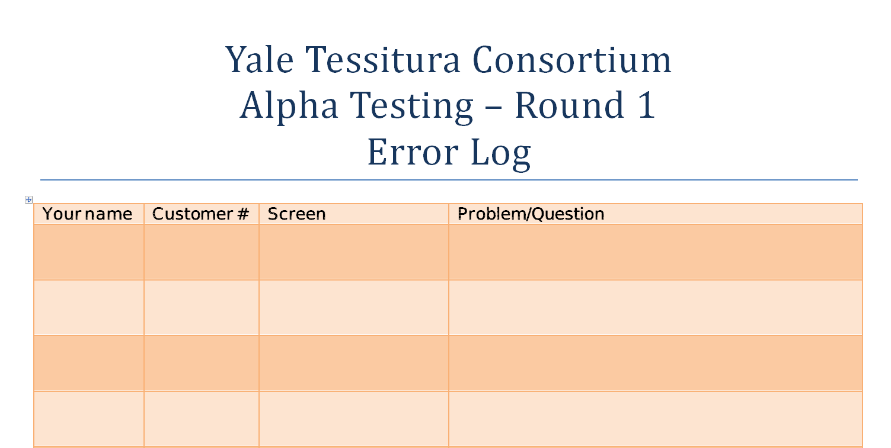
Yale Alpha Testing Log

Slide 17
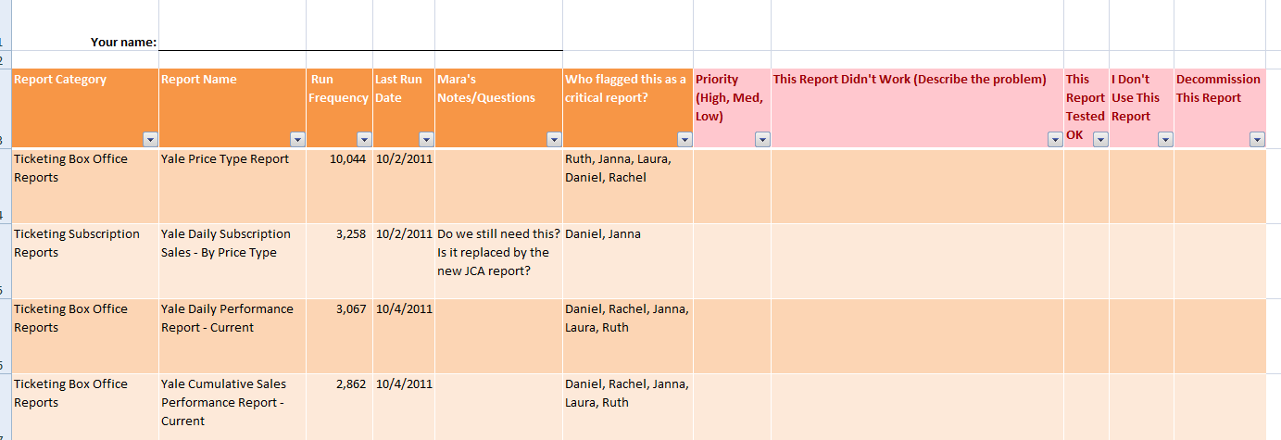
Yale Custom Report Testing Log

